Slide 1
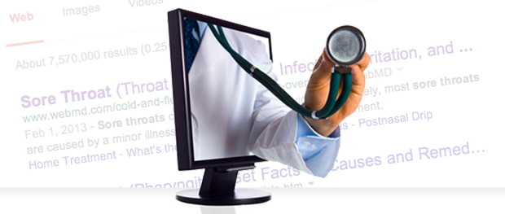

Finding Good Health Information Online
Terri Ottosen, MLIS, AHIP
Community Engagement and Health Literacy Librarian

Slide 2
Consumer Health on the Internet
The ABC’s of evaluation
  Accuracy
  Authority
  Bias
  Currency
  Coverage
  And, user friendliness

Slide 3
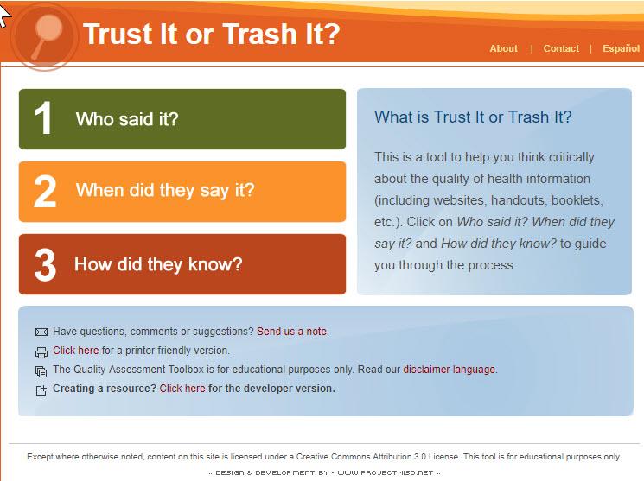
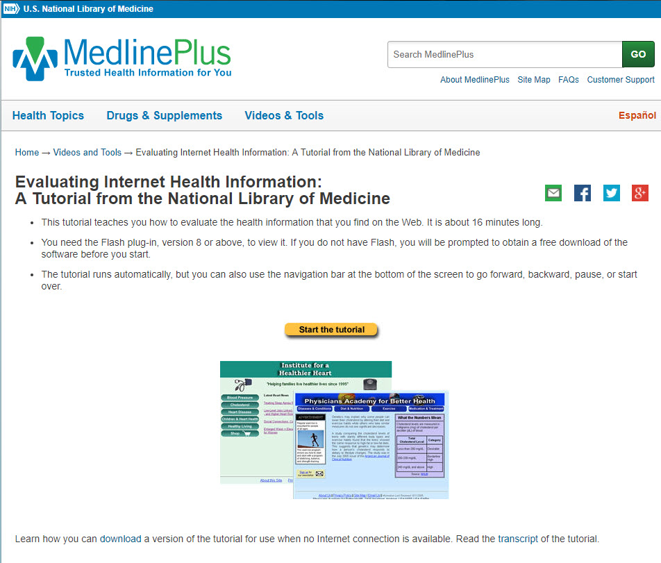
(http://www.trustortrash.org)
(https://medlineplus.gov/webeval/webeval.html)

Slide 4
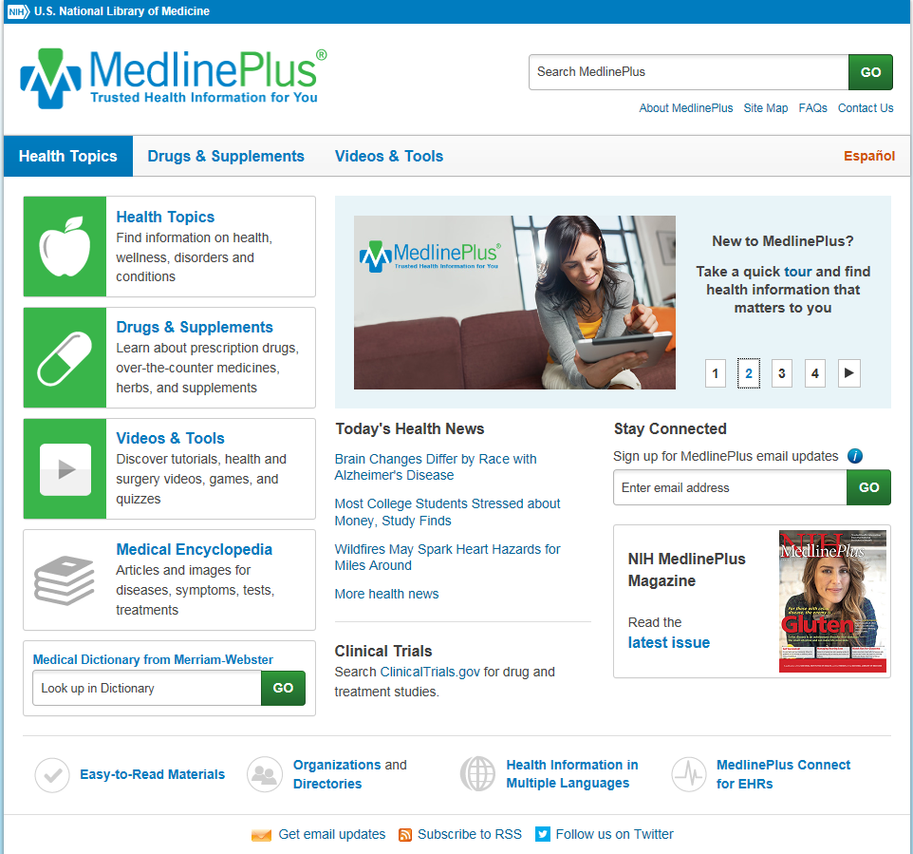
Mmedline Plus home page
(https://medlineplus.gov)

Slide 5
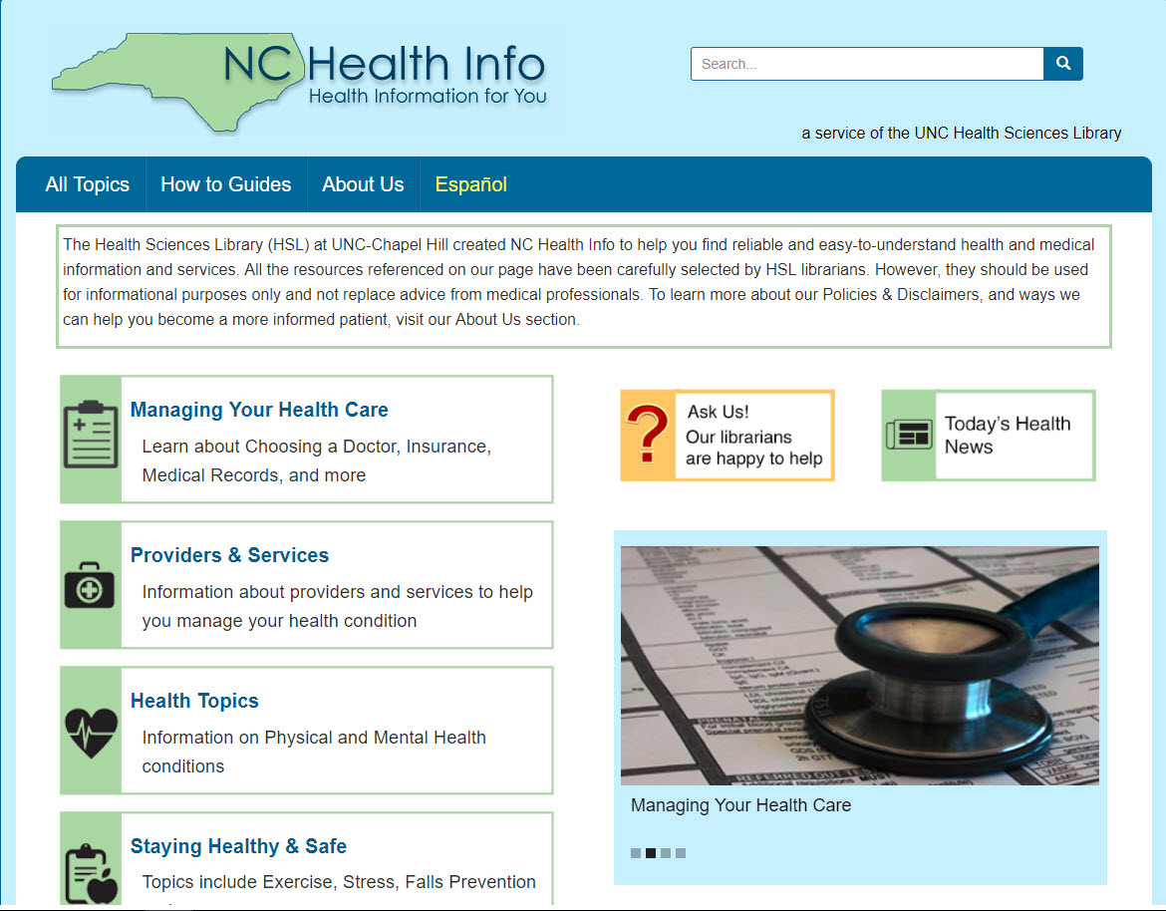
(http://nchealthinfo.org)

Slide 6
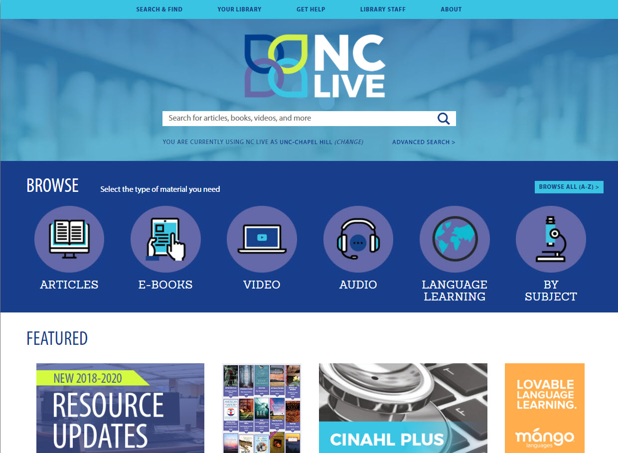
(http://nclive.org)

Slide 7
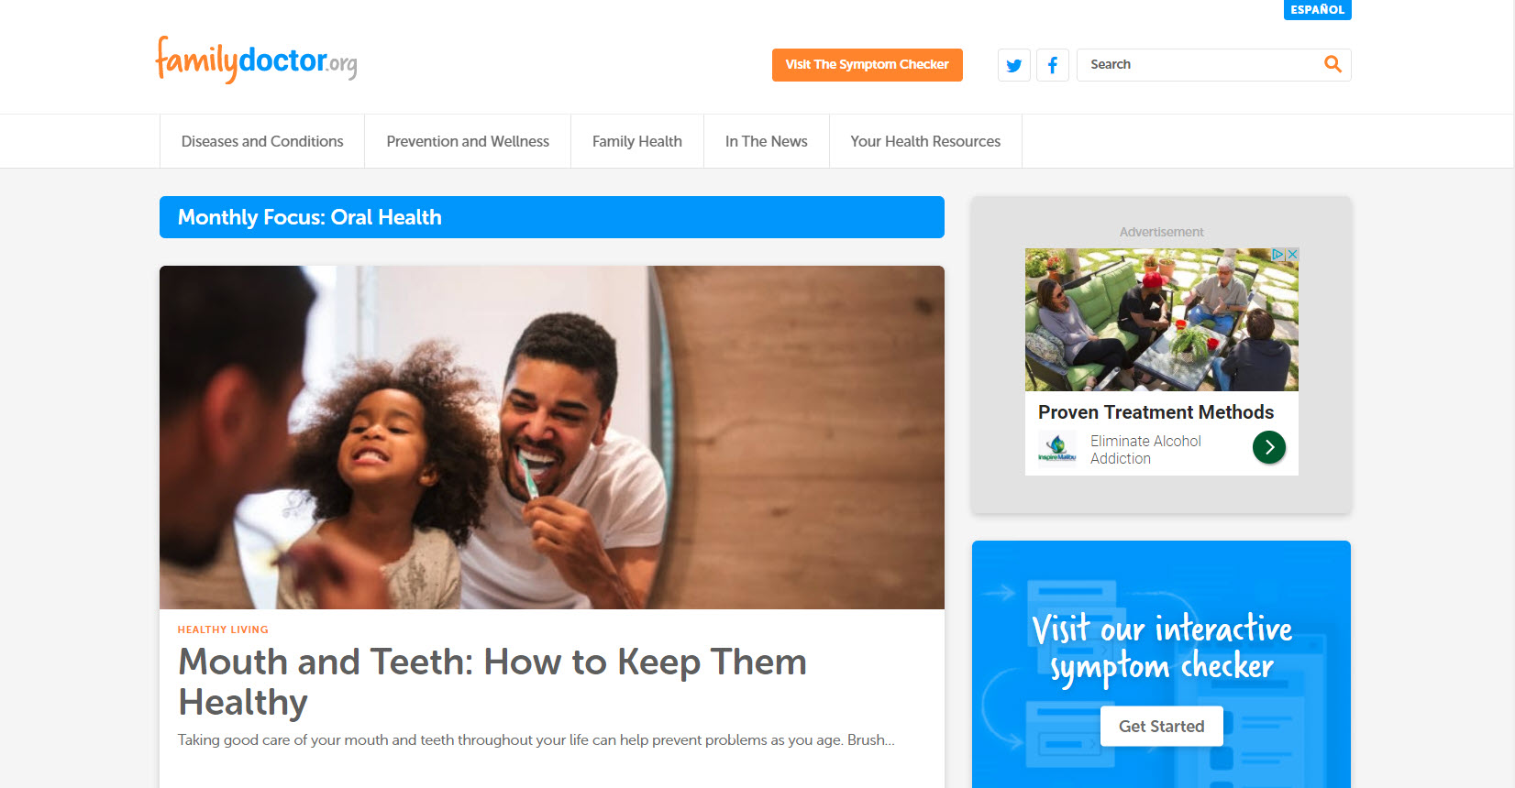
(https://familydoctor.org)

Slide 8
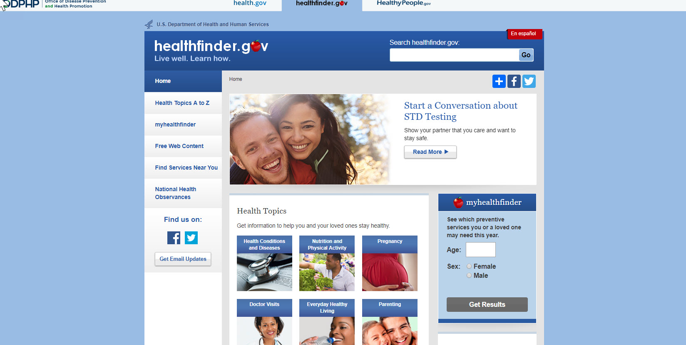
(https://healthfinder.gov)

Slide 9
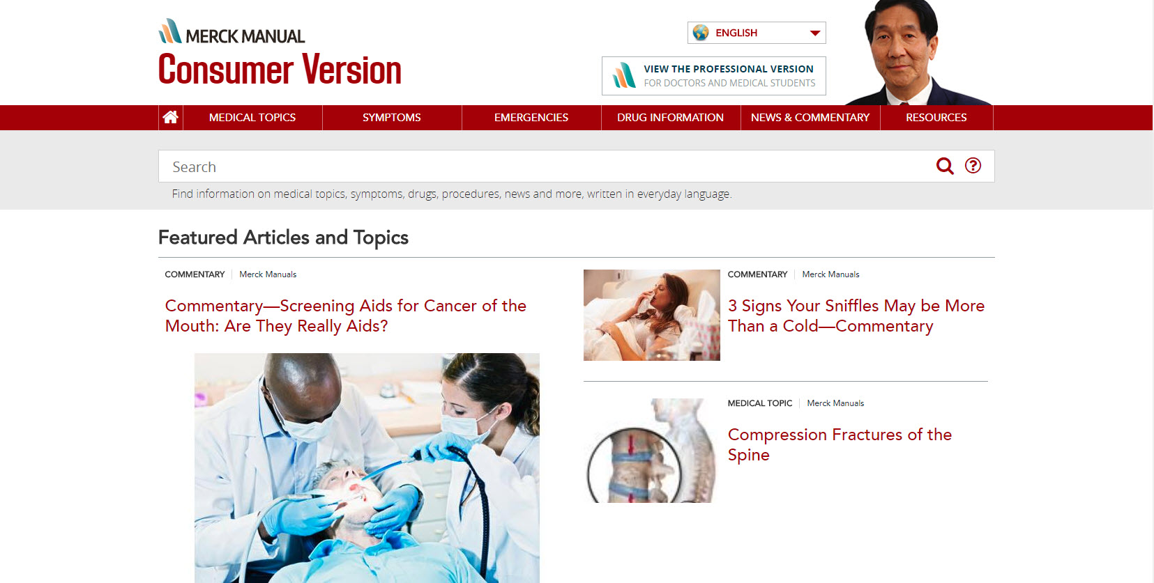
(https://merckmanuals.com/home)

Slide 10
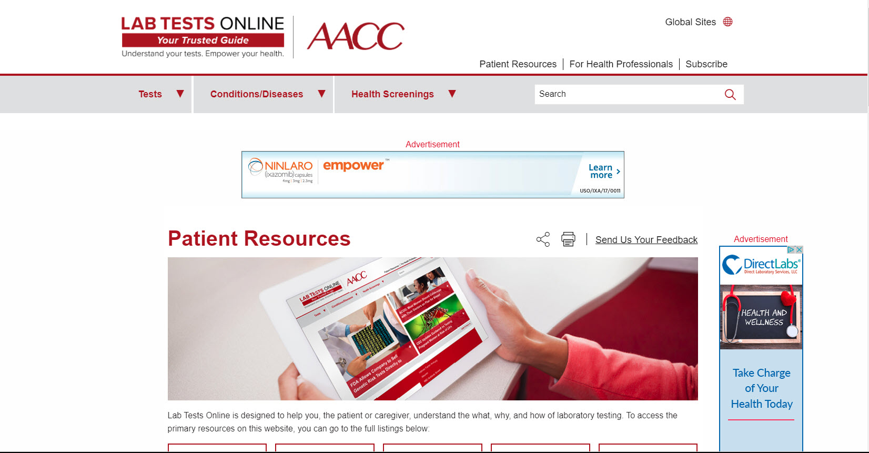
(https://labtestsonline.org)

Slide 11
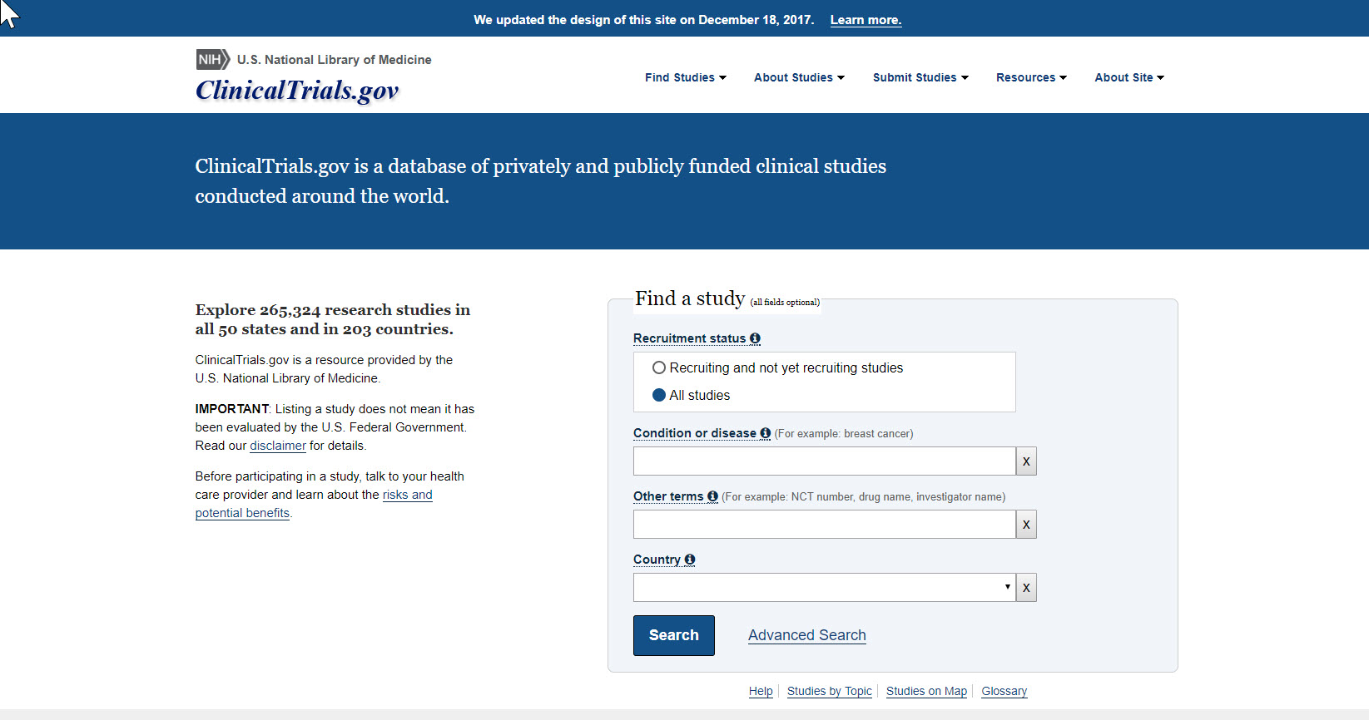
ClinicalTrials.gov home page
(https://clinicaltrials.gov)

Slide 12
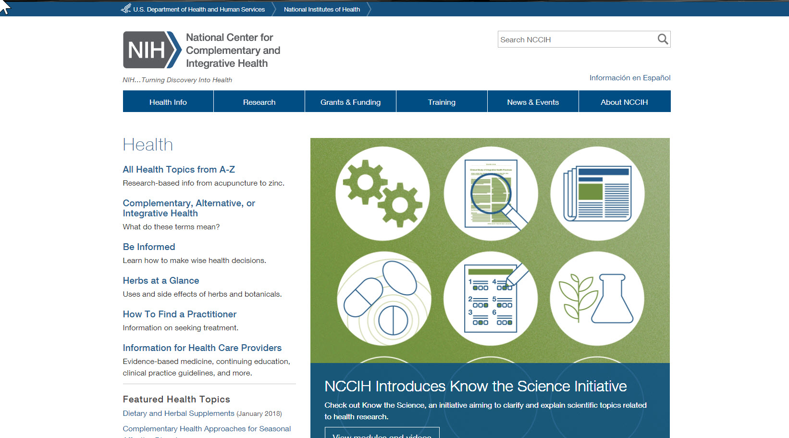
NCCIH home page
(https://nccih.nih.gov)

Slide 13
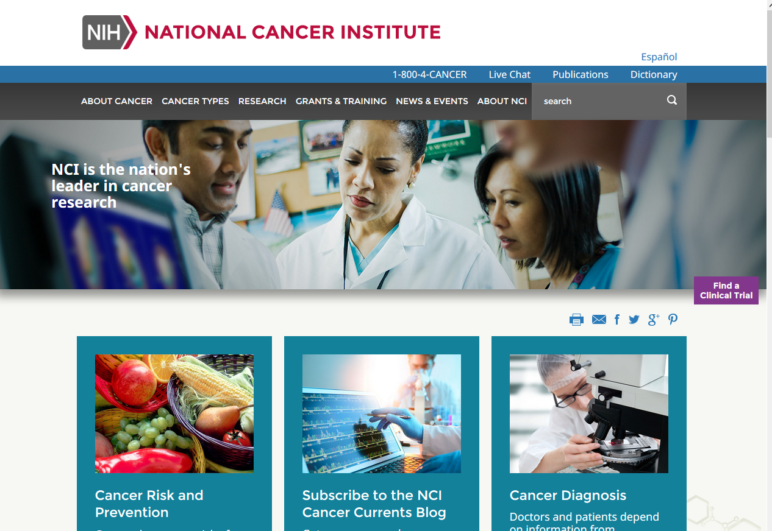
NCI home page
(https://cancer.gov)

Slide 14
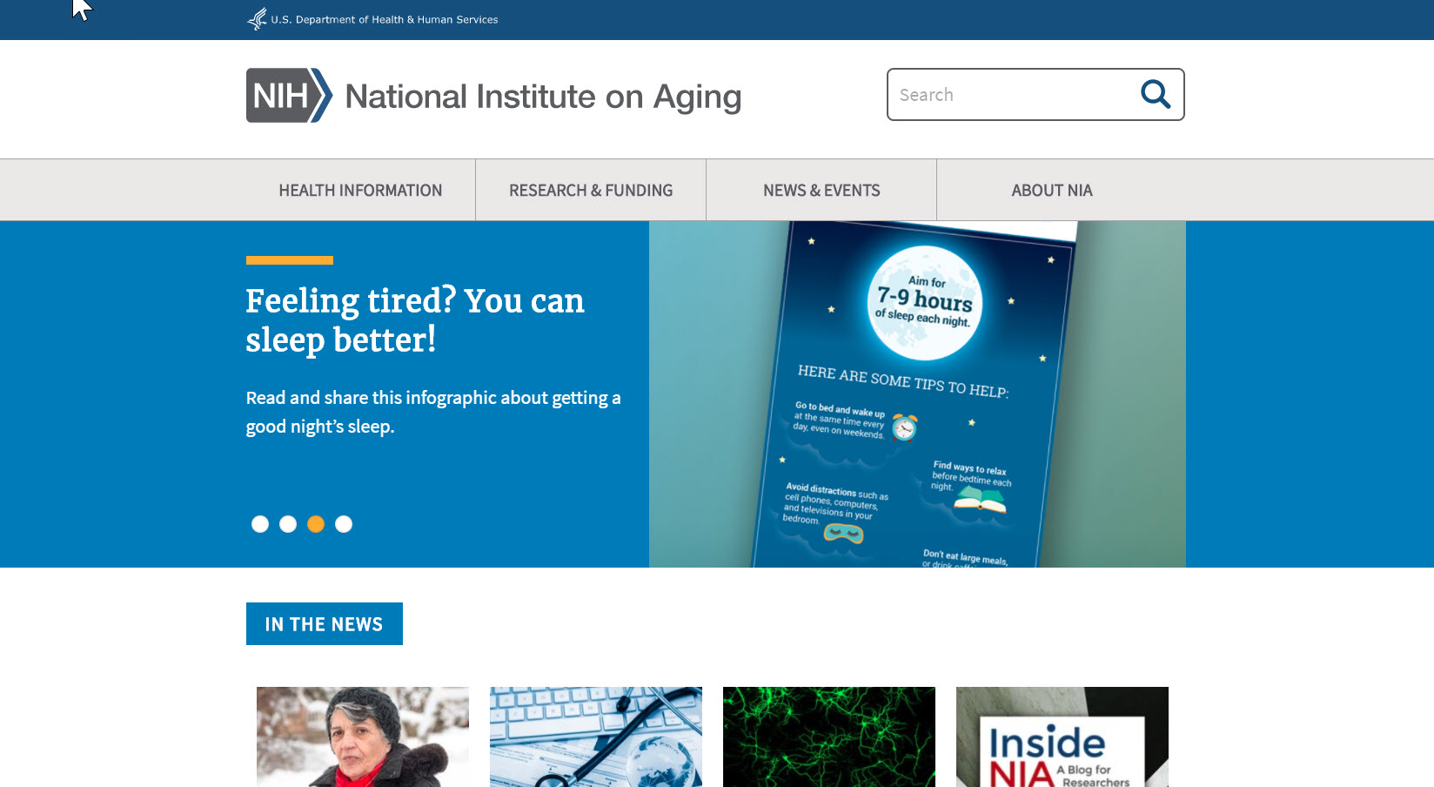
(https://nia.nih.gov)

Slide 15
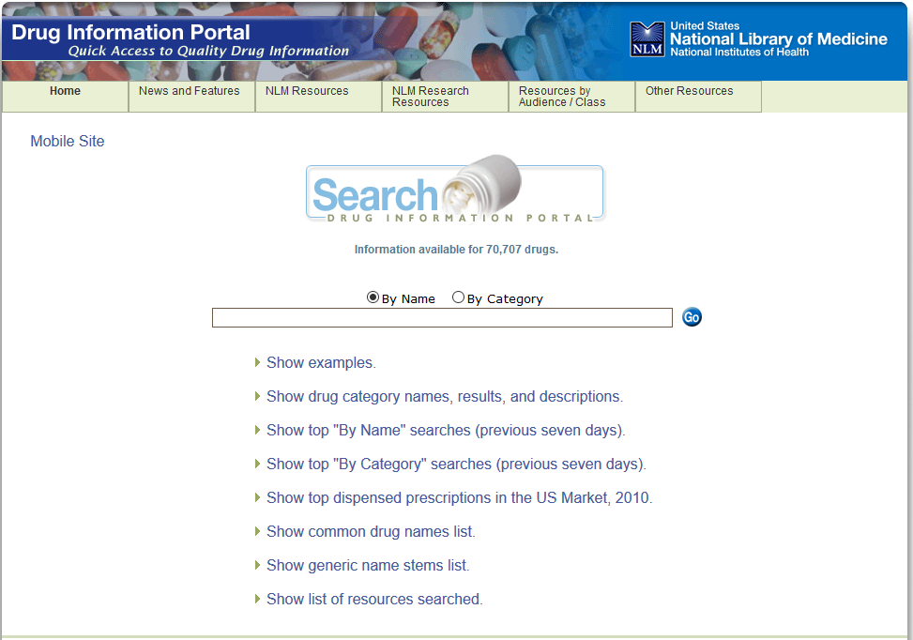
Drug Info Portal NLM home page
(https://druginfo.nlm.nih.gov/drugportal/)

Slide 16
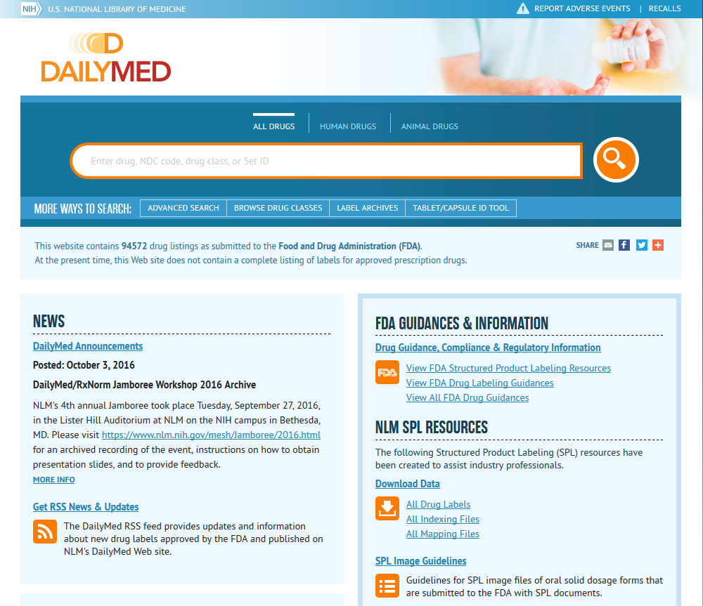
Daily Med home page
(https://dailymed.nlm.nih.gov/dailymed/)

Slide 17
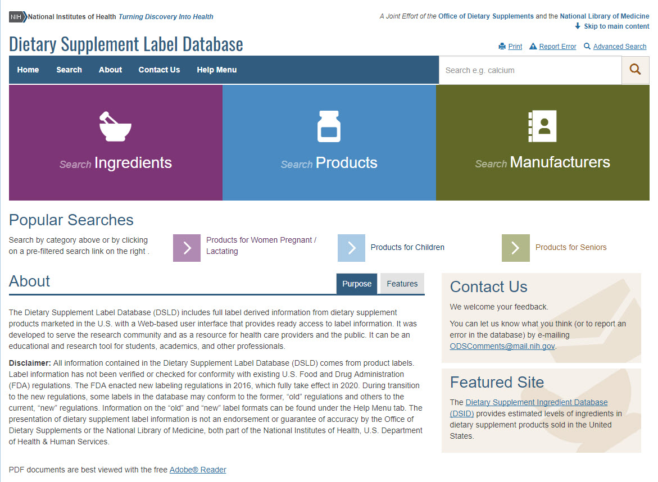
Dietary Supplents home page
(https://www.dsld.nlm.nih.gov/dsld/)

Slide 18
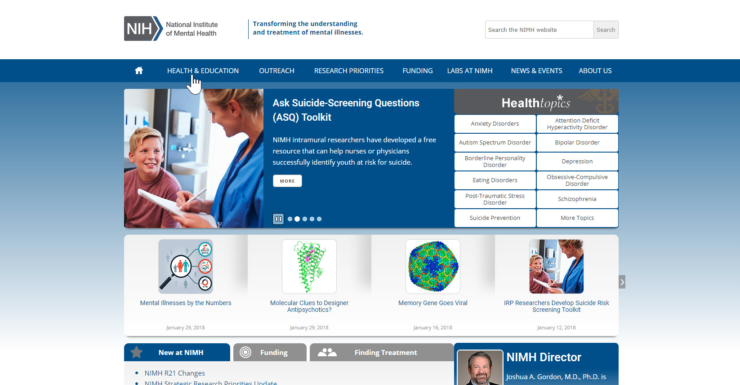
(https://nimh.nih.gov)

Slide 19
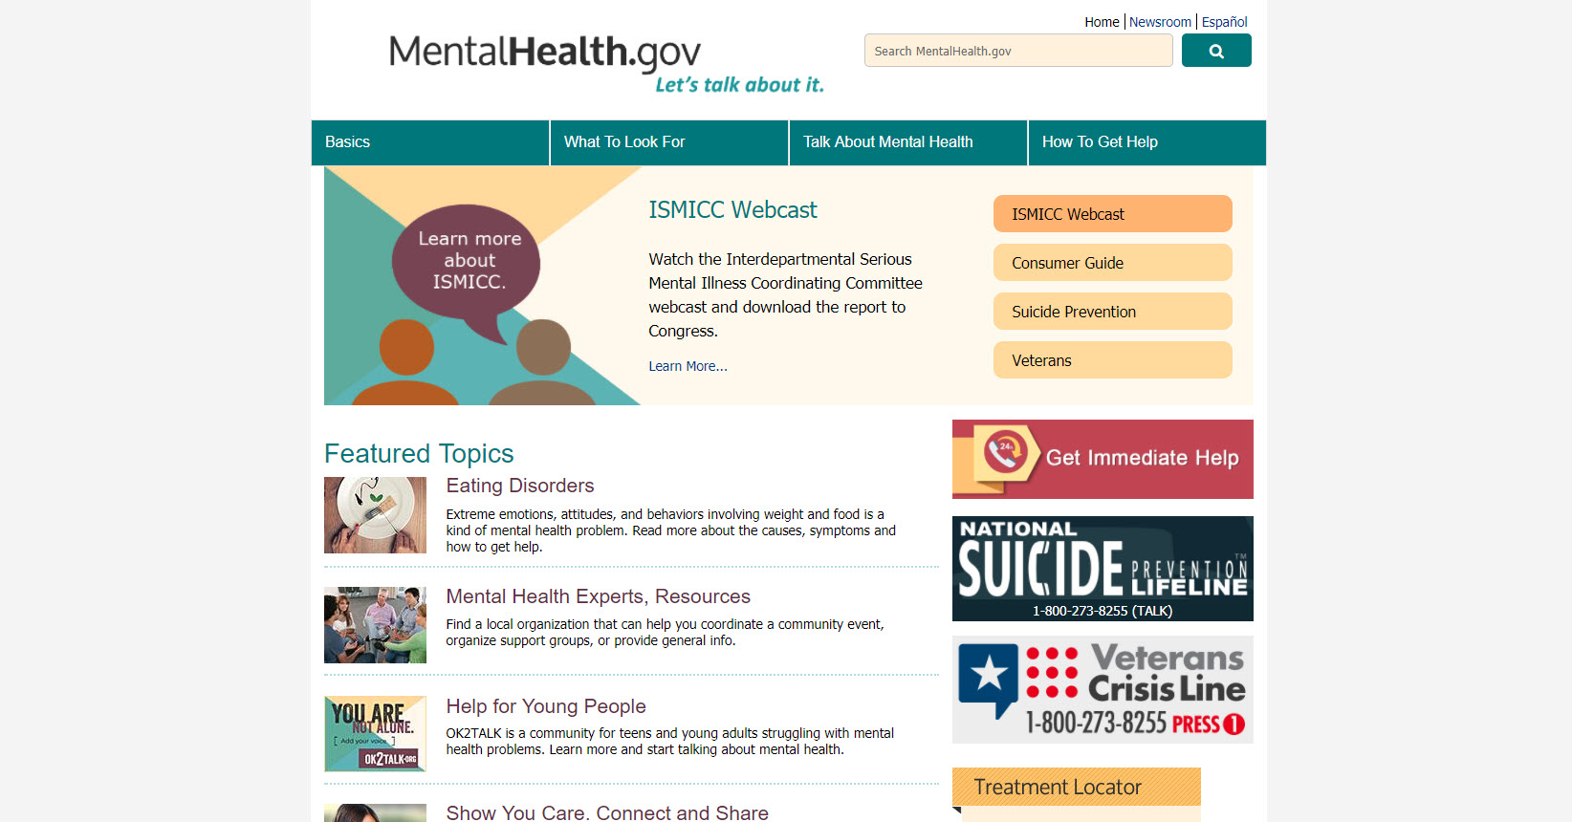
(https://mentalhealth.gov)

Slide 20
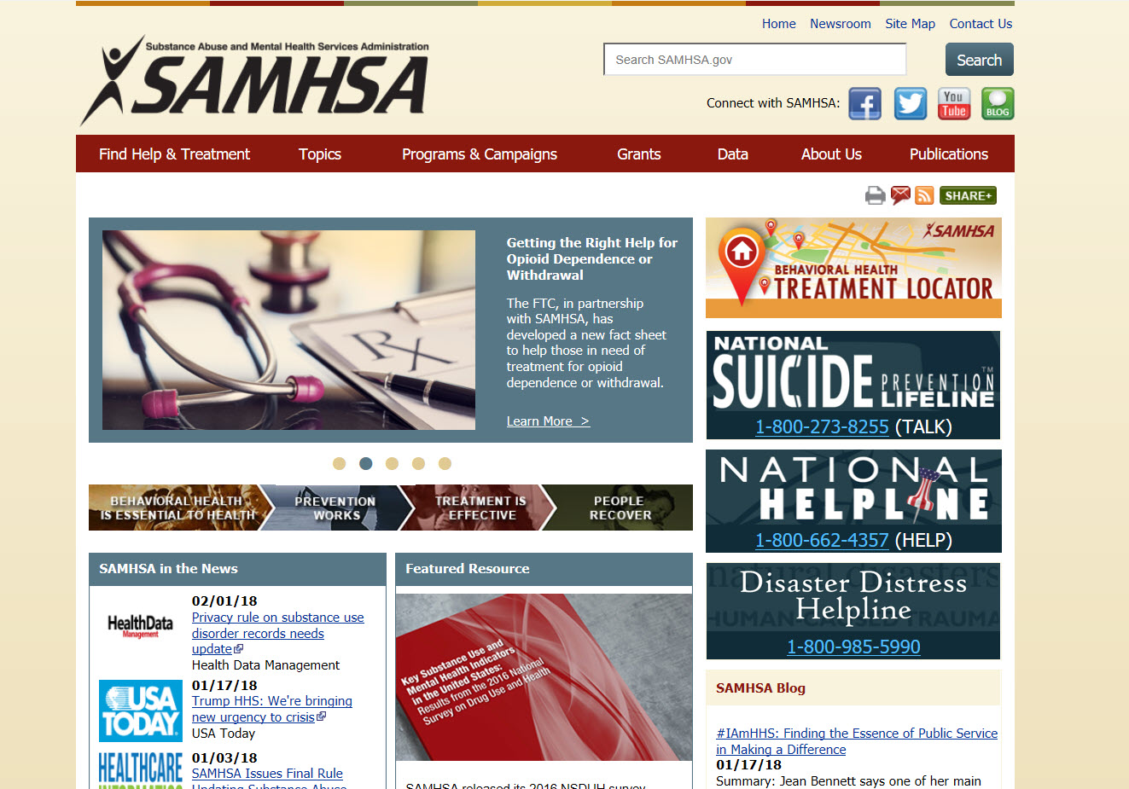
(https://www.samhsa.gov)

Slide 21
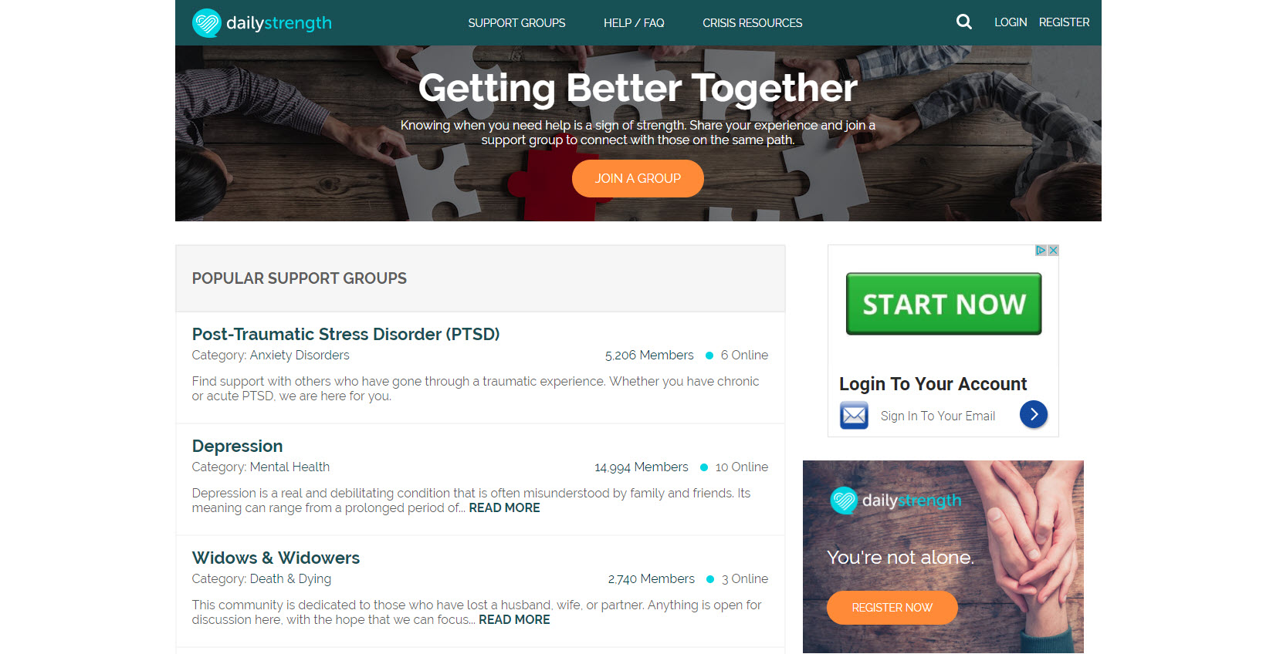
(https://www.dailystrength.org)

Slide 22
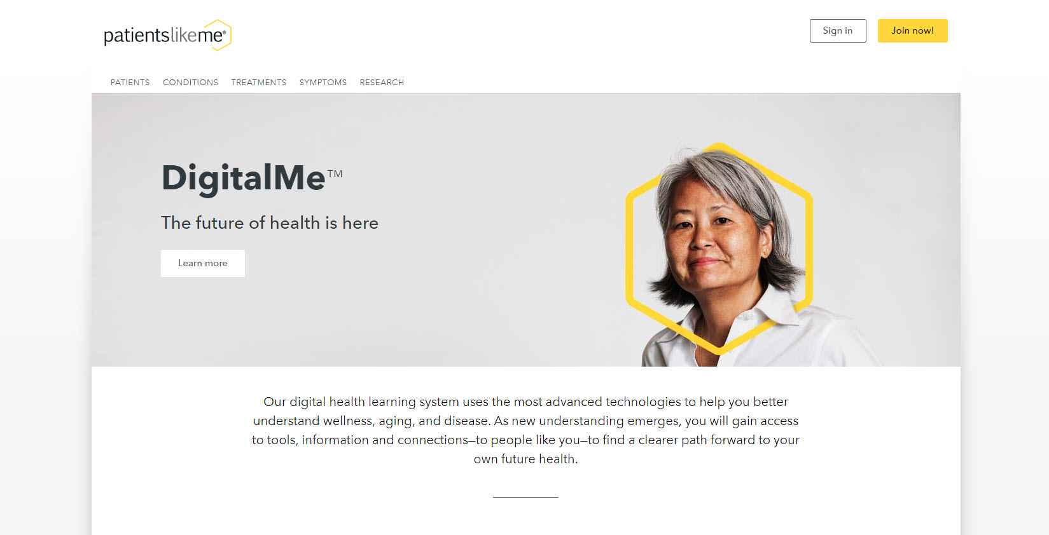
(https://www.patientslikeme.com)

Slide 23

Questions?
Use the “Ask Us” button on NCHealthInfo.org site or contact me:
          Terri Ottosen
          ottosen@email.unc.edu
          919-843-3102

