Slide 1
Chronic Illness in Second Life: Virtual Communities Supporting Real Healing
Saira N. Haque, PhD, MHSA
March 16, 2012

Slide 2
Challenges Managing Chronic Conditions
Lifestyle-based interventions such as diet and exercise are difficult
Patients may be homebound or have limited mobility
Access to healthcare may be limited
Geography
Resources
Insurance status
Patients with complex conditions and varied disease states benefit from social support

Slide 3
Virtual Communities and Chronic Conditions
Adults increasingly use internet for health-related purposes
Provides social support with people with similar conditions
Does not require access to traditional means of healthcare
Physical limitations can be accommodated through technology

Slide 4
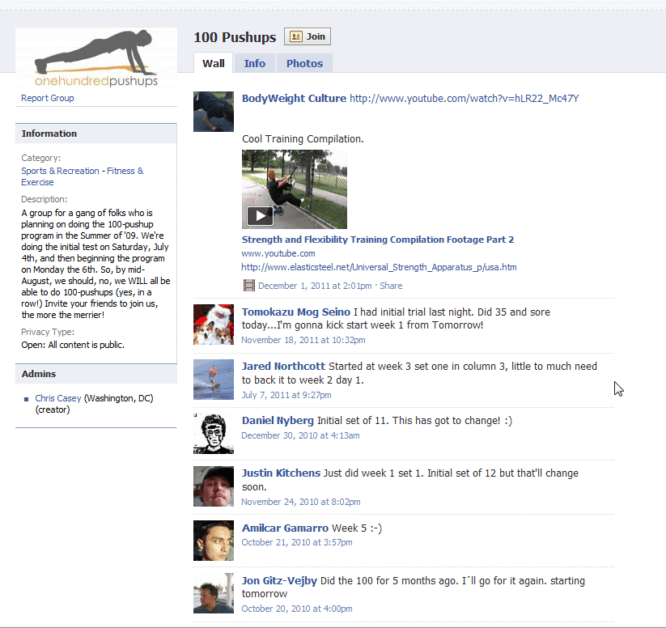
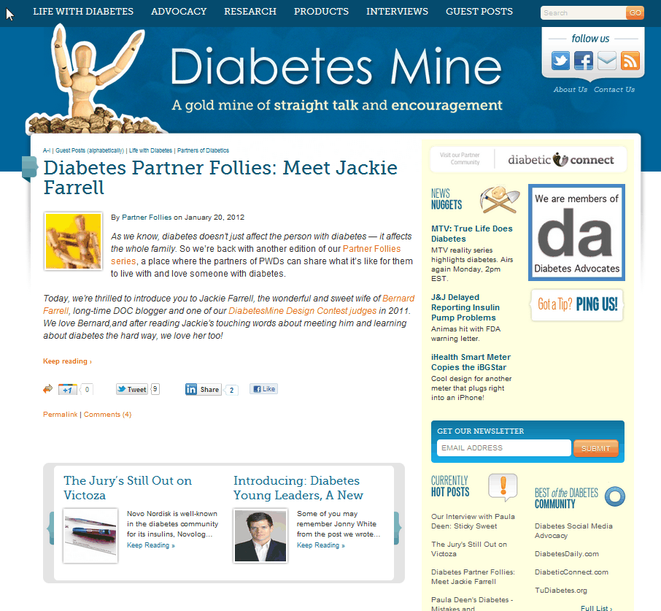
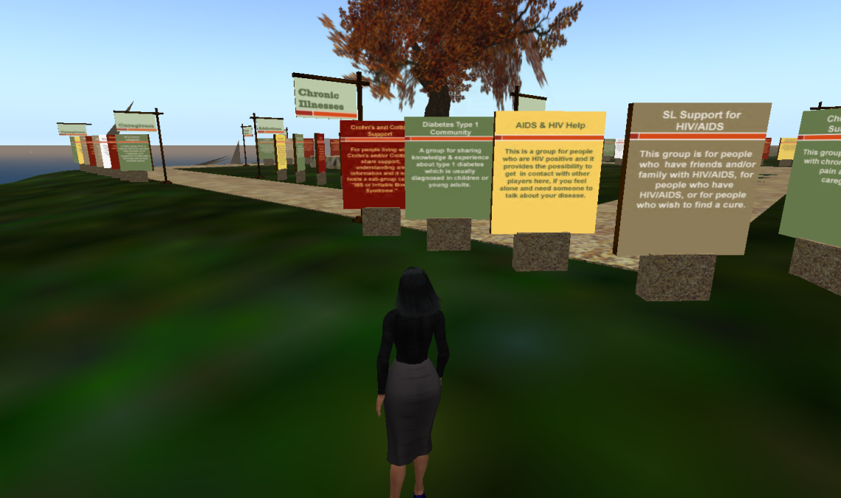
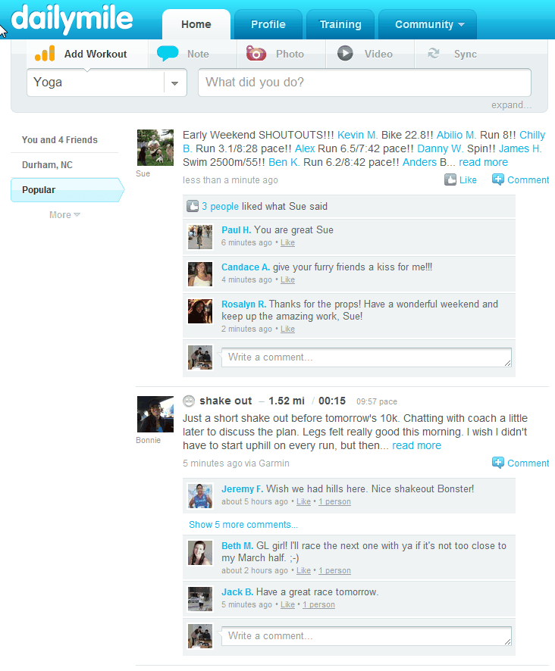
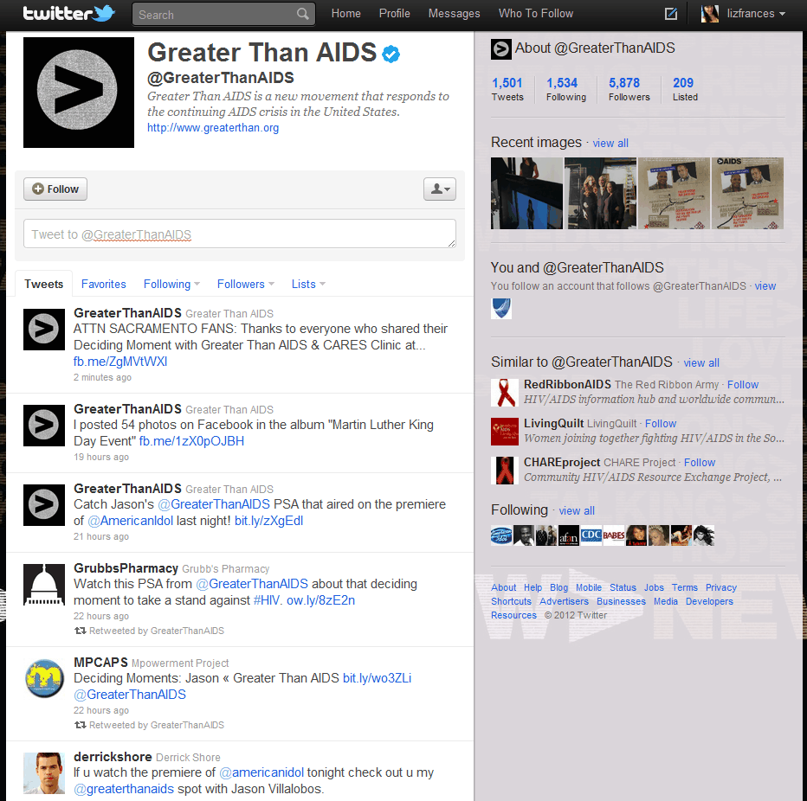
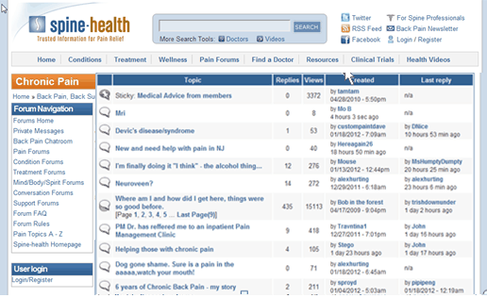
Types of Virtual Communities
Second Life
Messageboards
Blogs
Fitness trackers
Twitter
Facebook

Slide 5
Study Objectives
Health IT
How can we use virtual words to enact changes in real world behaviors and activities?
Survey Research
How do we recruit people in virtual words versus real worlds?
Health IT and Survey Research
How can we reach patients from difficult to reach populations?

Slide 6
Second Life and Chronic Conditions
Second Life is a 3D virtual world which provides real-time two-way communication
Provides a mechanism to interact with people of similar interests and conduct simulated activities
Allows patients to integrate care with other aspects of their online life

Slide 7
Why Use Second Life for Interventions?
Some studies have shown promise in activities in SL having real-world implications
If one’s avatar engages in healthy behaviors, this can translate to real-life benefits!
Stanford University Virtual Human Interaction Lab
If avatars exercise, people do too!
International Health Challenge
Improve health knowledge, attitudes and behaviors in real life through work in Second Life

Slide 8
HealthInfo Island

Slide 9
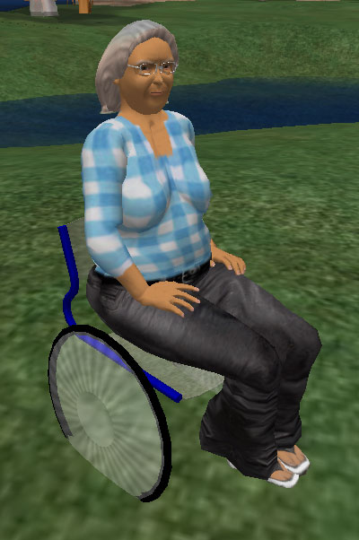
Communities in Second Life
Communities have formed organically
They are self-moderating
Each community generally has a leader to manage administrative aspects
Communities are support-driven and are suspicious of outsiders

Slide 10
Communities in Second Life
General Health
HealthInfo island; Health Support Coalition
Diabetes
Diabetes Type 1 Community; SL Foundation for Diabetic Children
HIV+
AIDS and HIV Help; AIDS and HIV Support
Cancer
All About Cancer; Cancer Co-Op
Chronic Pain
Fibromyalgia Support Friends

Slide 11
Leveraging Communities in Second Life
Engage with leaders of condition-specific and chronic condition communities
Provide IRB documentation
Use communities to advertise study
Postings onsite & distributed to established support groups
If applicable, become a member of the community to gain trust

Slide 12
Recruiting Considerations in Second Life
Need to be clear about benefits to those with chronic illnesses
While SL promises anonymity, that does not extend to those studying them
Important to have a sense of legitimacy (study & avatars)
Avatars used for recruiting should be professional and have a history of SL positive activities

Slide 13
Privacy

Slide 14
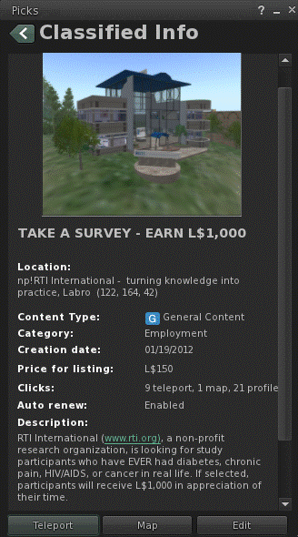
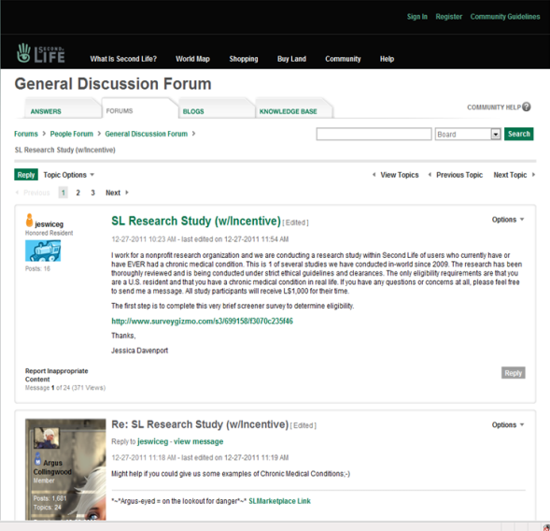
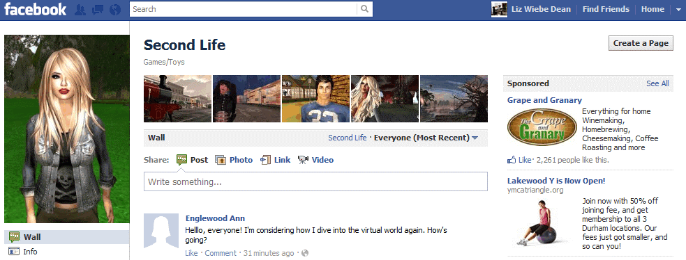
Recruiting Methods in Second Life
Classified Ads
Second Life Forums
Facebook page
Information Sessions scheduled in-world to discuss study and answer questions
Notes:
Classified ads posted on Second Life website & at support community locations

Slide 15
Other Recruitment Methods
Craigslists postings in major metropolitan cities
Survey Referral Program inworld
Direct Invitation
Recruitment avatars visit popular places and those frequented by the target population

Slide 16
Information Session Recruitment

Slide 17
Survey Administration
Survey comprised of existing measures from national surveys
Demographics
Computer use
Internet use
Health status
Access to healthcare

Slide 18
Survey Participants
Breakdown
78% chronic pain
28% diabetes
14% cancer
1% HIV+/AIDS

Slide 19
Survey Results
Range of health status
Interest in alternative medicine
Majority do not use other social media for their condition
Majority are high internet users
Majority self-report health as good and are not homebound or overly limited in mobility
Majority do have access to healthcare, but use SL as augmentation

Slide 20
Conclusions
Virtual technologies such as Second Life provide new ways of interacting with patients with chronic conditions
Key success factors for interventions
Recruiting
Understanding the population
Using existing groups and mechanisms in Second Life
Engaging with the community

Slide 21
Many thanks to our SL team!

Slide 22
Thank you for your attention!
For more information
Saira N. Haque, PhD, MHSA
shaque@rti.org
SL: Noor Jehan

