Slide 1

Affective Features based Image Retrieval
Kun Huang
huangkun@bnu.edu.cn
Dept. of Information Management
Beijing Normal University
2011-04-08

Slide 2
How I come here
Supported by Chinese Scholarship Council to be a visiting scholar for 12 months
Thanks for Professor Marchionini and Kelly offer me the opportunity to visit SILS at UNC-CH, the top one LIS School.
Notes:
I’m a visiting scholar and was supported by Chinese scholarship Council. I have stayed here for 3 months and I will go back home at the end of this year.
Thanks for Professor Marchionini and Kelly offer me the opportunity to visit SILS. The top one LIS School.

Slide 3
What I’m doing here
Observing courses:
  Observing three courses( 2 Ph.D courses and 1 undergraduate course taught by Dr. Diane Kelly)
  Observing Odum institution course and Workshop
  Finished the teaching material “Basic Social Science Statistical Methods with EXCEL”(in Chinese)
Notes:
What I’m doing here. I have two purposes. One of them is to observe some courses. Now I’m observing three courses taught by Diane. Diane is great helpful to me and I learn much from her. And on her courses, i have the chance to listen to different guest speaker’s lecture and know more about how American teachers teach students.
And I also Observed Odum institution course and Workshops.
Thanks Chapel Hill provide me a quiet and peaceful environments to finish my teaching material”Basic Social Science Statistical Methods with EXCEL”. It is used to help non-statistics major students to learn statistics as soon as quickly. Some students feel scared to start with SPSS, but Excel can shorten the distance at the beginning and strengthen their confidence.

Slide 4
What I’m doing here
Research
  Taking part in academic seminars
  Establishing on-line experimental environment for the Research ”Query Rating”(instructed by Diane and Wan-qing)
  To have IRB ethical training
  To continue my research
Notes:
Taking part in academic seminars hold here.
Taking part in Diane and Wan-qing’s experiment-”Query Rating”. Under the Diane’s instruction, we establish the on-line experiment environments. And we will meet every week.
To have IRB ethical training
To continue my research

Slide 5
Where I come from

Slide 6
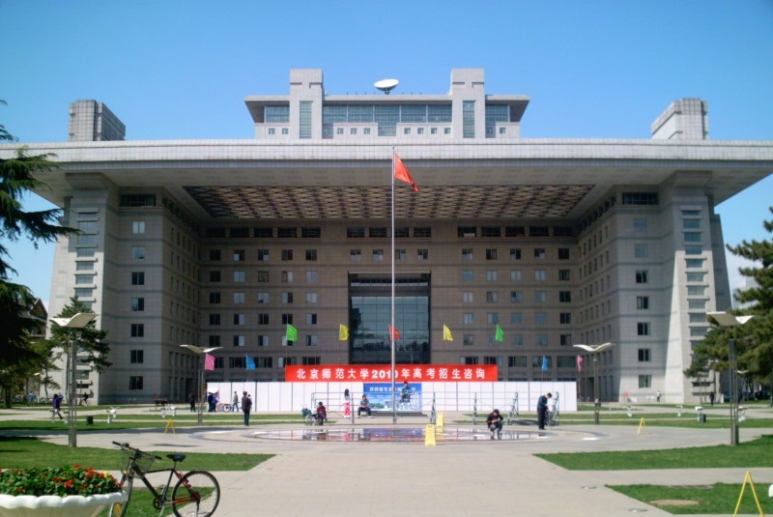
Beijing Normal University http://www.bnu.edu.cn
Notes:
This photos show the two main buildings on the campus.
The former building was built in 2002 to celebrate the 100th anniversary. Our school is on the fifth floor , not the whole building. The two yellow windows are our office windows. There are 15 faculties working in the room.
The latter building was just completed last Fall. One the top of the building, you can have great view of Beijing Town. It is said there is a spacious meeting on the top floor, in order to bring participants great insights, for there is a saying that said one can look far ahead from a high place.
As a normal university, ten years ago most of our graduates will work as a teacher in Primary school, middle school, high school. Nowadays our university becomes more comprehensive. And more and more will find a job at government offices and enterprises.
You can see there is a banner in the photo. In April every year. Our university will open to the parents and high school students who want to consult some information about BNU before they determine which university their will choose. The national entrance examination will be hold in June every year.
http://www.bdqhjd.com/Article.asp?id=792

Slide 7
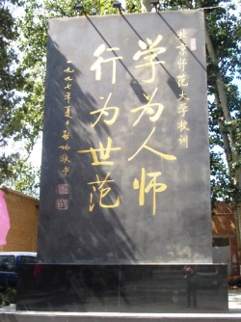
Areas | 172.6 acres
Faculty | over 3,000
Fulltime students | 21,000
Undergraduates: 8700 Graduates:10,000 Long-term international students:1800
22 schools and colleges 2 departments 24 research institutes
Notes:
This table indicates some basic data of BNU, its area, the number of faculties, fulltime students and academic organizations.
In China teaching is a career with a good reputation. It makes high requirements for teachers. So as a normal university, our mottos are written on a stele, standing on the south entrance of the campus. The photo is the motto.
We can read from right to left, from the top to the bottom.
Xueweirenshi means if a person he wants to be a teacher, he should work very hard and keep learning all the time.
Xingweishifan means that as a faculty, staff or student, anyone who work and study at BNU, we should pay more attentions to our behavior to set up good examples for others.
The motto encourages us to be a person with both good moral quality and knowledge quality.

Slide 8
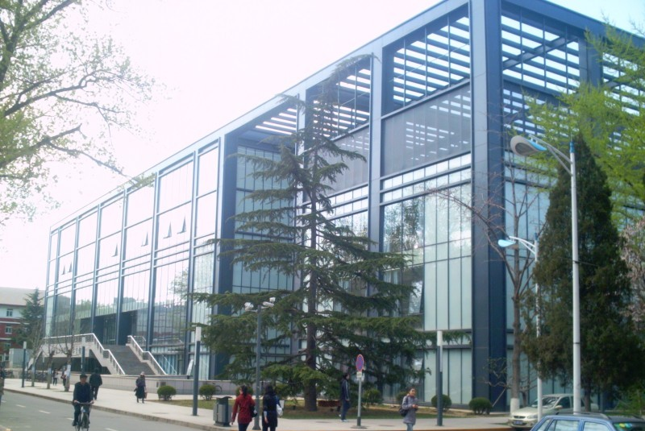
QiujiDuan Gymnasium
Notes:
It is the QiujiDuan gymnasium. During the Olympic games, it was used for America Swimming Team to have regular training.

Slide 9
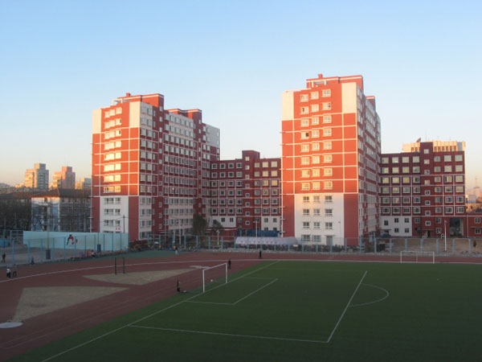
Play ground and students dorms
Notes:
And this is the play ground.
On the beside of the playground, there are five to six buildings like this two. All of them are dormitories for graduate students.
All the students will live on campus, except part-time students.

Slide 10
Department of Information Management at BNU
School of Management
HRM
PA
IM
SS
.
http://manage.bnu.edu.cn
Faculties:
3 professors, 9 associate profesors,3 assistant professors
Students:
100-120 undergraduate students
45-55 graduate student
Part-time adult students: 100 per year
BA.
Information Science
MA.
Information Science
MA.
Library Science
Notes:
Our department was set up in 1980s. The original name is Department of Library Science. In 1993, with the great crisis of library science, our department was renamed to Department of Information Management. And in 2002, we were merged to School of Management.
Now there are 4 departments in our School. Human resource management, public administration, information management and System engineering and science.
In my department there are 15 faculties.
We have BA for information science and MA for both IS and LS.
Besides, we recruit almost 100 part-time adult students per year.

Slide 11
Research
Information Retrieval, Information System, Info metrics and Information visualization
Information Behavior , information literacy , information law and policy
Notes:
In my department, faculties have different research interests.
Some mainly develop programs and systems to do research on Information Retrieval, Information System, Info metrics and Information visualization.
The others mainly conduct surveys and experiments to do research on Information Behavior and information Literacy.
Only one teacher does research on Cataloguing of ancient books.

Slide 12

Teaching
Information Science
Math+Programming+Database+Statistics
Notes:
For undergraduate program, we teach some basic courses of Information science, such as the foundation of Information science, Information organization and so on.
At the same time we require students to learn math, programming, database and statistics.

Slide 13
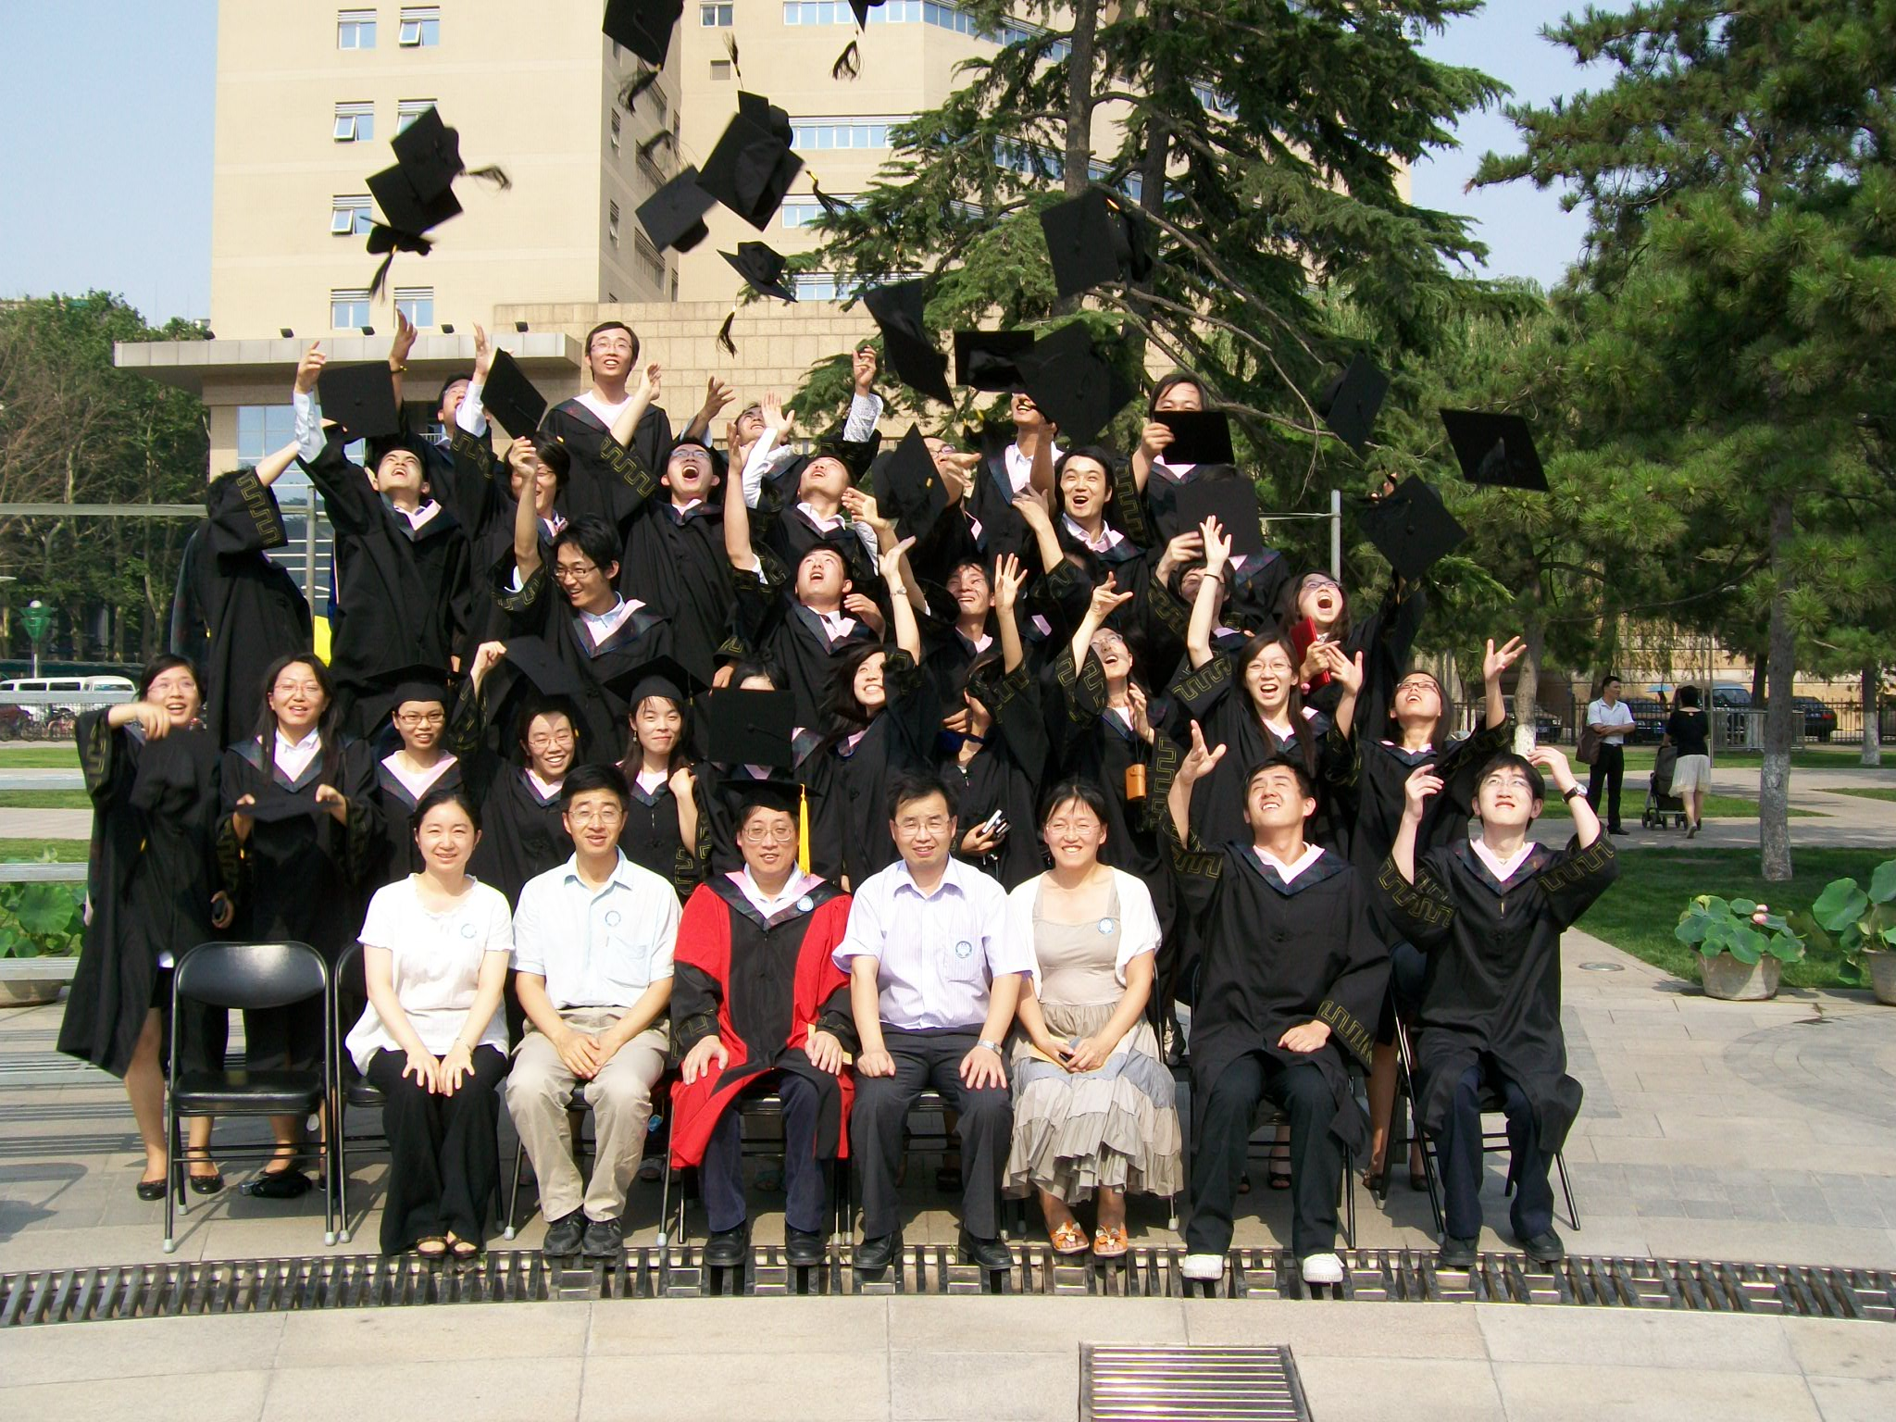
Graduation picture
Notes:
This is a graduation picture of undergraduate students .

Slide 14
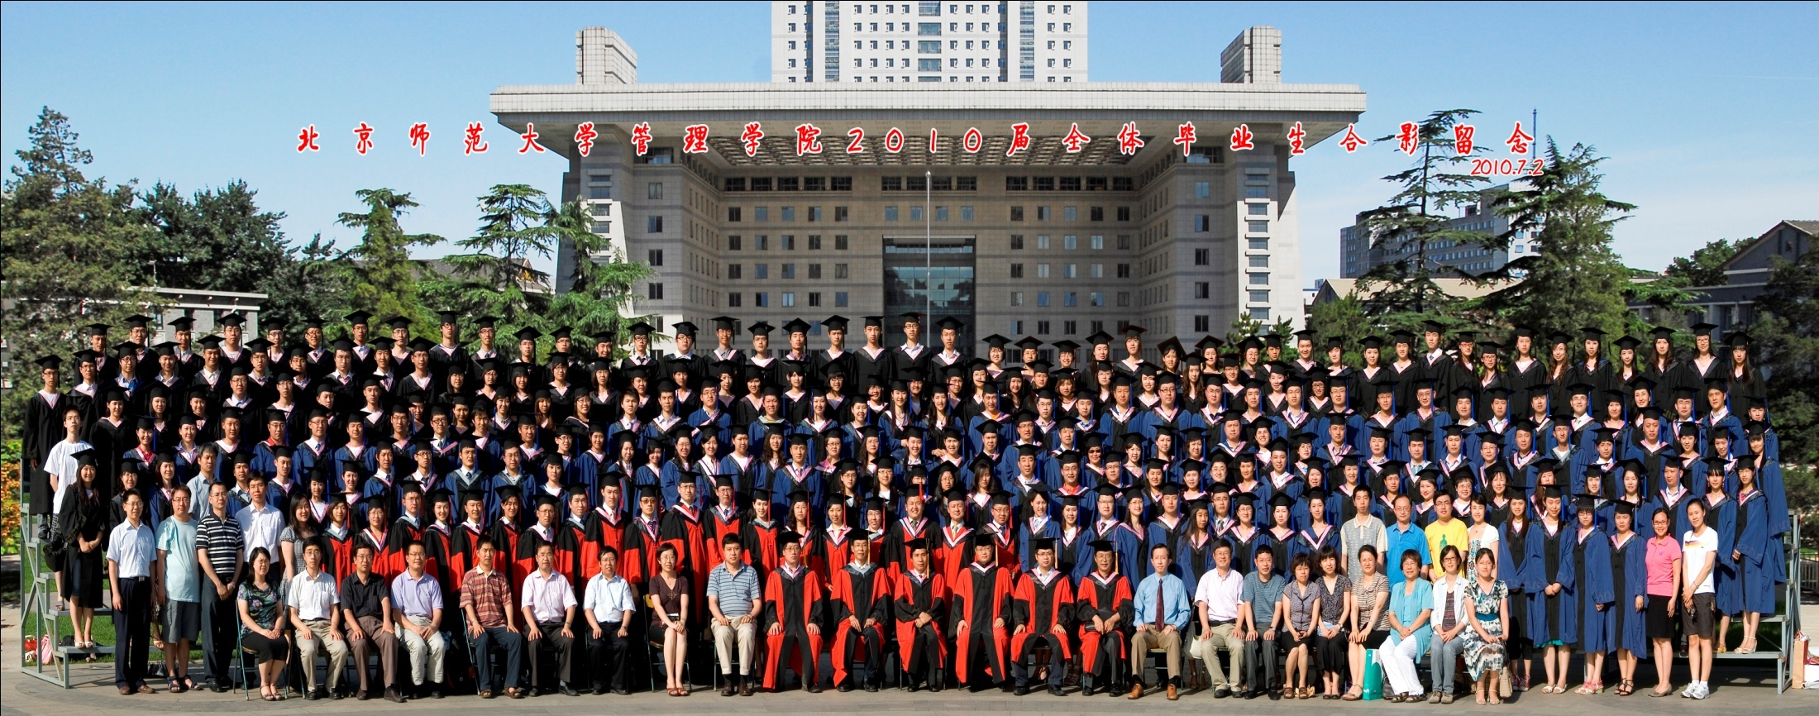
Notes:
This is a graduation picture for the whole school.

Slide 15
Kun Huang
Education
Ph.D : Information Retrieval / Peking University
M.A.: Information System/ Beijing Normal University
B.A.: Information Science/ Beijing Normal University
Teaching
Management Information System, Research Methods, VBA Programming, Database Programming, C Programming, Data Structure, Introduction to Information Management, Information Resource Management
Research Interests
Image retrieval and Image user study
Affective information Processing
Notes:
I have a close relationship with BNU, for I got my MA and BA from BNU. After I got my Ph.D, I came back to BNU to be a teacher.
My research interests include image retrieval and image user study, the other one is affective information processing. Today’s topic is a combination of these issues.

Slide 16









What is affective features based Image retrieval?
excited
beautiful
touching
bright
happy
warm
Notes:
Now let’s get to the point.
In our daily life we have all kinds of information needs. Images are an important media type. They describe abstract information in a vivid way.
We are used to use Google, Bing and such kind of search engines to search a picture. We can input forest, sea, rose anything you want to find.
But for other situations, we may just want to find a picture that is beautiful, or bright, or touching. We hope the picture can bring us certain emotion influence. Especially when our needs are vague, not clear. It’s hard to know what the image will look like but I know what the feeling I’d like.That is what the affective features based image retrieval care about.

Slide 17
What are Affective features ?
Subjective experiences aroused by images, including impression, sense, emotion or even feeling etc. ,described in adjective or adverb words.
Notes:
Subjective experiences aroused by images, including impression, sense, emotion or even feeling etc. ,described in adjective or adverb words.

Slide 18
the Procedure of AFBIR
cold, peaceful,
beautiful…
Search results
matching
query
Will users use affective words to search images?
Can they describe the impressions about images clearly?
Can we establish a baseline for affective features analysis?
Notes:
The procedure of AFBIR is the same as general image retrieval. The difference is the query.
For non-searching experience users, it will be much easier to describe their impressions about an image.
Is it applicable to do in this way?
So we need to answer. Whether users will use affective words to search images? Can they describe their impression about images clearly? Can we establish a baseline for affective features analysis?If the answers are YES, it’s possible to do in this way.
I choose natural scenes and conducted a survey as a pilot study. All my research is about colorful natural scenes.

Slide 19
A survey on image user
59.50% | When I search natural scenes, the most important thing is the experience they may bring me. After that I will notice what it contains certain objects.
78.10% | When I browse natural scenes, I care more about the impressions than the objects it contains.
65.60% | I have tried to find some natural scenes that can arose my emotions and feelings, such as happy spring picture or warm winter picture, etc.
64.80% | When watching natural scenes, I can describe what kind of feelings they bring me in words.
53.20% | When watching natural scenes, I have the similar evaluation with most of the people.
Participants: 4910 Female: 46% Male:52%
Notes:
In the online survey we asked participants 18 questions, offering yes or no choices. It collected data from 4910 participants.
I choose five questions. The percentage indicates the ratio who said YES.
From the first two, they reported that different from text retrieval, when users watching and searching natural scenes, affective features will influence their decisions.
The third question show that 65.6% of participants have tried affective keywords to search natural scenes.
The last two questions indicate that over half of the participants think it is possible to express their feeling in words and they may have the similar feelings with others.
The findings of the survey suggest that it is applicable to make a further study on it.

Slide 20
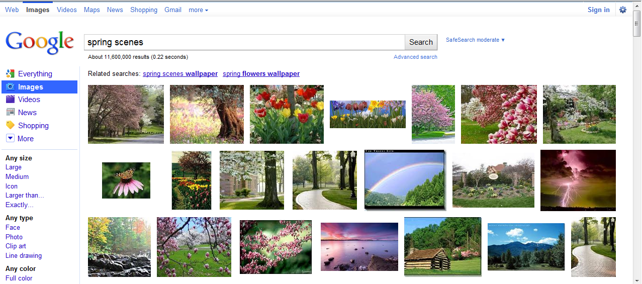
Can we search affective images from Google?
Notes:
In fact, even no new method is come up, the current search engine like Google, bing can process queries with affective words.
For example, we can input spring scenes. Google will return a great number of images.

Slide 21
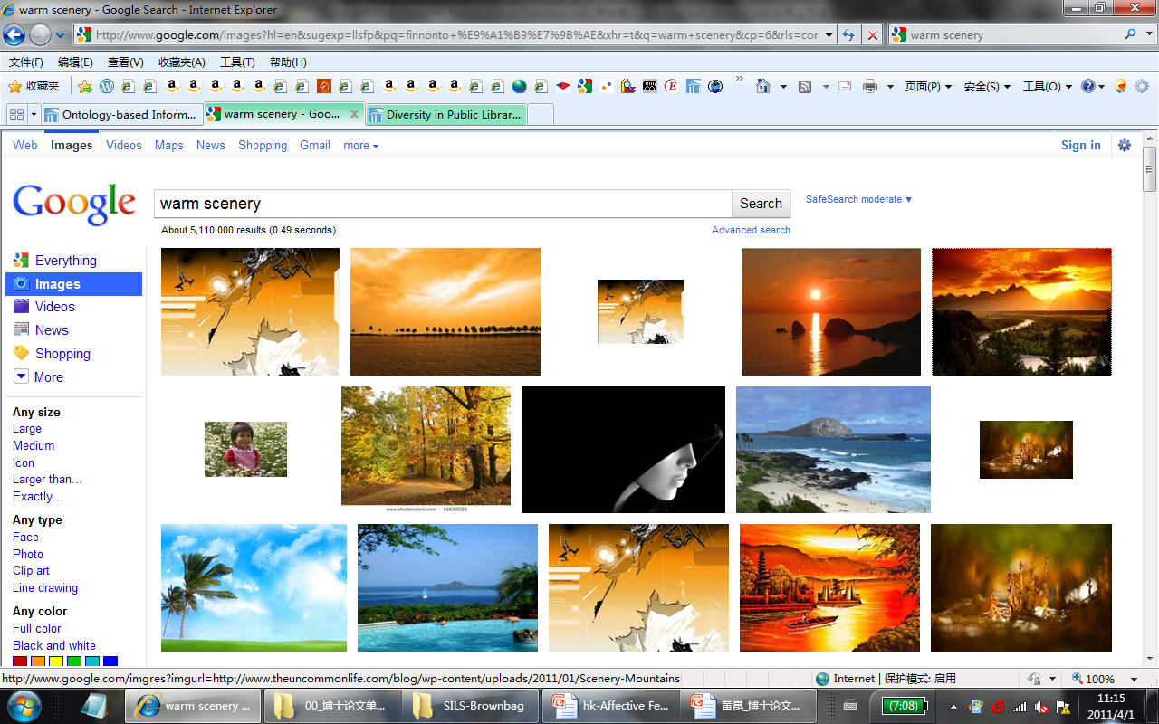
Disadvantage: Text context based image retrieval do not reveal the
content semantic of images
Notes:
Another example is searching warm scenery. We can also get many results.
So the big disadvantage of search engine is that they pay little attentions to the content analysis of images. Based on the web page context can not provide sufficient correct information for image analysis. Especially for affective features, its context may discuss more about the subject, less about the feelings or emotions they may bring viewers.
Although Content-based image retrieval do analyze the content semantic of images, they focus more on the subject and objects features and ignoring the emotions and feelings in images.
AFs are beneficial complements to current content-based image retrieval.

Slide 22
Questions
How to extract AF from natural scenes?
How to apply AF in image retrieval?
Purposes
To meet users’ affective searching needs
To provide affective faceted retrieval function
Notes:
In my research I focus on two issues. That is how to extract AF from images? And how to apply AF in image retrieval?
If we can answer these two questions and develop new method to realize it, we can not only meet the affective searching needs, but also provide faceted retrieval function to distinguish images with natural things.

Slide 23
Outline
Research Problem
Related Research
Research Design
Findings and Conclusions
Notes:
It’s sure I’m not the first one who thinks about these questions. Let’s have a quick view on related research.

Slide 24
2 Related Research
In 1990s, Japanese researchers came up with methods to extract human being’s Kansei in product design.
In 1995, America Professor Picard put forwards Affective computing to make computer understand and simulate human emotions.
Later, more efforts were put on the research about AF extraction of arts and paintings, natural scenes and web images.
Notes:
In 1990s, Japanese researchers came up with methods to extract human being’s Kansei in product design.
In 1995, America Professor Picard put forwards Affective computing to make computer understand and simulate human beings emotions
Later, more efforts were put on the arts and paintings, natural scenes and web images.

Slide 25
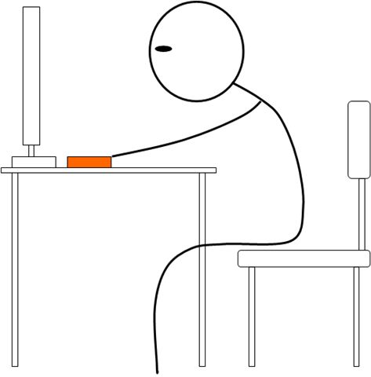
General technical solution
Mapping
Emotions
Image features
Notes:
All these research took a general technical solution.
First it extract visual features. At the same time, it collects user feelings. Finally it establish the mapping and use machine learning to update the mapping model.
When new images were added into database, the affective features are extracted automatically. Each image are represented by keyword vector.

Slide 26

AF Modeling
Theoretical model
Psychological model: Plutchik、Izard、Wundt…
Physiological signals
measurement
mapping
Low level features(color, texture etc)
mapping
User
Images
measurement
mapping
Vocabulary list, lexicon
Psychological features
Statistical model: regression analysis, neural network, support vector machine
Mathematical modeling
Information organization modeling
Notes:
Based on the existing research, three’re three levels to show how they study affective issues.
On the top it is theoretical level. Most are provided by psychologist. R. Plutchik considered there to be eight primary emotions. C. E. Lzard set up 9.
On the middle level it is mathematical level. When we view the images we may produce some responses. By means of psychological scale and physiological measurement we can collect users responses. For example, we can use sensors to gather users’ blood pressure or eye movement to judge user’s emotion mood. And we can also use self-report scale to judge users' attitudes. After that we can use statistical methods to qualify the relationship between responses and physical signals.
On the bottom, it is information organization model. It manages the affective features based on vocabulary list, lexicons.
In my research, I use psychology model provided by Wundt. He classify emotions based on three dimensions.
And we also build regression model and information organization model.

Slide 27
Outline
Research Problem
Related Research
Research Design
Findings and Conclusions
Notes:
I also conduct my research by the general procedure.

Slide 28
3 Research Design
to quantify the relationship between visual and affective features to establish the mapping model
to extract visual features of images
to collect users’ feelings
to build affective features model
to evaluate the precision of features recognition and image retrieval
Phase 1:
Phase 2:
Phase 3:
Phase 4:
Phase 5:

Slide 29
Phase I: Affective Features Hierarchical Model
beautiful-ugly
fond-disgusting
Preference
Emotion
Type
Physics
happy-unhappy
excited-peaceful
nervous-relaxed
Concrete Abstract
spring summer
autumn winter
warm-cold
Notes:
In content based image retrieval, they also have come up with the semantic model for images. But emotions and feelings are regarded only as the top level of semantic features.
But in image retrieval related with affective issues, they also consider bright, warm, dark, rough or smooth. So the affective model should cover the psychical level to preference level. We classify human beings subjective experiences to four level.
On the the first level, affective features are aroused by physical elements in images, such as color(co), texture(te), shape(sh) etc. Affective features in physical level reflect human being’s direct physical sense.
Affective features in the second level represents the style of whole image. For example, when colorful natural scenes are involved, AF could be descriptors of season and time, such as spring, summer, morning and night etc. They are always determined by the specific objects contained in images.
Affective features in the third level is used to express emotions evoked in human mind. Many theories on emotion classification can be put to this level.
affective features in the forth level is the highest level. They reflect individuals’ aesthetic tendency. They are adjective words to express users’ different aesthetic tendency and personal attitudes, such as beautiful, ugly, like or not.
For colorful natural scenes we choose 10 affective features according to AFHM. The features could be divided into two groups. One group is made up of season features, and the other group contains affective features in the rest three levels.

Slide 30
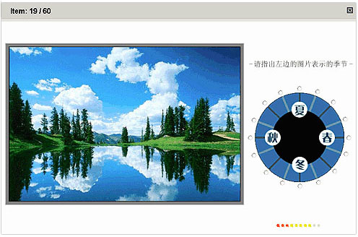
Phase II: Collect users’ feelings
Notes:
After determining the affective features, phase II we collected users’ feelings.
There are 217 natural scenes collected from Internet in our research.
Over 2000 persons take part in the survey.
This is the interface we ask participants to choose the season feature of the picture.

Slide 31
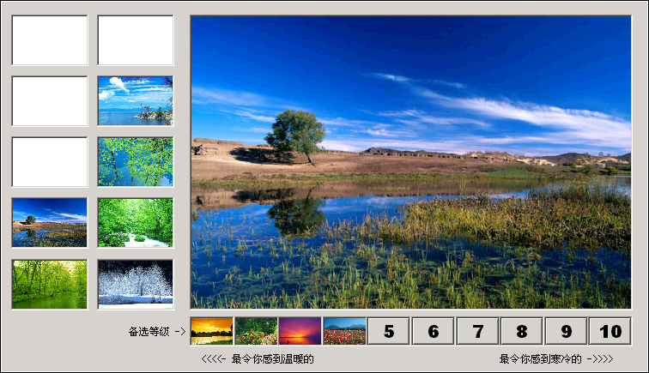
Phase II: Collect users’ feelings
Notes:
For other kind of affective features, we used semantic differential to collect users experiences about images.

Slide 32
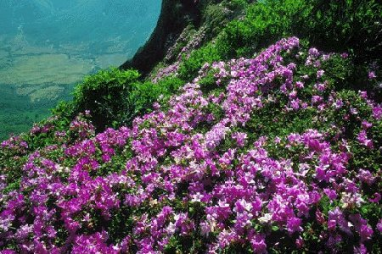
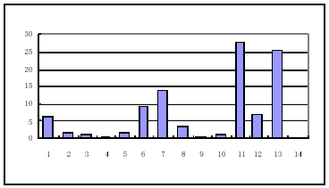
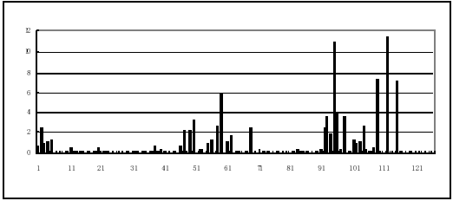
Phase III: Extract VF
Color Space: Hue/ Saturation /Value
Color Representation by 20-FM
Color Representation by 126-FM
Notes:
In phase III, we attempted to apply two strategies to quantify color. perspective
One called 20-FM means to quantify color features by Hue/Saturation /Value separately. Thus each image could have a vector with 20 parameters.
The other one called 126-FM is to quantify HSV by one formula. Each image could be represented by a vector with 126 parameters.

Slide 33
Phase III: Extract VF
1
3
5
2
4
6
Part 1 Part 2 Part3
Part 4 Part 5 Part6
120-FM

Slide 34
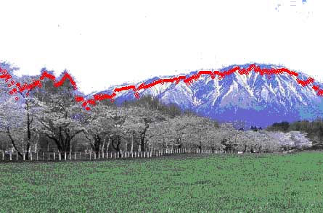
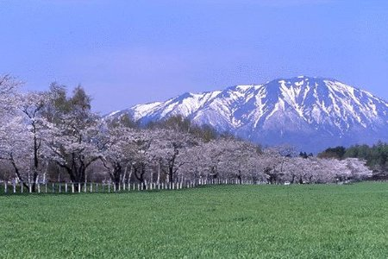
Sky Exclusion plus ½ Area Analysis
Correlation Analysis with the color features of the rest area after sky exclusion and those of bottom half area
20-FM: 0.91
126 FM: 0.89
1/2
Notes:
we observe that most natural scenes have the sky in the picture. In order to reduce the impact of sky blue on the whole impressions, is it possible for us to analyze the rest part without the sky?
After getting rid of the sky, we find an interesting thing that as far as the rest picture is concerned, the bottom half area may have the similar characteristics with the rest area without sky. If it is correct, we only need to analyze the bottom half of images. Then we do a relevancy analysis on the color features of the rest area after sky exclusion and those of bottom half area. The finding is that the correlations are significant. The relevancy parameter is 0.91 when color feature is represented by 20-FM and is 0.89 when color feature is represented by 126-FM.
So a sky exclusion strategy is developed. The basic principle is to detect the boundary of sky and the earth

Slide 35
Phase IV: Mapping
Season Style
Between winter and spring
Not autumn
Other affective features
more pleasant
Less nervous
Season Feature: 1 Spring,5 Summer,9 Autumn, 13 Winter
(a) Features indexed based on regression model
(b) Users’ evaluations on season
Other AF: 1 warm-cold 2 happy-unhappy 3 excited-peaceful 4 nervous-relaxed
5 beautiful-ugly 6 fond-disgusting
(c) Features indexed based on regression model
(d) Users’ evaluations on other AF

Slide 36
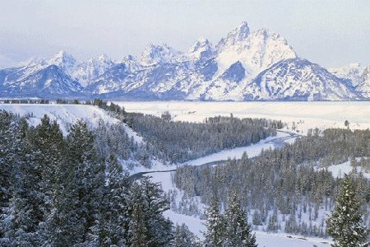
Phase IV: Mapping
Season Style
Typical winter
Other AF
Much colder
More Beautiful and Welcomed
Season Feature: 1 Spring,5 Summer,9 Autumn, 13 Winter
(a) Features indexed based on regression model
(b) Users’ evaluations on season
Other AF: 1 warm-cold 2 happy-unhappy 3 excited-peaceful 4 nervous-relaxed
5 beautiful-ugly 6 fond-disgusting
(c) Features indexed based on regression model
(d) Users’ evaluations on other AF

Slide 37
Phase V: Experiments
Experiment One: To evaluate the precision of AF extraction
Experiment Two: To evaluate the precision of AF retrieval
Notes:
In phase V, we conduct two experiment to testify the precise of predictions.
Experiment one is designed to find out the precise of AF extraction
Experiment two is designed to find out the precise of AF retrieval

Slide 38
Experiment ONE
Goal:
To Compare the results indexed based on regression model and the results evaluated by users
Criteria:
SF: The top four among 16 points between two results
Other AF: The deviation between two results

Slide 39
Class of Level | Affective Features | Precision
 |  | Learning set | New set
Preference | beautiful-ugly | 78.75% | 50.00%
 | fond-disgusting | 76.25% | 55.00%
Emotional | happy-unhappy | 78.75% | 65.00%
 | excited-peaceful | 70.00% | 70.00%
 | nervous-relaxed | 78.75% | 55.00%
Style | spring summer autumn winter | 86.25% | 78.83%
Physics | warm-cold | 78.75% | 85.00%
Max |  | 86.25% | 85.00%
Min |  | 70.00% | 50.00%
Average |  | 78.21% | 65.55%
Notes:
First, In all the results, the Average precision is over 65.55%. The maximum is 86.25%. The minimum is 50%. At least half of the images will be indexed correctly. In fact most of them are above 60%. It sounds not bad. At least we can help people to figure out the more trivial difference between images.
Next, it indicates that the precision of indexing learning examples are higher than that of indexing images in new set. For images in new set, it could get 85% in precision at most. And at least it could index half of images correct.
Then,we can have a look over 4 levels. From the lower level to the higher level, the precision is decreasing.

Slide 40
1 warm-cold 2 season features 3 happy-unhappy 4 excited-peaceful
5 nervous-relaxed 6 beautiful-ugly 7 fond-disgusting
Notes:
It indicates that the higher level is, the lower precision may get. It proves the same with what we have though when we put up the hierarchical model. That means affective features on higher level, they will be more abstract and harder to recognize.

Slide 41
Experiment Two
Goal:
To evaluate the precision of natural scenes retrieval and compare the precision between one-keyword query and two-keyword query
Notes:
To evaluate the precision of natural scenes retrieval and compare the precision between one-keyword query and two-keyword query

Slide 42
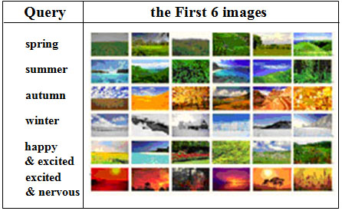






The top 6 images
spring
summer
autumn
winter
happy+excited
excited+nervious

Slide 43
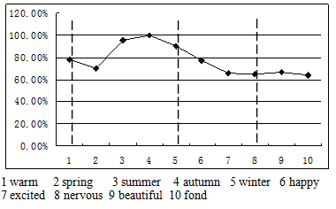
The precision of one-keyword query
Notes:
It indicates that the higher level is, the lower precision is as a whole. But there is a cross among levels when affective words are more abstract in lower level, the precision may be lower than that of higher level.

Slide 44
The precision comparison between one-keyword and two-keyword query
Notes:
The comparison of precision between one-keyword and two-keyword query
It indicates that almost two-keyword queries retrieval get lower precision than single keyword queries, except for the query “excited and autumn”, which get higher precision than “excited” but lower than “autumn”. The results reveal that most two-keyword retrievals get lower precision than one-keyword. It’s seems that when searching by affective features, more words added into query may eliminate the clarity of demands and make them more vague and abstract. Thus it becomes tougher for the retrieval program to match the query. The outcome is that the precision becomes lower.
The precision of retrieval has closed relationship with the abstract degree of queries, which is different from text retrieval. In text retrieval, more keywords added to query may usually make the query more concrete and it could do good to improving the precision.

Slide 45
Findings
From the two experiments, they both prove that the regression model can be used to extract the AF from natural scenes (Min=50%,Max=85%). In additions, it also indicates that the “sky exclusion plus 1/2 area analysis” is effective to be used to process images. That will reduce the image processing cost.
Notes:
From the two experiments, they both prove that the regression model can be used to extract the AF from natural scenes (Min=50%,Max=85%). In additions, it also indicates that the “sky exclusion plus 1/2 area analysis” is effective to be used to process images. That will reduce the image processing cost.

Slide 46
Findings
About the AFs Model, the lower the level is, the easier affective features could be recognized, which is according with the common sense that the more abstract things are, the more difficult to describe clearly.
The similar discipline also exists in retrieval procedure. That means the lower the level is, the easier affective features could be searched. But it is not absolute. In other words, the retrieval effect lies on the abstract degree of queries to some extent.
Notes:
About the AFs Model, the lower the level is, the easier affective features could be recognized, which is according with the common sense that the more abstract things are, the more difficult to describe clearly.
The similar discipline also exists in retrieval procedure. That means the lower the level is, the easier affective features could be searched. But it is not absolute. In other words, the retrieval effect lies on the abstract degree of queries to some extent.

Slide 47
My current work
Image user study:
  the purpose is to figure out the characteristics of image needs and usage among undergraduate students, including the demands on images and the principles of their information behavior.
  A Survey across BNU :
  Covering 6 schools, 519/601 (86.36%)
  27 questions
Notes:
My current work include two task. I’m analyzing the data and haven’t published on these two work.

Slide 48
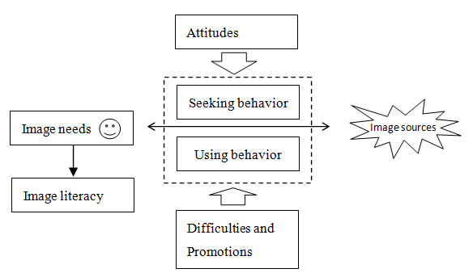
Image tagging
Copyright
Satisfactions
Entertainment
Major learning or studying
Social activities or part-time job
SE always used
How to input and refine queries
Search on cell phone
Image saving
Image processing( rename image name, folder name, reorganize folders)
Image sharing(uploading)
Image organization
From social network
From non-social network
Difficulties
Promotion methods
Image Format
Popular Image processing software
Notes:
First of all, it can provide suggestions for university libraries to establish image resources; Second, it can provide instructions on training undergraduate students on image literacy; Finally, it can provide suggestions for current image service provider to improve the service quality.

Slide 49
My current work
2. Affective features organization:
  The purpose is to establish a model to manage Chinese affective words.
  A Pilot study:
  Collecting 60 basic affective words
  Asking users rating the degree and frequency

Slide 50
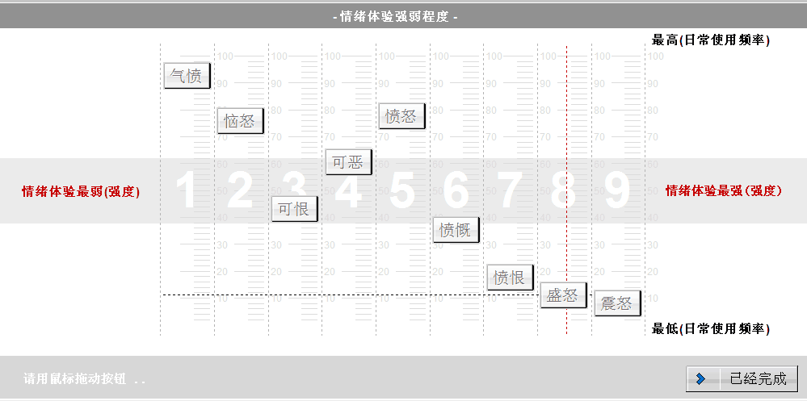
Highest Frequency
Weakest emotion
Strongest emotion
The correlations of words frequency order between survey and the search results are significant.(Angry r= 0.967 Happy r=0.9)
The higher the frequency is or the stronger the emotion is , the higher the consistency is.
Lowest Frequency
Notes:
The frequency order of words between survey and the search results are significant.(Angry r= 0.967 Happy r=0.9)
The higher the frequency is or the stronger the emotion is , the higher the consistency is.

Slide 51
Thank you and Welcome to BNU☺
Thanks Diane for helping me rehearse my presentation in advance.

