Slide 1
Framework and Models

Slide 2
Framework
To help understand the field
To develop a system that will allow us to
  Develop good designs
  Test
  Evaluate
  We need a framework for describing and modeling the visualization process.

Slide 3
Let’s take a Historical Look
Static images
  10,000 years
  art, graphic design
Abstract constructs
  200-500 years
  Maps, charts, tables
Moving images, pictures
  100-200 years
  Photography, Cinematography, TV
Interactive graphics, 3D
  20 years
  computer graphics, human-computer interaction, computer games, 3D
How about an interactive visualization of this History: A Brief History
Notes:
History Link: http://www.math.yorku.ca/SCS/Gallery/milestone/

Slide 4
What’s passed the test of time?
Direct representations
  Sketches
  Pictures
  Maps
  Photography, Video capture
Abstractions
  Charts (which kinds?)
  Graphs
Kind of hard to make calls on stuff that’s < 20 years old…Clearly interactive tools, dynamic control and 3D will play major roles. Currently, though, lots of specialized tools. What will still be important in 100 years?
Notes:
Under Abstractions – what about diagrams/models? And symbols?
Add to third bullet point:
Information visualization a young field; kind of hard to make a call….

Slide 5
What Brad thinks is new about visualizations (last 20 years)
Interaction with information
Exploration of information
User control of filtering, processing, which enables exploration and “visual analytics”.
Some specific examples of new interactions
Interact with environment (live map data, GPS)
Interact with people (social networks)
Interact with live data (sensor networks, webcam, ski report)

Slide 6
Taxomony, Models, Framework
Major Thinkers
1900s: Philosophers (mostly French, like Ferdinand de Saussure (1959)), in US C.S.Peirce described the study of symbols, call semiotics.
1983: Jaques Bertin’s masterpiece, Semiology of Graphics. Personal preferences, graphic design based approach to semiotics.
Gibson: Theory of affordances, top down approach to perceptual processing that affects HCI.
Tufte: several books on Visualization. From artistic, graphic design approach.
1980s-Today: Trying to make a science of it
  Colin Ware
  Stuart Card
  Jock Mackinlay
  Ben Shneiderman
  Stephen Few

Slide 7
Major Publications
The Structure of the Information Visualization Design Space Stuart K. Card and Jock Mackinlay
The Eyes Have It:A Task by Data Type Taxonomy for Information Visualizations Ben Shneiderman
The Value of Visualization, Jarke J. van Wijk
Rethinking Visualization: A High-Level Taxonomy, Melanie Tory, Torsten Möller
Automating the design of graphical presentations of relational information Mackinlay

Slide 8
Taxomony, Models, Framework
Bertin’s Semiology of Graphics. Foundation work describing use of signs/symbols for 2D static presentations. Based on valuable practical experience, although it some cases untested (and didn’t always turn out to be true, and sometimes is misleading). http://en.wikipedia.org/wiki/Jacques_Bertin

Slide 9
Taxomony, Models, Framework
What’s your framework?
What do you think are the important things to include?
What things are given to you?
What do you get to choose?
How can you evaluate what is better/best?
Class exercise: Develop Framework Proposal

Slide 10
Basic Framework—”CUT-DDV”
Context
User
Task
Data
Display
Visualization Techniques

Slide 11
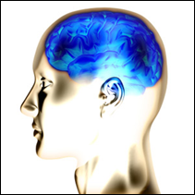
CUT-DDV Framework
Context
Visualization Techniques
Displays
Dataset
Processed
Data
Represented in
Data Model
Raw Data
Display to
Eye
Map to Display(s)
Filter,
Transform,
Modify
User
Mapping to Data Model
Task

Slide 12
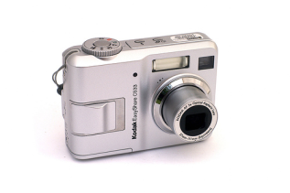
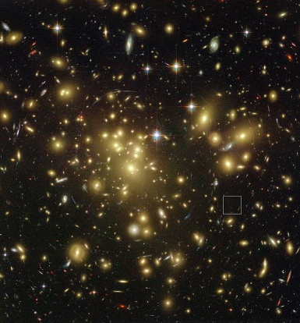
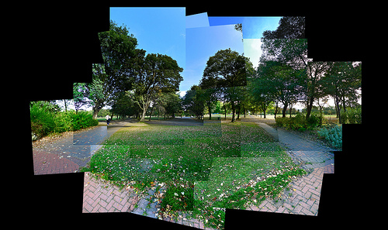
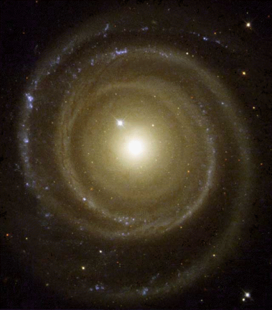
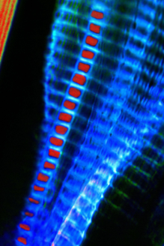
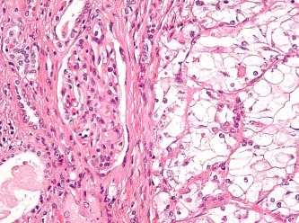

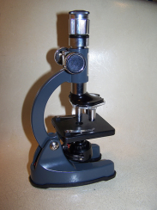
CUT-DDV Framework
Raw Data
Dataset
Notes:
RAW DATA:
Numbers in blue: Clip art.
Cell: http://commons.wikimedia.org/wiki/File:Clear_cell_renal_cell_carcinoma_high_mag_cropped.jpg
Creative Commons Attribution-Share Alike 3.0 Unported
Microscopic Worm: http://commons.wikimedia.org/wiki/File:Microscopic_Worm.jpg
Creative Commons Attribution 3.0 Unported
Galaxy: http://commons.wikimedia.org/wiki/File:A1689-zD1_2.JPG (public domain)
Spiral: http://commons.wikimedia.org/wiki/File:Gal%C3%A1xias_espiral.gif (public domain)
Photo Collage: <div xmlns:cc="http://creativecommons.org/ns#" about="http://www.flickr.com/photos/p0ps/2586352201/"><a rel="cc:attributionURL" href="http://www.flickr.com/photos/p0ps/">http://www.flickr.com/photos/p0ps/</a> / <a rel="license" href="http://creativecommons.org/licenses/by-nc-sa/2.0/">CC BY-NC-SA 2.0</a></div>
Photo Mashup: <div xmlns:cc="http://creativecommons.org/ns#" about="http://www.flickr.com/photos/spikemorris/3975049514/"><a rel="cc:attributionURL" href="http://www.flickr.com/photos/spikemorris/">http://www.flickr.com/photos/spikemorris/</a> / <a rel="license" href="http://creativecommons.org/licenses/by-nc/2.0/">CC BY-NC 2.0</a></div>
COLLECT:
Satellite: <div xmlns:cc="http://creativecommons.org/ns#" about="http://www.flickr.com/photos/gord99/2224184085/in/set-72157603803185760/"><a rel="cc:attributionURL" href="http://www.flickr.com/photos/gord99/">http://www.flickr.com/photos/gord99/</a> / <a rel="license" href="http://creativecommons.org/licenses/by-nc-nd/2.0/">CC BY-NC-ND 2.0</a></div>
Microscope: <div xmlns:cc="http://creativecommons.org/ns#" about="http://www.flickr.com/photos/spike55151/417096716/"><a rel="cc:attributionURL" href="http://www.flickr.com/photos/spike55151/">http://www.flickr.com/photos/spike55151/</a> / <a rel="license" href="http://creativecommons.org/licenses/by-nc-sa/2.0/">CC BY-NC-SA 2.0</a></div>
Camera: <div xmlns:cc="http://creativecommons.org/ns#" about="http://www.flickr.com/photos/captkodak/271877082/"><a rel="cc:attributionURL" href="http://www.flickr.com/photos/captkodak/">http://www.flickr.com/photos/captkodak/</a> / <a rel="license" href="http://creativecommons.org/licenses/by-nc/2.0/">CC BY-NC 2.0</a></div>

Slide 13
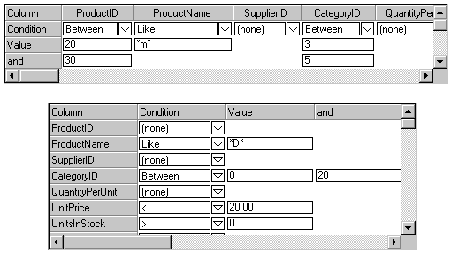
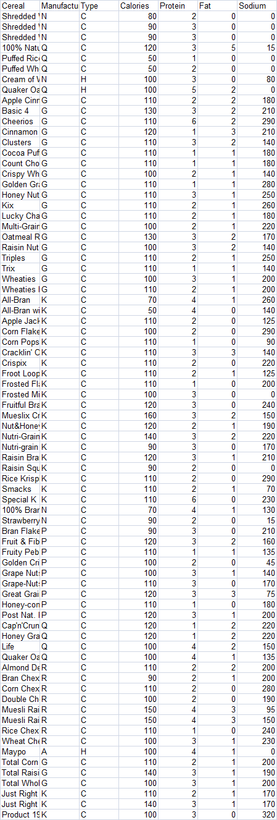
CUT-DDV Framework
Dataset
Mapping to Data Model
Processed
Data
Represented in Data Model
Notes:
Data Sources:
RAW DATA:
Numbers in blue: Clip art.
Galaxy: <div xmlns:cc="http://creativecommons.org/ns#" about="http://www.flickr.com/photos/jaredsmith/176375861/"><a rel="cc:attributionURL" href="http://www.flickr.com/photos/jaredsmith/">http://www.flickr.com/photos/jaredsmith/</a> / <a rel="license" href="http://creativecommons.org/licenses/by-sa/2.0/">CC BY-SA 2.0</a></div>
Photo Collage: <div xmlns:cc="http://creativecommons.org/ns#" about="http://www.flickr.com/photos/p0ps/2586352201/"><a rel="cc:attributionURL" href="http://www.flickr.com/photos/p0ps/">http://www.flickr.com/photos/p0ps/</a> / <a rel="license" href="http://creativecommons.org/licenses/by-nc-sa/2.0/">CC BY-NC-SA 2.0</a></div>
COLLECT:
Satellite: <div xmlns:cc="http://creativecommons.org/ns#" about="http://www.flickr.com/photos/gord99/2224184085/in/set-72157603803185760/"><a rel="cc:attributionURL" href="http://www.flickr.com/photos/gord99/">http://www.flickr.com/photos/gord99/</a> / <a rel="license" href="http://creativecommons.org/licenses/by-nc-nd/2.0/">CC BY-NC-ND 2.0</a></div>
Microscope: <div xmlns:cc="http://creativecommons.org/ns#" about="http://www.flickr.com/photos/spike55151/417096716/"><a rel="cc:attributionURL" href="http://www.flickr.com/photos/spike55151/">http://www.flickr.com/photos/spike55151/</a> / <a rel="license" href="http://creativecommons.org/licenses/by-nc-sa/2.0/">CC BY-NC-SA 2.0</a></div>
Camera: <div xmlns:cc="http://creativecommons.org/ns#" about="http://www.flickr.com/photos/captkodak/271877082/"><a rel="cc:attributionURL" href="http://www.flickr.com/photos/captkodak/">http://www.flickr.com/photos/captkodak/</a> / <a rel="license" href="http://creativecommons.org/licenses/by-nc/2.0/">CC BY-NC 2.0</a></div>
DATASET: cut/paste from excel
PROCESSED DATA:
Starred email: <div xmlns:cc="http://creativecommons.org/ns#" about="http://www.flickr.com/photos/pesut/302429586/"><a rel="cc:attributionURL" href="http://www.flickr.com/photos/pesut/">http://www.flickr.com/photos/pesut/</a> / <a rel="license" href="http://creativecommons.org/licenses/by-sa/2.0/">CC BY-SA 2.0</a></div>
Filter Screenshot: <div xmlns:cc="http://creativecommons.org/ns#" about="http://www.flickr.com/photos/90104203@N00/4050129572/"><a rel="cc:attributionURL" href="http://www.flickr.com/photos/90104203@N00/">http://www.flickr.com/photos/90104203@N00/</a> / <a rel="license" href="http://creativecommons.org/licenses/by-nc-sa/2.0/">CC BY-NC-SA 2.0</a></div>

Slide 14


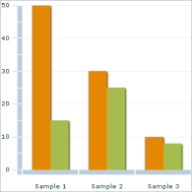
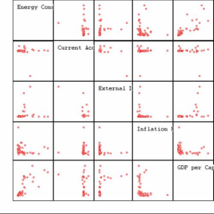
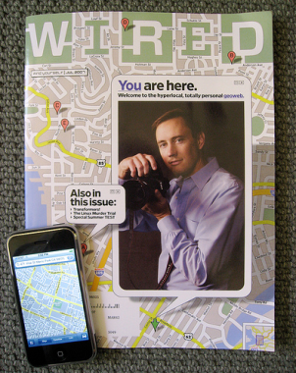
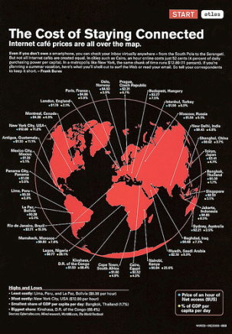
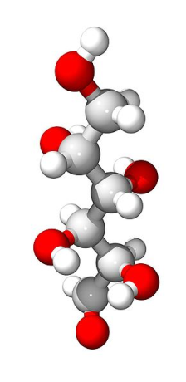
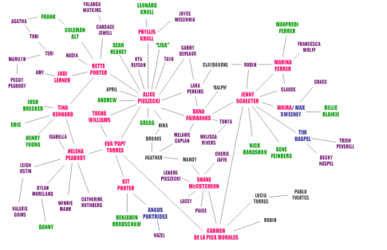
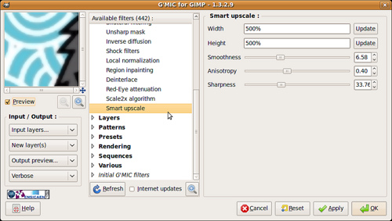
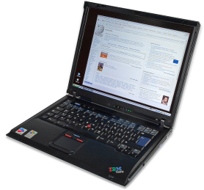
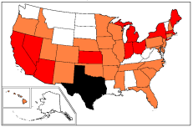
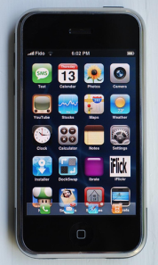
CUT-DDV Framework
Visualization Techniques
Display
Map to Display(s)
Filter,
Transform,
Modify
Notes:
VISUALIZATION TECHNIQUES:
Barchart: http://commons.wikimedia.org/wiki/File:Adobe_Flex_ColumnChart.png
GNU Free Documentation License.
Scatterplot Mulitples: http://commons.wikimedia.org/wiki/File:Scatterplot.jpg
GNU Free Documentation License,
3D (red, white, gray): http://commons.wikimedia.org/wiki/File:Galactose-3D.jpg (public domain)
3D (white,yellow, red, blue, black connectors): http://commons.wikimedia.org/wiki/File:Cevimeline_3D.png (public domain)
Network (with red and green dots):
<div xmlns:cc="http://creativecommons.org/ns#" about="http://www.flickr.com/photos/gustavog/4557105/"><a rel="cc:attributionURL" href="http://www.flickr.com/photos/gustavog/">http://www.flickr.com/photos/gustavog/</a> / <a rel="license" href="http://creativecommons.org/licenses/by-nc-sa/2.0/">CC BY-NC-SA 2.0</a></div>
Network (colored names): http://commons.wikimedia.org/wiki/File:El_chart.png
Creative Commons Attribution 2.5 Generic
US MAP: http://commons.wikimedia.org/wiki/File:2009_flu_US_map.png
GNU Free Documentation License,
DISPLAYS:
Ipod ad on building in Japan: <div xmlns:cc="http://creativecommons.org/ns#" about="http://www.flickr.com/photos/cybernezumi/482820405/"><a rel="cc:attributionURL" href="http://www.flickr.com/photos/cybernezumi/">http://www.flickr.com/photos/cybernezumi/</a> / <a rel="license" href="http://creativecommons.org/licenses/by-nc-sa/2.0/">CC BY-NC-SA 2.0</a></div>
Ipod on street adboard: <div xmlns:cc="http://creativecommons.org/ns#" about="http://www.flickr.com/photos/hur/183065997/"><a rel="cc:attributionURL" href="http://www.flickr.com/photos/hur/">http://www.flickr.com/photos/hur/</a> / <a rel="license" href="http://creativecommons.org/licenses/by-nc-nd/2.0/">CC BY-NC-ND 2.0</a></div>
Wired: The Battle for Blue <div xmlns:cc="http://creativecommons.org/ns#" about="http://www.flickr.com/photos/philgyford/56867986/"><a rel="cc:attributionURL" href="http://www.flickr.com/photos/philgyford/">http://www.flickr.com/photos/philgyford/</a> / <a rel="license" href="http://creativecommons.org/licenses/by-nc-nd/2.0/">CC BY-NC-ND 2.0</a></div>
Wired: GPS <div xmlns:cc="http://creativecommons.org/ns#" about="http://www.flickr.com/photos/djm/3211298331/"><a rel="cc:attributionURL" href="http://www.flickr.com/photos/djm/">http://www.flickr.com/photos/djm/</a> / <a rel="license" href="http://creativecommons.org/licenses/by-nc-sa/2.0/">CC BY-NC-SA 2.0</a></div>
Wired: Cost of Staying Connected: <div xmlns:cc="http://creativecommons.org/ns#" about="http://www.flickr.com/photos/ninjanoodles/156209557/"><a rel="cc:attributionURL" href="http://www.flickr.com/photos/ninjanoodles/">http://www.flickr.com/photos/ninjanoodles/</a> / <a rel="license" href="http://creativecommons.org/licenses/by/2.0/">CC BY 2.0</a></div>
Wired Magazine with Iphone photo: <div xmlns:cc="http://creativecommons.org/ns#" about="http://www.flickr.com/photos/jurvetson/709747240/"><a rel="cc:attributionURL" href="http://www.flickr.com/photos/jurvetson/">http://www.flickr.com/photos/jurvetson/</a> / <a rel="license" href="http://creativecommons.org/licenses/by/2.0/">CC BY 2.0</a></div>
Iphone: <div xmlns:cc="http://creativecommons.org/ns#" about="http://www.flickr.com/photos/antidigerati/1375118941/"><a rel="cc:attributionURL" href="http://www.flickr.com/photos/antidigerati/">http://www.flickr.com/photos/antidigerati/</a> / <a rel="license" href="http://creativecommons.org/licenses/by-sa/2.0/">CC BY-SA 2.0</a></div>
Laptop: http://commons.wikimedia.org/wiki/File:IBM_Thinkpad_R51.jpg
Author: André Karwath aka Aka, Creative Commons Attribution-Share Alike 2.5 Generic license.

Slide 15
CUT-DDV Framework
Task
Detection
Search
Recognition
In depth study
Entertainment
Display to
Eye
User
Visual acuity
R/G colorblind
Attentiveness
Multitasking
Memory
Disabilities
Context
Notes:
<div xmlns:cc="http://creativecommons.org/ns#" about="http://www.flickr.com/photos/elidorata/561329054/"><a rel="cc:attributionURL" href="http://www.flickr.com/photos/elidorata/">http://www.flickr.com/photos/elidorata/</a> / <a rel="license" href="http://creativecommons.org/licenses/by-sa/2.0/">CC BY-SA 2.0</a></div>

Slide 16
User Diversity
Perceptual differences
  Color-blindness
  Age-related issues
Disabilities
  Blindness, deafness
  Motor impairments
  Cognitive issues
Literacy
Cultural
Gender
Education
Notes:
User Diversity
● Perceptual differences
- Color-blindness
- Age-related issues
● Disabilities
- Blindness, deafness
- Motor impairments
- Cognitive issues
● Literacy
● Cultural
● Gender
● Education

Slide 17
Tabletop Sharing of Digital Photographs for the Elderly
(Apted et. al, 2006)
Visual issues
  Reduced acuity
  Loss in color perception
  Increased sensitivity to glare
Motor issues
  Slower
  Poorer coordination
  Fine motor action
  Less experience with computer
Notes:
Tabletop Sharing of Digital Photographs
for the Elderly
Apted, et al, 2006
● Visual issues
- Reduced acuity
- Loss in color perception
- Increased sensitivity to glare
● Motor issues
- Slower
- Poorer coordination
- Fine motor action
- Less experience with computer.

Slide 18
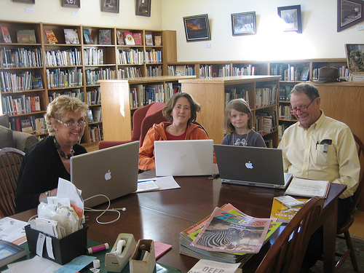

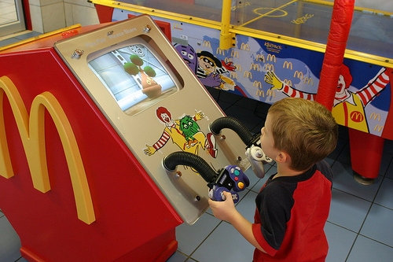
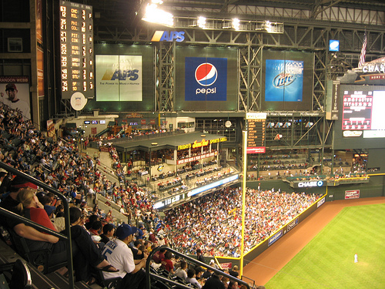

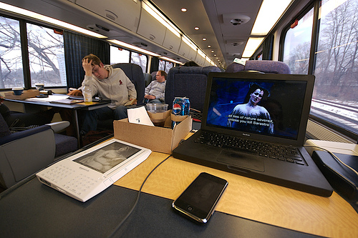
CUT (Context) Examples
Notes:
McDonalds: <div xmlns:cc="http://creativecommons.org/ns#" about="http://www.flickr.com/photos/stephenr/1012150929/"><a rel="cc:attributionURL" href="http://www.flickr.com/photos/stephenr/">http://www.flickr.com/photos/stephenr/</a> / <a rel="license" href="http://creativecommons.org/licenses/by-nc-sa/2.0/">CC BY-NC-SA 2.0</a></div>
Nintendo<div xmlns:cc="http://creativecommons.org/ns#" about="http://www.flickr.com/photos/jauladeardilla/3580703635/in/set-72157618957843339/"><a rel="cc:attributionURL" href="http://www.flickr.com/photos/jauladeardilla/">http://www.flickr.com/photos/jauladeardilla/</a> / <a rel="license" href="http://creativecommons.org/licenses/by-nc-nd/2.0/">CC BY-NC-ND 2.0</a></div>
Amtrak <div xmlns:cc="http://creativecommons.org/ns#" about="http://www.flickr.com/photos/andyi/2131610078/"><a rel="cc:attributionURL" href="http://www.flickr.com/photos/andyi/">http://www.flickr.com/photos/andyi/</a> / <a rel="license" href="http://creativecommons.org/licenses/by-nc-nd/2.0/">CC BY-NC-ND 2.0</a></div>
Woman with Phone and Ice Tea: <div xmlns:cc="http://creativecommons.org/ns#" about="http://www.flickr.com/photos/yourdon/3599753183/"><a rel="cc:attributionURL" href="http://www.flickr.com/photos/yourdon/">http://www.flickr.com/photos/yourdon/</a> / <a rel="license" href="http://creativecommons.org/licenses/by-sa/2.0/">CC BY-SA 2.0</a></div>
Stadium: <div xmlns:cc="http://creativecommons.org/ns#" about="http://www.flickr.com/photos/kenlund/3441046730/"><a rel="cc:attributionURL" href="http://www.flickr.com/photos/kenlund/">http://www.flickr.com/photos/kenlund/</a> / <a rel="license" href="http://creativecommons.org/licenses/by-sa/2.0/">CC BY-SA 2.0</a></div>
Family on Laptops in Library: <div xmlns:cc="http://creativecommons.org/ns#" about="http://www.flickr.com/photos/iamthebestartist/701545692/"><a rel="cc:attributionURL" href="http://www.flickr.com/photos/iamthebestartist/">http://www.flickr.com/photos/iamthebestartist/</a> / <a rel="license" href="http://creativecommons.org/licenses/by-nc-sa/2.0/">CC BY-NC-SA 2.0</a></div>
Guy with Laptop on Street <div xmlns:cc="http://creativecommons.org/ns#" about="http://www.flickr.com/photos/lucas3d/2658319883/"><a rel="cc:attributionURL" href="http://www.flickr.com/photos/lucas3d/">http://www.flickr.com/photos/lucas3d/</a> / <a rel="license" href="http://creativecommons.org/licenses/by-nc/2.0/">CC BY-NC 2.0</a></div>

Slide 19
Complete Model
Where do design principles like Tufte’s guidelines fit in?
What about evaluation and refinement?
Let’s put it all in one picture, and highlight the parts we can control.

Slide 20
Full Framework: CUTT-AD-DDV
Given, and should be identified by designer
Context
User
Task
Data Types
Generally known
Human Abilities (perception, memory, cognition)
Design Principles
These you have some control over
Data Model
Display
Visualization Techniques
Notes:
Replace CUTT-AD-DDV with graphic…

Slide 21
Visualization Framework
Given
Human Abilities
Visual perception
Cognition
Memory
Motor skills
Design Principles
Visual display
Interaction
Chosen
Imply
Inform design
Design Process
Iterative design
Design studies
Evaluation
Context
User
Tasks
Data Types
Constrain
design
Data Model
Display(s)
Visualization Techniques

