Slide 1
Relationships Introduction
oversimplified model will…
help you get a feel for the bigger project
Is not a completed design;
it is just a beginning draft

Slide 2
Consider Four Books purchased
1. Could be the start of a personal library web site
2. need to know what is on hand and what is on order; web owner makes the claim that he only reviews book he owns and has read
3. Need to track all authors as individuals (not as teams) why?
Because sometimes they don’t write as a team
Notes:
The fact that one book is on order is highly relevant to your 05 database project.

Slide 3
Authors
Connection table
Books
Orders
AuthID
AuthorName
ConnectionID
BookTitleID
OrdersID
And we
Need some
attributes
BookTitle
BookTitle
OnShelf
NumBooksOrdered
This suggests a
books table
authors table
connection table
orders table

Slide 4
Lets start entering some raw data even before we set up relationships start by entering the authors over and down…

Slide 5
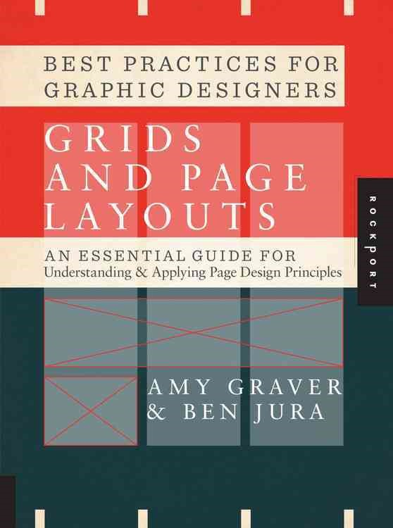
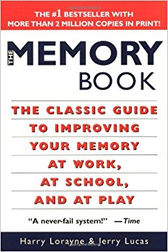
This one is on order
Grids and Page Layouts
Amy Graver & Ben Jura
2012
Rockport
$40.00
The Memory Book
Lorayne, Harry & Lucas, Jerry
1974
Ballentine
$12.80
2 authors
2 authors
Fever 1793
Anderson, Laurie
2000
Aladdin Paperbacks
$7.33
Miracle Math
Lorayne, Harry
1974
Balentine
$40.00
1 author
1 author?
0 author

Slide 6
let’s list all the authors and books

Slide 7
Authors:
1 Lucas
2 Lorayne
3 Anderson
4 Graver
5 Jura
Books:
1 The Memory Book
2 Fever 1793
3 Miracle Math
4 Grids and Page Layouts
Publishers:
1 Rockport
2 Aladdin Paperbacks
3 Ballentine
Assume that we will
Create additional first name field to differentiate authors with same last name
Maybe I might want to track publishers.
Its interesting that four books yields 3 publishers and
5 authors.
We may need to add City, State, and Postal code if publisher has more than one location

Slide 8
Lets build a basic book table and author table

Slide 9
Authors
Connection table
Books
Orders
AuthID
AuthorLName
BookTitleID
Book Title
OnShelf
OrdersID
Book Title
ConnID
FK
PK
1 Lucas
2 Lorayne
3 Anderson
4 Graver
5 Jura
1 1 1
2 2 1
3 3 2
4 2 3
5 4 4
6 5 4
1 The Memory Book 1
2 Fever 1793 1
3 Miracle Math 1
4 Grids and Page Layouts 0
1 4 1
FK
NumBooksOrdered
PK
FK
AuthID
Publishers
1 Rockport
2 Aladdin Paperbacks
3 Ballentine
PubID
State
City
Country

Slide 10
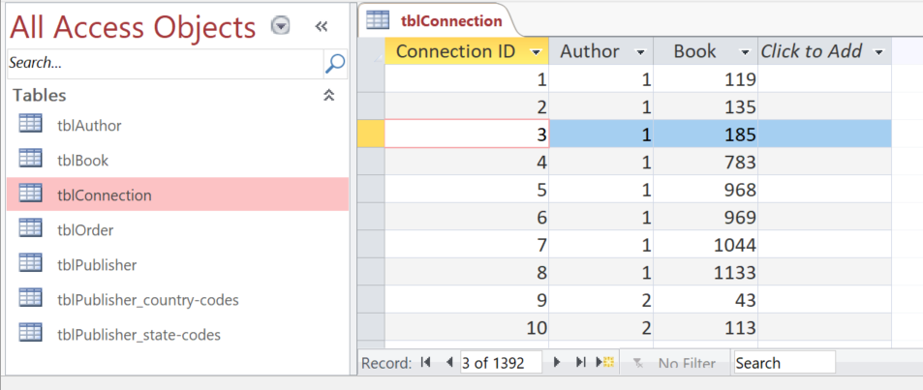
AuthID
BookTitleID
Authors
Connection table
Books
AuthID
AuthorLName
ConnectionID
BookTitleID
Book Title
OnShelf
1 Lucas
2 Lorayne
3 Anderson
4 Graver
5 Jura
1 1 1
2 2 1
3 3 2
4 2 3
5 4 4
6 5 4
1 The Memory Book 1
2 Fever 1793 1
3 Miracle Math 1
4 Grids and Page Layouts 0
The connection table
is pretty much the same as the one in our
task 05 project
This is not human readable, so lets dig into
Access Relationships to build some lookup tables

Slide 11
To Set up Relationships Start with the Foreign Keys

Slide 12
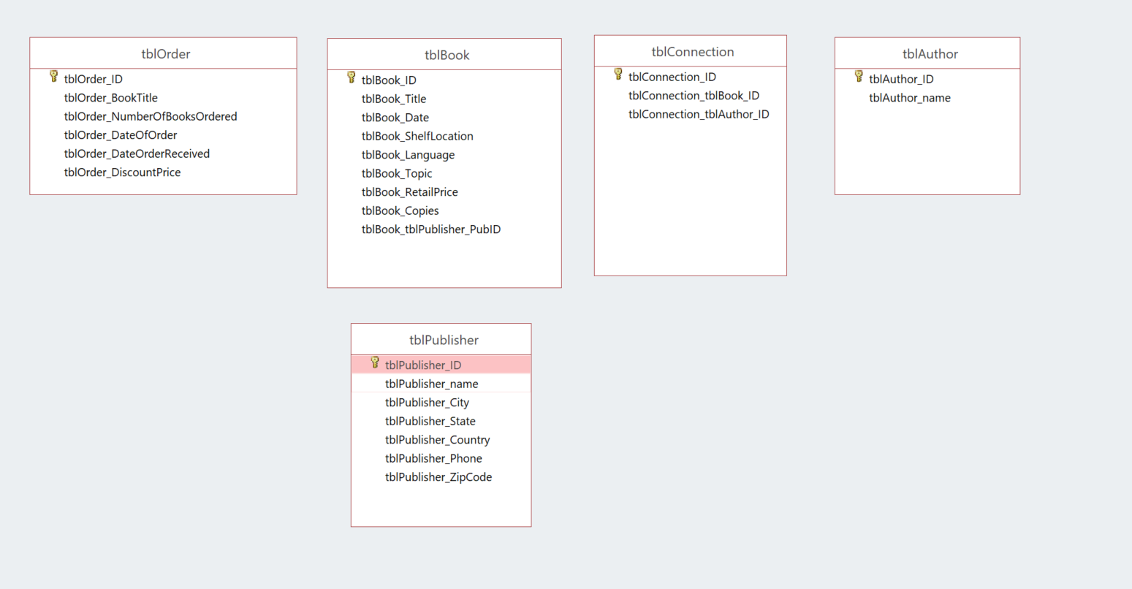
Primary keys have gold key icon
Foreign keys relate to other tables
FK
FK
FK
No FK
FK
No FK

Slide 13
now on to Access

