Slide 1
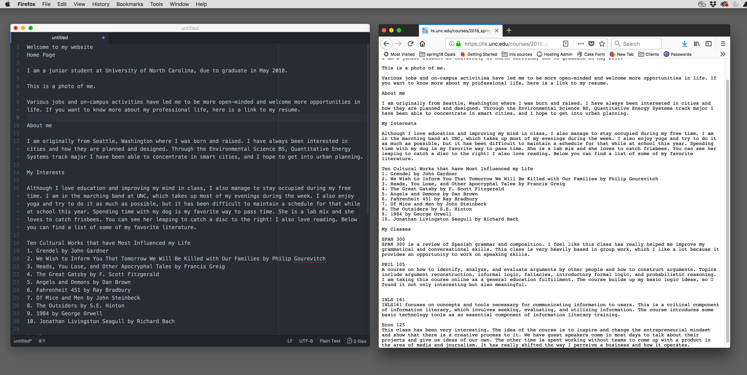
This will be a hands on class
Open chrome or Firefox and a text-editor next to each other on your desktop:

Slide 2
HTML Introduction
HTML IS MARKUP LANGUAGE

Slide 3
What is Markup Language?
SHORT ANSWER:
codes embedded in files for formatting
It is in every text processing tool: Word, Excel, PowerPoint, Access, HTML and others

Slide 4
What is Markup Language?
LONGER ANSWER:
It's a collection of codes that explain the meaning or desired formatting of the marked text
It's a way of describing, using instructions buried in the document, what the document is supposed to look like
Every electronic text processing tool uses some kind of markup language, (usually XML) though you may not necessarily be able to see the commands

Slide 5
What is Markup Language?
TLDR ANSWER:
Embedded, hidden, formatting codes in most text based documents (i.e. xml, html)

Slide 6
Markup Language helps with Interoperability (COPY Paste Word>Ppoint)
So standardization in mark up language facilitates the movement of text and graphics between different applications
You can export html out of Microsoft Word, but it adds a lot of extra code that you do not need. You can also paste HTML into Word, but you don’t see the html when you copy and paste it.
Markdown is simply short-hand for html. The markdown code is processed into html by JavaScript or PHP or other any other programming language that can transform text.

Slide 7
Html basics

Slide 8
HTML follows the same three-part-instruction model we used in command line situations PLUS some inner HTML
user$
ls
-al
*

Slide 9
user$ ls -al *
-rw-r--r-- 1 user staff 2792 Jan 30 09:27 README.md
-rw-r--r--@ 1 user staff 1310 Jan 31 07:24 demo.html
-rw-r--r--@ 1 user staff 5364 Jan 30 10:30 index.html
css:
total 56
drwxr-xr-x@ 6 user staff 192 Jan 30 08:43 .
drwxr-xr-x 7 user staff 224 Jan 31 06:36 ..
-rw-r--r--@ 1 user staff 745 Sep 20 07:10 custom.css
-rw-r--r--@ 1 user staff 1930 Sep 20 07:10 nav.css
-rw-r--r--@ 1 user staff 7719 Sep 20 07:10 normalize.css
-rw-r--r--@ 1 user staff 11430 Sep 20 07:10 skeleton.css

Slide 10
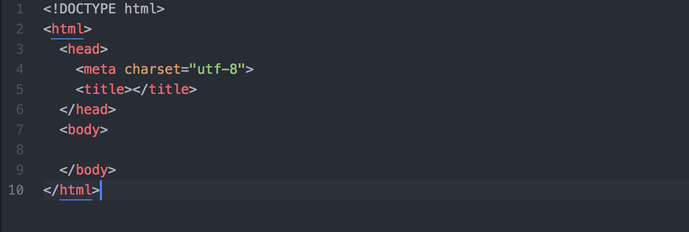
HTML Page Structure; all markup, no data
HINT: FILE MUST END IN .html
for code to show up in colors in Atom editor. If you start coding in an unsaved file, all the text will be white.
(Atom Screen shot)

Slide 11
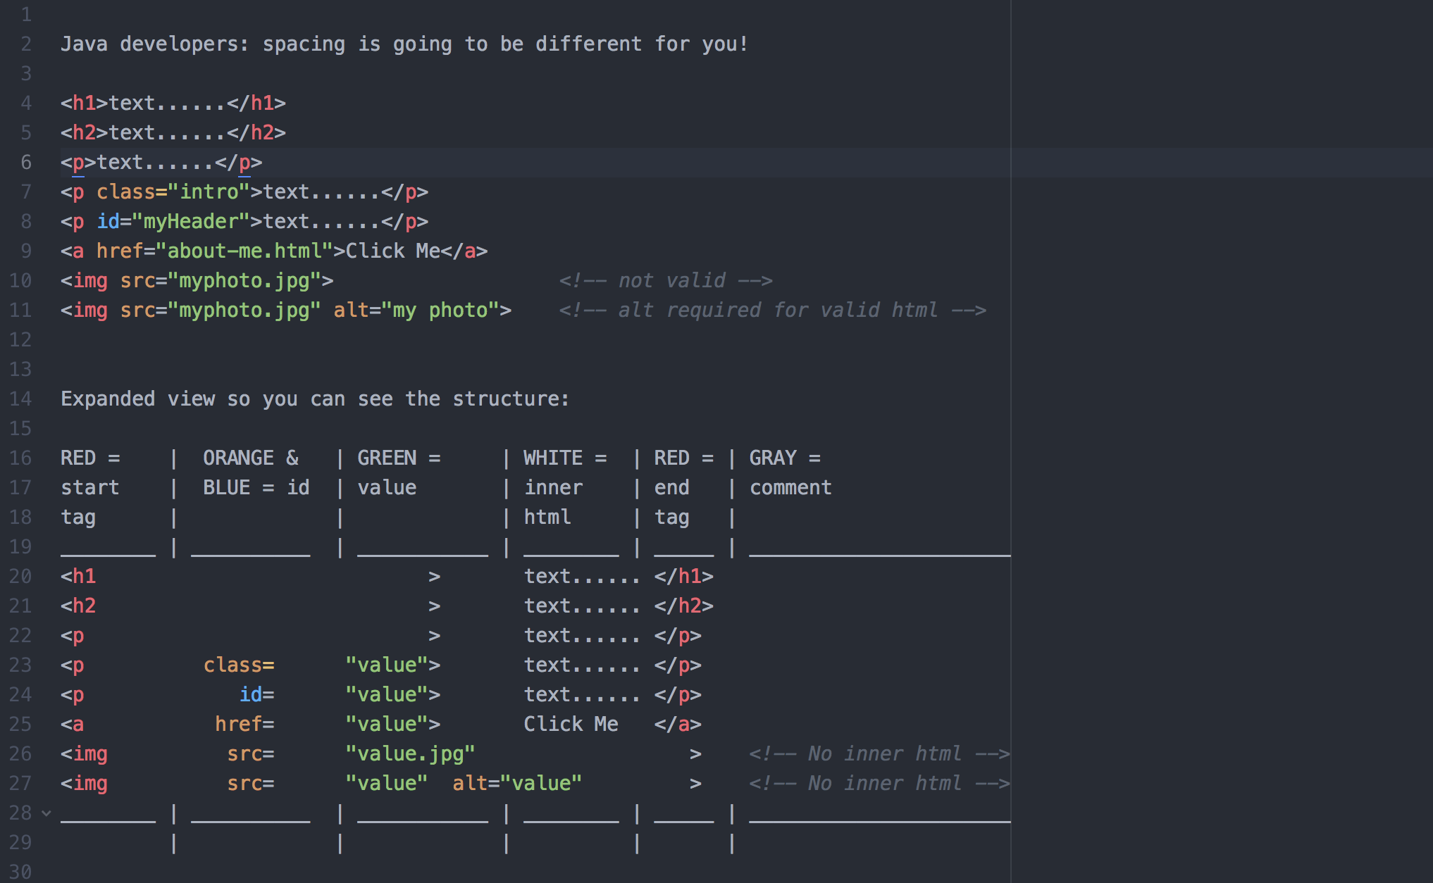
Command
Inner HTML
Value
Attribute
Command
Value
Command
Inner HTML
Attribute

Slide 12
What we are going to see: the first 4 files and File Extensions
plain text + .txt
plain text + markdown code + .md
plain text + markdown code + PHP code without php extension will not work)
Plain text + markdown code + PHP code + .php (works but not valid html)

Slide 13
Content Before HtML: Plain-text; no formatting
Welcome to my website
Home Page
I am a junior student at University of North Carolina, due to graduate in May 2018.This is a photo of me. Various jobs and on-campus activities have led me to be more open-minded and welcome more opportunities in life. If you want to know more about my professional life, here is a link to my resume.
About me
I am originally from Seattle, Washington where I was born and raised. I have always been interested in cities and how they are planned and designed. Through the Environmental Science BS, Quantitative Energy Systems track major I have been able to concentrate in smart cities, and I hope to get into urban planning.

Slide 14
File 01-Plaintext.txt super simple
No markup
Ends in txt.
By the Way: there is no need for file extensions on the command line.
On command line you can touch ”myfile” put some text in it and cat “myfile”
Windows and macs do not always show extensions. This is why some of you have files like this on opal: vpn.png.png Screen shots add the .png extension, but the system does not always show it.

Slide 15
File 02-Plaintext.md
Markdown files end in .md
Markdown files must be processed by a server or an app that knows markdown.
Opal DOES NOT process .md files: but we can HACK (legal hack) it so it will!
GitHub DOES process .md files (you can mix html in .md files and it will work).

Slide 16
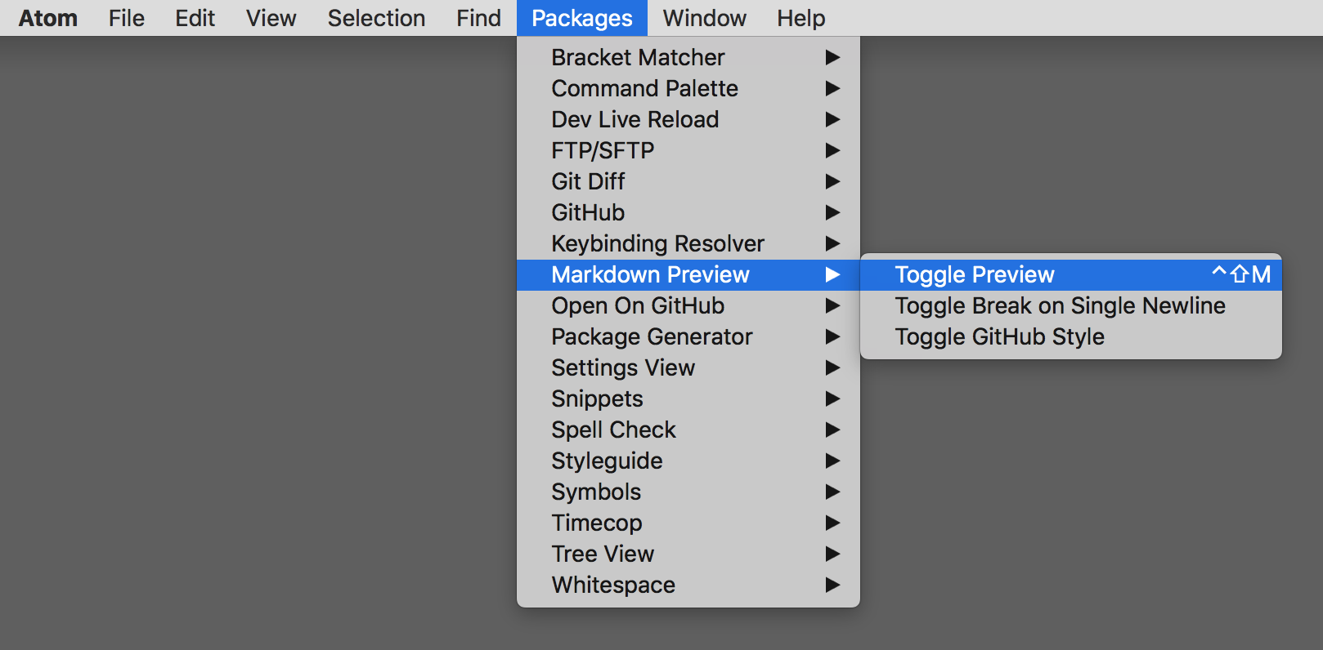
File 02-Plaintext.md: ATOM Editor
ATOM has a markdown preview so it CAN process markdown files:
FILE MUST END IN .md for this to work!

Slide 17
File 02-Plaintext.md Simple Markdown
Simple markdown code: | # for h1 | ## for h2 | ### for h3 |
Good form: # About (put a space between hashtags and text)
Bad form: #About Me (this will not render in all cases but it might in some cases)

Slide 18
File 03-md.php-example-code (same data)
<?php echo(` all the markdown is in a long string like this `);?>
There is a small bit of php code at the top and bottom of the file that links to a markdown parser script. Since OPAL is running php, this will work if we rename the file to end in .php. Then it will render our markdown as html.
The .example-code is just a value. The browser does not recognize it, so runs as a text file.

Slide 19
File 04-.md.php with PHP Extension
By adding the php extension, OPAL now runs the php script. It did not know that there was a php script in the file until we named it with a .php extension.
The only thing we changed was the file name. The code is the same as in the 03 file.
The linked Parsedown file will now convert the markdown to html!
BUT…. It only converts what it finds. So, the output does not have the <!doctype html>, the html wrapper, or the head the title or the body tags.

Slide 20
First four files overview
We looked at this progression:
plain-text > markdown > markdown to html via PHP. None of these resulted in a valid html file.
File names matter. They matter very much. OPAL and ATOM need file names for processing directives.
PHP files only run on a server that runs PHP. PHP is a server-side technology.
PHP does not run on your computer. You can download free PHP servers to run on your laptop if you want to be able to develop PHP locally.

Slide 21
Now we can look at the files 05-09 and see the following evolution: no styling > Decent Styling
05-01 Valid html, no css so no styling at all.
05-02 Valid html, minifier link no styling at all.
05-03 Valid html, minified no styling at all.
06 06-dark.css file with #000000 (black) background and #ffffff text using just the body tag http://www.color-hex.com/
We will talk more about why colors are expressed in hex next class. (Hex is Base 16)
07 Valid html using the 06-dark.css file. (white text/black background)
08 CSS file names 08-muted.css with several CSS Rules.
09 Valid html using the 08-muted.css This is enough CSS to make a reasonably good-looking page.

Slide 22
Files 10-14 Are reference files
Files | Description
10-doc.docx | Word format
11-doc.html | Word HTML export, no filter ( can be reopened in Word) Lots of extra data
12-doc-filtered.html | Word HTML export, less extra data, but still messy
13-three-part-model.html | This is the actual file that has the exploded html, if you want to work with it
14-atom-shortcuts.html | These are the most useful atom shortcuts. Arranged alphabetically. Don’t start out with the shortcuts too soon.

Slide 23
Connecting Html to a CSS stylesheeT
<head>
<title>My Web Site</title>
<link rel="stylesheet" href= "style.css">
</head>

Slide 24
If we have time, or Next time: Connecting google fonts in html Page
<head>
<title>My Web Site</title>
<link rel="stylesheet" href="style.css">
<link href="https://fonts.googleapis.com/css?family=Roboto+Slab" rel="stylesheet">
</head>

Slide 25
And connecting Google in css page
body {
background:#f4f4f4;
font-family: 'Roboto Slab', serif;
}

