Slide 1
Agenda
Thinking about PowerPoint
Working views
Designing a presentation
Tour the workspace
Delivering a presentation
Notes:
Tell ‘em what you’re going to tell ‘em

Slide 2
Presentation Tools
03 December 2017
[this  is an annotation]
the date is an automatic date object
so is this, but it’s in the master

Slide 3
Presentation Tools with a new template
03 December 2017
[this  is an annotation]
the date is an automatic date object
so is this, but it’s in the master

Slide 4
Oh, yes, we will tell you what we are going to say
Navigation & Transition between slides
Animation of objects on slides
Hiding slides
Linking slides
Narrate your slides and add timing to make them run in a stand alone mode
Package all your linked files into a single folder for stand alone presentation

Slide 5
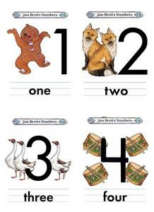

Or, we can tell you what we are going to say in another way
Hiding
Linking
Narration
Packaging
Tell ‘em
what your’re going to tell ‘em
Navigation & Transitions
Animation

Slide 6
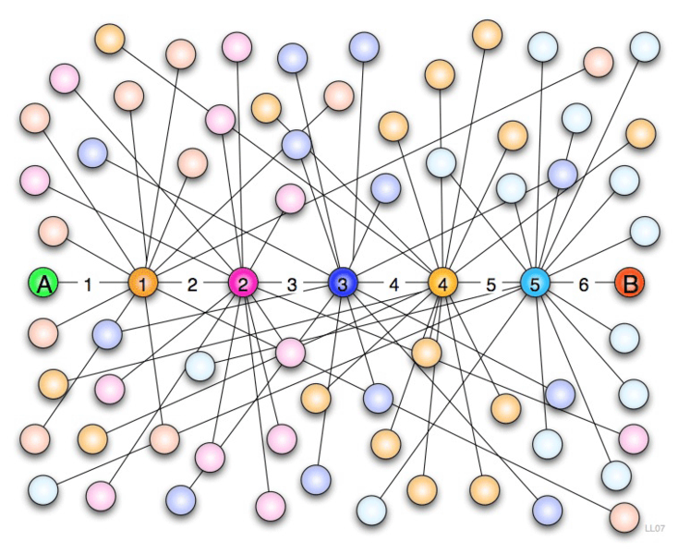
But I like this one
And on each slide

Slide 7
Navigation

Slide 8
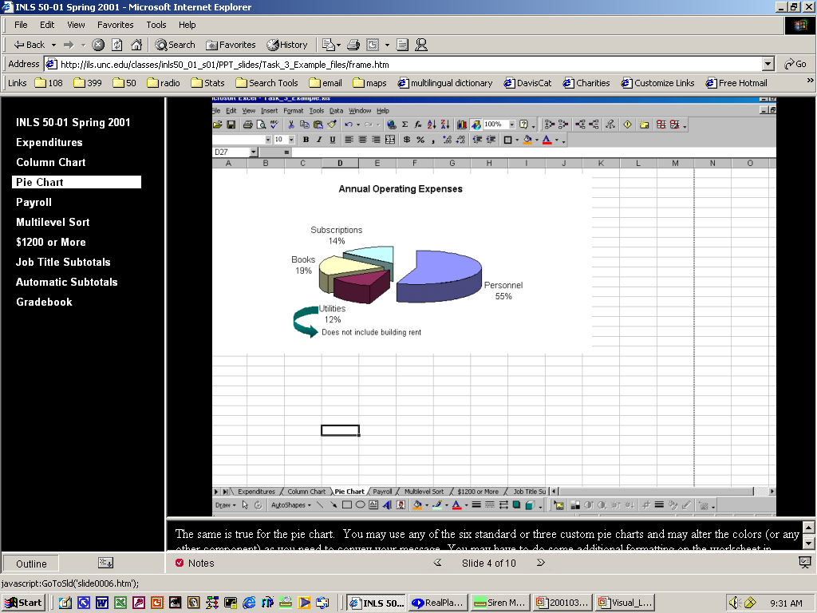
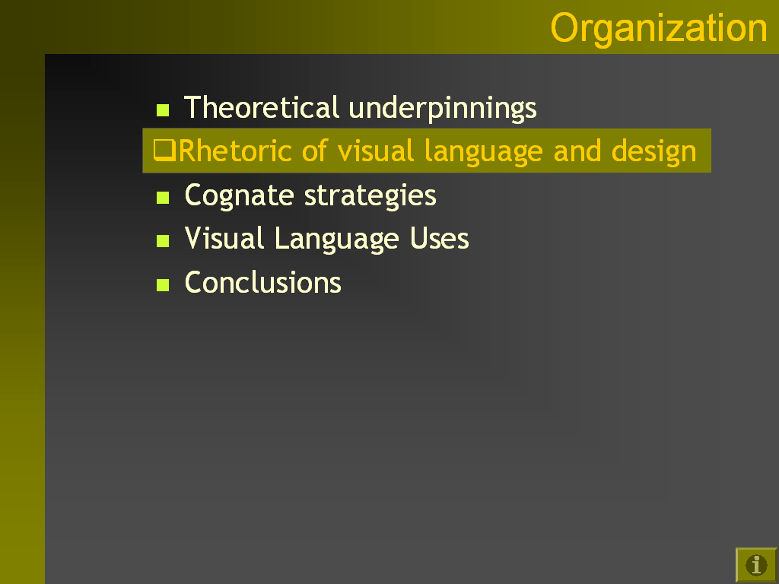
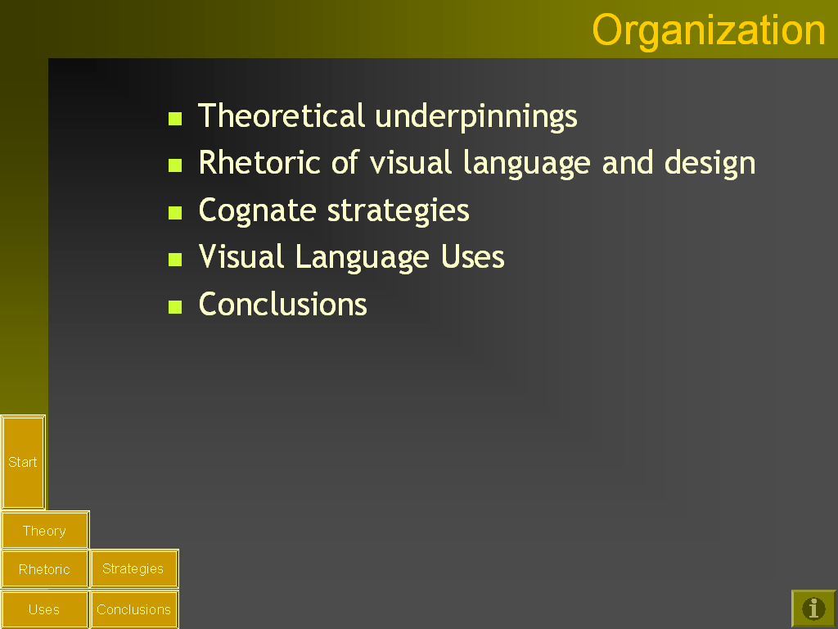
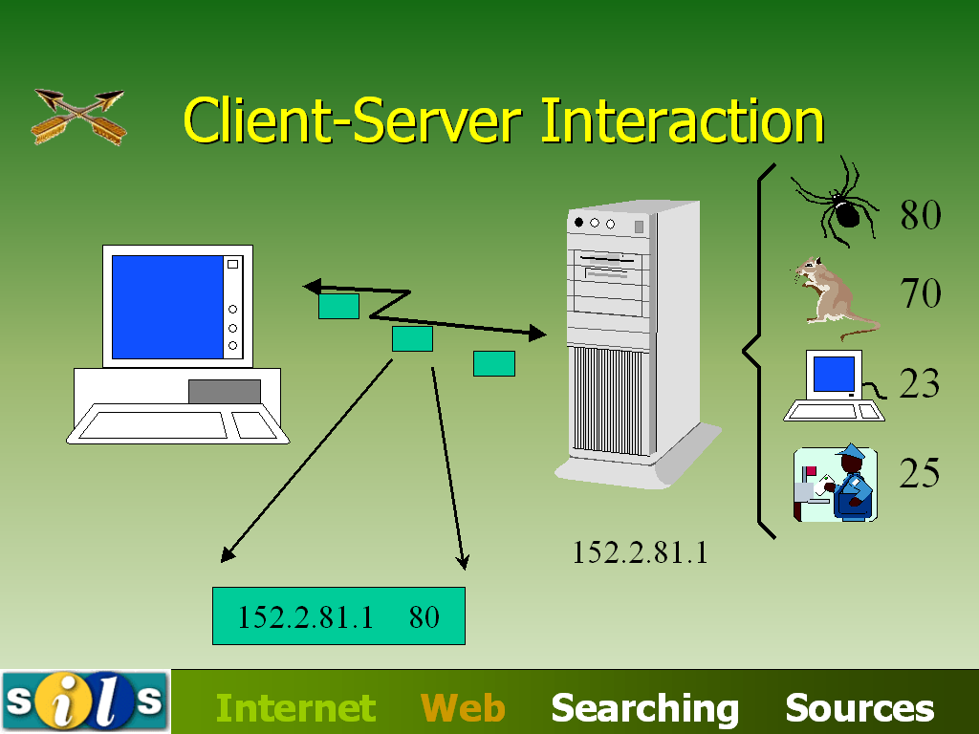
Navigation
Help the viewers understand
where they are in the presentation

Slide 9
You could use Smart Art
A cycle diagram
LINKING
NARRATION
HIDING
tRANSITION
PACKAGING
ANIMATION
Notes:
Discuss normal view, slide sorter view, slide show view

Slide 10
You could use Smart Art
A cycle diagram
ANIMATION
HIDING
LINKING
NARRATION
PACKAGING
tRANSITION
Notes:
Discuss normal view, slide sorter view, slide show view

Slide 11
Alternating flow
TRANSITION
NAVIGATION
SLIDES
ANIMATION
OBJECTS
GROUPS
PACKAGING
ALL TOGETHER
HIDING
LINKING
NARRATION
Retain the spacing of smart art by copying slides
Notes:
Discuss normal view, slide sorter view, slide show view

Slide 12
Transitions
Making the slides work for you
Notes:
Change the logo in master view. Turn off snap to grid.

Slide 13
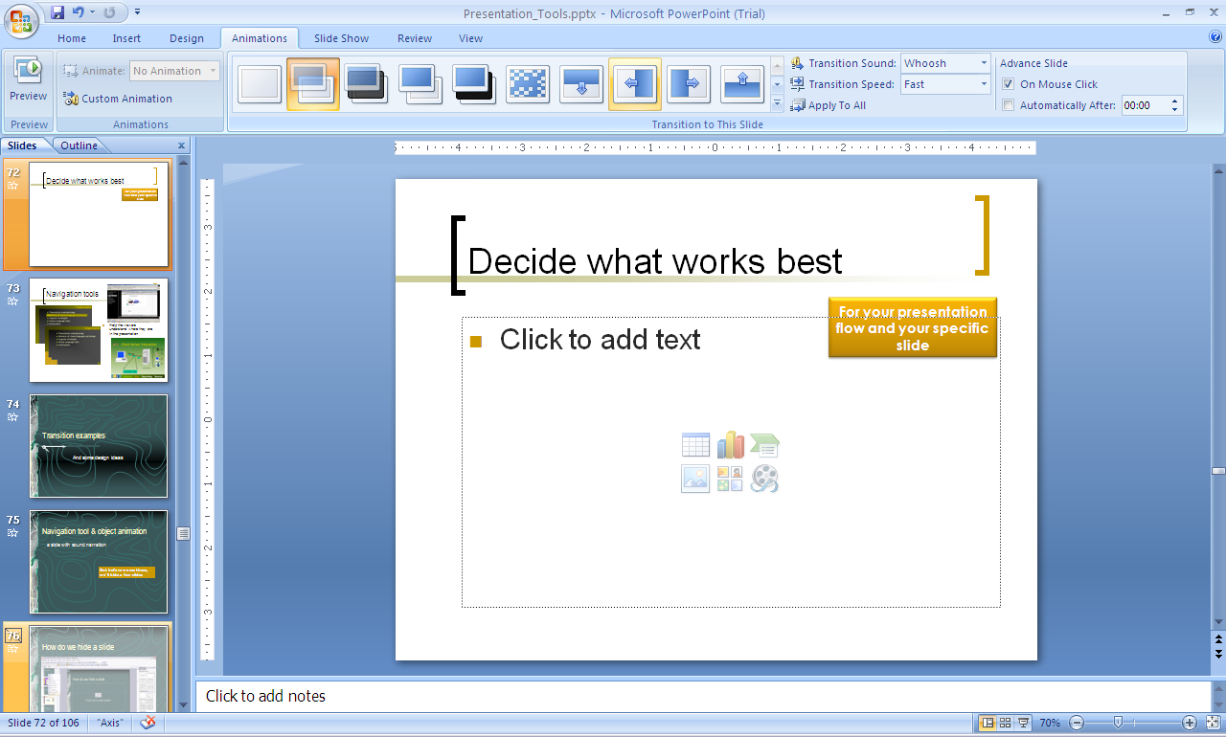
Decide what works best
For your presentation flow and your specific slide
Let’s try several and decide what works best for the following slides

Slide 14
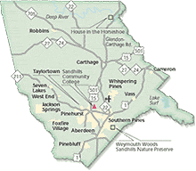
Carthage – town to county library
Started by Women’s Club
Fell apart and morphed into a county library
These are currently set to fade smoothly
and change every 2 seconds
but will change several times.
Which works better?
Proto
Aberdeen
Robbins
Carthage
Vass
Pinebluff

Slide 15
Carthage – begins as a town library
Women’s Club
Counties allowed to use tax funds
Cities allowed to use tax funds
State aid to counties
1905
1920
1930
1940
1950
1960
1970
1980
1990
2000
2005
Proto
Aberdeen
Robbins
Carthage
Vass
Pinebluff
Notes:
So Carthage’s library began when towns couldn’t use tax funds for libraries. But even when they were allowed to do so, Carthage didn’t.

Slide 16
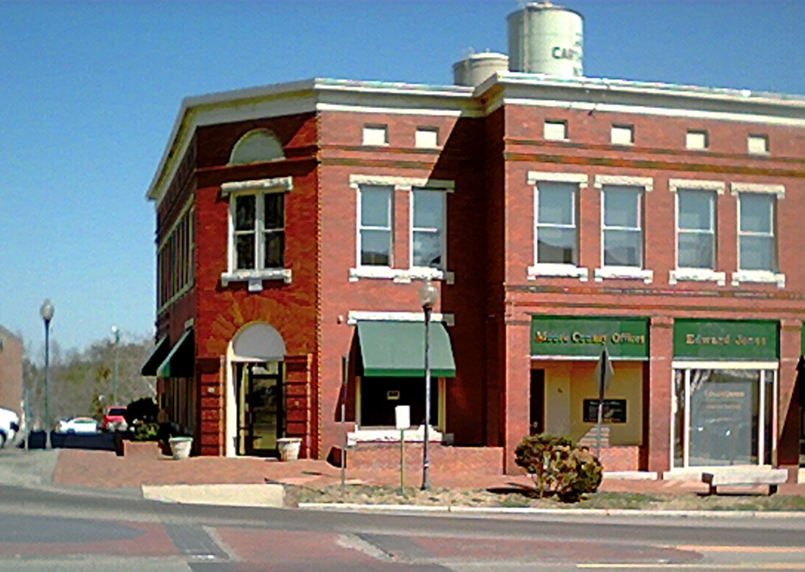
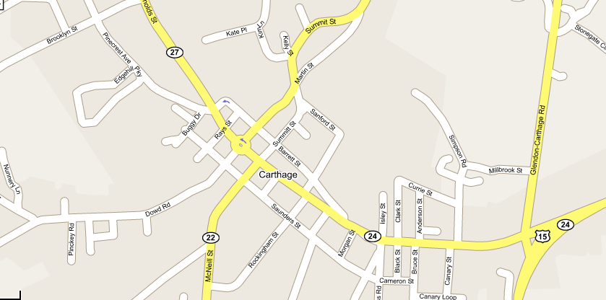
Donated spaces
Above a drug store
1912-1930
1905
1920
1930
1940
1950
1960
1970
1980
1990
2000
2005
Proto
Aberdeen
Robbins
Carthage
Vass
Pinebluff
Notes:
The club depended on donated spaces to house the books, starting first on the second floor of a building on the courthouse square, donated by the owner of the building.

Slide 17
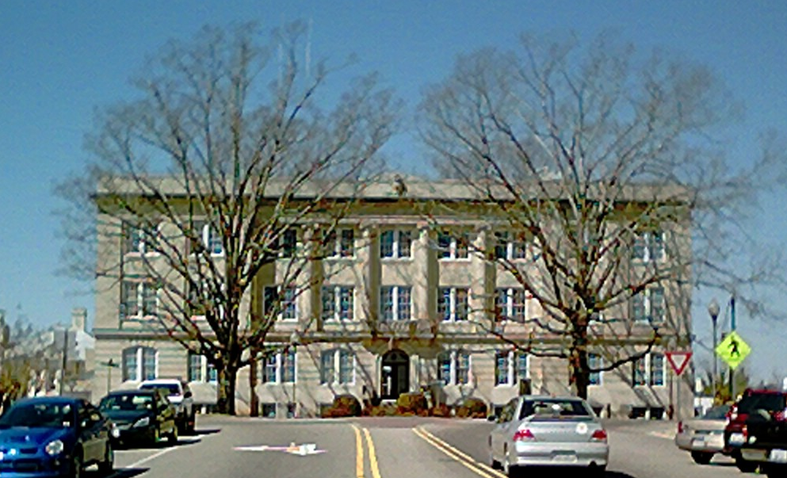
County donates a room
1930-1939
In the basement of the Courthouse
WPA pays salaries
1905
1920
1930
1940
1950
1960
1970
1980
1990
2000
2005
Proto
Aberdeen
Robbins
Carthage
Vass
Pinebluff
Notes:
Later moving to a room in the basement of the courthouse, space donated for use by the county, not the town. The WPA helped keep it open by paying for women’s club members to work there.

Slide 18
… but has to ask for it back
1930-1939
And the library has to close in 1939
WPA pays salaries
1905
1920
1930
1940
1950
1960
1970
1980
1990
2000
2005
Proto
Aberdeen
Robbins
Carthage
Vass
Pinebluff
Notes:
But when the county needed the room, the books had nowhere to go and the library had to close.

Slide 19
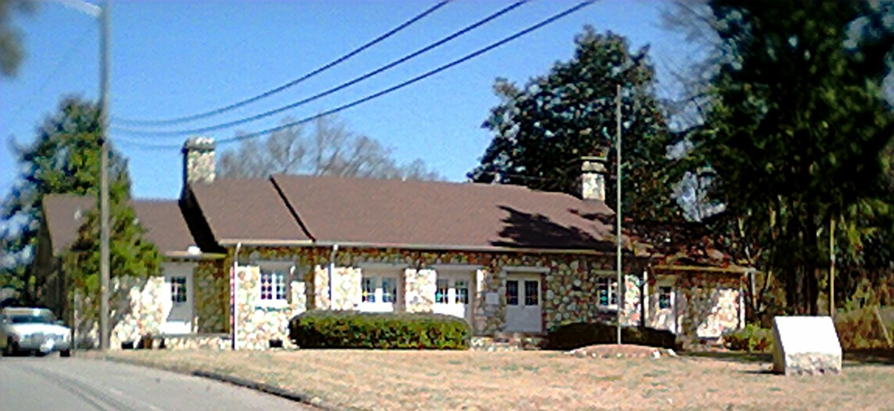
WPA – Community House space
1940-1959
WPA pays for Community House
1905
1920
1930
1940
1950
1960
1970
1980
1990
2000
2005
Proto
Aberdeen
Robbins
Carthage
Vass
Pinebluff
Notes:
While the books were in storage, many of them were damaged by a fire and the Women’s Club could no longer afford to keep up its library effort. The WPA came back into the scene, however, by building a new Community House in Carthage and it included a room that could be used as a library. WPA funding paid the salaries.

Slide 20
Fades away …
1940-1959
Closes 1942
1905
1920
1930
1940
1950
1960
1970
1980
1990
2000
2005
Proto
Aberdeen
Robbins
Carthage
Vass
Pinebluff
Notes:
But when the salary funds ended, the library did too.

Slide 21
… to reopen in a different way
1940-1959
State aid to counties
Reopens 1944, but not as the Carthage Library
1905
1920
1930
1940
1950
1960
1970
1980
1990
2000
2005
Proto
Aberdeen
Robbins
Carthage
Vass
Pinebluff
Notes:
In 1944, the county library was established and the community house library became the defacto county library. The Women’s Club Library had always thought of itself as the county library, but now it was.

Slide 22
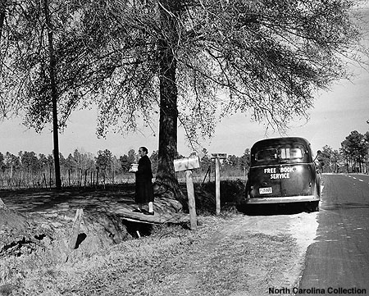
Evolves into county library
Southern Pines offers admin space for county library
Southern Pines
County
While Carthage acts as de facto county library one day a week
1905
1920
1930
1940
1950
1960
1970
1980
1990
2000
2005
Proto
Aberdeen
Robbins
Carthage
Vass
Pinebluff
Notes:
The actual county library was a bookmobile, and Southern Pines had offered book storage and admin spaces to act as the “County Library”, but the Carthage Library was open one day a week and thought of itself as the county library. It certainly wasn’t the Carthage library since the town bore little of the cost other than allowing it to use the space in the Community House.

Slide 23
But loses connection with town
Carthage Librarian Dies in 72nd Year
Funeral services were held Friday afternoon from the Carthage Baptist Church for Mrs. Annette B. Dewey, who died Thursday afternoon in the Moore county Hospital following a lingering illness. She was 72 years of age.
… Mrs. Dewey was the daughter of the late Mr. and Mrs. Jess Barrett, well known Carthage residents.
For a number of years Mrs. Dewey served as the Carthage librarian, during which time she made many friends, both old and young, alike.
Mrs. Dewey was also a writer, using as her pen name Anne Windsor. Some of her works appeared in this newspaper. However, during the past few years she had devoted most of her time to her library duties. …
Moore County News 20 December 1956, page 1
Southern Pines
County
1905
1920
1930
1940
1950
1960
1970
1980
1990
2000
2005
Proto
Aberdeen
Robbins
Carthage
Vass
Pinebluff
Notes:
The librarian certainly thought of herself as Carthage’s librarian even though her salary was paid by the county. However, upon her death, that connection to the town seems to have been severed.

Slide 24

Leased space for county library
1959-1969
1905
1920
1930
1940
1950
1960
1970
1980
1990
2000
2005
Proto
Aberdeen
Robbins
Carthage
Vass
Pinebluff
Notes:
In 1959, the county leased space in a new building in Carthage …

Slide 25
Once the books moved to Carthage …
1959-1969
Southern Pines
Southern Pines faded out of the picture and went its own way
1905
1920
1930
1940
1950
1960
1970
1980
1990
2000
2005
Proto
Aberdeen
Robbins
Carthage
Vass
Pinebluff
Notes:
… because Southern Pines felt it needed to reclaim the space it had offered to the county. The county’s book stocks were moved from Southern Pines to Carthage and the county library became a fixture in Carthage.

Slide 26

Moore County Library, in Carthage
1969-present
Originally the headquarters of the Sandhill Regional Library System
1905
1920
1930
1940
1950
1960
1970
1980
1990
2000
2005
Proto
Aberdeen
Robbins
Carthage
Vass
Pinebluff
Notes:
That building was never really adequate, so the county funded the building of a new facility which, on its opening, was also the headquarters of the regional library system. At that time, the regional directors seemed to want to live in Southern Pines, but that too was to change.

Slide 27
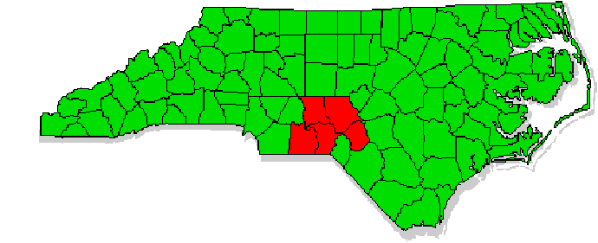
Carthage – the Moore County Library
Vass
Robbins
Pinebluff
County
Aberdeen
But no longer Carthage’s library
Founding member Sandhill Regional Library System
1905
1920
1930
1940
1950
1960
1970
1980
1990
2000
2005
Proto
Aberdeen
Robbins
Carthage
Vass
Pinebluff
Notes:
Over the next three decades, the county library expanded as it added town branches.

Slide 28
Moore County Library in Carthage today
1969-present
A county function
Weak personal commitment
No political commitment
Originally, but no longer, the headquarters of the Sandhill Regional Library System
1905
1920
1930
1940
1950
1960
1970
1980
1990
2000
2005
Proto
Aberdeen
Robbins
Carthage
Vass
Pinebluff
Notes:
… but it never regained the feeling that it was Carthage’s town library. It is the library in Carthage, but it isn’t the Carthage Library any more.

Slide 29
Animation

Slide 30
Animation
Why do this?
How do we do this?
Notes:
Change the logo in master view. Turn off snap to grid.

Slide 31






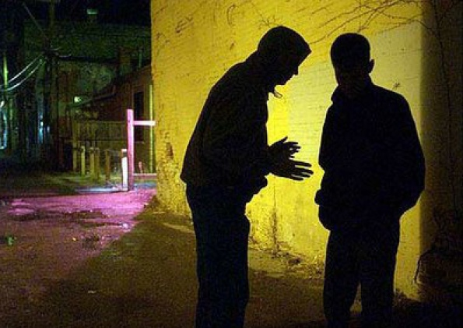









Espionage & Clandestine Activities
Human Intelligence (HUMINT)
Overt Diplomatic Engagement
Overview
Agencies
Careers
Clearance
Summary
Notes:
Audio: We’ll start with the CIA. The CIA is the main organization involved in Human Intelligence. Their collection capabilities are both overt, such as interacting with foreign diplomats, and clandestine, like recruiting spies.
US Government Logo Source, http://www.dni.gov/index.php/intelligence-community/members-of-the-ic
Hidden Slide Link Icon, https://commons.wikimedia.org/wiki/File:WikiProject_Council_project_list_icon.svg
Main Image Source, http://knightassociates.ie/wp-content/uploads/2013/01/Covert-Human-Intelligence-Sources.jpg
U.S. Government Logos are Grouped so that they can spin in a synchronized fashion. The arrows in the bottom progress bar are grouped for easy repositioning as needed.
Reference Material:
“The Central Intelligence Agency (CIA) is responsible for providing national security intelligence to senior U.S. policymakers. The CIA director is nominated by the president and confirmed by the Senate. The director manages the operations, personnel and budget of the CIA and acts as the National Human Source Intelligence manager. The CIA is separated into four basic components: the National Clandestine Service, the Directorate of Intelligence, the Directorate of Science & Technology, and the Directorate of Support. They carry out “the intelligence cycle,” the process of collecting, analyzing, and disseminating intelligence information to top U.S. government officials.”-http://www.dni.gov/index.php/intelligence-community/members-of-the-ic
“Human-Source Intelligence (HUMINT)
The oldest method for collecting information, this is intelligence derived from human sources. Collection includes clandestine acquisition of photography, documents, and other material; overt collection by personnel in diplomatic and consular posts; debriefing of foreign nationals and US citizens who travel abroad; and official contacts with foreign governments. To the public, HUMINT is synonymous with espionage and clandestine activities. However, most of it is accumulated by overt collectors such as diplomats and military attaches.
HUMINT is used mainly by the Central Intelligence Agency (CIA), the Department of State (DoS), the DoD, and the FBI. The CIA, working closely with the Office of the Director of National Intelligence (ODNI) established the National Clandestine Service (NCS) to improve HUMINT throughout the IC. The NCS serves as the national authority for coordination, de-confliction, and evaluation of clandestine HUMINT operations, both abroad and inside the United States. While the ODNI establishes policy related to clandestine HUMINT, the NCS executes and implements that policy across the Intelligence Community.“ - http://www.intelligence.gov/mission/data-gathering.html

Slide 32


Design & Build Satellites
Supports CIA and DoD
Cell Phones, GPS and more
Overview
Agencies
Careers
Clearance
Summary
Notes:
Audio: The National Reconnaissance Office is responsible for designing & building satellites. These satellites collect intelligence globally. The existence of the NRO, itself, was classified until 1992. Their engineering capabilities have led to technologies like Cell Phones and GPS making their way to the public realm.
US Government Logo Source, http://www.dni.gov/index.php/intelligence-community/members-of-the-ic
Hidden Slide Link Icon, https://commons.wikimedia.org/wiki/File:WikiProject_Council_project_list_icon.svg
Main Image Source, http://news.satimagingcorp.com/wp-content/uploads/2010/03/GeoEye-2_r-1024x787.jpg
Reference Material:
“The National Reconnaissance Office designs, builds and operates the nation's reconnaissance satellites. NRO products, provided to an expanding list of customers like the Central Intelligence Agency and the Department of Defense, can warn of potential trouble spots around the world, help plan military operations, and monitor the environment. As part of the Intelligence Community, the NRO plays a primary role in achieving information superiority for the U.S. Government and Armed Forces. A DOD agency, the NRO is staffed by DOD and CIA personnel. It is funded through the National Reconnaissance Program, part of the National Foreign Intelligence Program.”-http://www.dni.gov/index.php/intelligence-community/members-of-the-ic
“Headquartered in Chantilly, Virginia, the National Reconnaissance Office (NRO) develops and operates unique and innovative overhead reconnaissance systems and conducts intelligence-related activities for U.S. national Security.” - http://nro.gov/about/nro/who.html
“Together with other Defense Department satellites, the NRO systems play a crucial role in providing global communications, precision navigation, early warning of missile launches and potential military aggression, signals intelligence, and near real-time imagery to U.S. forces to support the war on terrorism and other continuing operations.
NRO satellites also support civil customers in response to disaster relief and environmental research. Scientists created a global environment database using NRO imagery to help predict climate change, assess crop production, map habitats of endangered species, track oil spills, and study wetlands. NRO data also forms the basis for products that help depict and assess the devastation in areas affected by natural disasters.
The NRO's innovation also inspired technology in everyday life with contributions to medical imaging, global communications, high-definition television, cellular phones, the global positioning system (GPS), and much more.”-http://nro.gov/about/nro/what.html

Slide 33

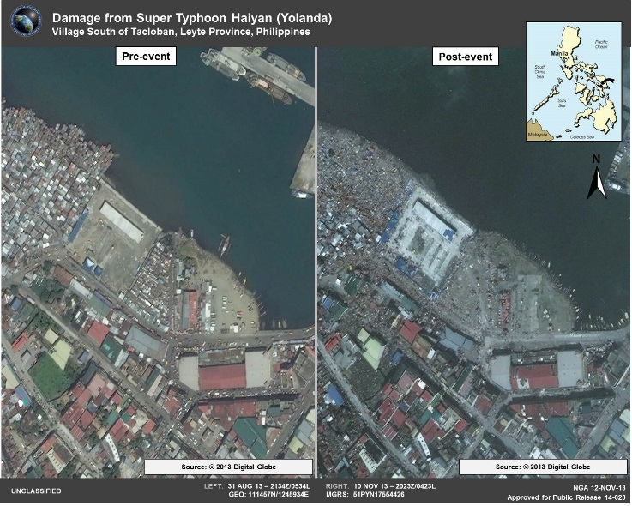
Geospatial Intelligence (GEOINT)
Imagery Intelligence (IMINT)
Humanitarian Efforts
Overview
Agencies
Careers
Clearance
Summary
Notes:
Audio: The NGA is best known for its expertise in imagery and geospatial intelligence. The intelligence is derived from analyzing collection from things such as visual photography, radar sensors and infrared sensors. This capability has a dual-purpose, it can be used to support the intelligence apparatus but it can also be used to aid in humanitarian relief efforts after natural disasters.
US Government Logo Source, http://www.dni.gov/index.php/intelligence-community/members-of-the-ic
Hidden Slide Link Icon, https://commons.wikimedia.org/wiki/File:WikiProject_Council_project_list_icon.svg
Main Image Source, https://www1.nga.mil/PublishingImages/HaiyanDamageAssessment2.jpg
Reference Material:
“The National Geospatial-Intelligence Agency provides timely, relevant, and accurate geospatial intelligence in support of national security objectives. Information collected and processed by NGA is tailored for customer-specific solutions. By giving customers ready access to geospatial intelligence, NGA provides support to civilian and military leaders and contributes to the state of readiness of U.S. military forces. NGA also contributes to humanitarian efforts such as tracking floods and fires, and in peacekeeping. NGA is a Department of Defense Combat Support Agency. Headquartered in Springfield, Va., NGA operates major facilities in the St. Louis, Mo. and Washington, D.C. areas. The agency also fields support teams worldwide.”-http://www.dni.gov/index.php/intelligence-community/members-of-the-ic
“Imagery Intelligence (IMINT)
Representations of objects reproduced electronically or by optical means on film, electronic display devices, or other media. It can be derived from visual photography, radar sensors, infrared sensors, lasers, and electro-optics.
The National Geospatial-Intelligence Agency manages all IMINT activities, both classified and unclassified, within the government. This includes requirements, collection, processing, exploitation, dissemination, archiving, and retrieval.
Geospatial Intelligence (GEOINT)
Imagery and geospatial data produced through an integration of imagery, imagery intelligence, and geographic information. GEOINT is typically gathered from commercial satellites, government satellites, reconnaissance aircraft, or by other means such as maps, commercial databases, census information, GPS waypoints, utility schematics, or any discrete data that have locations on earth. This data is utilized to support troops on the battlefield as well as to assist in humanitarian and disaster relief efforts.
The Director of the National Geospatial-Intelligence Agency (NGA) is the functional manager for GEOINT.” - http://www.intelligence.gov/mission/data-gathering.html

Slide 34


Foreign Language Analysis
Protect Information Systems
Signals Intelligence (SIGINT)
Mathematicians & Computer Scientists
Overview
Agencies
Careers
Clearance
Summary
Notes:
Audio: Next up is the National Security agency which we’re all too familiar with because of a guy by the name Edward Snowden. Regardless, the NSA’s primary job is dealing with Signals Intelligence. Basically, anything that can communicate electronically falls into this area. Because of rapidly changing technologies they are very interested in bringing in mathematicians and computer scientists. Additionally, US Citizens who are fluent in certain languages are highly desirable.
US Government Logo Source, http://www.dni.gov/index.php/intelligence-community/members-of-the-ic
Hidden Slide Link Icon, https://commons.wikimedia.org/wiki/File:WikiProject_Council_project_list_icon.svg
Main Image Source, http://www.dubchamber.ie/images/about-us-council/hacker.jpg
Reference Material:
“The National Security Agency/Central Security Service is the nation's cryptologic organization that coordinates, directs, and performs highly specialized activities to protect U.S. information systems and to produce foreign signals intelligence information. A high-technology organization, NSA is at the forefront of communications and information technology. NSA is also one of the most important centers of foreign language analysis and research within the U.S. government and is said to be the largest employer of mathematicians in the United States and perhaps the world. Founded in 1952, NSA is part of the Department of Defense and a member of the U.S. Intelligence Community. The Agency supports military customers, national policymakers, and the counterterrorism and counterintelligence communities, as well as key international allies. Its workforce represents an unusual combination of specialties: analysts, engineers, physicists, mathematicians, linguists, computer scientists, researchers, as well as customer relations specialists, security officers, data flow experts, managers, administrative officers and clerical assistants.”-http://www.dni.gov/index.php/intelligence-community/members-of-the-ic
“Signals Intelligence (SIGINT)
The interception of signals, whether between people, between machines, or a combination of both.
The National Security Agency (NSA) is responsible for collecting, processing, and reporting SIGINT. Within the NSA, the National SIGINT Committee advises the NSA Director and the Director of National Intelligence (DNI) on policy issues and manages the SIGINT requirements system.“ - http://www.intelligence.gov/mission/data-gathering.html

Slide 35

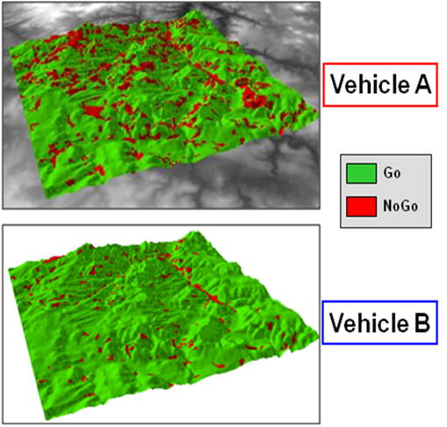
Measurement & Signature Intelligence (MASINT)
Manage Foreign Military Intelligence
Human Intelligence (HUMINT)
Overview
Agencies
Careers
Clearance
Summary
Notes:
Audio: The Defense Intelligence agency is the lead agency for Measurement & Signature Intelligence. In layman's terms, this is all of the other scientific areas such as nuclear detection or analyzing seismic activity. In addition, like the Central Intelligence Agency, they have human intelligence capabilities. But unlike the CIA, the primary focus of the defense intelligence agency is to support the Department of Defense.
US Government Logo Source, http://www.dni.gov/index.php/intelligence-community/members-of-the-ic
Hidden Slide Link Icon, https://commons.wikimedia.org/wiki/File:WikiProject_Council_project_list_icon.svg
Main Image Source, http://www.amsaa.army.mil/Images/CSAD/MPE_5.png
Reference Material:
“The Defense Intelligence Agency is a Department of Defense combat support agency. With more than 16,500 military and civilian employees worldwide, DIA is a major producer and manager of foreign military intelligence and provides military intelligence to warfighters, defense policymakers and force planners, in the DOD and the Intelligence Community, in support of U.S. military planning and operations and weapon systems acquisition. The DIA director serves as principal adviser to the secretary of defense and to the chairman of the Joint Chiefs of Staff on matters of military intelligence. The director also chairs the Military Intelligence Board, which coordinates activities of the defense intelligence community.”-http://www.dni.gov/index.php/intelligence-community/members-of-the-ic
“Measurement and Signature Intelligence (MASINT)
Scientific and technical intelligence information used to locate, identify, or describe distinctive characteristics of specific targets. It employs a broad group of disciplines including nuclear, optical, radio frequency, acoustics, seismic, and materials sciences. For example, MASINT can identify distinctive radar signatures created by specific aircraft systems or the chemical composition of air and water samples.
The Central MASINT Organization, a component of the Defense Intelligence Agency, is the focus for all national and Department of Defense (DoD) MASINT matters.” - http://www.intelligence.gov/mission/data-gathering.html

Slide 36





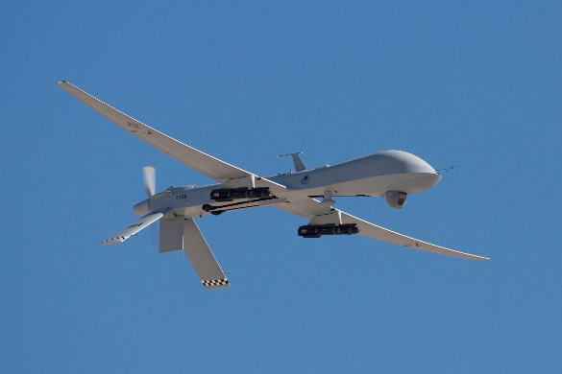
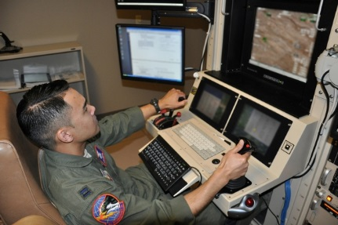
Support Commanders
Support Warfighters
Hellfire Missiles
Tactical & Operational
Pilot & Control Station
Overview
Agencies
Careers
Clearance
Summary
Notes:
Audio: This slide will cover the rest of the department of defense, from the perspective of the 4 major military services. I’ve intentionally left the Coast Guard out of the mix, it’ll be covered later. Each military service has its own intelligence capabilities and they vary from drones to ships to human intelligence collectors. Often times their intelligence feeds back into the service to support military operations. For the sake of trivia, drones are never referred to as such by people who work with them. Professionally they are called Unmanned Aerial Vehicles, Remotely Piloted Aircraft or Unmanned Aerial Systems.
US Government Logo Source, http://www.dni.gov/index.php/intelligence-community/members-of-the-ic
Hidden Slide Link Icon, https://commons.wikimedia.org/wiki/File:WikiProject_Council_project_list_icon.svg
Main Image Source1, http://www.nv.ngb.army.mil/nvng/cache/file/D60C56D5-7381-4C3B-967CFEC375BFB757.jpg
Main Image Source2, http://www.214rg.ang.af.mil/shared/media/photodb/photos/061112-F-8831C-001.jpg
Reference Material:
“The U.S. Air Force Intelligence, Surveillance, and Reconnaissance (USAF ISR) Enterprise is America's leading provider of finished intelligence derived from airborne, space, and cyberspace sensors. The USAF ISR Enterprise delivers decision advantage in order to enable commanders to achieve kinetic and non-kinetic effects on targets anywhere on the globe in support of national, strategic, operational, and tactical requirements. The AF/A2 is the USAF's Senior Intelligence Officer and is responsible for functional management of all Air Force global integrated ISR capabilities, including oversight of planning, programming, and budgeting; developing and implementing the Air Force policies and guidance for managing Air Force global integrated ISR activities; and professional development, training, education, readiness, and deployment of 50,000 military and civilian United States Air Force intelligence personnel.
U.S. Army Intelligence (G-2) is responsible for policy formulation, planning, programming, budgeting, management, staff supervision, evaluation, and oversight for intelligence activities for the Department of the Army. The G-2 is responsible for the overall coordination of the five major military intelligence (MI) disciplines within the Army: Imagery Intelligence, Signals Intelligence, Human Intelligence, Measurement and Signature Intelligence, and Counterintelligence and Security Countermeasures.
The U.S. Marine Corps produces tactical and operational intelligence for battlefield support. Its IC component is comprised of all intelligence professionals in the Marine Corps responsible for policy, plans, programming, budgets, and staff supervision of intelligence and supporting activities within the USMC. The department supports the commandant of the Marine Corps in his role as a member of the Joint Chiefs of Staff, represents the service in Joint and Intelligence Community matters, and exercises supervision over the Marine Corps Intelligence Activity. The department has service staff responsibility for geospatial intelligence, advanced geospatial intelligence, signals intelligence, human intelligence, counterintelligence, and ensures there is a single synchronized strategy for the development of the Marine Corps Intelligence, Surveillance, and Reconnaissance Enterprise. The Marine Corps' director of intelligence is the commandant's principal intelligence staff officer and the functional manager for intelligence, counterintelligence, and cryptologic matters.
The Office of Naval Intelligence is the leading provider of maritime intelligence to the U.S. Navy and joint warfighting forces, as well national decision makers and other consumers in the Intelligence Community. Established in 1882, ONI specializes in the analysis, production and dissemination of vital, timely and accurate scientific, technical, geopolitical and military intelligence information to key consumers worldwide. ONI employs more than 3,000 military, civilian, mobilized reservists and contractor personnel worldwide, including analysts, scientists, engineers, specialists and technicians. While ONI is the largest Naval Intelligence organization with the largest concentration of Naval Intelligence civilians, most of Naval Intelligence is comprises active duty military personnel, serving throughout the world.”-http://www.dni.gov/index.php/intelligence-community/members-of-the-ic

Slide 37


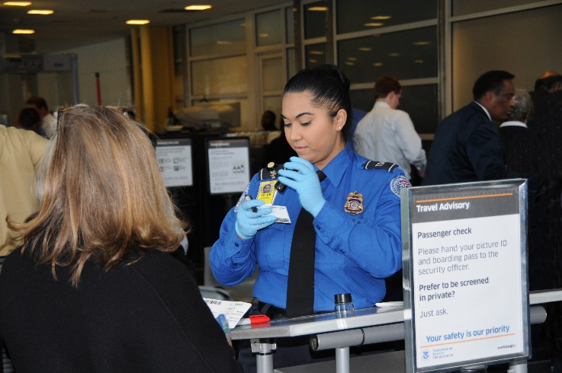
Identify Current & Future Threats
Enforce Immigration Laws
Secure & Manage Borders
Overview
Agencies
Careers
Clearance
Summary
Notes:
Audio: DHS, you may know them most intimately by your interactions with the TSA agents who want to pat you down at the airport. But aside from the TSA agents who get complained to by irate travelers all day long, the DHS handles areas such as enforcing immigration laws and securing our borders. The US Coast Guard also typically falls under the DHS.”
US Government Logo Source, http://www.dni.gov/index.php/intelligence-community/members-of-the-ic
Hidden Slide Link Icon, https://commons.wikimedia.org/wiki/File:WikiProject_Council_project_list_icon.svg
Main Image Source, http://www.dhs.gov/sites/default/files/styles/large/public/images/2012-tsa-tso-checks-passenger-id.JPG?itok=0lhEroQM
Reference Material:
“The Office of Intelligence and Analysis is responsible for using information and intelligence from multiple sources to identify and assess current and future threats to the U.S. DHS Intelligence focuses on four strategic areas: Promote understanding of threats through intelligence analysis; Collect information and intelligence pertinent to homeland security; Share information necessary for action; and Manage intelligence for the homeland security enterprise. The Under Secretary for I&A also serves as DHS’ chief intelligence officer and is responsible to both the secretary of Homeland Security and the director of National Intelligence.”-http://www.dni.gov/index.php/intelligence-community/members-of-the-ic
“The Core Missions
There are five homeland security missions:
Prevent terrorism and enhancing security;
Secure and manage our borders;
Enforce and administer our immigration laws;
Safeguard and secure cyberspace;
Ensure resilience to disasters;”- http://www.dhs.gov/our-mission

Slide 38

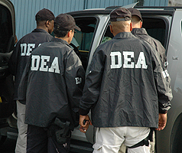
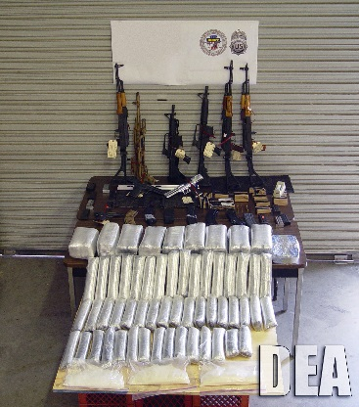
Enforce Controlled Substance Laws
Manage Drug Intelligence Program
Investigate Drug Gangs
Overview
Agencies
Careers
Clearance
Summary
Notes:
Audio: Narco-trafficking by Cartels and Gangs…to me, these things are scarier than your average fundamental terrorist. The Drug Enforcement Administration manages the drug intelligence program and is the lead agency for dealing with drug enforcement. They also work with other federal and local law enforcement to stem the flow of drugs into the country.
US Government Logo Source, http://www.dni.gov/index.php/intelligence-community/members-of-the-ic
Hidden Slide Link Icon, https://commons.wikimedia.org/wiki/File:WikiProject_Council_project_list_icon.svg
Main Image Source 1, http://www.dea.gov/divisions/car/2010/carib092910_02.jpg
Main Image Source 2, http://www.dea.gov/divisions/hq/2009/9.jpg
Reference Material:
“The Drug Enforcement Administration is responsible for enforcing the controlled substance laws and regulations of the United States. DEA’s Office of National Security Intelligence (ONSI) became a member of the IC in 2006. ONSI facilitates full and appropriate intelligence coordination and information sharing with other members of the U.S. Intelligence Community and homeland security elements. Its goal is to enhance the U.S.’s efforts to reduce the supply of drugs, protect national security, and combat global terrorism. DEA has 21 field divisions in the U.S. and more than 80 offices in more than 60 countries worldwide.”-http://www.dni.gov/index.php/intelligence-community/members-of-the-ic
“The mission of the Drug Enforcement Administration (DEA) is to enforce the controlled substances laws and regulations of the United States and bring to the criminal and civil justice system of the United States, or any other competent jurisdiction, those organizations and principal members of organizations, involved in the growing, manufacture, or distribution of controlled substances appearing in or destined for illicit traffic in the United States; and to recommend and support non-enforcement programs aimed at reducing the availability of illicit controlled substances on the domestic and international markets.
In carrying out its mission as the agency responsible for enforcing the controlled substances laws and regulations of the United States, the DEA's primary responsibilities include:
Investigation and preparation for the prosecution of major violators of controlled substance laws operating at interstate and international levels.
Investigation and preparation for prosecution of criminals and drug gangs who perpetrate violence in our communities and terrorize citizens through fear and intimidation.
Management of a national drug intelligence program in cooperation with federal, state, local, and foreign officials to collect, analyze, and disseminate strategic and operational drug intelligence information.
Seizure and forfeiture of assets derived from, traceable to, or intended to be used for illicit drug trafficking.
Enforcement of the provisions of the Controlled Substances Act as they pertain to the manufacture, distribution, and dispensing of legally produced controlled substances.
Coordination and cooperation with federal, state and local law enforcement officials on mutual drug enforcement efforts and enhancement of such efforts through exploitation of potential interstate and international investigations beyond local or limited federal jurisdictions and resources.
Coordination and cooperation with federal, state, and local agencies, and with foreign governments, in programs designed to reduce the availability of illicit abuse-type drugs on the United States market through nonenforcement methods such as crop eradication, crop substitution, and training of foreign officials.
Responsibility, under the policy guidance of the Secretary of State and U.S. Ambassadors, for all programs associated with drug law enforcement counterparts in foreign countries.
Liaison with the United Nations, Interpol, and other organizations on matters relating to international drug control programs.”-http://www.dea.gov/about/mission.shtml

Slide 39


Intelligence & Law Enforcement
National Security Threats
Criminal Threats
Overview
Agencies
Careers
Clearance
Summary
Notes:
Audio: The FBI is the main domestic intelligence organization. They have to deal with everything from illegal downloads to nuclear weapons proliferation. Both the FBI and DEA fall under the Department of Justice, they have a dual-role of intelligence and law enforcement. Both roles have different authorities and rules.
US Government Logo Source, http://www.dni.gov/index.php/intelligence-community/members-of-the-ic
Hidden Slide Link Icon, https://commons.wikimedia.org/wiki/File:WikiProject_Council_project_list_icon.svg
Main Image Source, http://www.fbi.gov/news/stories/2009/april/image/amw041409c.jpg
Reference Material:
“The FBI, as an intelligence and law enforcement agency, is responsible for understanding threats to our national security and penetrating national and transnational networks that have a desire and capability to harm the U.S. The National Security Branch was established in response to a presidential directive and Weapons of Mass Destruction Commission recommendation to establish a National Security Service that combines the missions, capabilities, and resources of the FBI’s counterterrorism, counterintelligence, and intelligence elements under the leadership of a senior FBI official. In July 2006, the NSB created the WMD Directorate to integrate components previously distributed throughout the FBI. The NSB also includes the Terrorist Screening Center, which provides crucial, actionable intelligence to state and local law enforcement, and the High-Value Detainee Interrogation Group, an interagency body that collects intelligence from key terror suspects to prevent attacks against the U.S. and its allies.”-http://www.dni.gov/index.php/intelligence-community/members-of-the-ic
“The FBI’s national security mission is to lead and coordinate intelligence efforts that drive actions to protect the United States.
Our goal is to develop a comprehensive understanding of the threats and penetrate national and transnational networks that have a desire and capability to harm us. Such networks include: terrorist organizations, foreign intelligence services, those that seek to proliferate weapons of mass destruction, and criminal enterprises.
In order to be successful, we must understand the threat, continue to integrate our intelligence and law enforcement capabilities in every FBI operational program, and continue to expand our contribution to the Intelligence Community knowledge base.
Because national security and criminal threats are often intertwined, our ability to integrate intelligence and investigations makes us uniquely situated to address our nation’s threats and vulnerabilities.”-http://www.fbi.gov/about-us/intelligence/mission
“The mission of the FBI is to protect and defend the United States against terrorist and foreign intelligence threats, to uphold and enforce the criminal laws of the United States, and to provide leadership and criminal justice services to federal, state, municipal, and international agencies and partners.
To perform its mission, the FBI employs a number of core tools, including investigative techniques, forensics, information technologies, and strategic partnerships. Intelligence is also one of those core tools. As such, intelligence is an integral part of the FBI’s investigative mission. It is embedded in the day-to-day work of the FBI, from the initiation of preliminary investigations to the development of FBI-wide investigative strategies.”-http://www.fbi.gov/about-us/intelligence/philosophy

Slide 40

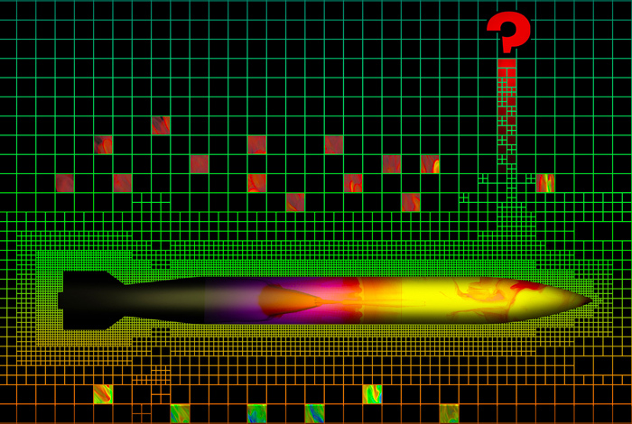
Nuclear Weapons
Scientific labs and plants
Technical Expertise
Overview
Agencies
Careers
Clearance
Summary
Notes:
Audio: The Department of Energy is responsible for Scientific Labs and Plants. Their intelligence capability is used to protect these locations as well as the sensitive scientific research that is conducted. For example, in the past the DoE ranges were used for Nuclear Bomb tests. Now, labs have the responsibility for analyzing our aging nuclear stockpiles.”
US Government Logo Source, http://www.dni.gov/index.php/intelligence-community/members-of-the-ic
Hidden Slide Link Icon, https://commons.wikimedia.org/wiki/File:WikiProject_Council_project_list_icon.svg
Main Image Source, http://farm9.staticflickr.com/8261/8653113739_2f66fecfa6_b.jpg
Reference Material:
“The U.S. Department of Energy's Office of Intelligence and Counterintelligence is responsible for the intelligence and counterintelligence activities throughout the DOE complex, including nearly 30 intelligence and counterintelligence offices nationwide. The mission is to protect, enable, and represent the vast scientific brain trust resident in DOE's laboratories and plants. The office protects vital national security information and technologies, representing intellectual property of incalculable value, and provides unmatched scientific and technical expertise to the U.S. government to respond to foreign intelligence, terrorist and cyber threats, to solve the hardest problems associated with U.S. energy security, and to address a wide range of other national security issues.”-http://www.dni.gov/index.php/intelligence-community/members-of-the-ic
“The United States and its allies depend upon the reliability, safety, and security of the U.S. stockpile of nuclear weapons as their primary deterrent against nations making nuclear threats. But the weapons in the stockpile are aged beyond their expected lifespans. The questions this poses are: Will these weapons still work? If so, how well will they work?”-http://www.laao.doe.gov/newsroom/publications/national-security-science/2013-april/but-will-it-work.php

Slide 41

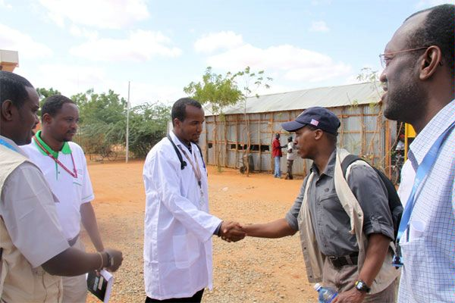
Interaction with U.S. and foreign scholars
Embassies
Diplomatic Reporting
Overview
Agencies
Careers
Clearance
Summary
Notes:
Audio: The State Department is charged with handling diplomatic issues. They are responsible for interacting with scholars and diplomats as well as protecting US Embassies around the world. The intelligence function is responsible for diplomatic reporting and other foreign affairs. If you enjoy policy, this would be a place to go.
US Government Logo Source, http://www.dni.gov/index.php/intelligence-community/members-of-the-ic
Hidden Slide Link Icon, https://commons.wikimedia.org/wiki/File:WikiProject_Council_project_list_icon.svg
Main Image Source, http://www.state.gov/img/11/44763/2011_DASBrigetyDadaab10_600_1.jpg
Reference Material:
“The Bureau of Intelligence and Research provides the Secretary of State with timely, objective analysis of global developments as well as real-time insights from all-source intelligence. It serves as the focal point within the Department of State for all policy issues and activities involving the Intelligence Community. The INR Assistant Secretary reports directly to the Secretary of State and serves as the Secretary's principal adviser on all intelligence matters. INR's expert, independent foreign affairs analysts draw on all-source intelligence, diplomatic reporting, INR's public opinion polling, and interaction with U.S. and foreign scholars. Their strong regional and functional backgrounds allow them to respond rapidly to changing policy priorities and to provide early warning and in-depth analysis of events and trends that affect U.S. foreign policy and national security interests.”-http://www.dni.gov/index.php/intelligence-community/members-of-the-ic

Slide 42


Safeguarding Financial Systems
Tracking down Kingpins
Combating Terrorist Facilitators
Overview
Agencies
Careers
Clearance
Summary
Notes:
Audio: Finally, the Department of Treasury. Their Office of Terrorism and Financial Intelligence follows the path that money takes in an attempt to safeguard the financial system against illicit use. They use their capabilities to combat terrorist facilitators, drug kingpins and other targets.
US Government Logo Source, http://www.dni.gov/index.php/intelligence-community/members-of-the-ic
Hidden Slide Link Icon, https://commons.wikimedia.org/wiki/File:WikiProject_Council_project_list_icon.svg
Main Image Source, http://www.treasury.gov/initiatives/financial-stability/PublishingImages/TARP%20Prog%20-%20Money.gif
Reference Material:
“The Office of Intelligence and Analysis was established by the Intelligence Authorization Act for fiscal 2004. OIA is responsible for the receipt, analysis, collation, and dissemination of foreign intelligence and foreign counterintelligence information related to the operation and responsibilities of the Department of the Treasury. OIA is a component of the U.S. Department of the Treasury’s Office of Terrorism and Financial Intelligence (TFI). TFI marshals the Department’s intelligence and enforcement functions with the twin aims of safeguarding the financial system against illicit use and combating rogue nations, terrorist facilitators, weapons of mass destruction proliferators, money launderers, drug kingpins, and other national security threats.”-http://www.dni.gov/index.php/intelligence-community/members-of-the-ic

Slide 43
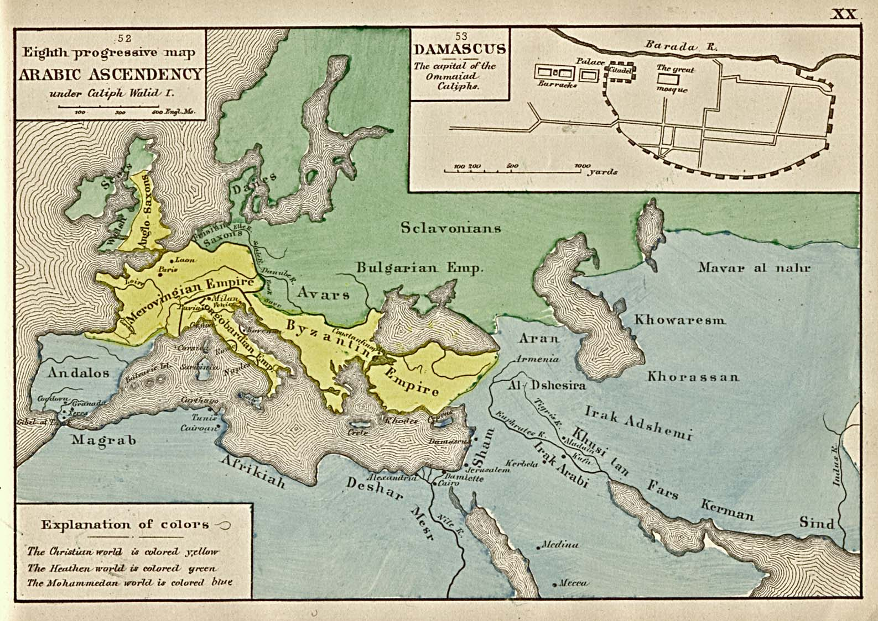
Arab Translation Efforts
Notes:
The period shortly before Ibn Fadlan’s time was the high-water mark of Arab/Muslim intellectual progress. The century from ca. 750 – 850 CE was an epoch of translation as the Abbasid capital of Baghdad was the center of a massive effort to translate into Arabic the knowledge of the ancient world. As seen in this map from 1884, Baghdad was situated at the crossroads between the west and east, where Arab translators drew in Greek works from Asia Minor through Syria and Palestine and from the repositories in Alexandria in North Africa. Persian works came from Iran, and Hindu works from India. Among other things, the Arabs translated works on medicine from the Greeks, Hindus, and Persians and added their own discoveries in anatomy, ophthalmology, pharmacology, epidemiology, and the veterinary sciences to the body of work that was later to be translated from Arabic into Latin for introduction into Europe.

Slide 44
Transmission to the West
Notes:
This knowledge that was translated and, on occasion, originally discovered in Baghdad was disseminated throughout the Arab world. It came into contact with the west in the Iberian peninsula where Muslim centers of learning, most notably in Cordoba, Spain became a source for European knowledge. What began initially as a Christian religious effort to gather information from the Muslims to use against them in polemical ways, over time developed into a serious effort to learn from the Arabs and to translate the Arab works into Latin for wider dissemination into the European environment.

Slide 45
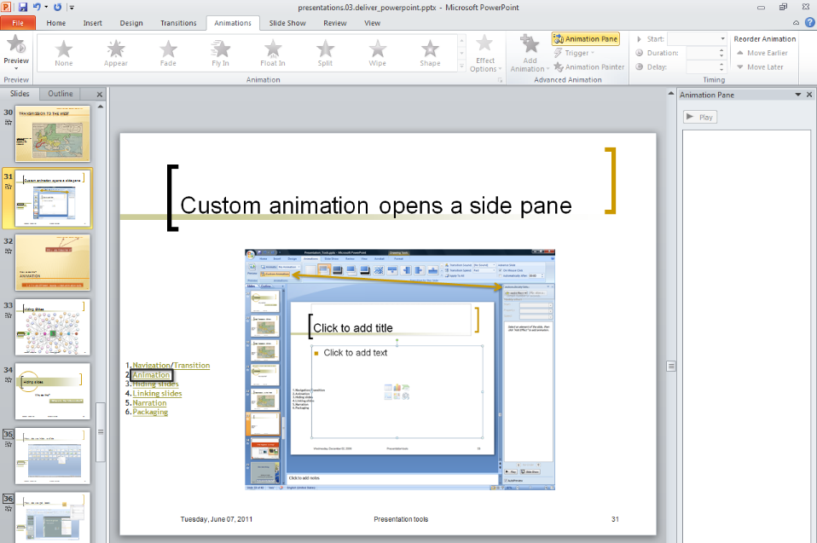
Custom animation opens a side pane

Slide 46
Animation
Why are these here?
How to do this?
Let’s use different layouts to test animation tools
Notes:
Change the logo in master view. Turn off snap to grid.

Slide 47
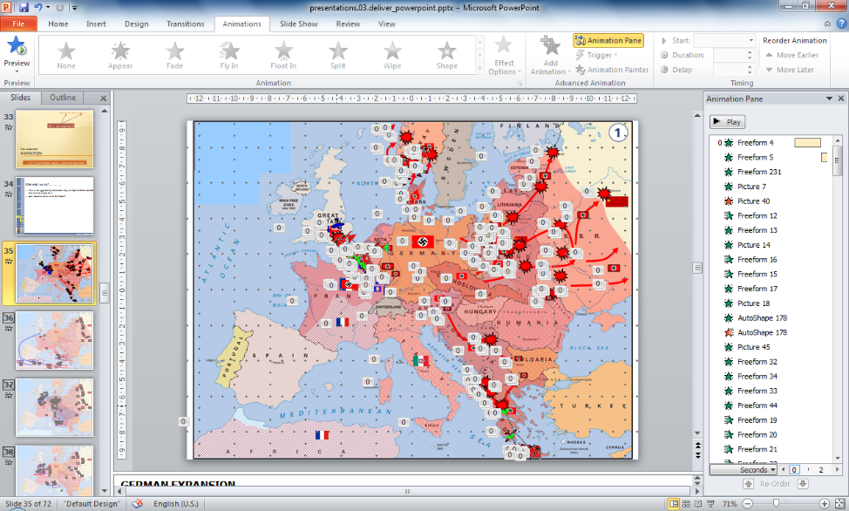
What shall we try?
This is an opportunity to consider why we might animate something and how we might do it
How about a whole lot of animation?

Slide 48







Notes:
GERMAN EXPANSION
1933 – The Nazi Party came to power in Germany (the Third Reich forms). Hitler began to rebuild the military in direct violation of the Treaty of Versailles (secretly at first, and in public by 1935 – the Western democracies do nothing).
March 1936 – Germans occupied the Rhineland with troops – again violating the Treaty of Versailles and again resulting in no reaction from the Western democracies.
March 1938 – Austria was annexed by the Third Reich.
Sept 1938 – Munich Agreement. Britain and France agreed to Hitler’s demands to ‘free’ oppressed German people that lived within the Czech Republic. German troops occupied the Sudetenland in the first weeks of October.
March 1939 – Germany seized the remainder of western Czechoslovakia. The western democracies finally realized Hitler’s true intention of conquest. The southeastern portion became the Slovak Republic, allied with Germany.
April 1939. Similarly, Italy invaded Albania and then become officially allied with Germany with the “Pact of Steel” in May.
1 September 1939 Germany invaded Poland with two Army Groups. On 17 Sept the Soviet Union, who had previously signed a non-aggression agreement with Germany (Molotov-Rippentrop Pact: 27 AUGust 1939) invaded and occupied eastern Poland. France and Britain declared war on Germany.
03 Octtember 1940. Tripartite Pact: The Axis Powers formally came into being. Germany, Japan and Italy signed this agreement to mutually support each other in their quest to conquer their spheres of influence. Hungary and Romania joined in November ’40 and Bulgaria joined in March 41.
October 1939-April 1940. The ‘Phony War’. Germany built up forces to invade France while France established defenses behind her Maginot Line (a series of strong fortifications on the French-German Border). Since the Maginot Line did not extend beyond that border, the French positioned their more mobile forces, including the British Expeditionary Force, on the Belgium Border, which would cross that border should the Germans attempt a repeat of the Schlieffen plan they had executed at the beginning of WW I. This, the Dyer Plan, would meet and defeat any German attack trying to swing around the Maginot Line, through Belgium/Netherlands.
9 April – German forces occupied Denmark
9 April – June. Germans invaded Norway. These two actions protect the German trade routes with Sweden (Iron Ore) and assisted Germany to execute her future submarine campaign in the Atlantic.
10 May 1940 – Battle of France. The Germans invaded the Netherlands and Belgium (bypassing the Maginot Line). Britain and France moved to counter this attack.
German Army Group A (containing the majority of the Panzer Units) attacks through the Ardennes Forrest and cuts off two French Armies and the BEF from the rest of the French Forces. These troops either surrendered or were evacuated at Dunkirk.
22 June – The Battle of France ends. After the disaster in the Low Countries, the French Army becomes almost totally ineffective, and the Germans easily attack through northern and eastern France. France surrenders and Vichy France was established, which is Southern France, Corsica and the French Colonies that now became essentially allied with Germany.
July – October 1940. Battle of Britain. An attempt by Germany to gain air superiority, in order to invade Britain (Operation Sea Lion). The Germans failed and eventually called off the Operation.
NOT SHOWN: Sept 1940-Nov 1942: North Africa Campaign. A series of see-saw battles between German/Italian Forces (Libya) and the British (Egypt).
October 1940. Italy attempted to invade Greece, but failed miserably. They actually lose half of Albania, and the British sent forces to defend Greece.
April 1941. Germany goes to the aid of Italy by invading Greece, and consequently Yugoslavia when the Yugoslav government was overthrown, cancelling her previous agreement to allow the Germans to pass through their county.
20-31 May 1941. Germany seized Crete with an almost purely Airborne Assault. They suffered such great losses, they never again conducted a major airborne assault.
22 June – December 1941. Operation Barbarossa. Three German Army Groups attacked into the Soviet Union, but were finally stopped just short of Moscow by stiff Soviet resistance, strategic overreach and the winter.

Slide 49
Montgomery
Clark
5
15th Army Grp
Alexander
Western
Task Force
Center
Task Force
Eastern
Task Force
1th Abn Div
1
7
8
Patton
Montgomery
15th Army Grp
Alexander
8
Notes:
NORTH AFRICA AND ITALY
8 November 1942: Operation Torch. Knowing that they are not yet strong enough for a direct assault into Europe, but realizing they must attack somewhere, the Allied Combined Chiefs of Staff decided to attack North Africa to assist the British 8th Army destroy the German/Italian Forces that were fighting in the vicinity of Egypt. At three landing sights, the Allies landed in Morocco and Algeria and quickly defeat the Vichy forces there.
10 November 1942: Germans occupied Southern France and Corsica as the Vichy government began to topple (due to defections in N. Africa).
November 1942 – The allies advanced toward Tunisia to seize critical supply ports. However, the Germans rushed troops into Tunisia from Italy/Sicily and form the 5th Panzer Army. The Germans successfully halted the Allied advance just short of their goal. The British 1st Army was now forced to go on the defense and wait for supplies and reinforcements to arrive from their very long supply lines, as well as wait for better weather. A French and American Corps occupied positions to the south of the main British Corps. In early February, Panzer Army Afrika (Rommel) arrived in Tunisia after being driven from Egypt by the 8th Army.
Rommel proposed that the combined German Armies attack the weak allied right flank to attempt to cut the 1st Br Army from its supply lines prior to the 8th Army’s arrival in force.
Feb 1943. Battle of Kasserine Pass: This battle was a tactical defeat for the Americans, but an operational failure for the Germans who are unable to follow up on their initial success. The 8th Army finally arrived in force and the two German Armies surrendered in May 1943.
With the Allies still unprepared to invade Europe, a decision was made at the Casablanca Conference to attack into Sicily (the decision to invade Italy was made with the success of the Sicilian operation)
10 July 43: 15th Army Group (AG) with the US 7th Army (Patton) and the British 8th Army (Montgomery) invade Sicily (Operation Husky). 505th Parachute Regt (82nd Airborne Division) and 1st British Airborne Division assist.
10 July – 17 August 43: Sicily was conquered. The US 7th Army attacked up the western side of the island, protecting the flank of the British 8th Army that attacked up the eastern side. The Germans were able to evacuate much of their men and equipment.
3 Sept 43: British 8th Army invaded the ‘toe’ of Italy as a diversion (Operation Baytown). The US 5th Army (Clark) then made the Allied main amphibious assault (Operation Avalanche) at Salerno on 9 September, while the 1st British Airborne Division conducted a supporting amphibious assault (Operation Slapstick) at the ‘heel’ of Italy. Salerno was a very difficult operation for the allies, but poor German coordination resulted in a successful invasion.
Just prior to the Salerno invasion, Italy surrendered to the Allies. This was announced during the invasion to create havoc for the Germans. The Germans, however, had anticipated this capitulation and rapidly disarmed the Italian forces.
16 Sept – 8 Oct 43: Movement to the Gustav Line. The British 8th Army linked up with the US 5th Army by 16 Sept and the Germans (under Luftwaffe Field Marshall Kesselring) withdrew to and held the Gustav line by 8 October.
July-Nov 43: After two failed German offensives (Stalingrad in 1942 and Kursk in July 1943), the Soviet Union begin the 1st of their major offensives to push the Germans back to Germany. This offensive occurred along the majority of the eastern front and reached the Dnieper River.

Slide 50
8
21th Army Grp
Montgomery
1
2
15th Army Grp
Alexander
Montgomery
15
5
8
Clark
15th Army Grp
Alexander
Notes:
INVASION OF EUROPE
24 December 1943: Montgomery is named the 21st AG commander (the US 1st Army and the British 2nd Army) and the final preparations for the invasion of Europe (Operation Overlord) began.
Fall 1943: With the capture of Foggia in Italy, the US Army Air Force now had two locations to conduct the Strategic Bombing of the German industry and resources. The 8th Air Force had begun limited operations from England in the summer of 1942, and now with the 15th Air Force in Italy (and with the British Bomber command conducting night raids against German moral) the US Strategic bombers conducted large, 1000 bomber raids (with emphasis on transportation and oil production) deep into enemy territory. These initial raids proved to be very costly, but continued through the rest of the war.
22 Jan 1944: After continuously unsuccessful attacks on the Monte Casino and the rest of the Gustav Line, the 15th AG attempted to break the stalemate by conducting another major amphibious landing with the US VI Corps at Anzio (Operation Shingle). While the landing was virtually unopposed, the US Corps Commander, General Lucas, failed to advance. Simultaneously, the drive by the US 5th Army (to link up with VI Corps) failed again to break the Gustav line.
16-19 Feb 44: The Germans counter-attacked the US beachhead, and almost pushed them back to the sea, but ultimately failed. Anzio now turned into a siege until May.
19-25 Feb 44: Bomber Offensive. The US orient on the destruction of the German aircraft industry. The scale and success of the attacks resulted in it being called ‘Big Week’ after the fact.
US Fighter Planes were now able to escort the bombers all the way to their targets and back (due to drop tanks). They (and the heavily defended bombers) destroyed so many German fighter planes, that air superiority was assured for the coming Overlord invasion. The Germans can now only defend their most critical industrial locations.
Jan-Apr 44: Soviet Spring Offensive frees Leningrad from it’s two year siege and pushes into the Ukraine.
11 May – 4 June 44: In attempt to draw German units into the Italian Theater (and thus away from the Overlord Invasion) the 15th AG conducted Operation Diadem and finally broke the Gustav Line. The 5th Army linked up with the VI Corps at Anzio and entered Rome on 4 June (two days prior to Overlord).
6 June 44: Operation Overlord – 3 Airborne Divisions (82nd, 101st and 6th British) landed in Normandy in the early hours, to protect the flanks of the amphibious landing sites.
6 June 44: Operation Overlord – 21st AG landed in Normandy on 5 beachheads: Utah (4th ID), Omaha (1st and 29th ID), Gold (50th British ID), Juno, (3rd Canadian ID) and Sword (3rd British ID).
Allied air forces successfully conducted strikes which slowed and even prevented German reinforcements from arriving at the Normandy beachheads.
June-Oct 44: After the fall of Rome, the 15th AG was able to push the Germans north on the Italian Peninsula. They quickly break the German Gothic line but cannot push much further and the opposing forces settled into a static line for the winter/spring of 44/45.

Slide 51


8
21th Army Grp
Montgomery
1
2
21th Army Grp
Montgomery
9
2
1
12th Army Grp
Bradley
9
1
3
12th Army Grp
Bradley
6th Army Grp
Devers
1
7
5
8
15th Army Grp
Alexander
15th Army Grp
Clark
15
Notes:
BREAKOUT
25 July 1944. Operation Cobra. After an immense buildup of forces and the slow expansion of the allied beachhead, the US 8th and 9th Air forces (strategic and tactical) conduct a concentrated ‘carpet bombing’ mission which assisted in the breakout attack of the US 1st Army through the very difficult bocage countryside.
1 August 44: With this breakout, the US 12th Army Group (Bradley) was formed – US 1st Army (Hodges) and US 3rd Army (Patton).
1-25 August 44: Patton’s 3rd Army poured through and exploits the breakout created by Operation Cobra and attacked in two directions – Brittany and the Seine River. With this rapid movement, the German 7th and 5th Panzer Armies are almost cut off, but escape with a large portion of their men (but not equipment) at the Falaise Gap when the Canadian 1st Army failed to rapidly link up with the US 3rd Army. Paris was liberated on 25 August.
15 August 44: Operation Anvil (Dragoon) – US 7th Army landed in Southern France in support of the attack in Normandy.
June-August 44: The Soviets crush the German Army Group Center and reach the outskirts of Warsaw.
25 August – 15 September 44: Eisenhower takes over direct control of the ground battle from Montgomery (1 September) and the 21st and 12th Army Groups attacked along a ‘Broad Front’ toward the Rhine River. The 12th Army Group linked up the newly formed 6th AG (Devers) which contained the US 7th and French 1st Armies. Also, the 9th Army (Simpson) is formed in 5 September and clears the rest of Brittany (The port of Brest). General Clark became the 15th AG commander in October.
Operation Market-Garden: 21st AG’s attempt to rapidly cross many rivers/canals in the Netherlands (2 part operation)
17 Sept 44: Operation Market - 101st, 82nd, and 1st British Airborne divisions are dropped to capture a series of bridges located between Arnhem and the British front lines.
17-26 September 44: Operation Garden - British XXX Corps attacks to link up with the Airborne (ABN) units and cross the captured bridges. The XXX Corps is finally stopped after it links up with the US 82nd ABN just short of the British 1st ABN at Arnhem. Only 2,200 of that surrounded division escaped back to British lines.
August – December 44: Soviet offensive to clear the Balkans. Romania and Bulgaria surrender and join the Allies.
Nov 8 – 15 Dec 44: Eisenhower shifted the Main Effort to the 12 AG. Both the 3rd and 7th Armies attacked to the German “West Wall”. This was also the time that 1st Army fights the costly battle of the Hurtgen Forrest. The 9th Army, initially paced between 1st and 3rd Armies, was moved to the 12 AG’s northern boundary. Bradley, anticipating a future transfer of forces to Montgomery, made the shift as he did not want to lose his veteran Army.

Slide 52
8
21th Army Grp
Montgomery
1
2
9
1
9
1
12th Army Grp
Bradley
1
7
3
6th Army Grp
Devers
1
5
8
15th Army Grp
Clark
15
Notes:
Battle of The Bulge and Final German Defeat
Ardennes Offensive (Operation Watch on the Rhine) The Germans massed the 6th SS Panzer, 5th Panzer and 7th Armies for a final counter-attack against the Western Allies. Hitler planned to split the US from the British at the lightest defended portion of the American line – the Ardennes (the same location that they concentrated their panzer forces to defeat the French in 1940). This attack would then continue to the coast and capture the critical supply port of Antwerp. This would become known as the Battle of the Bulge.
15-24 Dec 44: Battle of the Bulge (1) - Germany attacked and created a ‘bulge’ in the allied line.
As the 1st and 9th Armies are cut off from the 12th AG (due to the ‘bulge’), command of these two armies shift to the 21st AG.
20-21 Dec 44: 3rd Army displaced from its front lines and reoriented to attack into the southern portion of the ‘bulge’. Patton began his attack on 22 December.
26 Dec – 7 Feb 45: Battle of the Bulge (2) - the 12th and 21st AGs pushed the Germans back to their start line.
Jan – Apr 45: The Soviets pushed to the Oder river in the north, followed by attacks in Hungry and Austria in the south.
22 Feb – 21 March: Rhineland Campaign. All Army Groups pushed forward to the Rhine River. By chance, the US 1st Army was able to capture a bridge still intact on 7 March at Remagen and created an unexpected bridgehead on the east side of the Rhine River. (The 1st Army was returned to 12 AG after the Battle of the Bulge)
22 & 23 March: The US 3rd and British 2nd Armies conducted river crossings of the Rhine.
28 March – 7 May: Attack and occupation of Germany. The German Army Group B (Model) is captured in the Rhur Pocket. The 15th AG made a final push to capture the rest of Italy and the US 5th and 7th Armies linked up on 4 May.
15 Apr – 6 May: Soviets attacked into Eastern Germany and captured Berlin. Hitler committed suicide on 30 April and the Germans surrendered on 7 May.

Slide 53
Notes:
Post War Occupation of Germany:
US Sector
British Sector
Soviet Sector
French Sector
All 4 Powers divide Berlin

Slide 54
¿Interesante?

Slide 55
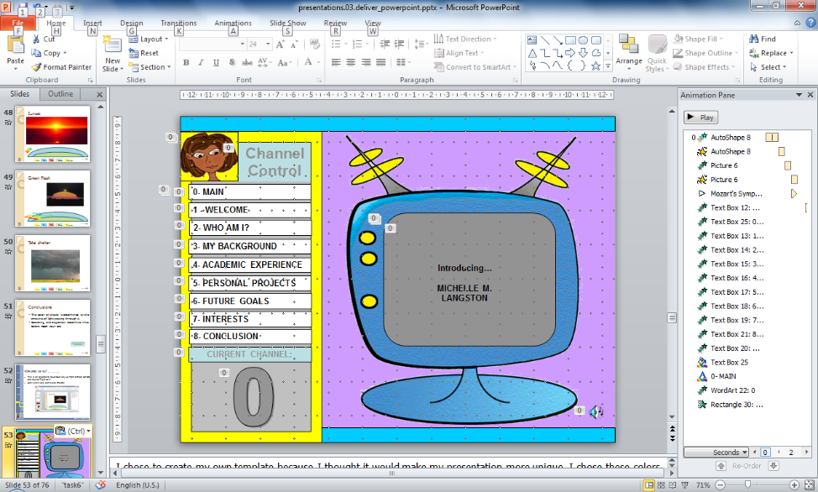
What shall we try?
This is an opportunity to consider why we might animate something and how we might do it
What looks complex, works as if it were simple

Slide 56



Introducing…
MICHELLE M.
LANGSTON
Channel Control
0- MAIN
1 - WELCOME
2- WHO AM I?
3- MY BACKGROUND
4- ACADEMIC EXPERIENCE
5- PERSONAL PROJECTS
6- FUTURE GOALS
7- INTERESTS
8- CONCLUSION
CURRENT CHANNEL:
0
Notes:
I chose to create my own template because I thought it would make my presentation more unique. I chose these colors because they are fun and light-hearted, the mood I wanted to convey for this presentation! In this opening slide, I animated the TV screen, my logo and the menu items. I also incorporated a Mozart song I found in the Clip Gallery. This song serves as the background music. SHADOW EFFECT added on the number “0.” The menu items are all clickable.

Slide 57
Channel Control
0- MAIN
Introducing…
MICHELLE M. LANGSTON
1 - WELCOME
2- WHO AM I?
3- MY BACKGROUND
4- ACADEMIC EXPERIENCE
5- PERSONAL PROJECTS
6- FUTURE GOALS
7- INTERESTS
8- CONCLUSION
CURRENT CHANNEL:
0
Notes:
This slide is simply a “zoom-in” slide. The TV screen on the previous slide is too small for a presentation, so I felt it appropriate to zoom in closer to the TV set so we could see what’s going on in the show!

Slide 58

Welcome!
Channel Control
0- MAIN
1 - WELCOME
The purpose of this presentation is to allow me to introduce myself to you. I will share a bit of information about myself and my background.
I will then give an overview of skills that I learned in classes as well as skills I picked up on my own.
I’ll follow up with discussion of my personal goals and interests!!
Hope you enjoy!
2- WHO AM I?
3- MY BACKGROUND
4- ACADEMIC EXPERIENCE
5- PERSONAL PROJECTS
6- FUTURE GOALS
7- INTERESTS
8- CONCLUSION
CURRENT CHANNEL:
1
Notes:
This slide serves as an overview of this presentation and where it’s going to go. The custom animation effect used on this slide and all of the other Channel Header slides for the title is called “Grow With Color.”

Slide 59
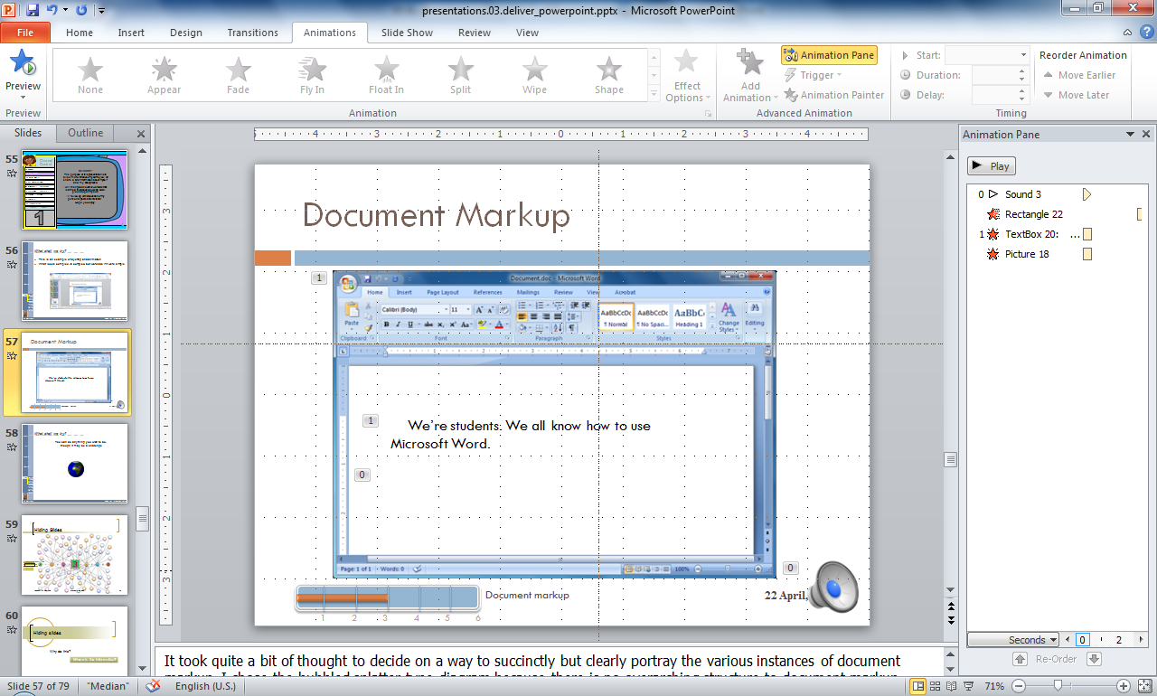
What shall we try?
This is an example of layering and animation
What looks complex, is complex, but works as if it were simple

Slide 60


Document Markup
Page set-up: orientation, margins, layout, views
Breaks
Appearance: styles, themes, headers & footers
Formatting: font, paragraph
Navigation: table of contents, footnotes
Markup
We’re students. We all know how to use Microsoft Word.
…Right?
To view an example, please click on the diagram above.
Document markup
1
2
3
4
5
6
Notes:
It took quite a bit of thought to decide on a way to succinctly but clearly portray the various instances of document markup. I chose the bubbled splatter-type diagram because there is no overarching structure to document markup—settings can be applied, deleted, and altered at any time without (typically) affecting others. They overlap, underscore, and gently push aside depending on what you’re trying to accomplish, and it reminded me of very artistically spattered paint. Also above is a link to an external file—in this case, a copy of our Task 3, the document markup of Louisa May Alcott’s “Little Women”.

Slide 61

What shall we try?
You can do anything you wish to do,
though it may be a challenge

Slide 62
Hiding Slides

Slide 63
Hiding slides
Why do this?
Where is the information?
Notes:
Change the logo in master view. Turn off snap to grid.

Slide 64
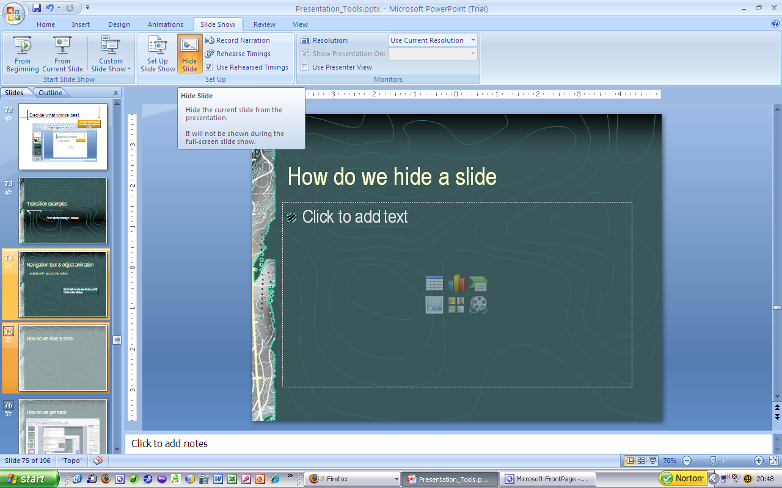
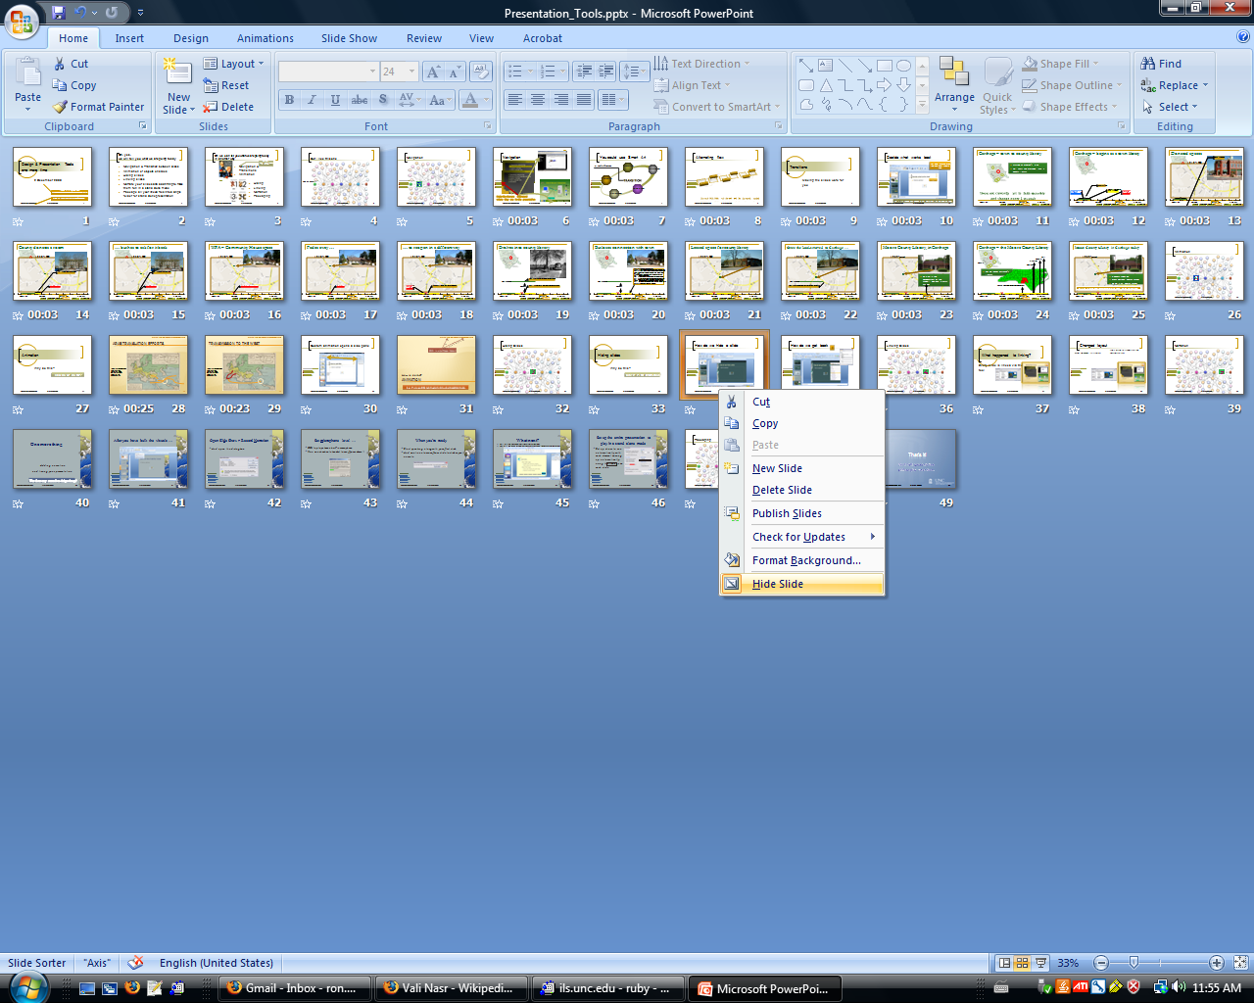
How do we hide a slide

Slide 65
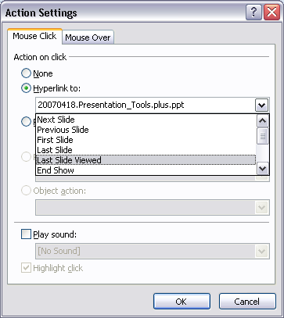
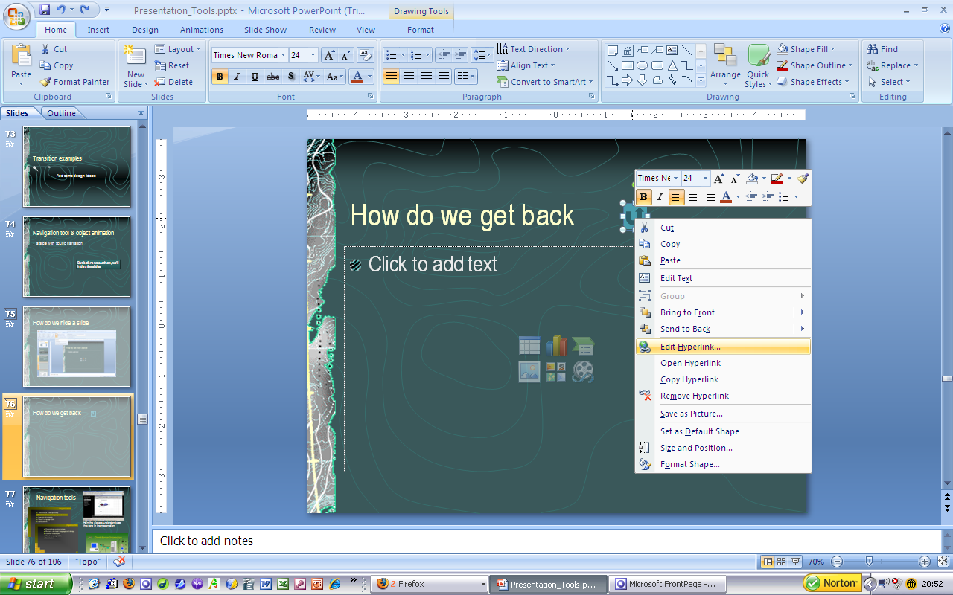
How do we get back

Slide 66
Linking Slides

Slide 67
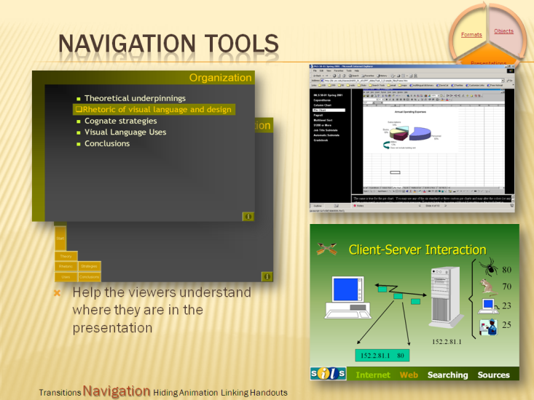
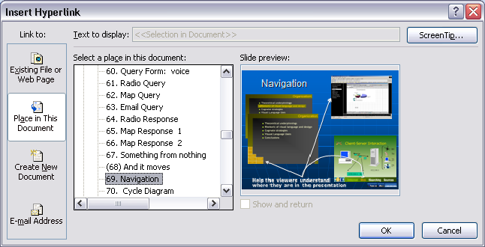
What happened to linking?
Every slide is linked via the navigation tool

Slide 68
Changed layout
What happened to linking?
Every slide is linked via the navigation tool

Slide 69
Narration

Slide 70
One more thing
Adding narration
and timing your presentation
Was there any reason for a design change?

Slide 71
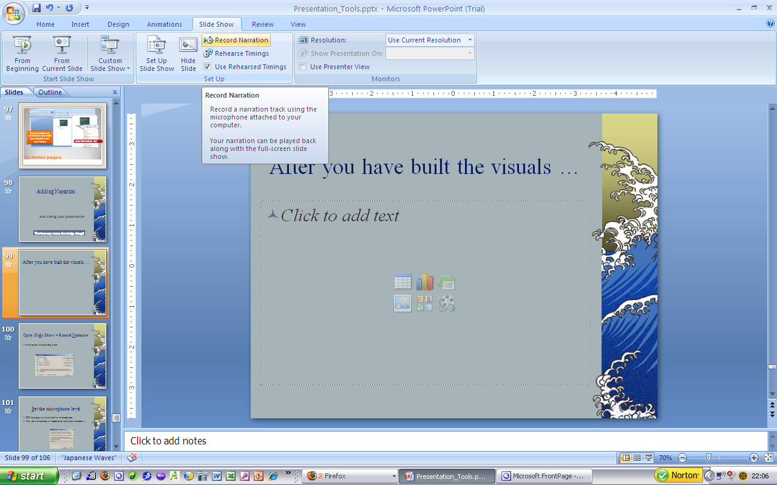
After you have built the visuals …
2007

Slide 72
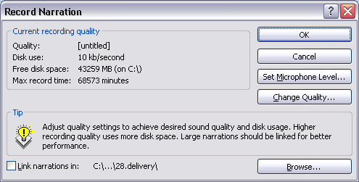
Open Slide Show > Record Narration
And open the dialog box
2007

Slide 73
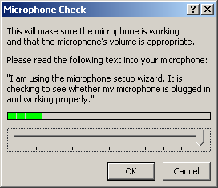
Set microphone level …
CCI laptops have a built-in microphone
You can check out a headset to use if yours doesn’t
2007

Slide 74

When you’re ready
Start speaking along with your first slide
And continue to move from slide to slide as you narrate
2007

Slide 75
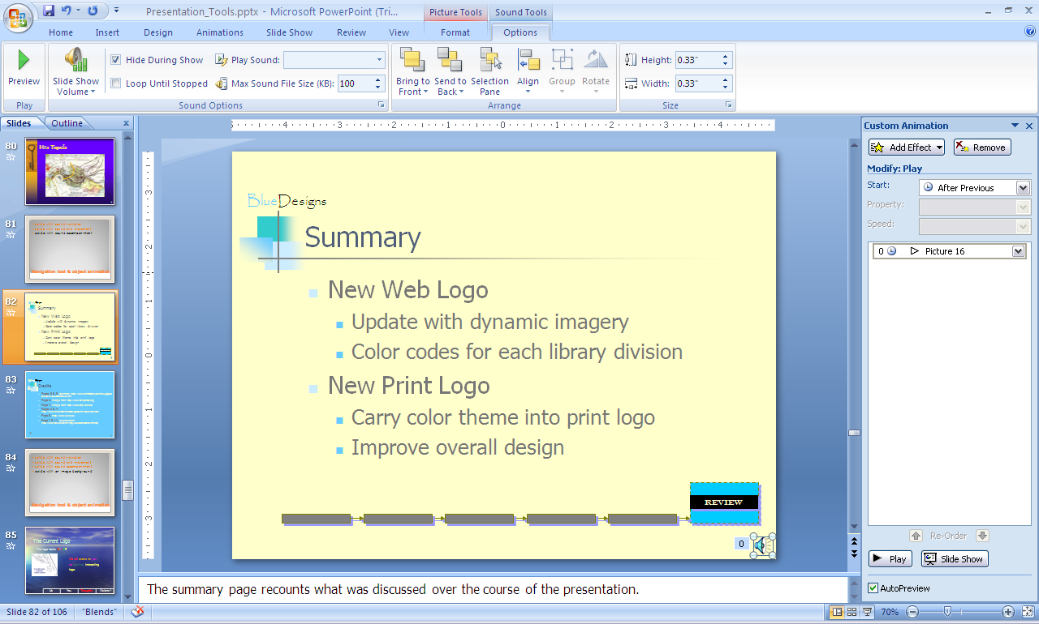
What next?
This will add a sound file to the slide on screen as you speak
You will then be able to control when and how the sound file is played during the presentation
2007

Slide 76
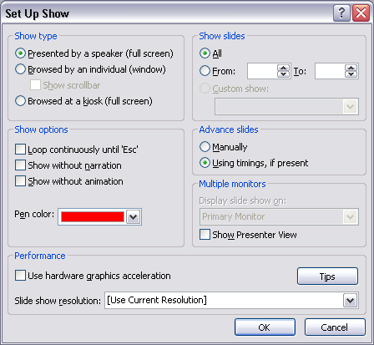
Set up the entire presentation to play in a stand alone mode
Set up show to run automatically with each element coming up automatically, using the timings on each slide
2007

Slide 77
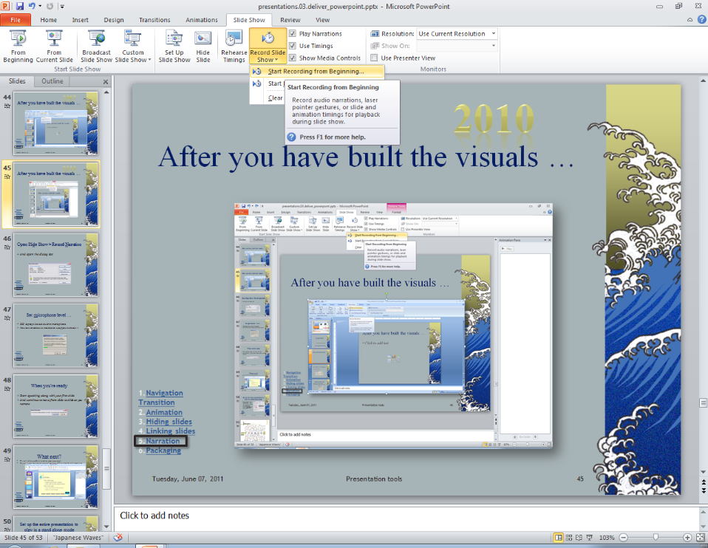
After you have built the visuals …
2010

Slide 78
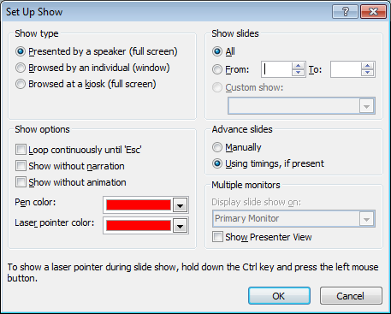
Set up the entire presentation to play in a stand alone mode
Set up show to run automatically with each element coming up automatically, using the timings on each slide
2010

Slide 79
Packaging

Slide 80
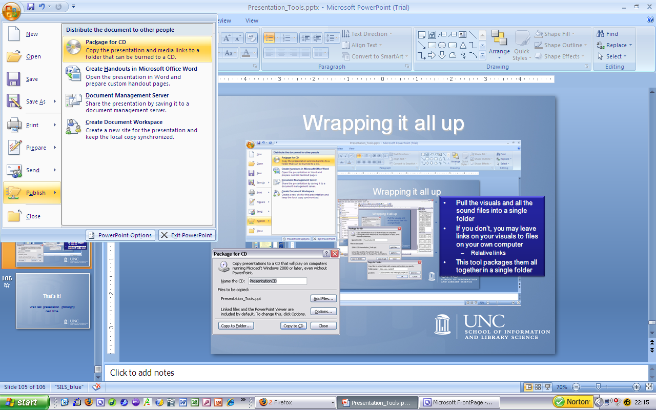
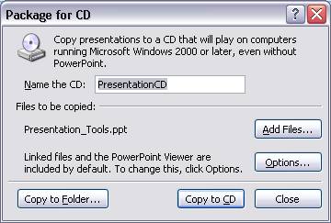
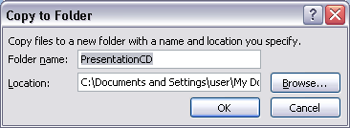
Wrapping it all up
2007
Pull the visuals and all the sound files into a single folder
If you don’t, you may leave links on your visuals to files on your own computer
  Relative links
This tool packages them all together in a single folder

Slide 81
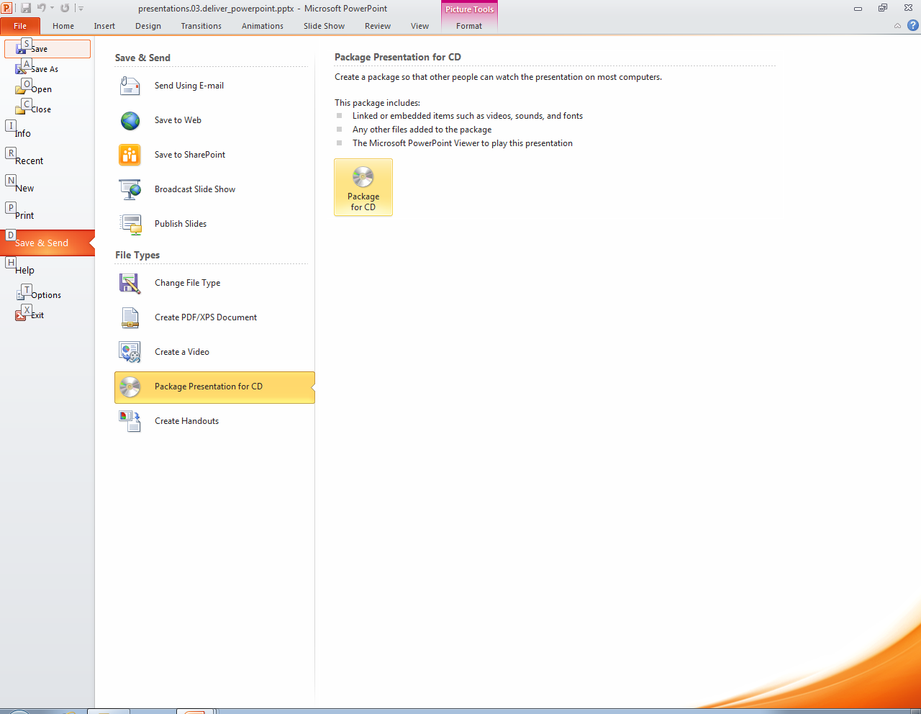
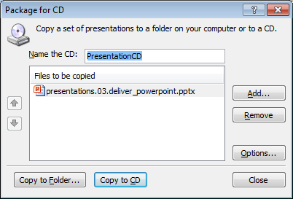
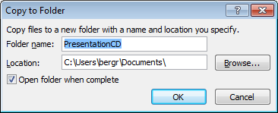
Wrapping it all up
2010
Pull the visuals and all the sound files into a single folder
If you don’t, you may leave links on your visuals to files on your own computer
  Relative links
This tool packages them all together in a single folder

Slide 82

Could it be Prezi?
Yes, it could, and now you have the narration capability
And, it needs to be good

Slide 83
That’s it!
We’ll talk presentation philosophy next time.

Slide 84
Agenda
Thinking about PowerPoint
Working views
Designing a presentation
Tour the workspace
Delivering a presentation
Done!
Notes:
Tell ‘em what you’re going to tell ‘em

