Slide 1
Page numbering
Step by step

Slide 2
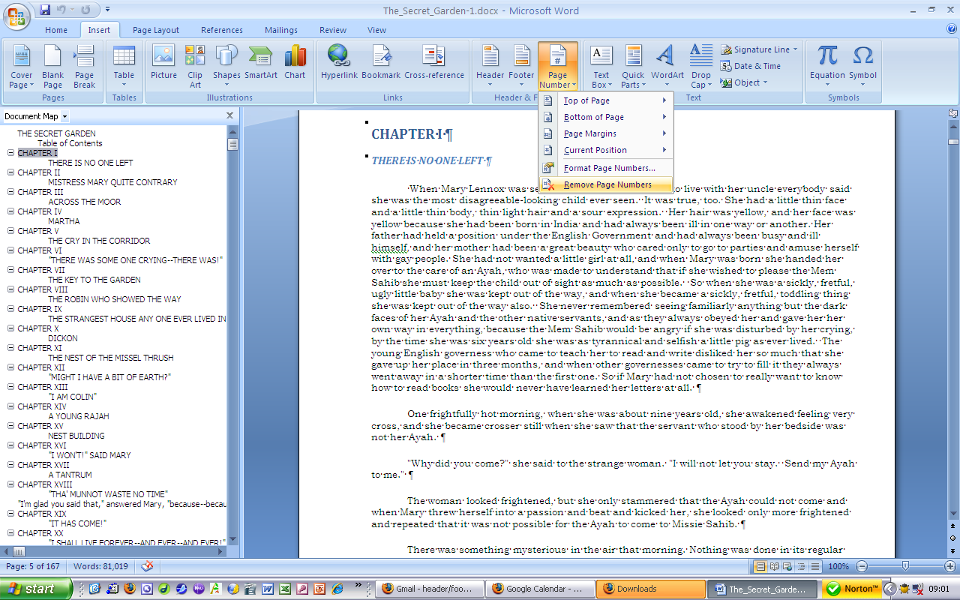
Remove page numbers

Slide 3
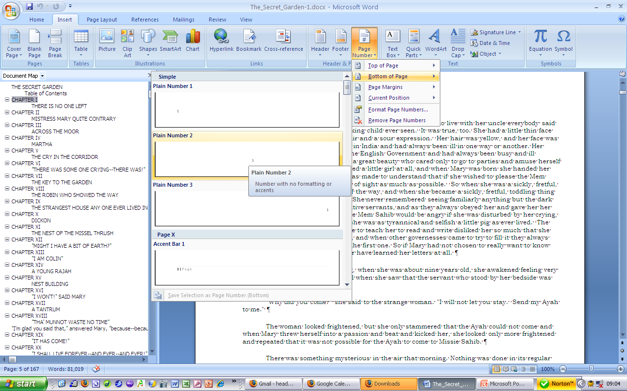
Insert new page numbers

Slide 4
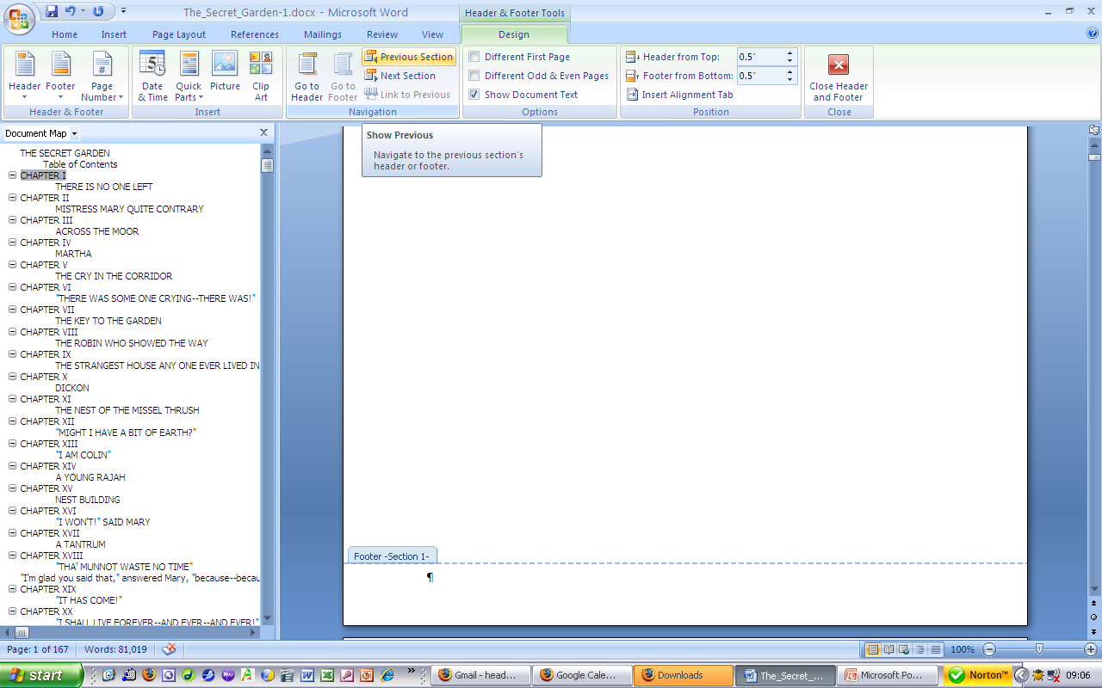
Navigate to footer in section 1
If there is no number here, good

Slide 5
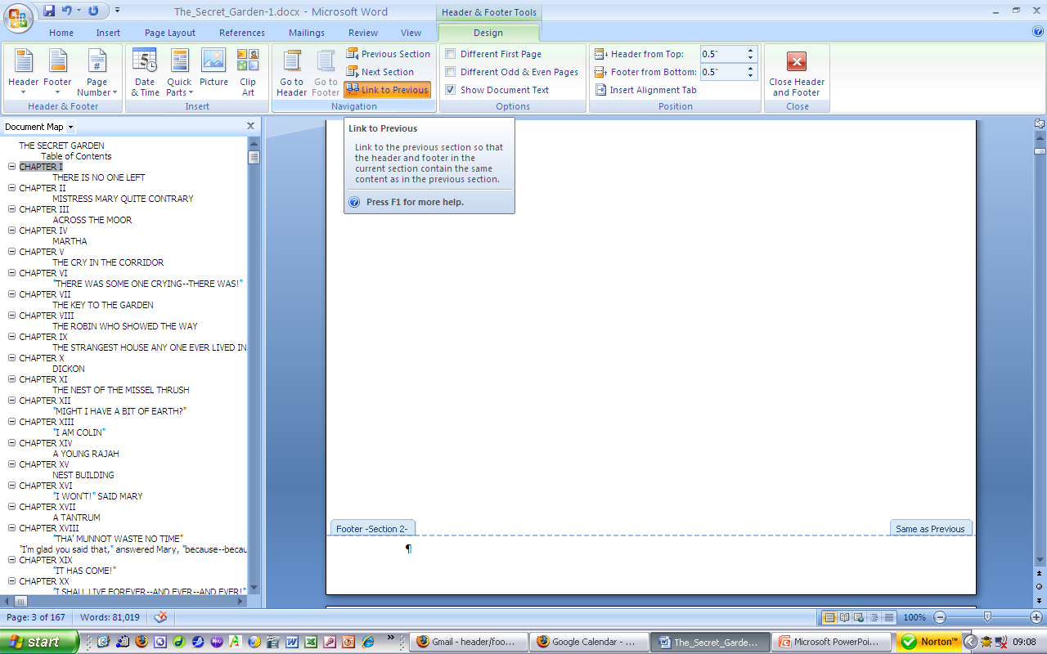
Navigate to next section
You don’t want this section to inherit the no number from previous section, so deselect its Link to previous

Slide 6
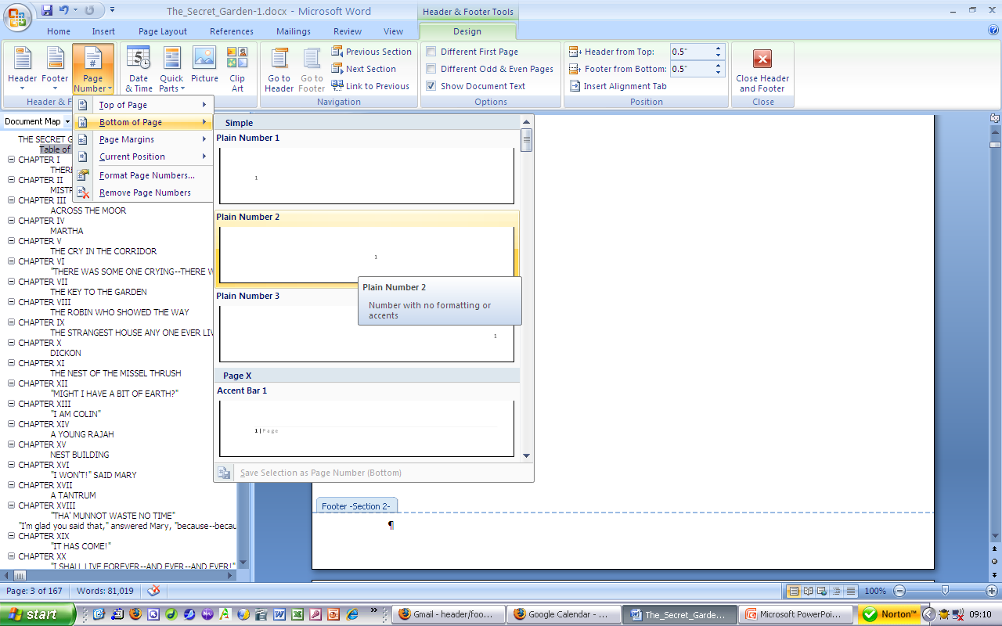
And add a page number in this section

Slide 7
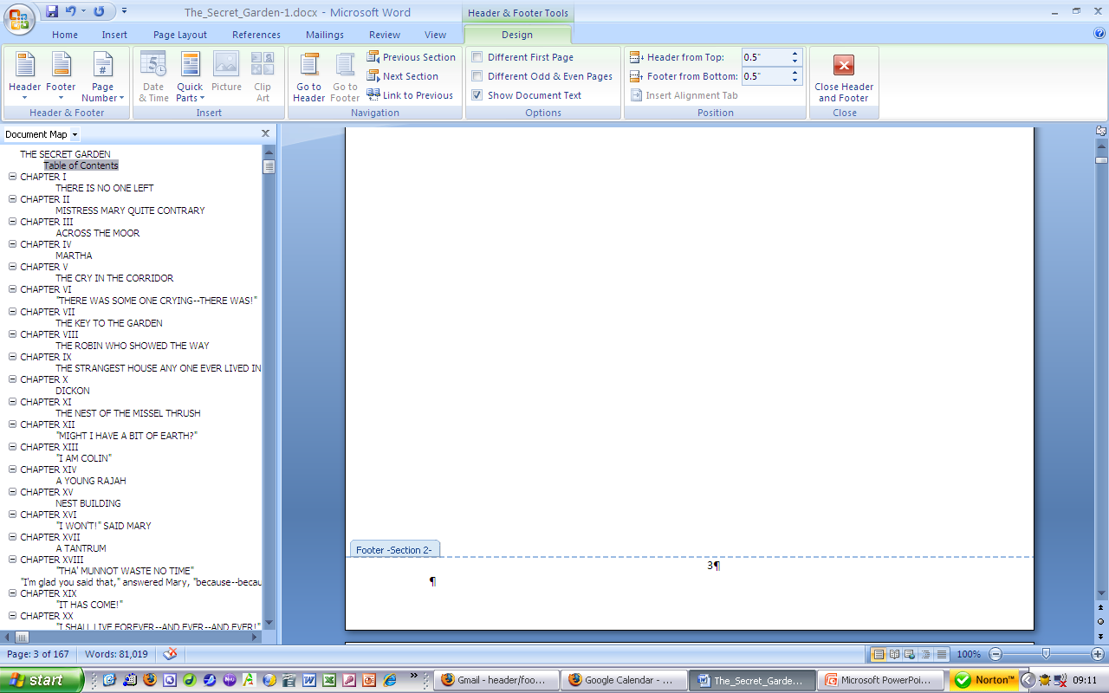
Thusly
Section 2 has numbers in footer, section 1 does not

Slide 8
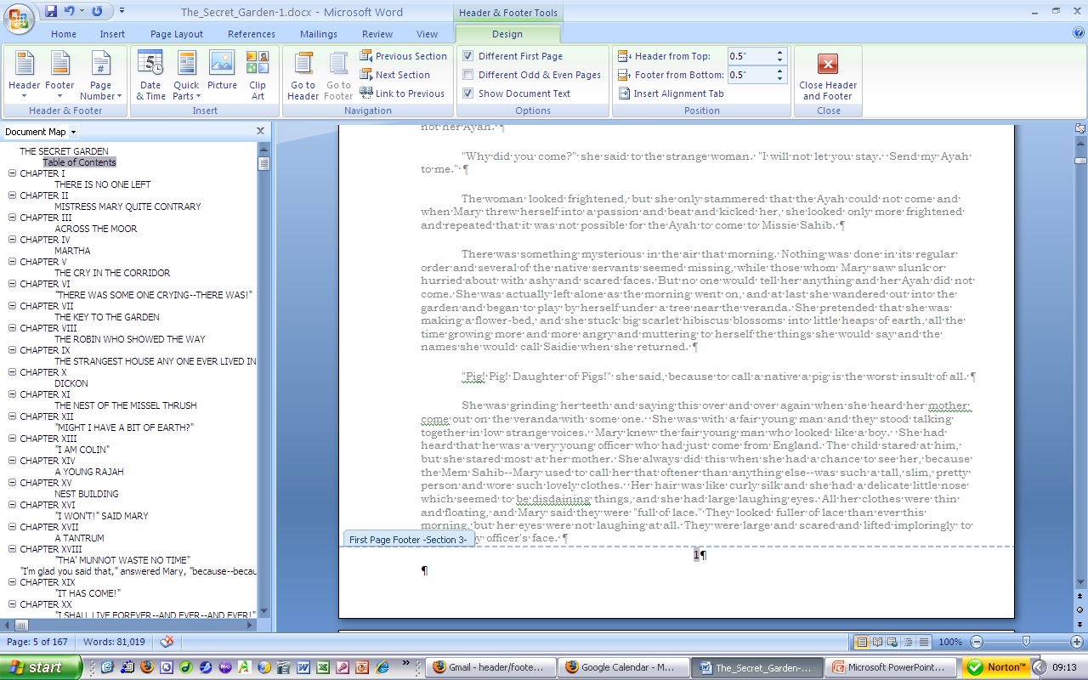
Move section by section until you encounter a problem

Slide 9
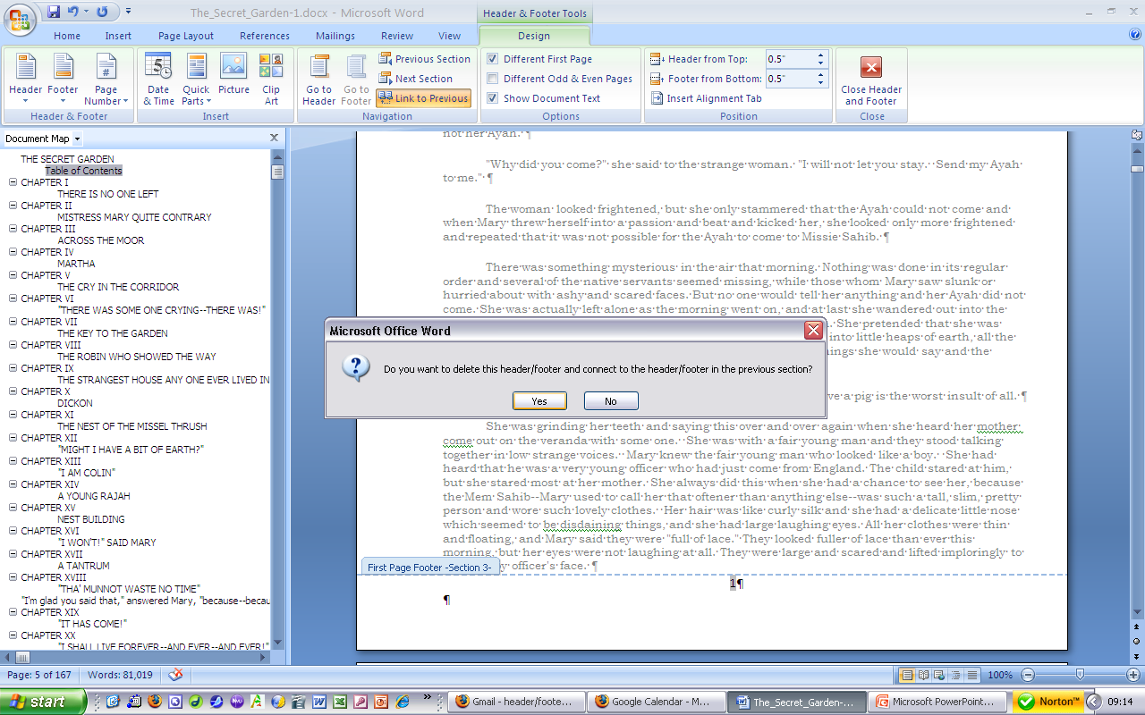
Link it to previous section

Slide 10
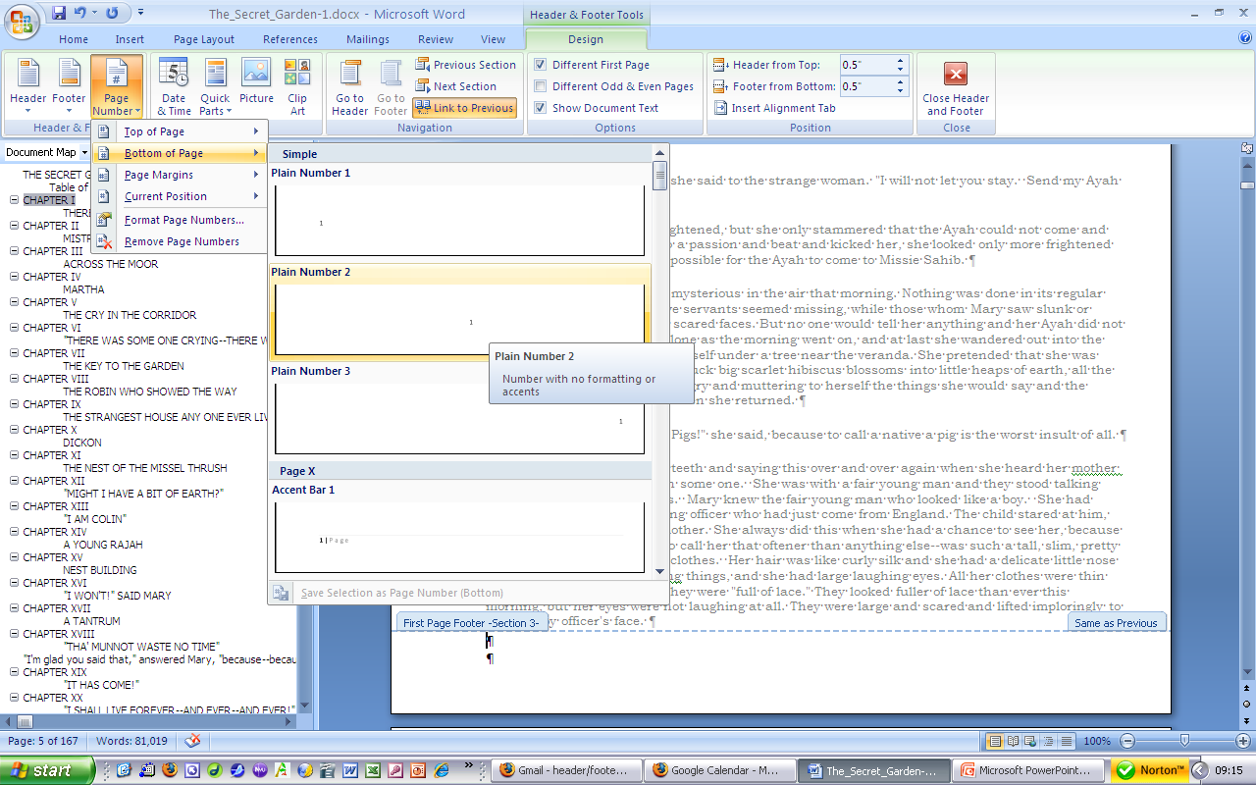
Add the page number

Slide 11
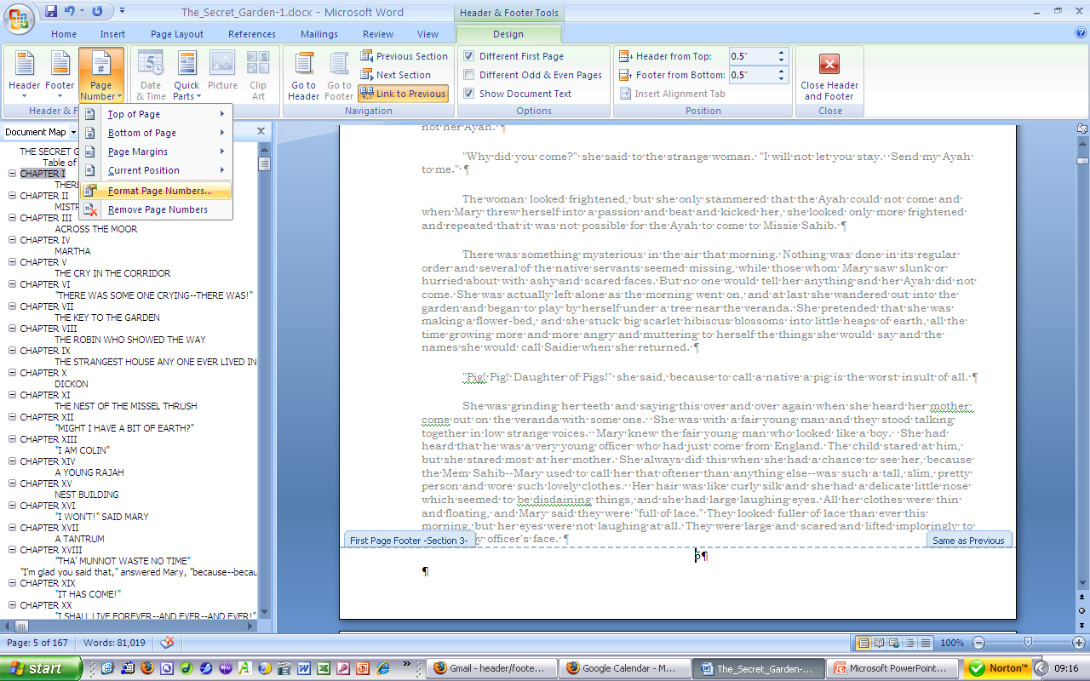
If you need to, format the page numbers

Slide 12
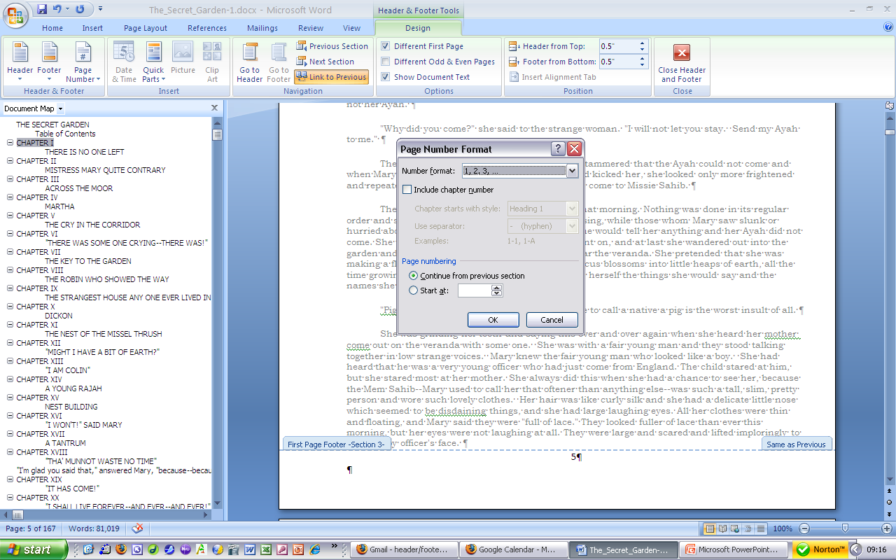
To be certain it continues the numbering from the previous section

Slide 13
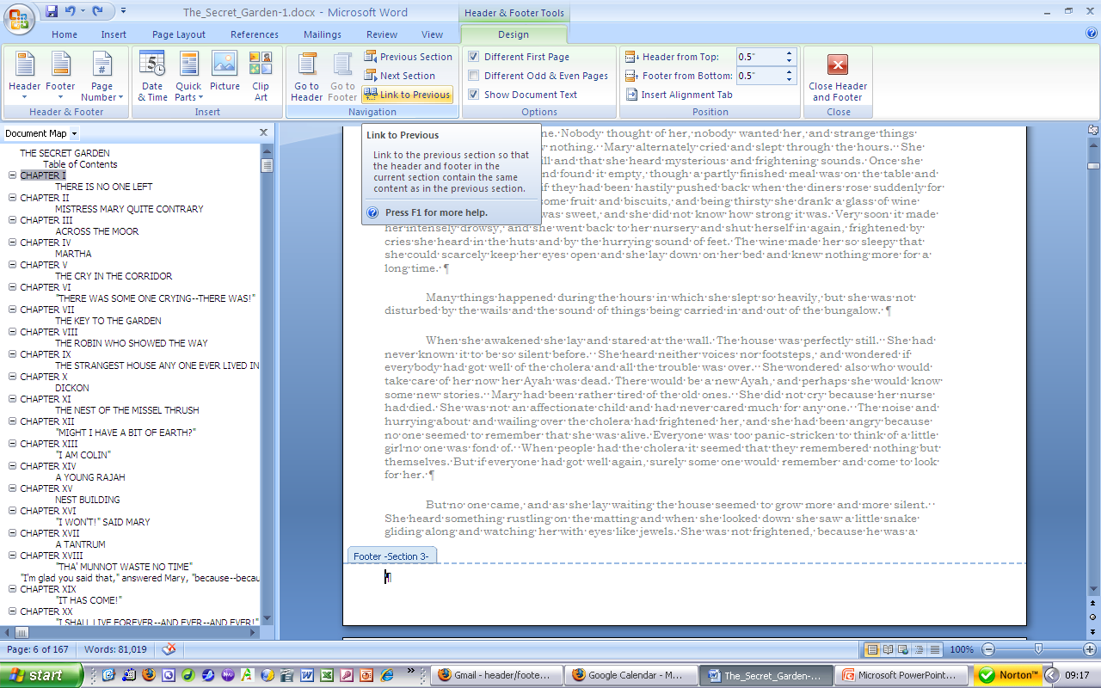
Continue this process …

Slide 14
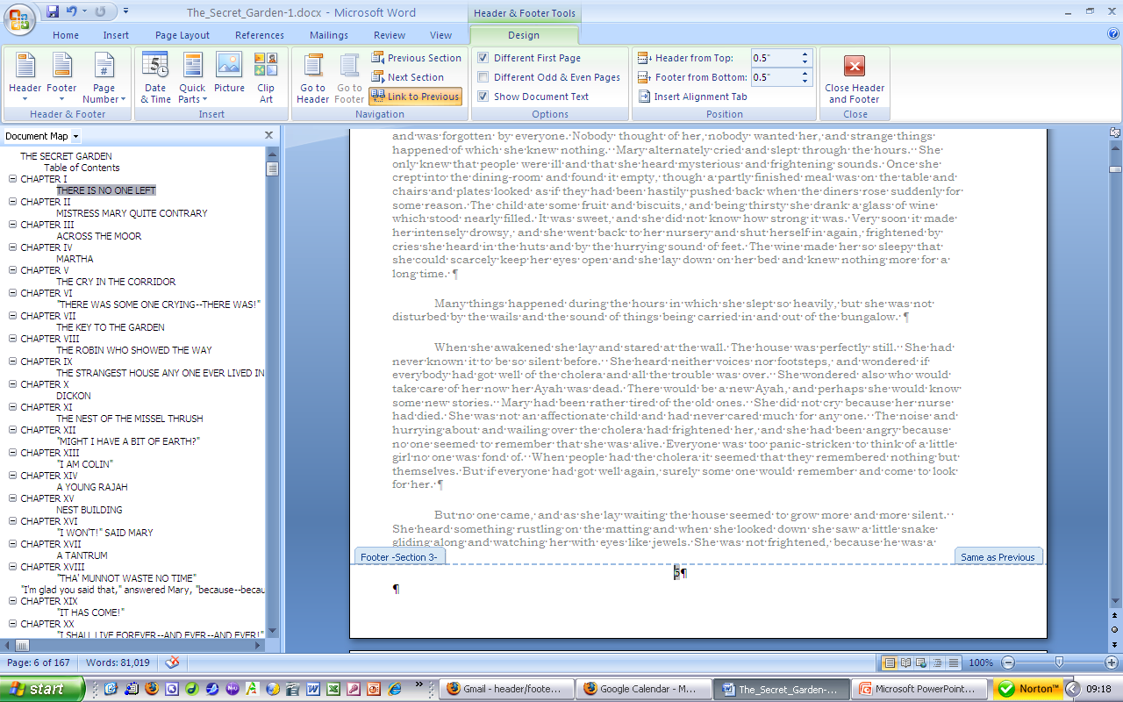
Linking to previous, as needed

Slide 15
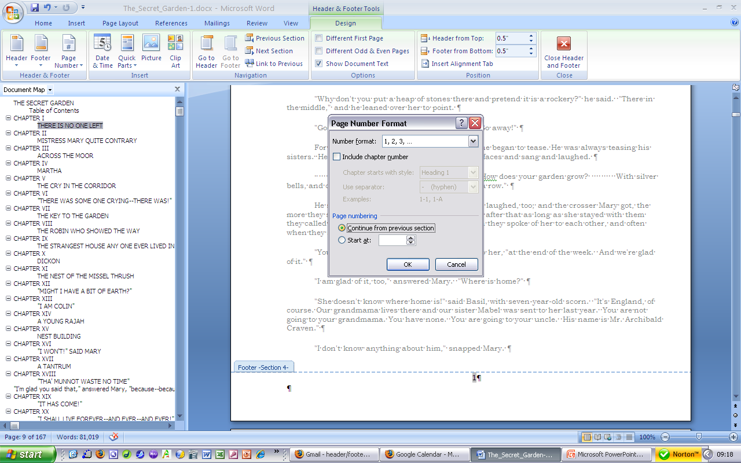
Formatting the numbers, as appropriate

Slide 16
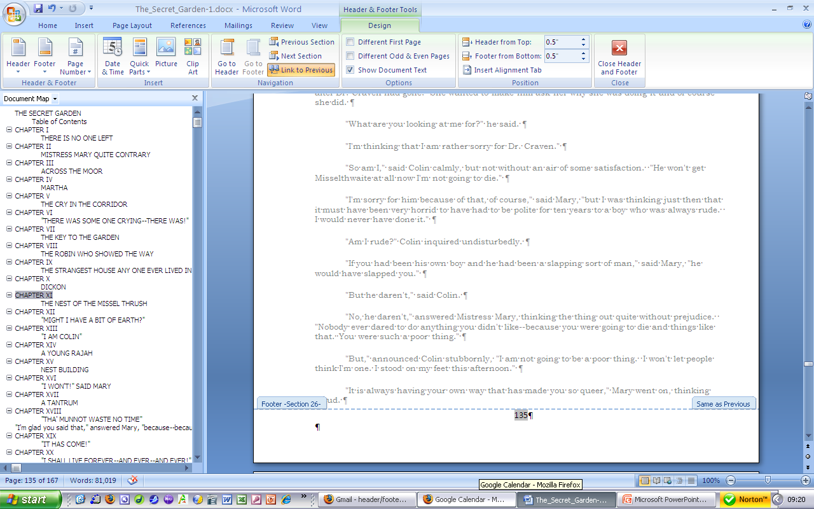
In the end, all sections will be same as previous and continue the numbering

Slide 17
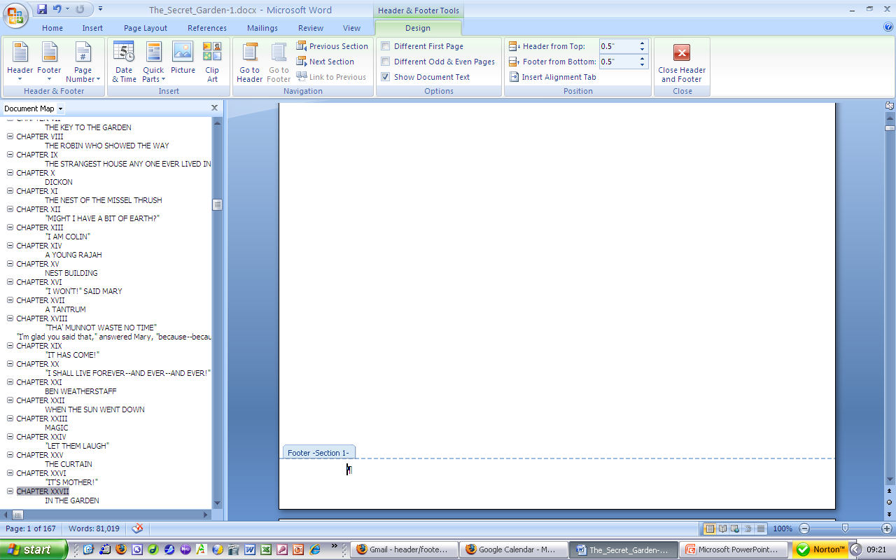
Except for section 1 (which has no number)

Slide 18

And section 2 (which is not linked to its previous section)

Slide 19
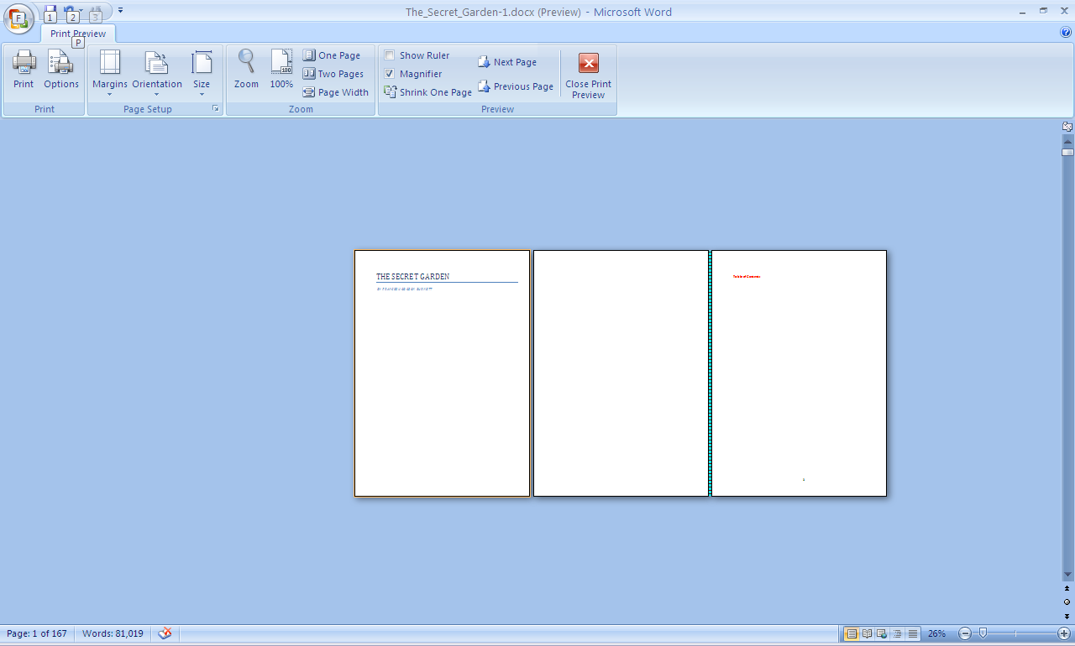
So section 1 has no numbers and section 2 begins on page 3

