Slide 1
Access Intro
RDBMS
Relational Database Management System

Slide 2
Getting Started

Slide 3
Start Access

Slide 4
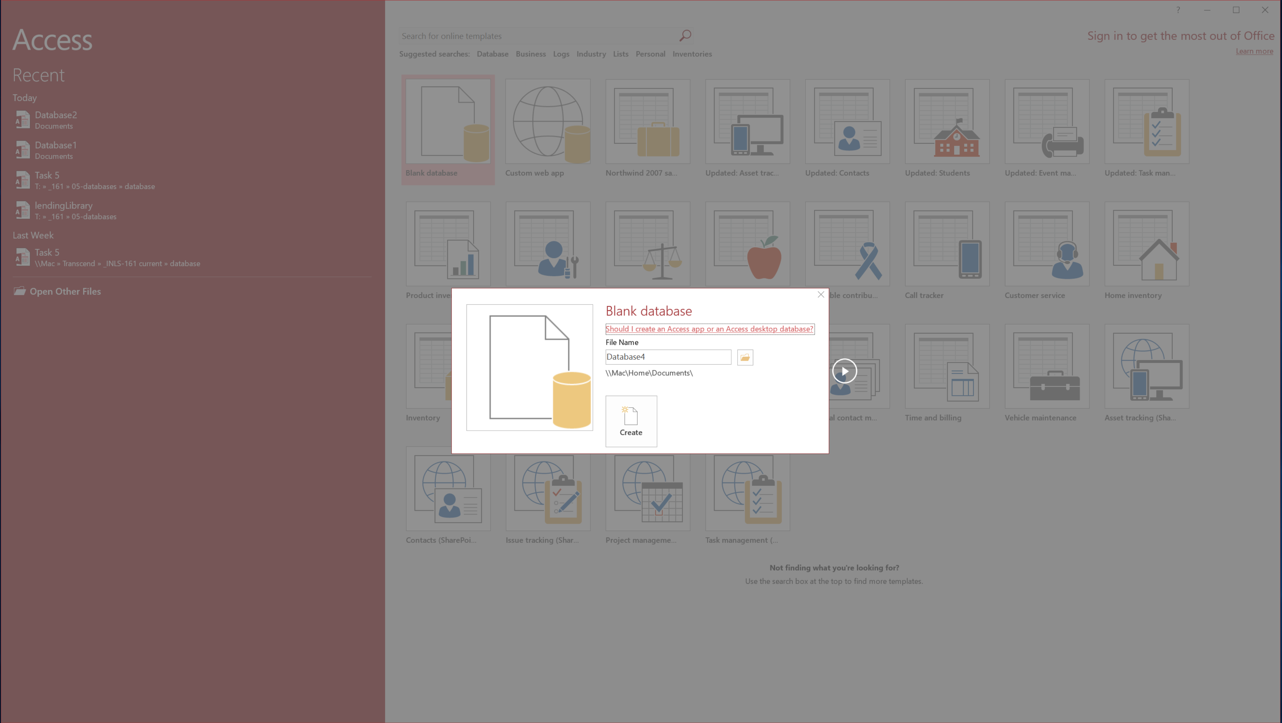
New Blank Database

Slide 5
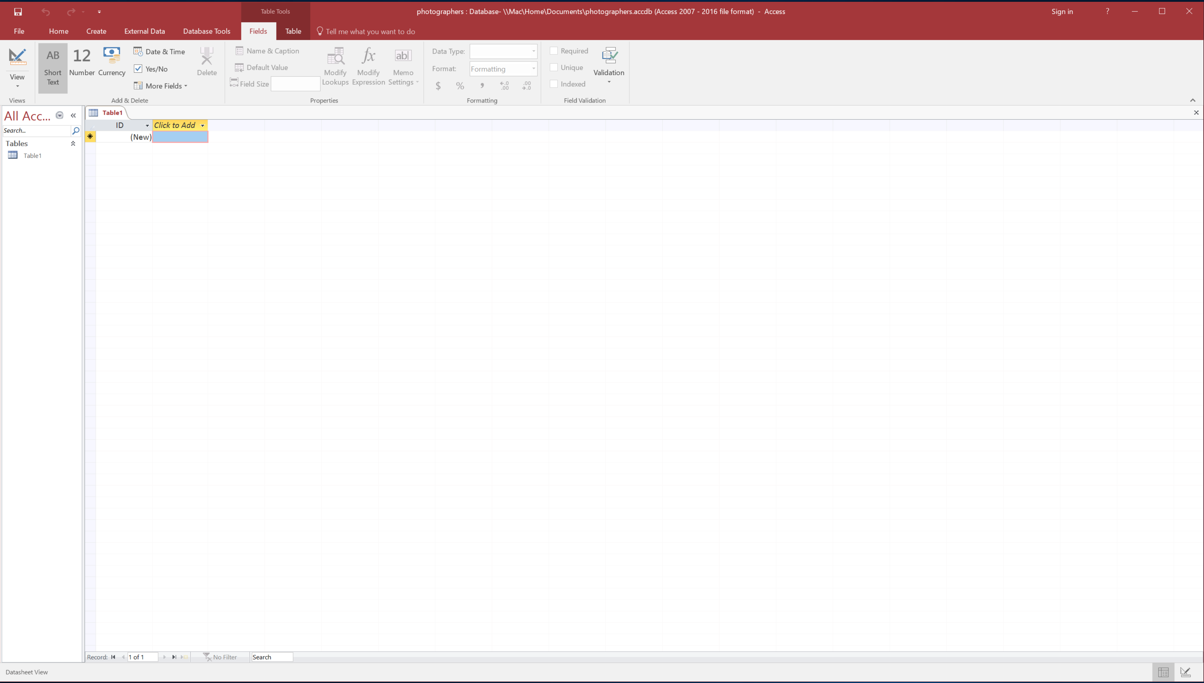
Default Start: Table Tools: Fields

Slide 6
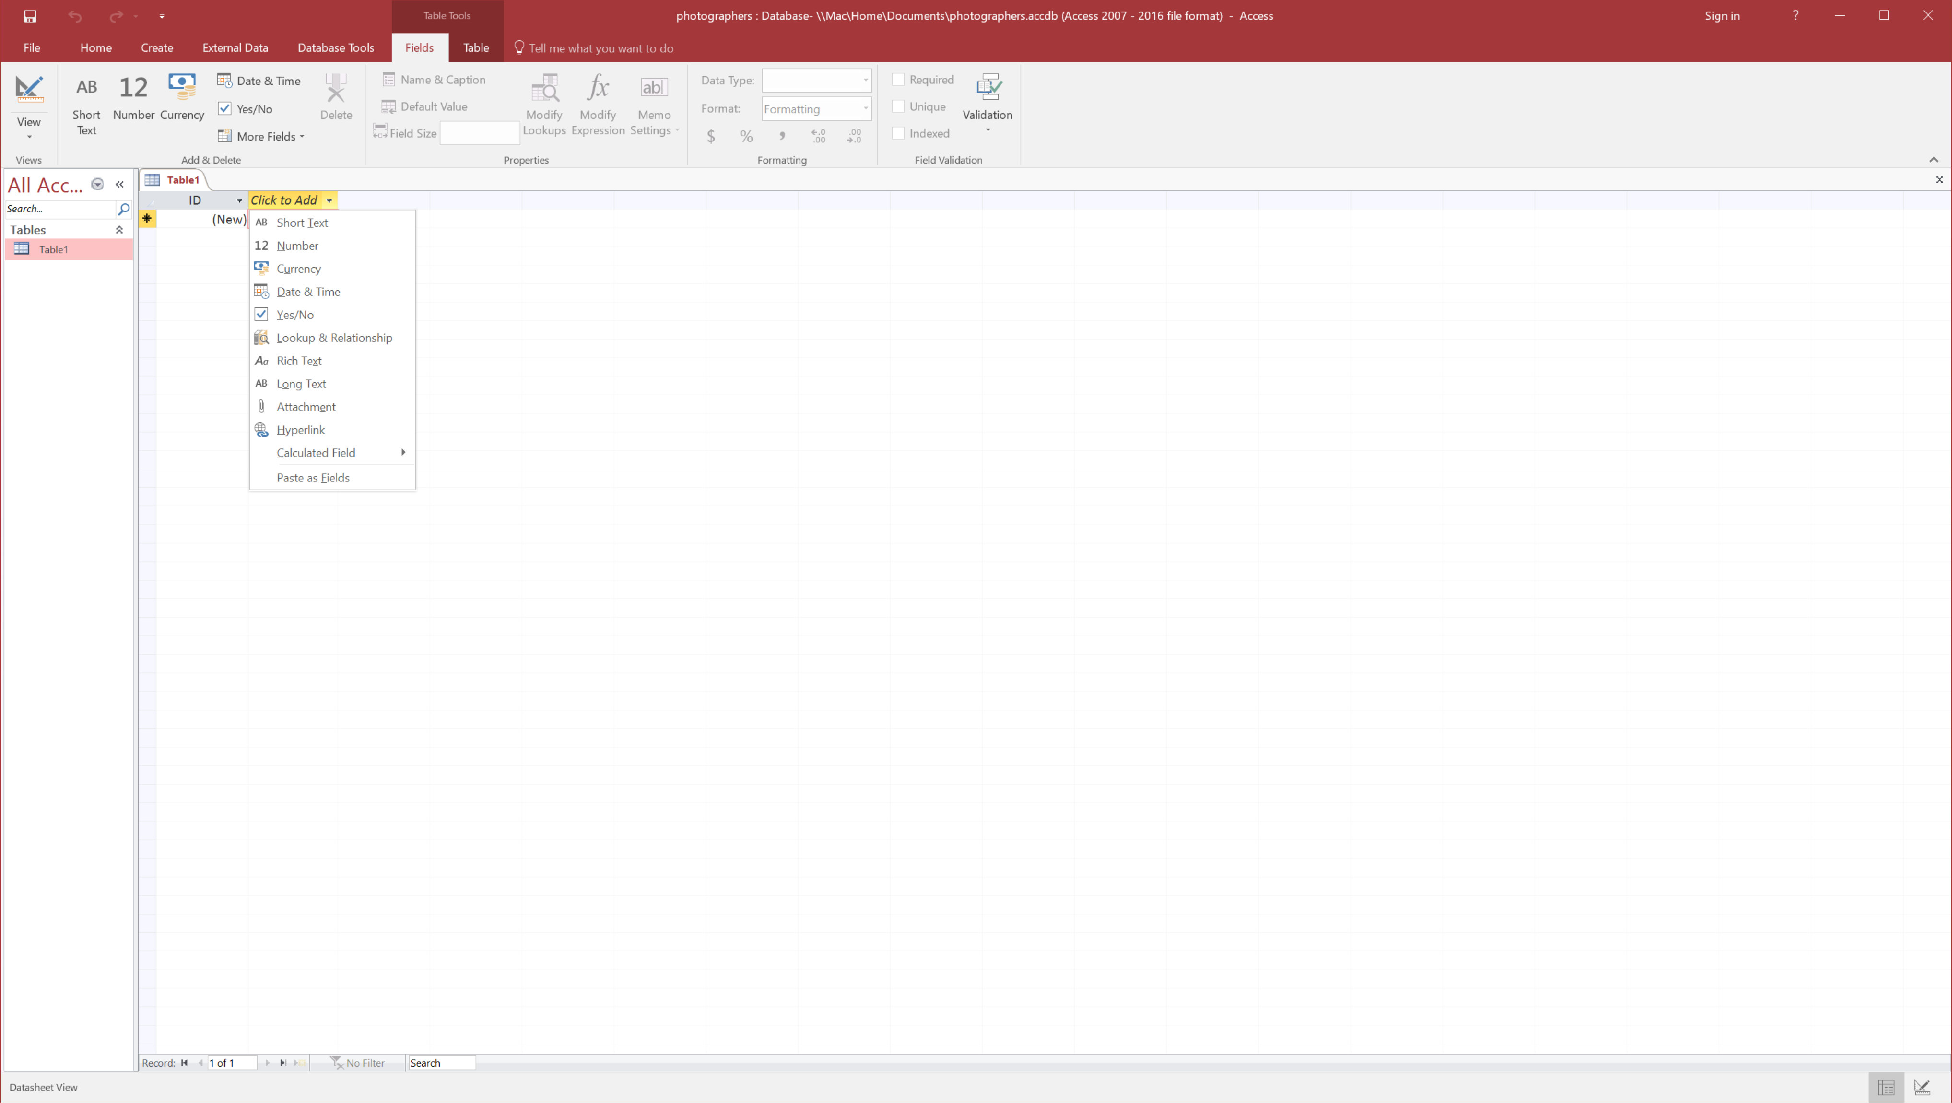
Click to Add: Text, Number, Date, etc.

Slide 7
That was stariting from
nothing…

Slide 8
Lets’ open a small DB…

Slide 9
Open Photographers DB

Slide 10
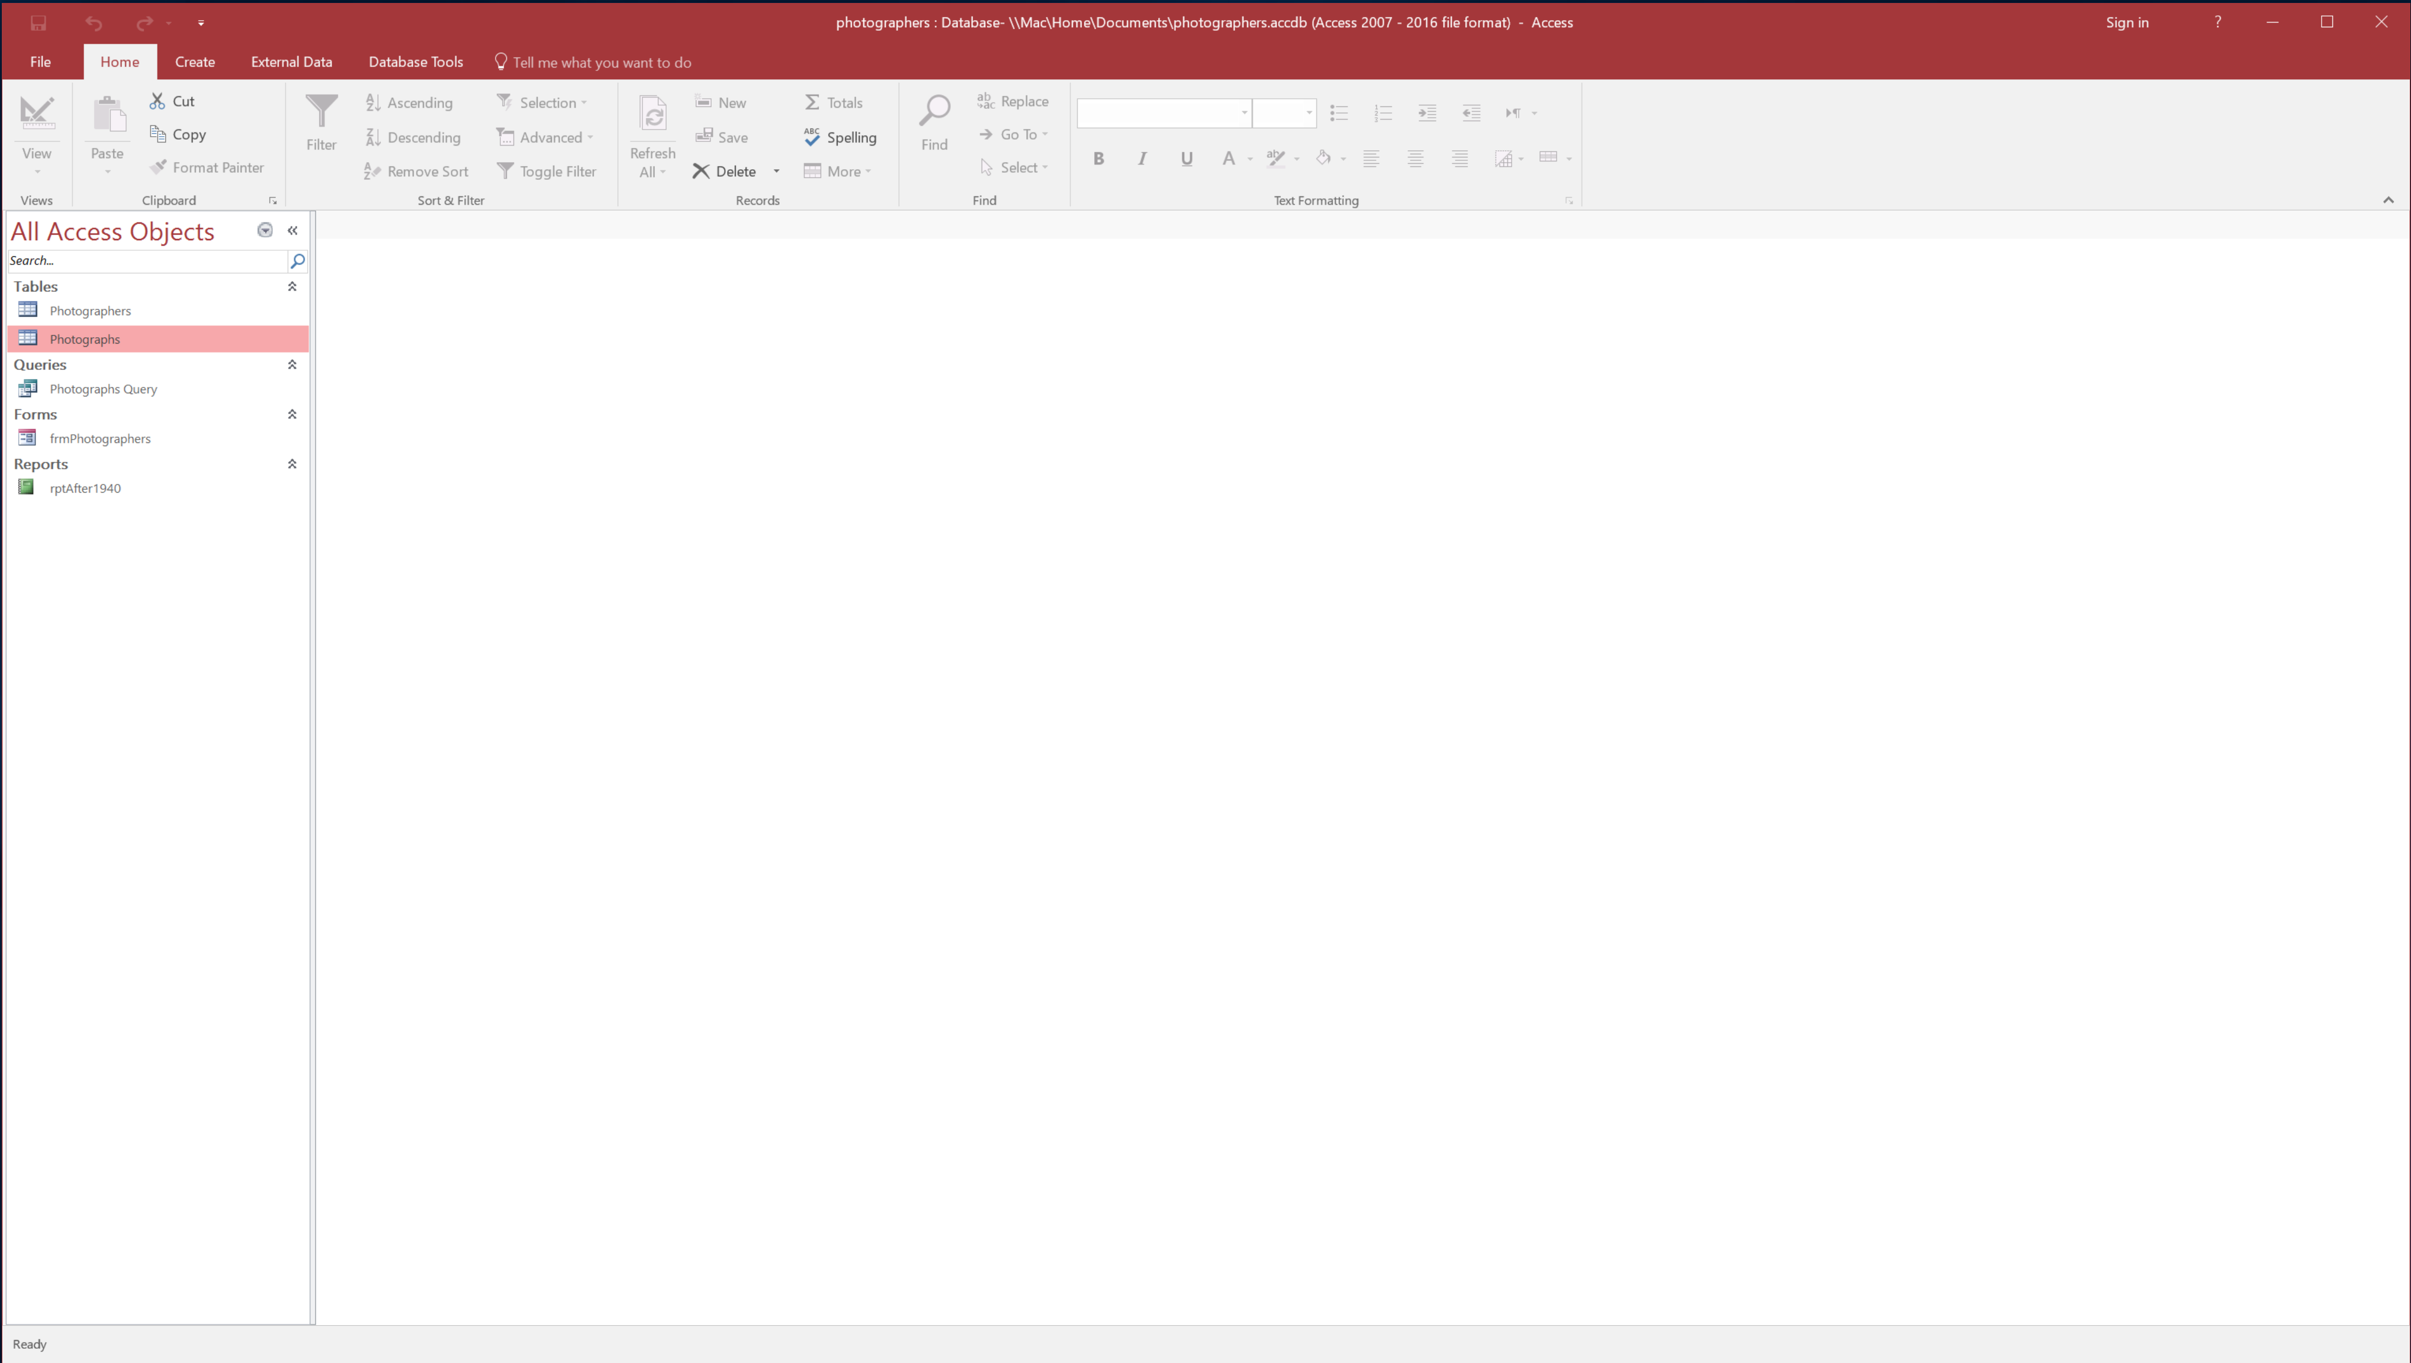
Home Tab: Photographers Database

Slide 11
Navigation Pane
Home Tab: Photographers Database

Slide 12
Let’s Check out the
Ribbons

Slide 13
Go Backstage
Home Tab Ribbon

Slide 14
Backstage View

Slide 15
Go Back to Ribbon Tabs
Backstage View

Slide 16
Clipboard
Sort and Filter
Records
Find
Text Formatting
Back to Home Tab

Slide 17
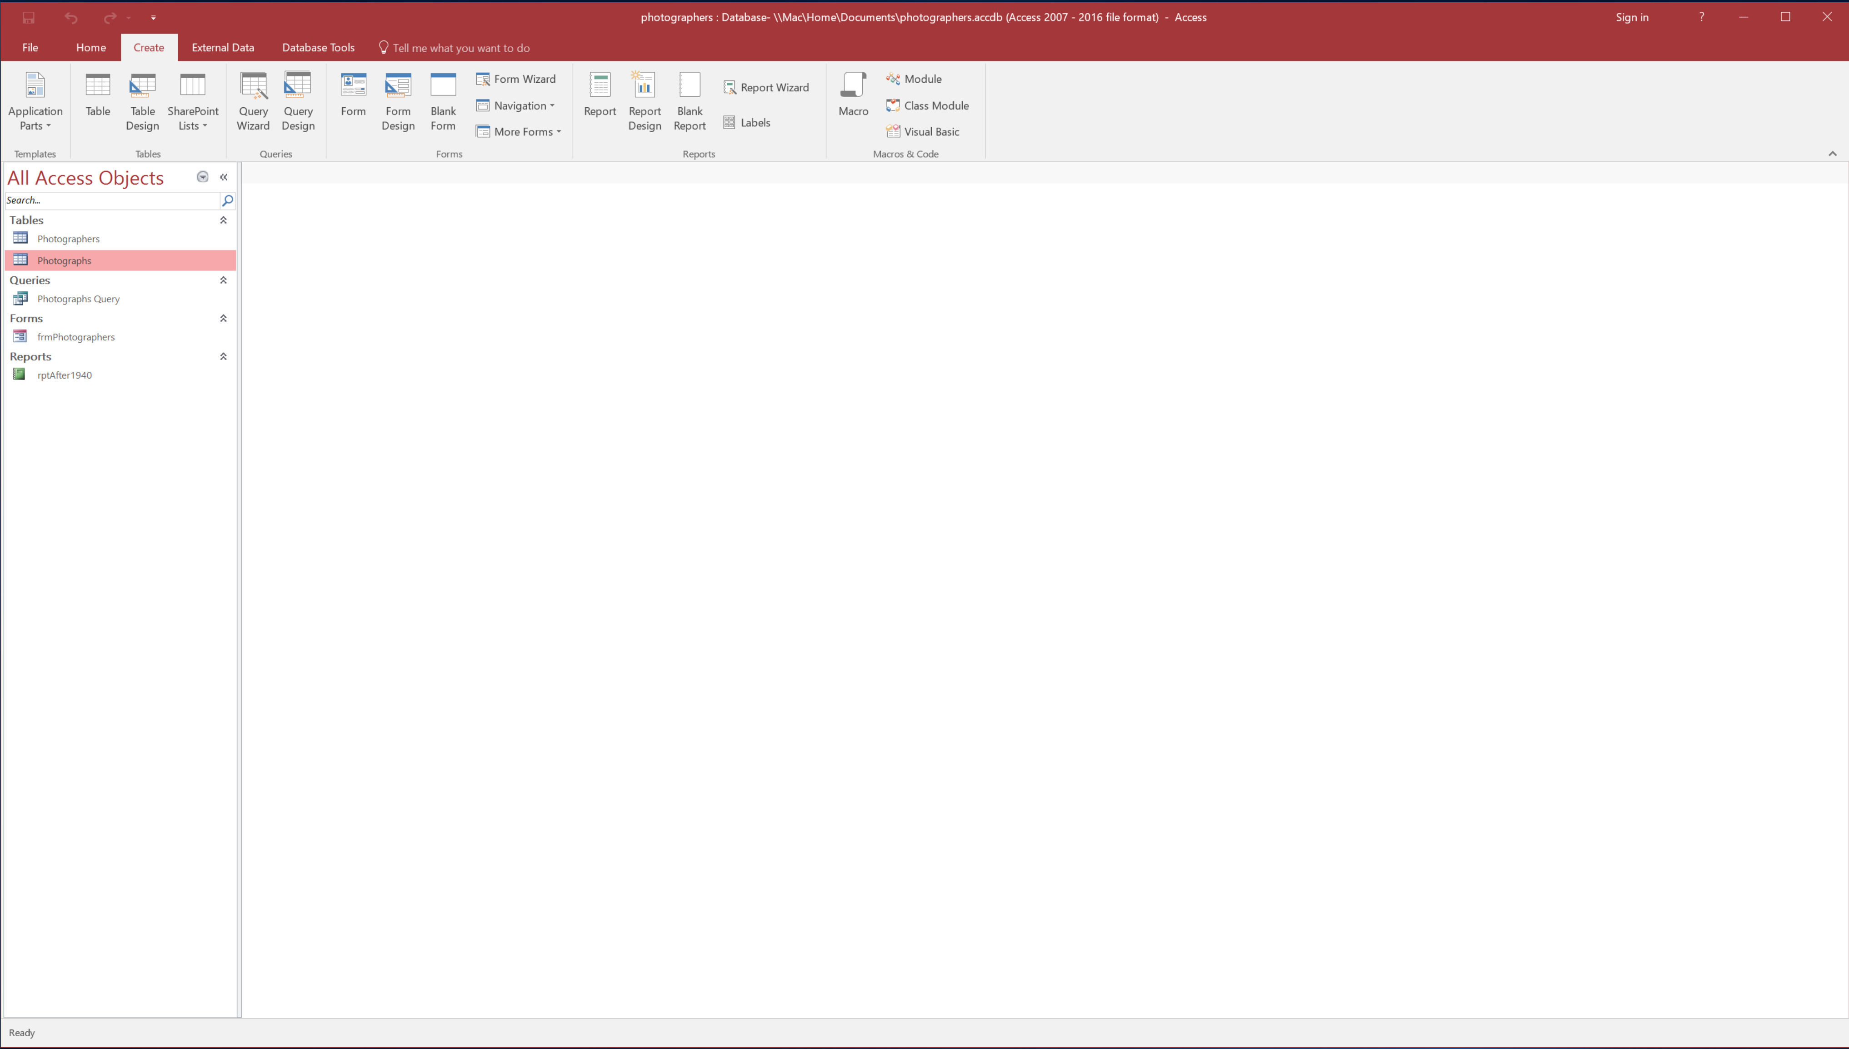
Create Tab: “Grand Central” for objects

Slide 18
Before next Ribbon let’s
talk about Objects

Slide 19
What are Objects?

Slide 20
Objects are
Templates
Tables
Wizards
Forms
Reports
Macros
Next: more on each object
Create Tab

Slide 21
Close
Relationship Tab
Tables
Queries
Relationships (not an object)
Forms
Reports
1.Tables
2.Queries
(Macros)
3. Forms
4. Reports
5. Macros
There are 5 Access Objects

Slide 22
End of Objects for now…
Next Ribbon is…

Slide 23
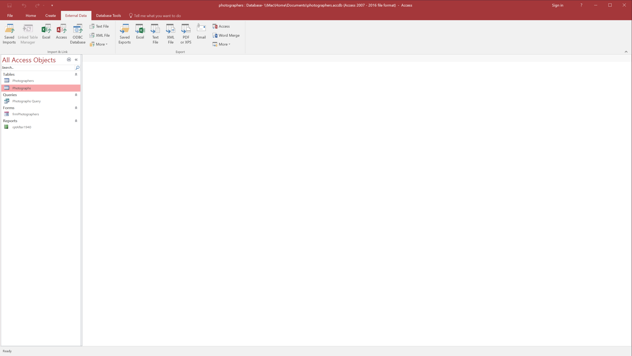
Data In and Out
External Data Tab Ribbon

Slide 24
for our purposes,
mostly used for getting to Relationships
Database Tools Ribbon

Slide 25
Tell me what you want to do (2016 only)
Tell Me Button… not really a tab or Ribbon

Slide 26
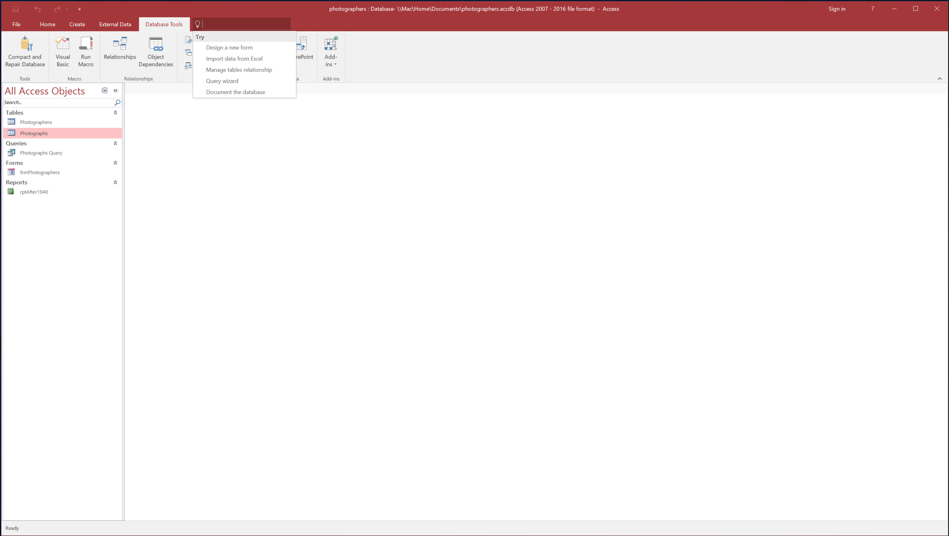
Tell me what you want to do
dropdown
Tell me

Slide 27
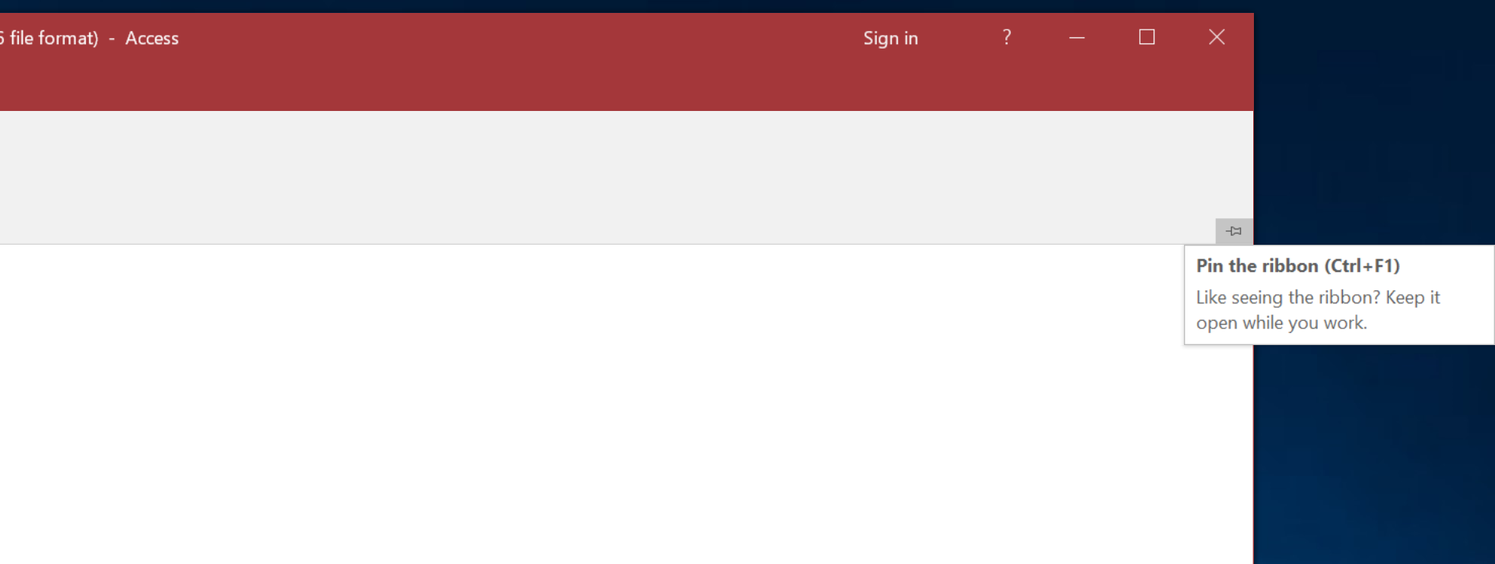
Hide/Pin toggle Ribbon

Slide 28
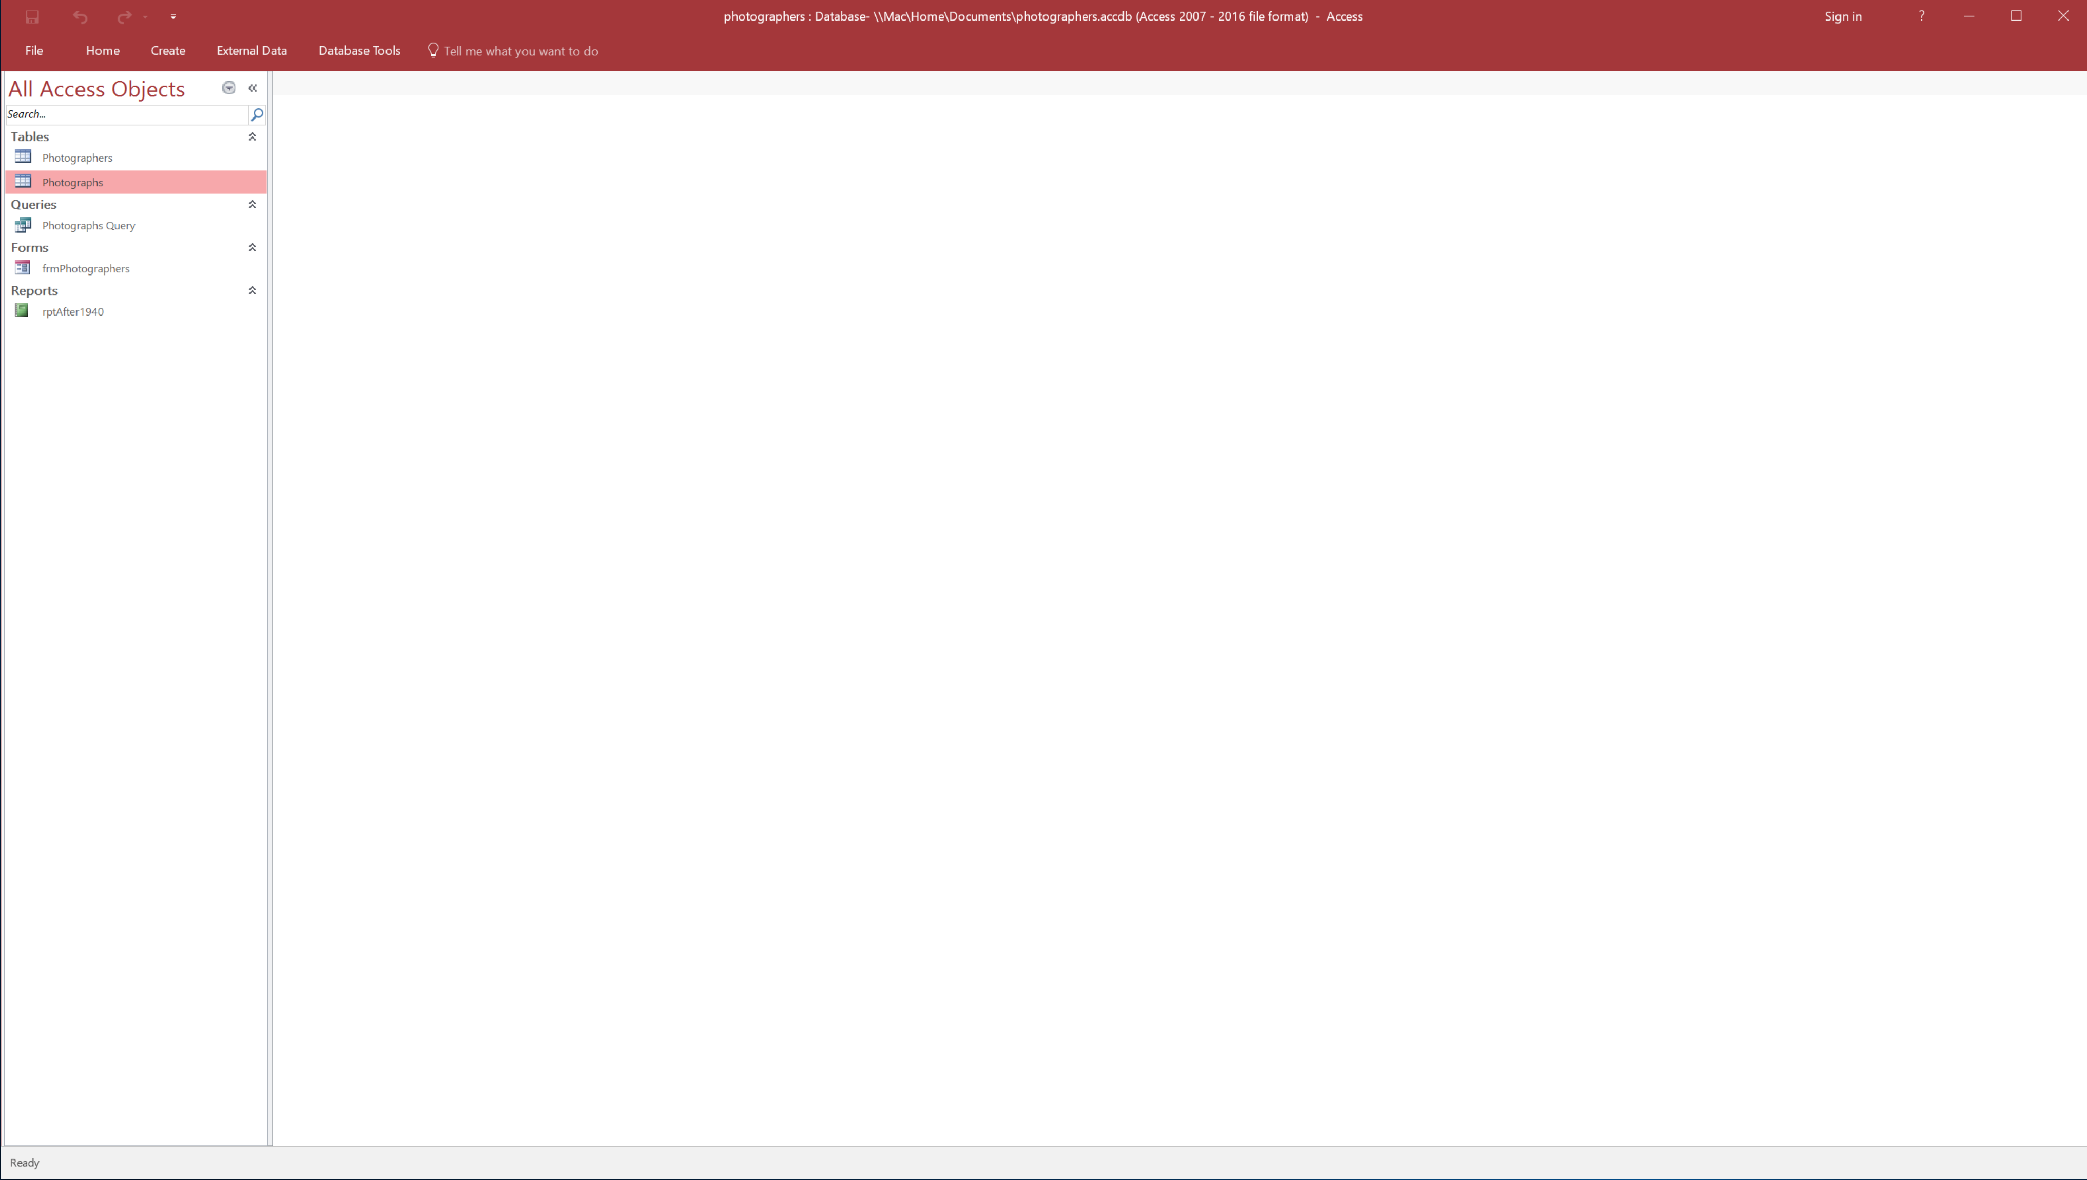
Hidden Ribbon

