Slide 1
INLS 623– MySQL Commands
Instructor: Jason Carter

Slide 2
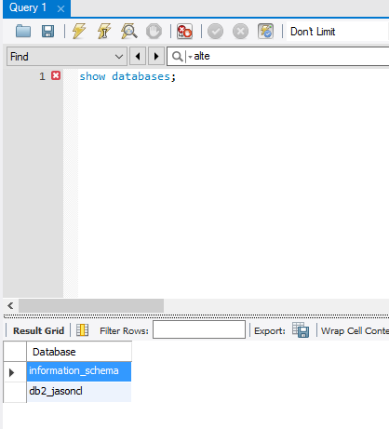
Databases
Show Databases;

Slide 3
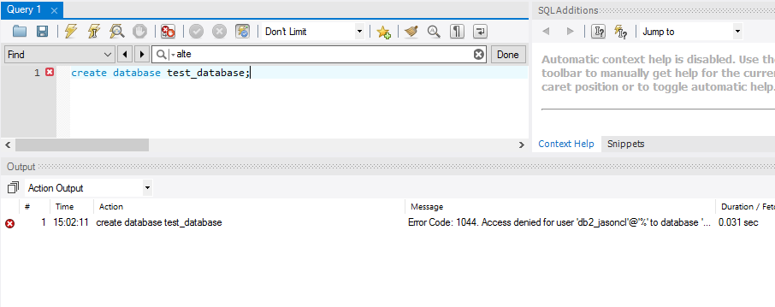
Databases
Create Databases;

Slide 4
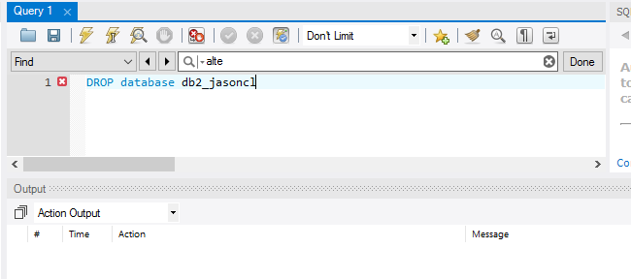
Databases
Drop Database db2_jasoncl
PLEASE DO NOT DO THIS!!!!!

Slide 5
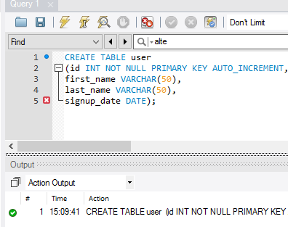
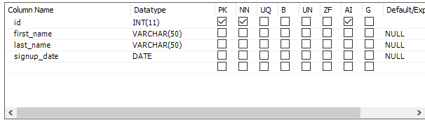
DATABASE TABLES
Creating a Table

Slide 6
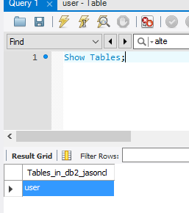
DATABASE TABLES
Show Tables;

Slide 7
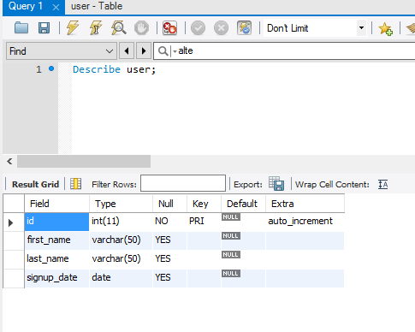
DATABASE TABLES
Describe user;

Slide 8
DATABASE COLUMNS
Add Column
Alter TABLE user ADD email VARCHAR(50);

Slide 9
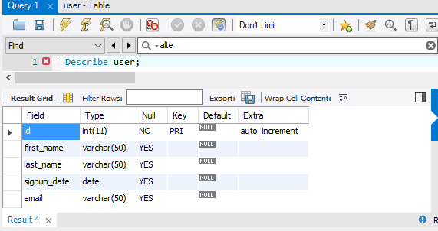
DATABASE COLUMNS: Add Column
Describe user

Slide 10
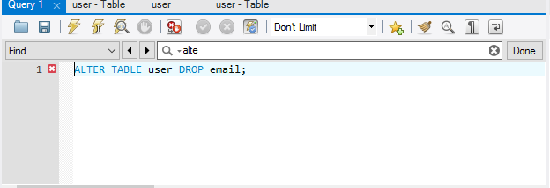
DATABASE COLUMNS: Remove Column
Remove Column
Alter TABLE user DROP email;

Slide 11
DATABASE COLUMNS: Remove Column
Describe user
NO EMAIL COLUMN

Slide 12
Foreign Keys
Two ways to create foreign keys
While creating the Table
After creating Table

Slide 13
Foreign Keys While creating Table
Foreign Key Constraint Has no Name

Slide 14
Foreign Keys While creating Table
Naming the Foreign Key Constraint

Slide 15
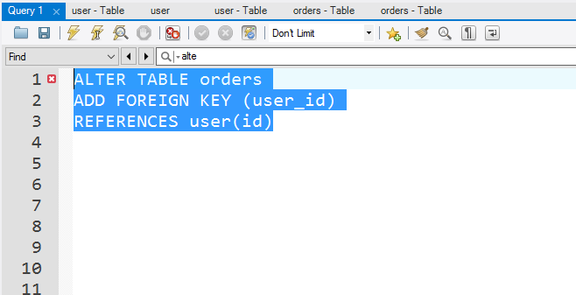
Foreign Keys After creating Table
Foreign Key Constraint Has no Name

Slide 16
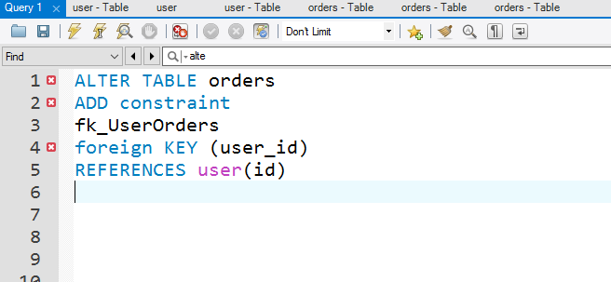
Foreign Keys While creating Table
Naming the Foreign Key Constraint

Slide 17
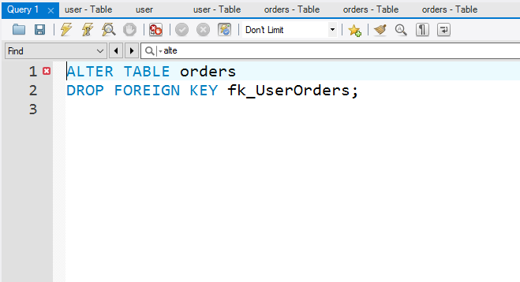
Foreign Keys: Removing

