Slide 1
The Internet
A network of networks

Slide 2
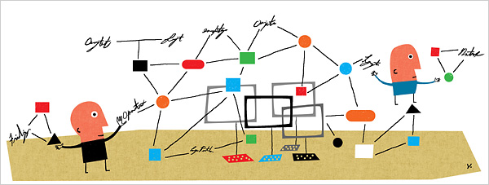
Based on standards
A network of networks

Slide 3
Remember the model
Application/process to process FTP, telnet, HTTP, SSH
Transport/host to host TCP
Internetworking
IP
Hardware – wires, hosts, routers

Slide 4
The TCP/IP Standard Model
Or run - Application/process to process FTP, telnet, HTTP, SSH
Transport/host to host TCP – to provide
Internetworking
IP – to provide
Hardware – wires, hosts, routers - use
protocols & standards are key

Slide 5
History ...
A RAND study led to the myth that the ARPANET was somehow related to building a network resistant to nuclear war
This was never true of the ARPANET, only the unrelated RAND study on secure voice considered nuclear war.
However, the later work on Internetting did emphasize robustness and survivability, including the capability to withstand losses of large portions of the underlying networks.

Slide 6
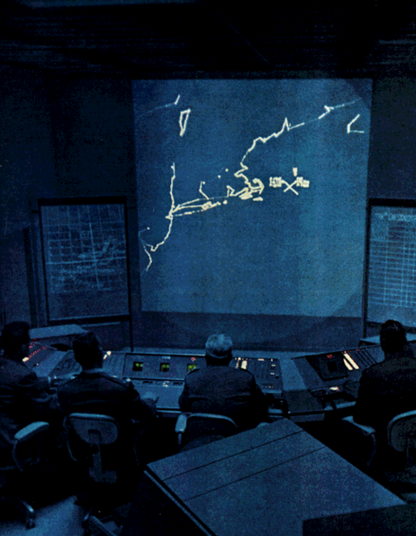
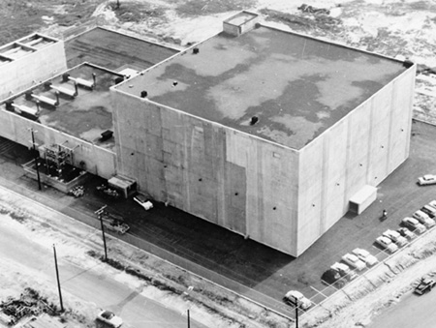
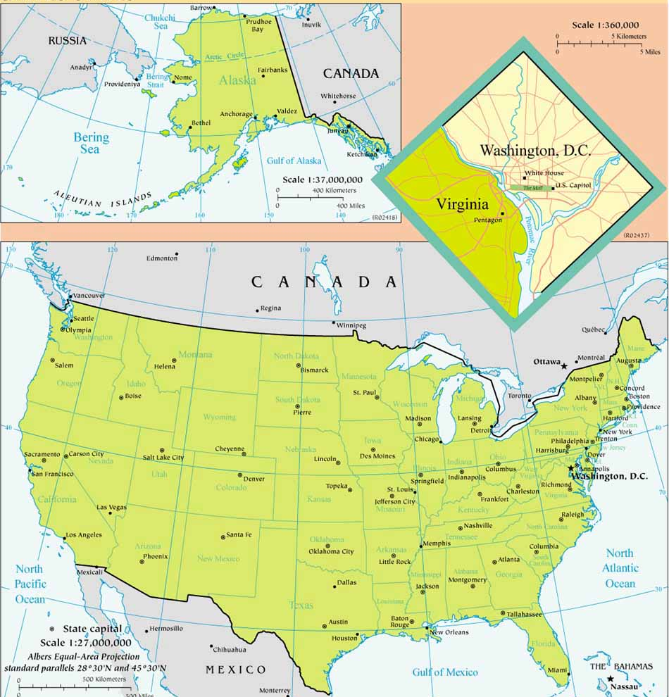
Remember Fort Lee AFS, Virginia?
life in a SAGE blockhouse

Slide 7
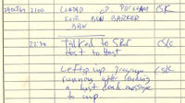
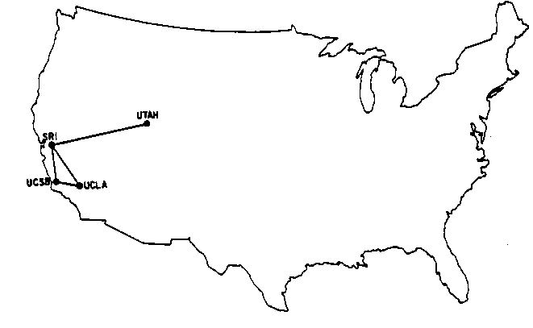
Advanced Research Projects Agency Net
ARPA managed (and funded) for 15+ years
a record of the first message ever sent over the ARPANET; it took place at 10:30PM on October 29, 1969.

Slide 8
Steady growth - 1972

Slide 9
Steady growth - 1977

Slide 10
Steady growth - 1980

Slide 11
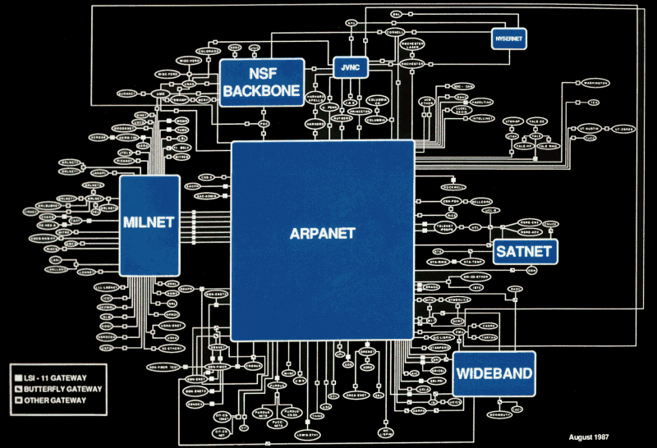
NSF took over - 1986
Give the technology to the masses,
not just to academia
NSF funded the “backbone” for 7-8 years
Connectivity proliferated

Slide 12
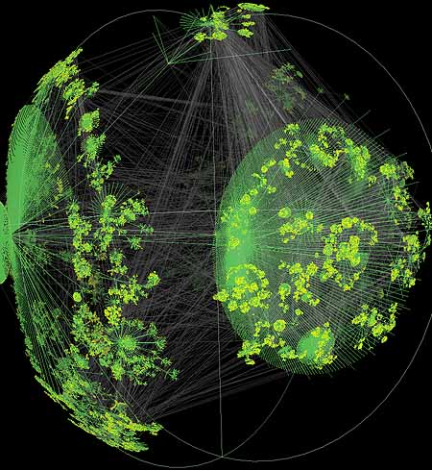
1994 - NSF ceased direct support
Now funded by “the market”, government, industry
Growth 2000-2007

Slide 13
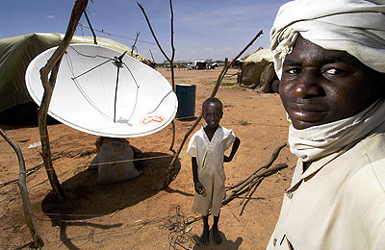
2009 – user growth expanding
More users in China than in USA

Slide 14
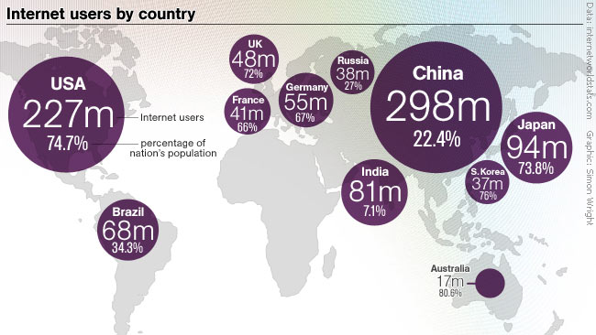
2009 – user growth expanding
More users in China than in USA

Slide 15
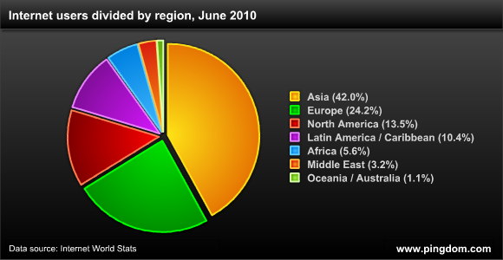
2009+ – connectivity connects
Almost no limit to usages

Slide 16
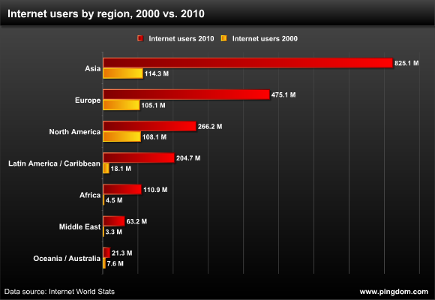
2009+ – connectivity connects
Almost no limit to usages

Slide 17
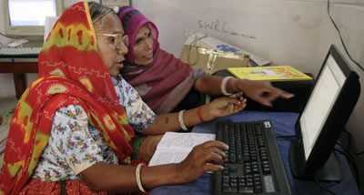
2009+ – connectivity connects
Almost no limit to usages

Slide 18
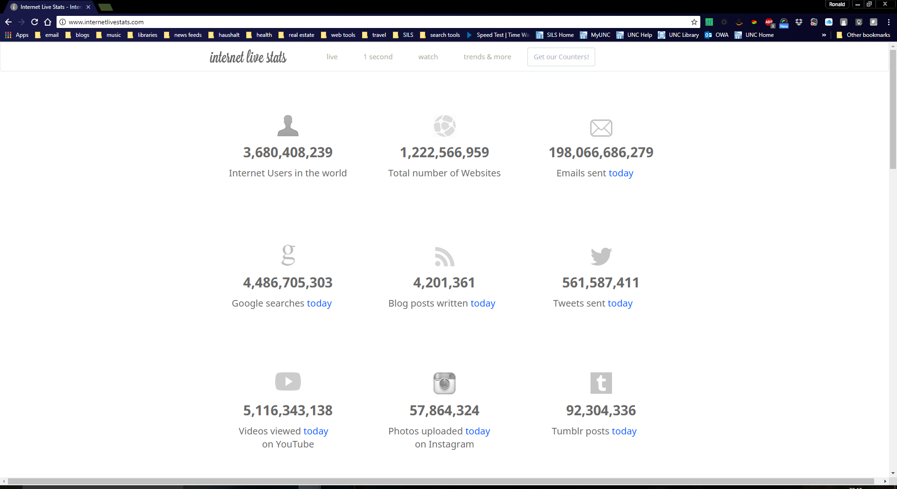
What’s going on now?

Slide 19
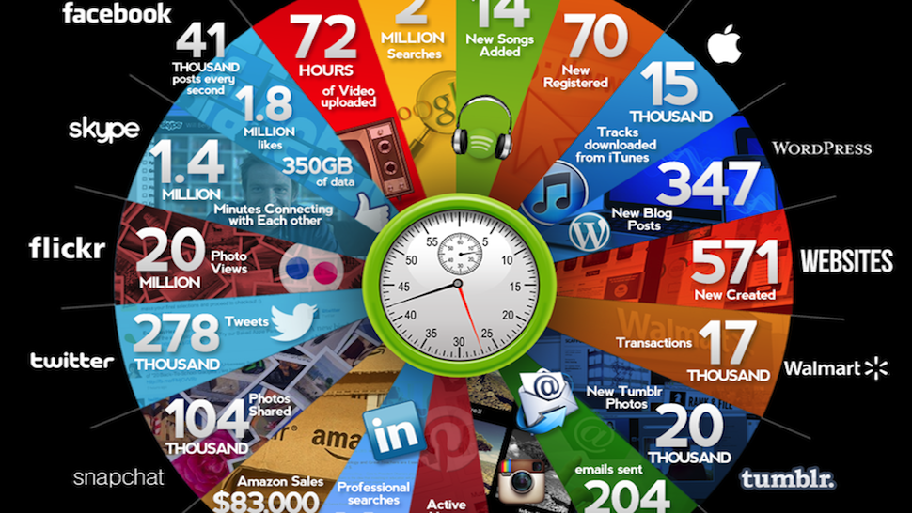
What’s going on now? Lots of stuff

Slide 20
But why did it grow so?
Access to information through Standards

Slide 21
Some of these are key
Transport and application layer protocols (i.e. TCP, HTTP, FTP) ensure that the sender and receiver are speaking the same language, and that the communication can be interpreted
Or run - Application/process to process FTP, telnet, HTTP, SSH
Transport/host to host TCP – to provide
Internetworking
IP – to provide
Hardware – wires, hosts, routers - use
protocols & standards are key

Slide 22
Servers, again
Servers can be physical computers
Servers can also be software applications
One server (physical computer) can run many servers (software applications) at a time
For example, Isis has several:
listproc
web
ftp
mail
address book

Slide 23
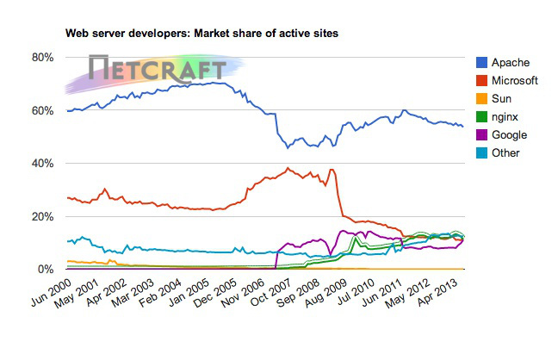
Servers, again – over time
Servers can be physical computers

Slide 24
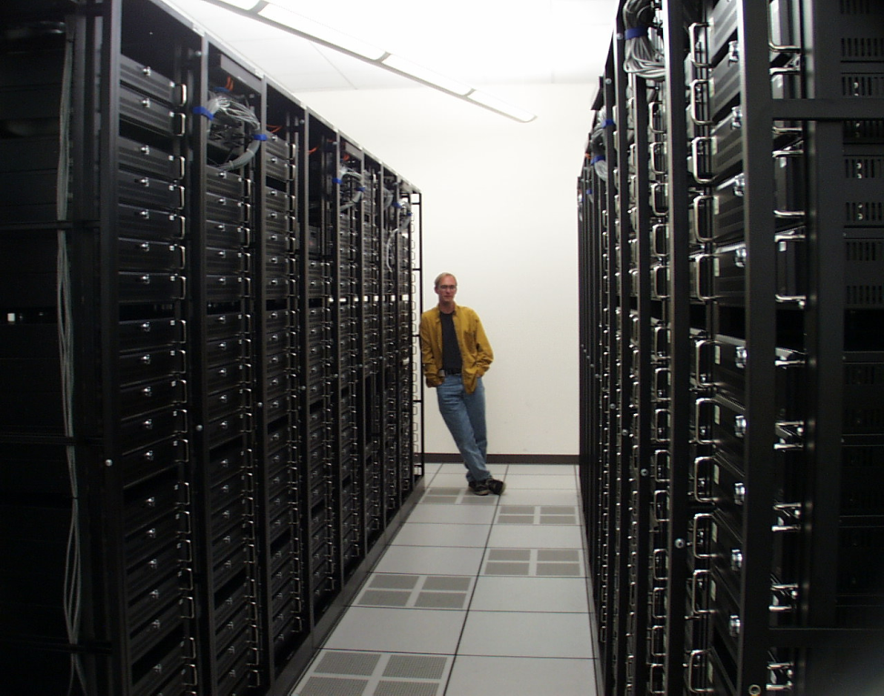
Servers, again
Servers can be physical computers
One of Google’s server farms

Slide 25
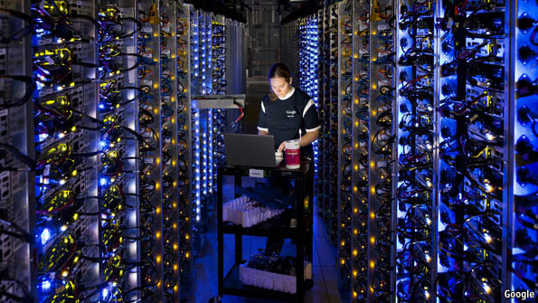
Servers, again
Servers can be physical computers
One of Google’s server farms
How does the host application know when the data being received is for it?

Slide 26
Ports
Each software server listens on a different ‘port’
Some common ports are:
web (80)
FTP (20,21)
telnet (23)
smtp (25)
The combination of IP address and port number dictates where the data goes
Who assigns ports?

Slide 27
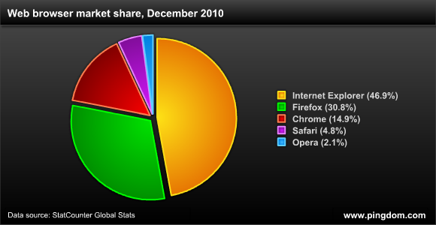
Clients, again
For any given application, there can be many clients
People are more familiar with clients, since they interface with them directly
Examples of clients are:
browsers
FTP clients
Email clients

Slide 28
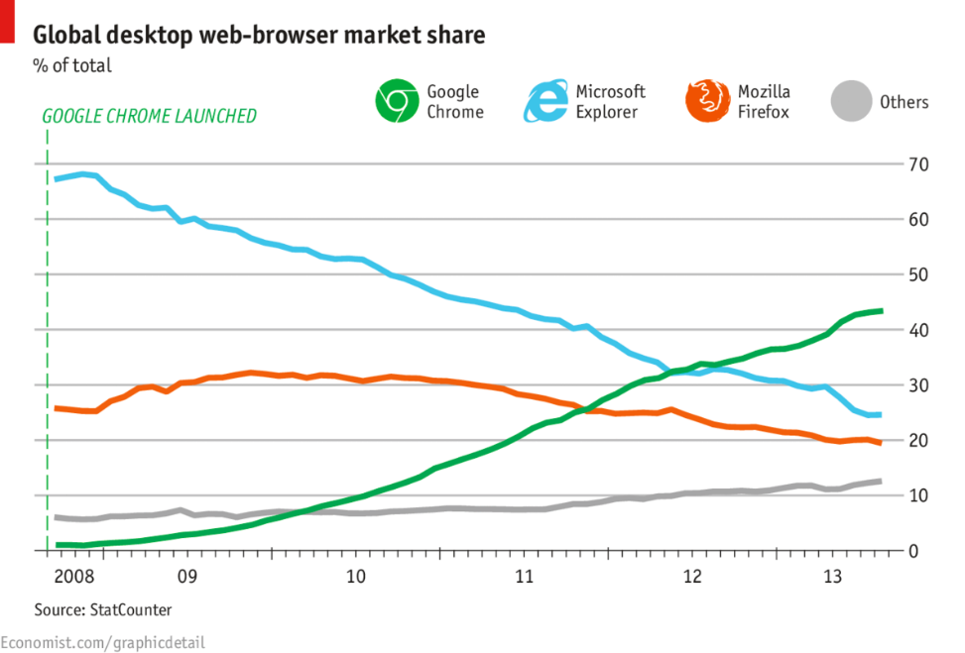
Clients, again
For any given application, there can be many clients
People are more familiar with clients, since they interface with them directly
Examples of clients are:
browsers
FTP clients
Email clients

Slide 29
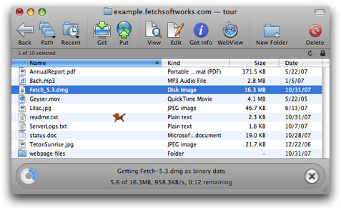
Clients, again
For any given application, there can be many clients
People are more familiar with clients, since they interface with them directly
Examples of clients are:
browsers
FTP clients
Email clients

Slide 30
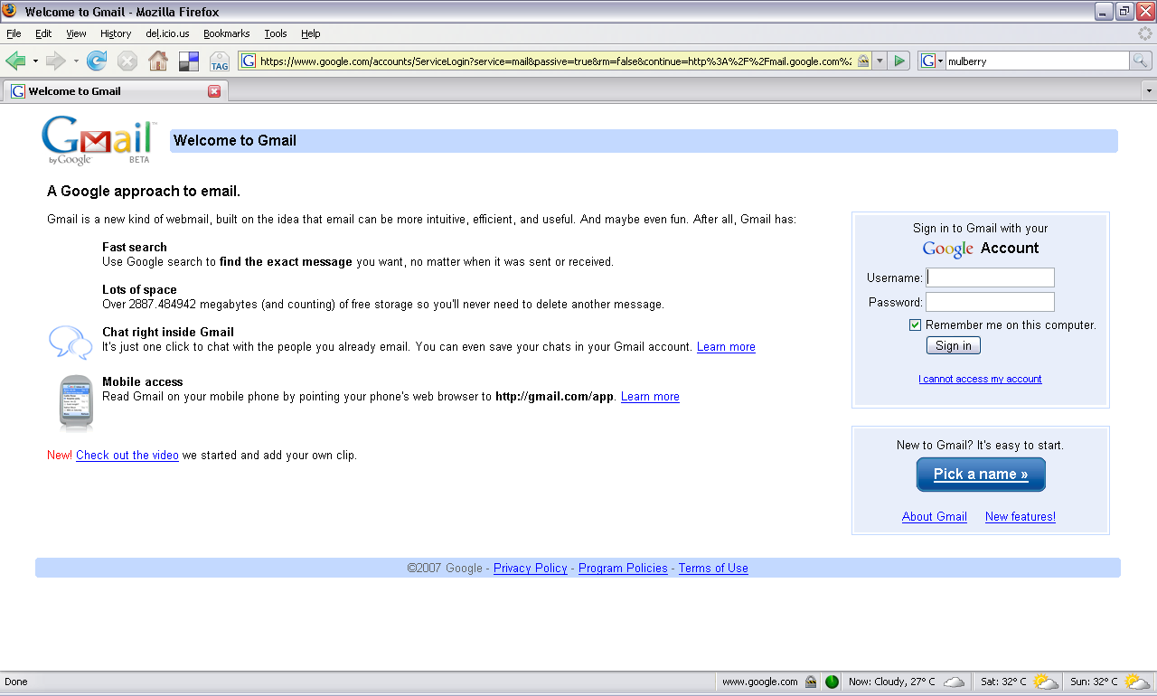
Clients, again
For any given application, there can be many clients
People are more familiar with clients, since they interface with them directly
Examples of clients are:
browsers
FTP clients
Email clients

Slide 31
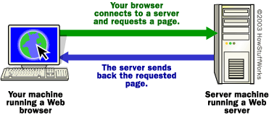
Let’s use the web as an example
The client (your web browser) sends a request for a URL to a server
The server finds the requested page and sends it back to the client
The protocol used is called HTTP (HyperText Transfer Protocol)
Many different types of clients, and many different types of servers, but all work the same

Slide 32
How do you know what to ask for?
there is only one Web naming/addressing technology: URIs.
Uniform Resource Identifiers (URIs, aka URLs) are short strings that identify resources in the web: documents, images, downloadable files, services, electronic mailboxes, and other resources.
According to the W3C

Slide 33
Anatomy of a URL [Uniform or Universal Resource Locator]
http://www.unc.edu/~onyen/pwd
Protocol
Host port name
Domain name
Item requested
http://
www.
unc.edu/
~onyen/pwd
Fully qualified hostname

Slide 34
URLs go to file locations: IP addresses go to servers
http://www.unc.edu/~onyen/pwd
Host port name
Item requested
Host IP address
~onyen/pwd
http://193.145.50.56
The alternate site for Information Visualization is in Spanish. The server will return this default root page when a request is made by IP address. A URL allows the client to request a specific page on the server, such as the English version.

Slide 35
Anatomy of a URL [Uniform or Universal Resource Locator]
http://opal.ils.unc.edu/~onyen/pwd
Protocol
Host port name
Domain name
Item requested
http://
opal.ils.
unc.edu/
~onyen/pwd
Fully qualified hostname
But how does one find that name on the Internet?

Slide 36
Domain Name System
an Internet service that translates domain names into IP addresses.
Because domain names are alphabetic, they're easier to remember.
The Internet however, is really based on IP addresses.
Every time you use a domain name, therefore, a DNS service must translate the name into the corresponding IP address.
The DNS system is, in fact, its own network.
If one DNS server doesn't know how to translate a particular domain name, it asks another one, and so on, until the correct IP address is returned.

Slide 37
Naming vs. Addressing
Alice.com
129.86.8.90
Bob.edu
129.86.8.91
Names are tied to IP addresses

Slide 38
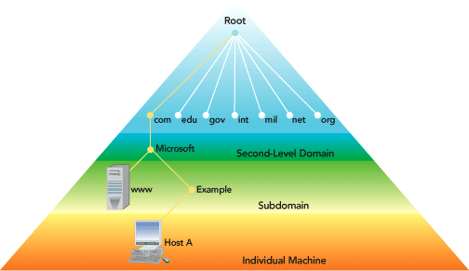
How does Alice find Bob?
“Bob.edu” is a name, not an address – the address could be: “152.2.81.1”
An Internet Address is
4 byte (32 bit) number
4 billion hosts possible (in theory, but...)
Alice.com
129.86.8.90
Bob.edu
Doled out by Internet Assigned Numbers Authority
ensures “adjacency”, no clashes
129.86.8.91
Names are tied to IP addresses

Slide 39
Why Names?
One could use 207.46.130.149 instead of www.microsoft.com…
IP addresses for configurability and administrative control,
but names for human memory
To connect the two, we use …

Slide 40
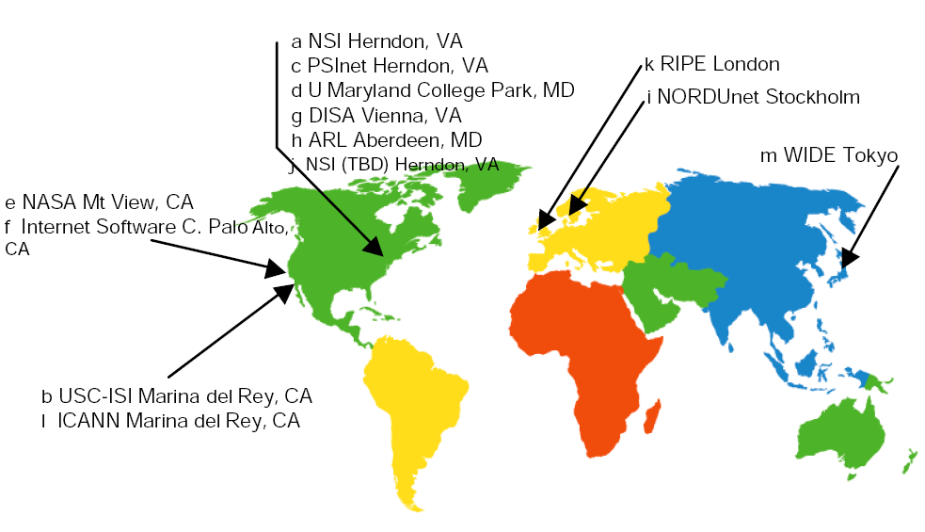
The Domain Name System (DNS)
Interspersed all over the internet are specialized servers that translate names into IP addresses
A DNS server stores the name/address pair
Bob.edu is a domain name
Domain Name System is hierarchical

Slide 41
DNS Example
opal.ils.unc.edu
Host name
Top Level Domain
Specificity
Most
Least

Slide 42
A Sample DNS Hierarchy
opal.ils.unc.edu
Admin zones
edu
unc
virginia
cs
ils
its
...
...
ruby
...
denali
opal

Slide 43
The Top level DNS hierarchy

Slide 44
Let’s see how it works
Alice.com
129.86.8.90
Bob.edu
129.86.8.91
Names are tied to IP addresses

Slide 45
Suppose Alice talks to Bob ...
Alice creates a message on his client and then the TCP/IP system looks for a
Hi, Bob, what’s up?
Domain Name Server
Alice.com
Bob.edu

Slide 46
Name Resolution in DNS
Alice’s computer
Bob.edu??
DNS Server
1. Resolve Name
Alice.com Bob.edu
2. Send Message
Hi, Bob, what’s up?
TCP/IP
Another explanation
Hi, B
ob
, W
hat’
s up?
To 129.86.8.90

Slide 47
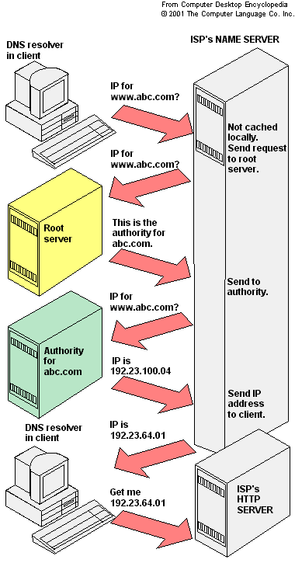
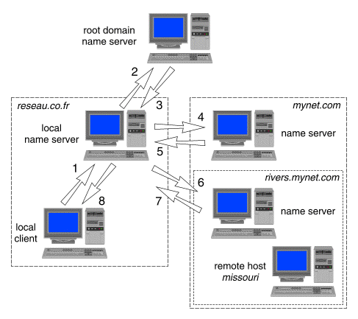
Name Resolution in DNS two other schematics
Another explanation

Slide 48
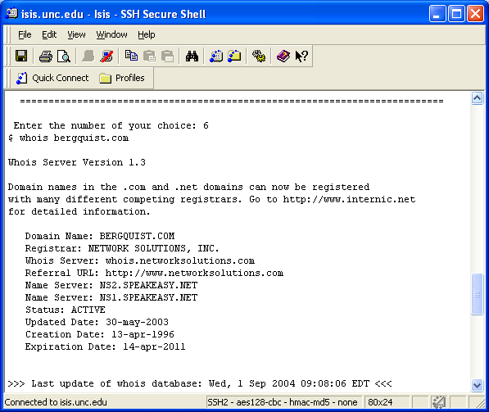
How do we find these servers and these locations?
We can use our tools, such as traceroute
Either using Unix tools on our server

Slide 49
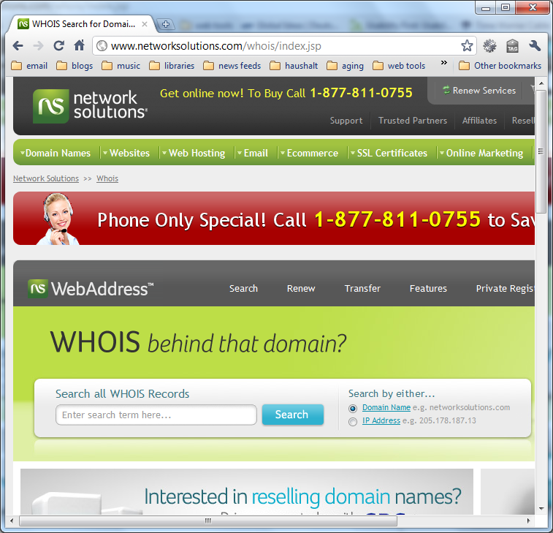
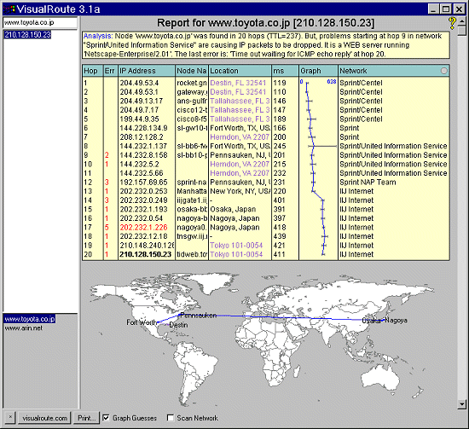
How do we find these servers and who is behind these locations?
We can use our tools, such as
whois
traceroute
or web based tools

Slide 50
but that’s for you to try out
On your own

