Slide 1
Basic Queries
Using the QBE Grid (Query by Example)

Slide 2
What is A query?
A query is a request of the database, the result of which is a new table.
a query selects records from one or more tables based on user-specified criteria
so a query is a way to ask questions of the database and your query design tells Access exactly what data to retrieve

Slide 3
When you run a query…
it checks for the latest data in your database and
the data returned by a query is called a recordset or a dynaset
You can browse through the recordset, select from it, sort it, and print it.
Typically, the recordset you produce with a query isn't saved, but the query structure and criteria you used to get the results are saved

Slide 4
Queries make it easy to:
combine data from multiple tables into a single view
summarize data
select and sort data
add, update, or delete large groups of records

Slide 5
The key to creating queries
read the question out loud and pull the elements of the question into the query design
If you are a tactile learner, you may want to get a few highlighters, print out a copy of the query and mark it up
Or do the same without printing it out: copy the query to Microsoft Word and digitally highlight the key words to better determine which tables and fields you need

Slide 6
Query Types
Select Query: extract specified data from tables
Parameter Query: a select query that allows the user to specify selected parameters at the time of each query.
All the Queries we will do in the Access assignment will be Select and/or Parameter Queries.
Crosstab Query: summarizes data and presents it in easy-to-read format
Action Query: makes changes to many records in a query at once
  Make-Table Query: creates a new table with data from existing tables
  Delete Query: deletes rows from a given table or tables
  Append Query: adds additional rows to the end of a given table
  Update Query: makes changes to one or more rows in a table

Slide 7
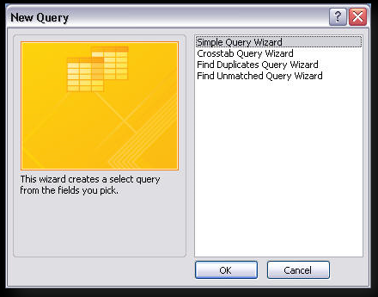
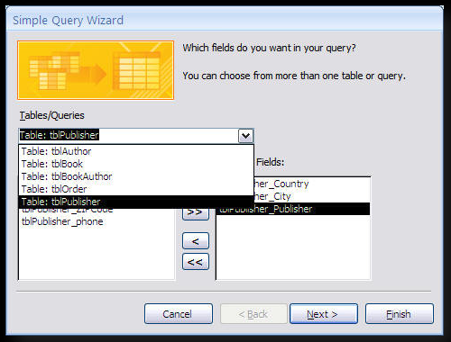
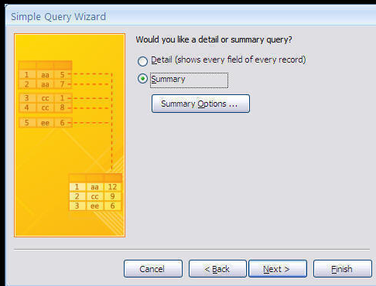
creating select queries USING THE Query wizard
The Wizard can do simple queries by asking you questions and creating a query based on your answers.
Summaries include:
Totals
Averages
Other summaries
If the fields include a number field, you may choose
Detail or summary

Slide 8
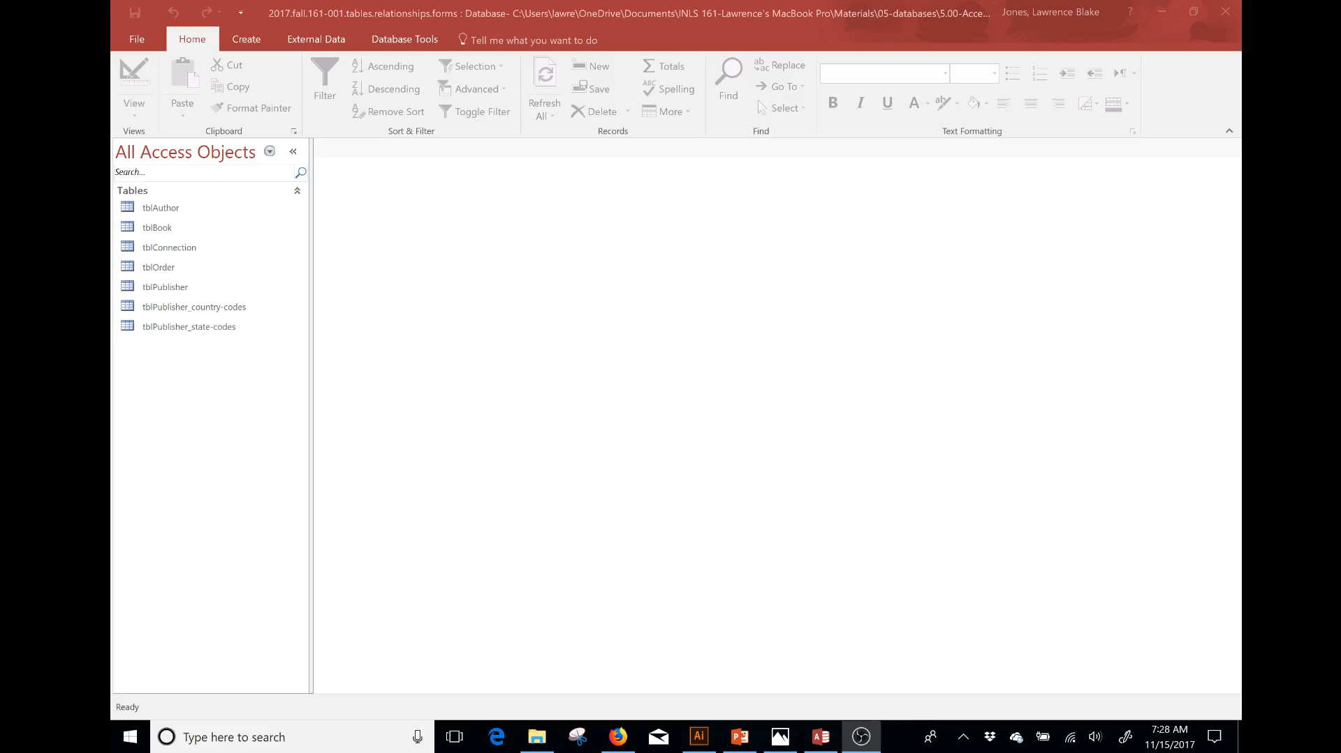
Adding Fields using the Query Design Window; step1
Create > Query Design > Show Table Popup > Add Tables > Close
This is a video.
Click to see the
Progression.
(no Sound)

Slide 9
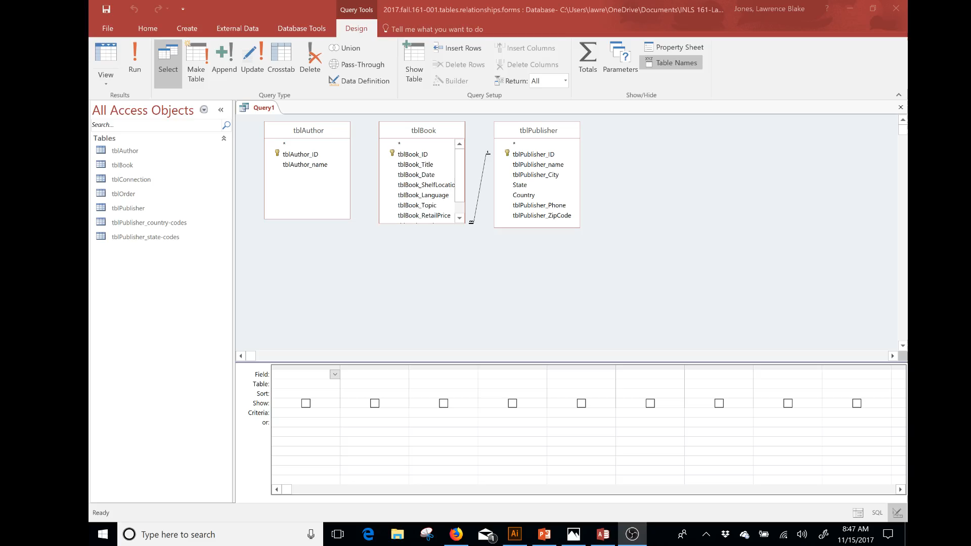
Adding Fields to the QBE Grid; step 2
This video
has narration.

Slide 10
Order of Columns is important
Order columns from left to right horizontally per instructions, then sort each column vertically per instructions (sorts are two-dimensional) Remember to do both to get full credit.
Ascending
A
B
C
D
Left
to
right
Can change any,
Some, or all to
Descending
$30
$20
$10
$0
I will demo how this works during both query classes and the final lab

Slide 11
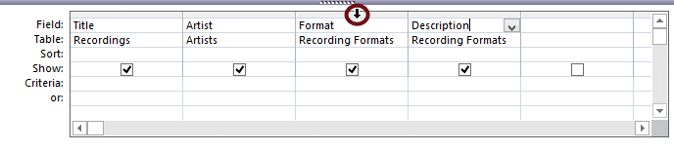
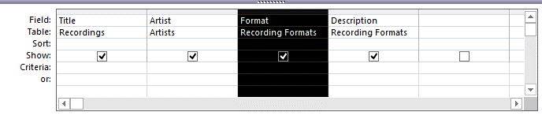
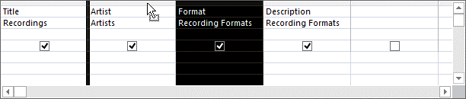
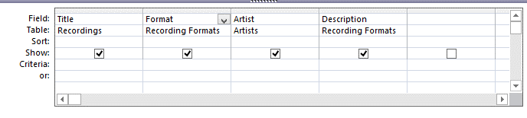
If you need to move a column
Hover over the gray bar at the top of the column and wait for arrow.
Click. Click and Drag
A Bold separator mark will guide you.
Release where you want it.
Demo is in this video (starts at1:34).

Slide 12
Showing Columns
You may need to include a column to obtain a result, but you may be asked to NOT SHOW that column (the column is needed to select data, but we don’t need to see the label). The “Show: box” is selected by default, so be sure to turn it off if the directions say to not show it.
Uncheck the show box, if you are not to list data in the result

Slide 13
Criteria row
This is where you put your criteria for pulling specific data.
“NC”
If you type NC in the box….
Access will wrap it in double quotes
This will only pull Publishers
With data that
EXACTLY matches NC
You do not always have to put Like before your search criteria.
For example, in this simple search “NC” yields the same data as Like “NC”

Slide 14
Criteria options overview; more detail to follow
Like "oxford" exact match
Like "*ford" ends with ford (one wildcard at start)
Like "ox*" begins with ox (one wildcard at end)
Like "*" begins with anything (only a wildcard)
Greater than: > 10
Less than: < 250
Boolean: > 1990 and <1999 (More on Boolean on following slides)
Find all empty fields: is NULL
Find all fields with data: is not NULL
Parameter [ ]
Totals
calculations

Slide 15




Boolean Criteria in general
imagine a group of various-sized dogs at a dog park; some have collars, some don't
Small dogs AND collars: 3 total
no collar
Small dogs OR collars: 5 total

Slide 16
Boolean Criteria in Access
Boolean "and" values go on the Criteria Line
Boolean "or" values go on the OR line.
(Depending on the syntax or needs of a specific Query,
you may need to type Or on the criteria line; I will demo this in class)

Slide 17
Wild CarD = asterisk symbol (*) = (shift+8)
Wild card(s) is(are) needed for situations were the search term is “part” of the data. For example, 51 rows of the Publisher records have university in the name of the publisher.
“university”
If we simply type in university, then 0 records will be returned
(If you added a publisher named exactly University,
then it would work; it would pull that single record)

Slide 18
Wild CarD = asterisk symbol (*) = (shift+8)
“*university”
will give us all values that
End in university
“*university”

Slide 19
Wild CarD = asterisk symbol (*) = (shift+8)
“university*”
will give us all values that
Start with university
“university*”

Slide 20
Wild CarD = asterisk symbol (*) = (shift+8)
“*university*”
will give us all values that
contain university
“*university*”

Slide 21
Parameters
A parameter query displays a dialog box when it runs, prompting the user to enter information to use as criteria for the query. What you type in between brackets [ ] becomes a pop-up dialog box. Wild card characters outside of the brackets determine how the parameter is processed.
Like [enter first letter(s) of last name] & "*"
Like "*" & [enter last letter(s) of first name]
How would you write a parameter
query to prompt to enter any "part" of a name?
You just may need to do this for one of your more complex queries!

Slide 22
Overview:
We covered most of what you need for all of your queries, except totals and built calculations.
I will demo the totals and calculations in the complex queries class, and again in the access lab
End of this presentation

