Slide 1
Design and Evaluation

Slide 2
Overview
Formal Evaluations of Visualization Techniques
Design (review)
Evaluation/Critique of Visualizations (what we’ve been doing all semester)

Slide 3
Formal Evaluations of Visualization Techniques

Slide 4
Evaluating Visualizations
Empirical:
  Usability Test
    Observation, problem identification
  Controlled Experiment
    Formal controlled scientific experiment
    Comparisons, statistical analysis
Analytic:
  Expert Review
    Examination by visualization expert
  Heuristic Evaluation
    Principles, Guidelines
    Algorithmic

Slide 5
Usability test vs. Controlled Experiment
Usability test:
    Formative: helps guide design
    Single UI, early in design process
    Few users
    Usability problems, incidents
    Qualitative feedback from users
Controlled experiment:
    Summative: measure final result
    Compare multiple UIs
    Many users, strict protocol
    Independent & dependent variables
    Quantitative results, statistical significance

Slide 6
Controlled Experiments
(a refresher)

Slide 7
What is Science?
Measurement
Modeling

Slide 8
Scientific Method
Form Hypothesis
Collect data
Analyze
Accept/reject hypothesis
How to “prove” a hypothesis in science?
    Easier to disprove things, by counterexample
    Null hypothesis = opposite of hypothesis
    Disprove null hypothesis
    Hence, hypothesis is proved

Slide 9
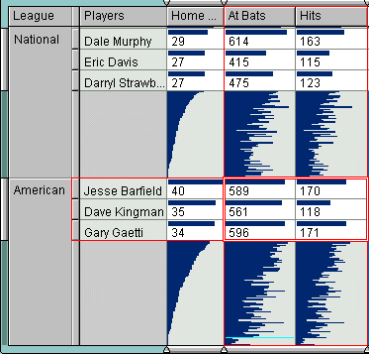
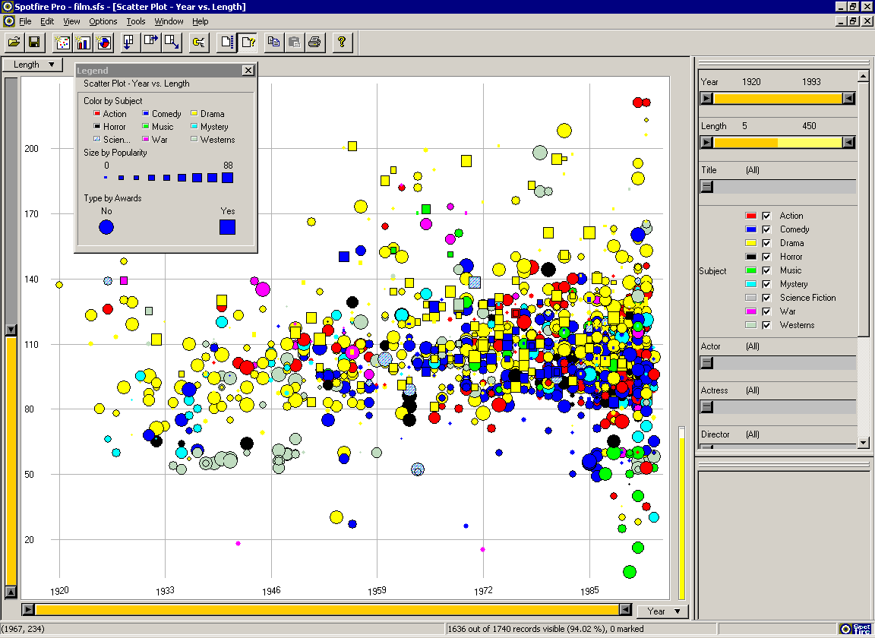
Empirical Experiment
Typical question:
    Which visualization is better in which situations?
Spotfire vs. TableLens

Slide 10
Cause and Effect
Goal: determine “cause and effect”
    Cause = visualization tool (Spotfire vs. TableLens)
    Effect = user performance time on task T
Procedure:
    Vary cause
    Measure effect
Problem: random variation
    Cause = vis tool OR random variation?
random variation
Real
world
Collected
data
uncertain conclusions

Slide 11
Stats to the Rescue
Goal:
    Measured effect unlikely to result by random variation
Hypothesis:
    Cause = visualization tool (e.g. Spotfire ≠ TableLens)
Null hypothesis:
    Visualization tool has no effect (e.g. Spotfire = TableLens)
    Hence: Cause = random variation
Stats:
    If null hypothesis true, then measured effect occurs with probability < 5%
    But measured effect did occur! (e.g. measured effect >> random variation)
Hence:
    Null hypothesis unlikely to be true
    Hence, hypothesis likely to be true

Slide 12
Variables
Independent Variables (what you vary), and treatments (the variable values):
    Visualization tool
        Spotfire, TableLens, Excel
    Task type
        Find, count, pattern, compare
    Data size (# of items)
        100, 1000, 1000000
Dependent Variables (what you measure)
    User performance time
    Accuracy, Errors
    Subjective satisfaction (survey)
    HCI metrics

Slide 13
Example: 2 x 3 design
n users per cell
Ind Var 2: Task Type
 | Task1 | Task2 | Task3
Spot-fire
Table-Lens
Ind Var 1: Vis. Tool
Measured user performance times (dep var)

Slide 14

Step 1: Visualize it
Dig out interesting facts
Qualitative conclusions
Guide stats
Guide future experiments

Slide 15
Step 2: Stats
Ind Var 2: Task Type
 | Task1 | Task2 | Task3
Spot-fire | 37.2 | 54.5 | 103.7
Table-Lens | 29.8 | 53.2 | 145.4
Ind Var 1: Vis. Tool
Average
user performance times (dep var)

Slide 16
TableLens better than Spotfire?
Problem with Averages ?
Avg
Perf time
(secs)
Spotfire TableLens

Slide 17
TableLens better than Spotfire?
Problem with Averages: lossy
    Compares only 2 numbers
    What about the 40 data values? (Show me the data!)
Avg
Perf time
(secs)
Spotfire TableLens

Slide 18
The real picture
Need stats that compare all data
Avg
Perf time
(secs)
Spotfire TableLens

Slide 19
p < 0.05
Woohoo!
Found a “statistically significant” difference
Averages determine which is ‘better’
Conclusion:
    Cause = visualization tool (e.g. Spotfire ≠ TableLens)
    Vis Tool has an effect on user performance for task T …
    “95% confident that TableLens better than Spotfire …”
    NOT “TableLens beats Spotfire 95% of time”
    5% chance of being wrong!
    Be careful about generalizing

Slide 20
p > 0.05
Hence, no difference?
    Vis Tool has no effect on user performance for task T…?
    Spotfire = TableLens ?

Slide 21
p > 0.05
Hence, no difference?
    Vis Tool has no effect on user performance for task T…?
    Spotfire = TableLens ?
NOT!
    Did not detect a difference, but could still be different
    Potential real effect did not overcome random variation
    Provides evidence for Spotfire = TableLens, but not proof
    Boring, basically found nothing
How?
    Not enough users
    Need better tasks, data, …

Slide 22
Class Exercise—Formal Evaluation
Usability Analysis
Controlled Experiment

Slide 23
Design (revisited)

Slide 24
Design
Use Field Guide to identify information relevant to planning visualization.
Formally plan visualization using CUT-AD-DDV.
Develop and try some visualizations. Mockup by hand, or by powerpoint. Test with users. Then develop real one. Don’t be afraid to modify/change.
Do testing with users to get feedback.
Do formal evaluation if needed.

Slide 25
Full Framework: CUTT-AD-DDV
Given, and should be identified by designer
Context
User
Task
Data Types
Generally known
Human Abilities (perception, memory, cognition)
Design Principles
These you have some control over
Data Model
Display
Visualization Techniques
Notes:
Replace CUTT-AD-DDV with graphic…

Slide 26
CUTT-AD-DDV Visualization Framework
Given
Human Abilities
Visual perception
Cognition
Memory
Motor skills
Design Principles
Visual display
Interaction
Imply
Chosen
Inform design
Design Process
Iterative design
Design studies
Evaluation
Context
User
Tasks
Data Types
Constrain
design
Data Model
Display(s)
Visualization Techniques

Slide 27
Evaluation and Critique

Slide 28
Evaluation
Critiquing
Formal user studies

Slide 29
Critiquing a Visualization
First, consider your reaction to the initial (Message) presentation
  1-2 seconds (Yes/No, Good/Bad)
  5-7 seconds (understandable, interesting, makes me want to ask questions, want to explore)
Second, consider your reaction to the exploration part of the visualization
  Study the visualization in more detail to evaluate it.
  If there is an interactive exploration capability explore that

Slide 30
Critiquing a Visualization
Third, identify the purpose, content and choices made in this visualization using our CUTT-AD-DDV model
  Identify the purpose of the visualization and who the intended audience is (Context/User/Task from our model).
  Identify the Data Types available, and what was chosen for the Data Model
  Identify display type(s) utilized (or expected).
  Identify Display techniques utilized.

Slide 31
Questions to Ask
Is the design visually appealing/aesthetically pleasing?
Is it immediately understandable? If not, is it understandable after a short period of study?
Does it provide insight or understanding that was not obtainable with the original representation (text, table, etc)?
Was the choice of data model appropriate?
Does it transform nominal, interval, and quantitative information properly?

Slide 32
Questions to Ask
Was the choice of display appropriate?
Does it use visual components properly? That is, does it properly represent the data using lines, color, position, etc?
Does the visualization provide insight or understanding better than some alternative visualization would? What kind of visualization technique might have been better?
Does it use labels and legends appropriately?

Slide 33
How Successful is the Visualization?
Does the visualization reveal trends, patterns, gaps, and/or outliers?
Does the visualization successfully highlight important information, while providing context for that information?
Does it distort the information? If it transforms it in some way, is this misleading or helpfully simplifying?
Does it omit important information?
Does it engage you, make you interested, want to explore?

Slide 34
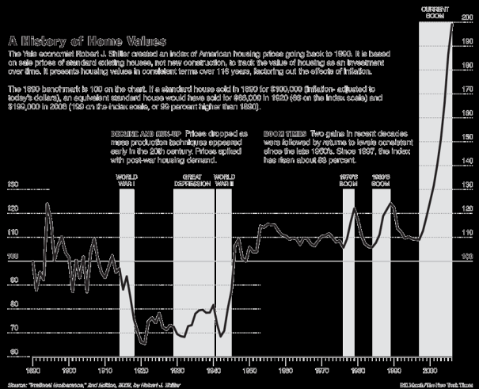
Example from NY Times on housing prices
  Message
    1-2 second understanding?
    5-7 second understanding
    Engage you? (could they have done more?)
  Highlighting of areas of interest, accompanying narrative text
  Dual axis appropriate to data values

Slide 35
Presentation in Time and Space
Static vs. Dynamic Information.
  Is there a good initial message presentation?
  Is there an obvious way to explore the data?
  Did the visualization appropriately divide information into these two parts?
Make use of screen space (not all space is created equal).
What should be highlighted (Don’t highlight too much!)

Slide 36
Data-to-Pixel Ratios
Examples of wasteful pixels:
  Decorative graphics
  Meaningless variations in color
  Borders to separate when white space will suffice
  Distracting backgrounds and fill colors
  Unnecessary grid lines in tables and graphs
  3D when not needed (nearly always not needed)
  Ornate/physical looking widgets

Slide 37
Data-to-Pixel Ratios
How to make non-data pixels work well:
  Use light, low-saturated colors
    Hard to see when printed though!
  Regularize the appearance of non-data visual elements.

Slide 38
Few on
“Eloquence Through Simplicity”
Well-designed dashboards are:
  Well-organized
  Condensed
    Summaries and exceptions
  Concise, communicate the data and its message in the clearest and most direct way possible.
  Can be assimilated quickly
  Provide a broad, high-level overview
  Address specific information needs

Slide 39
More General Guidelines
Simplify, simplify, simplify!
Must be the best way to show this data.

Slide 40
User Studies
Discussion of Readings on user studies.
Example(s)

Slide 41
Class Exercise—Evaluation
Putting it all together
Browser Market Share
Movie Ebb & Flow
Risky Roads
AOL Revenue Stream
Divide in groups of 4; each group works on one problem using Field Guide and CUTT-AD-DDV, and proposes evaluation.

