Slide 1
Agenda
Thinking about PowerPoint
Working views
Designing a presentation
Tour the workspace
Delivering a presentation
Notes:
Tell ‘em what you’re going to tell ‘em

Slide 2
Designing a presentation
Design templates & themes
Slide layouts
Modifying masters
Customizing themes
Using slides from file
Using and creating objects
Notes:
This is a logical use for a bullet slide

Slide 3
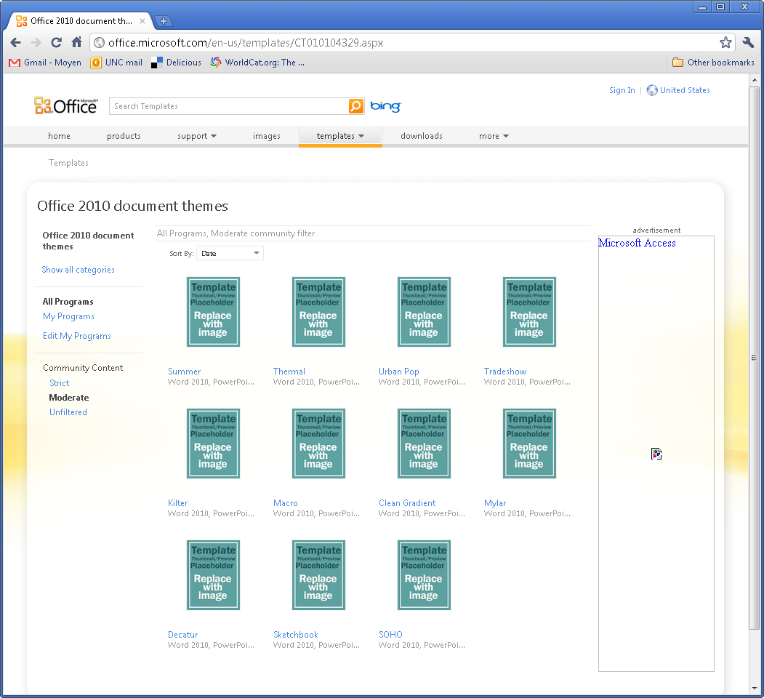
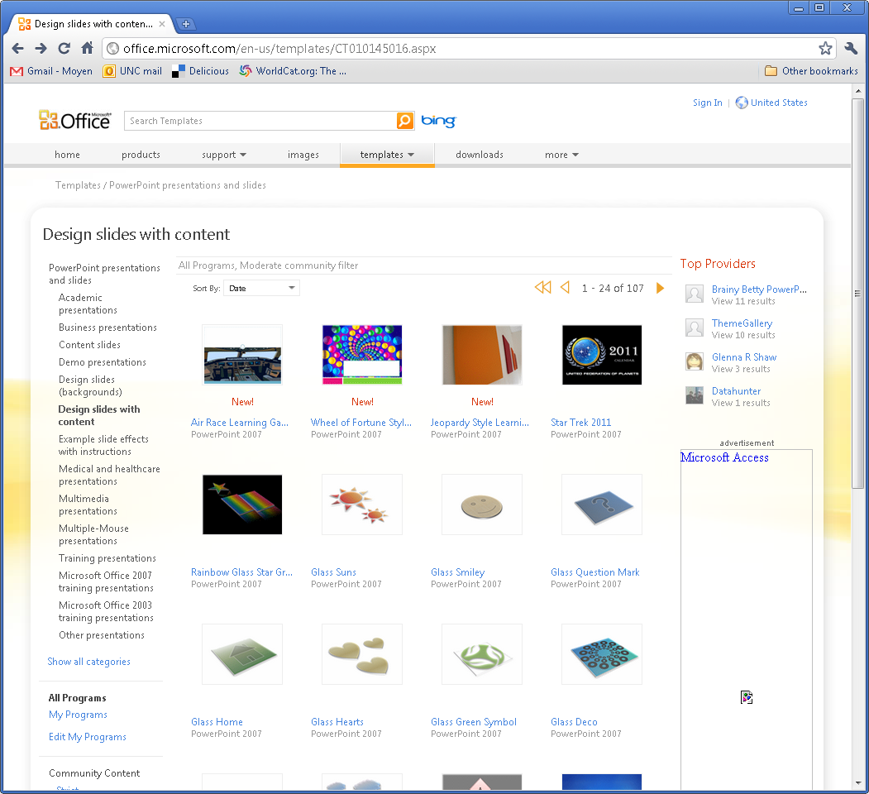
Help online
Templates
Themes
Notes:
Download a template

Slide 4
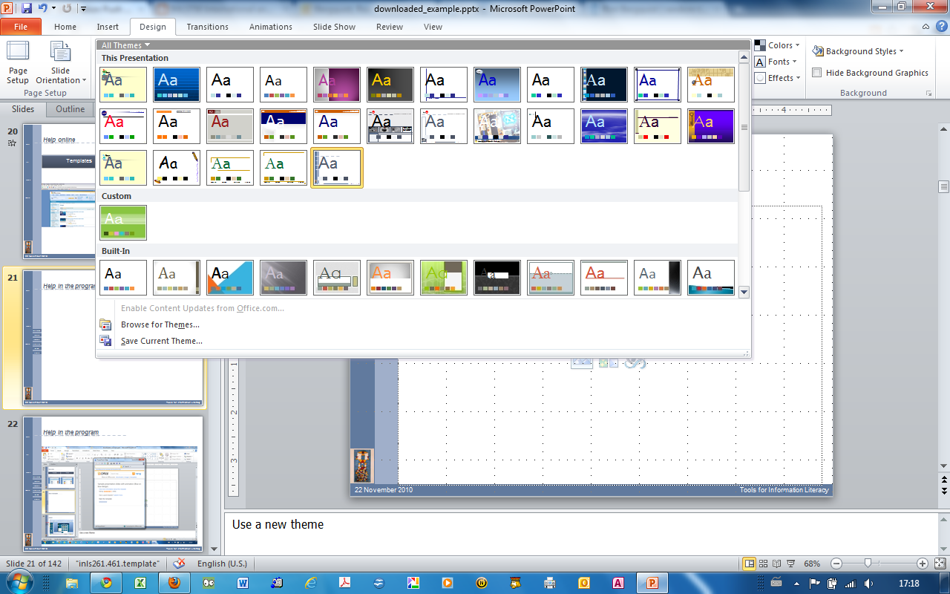
Help in the program
Notes:
Use a new theme

Slide 5
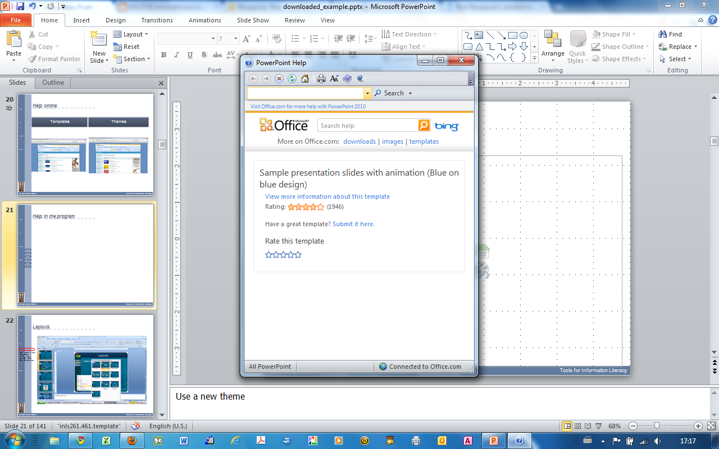
Help in the program
Notes:
Use a new theme

Slide 6
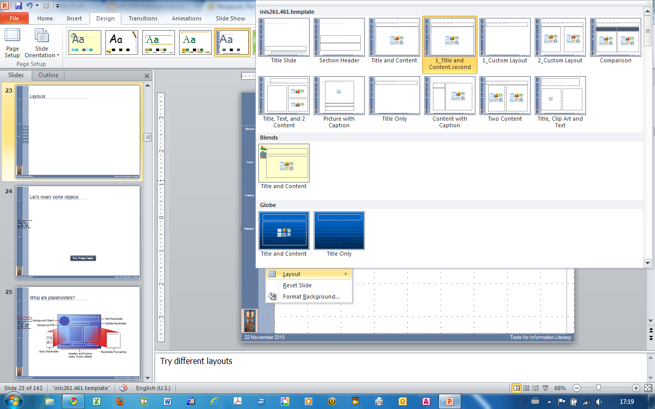
Layouts
Notes:
Try different layouts

Slide 7
Let’s insert some objects
Put Frazz here
Notes:
Show how a chart is linked to Excel table

Slide 8
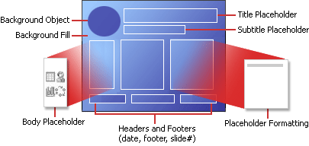
What are placeholders?
Notes:
Discuss placeholders and stylesheets

Slide 9
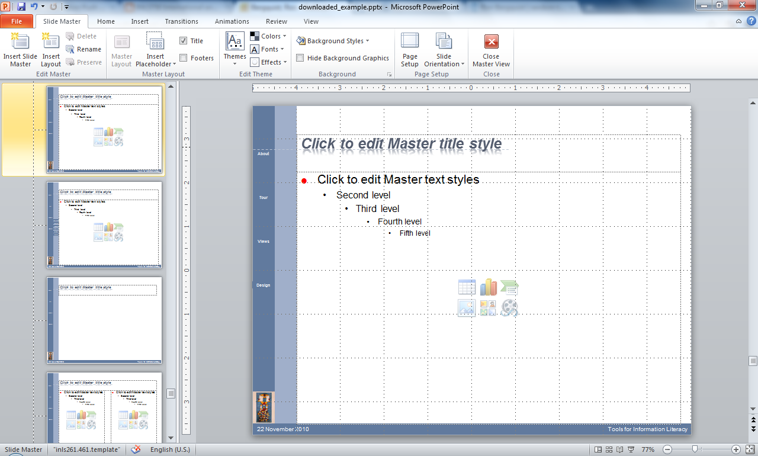
Modifying masters
Note that each layout has its own master
Notes:
Modify footers, fonts, colors, backgrounds. Modify a bullet

Slide 10
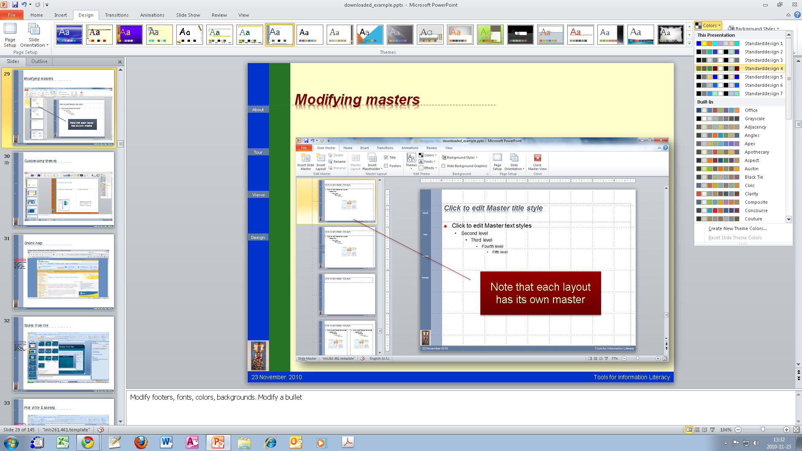
Customizing themes
Notes:
Try to build a custom font set

Slide 11
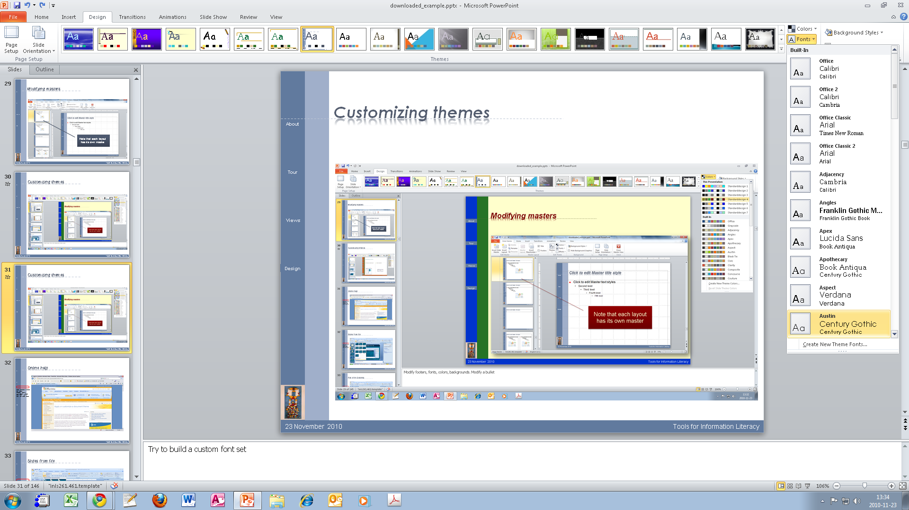
Customizing themes
Notes:
Try to build a custom font set

Slide 12
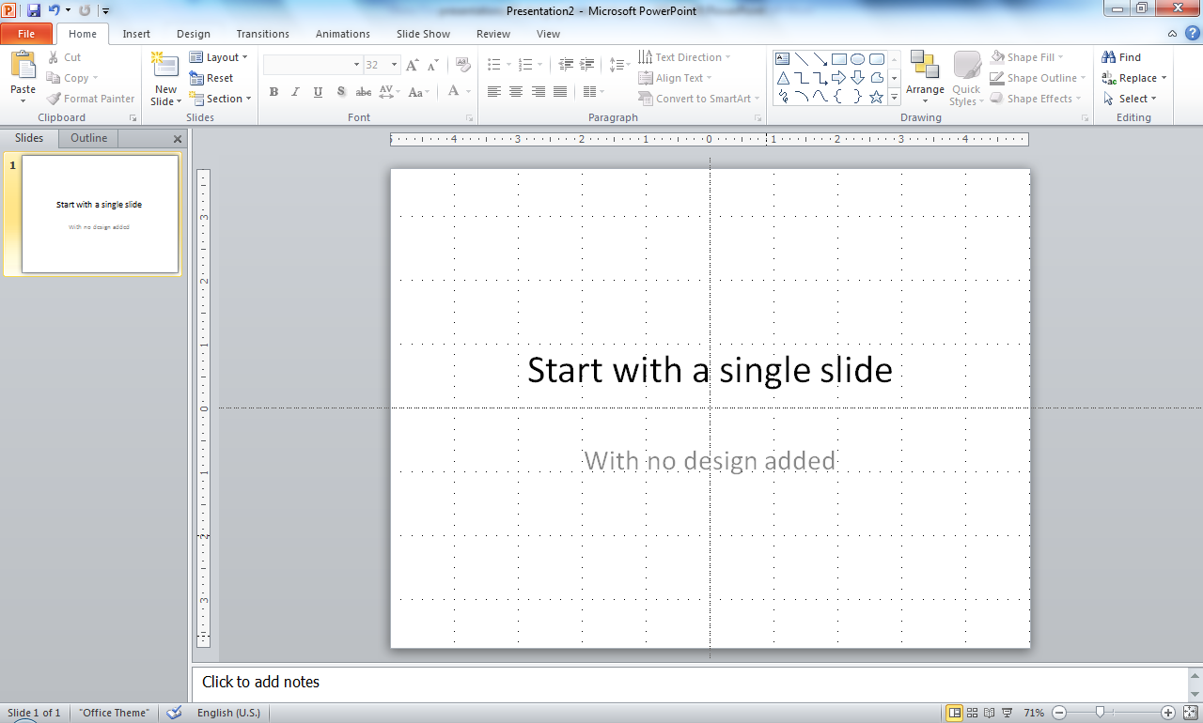
This is what it looks like

Slide 13
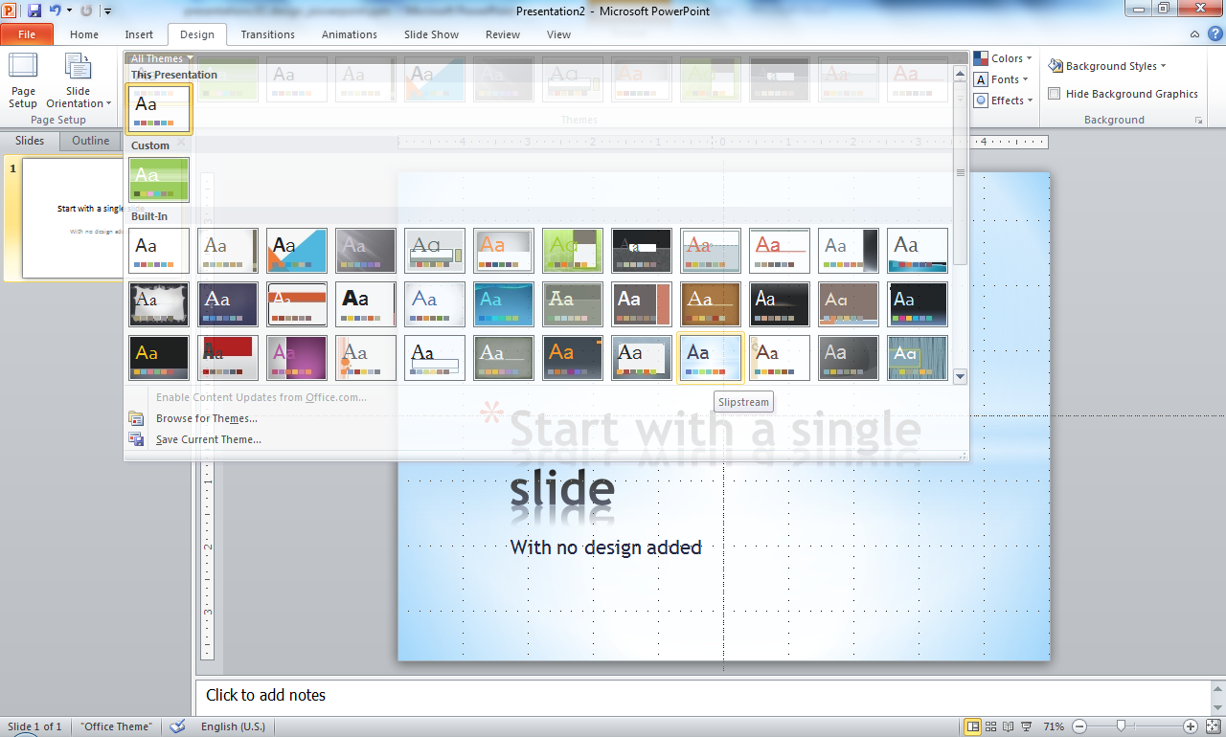
Add a theme - slipstream

Slide 14
And it looks like this
With slipstream design added

Slide 15
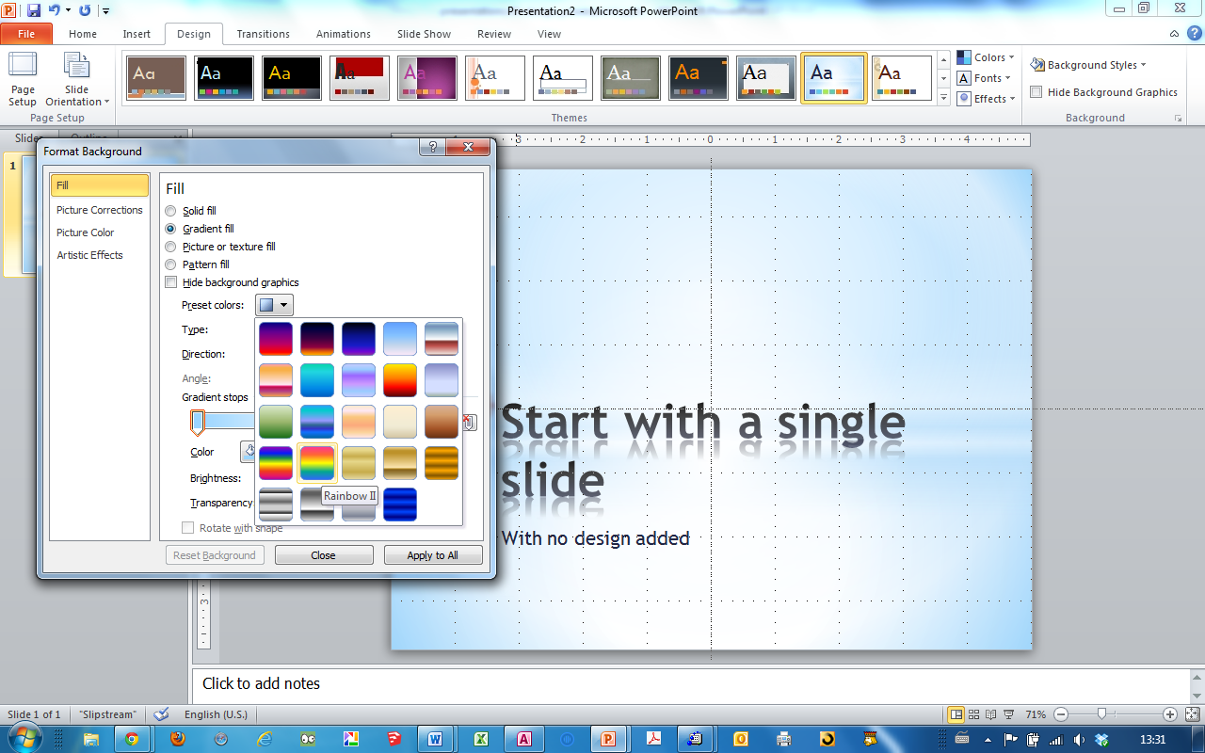
Change the background

Slide 16
New background on this slide alone
With slipstream design added

Slide 17
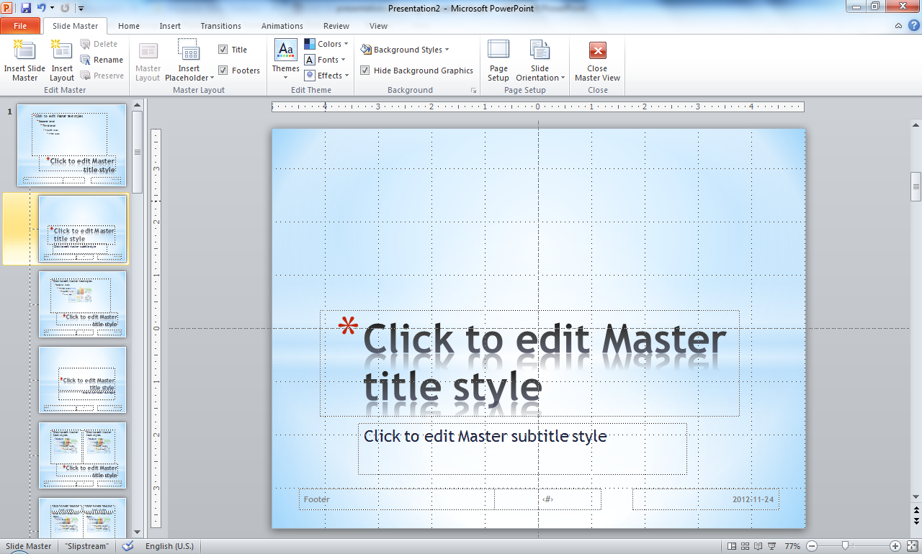
Modify the master

Slide 18
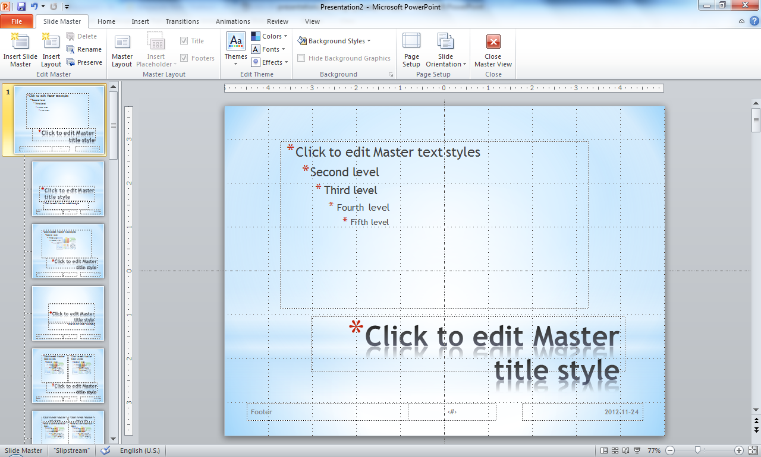
Modify the master layout
There is a master slide
from which almost all layouts inherit

Slide 19
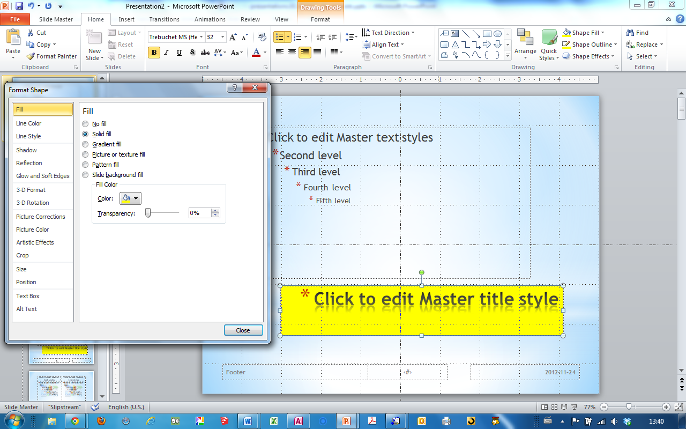
Modify an object in the master layout
Modify this on the master layout
almost all layouts inherit the properties of this object

Slide 20
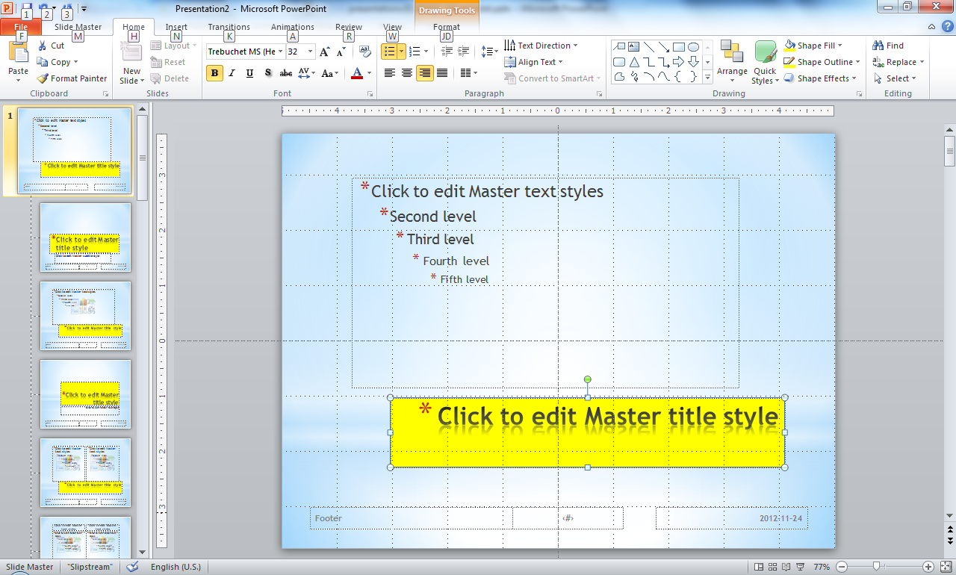
The same object in other layouts inherits the properties
Modify this on the master layout
almost all layouts inherit the properties of this object

Slide 21
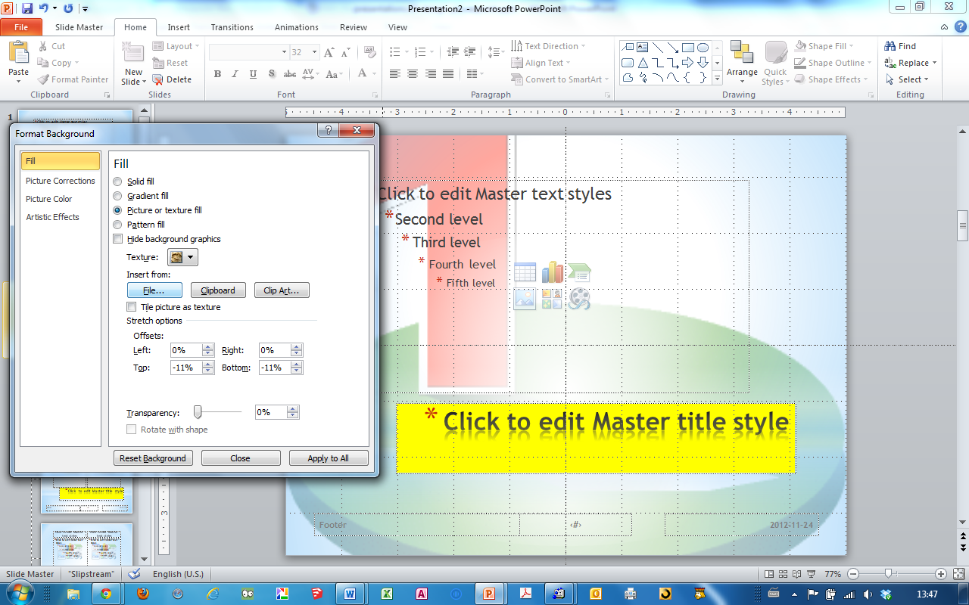
Let’s add a background image to one layout, not to the master layout
An image from file
Only this layout has this background

Slide 22
This is a normal slide
With a normal place to put bullets over the background image
What is that image?

Slide 23
But a “title slide”
Does not have the same background because the change was made only to the “title and content” master slide

Slide 24
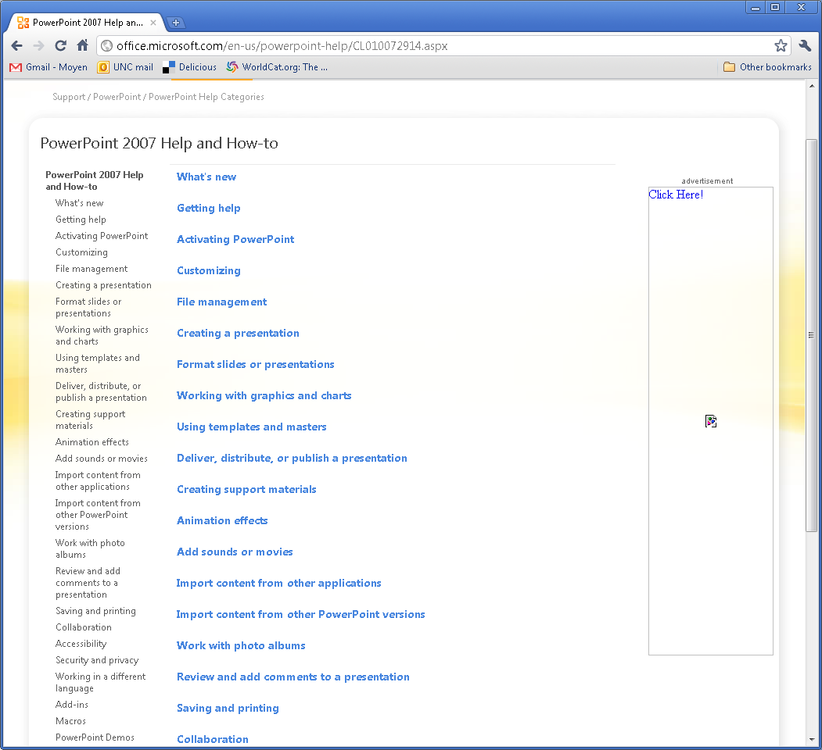
Online help
Notes:
Demo may not run correctly

Slide 25
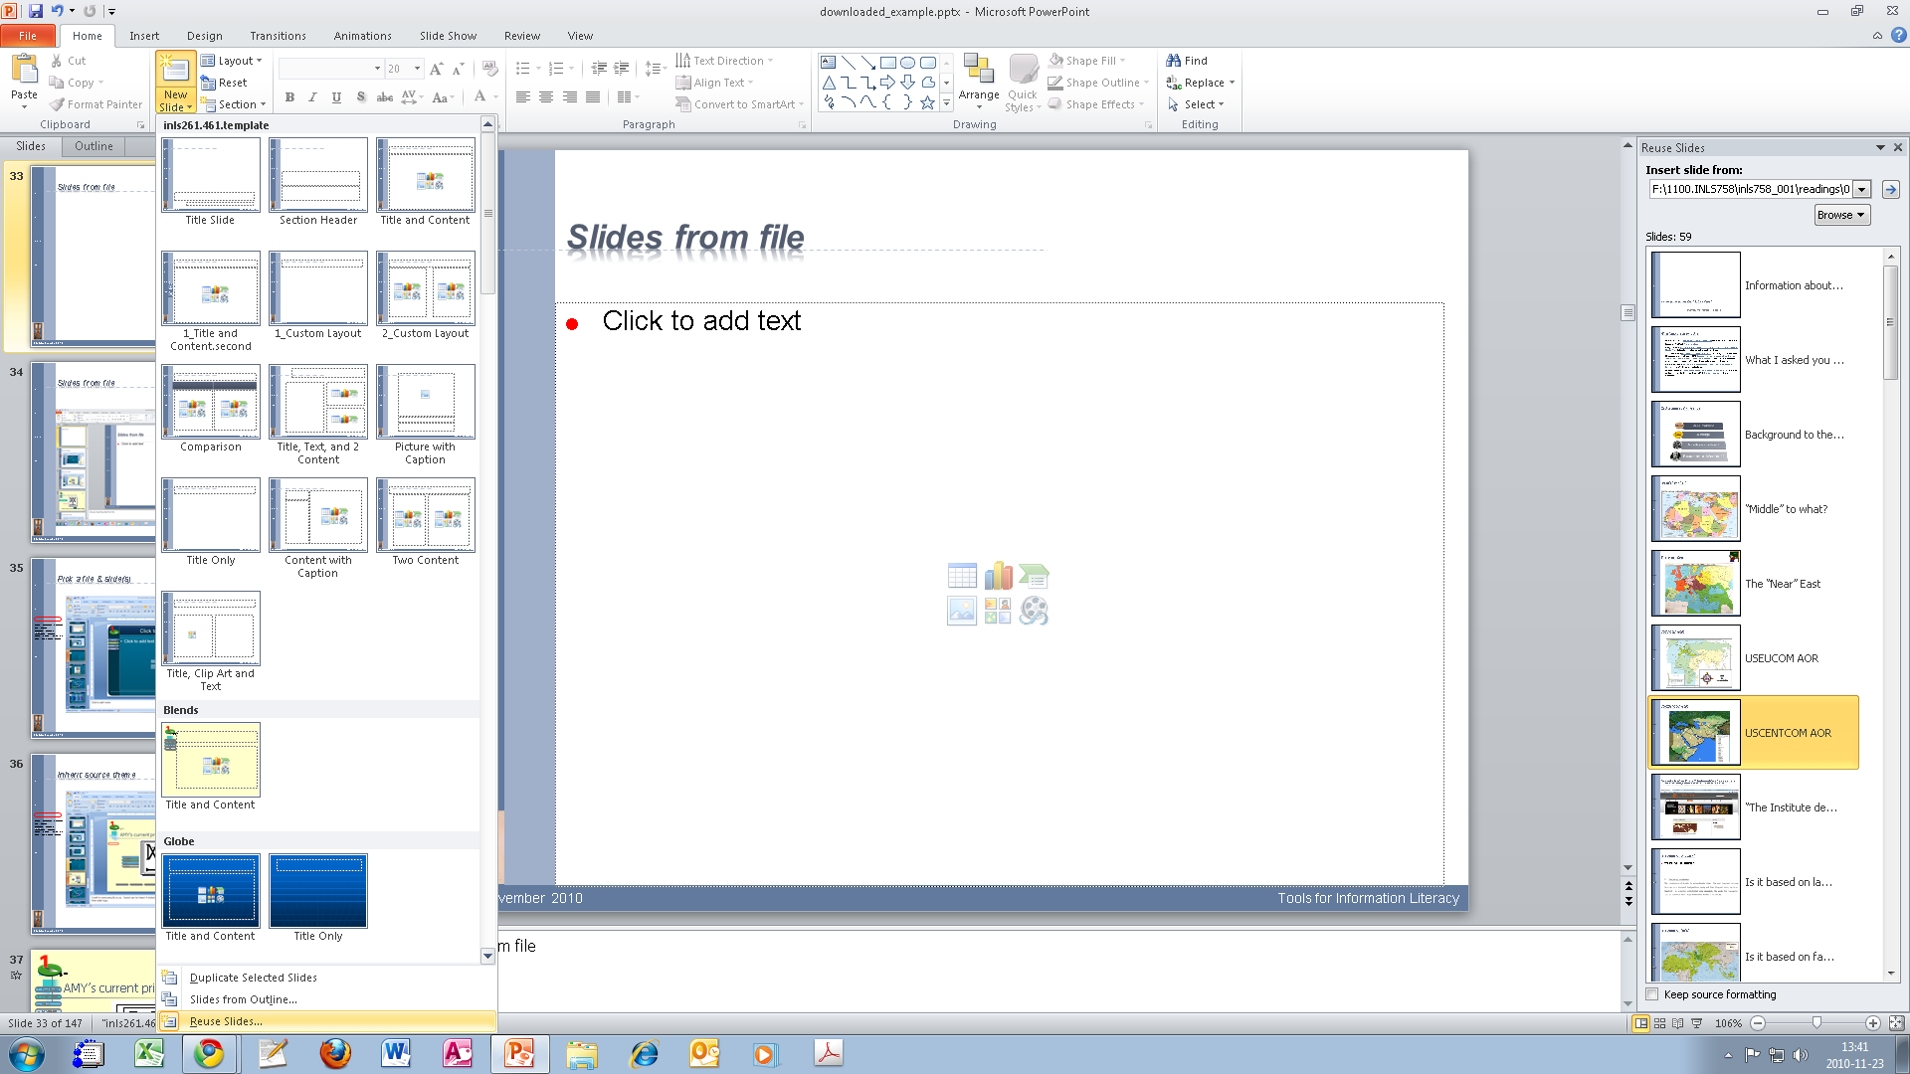
Slides from file
Notes:
Discuss importing slide from file

Slide 26
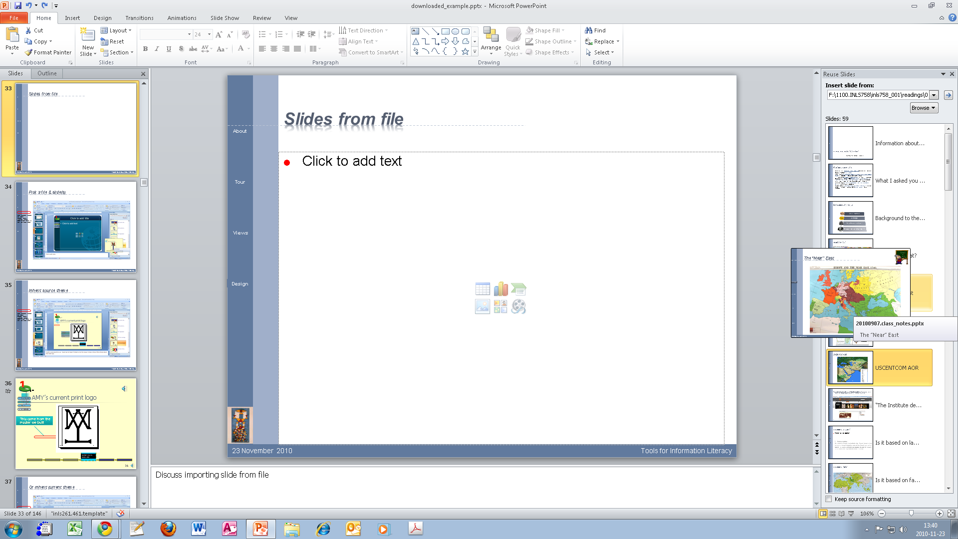
Pick a file & slide(s)
Notes:
Discuss importing slide from file

Slide 27
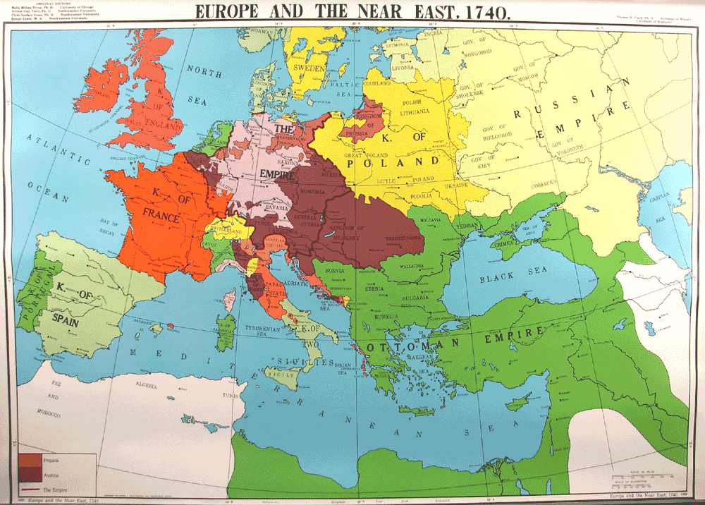
The “Near” East
Inserted

Slide 28
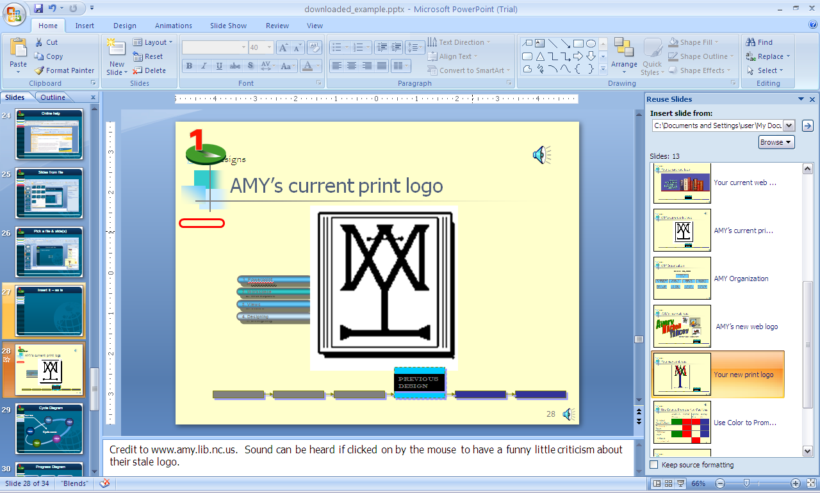
Inherit source theme
Notes:
Try the sound in the upper right

Slide 29


AMY’s current print logo
This came from the master we built
Previous design
Notes:
Credit to www.amy.lib.nc.us. Sound can be heard if clicked on by the mouse to have a funny little criticism about their stale logo.

Slide 30
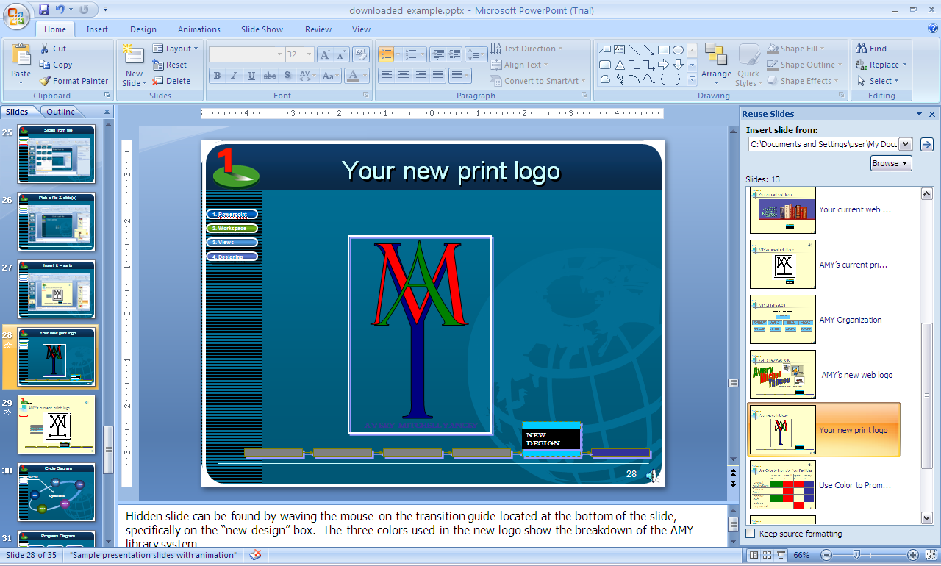
Or inherit current theme

Slide 31
Your new print logo
A
M
Y
AVERY MITCHELL YANCEY
new design
Notes:
Hidden slide can be found by waving the mouse on the transition guide located at the bottom of the slide, specifically on the “new design” box. The three colors used in the new logo show the breakdown of the AMY library system.

Slide 32
We are moving on to talk about two things
But how best to display them
Notes:
Next time, we’ll play with things

Slide 33
The default way
Formatting & themes
Objects
Is this the only way?

Slide 34

Or would this work better?
Tell them what you’re going to tell them
Formatting
Objects

Slide 35
Maybe bullets are better
We can talk about formatting first
Then move on to objects
After all,
that’s what everyone does

Slide 36
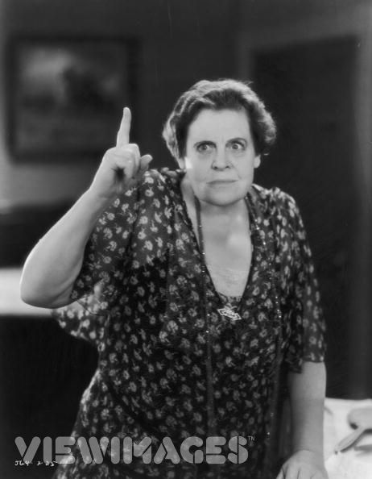
Or would this catch the eye better?
Tell them what you’re going to tell them
Formatting
Objects

Slide 37
Review of Style Sheets
the template sets the mood
pick the one that works for you
slide layout

Slide 38
Let’s consider why we might want a consistent look
What are you trying to talk about?
Notes:
Use a new theme

Slide 39
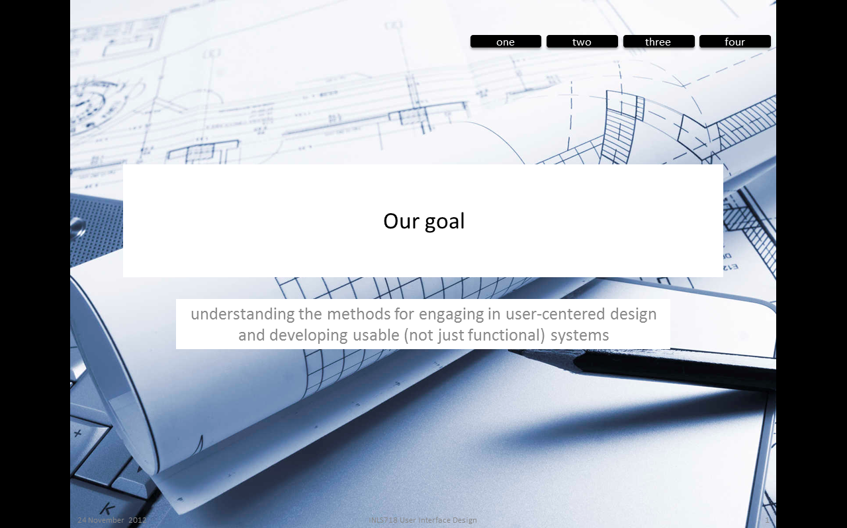
A distinctive look for user interface design
Notes:
Use a new theme

Slide 40
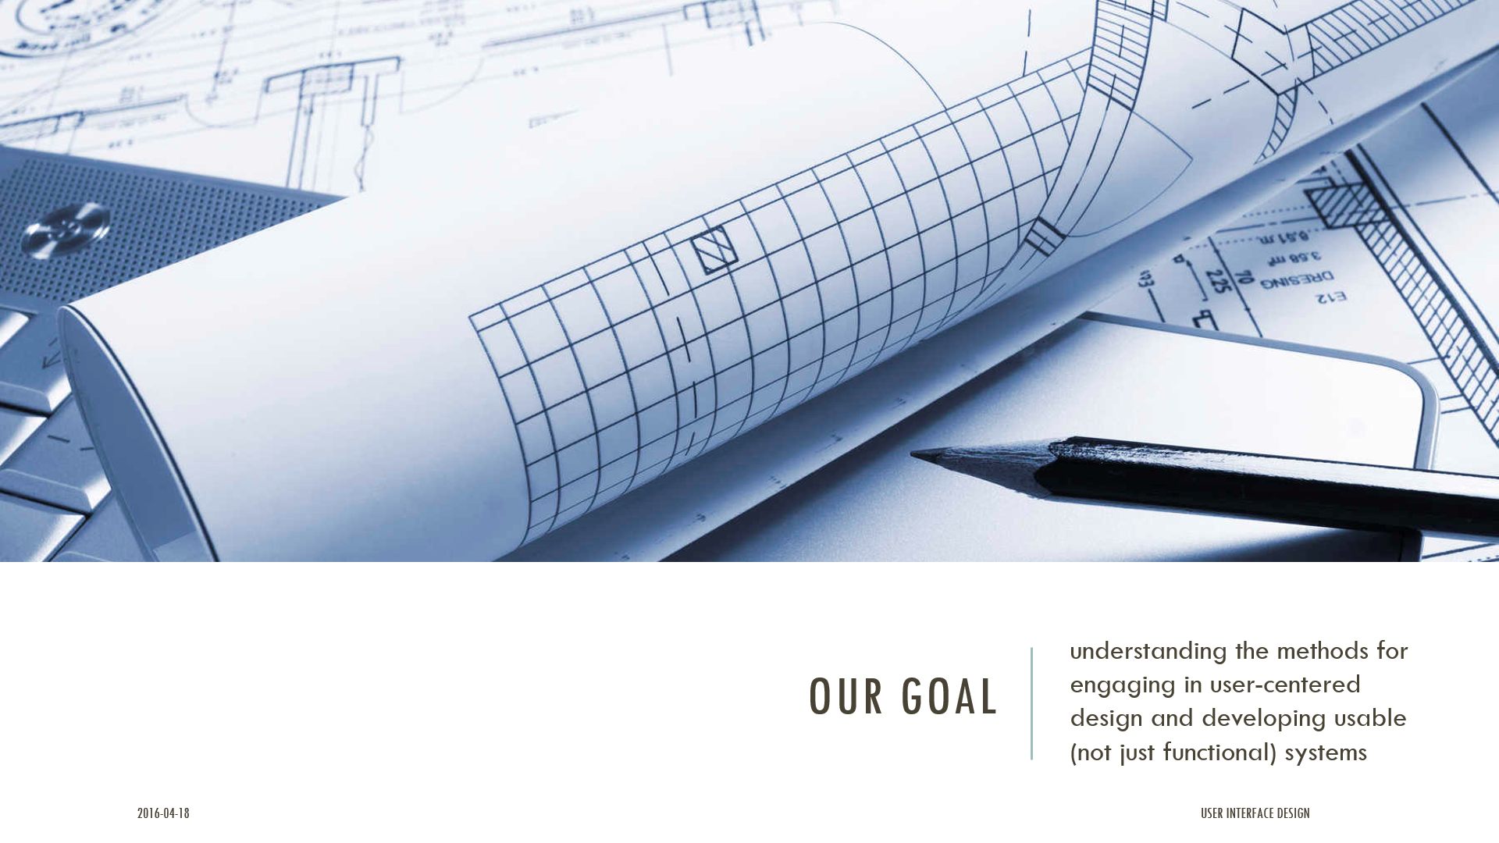
A distinctive look for user interface design
Notes:
Use a new theme

Slide 41
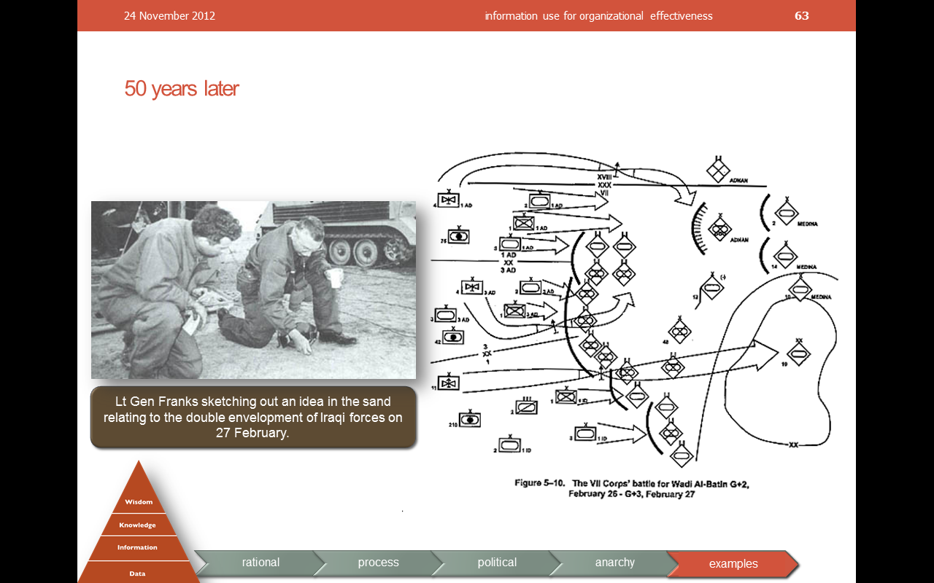
A distinctive look for information use in organizations
Notes:
Use a new theme

Slide 42
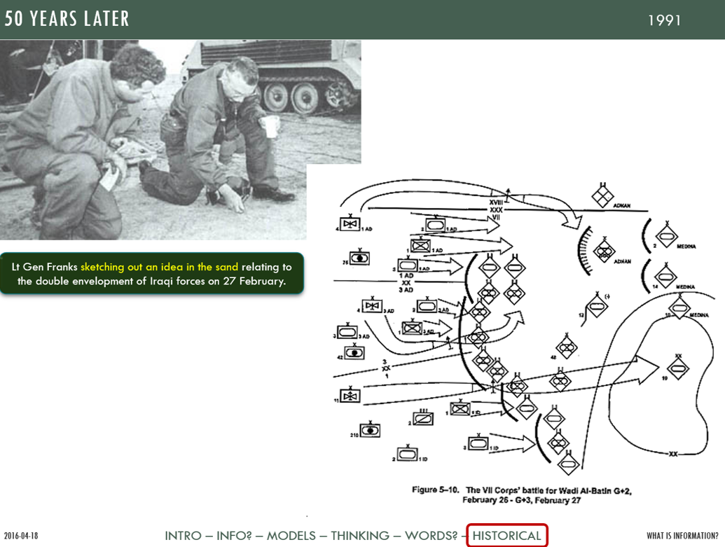
A distinctive look for information use in organizations
Notes:
Use a new theme

Slide 43
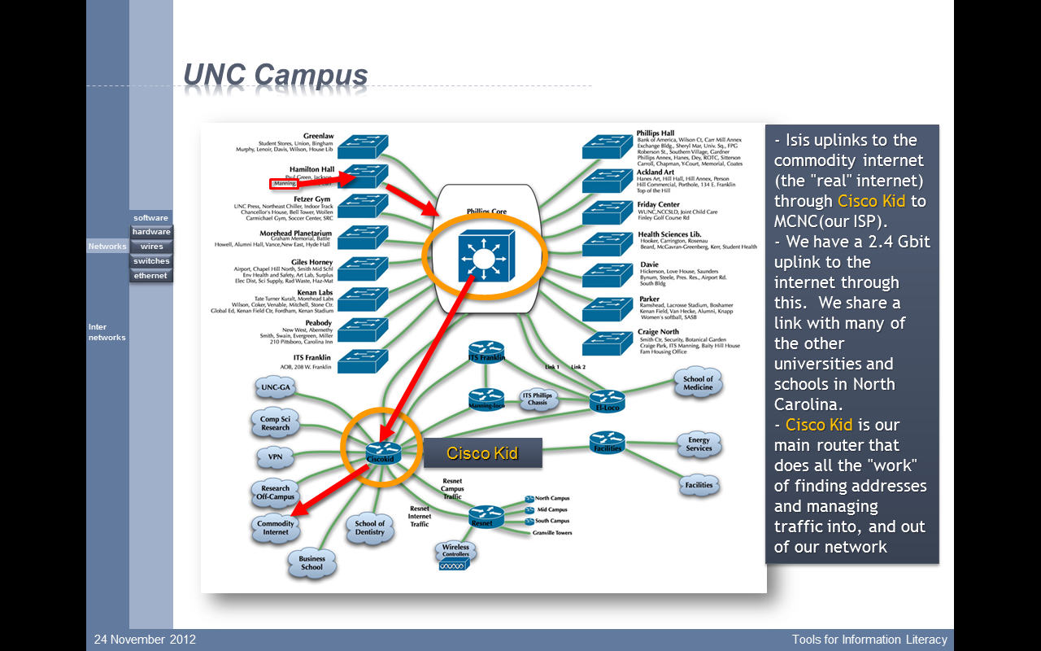
A distinctive look for this class
Notes:
Use a new theme

Slide 44
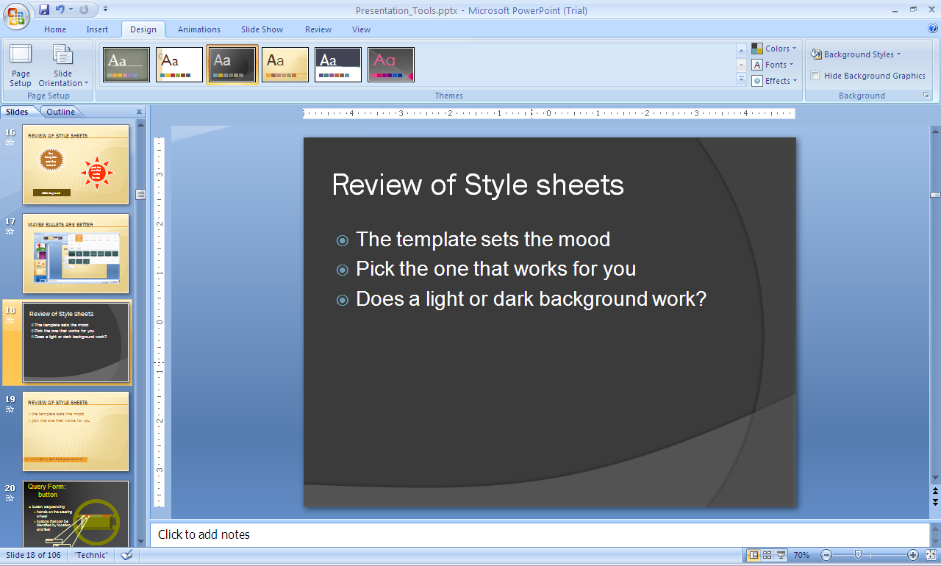
Review of Style Sheets
the template sets the mood
pick the one that works for you
does a light or dark background work?

Slide 45
Query Form: button
button sequencing
  hands on the steering wheel
  buttons that can be identified by location and feel
Radio
Map
E-Mail
dark background
Notes:
The driver may input a query by pressing buttons that are accessible with the thumbs while the hands remain on the steering wheel. The buttons are arrayed so that the driver can press them with the thumbs while the hands remain at the 3 and 9 o’clock positions on the steering wheel. In each group of three buttons, the outside buttons have a raised center portion while the middle button has an indented center portion. The set of buttons on the left side are for activating one of the three functions. Each left hand button has only one task – a single push initiates a single function. The driver can thus feel which button is being engaged without having to look.

Slide 46
EVERYTHING OLD IS NEW AGAIN---OR IS IT?
Paula Kaufman
March 17, 2003
dark background

Slide 47

Future Configuration
Chemistry
NIEHS
Sample
Audio-Video
Analysis S/W
Shared Apps
Audio-Video
Topo S/W
Analysis S/W
AFM
Shared Apps
nM
Phantom
nM
Phantom
faded background
Notes:
When NIEHS is connected, the nano network will have a second asymmetrical node. As will be the case with Gene Therapy, NIEHS will not have a complete suite of tools. They will most likely be collaborating with Chemistry, who will have a complete suite of tools. NIEHS scientists will not be able (at their location) to do sample preparation, nor to image the sample with an AFM. They will be able to observe these actions and can share in the visualization and manipulation.

Slide 48
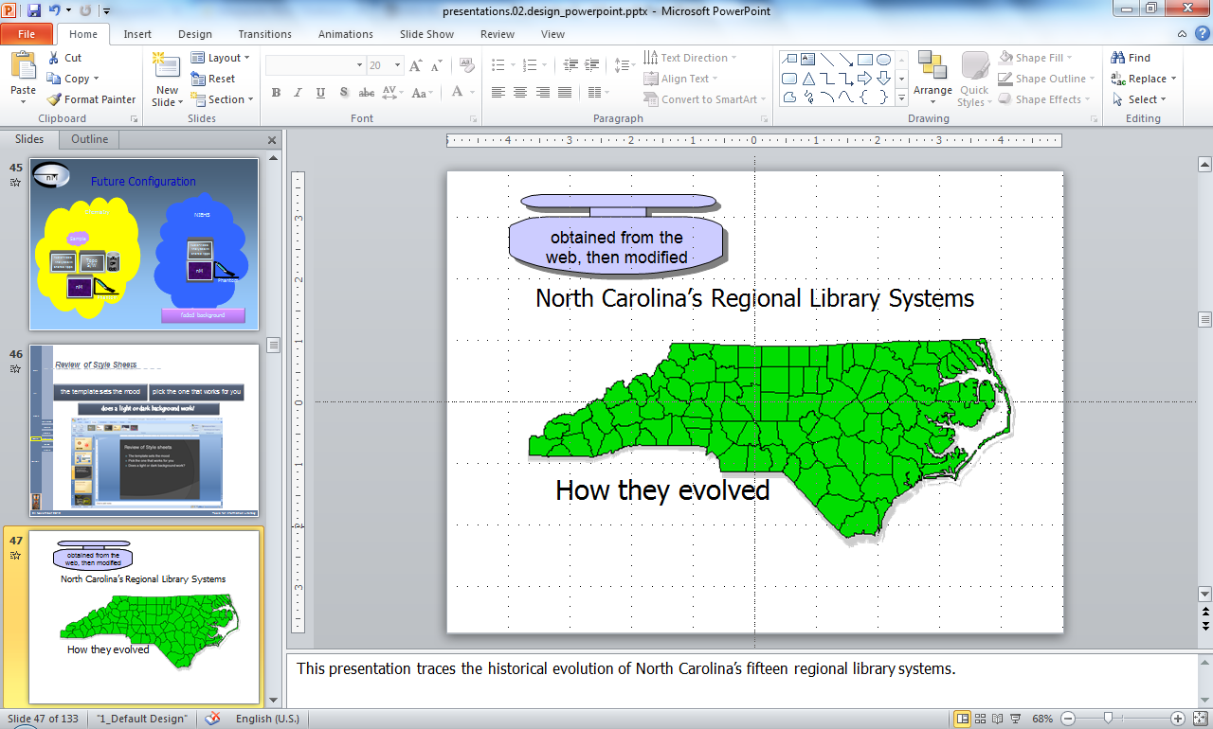
Review of Style Sheets
the template sets the mood
pick the one that works for you
A simple approach keeping the map consistent

Slide 49
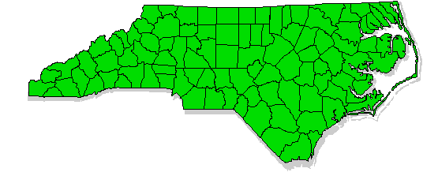
North Carolina’s Regional Library Systems
obtained from the web, then modified
How they evolved
Notes:
This presentation traces the historical evolution of North Carolina’s fifteen regional library systems.

Slide 50
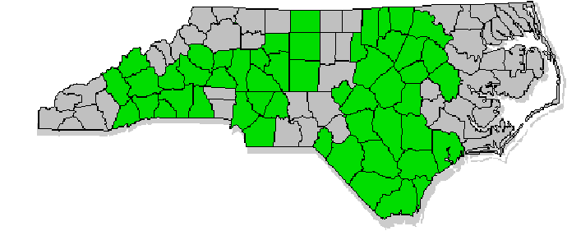
Where are the Regions?
let’s alter a county
Regional Library Systems
County Library Systems
Notes:
In North Carolina, 51 of the 100 counties have county library systems. The other 49 counties in the state are joined together into 15 separate multi-county regional library systems. Just as the evolution of public libraries from municipal systems to county systems depended on an act of the General Assembly, the movement toward regionalism was dependent on permission being granted by the legislature. In 1933, the General Assembly amended the library law to permit two or more adjacent counties to join together in a collective enterprise.

Slide 51
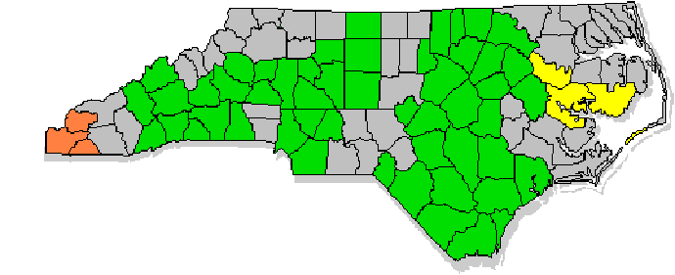
Starting in 1942 – one in the west, one in the east
Nantahala
BHM
1942
Placement is critical so the object doesn’t move
Notes:
In 1937, the Tennessee Valley Authority (TVA) sought to provide cultural and educational establishments for the families of workers building the Hiwassee Dam. To obtain library services, the TVA contracted with the Murphy Library Board to have that agency provide the desired service. The TVA also insisted that their infusion of funds was dependent upon obtaining a defined level of service that was probably more than this one municipal library itself could support. Accordingly, the TVA stimulated local library organizations to begin thinking about joining together into larger units. Cherokee County joined in the effort in 1940 and Clay and Graham counties were added in July 1941 to form the Nantahala Regional Library System. After the State of North Carolina began to provide financial support to public libraries in 1941, the Nantahala Regional Library System, the TVA, and the North Carolina Library Commission signed contracts making Nantahala the first multi-county system to receive state funds.
The model seemed to be attractive and later in the same year, Beaufort, Hyde, and Martin counties agreed to join together into the BHM Regional Library System and begin receiving both county and state funds.

Slide 52
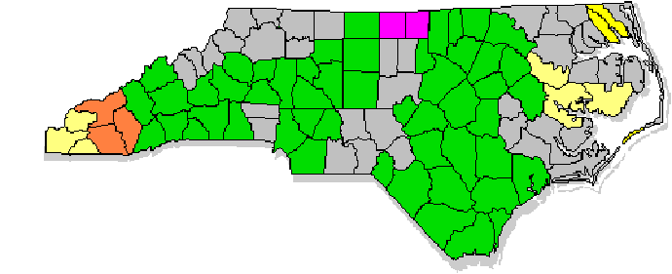
1944 – west, north central, northeast
Caswell-Person
Camden-Pasquotank
Fontana
1944
Notes:
At the same approximate time, other counties were experimenting with cooperative efforts. Chatham, Orange, and Person counties, in one instance, and Duplin, Onslow, and Sampson counties, in another, jointly employed a trained librarian, but did not go beyond that. They kept their individual library boards, headquarters, and collections and did not create a multi-county organizational structure at that time. Two years later, Person and Caswell counties had entered into a contract through which they shared the services of a trained librarian and a bookmobile in addition to permitting interlibrary sharing of materials. This cooperation, too, did not at that time extend to an overarching organizational structure.
The Library Commission felt that the regional model was a good one for counties who had smaller populations and lower tax bases. Were such counties to agree to work jointly, public library service could be expanded to more localities. In its Nineteenth Report in June 1946, the Commission told the governor that “each county has been offered the same amount from State Aid with the condition that county commissioners appropriate funds, and develop acceptable plans for rural library service. The smaller, poorer counties were encouraged to combine with neighboring counties to form library regions for more adequate and economical service.”
During the 1940s, the Nantahala and BHM regions were joined by Camden-Pasquotank, Caswell-Person, and Fontana in 1944;

Slide 53
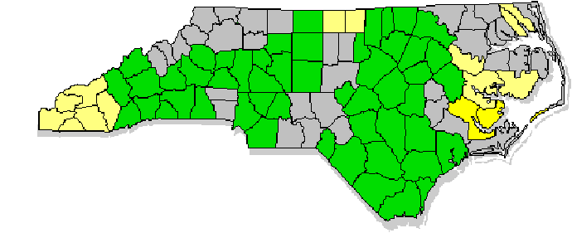
1947 – east central
1947
Craven-Pamlico
Notes:
Craven-Pamlico in 1947;

Slide 54
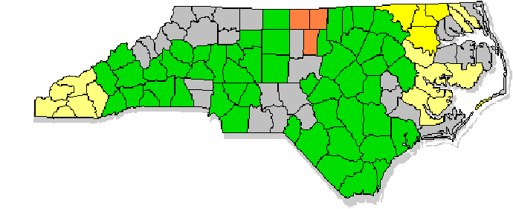
1948 – enlargement & northeast
Hyconeechee
Albemarle
1948
Notes:
and Hyconeechee (formed when Orange County joined Caswell-Person) and Albemarle in 1948.

Slide 55
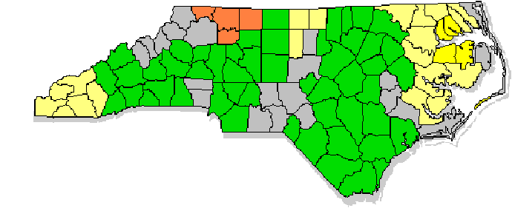
1959 – northwest & northeast
Northwestern
Pettigrew
1959
Notes:
The 1950s were a slow period, despite the fact that the Library Commission tried to tempt more regions to form by providing what the December 4, 1956 Minutes of the North Carolina State Library Board called “Incentive Grants,” in the form of an additional grant of state aid for each region (each region receiving state grants for each county plus an additional one for the region). Federal aid appeared about the same time. The General Assembly had authorized the state to accept and use Federal funds for library use in 1937, but such Federal aid to libraries was not a reality until 1956. Federal funds were targeted at the development and expansion of public library services in rural areas and the State Library Board proposed in 1959 to withhold a portion of any increases in state and federal aid to use for new incentive grants for new regions. New regions formed in 1956 with the Pettigrew Region and in 1959 with the Northwestern Region.

Slide 56
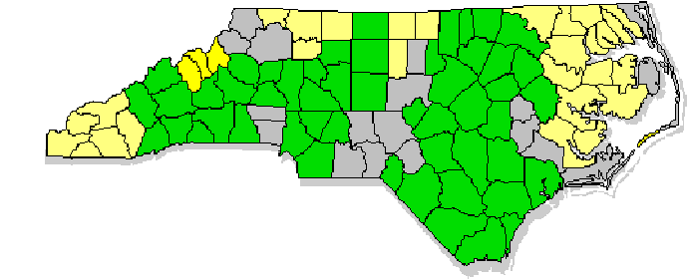
1961 - west
AMY
1961
Notes:
The Avery-Mitchell-Yancey area had been close to regional formation in 1959 and the new AMY Region became a reality in 1961.

Slide 57
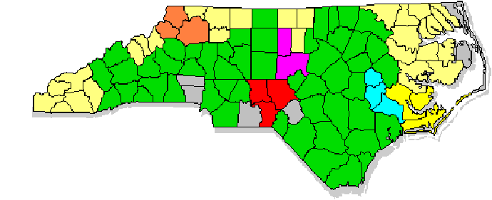
1963 – northwest, central, east central
Central NC
Appalachian
Sandhill
Craven-Pamlico-Carteret
1963
Neuse
Notes:
Four new regions formed in 1963 (Appalachian, Central North Carolina, Neuse, and Sandhill;) and an older region grew when Carteret County joined the Craven-Pamlico Region to form the Craven-Pamlico-Carteret Region.

Slide 58
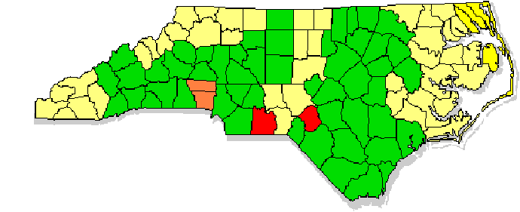
1964+ – southwest central, northeast, growth
East Albemarle
Gaston-Lincoln
1964
Notes:
Formation of new regions reached its conclusion in 1964 when the East Albemarle (an outgrowth of the Camden-Pasquotank Region) and Gaston-Lincoln Regional Library Systems came into being. Since 1964, the Sandhill Region has expanded, but there have been no new regions formed, even though the State Library Board was discussing the promotion of multi-county systems as a long range goal as late as 1971.

Slide 59
Stability since 1964
Regional Library Systems
County Library Systems
What’s this?
Notes:
So since 1964, the regional library structure has remained stable.

Slide 60
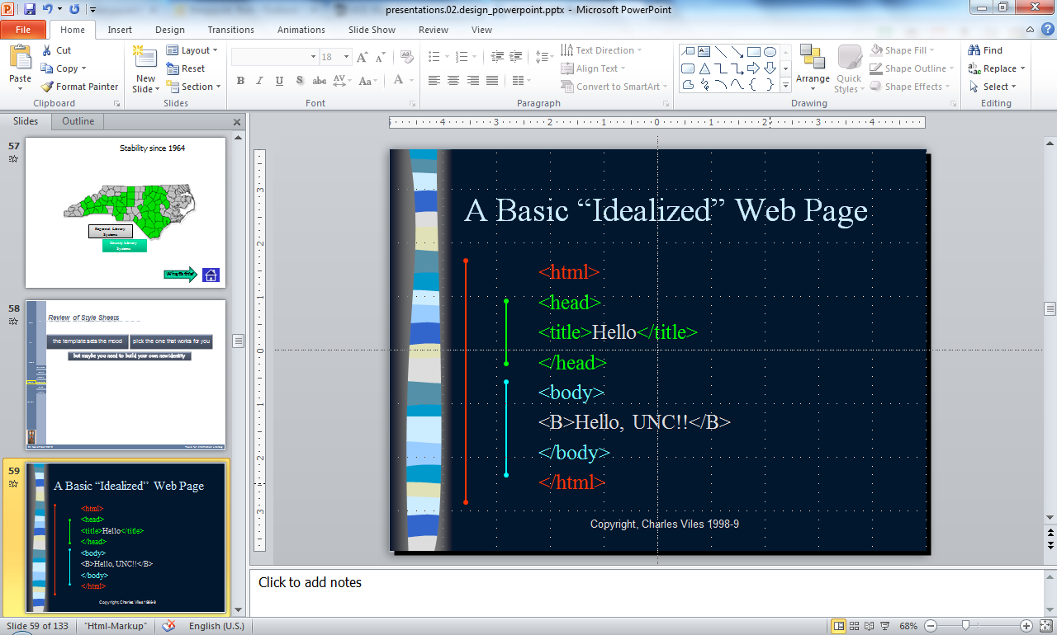
Review of Style Sheets
the template sets the mood
pick the one that works for you
but maybe you need to build your own new identity

Slide 61
A Basic “Idealized” Web Page
<html>
<head>
<title>Hello</title>
</head>
<body>
<B>Hello, UNC!!</B>
</body>
</html>

Slide 62



Internet History and Growth
William F. Slater, III
Chicago Chapter of the Internet Society
September 2002

Slide 63
SLA/News focus:
NEWSROOM technology training: a “cafeteria” model
*
New York City: June 10, 2003
By Debbie Wolfe
Technology Training Editor *
St. Petersburg Times
* and, former news researcher!

Slide 64
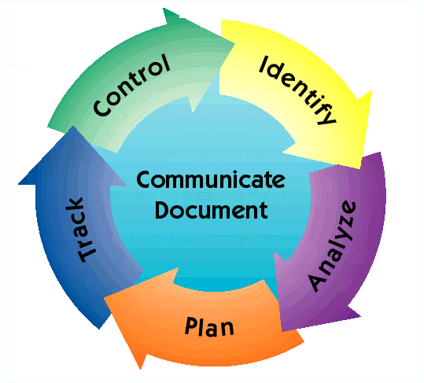
Risk Assessment & Management
Inputs
Mission
Success
Criteria
Technical
Data
Cost
Schedule
Management
Procedures
Other
Improved
Safety &
Performance
Qualitative Risk
Assessment
FMEA
FTA
Quantitative Risk
Assessment
Initiating Events
Scenario Modeling
(MLD, ESD, ETA, FTA)
Risk Quantification
Uncertainty Evaluation

Slide 65
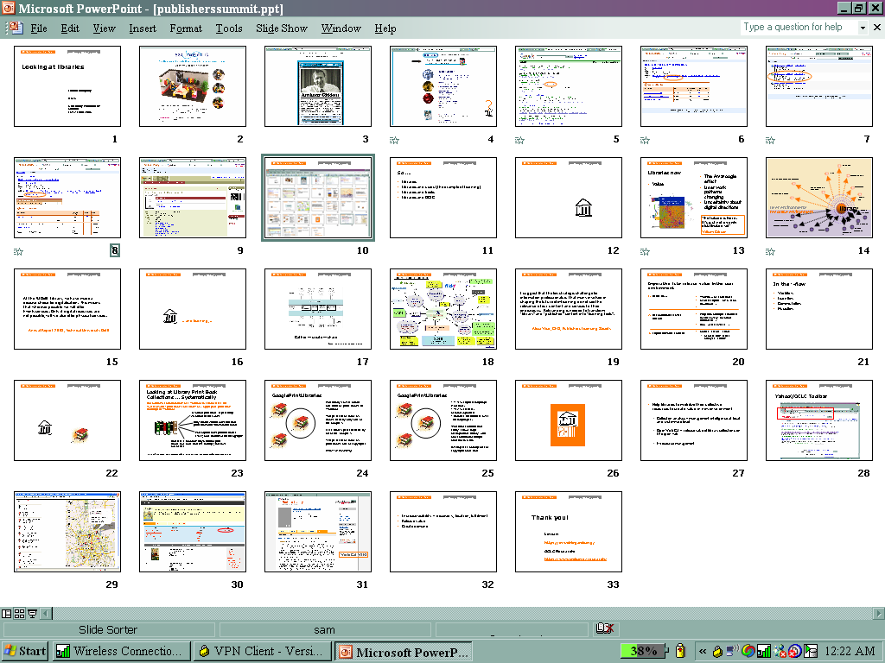
Overview

Slide 66
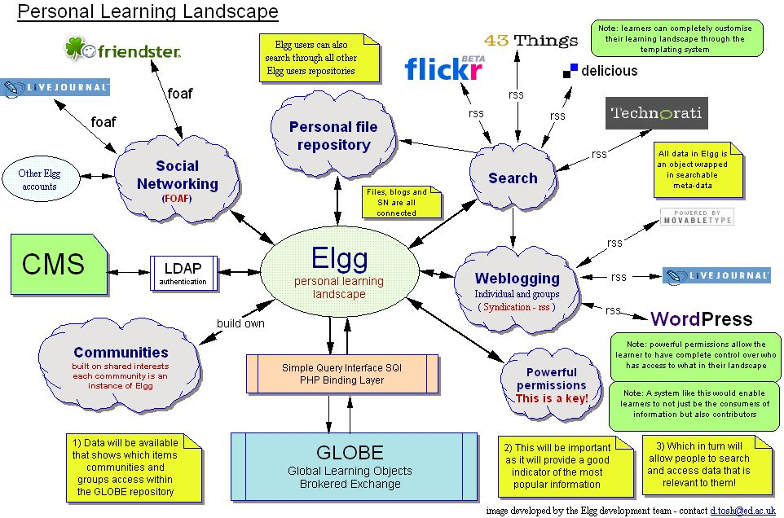
Elgg :: Personal Learning Landscape

Slide 67

eBooks for Libraries: 2004
Charleston Conference
Rick Lugg, Partner, R2 Consulting
November 5, 2004

Slide 68
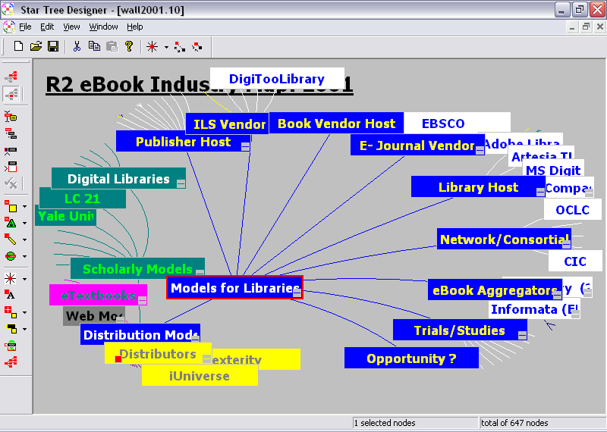

Slide 69
Using Dewey Differently
Research & New Technologies IG
OCLC Members Council
13 February 2006
Diane Vizine-Goetz
Thom Hickey

Slide 70
DDC added by Main Class
Try to label objects directly

Slide 71
Try to label objects directly

Slide 72
RedDot CMS Version 4.1.5
[text box]
look at the master

Slide 73
Die wichtigsten Neuigkeiten
Mediakatalog
RedDot CMS Cluster
Vollständig überarbeite Prozessverwaltung
Redlining für Versionierung und Workflow (Aufgaben)
Plug-In Schnittstelle
Integration Bearbeitungsdialoge für RD CIS im Template Editor
Geschwindigkeitssteigerung bei SmartEdit, Vorschau und Generierung
Neue Dialogsprache Italienisch

Slide 74
RedDot CMS Cluster – Architektur
Zugriff durch die Redakteure
Zugriff nur als Server Manager
Web Load Balancing
RedDot
Server
RedDot
Server
RedDot
Server
RedDot
Server
Datenbank
Server

Slide 75
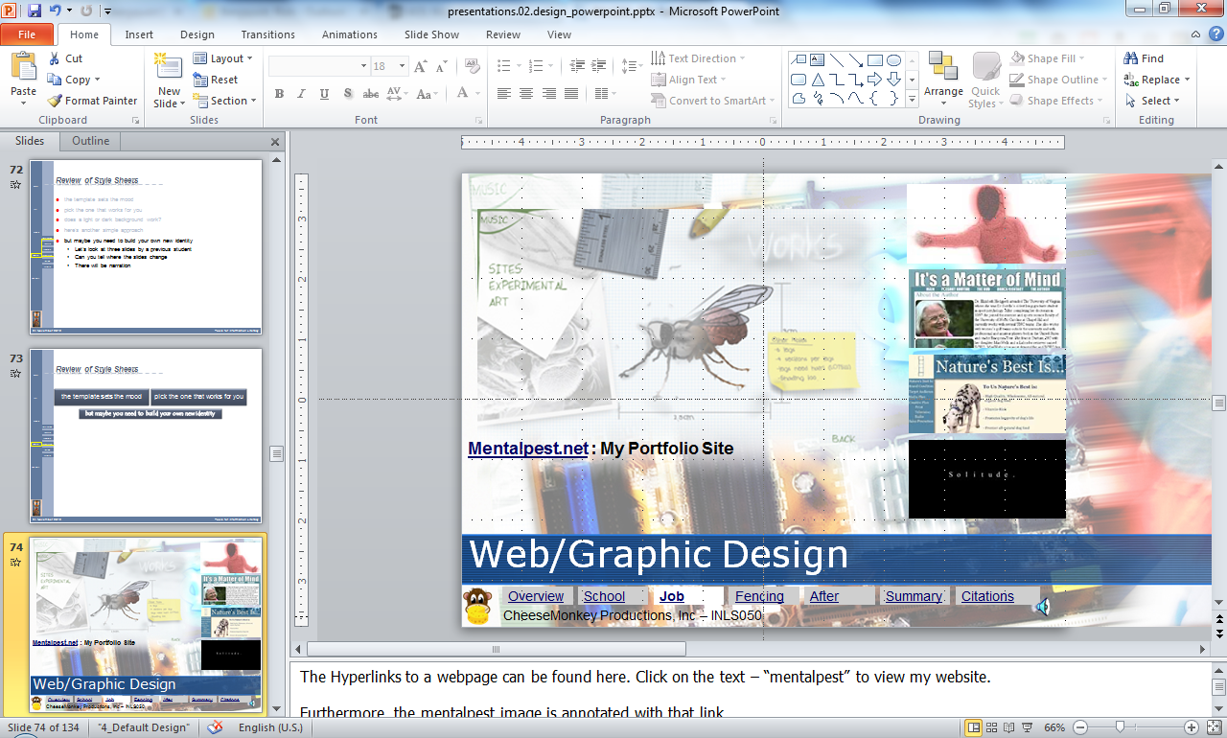
Don’t forget to adjust the sound
three slides by a previous student
Can you tell where the slides change?
but maybe you need to build your own new identity

Slide 76

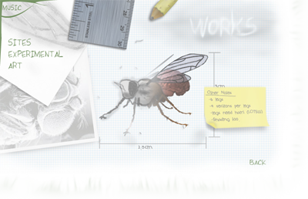
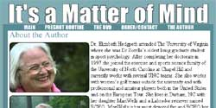


Web/Graphic Design
Mentalpest.net : My Portfolio Site
Overview
School
Job
Fencing
After
Summary
Citations
Notes:
The Hyperlinks to a webpage can be found here. Click on the text – “mentalpest” to view my website.
Furthermore, the mentalpest image is annotated with that link.

Slide 77

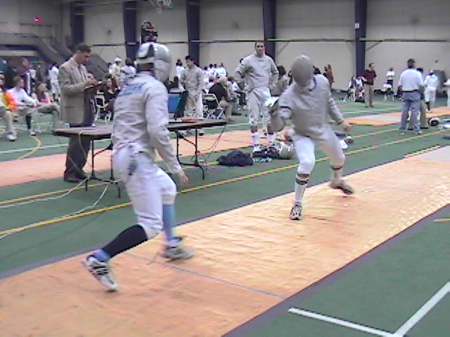



Fencing & Olympics
I will need to accumulate first National and then International points, by competing in tournaments.
Getting to the Olympics will be a combination of factors including; lifting, training, meditating through Zen Buddhism.
Overview
School
Job
Fencing
After
Summary
Citations
CheeseMonkey Productions, Inc – INLS050
Notes:
This section of the mural is a collage of me fencing a member of the Clemson club team, with the American Flag overlayed.
This was done to further imply the level to which I want to take fencing.

Slide 78

Post Olympics(?)
Not Sure What Comes Next…
Anything is possible…
Marriage?
Kids?
Coaching?
Overview
School
Job
Fencing
After
Summary
Citations
CheeseMonkey Productions, Inc – INLS050
Notes:
This section of the mural is composed of the American Flag and clouds behind it. The American flag transitions into the clouds, just as my life would transition away from fencing internationally to the rest of my life: whatever that may be.

Slide 79

Let’s move from formatting
Tell them what you’re going to tell them
Formatting

Slide 80
To objects
Tell them what you’re going to tell them
Formatting
Objects

Slide 81
Might this be a better image to use?
But be certain of your cultural messages
Formatting
Objects

Slide 82



Objects
they are of all kinds
you can
  copy existent objects
  modify (almost) any object
  create your own new objects
<object width="400" height="400" data="helloworld.swf"></object>

Slide 83
Design Tools
18 April 2016
[this  is an annotation]
the date is an automatic date object

Slide 84



[autoshape]
logos
[this is a text box]
modify pasted-in images

Slide 85
Variables
logo
Location B
Location A
Sample
new objects
Audio-Video
Analysis S/W
Audio-Video
Topo S/W
Shared Apps
Analysis S/W
AFM
Shared Apps
nM
Phantom
nM
Phantom
Notes:
There are six variables that may exist in combination at either Location A or Location B. A location may have all six of the variables tightly integrated together. A networked collaborating location may only have a subset of the variables, may lack one or more components. How they are arrayed and how they interact depends on a number of factors.

Slide 86


nano Network – NIEHS
captured from the web
modified
and grouped
Connection to NIEHS in RTP
Notes:
The next step will involve moving off the UNC-CH campus and connecting a suite of nanoManipulator equipment in Dr. Tom Kunkel’s lab at the National Institute of Environmental Health Sciences in Research Triangle Park.

Slide 87
Query Form: button
button sequencing
  hands on the steering wheel
  buttons that can be identified by location and feel
Radio
Map
E-Mail
Standard shapes
grouped to create sense of
a steering wheel
Notes:
The driver may input a query by pressing buttons that are accessible with the thumbs while the hands remain on the steering wheel. The buttons are arrayed so that the driver can press them with the thumbs while the hands remain at the 3 and 9 o’clock positions on the steering wheel. In each group of three buttons, the outside buttons have a raised center portion while the middle button has an indented center portion. The set of buttons on the left side are for activating one of the three functions. Each left hand button has only one task – a single push initiates a single function. The driver can thus feel which button is being engaged without having to look.

Slide 88
Query Form: voice
button sequencing
voice input
Radio
Map
E-Mail
Standard shapes
grouped to create sense of
a steering wheel
Notes:
The driver can also make a voice input to the system, though the system will have to be trained to recognize the driver’s voice and pronunciation. Voice input is made through a ceiling mounted microphone above the windshield in front of the driver.

Slide 89
Radio Query
Station
Location
Music Style
button sequencing
voice input
sequential actions or direct action
  driver’s choice
Radio
Map
E-Mail
Music Style
Location
Station
Notes:
An example of an input could be internet radio. The driver presses the radio button with the left hand to initiate the internet radio sequence. The system responds with a voice prompt, asking the driver to select a genre from a list pre-programmed into the system by the driver. It also displays the name of the depressed action key on the lower part of the windshield. The driver can either listen to a list of genres and hit the left button in the right hand group when the desired one is named or can say a genre name out loud. The system then goes through the same sequence asking for a country of origin, a subdivision of a country (as state, in the case of the USA), and finally a specific radio call sign. In each case, the driver has the option of permitting the system to seek an answer or of shortcutting the system with a voice prompt. In all three actions (genre, location, and station), the three buttons in the right hand group have two functions. Pressing one of the buttons initiates a sequence of actions. A subsequent push of the button stops the sequence and initiates a follow-on sequence if there is one (as there is in the location function).

Slide 90
Radio Response
KPIG
Freedom, CA
display on HUD (Head Up Display)
Radio
Map
E-Mail
Music style
Location
Station
Notes:
In the case of internet radio, the system will project the selected radio station on the windshield just to the right of the direct line of sight, but within the easy range of peripheral vision. The visual confirmation of the station will remain visible for 30 seconds and will be recallable with a button push, analogous to how current car radios work today.

Slide 91
Map Query
button to request GPS confirmation of present location
voice to request directions to a specific location
Radio
Map
E-Mail
Location
Directions
Map
Notes:
A map query follows the same structure. After initiating the map function with the left hand, the driver presses the left button in the right hand group to request the car’s present location. If the driver needs to know how to get from the present location to another location, the middle button is pressed and the driver then inputs the new location with a voice input. The locations will have to be ones that are retrievable in the map database, otherwise the system will respond with a voice request to select another desired location. The right button requests a map showing the current and desired locations.

Slide 92
Map Response 1
34.5N 74.6W
3 km NE of I-40 and I-85 interchange
text display on HUD
Radio
Map
E-Mail
Location
Directions
Map
Notes:
In the case of a GPS request, the system will voice the current location, with nearby reference points. To reinforce the aural response, it will also project the current location on the windshield just to the right of the direct line of sight, but within the easy range of peripheral vision. The visual confirmation of the station will remain visible for 30 seconds and will be recallable with a button push. The visual confirmation will be the same combination of latitude and longitude (or any map reference that the driver has preprogrammed into the system) and a reference to a nearby major geographic feature that the voice response provided.

Slide 93
Map Response 2
Durham, NC
5 KM
4 KM
NC55
5 KM
NC54
I-40
display on HUD
Radio
Map
E-Mail
Location
Directions
Map
Notes:
If the driver has requested driving instructions, the system will project a map on the windshield showing the present location at the bottom and the requested location at the top. The map will update itself every 60 seconds with a new GPS position for the car. The voice prompt will call out directions every 30 seconds until the driver either arrives at the desired location or the driver turns it off by pressing a button.

Slide 94
Email Query
hear sender names
hear notes
respond to notes
Radio
Map
E-Mail
Read Mail
ACK
ACK +
Notes:
Email is requested by the right button in the left hand set of buttons. The system would respond with the names of the senders, in the order of arrival of the mail. When the driver wants to hear a message, a press on the left button in the right hand group would prompt the system (a voice synthesizer) to read the note. The driver’s only capacity to respond will be to hit the middle button to send an automatic response of “Your message has been received at (date and time)” or the right button to send an a response of “Your message has been received at (date and time); I am unable to respond at the present time, but will respond more fully at a later date.”

Slide 95

Something from nothing
sound object
Why isn’t it here?
boom
Why does this one work?
Let’s deconstruct it
with a hidden slide

Slide 96
And it moves
boom
Let’s go back
to the visible slides

Slide 97

But, what else can we do with objects?
We can animate them

Slide 98


Various ways to keep the focus
Hiding slides
Animation
Linking
Handouts
Formatting
Objects

Slide 99
Object animation
But before we see them,
we’ll hide a few slides
Go to the hidden slide

Slide 100

How do we hide a slide

Slide 101


How do we get back

Slide 102

Object animation - Sound & Movement

Slide 103

Arab Translation Efforts
Notes:
The period shortly before Ibn Fadlan’s time was the high-water mark of Arab/Muslim intellectual progress. The century from ca. 750 – 850 CE was an epoch of translation as the Abbasid capital of Baghdad was the center of a massive effort to translate into Arabic the knowledge of the ancient world. As seen in this map from 1884, Baghdad was situated at the crossroads between the west and east, where Arab translators drew in Greek works from Asia Minor through Syria and Palestine and from the repositories in Alexandria in North Africa. Persian works came from Iran, and Hindu works from India. Among other things, the Arabs translated works on medicine from the Greeks, Hindus, and Persians and added their own discoveries in anatomy, ophthalmology, pharmacology, epidemiology, and the veterinary sciences to the body of work that was later to be translated from Arabic into Latin for introduction into Europe.

Slide 104
Arab Translation Efforts
Notes:
The period shortly before Ibn Fadlan’s time was the high-water mark of Arab/Muslim intellectual progress. The century from ca. 750 – 850 CE was an epoch of translation as the Abbasid capital of Baghdad was the center of a massive effort to translate into Arabic the knowledge of the ancient world. As seen in this map from 1884, Baghdad was situated at the crossroads between the west and east, where Arab translators drew in Greek works from Asia Minor through Syria and Palestine and from the repositories in Alexandria in North Africa. Persian works came from Iran, and Hindu works from India. Among other things, the Arabs translated works on medicine from the Greeks, Hindus, and Persians and added their own discoveries in anatomy, ophthalmology, pharmacology, epidemiology, and the veterinary sciences to the body of work that was later to be translated from Arabic into Latin for introduction into Europe.

Slide 105
Transmission to the West
Notes:
This knowledge that was translated and, on occasion, originally discovered in Baghdad was disseminated throughout the Arab world. It came into contact with the west in the Iberian peninsula where Muslim centers of learning, most notably in Cordoba, Spain became a source for European knowledge. What began initially as a Christian religious effort to gather information from the Muslims to use against them in polemical ways, over time developed into a serious effort to learn from the Arabs and to translate the Arab works into Latin for wider dissemination into the European environment.

Slide 106

Let’s use this opportunity to create new slides and animate new objects
Note the template change
Make some new slides about a new topic
Done to introduce a new look
Are NSA'S Prism PowerPoint Presentation Slides The Worst Ever Made?
Those PRISM Slides Are Hideous
Here, NSA. We redesigned them for you.
While we’re at it, let’s make them seem a little friendlier (after all, secret government data miners are people too!).

Slide 107

Object animation - Design-objects-navigation

Slide 108
Triangular Approach
Goal:
Give voice to those who aren’t usually heard
Observation
Documents
Interviews
starting with history
to compare what I heard with what I saw
to ask about what they think
Notes:
It’s overriding goal was to bring the underlying stories of effort and interest to the level of public awareness.

Slide 109
Looked at the development of these libraries in four contexts
How the library can become bound up in the issue of who is in control
Philosophical
Political
Professional
Community
Notes:
All the public libraries under discussion are part of some local political structure and all of them have evolved in some fashion within that structure. Part of the story is about how the library found its place in local government.

Slide 110
Findings
How did they get to where they are?
Notes:
So what do these stories tell us?

Slide 111
1900 – proto libraries
Robbins
Carthage
Southern Pines
Vass
Aberdeen
Pinebluff
Niagara
1905
1920
1930
1940
1950
1960
1970
1980
1990
2000
2005
Notes:
Maybe we might look at those timelines again, this time looking at them all together. Remember, before the first building was erected, four towns had fledgling libraries that were somewhat influenced by the railroad that connnected them all.

Slide 112
By 1910 …
Robbins
Carthage
Southern Pines
Vass
Aberdeen
Miss Page donates building
Pinebluff
Pinebluff Library Associations
Niagara
1905
1920
1930
1940
1950
1960
1970
1980
1990
2000
2005
Notes:
Aberdeen was the first building and Pinebluff was the first Association.

Slide 113
By 1920 …
Robbins
Carthage
Women’s Club operates
Southern Pines
Vass
Aberdeen
Town donates annual facility fee
Pinebluff
Town donates building
Niagara
Mr. Webster donates library
1905
1920
1930
1940
1950
1960
1970
1980
1990
2000
2005
Notes:
Niagara added a donated building at the same time as the Carthage Women’s Club started to operate a library in donated spaces. Aberdeen started to pay a bit for the Aberdeen library, but Pinebluff gave the library a place to be.

Slide 114
By 1930 …
Robbins
Carthage
Starting to need more funding
Southern Pines
Feels need to compete as literary place
Vass
Aberdeen
Starting to need more funding
Pinebluff
Center of social activity
Niagara
Center of social activity
1905
1920
1930
1940
1950
1960
1970
1980
1990
2000
2005
Notes:
The 1920s were a good time for most of them, but even so, funding was starting to become an issue.

Slide 115
By 1940 …
Robbins
Women’s Club starts up
Carthage
Women’s Club gives up
Southern Pines
Uses WPA funding to build new facility
Vass
One year, one person attempt to start a library fails
Aberdeen
Running on a shoestring
Pinebluff
Becomes “public” in operation, remains private in funding
Niagara
Librarian dies, no more books checked out
1905
1920
1930
1940
1950
1960
1970
1980
1990
2000
2005
Notes:
Carthage ran out of private funding early and the town did not pick up the slack. Niagara found out that it didn’t have what it needed to keep the place open after the librarian passes. Vass tried, but didn’t find support. Southern Pines got a new facility, but Aberdeen continued its slide. Pinebluff decided that it would be better situated if it operated as a public library even if the only public funds were facility maintenance.

Slide 116
By 1950 …
Robbins
County librarian visits keep it open
Carthage
de facto county branch library
1941 – state funding for county libraries
Southern Pines
Offers shared use of facility to county
Vass
Aberdeen
Crisis and partial recovery
Pinebluff
Continues on
Niagara
County bookmobile depository, community center
1905
1920
1930
1940
1950
1960
1970
1980
1990
2000
2005
Notes:
With state money came a county level effort. As the county effort evolved, the others struggled to get by. Niagara still had a library even if it was no longer checking out books.

Slide 117
By 1960 …
Barely hanging on
Robbins
Carthage
County, not town, library
Southern Pines
Pulls away from county involvement
Vass
Aberdeen
Getting by, but not thriving
Pinebluff
Votes for library tax & bond, new library
Niagara
Community center
1905
1920
1930
1940
1950
1960
1970
1980
1990
2000
2005
Notes:
The two-town county library experiment ended. Everyone else was suffering, except for Pinebluff which decided that if a library was a necessity for a town, then a regularized way of supporting that library was needed.

Slide 118
By 1970 …
Barely hanging on
Robbins
New blibrary, Sandhill Regional Library Hqs.
Carthage
Southern Pines
Independent town library
Vass
Aberdeen
Getting by, but not thriving
Pinebluff
Destroyed by fire
Niagara
Still there
1905
1920
1930
1940
1950
1960
1970
1980
1990
2000
2005
Notes:
Southern Pines had gone its own way. Carthage had lost its town library, but gained a regional library. Pinebluff had lost it’s library to fire, Aberdeen and Robbins still had theirs, but they were wobbling. Niagara still had its, but was it really a “library”?

Slide 119
By 1980 …
Can’t afford to become county branch - closes
Robbins
Bookmobile to towns
Carthage
Southern Pines
Vass
Aberdeen
More crises
Pinebluff
Rebuilt as before
Niagara
1905
1920
1930
1940
1950
1960
1970
1980
1990
2000
2005
Notes:
Robbins couldn’t sustain its library, but Pinebluff could. The county tried to help by sending its bookmobile to the towns.

Slide 120
By 1990 …
Still closed
Robbins
Adds branches
Carthage
Southern Pines
Vass
Joins on county terms
Aberdeen
Pinebluff
Joins on town terms
Niagara
1905
1920
1930
1940
1950
1960
1970
1980
1990
2000
2005
Notes:
The county system started to spread as town libraries saw advantages in affiliation.

Slide 121
At the end of a century
Robbins
Carthage
Southern Pines
Vass
Aberdeen
Pinebluff
Niagara
1905
1920
1930
1940
1950
1960
1970
1980
1990
2000
2005
Notes:
Robbins and Vass made comebacks and opened nice, new library facilities. Niagara still has a nice, old facility, but does it have a library?

Slide 122
Different paths taken, but some commonalities
Robbins
Carthage
Southern Pines
Vass
Aberdeen
Pinebluff
Niagara
1905
1920
1930
1940
1950
1960
1970
1980
1990
2000
2005
Notes:
The lines look different, but some things are the same.

Slide 123
Local philanthropy was a spur
Donated land
Robbins
Carthage
Southern Pines
Vass
Donated building
Donated building
Aberdeen
Donated building
Pinebluff
Niagara
1905
1920
1930
1940
1950
1960
1970
1980
1990
2000
2005
Notes:
Many towns could not have started had they not had residents who had the means to be generous.

Slide 124
Local organizations were key
Women’s Club started it all
Robbins
Women’s Club started it all
Carthage
Southern Pines
Vass
Aberdeen
Pinebluff Library Association was a women’s organization
Pinebluff
Niagara
1905
1920
1930
1940
1950
1960
1970
1980
1990
2000
2005
Notes:
Generosity of spirit was also critical. Volunteerism was key from the start.

Slide 125
But, for some, it wasn’t enough
Club alone couldn’t keep it up
Robbins
Club gives up
Carthage
Southern Pines
Vass
Aberdeen
Pinebluff
Niagara
1905
1920
1930
1940
1950
1960
1970
1980
1990
2000
2005
Notes:
… even if it wasn’t enough to be successful in some places

Slide 126
When state money became available, the county became involved
Robbins
State offers assistance to county library services
Carthage
Jointly acting as county library
County Outreach
Decides to opt out, go it alone
Southern Pines
Vass
Aberdeen
Pinebluff
Niagara
1905
1920
1930
1940
1950
1960
1970
1980
1990
2000
2005
Notes:
When the state offered some financial support, libraries became more of a reality in several places.

Slide 127
One library experienced it all
Robbins
Carthage
Southern Pines
Vass
Aberdeen
Pinebluff
Only town to tax itself
Only town to bond itself
Started with donations and a club
Rebuilt itself
Joined on its own terms
Niagara
1905
1920
1930
1940
1950
1960
1970
1980
1990
2000
2005
Notes:
But only one town experienced a complete evolution from private through town to county branch status. What made it different?

Slide 128
Key to success – individual continuity
Robbins
Theron Bell
Carthage
Southern Pines
Vass
John Wallace
Aberdeen
Mary Page
Pinebluff
Mary Page
Charlene Parker
Niagara
1905
1920
1930
1940
1950
1960
1970
1980
1990
2000
2005
Notes:
The key in many places was the individual effort and individual determination to provide library and reading services for their towns. But maybe what makes Pinebluff different is that it, alone among the towns, was able to sustain community, or group, efforts longer and more consistently. It wasn’t just one person, it was a village.

Slide 129




You can link any object
To a slide, to a web location, to a file location

Slide 130

Why handouts?
Sometimes you want to give them something to take away
Consider giving out the handouts at the beginning
  With room for them to take notes along with you

Slide 131


Or Notes pages
If your audience needs to see both your visuals and your notes
you can format to suit your needs
Notes:
You can give them your notes

Slide 132
Agenda
Thinking about PowerPoint
Working views
Designing a presentation
Tour the workspace
Delivering a presentation
Notes:
Tell ‘em what you’re going to tell ‘em

Slide 133
Agenda
Thinking about PowerPoint
Working views
Designing a presentation
Tour the workspace
Delivering a presentation
Notes:
Tell ‘em what you’re going to tell ‘em

