Slide 1
Maps and GIS

Slide 2
Historical Maps

Slide 3
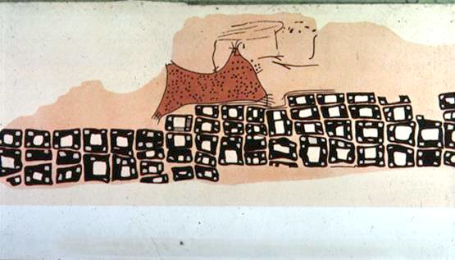
The oldest map?
Konya town map, Turkey, c. 6200 BC
Milestones Project
http://www.math.yorku.ca/SCS/Gallery/milestone/

Slide 4
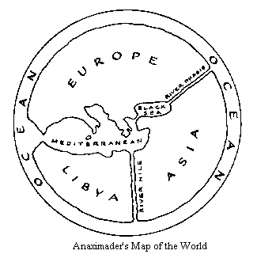
The First World Map
Anaximander of Miletus, Turkey, c. 550 BC
Milestones Project
http://www.math.yorku.ca/SCS/Gallery/milestone/

Slide 5
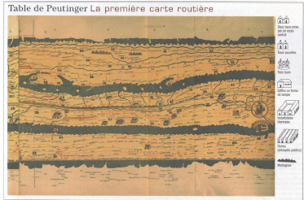
First Route Map
Roman road map, c. 366-335 BC
Milestones Project
http://www.math.yorku.ca/SCS/Gallery/milestone/

Slide 6
South Sea Islander’s Map
Based on slide from B. Tversky
Notes:
All later sources parrot the explanations of the charts given by Winkler: that the sticks (identified by Davenport as 'palm ribs bound by coconut fiber') represent nothing geographical, but rather the patterns of wave-swells between islands in the archipelago. Here is the secret—the navigators of the Marshall Islands locate island-masses by calculating the refraction and reflection of wave-fronts around and against the island shores. This is a technique specific to the geography of an island nation, and cannot be found anywhere else in the world. Every article on the subject, including the Wiki piece, explains the method to some degree, showing how a wave-swell reacts when it hits an island—curving around at an angle, and interfering with itself and with swells coming from other directions. The patterns of interference coalesce into long lines of 'nodes', stretching out to sea—the navigator can follows these nodes to the island.

Slide 7
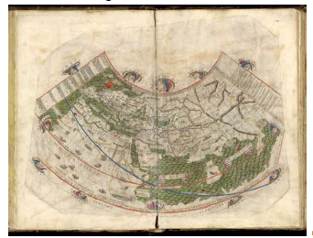
Ptolemy’s World Map
First use of longitude, c. 150 AD
Milestones Project
http://www.math.yorku.ca/SCS/Gallery/milestone/

Slide 8
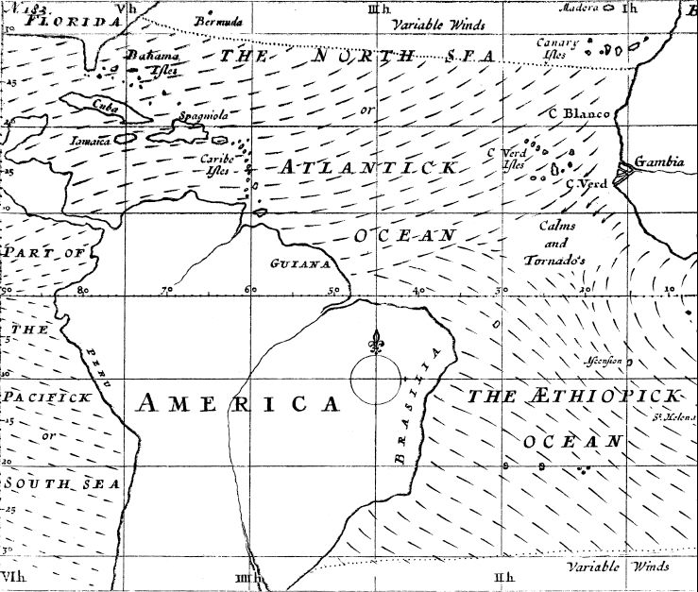
First Weather Map
Halley’s wind map, 1686

Slide 9
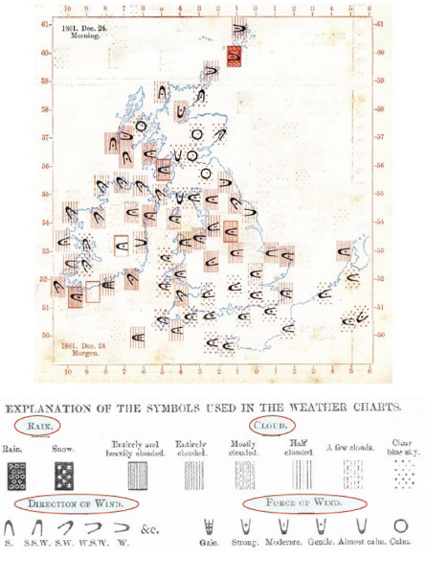
Galton’s Weather Map
Measurements 1861
Milestones Project
http://www.math.yorku.ca/SCS/Gallery/milestone/

Slide 10
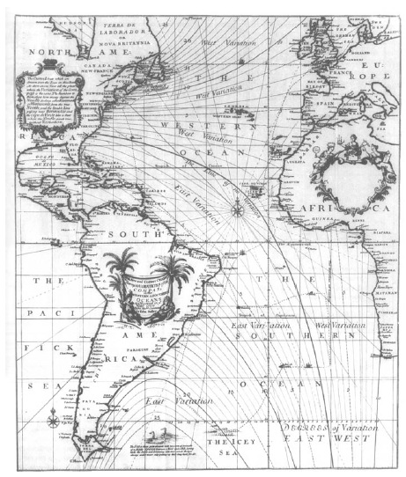
First Contour Map
Halley’s lines of equal magnetic declination, 1701

Slide 11
Park Map (contour)
wikipedia.org

Slide 12
Mapping geographic data
Visualizing information which has a spatial component
Graphical representations of our environment
Examples of types of maps:
Chloropleth (single variable displayed using color, texture on accurate geographic region)
Cartogram (area used to display value)
Topographic (accurate detailed depiction of cultural and natural features)
Nautical charts (same for bodies of water)
Image (pictures from sky of land/water)
Thematic (tell a story)
Abstractions (driving directions)
etc. etc.

Slide 13
Maps, Earth and Projection
Many properties can be measured on the Earth's surface independently of its geography. Some of these properties are:
Area
Shape
Direction
Bearing
Distance
Scale
Map projections can be constructed to preserve one or more of these properties, though not all of them simultaneously. Each projection preserves or compromises or approximates basic metric properties in different ways. The purpose of the map determines which projection should form the base for the map. Because many purposes exist for maps, many projections have been created to suit those purposes.
http://en.wikipedia.org/wiki/Map_projection

Slide 14
Cont’d
Another major concern that drives the choice of a projection is the compatibility of data sets. Data sets are geographic information. As such, their collection depends on the chosen model of the Earth. Different models assign slightly different coordinates to the same location, so it is important that the model be known and that the chosen projection be compatible with that model. On small areas (large scale) data compatibility issues are more important since metric distortions are minimal at this level. In very large areas (small scale), on the other hand, distortion is a more important factor to consider.
http://en.wikipedia.org/wiki/Map_projection

Slide 15
Map Projections
When mapping the earth, we must consider how to transform the 3D sphere (geoid) into a 2D plane that can be displayed on computer screen or print map.
Map projections are geometric transformations which do this. There are an infinite number of possible projections, but three major variants:
Conic, using a cone touching the sphere on a line (or two)
Planar (azimuthal), contact at one point on the sphere, accurate at that point
Cylindrical, contact at a line

Slide 17
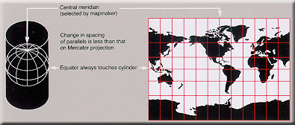
Projection Surface
Cylinder
The Mercator projection is a cylindrical map projection presented by the Flemish geographer and cartographer Gerardus Mercator, in 1569. It became the standard map projection for nautical purposes because of its ability to represent lines of constant course, known as rhumb lines or loxodromes, as straight segments (wikipedia.org)

Slide 18
Preserving spatial characteristics
There are four major features we may wish to preserve on a map:
Shape – feature shapes are maintained (conformal) (but we lose accuracy of size)
Area – the size of features are the same as in reality (lose shape)
Distance – the distance from a point to other points is preserved (typically on azimuthal projections)
Direction – the way to get from A to B is preserved as a straight line

Slide 19
Map Projection Choices
How does this affect our thinking?
Question #1: What is the smallest area?
China
US
Africa
Western Europe
Argentina

Slide 20
Question #2: What is the biggest area?
China
US
Africa
Western Europe
Argentina
By how much is it bigger?

Slide 21
http://strangemaps.wordpress.com/2006/11/20/35-the-size-of-africa/

Slide 22
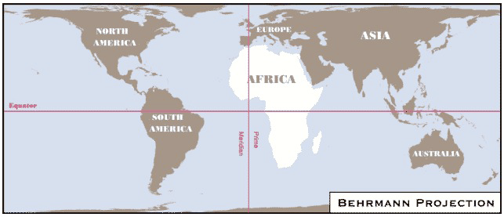
Two different cylinderical map projections
http://exploringafrica.matrix.msu.edu/
students/curriculum/m1/exercise1.php

Slide 23
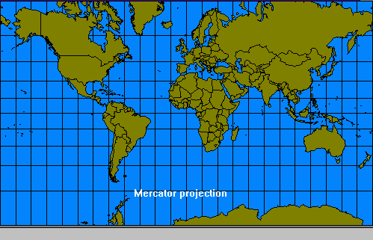
Direction-preserving: Mercator map projection
Question #3: Which is bigger: South America or Greenland?

Slide 24
Direction-preserving: Mercator map projection
Problem with this projection:
Area of Greenland: 2,166,086 sq km
Area of South America: 17,819,000 sq km – around 8 times larger!
This projection has often been accused of furthering tensions between North and South

Slide 25
Area-preserving Map: Peters

Slide 26
Latitude-Longitude
Snyder, “Flattening the Earth”
Based on slide from Hanrahan

Slide 27
Sinusoidal: Equi-Area
Snyder, “Flattening the Earth”
Based on slide from Hanrahan

Slide 28
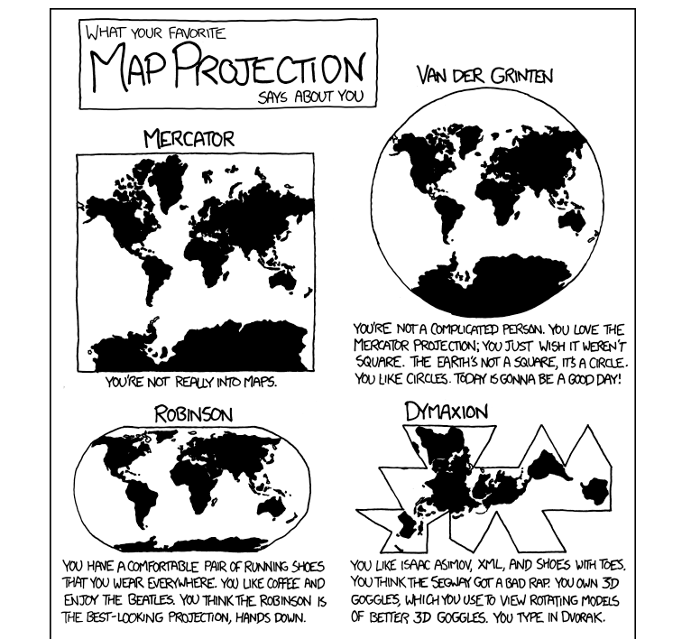
And for the real authority…
XKCD

Slide 29
What does most use look like?
Small scale, web based (route planning, local map (Google Maps), or sometimes larger extent (Google Earth)).
Main issue is to provide tools and interactions that operate accurately with respect to reference scale size.
How far is the airport?
What is the area of the property?
and that data from multiple sources aligns properly.

Slide 30
What are the big issues?
While many folks concentrate on whole earth projections, here’s what I think are the “big” issues:
Democratization of access to maps and individual control of maps
Ubiquitous GPS
Personal maps (Google My Maps)
Interactive Maps
Displaying multivariate data on maps

Slide 31
Biggest Change #1: GPS
Use of GPS systems is transforming maps in that individual users have accurate spatial location information (x,y coordinates on surface of earth). Think about
Explorers just click button to record where they are. Lost hikers locations are known.
Giving your home address as spatial coordinates
Recording spatial information with everyday actions (pictures taken, location of person via their cellphone, location of your car, geocaching, geoURL)
Marking property lines by absolute GPS and not landmarks or line of sight surveyors.

Slide 32
Biggest Change #2: Personal Maps
With the advent of the web, and dynamic maps, access to public information and mobile devices that supply GPS information, everyone can now interact with maps. They can both use, and contribute to maps. They can do it dynamically, and interact with maps and share maps and information on maps.

Slide 33
Personal Maps Examples
Route finding (Google Maps); sidenote: when was the pan/zoom interface commonly used in applications like Google Maps first published (late 1980s, comparative study in early 1990s)?
MapMyRun
HousePrices (Zillow)
Transit Maps
Next Bus, Seattle’s home grown One Bus Away (note positive effect on consumers)
Google’s format (GTFS) has enabled many such projects (transforming the industry)
Shopping, restaurants (Yelp)
You suggest!

Slide 34
Interactive Maps
Music Box (video, URL), visualization with faceted browsing, multiple selection techniques
Snake Oil (URL), map as an informative layout of categorical/nominal items, with rollover for detail.
Newcomers to New York (URL), standard spatial map but including time, and telling story about people living in neighborhoods, supports indexing searching
American Museum of Natural History map (URL), good HCI interface for visualizing exploring/understanding layout of museum with multiple floors.
Spotfire (URL): Airline Incident Analysis, Fantasy Football show multiple panes, trellis style, with linked updates.
As we go through these examples, identify the visualization techniques (combined with HCI techniques) used to effectively (or ineffectively) to present the data.
Notes:
For Spotfire, choose airline incident analysis. Talk about data type choice. Original is continuous then map to interval “hidden” behind the scenes. Bad is that they shown only scale of pos/threshold/neg (blue/white/red), but the maps shows interval graduations of red and blue. Better choice: don’t separate control from legend. Make one and make directly representative. I.e. have bar showing color graduation scale with the control bar displayed on this, allowing you to directly manipulate. (Always use direct controls when possible, and do NOT separate a single “mental” object into multiple separate things (control bar, and legend, etc). Also, don’t like that they highlight in different color (anytime you change representation adds mental load. Just highlight outline or something instead. In other like gas prices it actually changes color to match opposite value which is really confusing).

Slide 35
Multivariable Maps

Slide 36
Map Basics
Datatypes
Raster
Vector

Slide 37
Geographic Data Models - Raster
Models spatial areas by recording the locational extent of a variable
Uniformly spaced grid of discrete cells (pixels)
Simple model, simple storage, 1-1 mapping with display devices
Examples: digital photography, passive and active remote sensors (Landsat, Radarsat)
Terraserver example

Slide 38
Vector Data Models
Based on the objects that populate a space
Typically broken into four categories
Points – a city on a small-scale map
Lines - a hiking trail
Areas - a wildlife area
Volumes – 3d modelling (TINs)
Spatial objects have topological relationships
Near, beside, inside, intersection, bounds…
We can also operate at a higher level of abstraction:
Composition, etc.

Slide 39
Geographic Information Systems
A computer-based approach to managing digital spatial data (layering)
Most powerful programs combine vector and raster tools
Using topology, the GIS can be used for spatial query and inference
Show me what features are within 50 meters of object of interest.
In what census tracts > 100 sq km is the median age less than 40?

Slide 40
GIS Links and References
Grass
GeoVRML.org
Terraserver (noww MSR Maps)
GeoURL.org
ArcView (ArcInfo/ArcExplorer)
wikipedia list

Slide 41
Geodata from GPS
http://openstreetmap.org/
http://www.geograph.org.uk/

Slide 42
Spatial Information Visualization
Information visualization is well suited to spatial data
Large volumes of data
Novice users can receive clear explanations
Expert users can access high level of detail (e.g. Napoleon’s march), and especially if interactive
Map design process
1 – visualize different solutions
2 – specific plan: classes, symbols, etc.
3 – implement details on map construction
Emphasis for symbols
Point, line, area, volume emphasis
Is 3D a viable visualization metaphor? Why or why not?

Slide 43
Cartographic Design Principles
Enhance legibility
Clear and accurate text and graphics
Leverage familiarity
Ensure visual contrast
Symbols need to be distinguishable
Maintain figure-ground organization
Differentiation
Gestalt principles
Use hierarchical organization
Good graphic structure essential

Slide 44
Cartographic abstraction
Generalization is the technique of abstracting information at various levels
Four major techniques in cartography
Classification – order, scale, group
Simplification – reduce amount of information
Exaggeration – enlarge to capture essence
Symbolization – stylize attribute values (Bertin)

Slide 45
Maps and Interaction
Static maps – historical images (Baghdad), translations of paper maps, limited interactions (e.g. mouseover popups)
Fixed Animations – movies such as Flash, video, user has control of playback (forward, reverse, speed)
Dynamic maps – user has control of maps. Zoom/Pan selection/removal of objects, control of time/animation, filtering, etc. Really leverage the power of the computer.
Dynamic maps, like other web technologies, allow us to move from a push model to a pull model, where the user is in control of what they want to see, how they want to see it, and when they want to see it.

Slide 46
Web mapping tools
Flash and SVG – the vector drawing packages
Internet map servers.
ESRI IMS
MapInfo
Where is this area headed?
OpenGIS.org
3D viewers (mars)
VRML / X3D
What’s new since 2010—
Flash is dead
2D/3D Graphics is well supported directly in HTML5 (canvas object) and through SVG and WebGL. See Google Experiments for examples

Slide 47
Let’s Look at Some Examples

Slide 48
Cartograms
Mini-quiz: What’s definition of “cartogram”?

Slide 49
Scale Area by Data
Dent, “Cartography”
Based on slide from Hanrahan

Slide 50
Scale shape by value

Slide 51
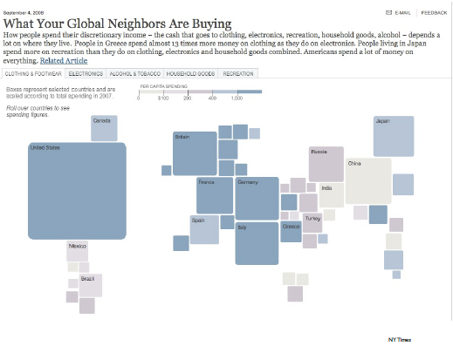
URL

Slide 52
Standard Maps Plus 1D/2D Data
Primary ways to display
Color
Symbol/icon
Bubbles
height

Slide 53
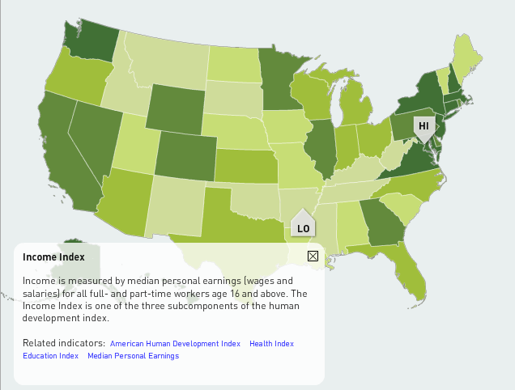
Color
1D as single hue shading
Name for this is?

Slide 54
Color
1D as single hue shading
Name for this is?
Chloropeth

Slide 55
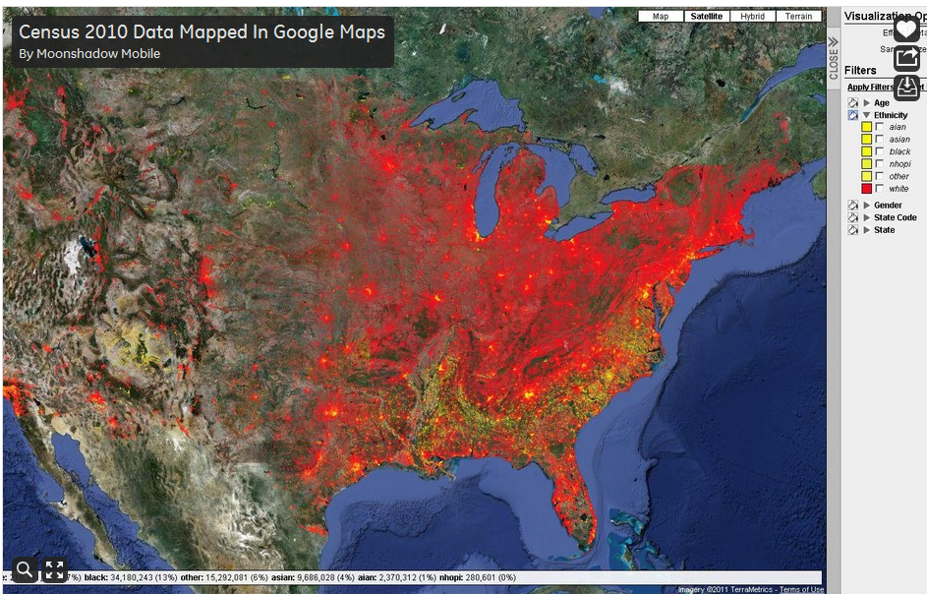
Overlapping use of color
What are problems with this map?

Slide 56
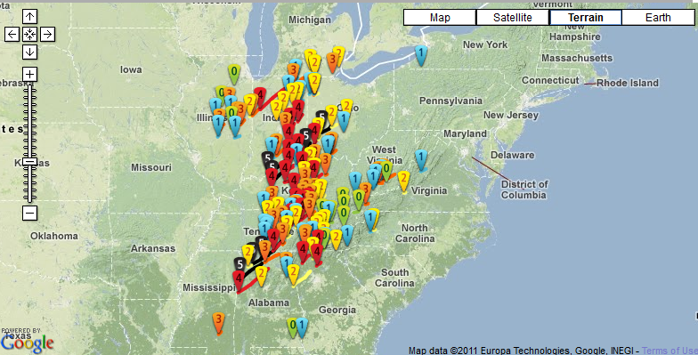
Symbols for 1D: what’s good/bad how can you do this better?

Slide 57
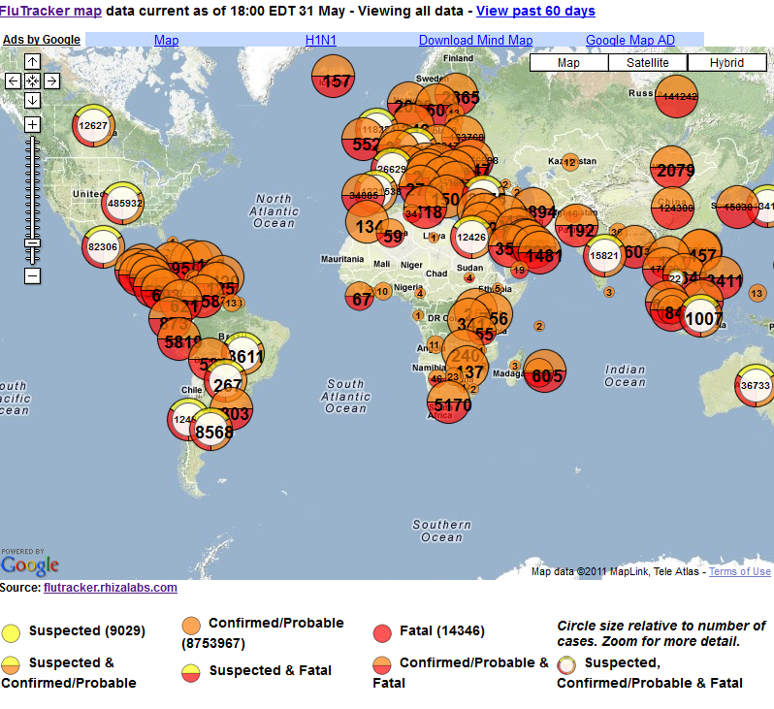
FluTracker
Size of circles
Color/style
Is overview too dense?

Slide 58
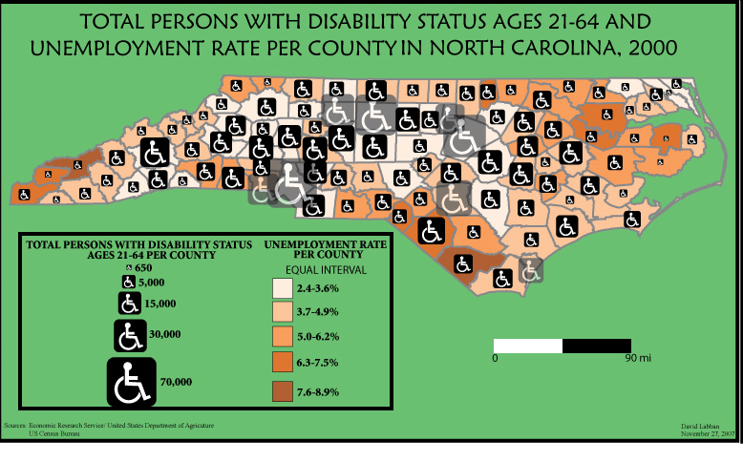
Symbols/Icons (plus color)

Slide 59
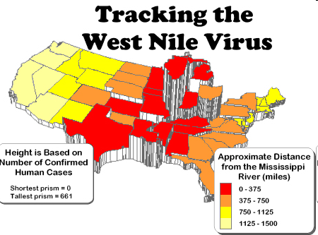
Height plus color

Slide 60
Bubbles
M. Ericson, NY Times

Slide 61
M. Ericson, NY Times

Slide 62
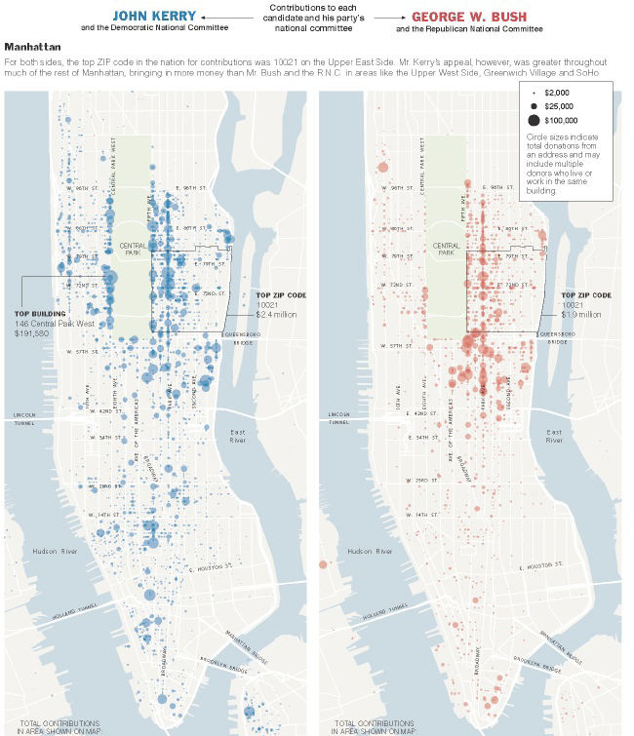
M. Ericson, NY Times

Slide 63
When not to use Maps?
Profile: Matthew Ericson NY Times
Homepage www.ericson.net
Produced many great visualizations for the NY Times.
Write about his visualizations AND about how he does them.
When Maps Shouldn’t be Maps

Slide 64
Flow Maps
“Patterns over time”
What if we could track objects over time? And could visualize their paths? What would be the best ways to do this?
Show all the individual routes?
Show summaries?

Slide 65
PS… we can track…(everything)
Traces of activity from GPS
http://geotracing.com/
http://realtime.waag.org/ (Amsterdam RealTime)
Social Networks (summary 2012)

Slide 66
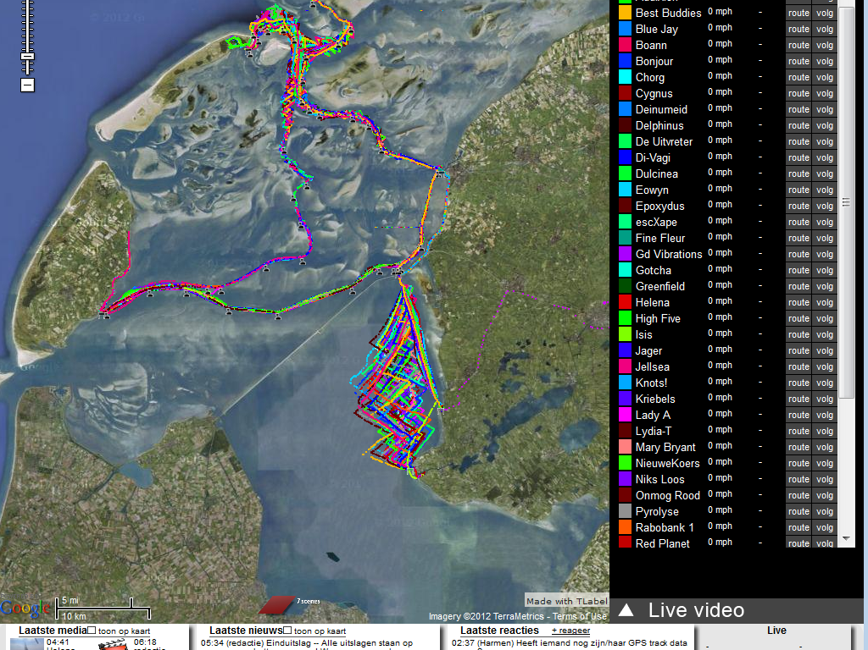
GeoTrace (2008) sailor’s paths

Slide 67
People’s Paths (Amsterdam realtime)

Slide 68
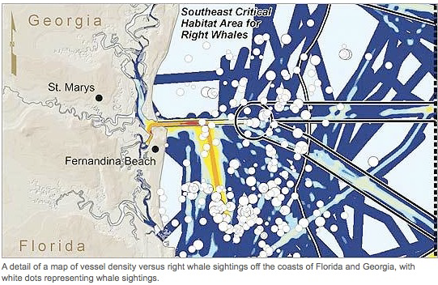

Slide 69
Passengers on Principal Railroads, 1862
Milestones Project: Data Visualization Gallery

Slide 70
Effect of US Civil War on Cotton Trade

Slide 71
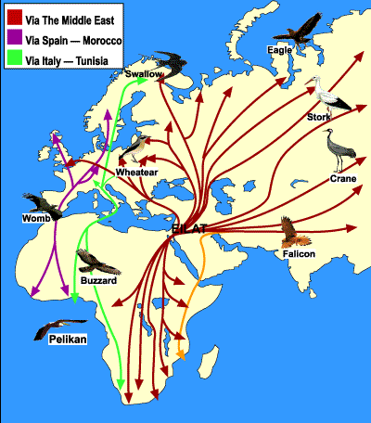
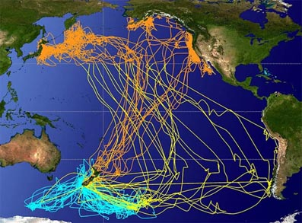
Bird Migrations (see eBird project)

Slide 72
Imagine if we know your every move…
What would your day look like?
Could we better plan cities, transit, work schedules, etc?

Slide 73
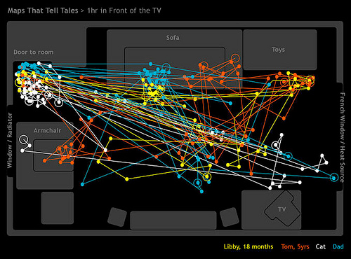
One hour in front of the TV
Like the “traces” showing paths. Eyetracking research is shown this way, and movements of tracked animals, etc.
Map by The Bumblebee
http://www.flickr.com/photos/the_bumblebee/2229041742

Slide 74
Route Maps

Slide 75
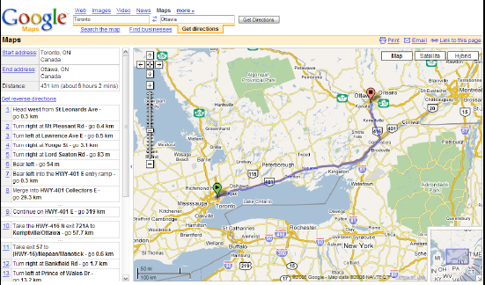
EXACT geography;
landmarks scale dependent

Slide 76
Pros and Cons of exact maps (matching reality in scale and/or appearance) versus abstracted maps (that adjust to emphasize things more meaningful to user).
How do people give directions?
How should computers give directions?
Notes:
Computers:
Precise
Incorporate visual landmarks
Know exactly where you are
Can take advantage of your prior behavior knowledge (go past your CVS store, then turn right)

Slide 77
Landmarks & Paths

Slide 79
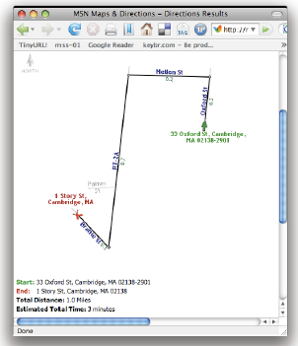

Slide 80
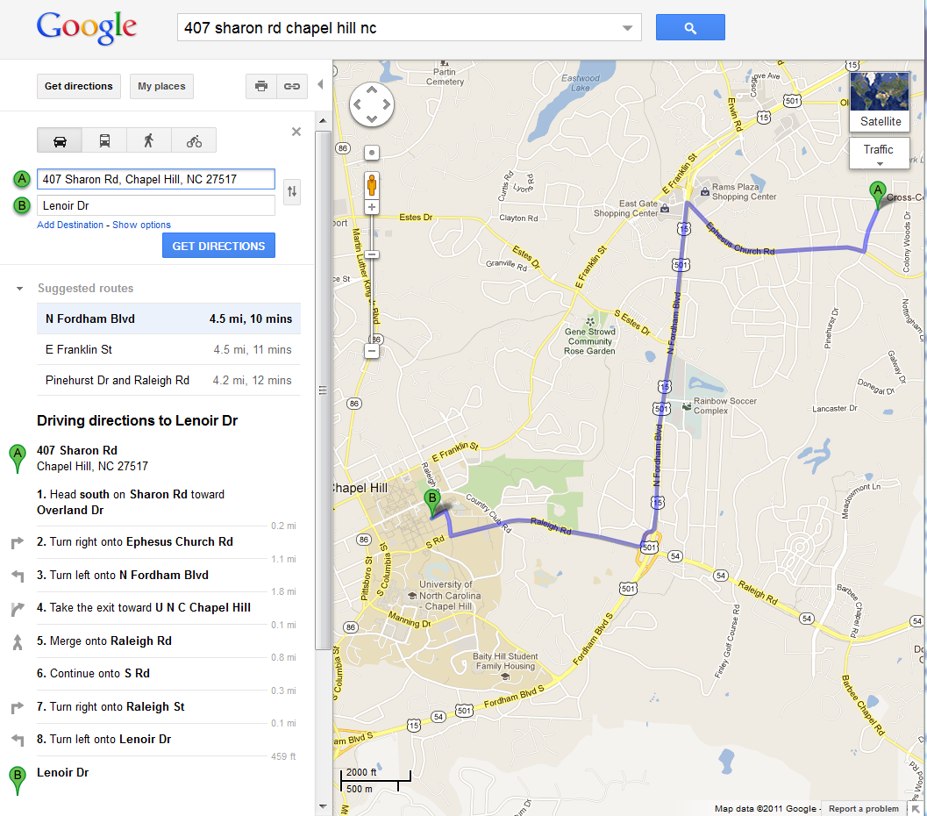
GoogleMaps
(circa 2011)
With this map dynamically scalable, what else do you need (hint: CUT).
Brainstorm: what the best interface!

Slide 81
Real-Time Maps

Slide 82
Traffic Maps
LA DOT
Navtec
SigAlert
Which do you prefer?

Slide 83
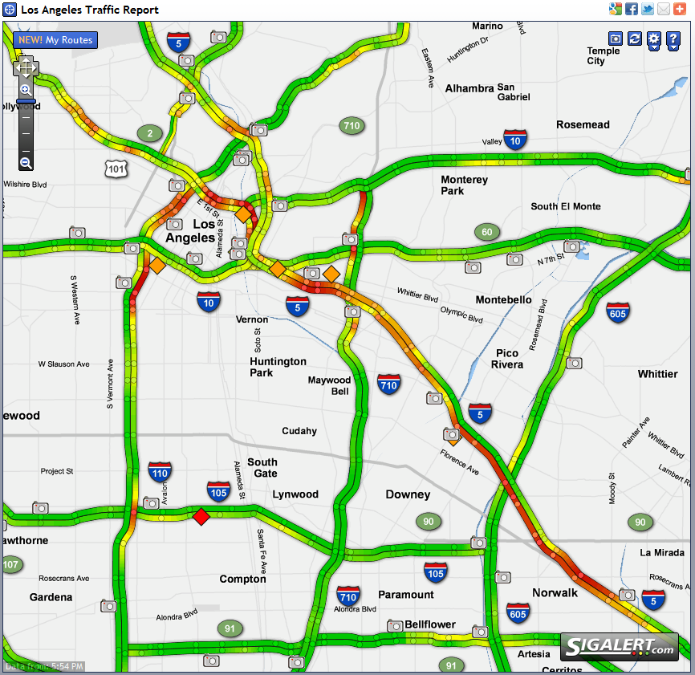
Traffic Maps

Slide 84
Thematic Maps
Themes, points of view, stories to tell
Often times, these may be combinations (using same chloropeth or symbol based 1D or 2D maps we looked at earlier)

Slide 85
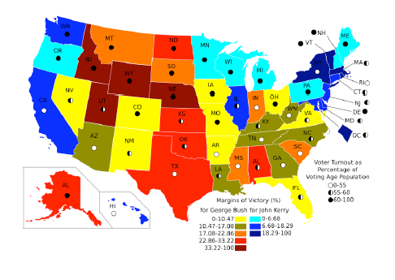
wikpedia.org

Slide 86
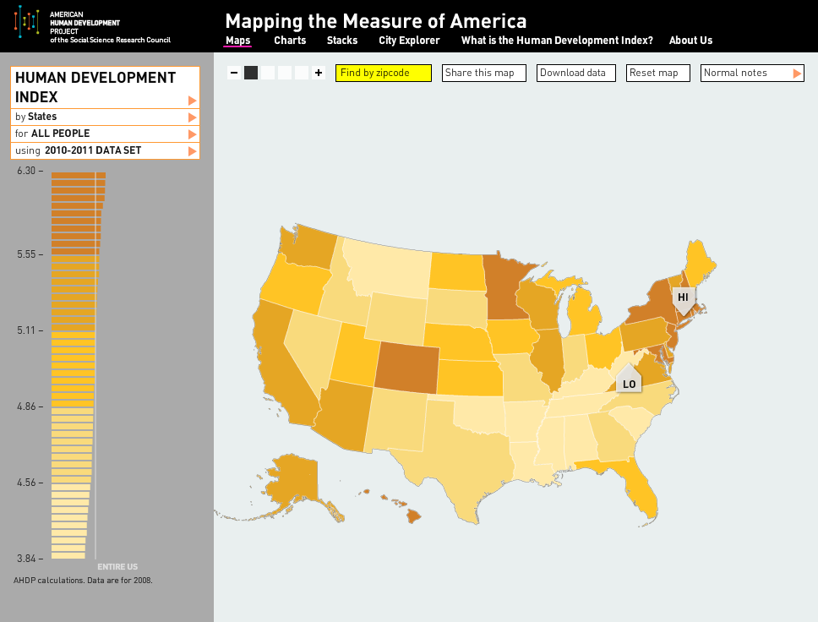
Measure of America
Linkage between 2D map and 1D scale (index) plus search (zipcode)

Slide 87
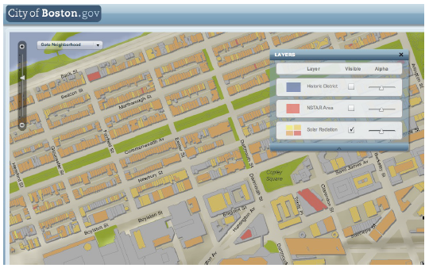
Note control of transparency, multiple variables

Slide 88
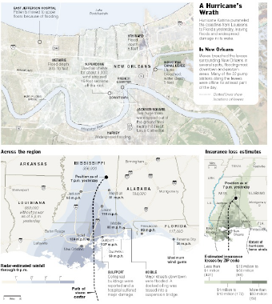
Multiple presentation areas; multiple story lines, but all connected
M. Erickson, NYTimes

Slide 89
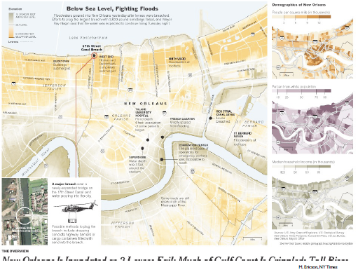

Slide 90
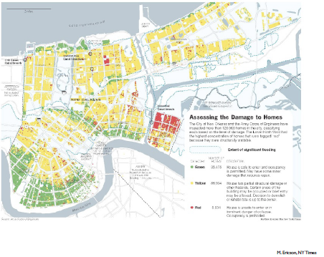

Slide 91
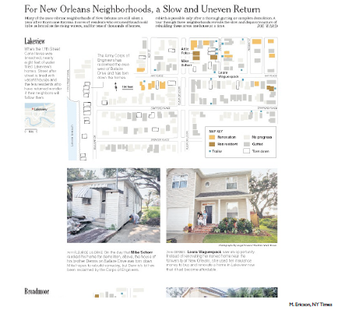
Engage user interest with pictures of homes

Slide 92
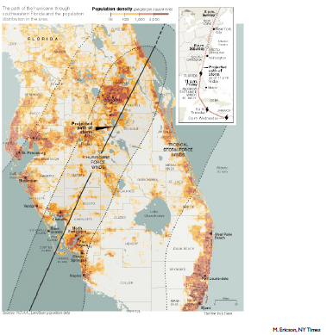
Shows population density (like we talked about for storm surge visualizations)

Slide 93
Show path via “traces” like we did with Google Motion Charts
http://www.msnbc.msn.com/id/26295161?preferredName=Gustav

Slide 94
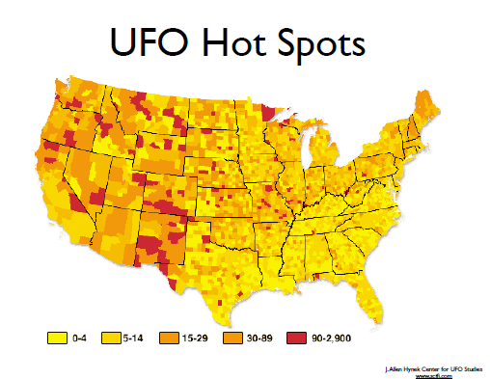
Describe the visualization type and date types

Slide 95
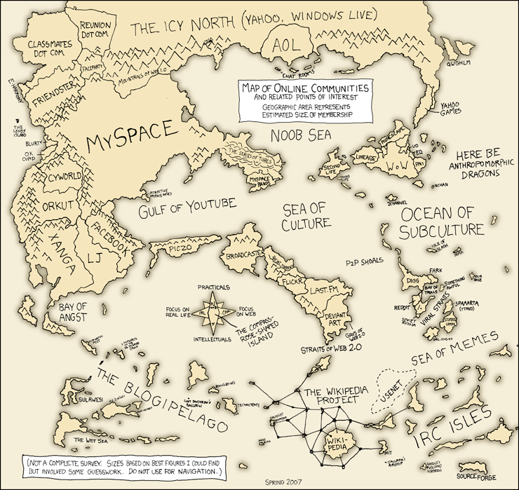
How has this changed since 2007 ☺?
http://xkcd.com/256/

Slide 96
Virtual Worlds (3D Maps)
Virtual Realities in Games
Virtual Worlds (2nd Life)
Visualization of our 3D world in new ways (need reference to artist/scientist working on this, well known)

Slide 97
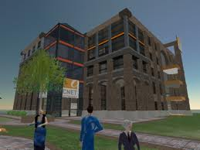

Slide 98
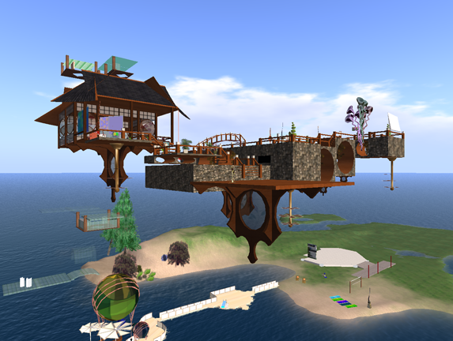

Slide 99
End of Slides

Slide 101
Possible Exercises

Slide 102
Design the next generation maps
mMaps (mobile maps on smartphone)
Driving
walking
Virtual reality overlay glasses
Driving
Walking
What about for sight limited?
Walking directions?

Slide 103
Route and Path Maps
First, let’s have a little fun
“Directions to my house” exercise
Spoken/written
Written with hand-sketches
Map
Interactive, dynamic, shared map

Slide 104
Real-Time Train Map
http://www.swisstrains.ch/

