Slide 1
Introduction and Framework
INLS 541: Information Visualization
Brad Hemminger

Slide 2
What do you know about visualizations?
Name some types of visualizations?
When did they first appear?

Slide 3
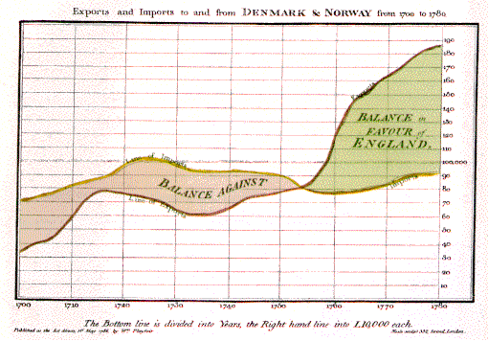
William Playfair: the first data chart
William Playfair (1759-1823) is generally viewed as the inventor of most of the common graphical forms used to display data: line plots, bar chart and pie chart. His The Commercial and Political Atlas, published in 1786, contained a number of interesting time-series charts such as these.
In this chart the area between two time-series curves was emphasized to show the difference between them, representing the balance of trade.
Playfair said, "On inspecting any one of these Charts attentively, a sufficiently distinct impression will be made, to remain unimpaired for a considerable time, and the idea which does remain will be simple and complete, at once including the duration and the amount."

Slide 4
Some more examples to motivate us
Napeoleans March by Minard. The French engineer, Charles Minard (1781-1870), illustrated the disastrous result of Napoleon's failed Russian campaign of 1812. The graph shows the size of the army by the width of the band across the map of the campaign on its outward and return legs, with temperature on the retreat shown on the line graph at the bottom. Many consider Minard's original the best statistical graphic ever drawn.
Weather Map (spatial, overlays)
A Century of Meat (timeline, annotated sections)
Baby Name Voyager (interactive visualization where you can modify/filter data and interact with visualization in real time)

Slide 5
Definitions

Slide 6
What is Information Visualization?
Some Definitions…
Visualize: to form a mental image or vision of.
Visualize: to imagine or remember as if actually seeing. (American Heritage dictionary, Concise Oxford dictionary)
The action or fact of visualizing; the power or process of forming a mental picture or vision of something not actually present to the sight; a picture thus formed. (OED)

Slide 7
More Definitions
“Transformation of the symbolic into the geometric” (McCormick et al., 1987) think columns of numbers into graphs
“... finding the artificial memory that best supports our natural means of perception.” (Bertin, 1983)

Slide 8
More Definitions
The depiction of information using spatial and graphical representations;
“ The use of computer-supported, interactive, visual representations of abstract data to amplify cognition.” (Card, Mackinlay, & Shneiderman, 1999)
Yes, we will focus on computer supported, interactive but let’s not limit ourselves to it.
Notes:
JUST ADDED DATE AND MOVED COMMENT BELOW

Slide 9
Good Working Definition
Visualization is the use of graphical techniques to convey information and support reasoning. (Pat Hanrahan)

Slide 10
Scope

Slide 11
What about all these variants of “Visualization”??
Information Visualization
Scientific Visualization
Data Visualization
InfoGraphics
Visual Analytics

Slide 12
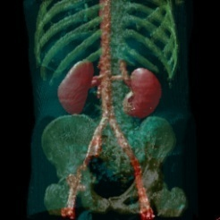
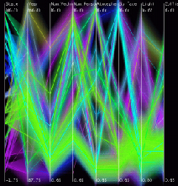
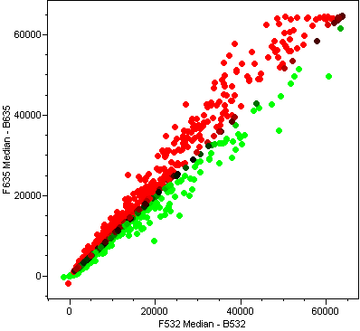
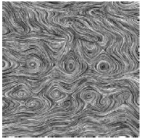
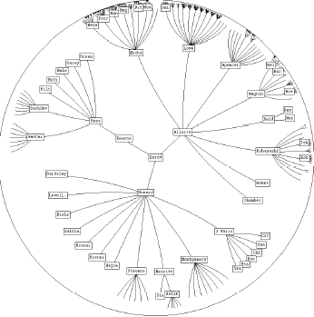

InfoVis versus SciVis
Direct Volume Rendering
Parallel Coordinates
[Hauser et al.,
Vis 2000]
[Fua et al., Vis 1999]
Isosurfaces
Glyphs
Scatter Plots
Line Integral Convolution
[http://www.axon.com/
gn_Acuity.html]
Node-link Diagrams
[Cabral & Leedom,
SIGGRAPH 1993]
Streamlines
[Lamping et al., CHI 1995]
[Verma et al.,
Vis 2000]
SciVis
InfoVis

Slide 13
InfoVis versus SciVis
Info Vis
  Spatialization chosen [Munzner]
  Spatialization chosen and you think of data as collection of discrete items [Tory]
SciVis
  Spatialization given [Munzner]
  Spatialization given and you think of data as samples from a continuous entity [Tory]
  Tamara Munzer, UBC InfoVis course
  Melanie Tory, University of Victoria, Visualization Course

Slide 14
Data Visualization
Data visualization is the study of the visual representation of data, meaning "information which has been abstracted in some schematic form, including attributes or variables for the units of information".^{[2]}
Wikipeda page. Good discussion of subjects within data visualization scope
Notes:
I’m having trouble finding definitions for Data Visualization. Many use the term, but don’t define outright! Some seem to use the term interchangeably with information visualization. Most of the talk is about infovis vs. scivis. Seems to me that data visualization could be a generic term that may include both.

Slide 15
Infographics
Information graphics or infographics are visual representations of information, data or knowledge. These graphics are used where complex information needs to be explained quickly and clearly, such as in signs, maps, journalism, technical writing, and education. They are also used extensively as tools by computer scientists, mathematicians, and statisticians to ease the process of developing and communicating conceptual information. (Wikipedia)
Notes:
See Anselm Spoerri, Interactive Infographics handout, slides 2-3 http://comminfo.rutgers.edu/~aspoerri/Teaching/InfoVisOnline/Lectures/Lectures.htm

Slide 16
Visual Analytics
  Visual Analytics = the science of reasoning with visual information; pairs machine intelligence (computing, bit-representations) with human intelligence (creativity, visual representations) [Klaus Mueller, Stony Brook, Introduction to Visualization course]
  “… the science of analytical reasoning supported by the highly interactive visual interface. People use visual analytics tools and techniques to synthesize information; derive insight from massive, dynamic, and often conflicting data; detect the expected and discover the unexpected; provide timely, defensible, and understandable assessments; and communicate assessments effectively for action.” (IEEE VAST Symposium description)
Notes:
Stasko has involved discussion of Visual Analytics – not sure what you would want to pull out
http://www.cc.gatech.edu/~john.stasko/7450/Talks/visualanalytics.pdf

Slide 17
Are these distinctions clear? Helpful?
What is
  US map with temperature readings from sensors?
  US map with census data, showing household income versus highest education via symbols?
  Same data but without the map (listed by state)
  What if you can interactively choose census data to visualize, and filter results before display?
Notes:
See Melanie Tory, Frameworks/Models, Slides 3-4, Problems with Categories InfoVis, SciVis
powerpoint download at http://webhome.cs.uvic.ca/~mtory/courses/vis_fall2006/schedule.html

Slide 18
Alternative Way to View
Classification through more detailed breakdown by Information Visualization Method, captured in the form of a Periodic Table .

Slide 19
For this course (my advice)
Consider everything as InfoVis, but recognize important high level differences including:
  Are spatial and time information part of the data?
  Interactive versus non-interactive (signs, infographics).
  Goal: Prepackaged (presented message) versus exploration (visual analytics).

Slide 20
Golden Age of Visualization
Increasing the representation of everything is in a digital form.
Explosion of capture of digital information about everything.
Digital data can easily be transformed into many kinds of visualizations.

Slide 21
InfoVis: Bridges many fields
graphics: drawings, static and in realtime. Draws on art, graphic design, media studies, science communication, information graphics, statistical graphics, computer science (rendering, computer graphics, image processing)
cognitive psychology: finding appropriate representation
HCI: using task to guide design and evaluation

Slide 22
Why is Visualization increasingly important these days?
Most data is represented in digital computer format
Increasing deluge of data, both in the quantity of things available and in the size (amount) of information in individual items. This makes it more difficult for our limited human brains to comprehend. Students suggest examples
Visualization has been shown to improve how well we understand data and how quickly we can understand it.
Addition of interactive visualizations under user control has increased these advantages.
Notes:
Changed to “increasingly” in title
What “advantages” in last bullet point?

Slide 23
Additional Motivation:
Data Deluge
Science (more sensors, higher resolution, more frequently captured)
Ubiquitous Sensors (environment, weather, traffic, …)
Tracking people and their activities (CCTV, …)
6 million FedEx transactions per day (reference http://www.fedex.com/us/about/today/companies/corporation/facts.html)
Average of 98 million Visa credit-card transactions per day in 2005 http://www.corporate.visa.com/md/nr/press278.jsp
Average of 5.4 petabytes of data crosses AT&T’s network per day (reference http://att.sbc.com/gen/investor-relations?pid=5711)
Average of 610 to 1110 billion e-mails worldwide per year (based on estimates in 2000) (reference http://www2.sims.berkeley.edu/research/projects/how-much-info/internet.html)
Average of 610 to 1110 billion e-mails worldwide per year (based on estimates in 2000)
Notes:
Do you want me to find more recent statistics?

Slide 24
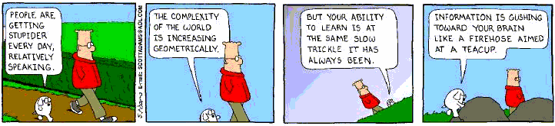
Let’s get sidetracked:
Stories from Science Data
Telescopes
Colliders
Medical
Microarrays
Environmental/Weather observations
Notes:
Why including Science Data examples here? What about other types of data?

Slide 25
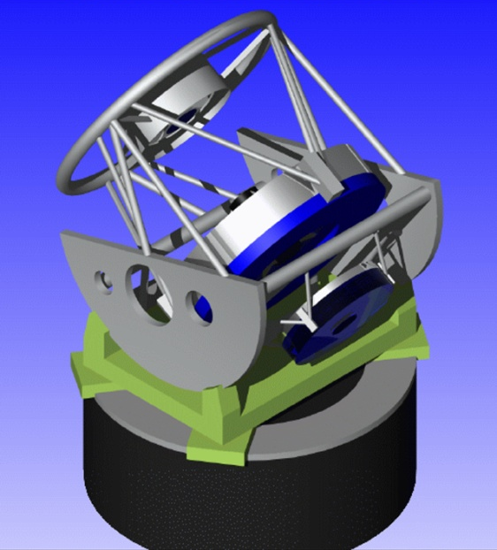
Astronomy Data Growth
From glass plates to CCDs
  detectors follow Moore’s law
The result: a data tsunami
  available data doubles every two years
Telescope growth
  30X glass (concentration)
  3000X in pixels (resolution)
Single images
  16Kx16K pixels
Large Synoptic Survey Telescope
  wide field imaging at 5 terabytes/night
3+ M telescopes area m^2
CCD area mpixels
Source: Alex Szalay/Jim Gray

Slide 26
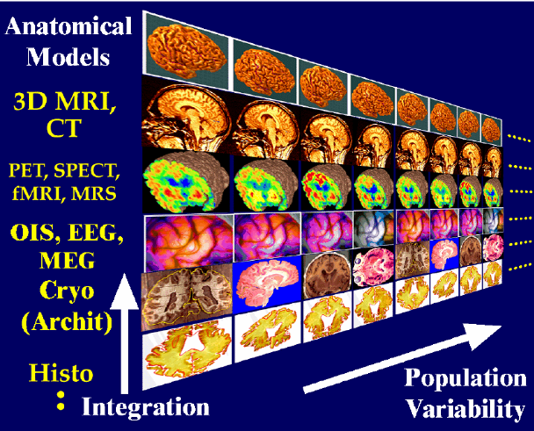
Medical
Source: Chris Johnson, Utah and Art Toga, UCLA

Slide 27
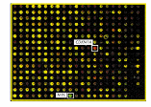

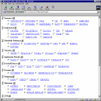
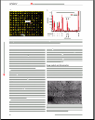
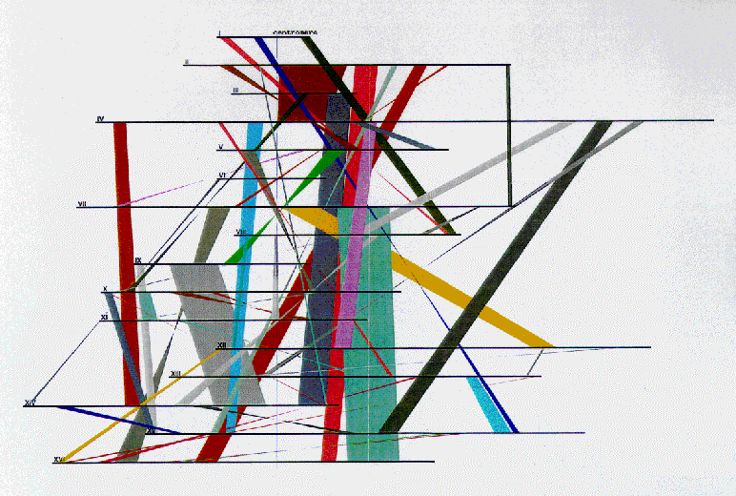

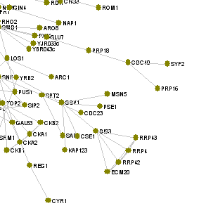
Data Heterogeneity and Complexity in Genetics
Phenotype
Disease
Clinical trial
Genomic, proteomic, transcriptomic, metabalomic, protein-protein interactions, regulatory bio-networks, alignments, disease, patterns and motifs, protein structure, protein classifications, specialist proteins (enzymes, receptors), …
Gene sequence
Genome sequence
Disease
Drug
Gene expression
Gene expression
Proteome
Disease
Disease
Protein
Protein Structure
Protein Sequence
homology
P-P interactions
Source: Carole Goble (Manchester)

Slide 28
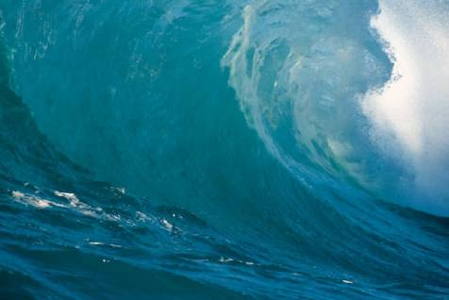
Technical Challenges:
The Data Tsunami
Many sources
  agricultural
  biomedical
  environmental
  engineering
  manufacturing
  financial
  social and policy
  historical
Many causes and enablers
  increased detector resolution
  increased storage capability
  Increased number of sensors
The challenge: extracting insight!
We Are Here!

Slide 29
How Does Visualization Help?

Slide 30
What are the ways in which Information Visualization Helps
communication
comprehension (amplifies cognition)
exploration and discovery
decision making (particularly use of filtering/dynamic queries)
Notes:
After communication, how about adding something like (quicker and more engaging)
Insight?

Slide 31
Visualization: Useful to group into two Primary Goals
Explain, Illustrate,
Communicate
Analyze, Explore,
Discover, Decide
Notes:
Like groupings, but I don’t like these colors/visualization for some reason ☺

Slide 32
Another way to think about it
Answer this question: Do you know the answer?
  If yes,
      Presentation, communication, education
  If no,
      Exploration, analysis
      Problem solving, planning,
      Aid to thinking, reasoning
Sometimes people distinguish by whether you are the creator or the viewer of the information; however, I think this is blurred, as many times a person does both.
Ideas from this slide from Stone & Zellweger

Slide 33
Goals of Information Visualization
In more detail, visualization should:
  Make large datasets coherent (present large amounts of information compactly) Newsmap
  Present information from various viewpoints Visualizing the U.S. Electric Grid
  Present information at several levels of detail (from overviews to fine structure) GapVis (GoogleMaps)
  Support visual comparisons Name Voyager (interactive)
  Tell stories about the data Walk This Way

Slide 34
How does Visualization help?
Utilize vision system for processing tasks more quickly, more naturally.
Enhance memory by using external representations supporting cognition by decreasing load on working memory.
Visual representation may be more natural and efficient way to represent data or problem space. For instance visual languages or symbols instead or spoken/written language.
Notes:
Change Title phrase – too close to Slide 22
Alternative title: Advantages of Information Visualization
Edit for 1st bullet point: Replace “ naturally” with “intuitively”

Slide 35
Visualization Amplifies Cognition
Provide natural perceptual mapping
  Discriminate different things
  Estimate quantities
  Segment objects into groups
  Enhance memory
  Minimize information in working memory
  Change recall to recognition
  Facilitate combining things into chunks
  Transform to a more memorable form
Notes:
Rework organization of these points to better fit with your presentation

Slide 36
Amplifies Cognition continued…
Reduce search time
  Retrieve information in neighborhood
  Natural spatial index
  Preattentive (fast, parallel) search process
  Perceptual inference
  Map inference to visual pattern finding
  Enforce constraints

Slide 37
Amplifies Cognition continued
Control attention
  Highlight to focus attention
  Control reading order
Provide context
  Style provides cultural cues
  Aesthetics makes tasks enjoyable
  Alternatives encourages creativity

Slide 38
Examples
(the Good, the Bad, the just plain Ugly)
Let’s look at some examples to see what works and what doesn’t.
Tell me if you think these are good, bad, or just plain ugly. And more importantly,
Why?

Slide 39
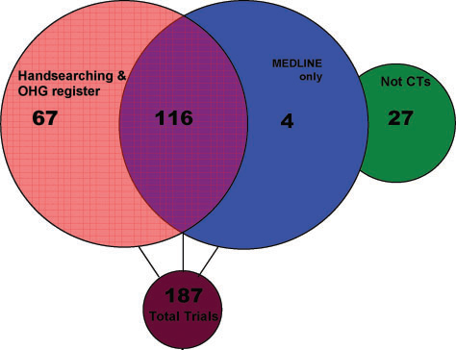
Search Results

Slide 40
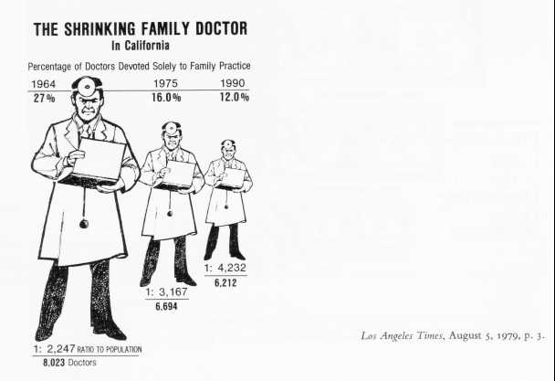
What’s the problem with this picture?
Another key element in making informative graphs is to avoid confounding design variation with data variation. This means that changes in the scale of the graphic should always correspond to changes in the data being represented. This graph violates that principle by using area to show one-dimensional data (example from Tufte, 1983, p.69)

Slide 41
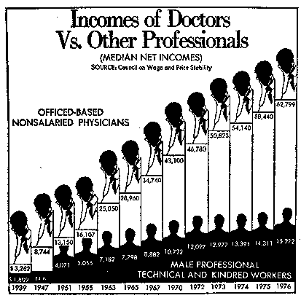
Another Problem
A less obvious (and therefore more insidious) way to create a false impression is to change scales part way through an axis. This graph, originally from the Washington Post purports to compare the income of doctors to other professionals from 1939--1976. This scale change in the axis is referred to as rubber-band scales.
It surely conveys the impression that doctors incomes increased about linearly, with some slowing down in the later years. But, the years have large gaps at the beginning, and go to yearly values at the end.

Slide 42
Interface they use to begin their search process

Slide 43
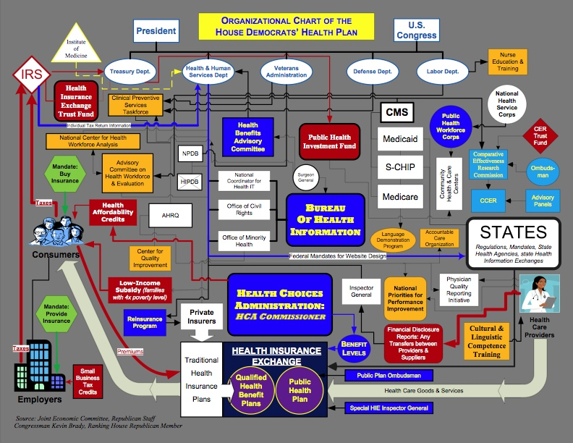
Health care reform:

Slide 44
BreakPoint
Be sure you know how to use our class wiki pages.
Make sure you know about Assignment 0 and Assignment 1.
Complete Assignment 0 for 2nd class.

Slide 45
Why might visualizations be helpful?

Slide 46
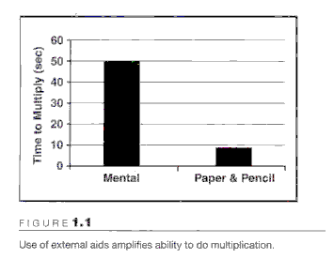
Visual Aids for Thinking
We build tools to amplify cognition.
In this case we use external memory supplement
CHALLENGE: Work the following problem.
Split class into two.
  Team A does in their head.
  Team B does on paper.
647 x 58 = ?
  People are 5 times faster with the visual aid
  (answer = 37526)
  (Card, Moran, & Shneiderman)

Slide 47
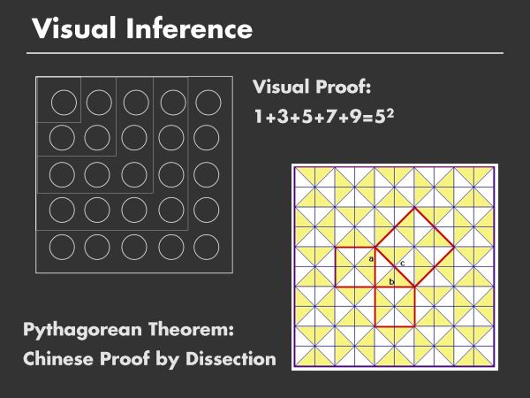
Can provide more natural process

Slide 48
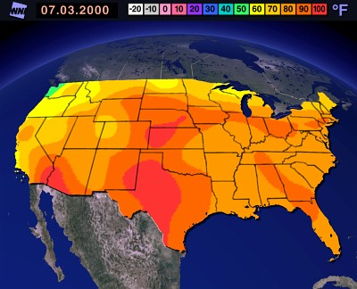
What is the temperature in Idaho Falls today?
What is the temperature distribution across the continental US today?
Which is best answered by this visualization?
Specific Query vs General Understanding Query
Notes:
Would it be useful to include a visualization that would answer the specific query?
http://www.weather.com/weather/map/interactive/USID0120?role=&from=maproom

Slide 49
Power of Visualization Examples
Maps
  London Subway, abstract map
  Route finding
Problem solving,
  Cholera Epidemic, map
  Florence Nightingale, coxcomb plot
  Challenger crash, graph
Correlations in Multivariate data (Census data)
Video Stop Motion Photography (horse gait)
3D (Virseum, 3D gaming environments)
Interactive Engagement (Baby Name Voyager)

Slide 50
Visualization for Communication, Clarification (easy comprehension)
London Subway Map Example, with spatially realistic depiction of route and stops.
Abstract Version of London Subway map, which abstracts away details for easier understanding. First of it’s kind, still commonly utilized (Metro map in Washington DC).
Notes:
VisWeek 2011: had great visual displays of designs for metro maps for Chicago, New York, Washington DC, Paris, London.
Compared realistic spatial layout, realistic landmarks, with abstracted, and structuring of lines (90’, 45/90’, curved).

Slide 51
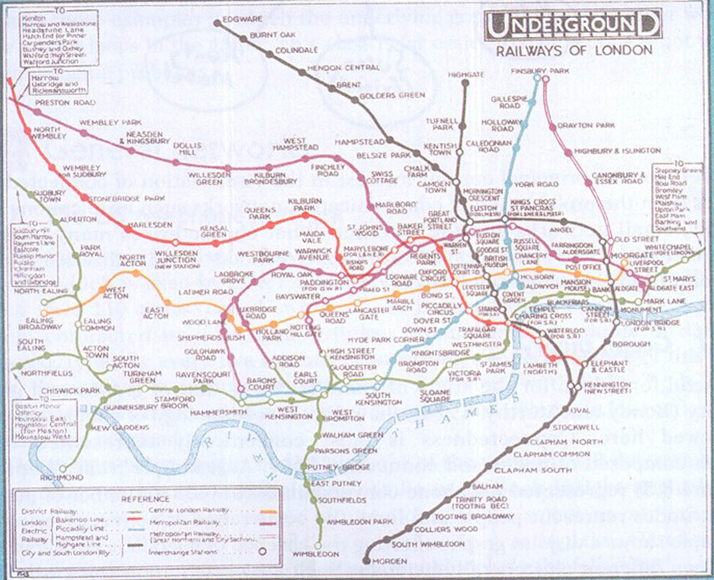
London Underground Map 1927

Slide 52
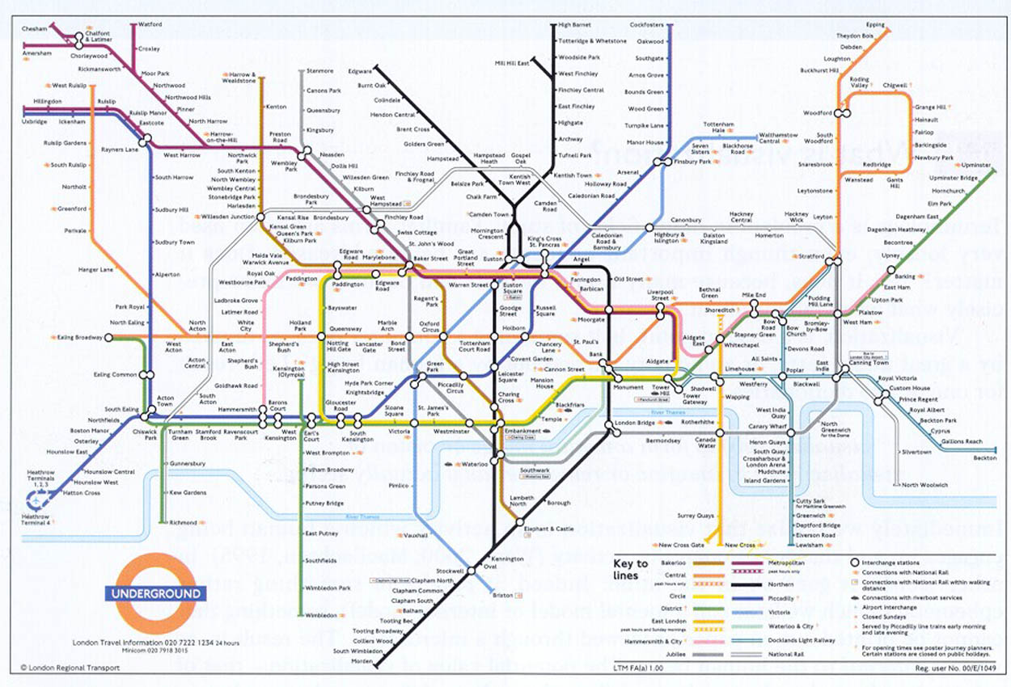
London Underground Map 1990s

Slide 53
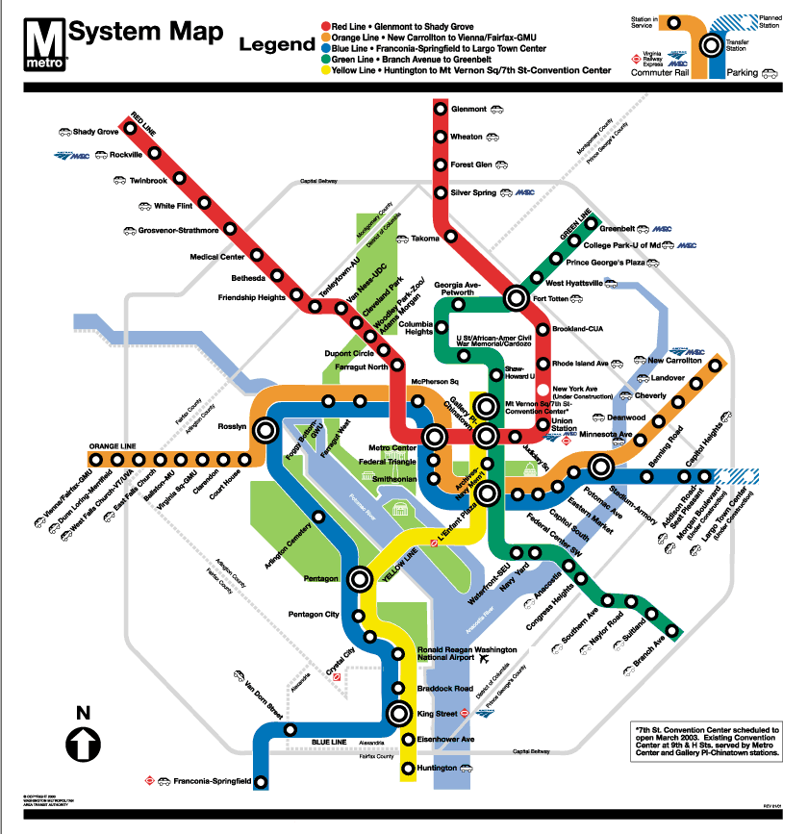

Slide 54
How have driving directions changed?
Head out of town on highway 58 (not labeled), then turn past the old post office, then right after Grandma Jone’s house, go about 3 miles and take the 2nd or 3rd dirt road on the right…

Slide 55
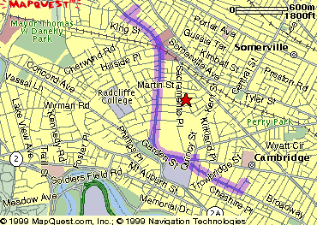
Show you map and your personalized route
1. Start out going Southwest on ELLSWORTH AVE
Towards BROADWAY by turning right.
2: Turn RIGHT onto BROADWAY.
3. Turn RIGHT onto QUINCY ST.
4. Turn LEFT onto CAMBRIDGE ST.
5. Turn SLIGHT RIGHT onto MASSACHUSETTS AVE.
6. Turn RIGHT onto RUSSELL ST.

Slide 56
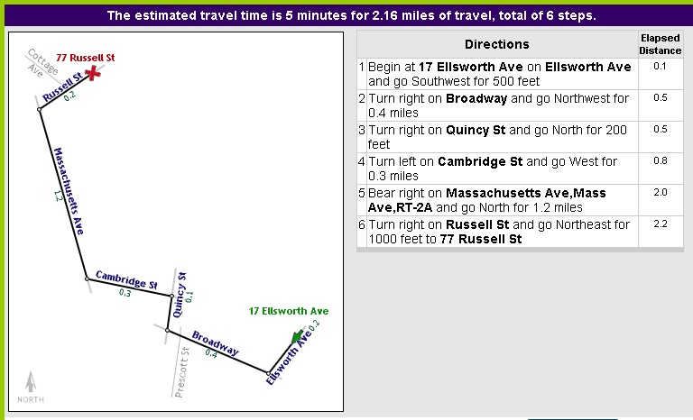
Abstraction to help focus on your route
Line drawing tool by Maneesh Agrawala http://graphics.stanford.edu/~maneesh/

Slide 57
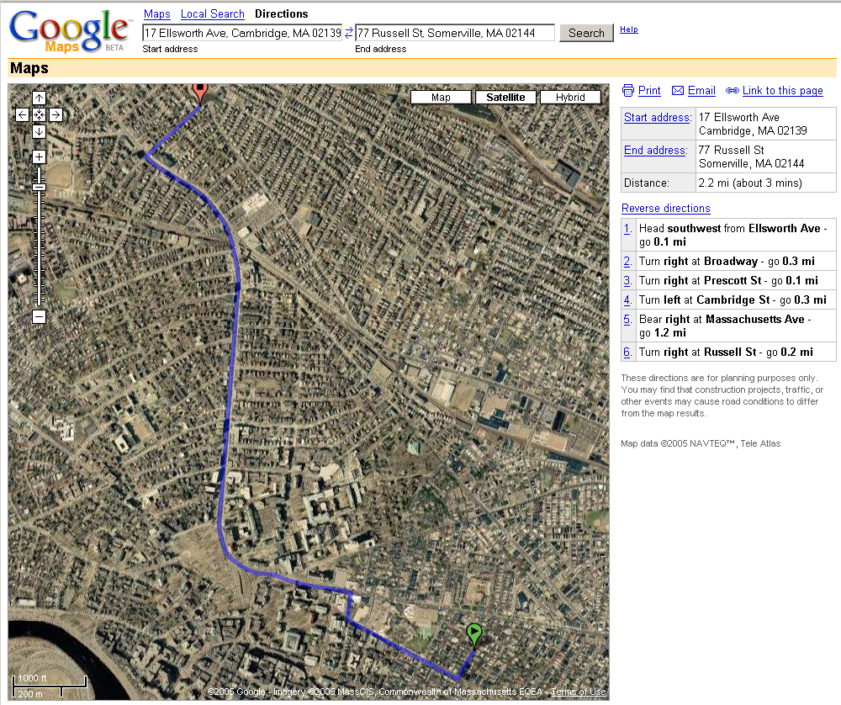
Visual map of what area looks like (less abstract); bird’s eye navigational view

Slide 58
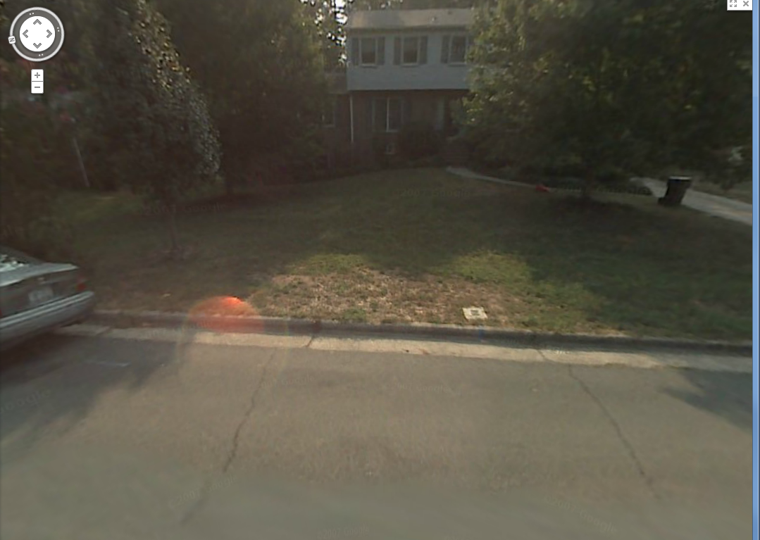
Google Streetview:
View from perspective of driver

Slide 59
Today’s Route Finding
Google Maps, MapQuest for evaluation, planning ahead
  (sideline: what is your favorite interaction for roaming/zooming images larger than your screen? Who first published the interaction used in Google Maps? )
GPS systems adds another element (current location) while in route.
Google Streetview to show where you are in current environment
What’s the future (Google Phone, etc)? What do you think?

Slide 60
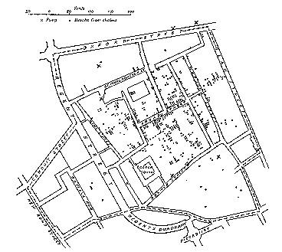
Visualization for Problem Solving
Illustration of John Snow’s
deduction that a cholera epidemic
was caused by a bad water pump, circa 1854. Pump is near “d” in “Broad Street”.
Dots indicate location of deaths.
From Visual Explanations by Edward Tufte, Graphics Press, 1997

Slide 61
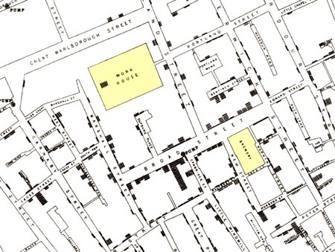
Visualization for Problem Solving
Illustration of John Snow’s
deduction that a cholera epidemic
was caused by a bad water pump, circa 1854.
Horizontal lines indicate location of deaths.
From Visual Explanations by Edward Tufte, Graphics Press, 1997

Slide 62
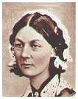
Florence Nightingale
Who was Florence Nightingale?
What do we remember her for?

Slide 63
Florence Nightingale
Florence Nightingale is remembered as the mother of modern nursing. But few realize that her place in history is at least partly linked to her use, following William Farr, Playfair and others, of graphical methods to convey complex statistical information dramatically to a broad audience.
She utilized coxcomb plots to show that more deaths were attributable to non battle causes than from battle causes. Nightingale's Coxcomb plot is notable for its display of frequency by area, like the pie chart. But, unlike the pie chart, the Coxcomb keeps angles constant and varies radius.
http://eagereyes.org/blog/2009/shining-a-light-on-data-florence-nightingale.html

Slide 64
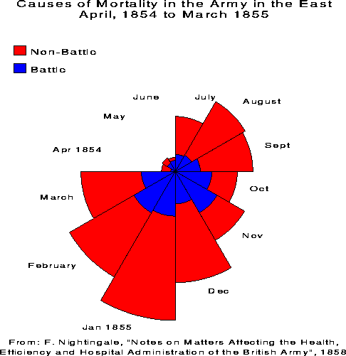
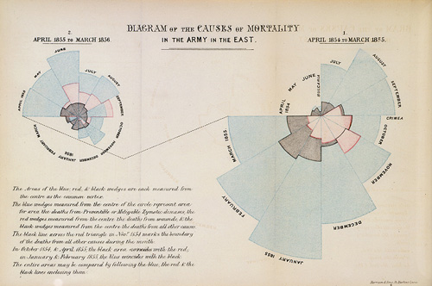
Florence Nightingale’s Plots
http://eagereyes.org/blog/2009/shining-a-light-on-data-florence-nightingale.html

Slide 65
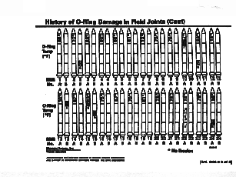
Challenger: Visualization Problems in both Analysis and Communication
Analysis was in text and utilized poor visualizations for exploring risks.
Presentation to management did not communicate risks effectively.

Slide 66
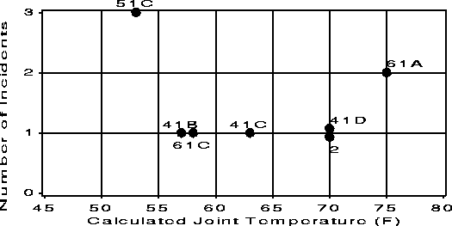
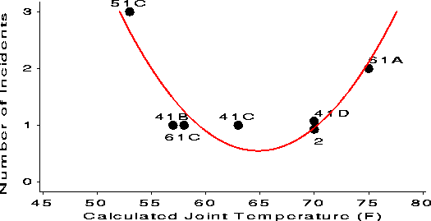
Challenger
What if they had graphed it?
Better, but they left out data points they thought were not interesting (where there were no failures). Important to include all data.

Slide 67
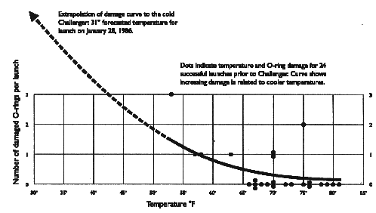
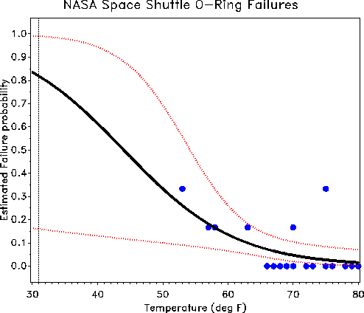
Include Analysis:
Statistical Fit
With data points and least squares fit (above), and then including probabilistic range surrounding estimated fit (left).
To read about ethics of this situation see http://www.onlineethics.org/Resources/Cases/RB-intro/RepMisrep.aspx

Slide 68
Quiz Time ☺! Ready?
Notes:
Is this supposed to go after the Challenger example?

Slide 69
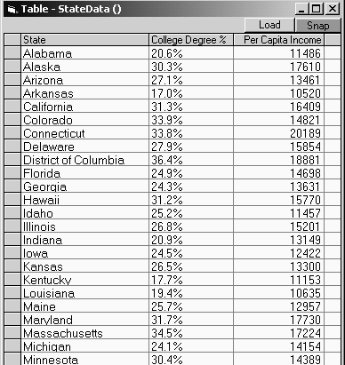
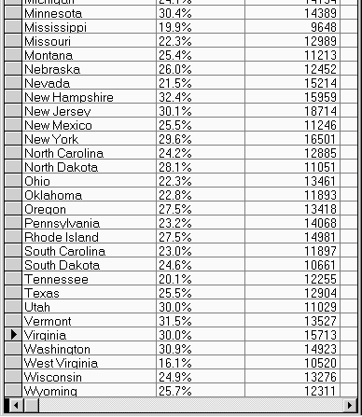
1) Which state has highest college degree %?
(two seconds to answer)
Notes:
Is this supposed to go after the Challenger example?

Slide 70
Your Answer?
Notes:
Is this supposed to go after the Challenger example?

Slide 71
2) Is there a correlation between degree and income? Are there any outliers?
Notes:
Is this supposed to go after the Challenger example?

Slide 72
Yes or No? Who are outliers?
Is there a better presentations available? Suggest?
Notes:
Is this supposed to go after the Challenger example?

Slide 73
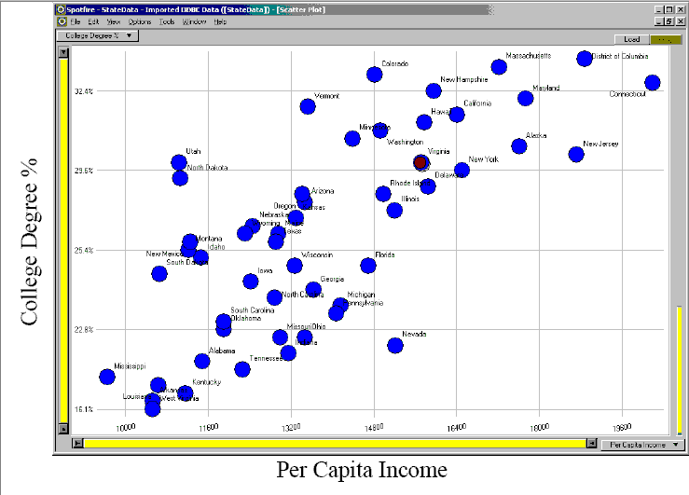
Is this better?

Slide 74
Better still?

Slide 75
Which is better: database query or visualization to answer these questions?
Are you looking for “exact or small answer” or “big picture”?
Notes:
Is this supposed to go after the Challenger example?

Slide 76
Time Lapse/Stop Motion Photography
Eadweard Muybridge. Horse running. In 1872, former Governor of California Leland Stanford, a businessman and race-horse owner, had taken a position on a popularly-debated question of the day: whether all four of a horse's hooves left the ground at the same time during a gallop. Stanford sided with this assertion, called "unsupported transit", and took it upon himself to prove it scientifically. (Though legend also includes a wager of up to $25,000, there is no evidence of this.) Stanford sought out Muybridge and hired him to settle the question.^{[2]} Muybridge's relationship with Stanford was long and fraught, heralding both his entrance and exit from the history books. (wikipedia)
Milk Splash experiment.

Slide 77
3D Visualization
Virseum: Captures a physical environment and makes available as virtual world, for experiencing, exploring, problem solving.
3D environments/gaming systems
  Virtual Presence independent of person’s location, appearance, resources. (SecondLife)
  Experience more intense involvement in 3D world (games)
  Training for high cost environments (surgery, military)
  Allow physically disabled to experience motion in world
  Allow people with conditions (fear of heights) to overcome through practice therapy.
Notes:
History Link: http://www.math.yorku.ca/SCS/Gallery/milestone/

Slide 78
Interactive Engagement
Visualizing the US Electric Grid

Slide 79
Exercise: College Tuition Increases
At the newspaper your editor asked you to make a chart for a story on increasing tuitions. The story compares tuition increases at 6 universities over the past 5 years.
Your job is to make a visualization to go in the newspaper which will communicate to the readers what the current tuitions are (and allow for easy comparison), and most importantly, what the tuition increases are (and how the percentage increases compare).
Tuition Excel File

Slide 80
The Need for Critical Analysis
We see many creative ideas, but they often fail in practice
The hard part: how to apply it judiciously
  Inventors usually do not accurately predict how their invention will be used
  Many people try for “cool looking”, exaggerated visualizations
This course will emphasize
  Having a framework for examining visualization problems
  Utilizing the framework to properly describe a problems and knowing what visualization techniques are applicable and desirable for a given situation
  Developing, testing, and evaluating visualizations
Notes:
Include under 2nd bullet point perhaps:
-- Refrain from including extraneous features that only serve to clutter
Include under 3rd bullet point perhaps:
-- Practical guidelines for matching design to task

Slide 81
Open Issues
Does visualization help?
  Certainly in some areas. As far as being a generally applied science, still in the formative stages. Not generalized set of rules of practice, although we’ll try to get close to this.
  Give examples of where you think visualization helps solve problems?

Slide 82
Open Issues
Does visualization sell?
  What do you think?
  Name tools that people pay for because they are effective.
Visualization is a hot area! New visualization techniques are constantly being developed. We are in the beginning stages of an explosion of interactive visualizations (especially mash-ups pulling data together from multiple sources) on the Web 2.0.

Slide 83
Course Outline
Introduction
Principles of Information Visualization
Data Representation and Mapping
Visual Understanding, Perception and Cognition
Information Display Technology
Interactive Information Visualization
Visualization Techniques & Domains
Design
Evaluation and Critique
Practice, Practice, Practice

Slide 84
What we will learn
All about the fundamentals
How to recognize factors important for design choice
Studying examples of good and bad designs
Designing visualizations (particularly interactive ones)
Critiquing designs
Empirically evaluate designs
Notes:
Perhaps delete 3rd bullet point: “Studying examples of good and bad designs”
Add “Techniques (trees, zoom, etc.)” and/or “Tools (e.g., ManyEyes, Tableau)”

Slide 85
Where would you like to spend time?
Static/Interactive?
What media? Computer display, newspapers/magazines, others?
2D/3D (virtual worlds, etc)
Graphic art type design?
Specific Techniques (maps, treemaps, network analysis, scientific visualizations, etc.)
Design
Evaluation

Slide 86
Your Examples
Let’s look to our wiki and assignment 0 to see what suggestions you have.

Slide 87
Framework Discussion is next
Go to CUT-DDV slides

Slide 89
EXTRA SLIDES….

Slide 90
Follow up analysis: Position Difference

Slide 91
21st Century Challenges
The three fold way
  theory and scholarship
  experiment and measurement
  computation and analysis
Supported by
  distributed, multidisciplinary teams
  multimodal collaboration systems
  distributed, large scale data sources
  leading edge computing systems
  distributed experimental facilities
Socialization and community
  multidisciplinary groups
  geographic distribution
  new enabling technologies
  creation of 21st century IT infrastructure
    sustainable, multidisciplinary communities
National Science Board (NSB) and NSF are promoting
and supporting this infrastructure.
Computation
Theory
Experiment

Slide 92
Other Taxonomies of Goals
Others:
  Analysis
  Monitoring
  Planning
  Communication
Tufte:
  Description
  Exploration
  Tabulation
  Decoration
Others:
  Aid to thinking
  Problem solving/Decision making
  Insight
  Clarifying
  Entertainment / Art
Ideas from this slide from Stone & Zellweger

Slide 93
Human Perceptual Facilities
Use the eye for pattern recognition; people are good at
  scanning
  recognizing
  remembering images
  Graphical elements facilitate comparisons via
  length
  shape
  orientation
  texture
  Animation shows changes across time
  Color helps make distinctions
  Aesthetics make the process appealing

Slide 94
Power of Representations
Distributed cognition
  Internal representations (mental models)
  External representations (cognitive artifacts)
The representational effect
  Different representations have different cost-structures / “running” times
  Big idea in computer and cognitive science

Slide 95
TripDirections: In Class Exercise
Form small groups. You're meeting friends in NC mountains for a hike on Sat, and need to give them directions (9982 Max Patch Rd, Madison NC). Do it one of four ways:
  Oral
  written instructions
  graph hand drawn on paper
  visualization of their choice.
Then have them share results, and how effective they think their method was.
Notes:
Oral: have to memorize instructions. If complex difficult.
Written instructions: helps with memory problem.
Graph paper: helps by adding spatial information which acts as complementary information to written/verbal instructions
Their choice: hopefully will include GPS type solutions that are relative to the process state the person is in. I.e. if they get lost, can self correct. (Brad’s main complaint with GPS is lack of overview of plan, only local display).

Slide 96
Case Study:
The Journey of the TreeMap
The TreeMap (Johnson & Shneiderman ‘91). It may take a while for a visualization technique to develop into something useful (both to improve enough, and to be utilized/accepted).
Idea:
  Show a hierarchy as a 2D layout
  Fill up the space with rectangles representing objects
  Nested rectangles indicated levels of hierarchy
  Size on screen indicates relative size of underlying objects.

Slide 97
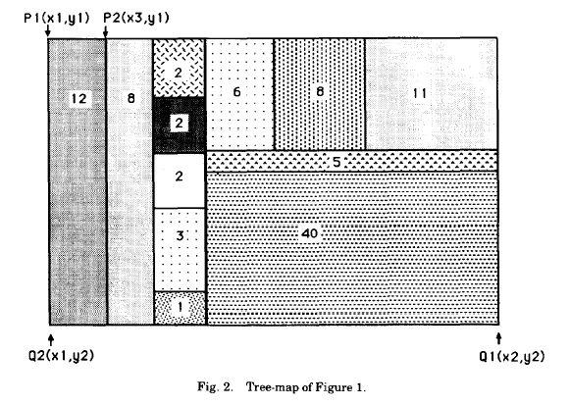
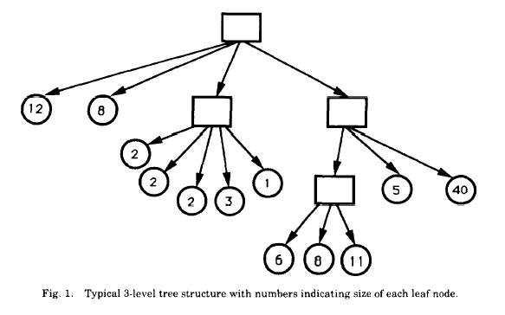
The Journey of the TreeMap
(Johnson & Shneiderman ‘91)

Slide 98
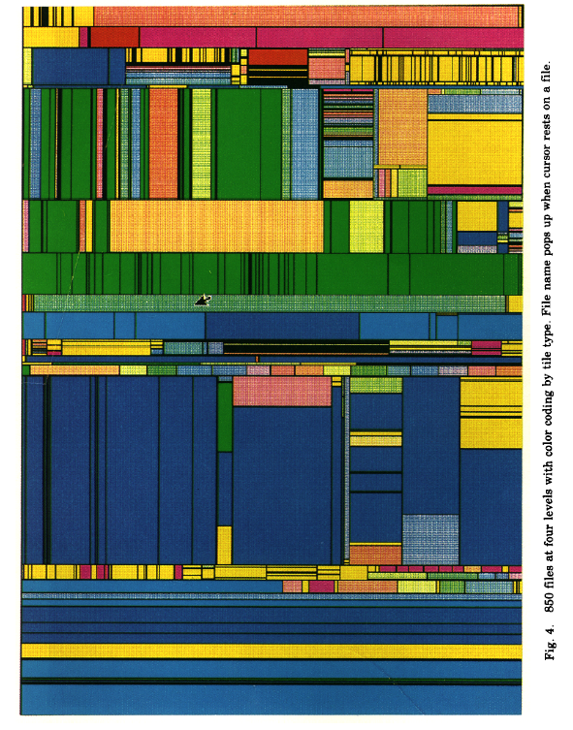
(Johnson & Shneiderman ‘91)

Slide 99
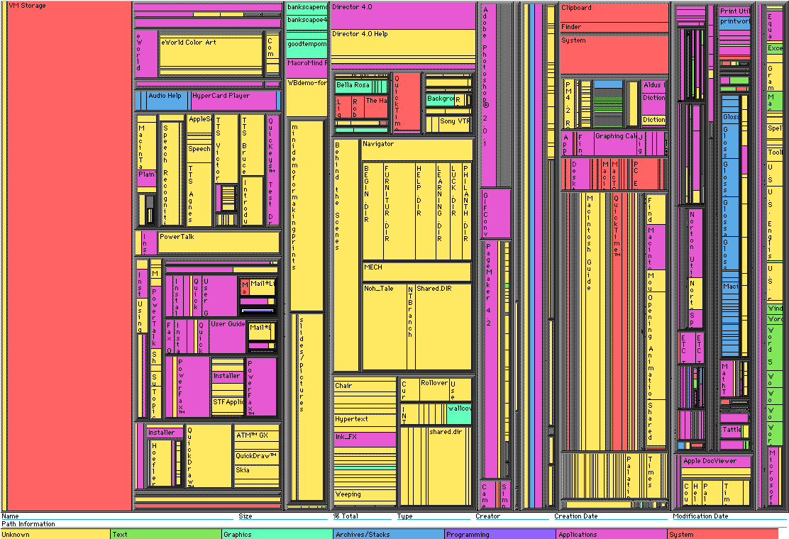
Early Treemap Applied to File System

Slide 100
What’s your reaction?
What problems does Treemap have?
Notes:
Other questions perhaps:
How is it better or worse than traditional tree structure?
Is it intuitive? Or do you have to consciously process?
Do you find the use of color helpful?

Slide 101
Treemap Problems
Too disorderly
  What does adjacency mean?
  Aspect ratios uncontrolled leads to lots of skinny boxes that clutter
Hard to understand
  Must mentally convert nesting to hierarchy descent
Color not used appropriately
  In fact, is meaningless here
Wrong application
  Don’t need all this to just see the largest files in the OS

Slide 102
Successful Application of Treemaps
Think more about the use
  Break into meaningful groups
Make appearance more usable
  Fix these into a useful aspect ratio
  Do not use nesting recursively
Use visual properties properly
  Use color to distinguish meaningfully
    Use only two colors:
      Can then distinguish one thing from another
    When exact numbers aren’t very important
Provide excellent interactivity
  Access to the real data
  Makes it into a useful tool

Slide 103
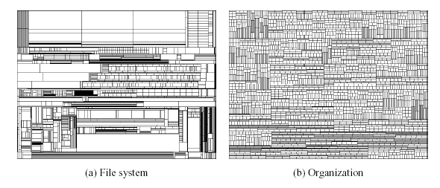
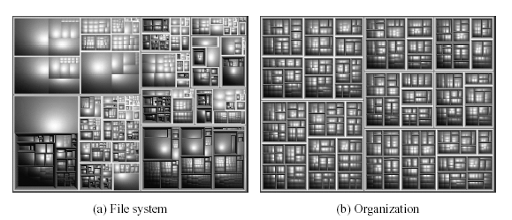
Squarified Treemaps
Bruls, Huizing, van Wijk, 1999
Notes:
Just wondering what this is demonstrating here

Slide 104
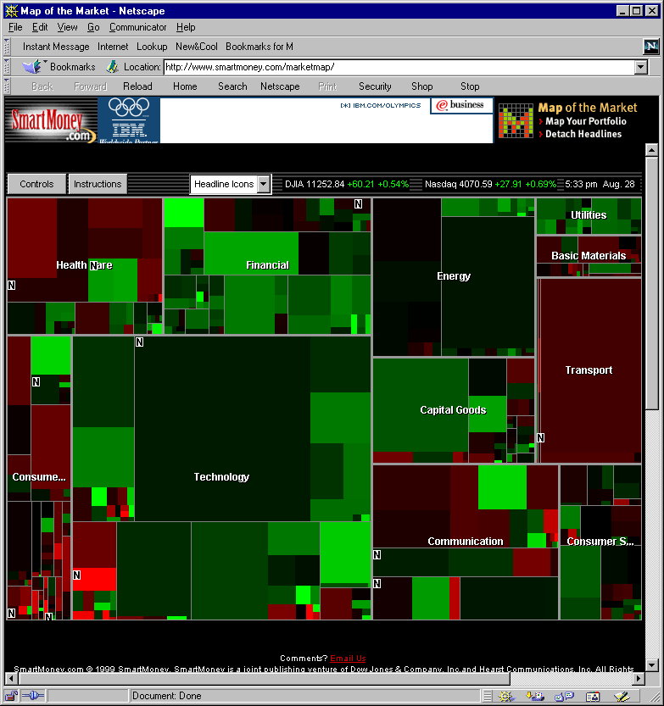
A Good Use of TreeMaps and Interactivity www.smartmoney.com/marketmap
www.smartmoney.com/marketmap

Slide 105
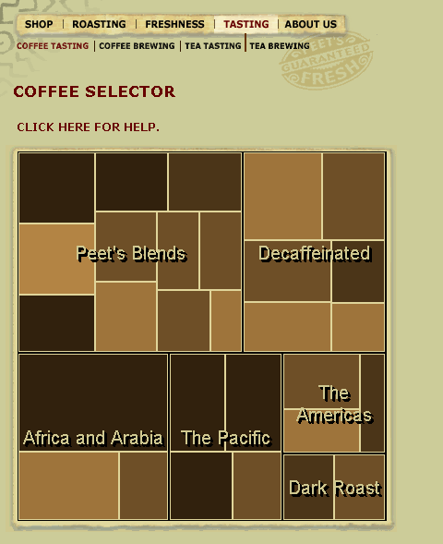

Treemaps in Peets site

Slide 106
Analysis vs. Communication
MarketMap’s use of TreeMaps allows for sophisticated analysis
Peets’ use of TreeMaps is more for presentation and communication
This is a key contrast

