Slide 1
INLS 151: Retrieving &
Analyzing Information

Slide 2
Lecture: Organization of
Information

Slide 3
Readings
Scholarly Article: Glushko, R. J., Maglio, P., Matlock, T., & Barsalou, L. (2008). Categorization in the wild. Trends in Cognitive Sciences 12(4), 129-135.

Slide 4
Quiz

Slide 5
Quiz – Two Questions
What three types of categorization does Categorization in the Wild discuss?
Give a real-world example of one type of categorization.

Slide 6
Glushko, et. al. (2008)
Key Points:
Cognitive science ignoring individual and institutional categorization and only focusing on cultural categorization in the past.
Technological advances have made individual and institutional
more robust
More attention now paid to social factors creating stability in classification systems and interoperability
The “profound impact of recent technological developments on classification systems indicates that basic categorization mechanisms are highly adaptive, producing new classification systems” as needs change.
“In the Wild” – refers to two other forms of categorization beyond cultural – i.e., individual and institutional.
10

Slide 7
Quiz Answers – question 1
Cultural categorization
Embodied in culture and language
Acquired implicitly through development via parent- child interactions, language, and experience
Formal education can build on this, but non-formal
cultural system can often dominate

Slide 9
Quiz Answers – question 1
Individual categorization
A system developed by an individual for organizing a personal domain to aid memory, retrieval, or usage
Can serve social goals to convey information,
develop a community, manage reputation
Have exploded with the advent of cyberspace, especially in applications based on “tagging”
An individual’s system of tags in web applications
is sometimes called a “folksonomy”

Slide 10
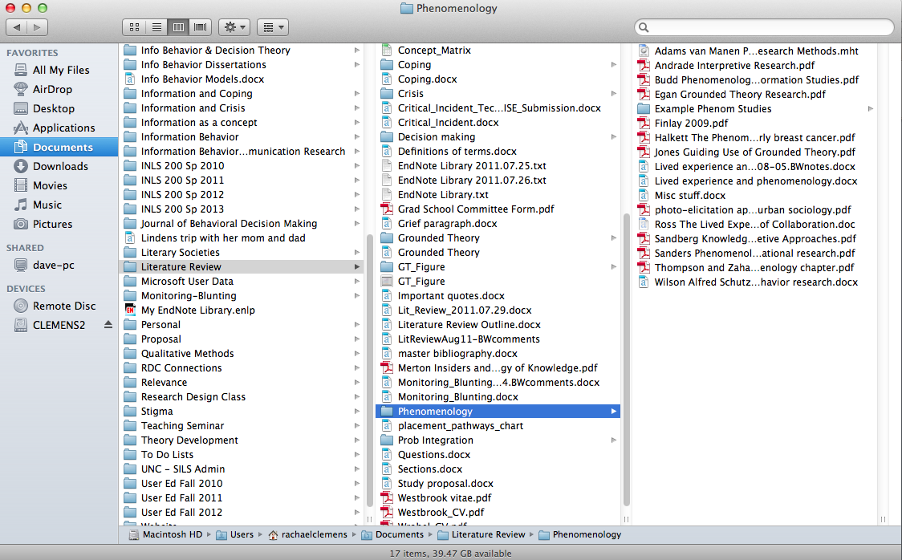

Slide 12
Quiz Answers – question 1
Institutional categorization
Systems created to serve institutional goals and facilitate sharing of information and increase interoperability
Helps to streamline interactions and transactions so that consistency, fairness and higher yields can result.

Slide 13
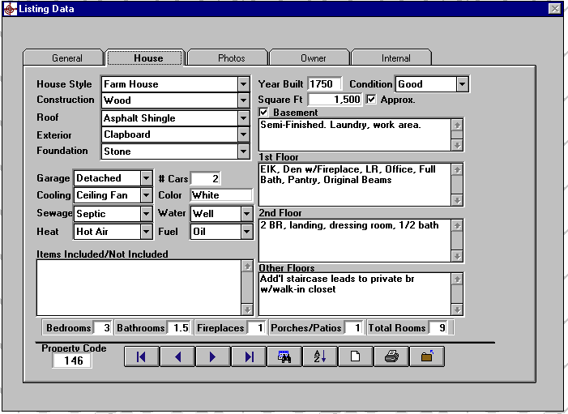

Slide 14
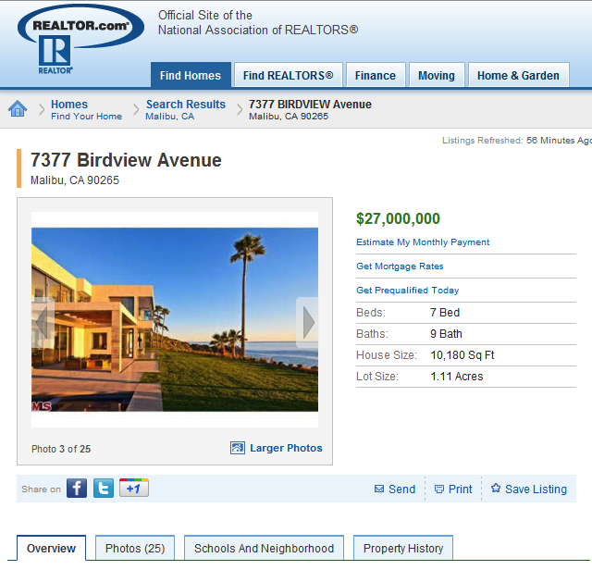

Slide 15
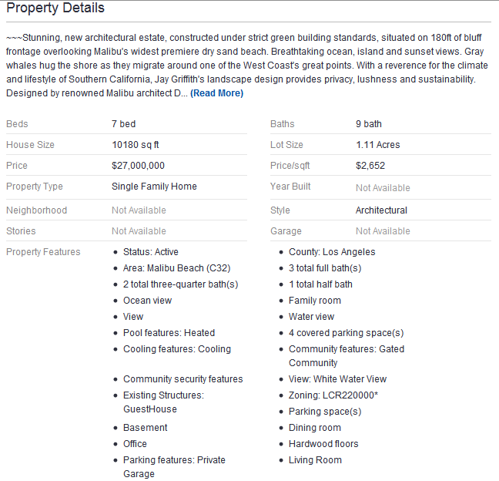

Slide 16
Why is information and library science (ILS) so concerned about organizing information?

Slide 17
Why organization is important
Makes it easier to find things.
Organizational structure makes it easier to figure out where to look.
Makes it easier to store and retrieve.
Facilitates browsing.
It’s easier to browse when like things are together.
Categorization/organization is a basic human
cognitive skill; we can’t avoid it.

Slide 18
Five ways to organize things
Chronological
Alphabetical
Spatially
Physical attributes (size, color, …)
Topic
Richard Saul Wurman

Slide 19
Categorization Basics: “Old School”
In the classical theory of categories, a category requires necessary and sufficient conditions for membership.
Necessary and sufficient means that:
Every condition must be met.
No other conditions can be required.
Example: A prime number
An integer divisible only by itself and 1.
Source: Webster's Revised Unabridged Dictionary,
© 1996, 1998 MICRA, Inc.
Example: mother:
A woman who has given birth to a child.

Slide 20
Problems with Classic Categorization
For the “mother” example, what do we do with
concepts such as:
Adoptive mothers.
Stepmothers.
Surrogate mothers.
Two mothers.

Slide 21
Problems with Classic Categorization
What are the necessary and sufficient conditions
to call something a game?
Game

Slide 22
Family Resemblances
There are no common properties shared by all games.
No competition: ring-around-the-rosy
No skill: dice games
No luck: chess
Only one player: solitaire
No rules: children’s games
There is no fixed boundary to the category; it can be extended to new games (such as video games).
Alternative notion of category membership: concepts related by family resemblances. Some games have some properties, some games have others.

Slide 23
More on Family Resemblances
Members of a category may be related to one another without all members having a common property.
Instead, they may share a large subset of properties.
Some properties are more likely than others.
Example: feathers, wings, capable of flight
Likely to be a bird, but not all features apply to
“ostrich.”
Unlikely to see an association with “barks.”

Slide 24
Prototype Effects
If the classic theory of categories were correct, no category members would be “better” or “more typical” than others. It turns out this is not the case.
Some members of a category are perceived by people to
be better examples than others (“prototypical” examples).

Slide 25
Which is a better example of a bird?
But just because they are perceived as “better” does that make them
better?

Slide 26
Ad-Hoc Categories
We create categories to deal with emergent situations; these categories are different for different people and change according to context.
Example: My list of “things to take on a weekend trip to the mountains” is different from your list of things. Even my list varies according to the season, activities I might have planned, and so forth.

Slide 27
Category Basics: Summary
The classic theory of categories claims that we can devise necessary and sufficient conditions for category membership.
Ideas such as family resemblances, prototype effects, and ad-hoc categories complicate the neat and orderly world of classic categories.
The point:
Categorization appears simple, but is actually difficult.
Categorization will never be perfect.

Slide 28
Library of Congress
A -General Works
B -Philosophy, Psychology, Religion
C -Auxiliary Sciences of History
D -History: General & Outside the Americas
E -History: United States
F -History: United States Local & America
G -Geography, Anthropology, Recreation
H -Social Sciences
J -Political Science
K -Law
L -Education
M -Music
N -Fine Arts
P -Language and Literature
Q -Science
R -Medicine
S -Agriculture
T -Technology
U -Military Science
V -Naval Science
Z -Library Science & Information Resources
http://www.loc.gov/catdir/cpso/lcco/

Slide 29
Have a nice day!
47

