Slide 1
INLS 200: Retrieving &
Analyzing Information

Slide 2
Today’s Agenda
Typically a quiz – no quiz today.
Review last week/ Administrivia
Can everyone access Sakai?
Today:
In-Class exercise
Lecture: “The Science of Information”
Reading and video
Budnip
Next class:
“The Internet and the World Wide Web”
2

Slide 3
In-class exercise: In Groups of 5
Introduce yourself to your colleagues
What are your most frequent sources for information? List the 3 most frequent places or people or sources people in your group consult.
What do you find most challenging about the whole process of information seeking?
4. What do you anticipate will be your biggest “information need” this semester? (particular course, research paper…)
16

Slide 4
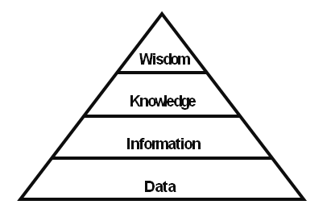
DIKW Pyramid

Slide 5
Data
Wikipedia article talks of Data as:
“…discrete, objective facts or observations, which are
unorganized and unprocessed and therefore have no
meaning or value because of lack of context and
interpretation.”
“Sensory stimuli which we perceive through our senses, or
including, sense or sensory readings of light, sound, smell,
taste, and touch. “
"recorded (captured or stored) symbols", including
"words (text and/or verbal), numbers, diagrams, and
images (still &/or video), which are the building blocks
of communication"

Slide 6
Information
Wikipedia article talks of information as:
"organized or structured data, which has been processed
in such a way that the information now has relevance for a
specific purpose or context, and is therefore meaningful,
valuable, useful and relevant.”
"data that changes us"
"the sum total of all the facts and ideas that are available to be known by somebody at a given moment in time"

Slide 7
Knowlege
Wikipedia article talks of knowledge as:
Knowledge is a fluid mix of framed experience, values,
contextual information, expert insight and grounded
intuition that provides an environment and framework
for evaluating and incorporating new experiences and
information. It originates and is applied in the minds of
knowers. In organizations it often becomes embedded not
only in documents and repositories but also in organizational
routines, processes, practices and norms.

Slide 8
Wisdom
Wikipedia article talks of information as:
Why is
Who do
Appreciation of why
Ability to create effectiveness
Adds Value

Slide 9
Data, Information, Knowledge, & Wisdom
Data – facts and statistics collected for reference or analysis.
Information – Facts provided or learned about something
or someone.
Knowledge – Facts, information, and skills acquired by
a person through experience or education.
Wisdom – the quality of having experience, knowledge, and
good judgment – or my favorite…knowledge rightly applied.

Slide 10
Data vs. information:
What is data?
Data can be defined in many ways. Information science defines data as unprocessed information.
What is information?
Information is data that have been organized and communicated in a coherent and meaningful manner.
Data is converted into information, and information is converted into knowledge.
Knowledge; information evaluated and organized so that it can be used purposefully.

Slide 11
Why do we study information?

Slide 12
Human Information Interaction
People interact with information routinely
Seekers
Targeted audience
“Innocent bystanders”
Prospectors
Interactions are influenced by situational
variables
Information as a personal construct

Slide 13
The Science of Information
What is information?
It’s a thing
It’s a process
It’s knowledge

Slide 14
Information as Thing
Something that is evidence that:
we can study
has meaning
can pass from one person to another
Tangible physical objects, items, and data
are examples.

Slide 15
Information as Thing
Information appears to us in a material form … and can be described in a language of physical things. As material objects, [information] can then be collected, organized, and retrieved for use.
Raber, 2003
10

Slide 16
Information as Process
Information involves learning – it is the act of informing; as you learn, you change
Information as a verb – the transfer of information; communication

Slide 17
Information as Knowledge
When information is internalized, it
becomes part of you
Intangible ideas such as theories, models and frameworks are examples

Slide 18
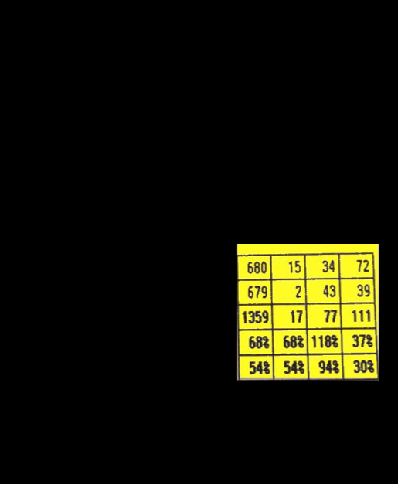

Slide 19
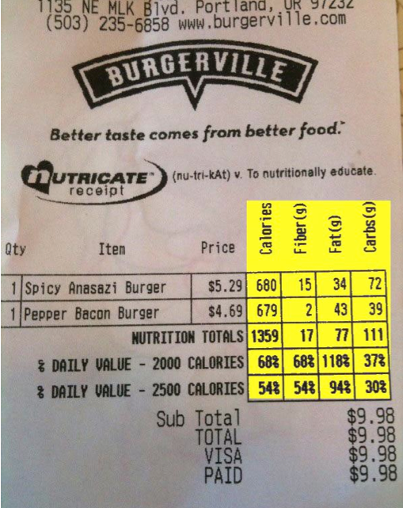

Slide 20
What are these?
#000000
Circumference
<HTML>
<TITLE>
</TITLE>
<BODY>
</BODY>
</HTML>

Slide 21
Is this Data or Information or both?

Slide 22
How about now?

Slide 23
Do we have knowledge? If so, what knowledge? What about Wisdom?
STOP

Slide 25
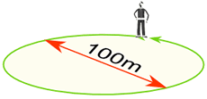
Example: You walk around a circle which has a diameter of 100m, how far have you walked?
Distance walked = Circumference = π × diameter

Slide 26
Distance walked = Circumference = π × 100m = 314.159...m
= 314m (to the nearest m)

Slide 27
Information Interaction Caveats
We interact with information constantly
Our interactions are related to our past experiences, our current situation, and our goals (among other things)
We do not have the same reactions to the same piece of information
We do not notice the same things
Designing interaction is a complex problem
15

Slide 29
Today’s Agenda
Review last week/ Administrivia
Can everyone access Sakai?
In-class exercise follow-up
Today:
Lecture: “The Science of Information”
Reading and video
Possible in-class exercise
Next class:
“The Internet and the World Wide Web”
17

