Slide 1
INLS 200: Retrieving &
Analyzing Information

Slide 2
Ford (2012), chap. 3, “Clarifying
what is required of you”
Analyze exactly what is expected
Identify the research questions
Interpret the question correctly
Answer the question effectively
The process

Slide 3
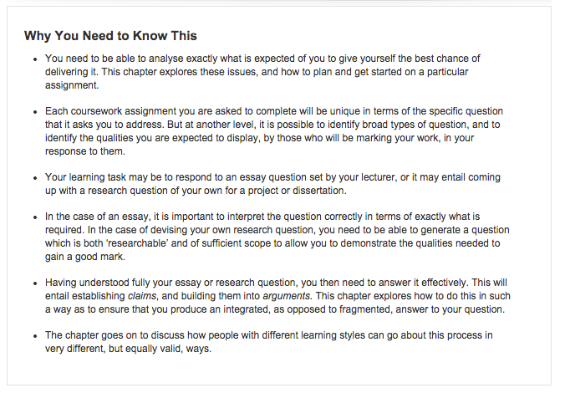
Clarifying what you know

Slide 4
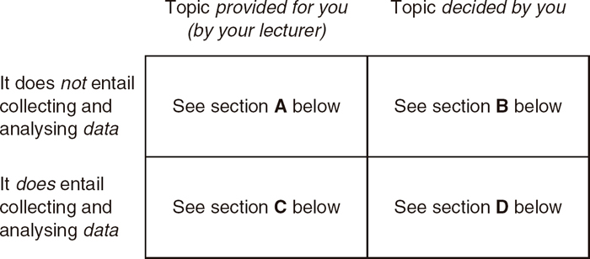
Clarifying the Nature of Your Assignment

Slide 5
A. You have been provided with a list of essays/topics from which to choose (rather than having to think of one yourself), and the work will be based on your reading (i.e. it will not entail collecting data such as from questionnaires or interviews).
B. You have to think of an essay/project topic yourself (rather than choosing from a list), and the work will be based on your reading (i.e. it will not entail collecting your own data such as from questionnaires or interviews).
C. You have been provided with a list of project topics from which to choose (rather than having to think of one yourself), and the project will involve collecting and analysing data (e.g. from questionnaires or interviews).
D. You have to think of a topic or title yourself (rather than choosing from a list), and the project will involve collecting and analysing data (e.g. from questionnaires or interviews).

Slide 6
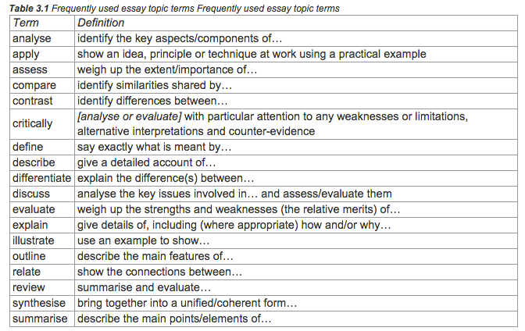

Slide 7
Ford (2012), chap. 3, “Clarifying what is required of you”

Slide 8
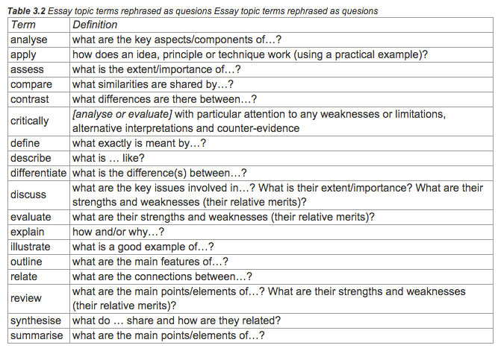

Slide 9
Developing a research question*
Two general ways RQs originate:
Your own experience and/or direct observation
Logical gaps that exist in our current knowledge of the field
5
*Wildemuth, B. M. (2009). Applications of Social Research Methods to Questions in Information and Library Science. Westport, Conn.: Libraries Unlimited.

Slide 10
Developing a research question*
Understanding what you want to ask
The question isn’t really a question unless there is some uncertainty about it
What is the importance of the question – what don’t we know that matters?
Symmetry of potential outcomes – no matter whether you confirm or refute your initial hypothesis, the findings of the study will be useful
What is the feasibility of answering this question?
6
*Wildemuth, B. M. (2009). Applications of Social Research Methods to Questions in Information and Library Science. Westport, Conn.: Libraries Unlimited.

Slide 11
Developing a research question
Preliminary RQ -- Avoid research questions that are:
Too broad
What is the history of public attitudes towards gender in the U.S.?
How have college sports programs influenced management
budget planning in large universities
Too bland
What is biochemistry?
How do motor engines work?
Too speculative
What will the housing market look like in 2050?
Will the physical book still be used in university classrooms in the future?
7

Slide 12
Developing a research question*
Attributes of a good research question:
It is clear, unambiguous and easily
understood
It is specific enough to suggest the data that you need to collect during your study
It is answerable, i.e., feasible given your
access to data and available information
It is interconnected with important concepts of phenomenon
It is substantively relative to the field
*Wildemuth, B. M. (2009). Applications of Social Research Methods to Questions in Information and Library Science. Westport, Conn.: Libraries Unlimited.
8

Slide 13
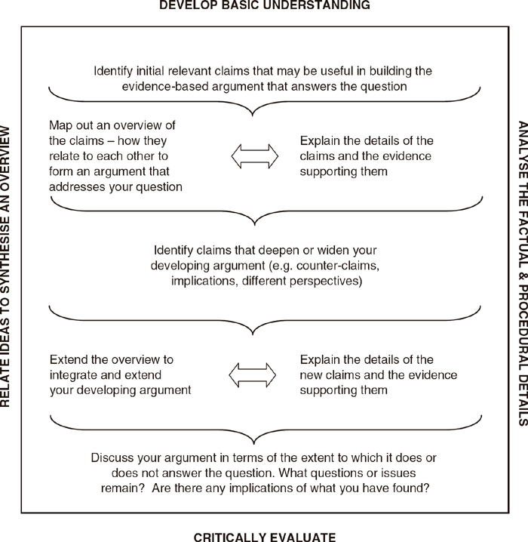
Process of putting together an essay or project.

Slide 14
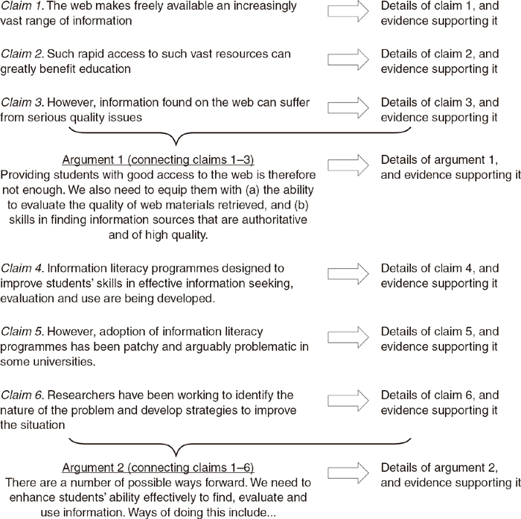

Slide 15
