Slide 1
INLS 623– Stored Procedures
Instructor: Jason Carter
Notes:
Functions

Slide 2
Midterm
Oct 8

Slide 3



Review: Internet
Server
Client
HTTP
Request
Response
GET
POST
Redirect
HTML
JavaScript
Java
PHP
SQL
ASP.NET
CSS
AJAX
Python
Cookies

Slide 4
Three Tiered Architectures
Presentation tier
Client Program (Web Browser)
Application Server
Middle tier
Database System
Data management tier

Slide 5
The Three Layers
Presentation tier
  Primary interface to the user
  Needs to adapt different displays (PC, cell, tablet, etc)
Middle tier
  Implements business logic (implements complex actions, maintains state between different steps of workflow)
  Access different data management systems
Data management tier
  One or more standard database management system

Slide 6
Technologies
HTML
Javascript
Client Program (Web Browser)
Application Server
(Apache)
PHP
Cookies
Database System
(MySQL)
XML
Stored Procedures
Functions

Slide 7
Advantages of the Three-tier Architecture
Heterogeneous
  Tiers can be independently maintained, modified, and replaced
Scalability
  Data Management Tier can be scaled by database clustering without involving other tiers
  Middle Tier can be scaled by using load balancing
Fault Tolerance
  Data Management Tier can be replicated without involving other tiers
Software development
  Code is centralized
  Interaction between tiers through well-defined APIs: Can reuse standard components at each tier

Slide 8
Disadvantages of 3-Tier Architecture
It is more complex
It is more difficult to build a 3-tier application
The physical separation of the tiers may affect the performance of all three
  If hardware and network bandwidth are not good enough because more networks, computers, and processes are involved

Slide 9
Technologies
HTML
Javascript
Client Program (Web Browser)
Application Server
(Apache)
PHP
Cookies
Database System
(MySQL)
XML
Stored Procedures
Functions

Slide 10
Stored Procedures
Database program modules that are stored and executed by the DBMS at the server
DELIMITER //
CREATE PROCEDURE GetAllProducts()
BEGIN
SELECT * FROM products;
END //
DELIMITER ;

Slide 11
Why Stored Procedures
Reduces Duplication of effort and improves software modularity
  Multiple applications can use the stored procedure vs. the SQL statements being stored in the application language (PHP)
Reduces communication and data transfer cost between client and server (in certain situations)
  Instead of sending multiple lengthy SQL statements, the application only has to send the name and parameters of the Stored Procedure
Can be more secure than SQL statements
  Permission can be granted to certain stored procedures without granting access to database tables

Slide 12
Disadvantages of Stored Procedures
Difficult to debug
  MySQL does not provide ways for debugging stored procedures
Many stored procedures can increase memory use
  The more stored procedures you use, the more memory is used
Can be difficult to maintain and develop stored procedures
  Another programming language to learn

Slide 13
Creating Stored Procedures
DELIMITER //
CREATE PROCEDURE NAME
BEGIN
SQL STATEMENT
END //
DELIMITER ;
DELIMITER //
CREATE PROCEDURE GetAllProducts()
BEGIN
SELECT * FROM products;
END //
DELIMITER ;

Slide 14
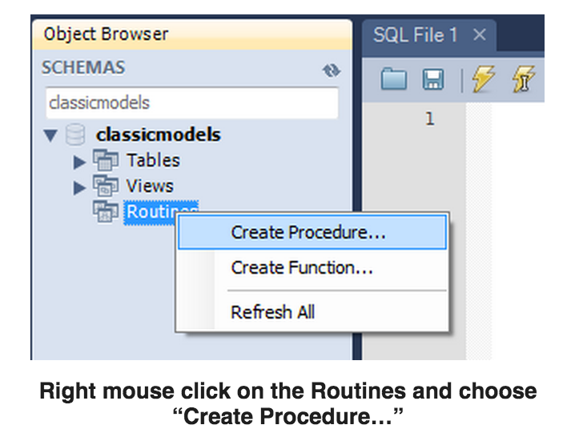
Stored Procedure in Workbench

Slide 15
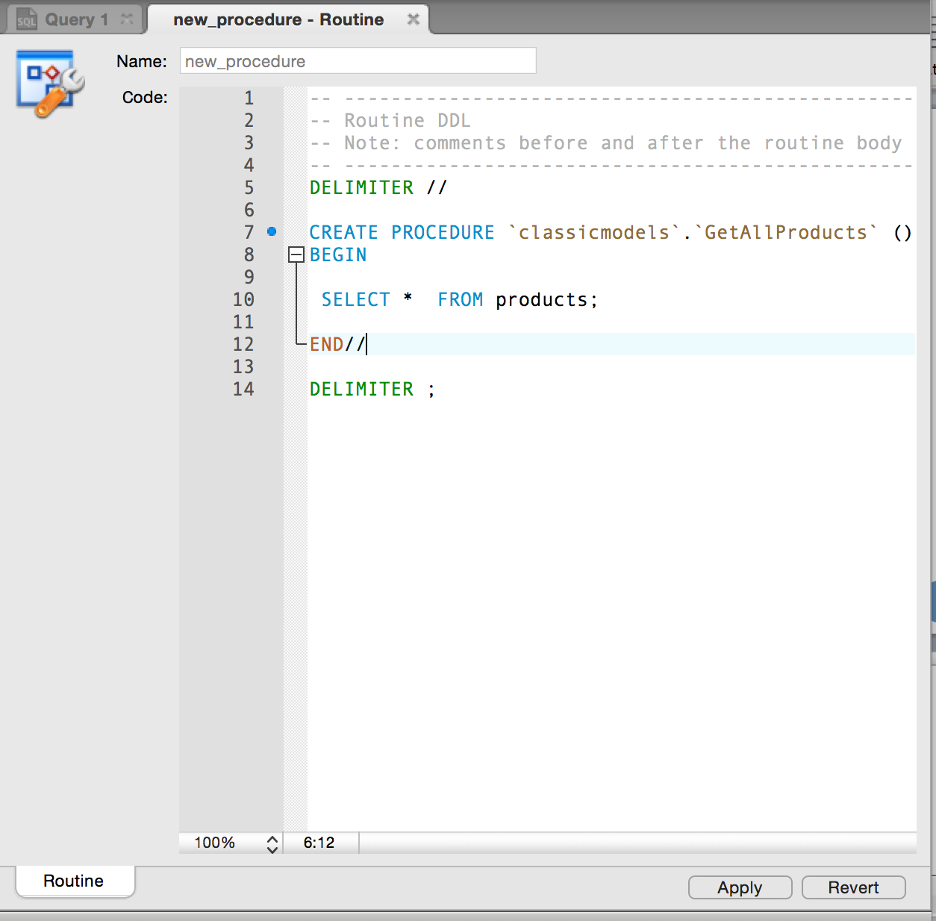
Stored Procedure in Workbench

Slide 16
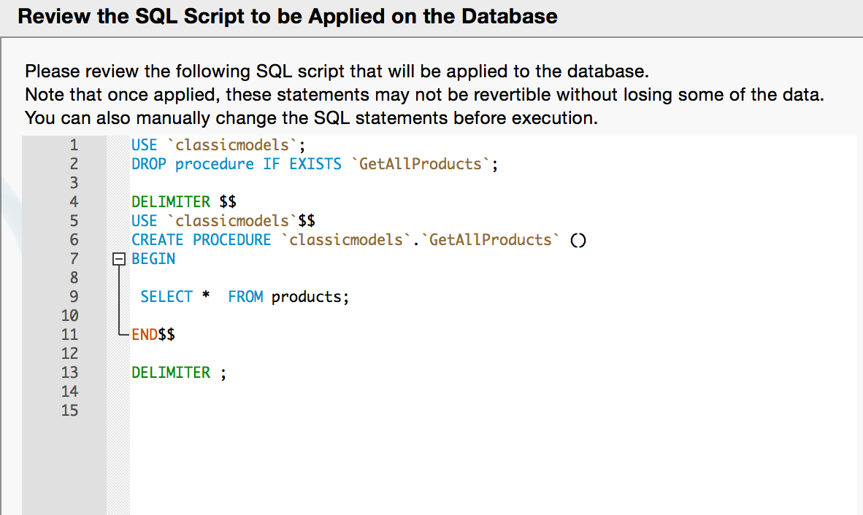

Slide 17
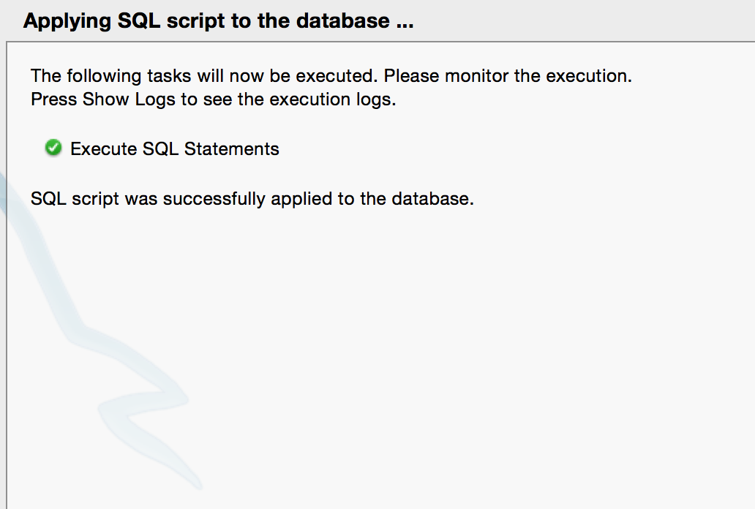

Slide 18
Calling Stored Procedures
CALL STORED_PROCEDURE_NAME
CALL GetAllProducts();

Slide 19
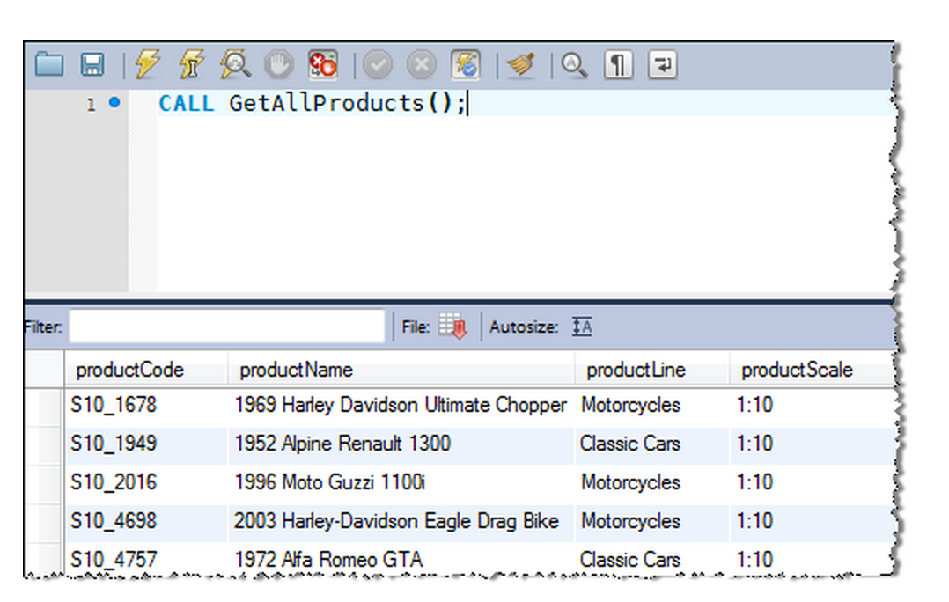

Slide 20
Variables
A variable is a name that refers to a value
A name that represents a value stored in the computer memory
PHP
$name = “Jason”
$age = 5;
MySQL
DECLARE name VARCHAR(255)
DECLARE age INT

Slide 21
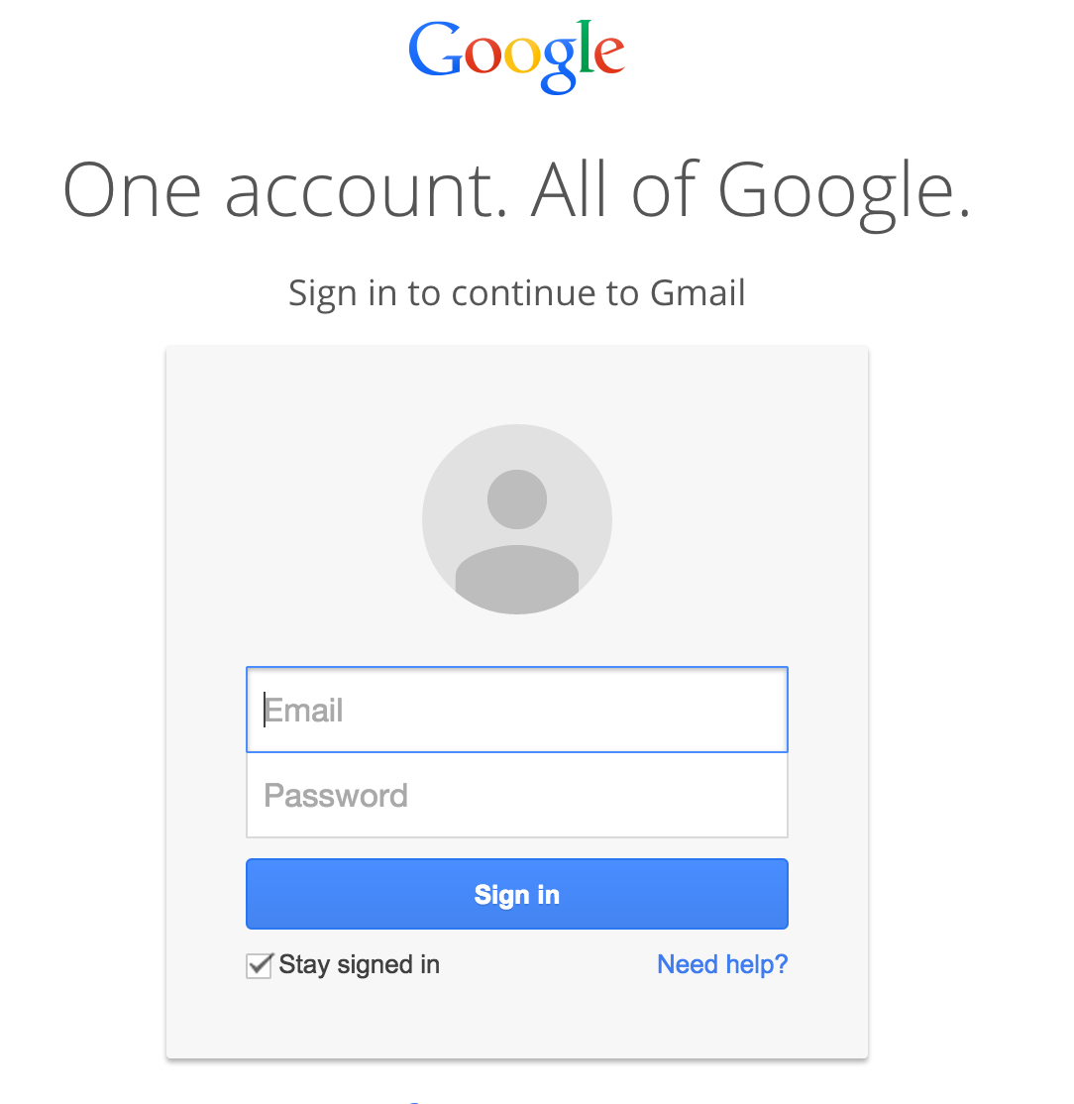
Parameters
There may be times where you want to pass information to the stored procedures
  Getting user input from a form and using that input in a SQL statement

Slide 22
Three Types of Parameters
IN
  Default
OUT
INOUT

Slide 23
In Parameter
Calling program has to pass an argument to the stored procedure.

Slide 24
Arguments and Parameters
Defining
DELIMITER //
CREATE PROCEDURE GetOfficeByCountry(IN countryName VARCHAR(255))
BEGIN
SELECT * FROM offices WHERE country = countryName;
END //
DELIMITER ;
Calling
CALL GetOfficeByCountry('USA')
The values being copied from the calling stored procedure are calling arguments.
The variables being copied into are called parameters.

Slide 25
Three Types of Parameters
IN
  Default
OUT
INOUT

Slide 26
Out Parameter
OUT – the value of an OUT parameter can be changed inside the stored procedure and its new value is passed back to the calling program
OUT is a keyword

Slide 27
Out Parameter
Defining
DELIMITER //
CREATE PROCEDURE CountOrderByStatus(IN orderStatus VARCHAR(25), OUT total INT)
BEGIN
SELECT count(orderNumber) INTO total FROM orders WHERE status = orderStatus;
END//
DELIMITER ;
Calling
CALL CountOrderByStatus('Shipped',@total);
SELECT @total;
The out parameter is used outside of the stored procedure.

Slide 28
Three Types of Parameters
IN
  Default
OUT
INOUT

Slide 29
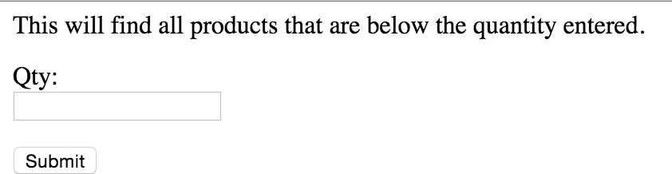
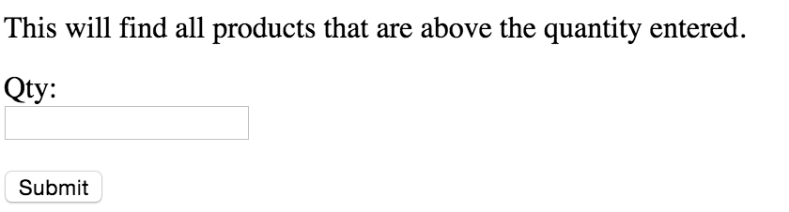
Conditionals
$sql = "select * from products WHERE quantityInStock < '".$quantityInStock ."’;
$sql = "select * from products WHERE quantityInStock > '".$quantityInStock ."’;
Could we have one call to the database instead of two?

Slide 30
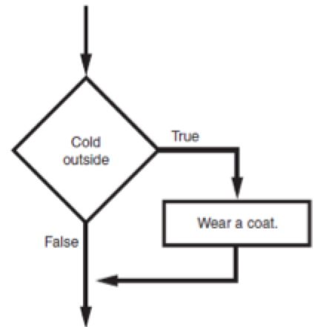
Conditionals

Slide 31
The “If” Statement
Mysql Syntax
IF if_expression THEN commands
[ELSEIF elseif_expression THEN commands]
[ELSE commands]
END IF;
First line is known as the IF clause
Includes the keyword IF followed by condition followed by the keyword THEN
  When the IFstatement executes, the condition is tested, and if it is true the block statements are executed. Otherwise, block statements are skipped

Slide 32
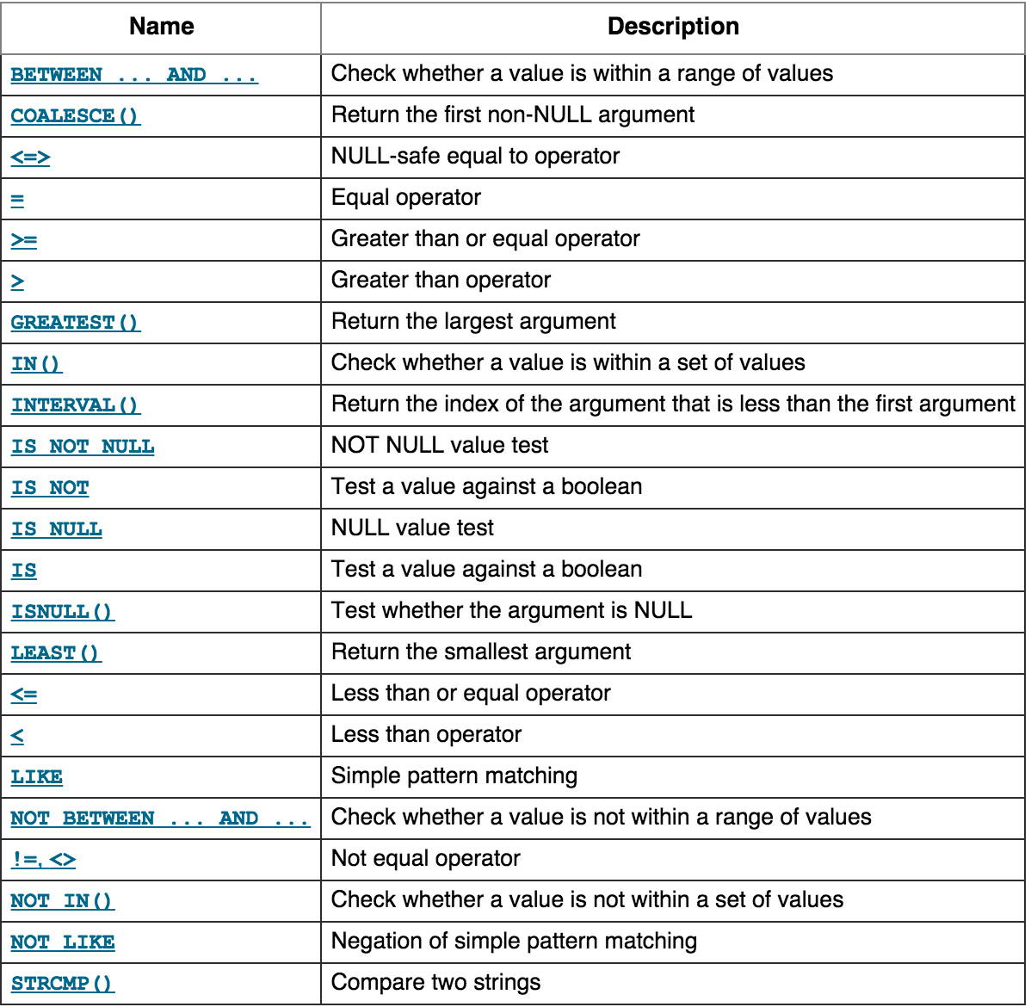
“IfExpression”: BOOLEAN Expressions and Operators

Slide 33
IF Statement
DELIMITER //
CREATE PROCEDURE GetProductsInStockBasedOnQuantitityLevel(IN p_operator VARCHAR(255), IN p_quantityInStock INT)
BEGIN
IF p_operator = "<" THEN
select * from products WHERE quantityInStock < p_quantityInStock;
ELSEIF p_operator = ">" THEN
select * from products WHERE quantityInStock > p_quantityInStock;
END IF;
END //
DELIMITER ;

Slide 34
IF Statement
CREATE PROCEDURE GetProductsInStockBasedOnQuantitityLevel
(IN p_operator VARCHAR(255), IN p_quantityInStock INT)
The ooperator > or <
The number in stock

Slide 35
The IF Statement
IF p_operator = "<" THEN
select * from products WHERE quantityInStock < p_quantityInStock;
ELSEIF p_operator = ">" THEN
select * from products WHERE quantityInStock > p_quantityInStock;
END IF;

Slide 36
Loops
While
Repeat
Loop
Repeats a set of commands until some condition is met
Iteration: one execution of the body of a loop
If a condition is never met, we will have an infinite loop

Slide 37
While Loop
WHILE expression DO
Statements
END WHILE
The expression must evaluate to true or false
while loop is known as a pretest loop
Tests condition before performing an iteration
  Will never execute if condition is false to start with
  Requires performing some steps prior to the loop

Slide 38
Infinite Loops
Loops must contain within themselves a way to terminate
  Something inside a while loop must eventually make the condition false
Infinite loop: loop that does not have a way of stopping
  Repeats until program is interrupted
  Occurs when programmer forgets to include stopping code in the loop

Slide 39
While Loop
DELIMITER //
CREATE PROCEDURE WhileLoopProc()
BEGIN
DECLARE x INT;
DECLARE str VARCHAR(255);
SET x = 1;
SET str = '';
WHILE x <= 5 DO
SET str = CONCAT(str,x,',');
SET x = x + 1;
END WHILE;
SELECT str;
END//
DELIMITER ;

Slide 40
While Loop
Creating Variables
DECLARE x INT;
DECLARE str VARCHAR(255);
SET x = 1;
SET str = '';

Slide 41
While Loop
WHILE x <= 5 DO
SET str = CONCAT(str,x,',');
SET x = x + 1;
END WHILE;

Slide 42
Practice
Create a stored procedure that lists all orders
Create a stored procedure that lists all customers
Create a stored procedure that takes as input a parameter. The parameter is customer state. The procedure should list all customers from that state
Create a stored procedure that counts the number of customers in the customers table and returns that number.

