Slide 1
Multivariate Display
From tables, charts, graphs
to more complicated methods

Slide 2
How Many Variables?
Data sets of dimensions 1, 2, 3 are common
Number of variables per class
  1 - Univariate data
  2 - Bivariate data
  3 - Trivariate data
  >3 - Hypervariate data

Slide 3
Representation
What are two main ways of presenting multivariate data sets?
  Directly (textually) → Tables
  Symbolically (pictures) → Graphs
When use which?

Slide 4
Strengths?
Use tables when
Use graphs when
The document will be used to look up individual values
The document will be used to compare individual values
Precise values are required
The quantitative info to be communicated involves more than one unit of measure
The message is contained in the shape of the values
The document will be used to reveal relationships among values
S. Few, Show Me the Numbers

Slide 5
Effective Table Design
See Show Me the Numbers
Proper and effective use of layout, typography, shading, etc. can go a long way
(Tables may be underused)

Slide 6
Basic Symbolic Displays
Graphs
Charts
Maps
Diagrams
From: S. Kosslyn, “Understanding charts and graphs”, Applied Cognitive Psychology, 1989.

Slide 7
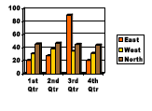
Graph
Showing the relationships between variables‟ values in a data table

Slide 8
Properties
Graph
  Visual display that illustrates one or more relationships among entities
  Shorthand way to present information
  Allows a trend, pattern or comparison to be easily comprehended

Slide 9

Issues
Critical to remain task-centric
  Why do you need a graph?
  What questions are being answered?
  What data is needed to answer those questions?
  Who is the audience?

Slide 10
Graph Components
Framework
  Measurement types, scale
Content
  Marks, lines, points
Labels
  Title, axes, ticks

Slide 11
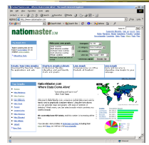
Many Examples
www.nationmaster.com

Slide 12
Quick Aside
Other symbolic displays
Chart
Map
Diagram

Slide 13
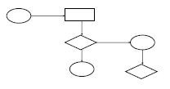
Chart
Structure is important, relates entities to each other
Primarily uses lines, enclosure, position to link entities
Examples: flowchart, family tree, org chart, ...

Slide 14
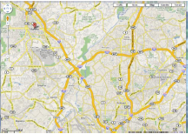
Map
Representation of spatial relations
Locations identified by labels

Slide 15
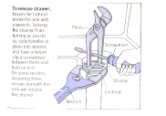
Diagram
Schematic picture of object or entity
Parts are symbolic
Examples: figures, steps in a manual, illustrations,...

Slide 16
Some History
Which is older, map or graph?
Maps from about 2300 BC
Graphs from 1600‟s
  Rene Descartes
  William Playfair, late 1700‟s

Slide 17
Details
What are the constituent pieces of these four symbolic displays?
What are the building blocks?

Slide 18
Visual Structures
Composed of
Spatial substrate
Marks
Graphical properties of marks

Slide 19
Space
Visually dominant
Often put axes on space to assist
Use techniques of composition, alignment, folding, recursion, overloading to
  1) increase use of space
  2) do data encodings

Slide 20
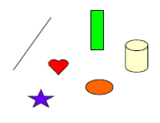
Marks
Things that occur in space
  Points
  Lines
  Areas
Volumes

Slide 21
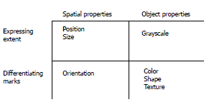
Graphical Properties
Size, shape, color, orientation...

Slide 22
Few’s Selection & Design Process
Determine your message and identify your data
Determine if a table, or graph, or both is needed to communicate your message
Determine the best means to encode the values
Determine where to display each variable
Determine the best design for the remaining objects
  Determine the range of the quantitative scale
  If a legend is required, determine where to place it
  Determine the best location for the quantitative scale
  Determine if grid lines are required
  Determine what descriptive text is needed
Determine if particular data should be featured and how
S Few “Effectively Communicating Numbers” http://www.perceptualedge.com/articles/Whitepapers/Communicating_Numbers.pdf

Slide 23
Points, Lines, Bars, Boxes
Points
  Useful in scatterplots for 2-values
  Can replace bars when scale doesn’t start at 0
Lines
  Connect values in a series
  Show changes, trends, patterns
  Not for a set of nominal or ordinal values
Bars
  Emphasizes individual values
  Good for comparing individual values
Boxes
  Shows a distribution of values

Slide 24
Bars
Vertical vs. Horizontal
Horizontal can be good if long labels or many items
Multiple Bars
•Can be used to encode another variable

Slide 25
Multivariate: Beyond Tables and Charts
Data sets of dimensions 1,2,3 are common
Number of variables per class
  1 - Univariate data
  2 - Bivariate data
  3 - Trivariate data
  >3 - Hypervariate/Multivariate data

Slide 26
Univariate Data
Representations
7
5
3
1
Bill
Tukey box plot
low
Middle 50%
high
Mean
0
20

Slide 27
Bivariate Data
Representations
Scatter plot is common
price
mileage

Slide 28
Trivariate Data
Representations
3D scatter plot is possible
price
horsepower
mileage

Slide 29
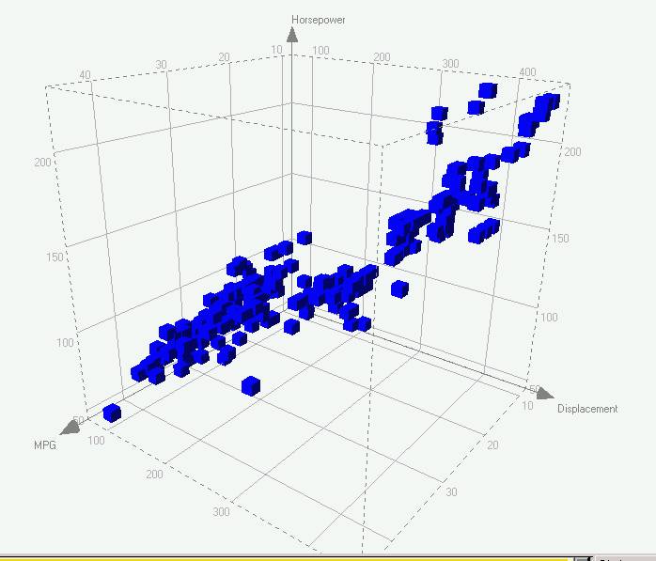
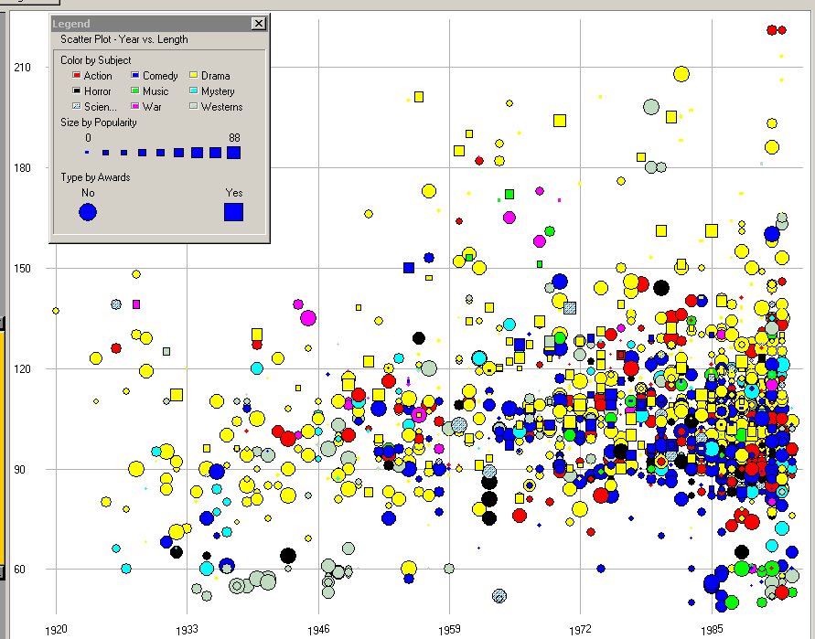
Trivariate
3D scatterplot, spin plot
2D plot + size (or color…)

Slide 30
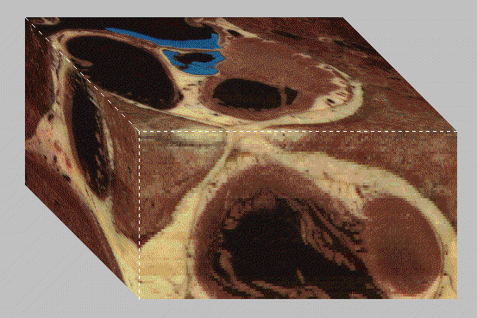
4D = 3D (spatial) + 1D variable

Slide 31
So we can do some “4D”
Spatial 3D plus 1D variable (like tissue density)
Spatial 3D plus 1D time
Orthogonal 3D of data (3D plot) plus time
And even 5D (3D spatial, 1D, and 1D time)
Note that many of the 3D spatial ones are best done only if you have 3D capable display.

Slide 32
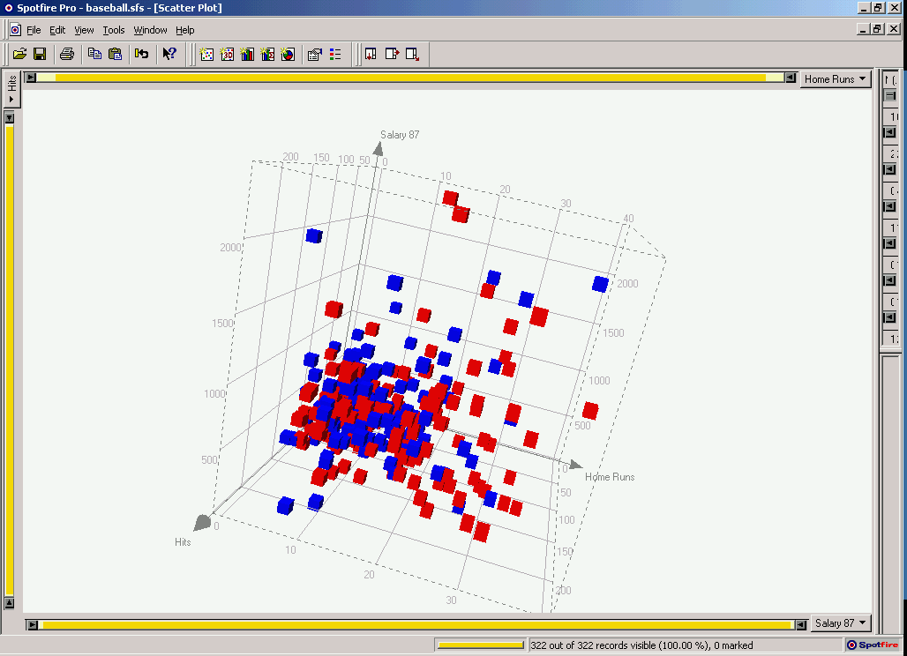
Different Arrangements of Axes
Axes are good
  Lays out all points in a single space
  “position” is 1st in Cleveland’s rules
  Uniform treatment of dimensions
Space > 3D ?
Must trash
orthogonality

Slide 33
Multivariate Data
Number of well-known visualization techniques exist for data sets of 1-3 dimensions
  line graphs, bar graphs, scatter plots OK
  We see a 3-D world (4-D with time)
Some visualization for 3,4,5D when some of variables are spatial or time.
Interesting (challenging cases) are when we have more variables than this. How best to visualize them?

Slide 34
Map n-D space onto 2-D screen
Visual representations:
  Complex glyphs
      E.g. star glyphs, faces, embedded visualization, …
  Multiple views of different dimensions
      E.g. small multiples, plot matrices, brushing histograms, Spotfire, …
  Non-orthogonal axes
      E.g. Parallel coords, star coords, …
  Tabular layout
      E.g. TableLens, …
Interactions:
  Dynamic Queries
  Brushing & Linking
  Selecting for details, …
Combinations (combine multiple techniques)

Slide 35
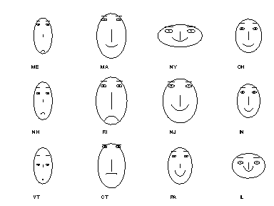
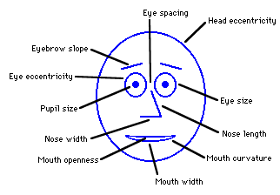
Chernoff Faces
Encode different variables’ values in characteristics
of human face
Cute applets:
http://www.cs.uchicago.edu/~wiseman/chernoff/
http://hesketh.com/schampeo/projects/Faces/chernoff.html

Slide 36
Glyphs: Stars
d1
d7
d2
d6
d3
d5
d4

Slide 37
Star Plots
Var 1
Space out the n
variables at equal
angles around a
circle
Each “spoke” encodes
a variable’s value
Var 5
Var 2
Value
Var 4
Var 3

Slide 38
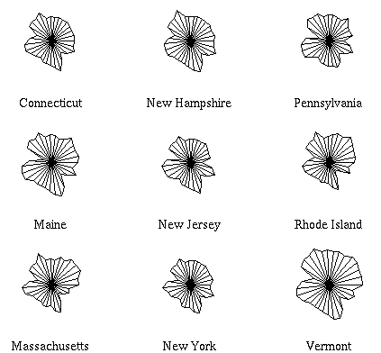
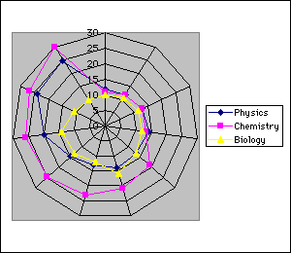
Star Plot examples
http://seamonkey.ed.asu.edu/~behrens/asu/reports/compre/comp1.html

Slide 39
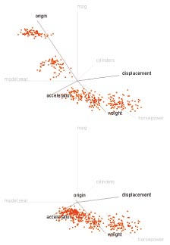
Star Coordinates
Kandogan, “Star Coordinates”
A scatterplot on Star Coordinate system

Slide 40
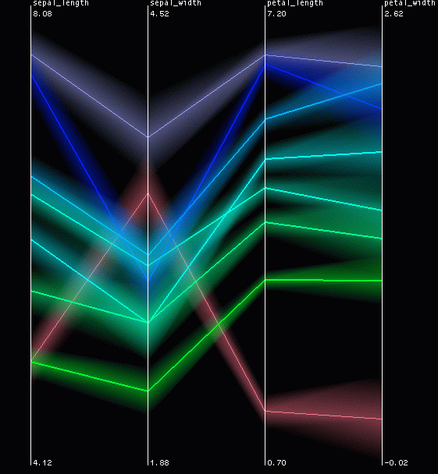
Parallel Coordinates
Inselberg, “Multidimensional detective”
(parallel coordinates)

Slide 41
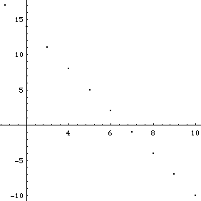
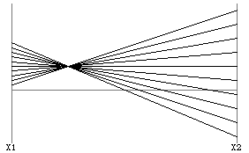
Parallel Coordinates (2D)
Encode variables along a horizontal row
Vertical line specifies values
Dataset in a Cartesian graph
Same dataset in parallel coordinates

Slide 42
Parallel Coordinates (4D)
Forget about Cartesian orthogonal axes
(0,1,-1,2)=
x
y
z
w
0
0
0
0

Slide 43
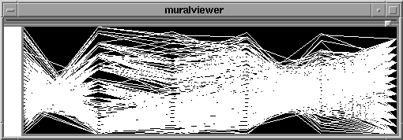
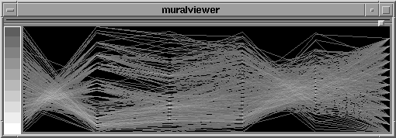
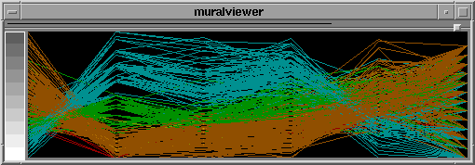
Parallel Coordinates Example
Basic
Grayscale
Color

Slide 44
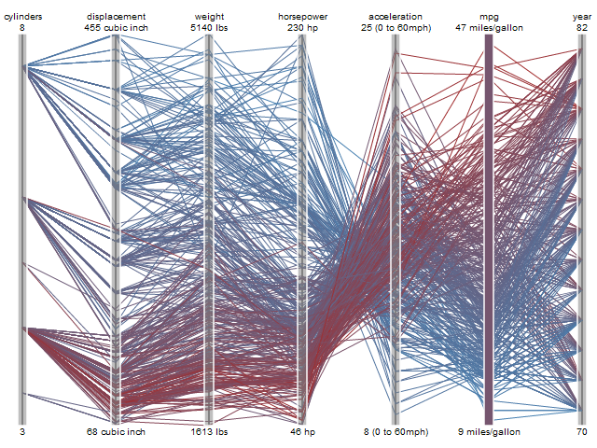

Slide 45
Multiple Views
Give each variable its own display
1
A B C D E
1 4 1 8 3 5
2 6 3 4 2 1
3 5 7 2 4 3
4 2 6 3 1 5
2
3
4
A B C D E

Slide 46
Small Multiples
Nice definitions and examplea from Juice Analytics.

Slide 47
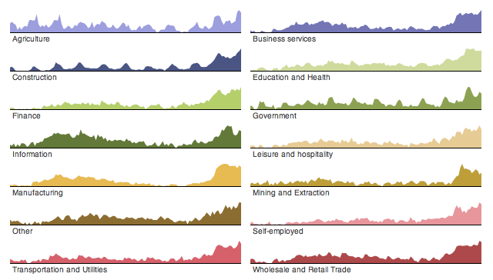
Small Multiples

Slide 48
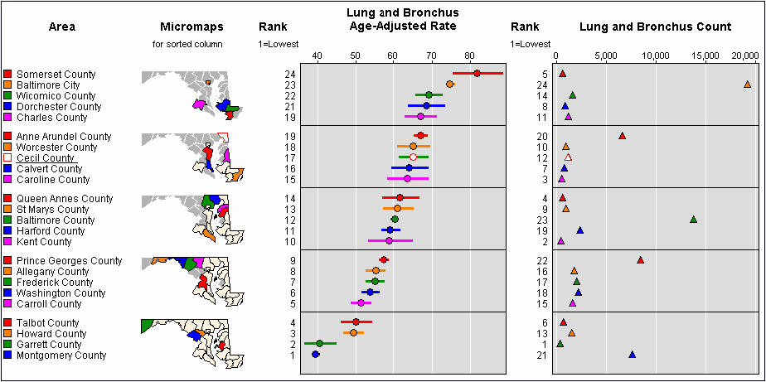
Small Multiples

Slide 49
Multiple Graphs--Trellis
Trellised visualizations enable you to quickly recognize similarities or differences between different categories in the data. Each individual panel in a trellis visualization displays a subset of the original data table, where the subsets are defined by the categories available in a column or hierarchy.
Two Examples (next slides):
Spotfire:For example, if you choose to trellis a visualization based on the two variables "Gender" and "Political affiliation", this will result in four separate panels representing the combinations Female-Republican, Female-Democrat, Male-Republican, and Male-Democrat. If the "Gender" variable is used in conjunction with another variable that has five different values, this will yield ten panels. From this follows that variables with a continuous distribution and a wide range of values (for example, Real values) should be binned before they are used to form a trellis visualization. Otherwise the number of panels quickly becomes unmanageable.
SilverLight: The trellis visualizations allow us to quickly compare data horizontally and vertically with visual sparklines. Not only can you quickly see an individual domain's trend for a region (i.e., domain1 in Europe), but you can also see how domain1.com traffic compares across all three regions. We can also quickly tell if the traffic is meeting our goals by comparing if the trrend line is above or below the KPI line (dotted line).

Slide 50
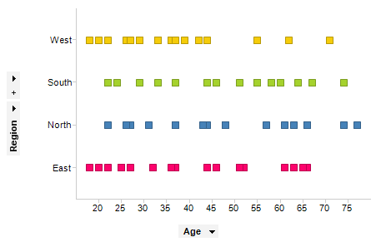

Slide 51
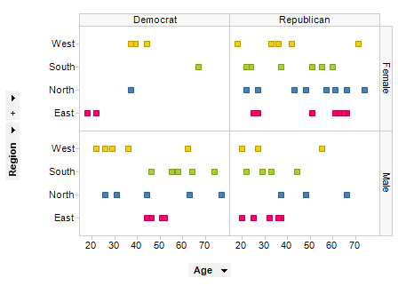

Slide 52
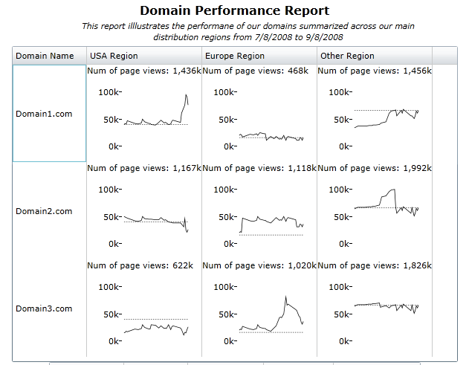

Slide 53
Sparklines
Use matrix, but in each cell put in not single value, but visual that represents compound element. This way you pack in multiple dimensions into each cell, but can easy scan across cells.
Tufte description (originated)
MicroSoft Excel examples
Infragistics example

Slide 54
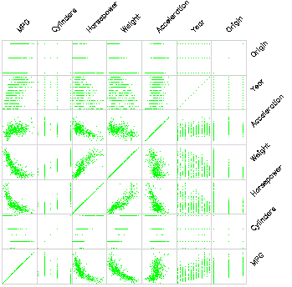
Scatterplot Matrix
Represent each possible
pair of variables in their
own 2-D scatterplot
Useful for what?
Misses what?

Slide 55
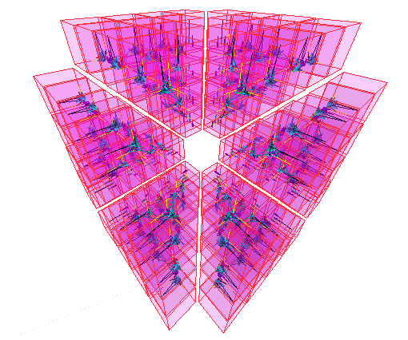
… on steroids

Slide 56
To Do Better…Need Interaction
Separate Static from Interactive
Very nice visual index of static presentations is Visualization Zoo
What can we do if we add interaction to the visualizations? In the next section we go further, by adding zoom, filtering, “brushing”, etc.

Slide 57
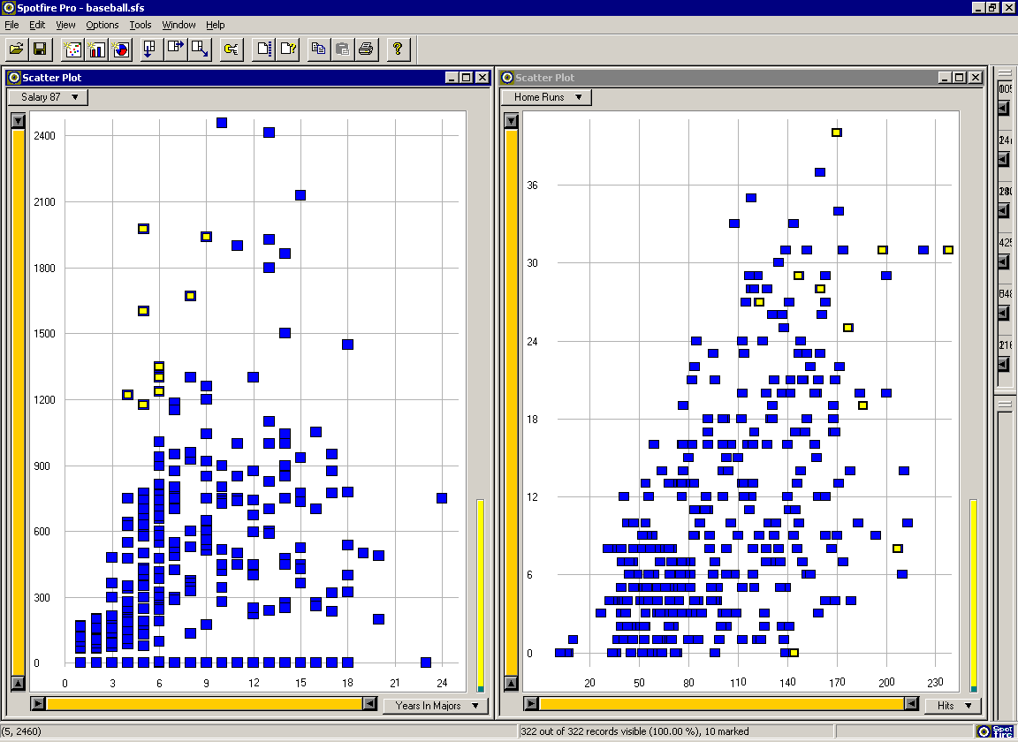
Multiple Views: Brushing-and-linking

Slide 58
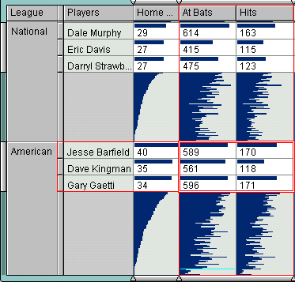
Table Lens
Rao, “Table Lens”

Slide 59
Table Lens
Spreadsheet is certainly one hypervariate data presentation
Idea: Make the text more visual and symbolic
Just leverage basic bar chart idea

Slide 60
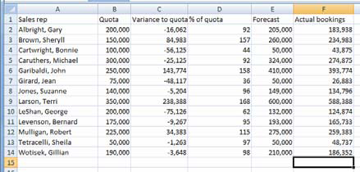

Visual Mapping
Change quantitative
values to bars

Slide 61
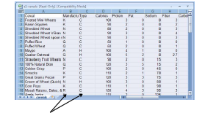
Tricky Part
What do you do for
nominal data?

Slide 62
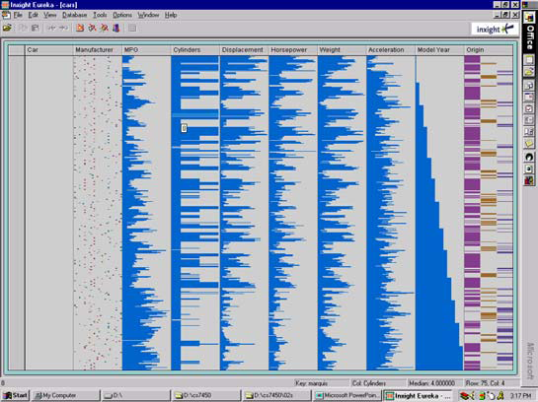
Instantiation

Slide 63
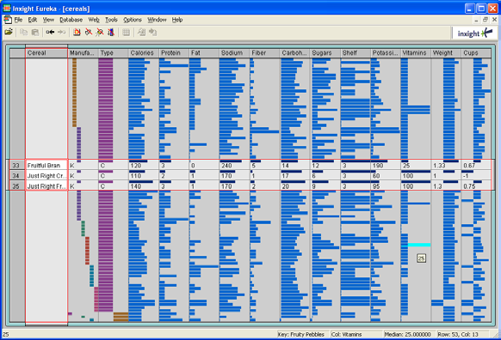
Details
Focus on
item(s)
while
showing
the context

Slide 64
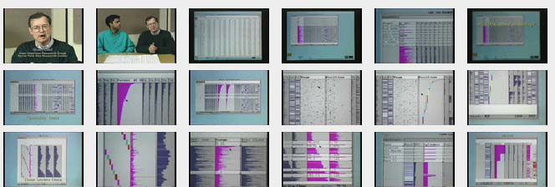
See It
http://www.open-video.org/details.php?videoid=8304

Slide 65
FOCUS
Feature-Oriented Catalog User Interface
Leverages spreadsheet metaphor again
Items in columns, attributes in rows
Uses bars and other representations for attribute values

Slide 66
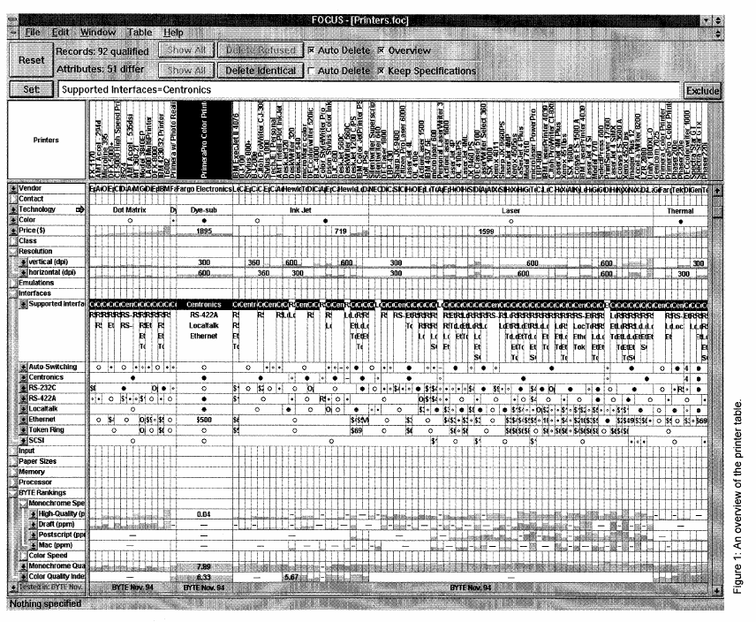

Slide 67
Characteristics
Can sort on any attribute (row)
Focus on an attribute value (show only cases having that value) by doubleclicking on it
Can type in queries on different attributes to limit what is presented to. Note this is main contribution: dynamic control (selection/change/querying/filtering) of individual attributes.

Slide 68
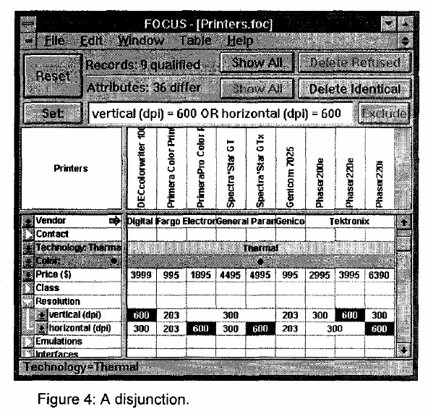
Limit by Query

Slide 69
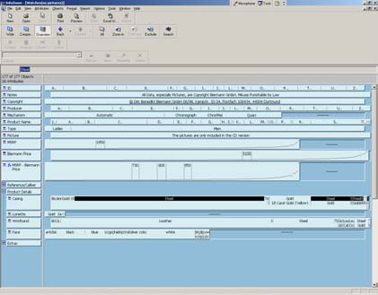
Manifestation
InfoZoom

Slide 70
Categorical data?
How about multivariate categorical data?
Students
  Gender: Female, male
  Eye color: Brown, blue, green, hazel
  Hair color: Black, red, brown, blonde, gray
  Home country: USA, China, Italy, India, …

Slide 71

Mosaic Plot

Slide 72
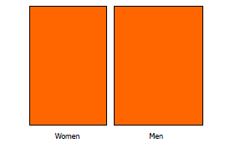
Mosaic Plot

Slide 73
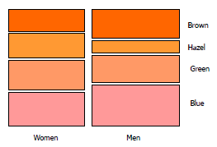
Mosaic Plot

Slide 74
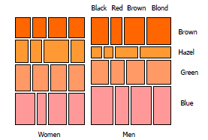
Mosaic Plot
Reminds you of? (treemaps)

Slide 75
IBM Attribute Explorer
Multiple histogram views, one per attribute (like trellis)
Each data case represented by a square
Square is positioned relative to that case’s value on that attribute
Selecting case in one view lights it up in others
Query sliders for narrowing
Use shading to indicate level of query match (darkest for full match)

Slide 76
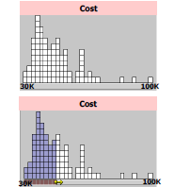
Features
Attribute histogram
All objects on all attribute scales
Interaction with attributes limits

Slide 77
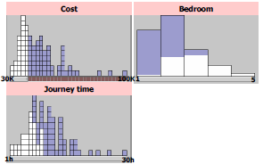
Features
Inter-relations between attributes – brushing

Slide 78
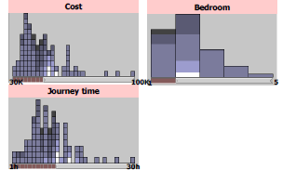
Features
Color-encoded sensitivity

Slide 79
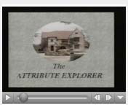
Attribute Explorer
http://www.open-video.org/details.php?videoid=8162

Slide 80
Polaris
See Chris Solte reading for class
Good example of integrated control, dynamic filtering, display.
Now best seen in Tableau (Chris Solte co-founder with adviser, Pat Hanrahan).

Slide 81
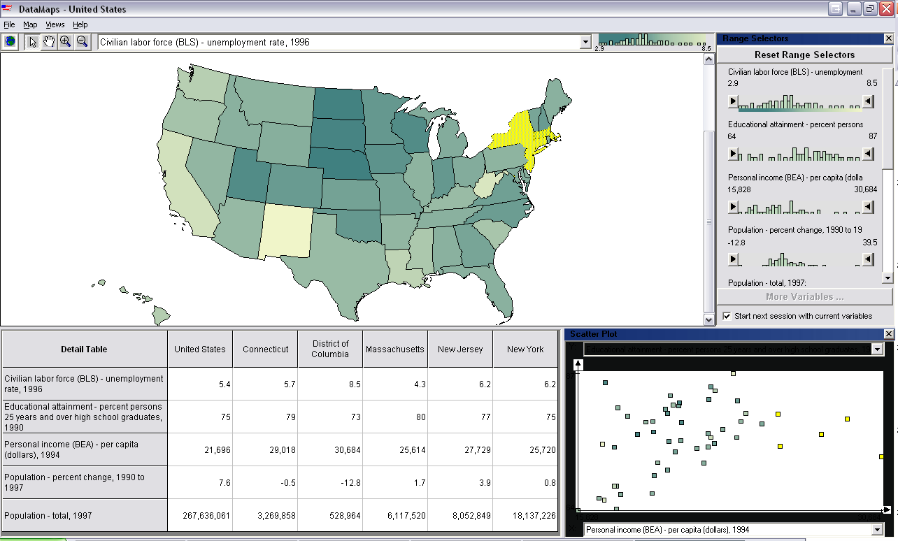
Combining Techniques
Multi-Dimensional + GeoSpatial (DataMaps VT)

Slide 82
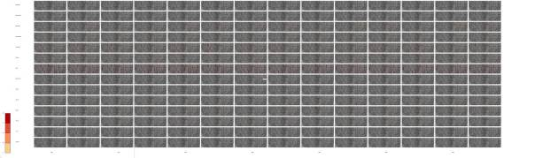

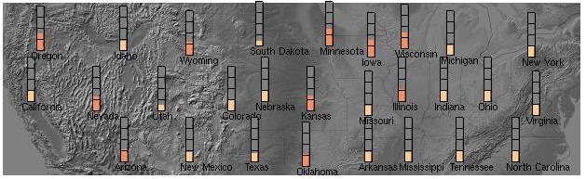
1. Small Multiples
Multiple views: 1 attribute / map
1976

Slide 83


2. Embedded Visualizations
Complex glyphs: For each location, show vis of all attributes

Slide 84
Comparison of Techniques
ParCood: <1000 items, <20 attrs
        Relate between adjacent attr pairs
StarCoord: <1,000,000 items, <20 attrs
        Interaction intensive
TableLens: similar to par-coords
        more items with aggregation
        Relate 1:m attrs (sorting), short learn time
Visdb: 100,000 items with 10 attrs
        Items*attrs = screenspace, long learn time, must query
Spotfire: <1,000,000 items, <10 attrs (DQ many)
        Filtering, short learn time

Slide 85
Limitations and Issues
Complexity
  Many of these systems seem only appropriate for expert use
User testing
  Minimal evidence of user testing in most cases

Slide 86
Scaling up further
Beyond 20 dimensions?
Interaction
    E.g. Offload some dims to Dynamic Query sliders, …
Reduce dimensionality of the data
    E.g. Multi-dimensional scaling
Visualize features of the dimensions, instead of the data
    E.g. rank-by-feature

Slide 87
Interactive Control
The most effective tool at your disposal for dealing with multiple dimensions of data is INTERACTIVITY.
Use it to allow user to control what dimensions are seen, how they filter mass of information into selected important parts of information, and to show linkages, and help in understanding data.

Slide 88
End of Main Presentation

Slide 90
Additional Examples

Slide 91
MultiNav
Each different attribute is placed in a different row
Sort the values of each row
  Thus, a particular item is not just in one column
Want to support browsing

Slide 92

Interface

Slide 93
Alternate UI
Can slide the values in a row horizontally
A particular data case then can be lined up in one column, but the rows are pushed unequally left and right

Slide 94

Attributes as Sliding Rods

Slide 95

Information-Seeking Dialog

Slide 96

Instantiation

Slide 97
Limitations
Number of cases (horizontal space)
Nominal & textual attributes don’t work quite as well

Slide 98
Dust & Magnet
Altogether different metaphor
Data cases represented as small bits of iron dust
Different attributes given physical manifestation as magnets
Interact with objects to explore data
Yi, Melton, Stasko & Jacko
Info Vis ‘05

Slide 99

Interface

Slide 100
Interaction
Iron bits (data) are drawn toward magnets (attributes) proportional to that data element’s value in that attribute
  Higher values attracted more strongly
All magnets present on display affect position of all dust
Individual power of magnets can be changed
Dust’s color and size can connected to attributes as well

Slide 101
Interaction
Moving a magnet makes all the dust move
  Also command for shaking dust
Different strategies for how to position magnets in order to explore the data

Slide 102

See It Live
ftp://ftp.cc.gatech.edu/pub/people/stasko/movies/dnm.mov

Slide 103

FOCUS / InfoZoom
Spenke, “FOCUS”

Slide 104

VisDB & Pixel Bar Charts
Keim, “VisDB”

