Slide 1
INLS 200
thursday, january 16

Slide 2
Seeker(s) and situation | Main motivation | Sources of information | Time pressure | Degree of thoroughness
Julie: car purchase | Optimize functionality and value | Friends, web pages, salespeople | Low (months) | low
Leslie: library research | Class assignment; earn credit/grade | Online catalogs, books, journals, professional advice (on how to search | Moderate (weeks) | moderate
Hospital ICU team members: caring for an accident victim | Work assignment; desire to help others | Observation of patient, paper and electronic records, monitoring devices, medical manuals, hospital employees | Very high (hours or days, based on patient improvement | High
Joe: horse race wager | Desire for thrill; to win money | Special journals, observation, intuition | Very high (minutes) | high
George: legal research | Work assignment; help relatives | Special databases and publications, professional advice | High (days) | high
Maria: information on cancers | Curiosity; preemptive information search | Web pages, books, brochures, friends, experts | None (lifetime) | moderate
What factors might determine an individual's point of satisficing? Or in other words if two people have the same information goal, time pressure, etc., what might make one person feel satisfied sooner/later than the other person?

Slide 3
What factors might determine an individual's point of satisficing?
Or in other words if two people have the same information goal, time pressure, etc., what might make one person feel satisfied sooner/later than the other person?
-James

Slide 4
A bat and a ball cost $1.10 in total. The bat costs $1 more than the ball. How much does the ball cost?
Text 147348 and
your message to 37607
shhhh…no whispering to your neighbor!!
http://www.polleverywhere.com/free_text_polls/IUQhOVVhxVEPqkh

Slide 5
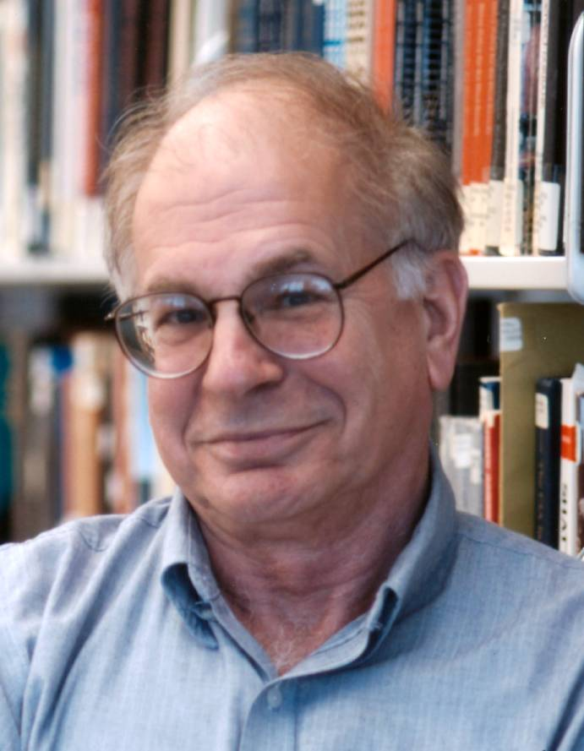
“People are not accustomed to thinking hard and are often content to trust a plausible judgment that comes quickly to mind.”
Daniel Kahneman. (2003). American Economic Review 93 (5), p. 1450

Slide 6
Two-systems of thought [exist in parallel]
System 1
Intuitive, implicit more “perceptual”
Affective
Heuristic-based
Relies on mental shortcuts
Unconscious
Automatic
Evolved early
Independent of general intelligence
Relatively invulnerable to aging
Generally faster
General feeling of certitude
System 2
Explicit and rule-based
More “analytical”
Conscious
Slow
Effortful
Controllable
Logical / abstract
Constrained by working memory, sequential
Permits hypothetical thinking
Correlated with general intelligence
Develops with age and is more vulnerable to aging

Slide 7
Decision Theory
Focuses on how we use our freedom
Assumption
There are options to choose between
Assumption
We choose in a non-random way
Our choices are goal-directed activities
Assumption
Assumption

Slide 8
Goal-directed behavior in the presence of options
Decision theory is concerned with…

Slide 9
rational choice theory
goal of maximization / optimization
human beings have well-ordered preferences
people go through life with all their options arrayed before them, as if on a buffet table
we have complete information about the costs and benefits associated with each option
we compare the options with one another on a single scale of preference, or value, or utility
and after making the comparisons, we choose so as to maximize our preferences, or values, or utilities.
von Neumann, J., & Morgenstern, O. (1944). Theory of games and economic
behavior. Princeton, NJ: Princeton University Press.

Slide 10
Decision Process Models: Expected Value Theory
The rational procedure is to:
identify all possible outcomes
determine their values (positive or negative)
determine the probabilities that will result from each course of action
multiply the two to give an expected value
Expected value theory says you should always choose the option with the HIGHEST EXPECTED VALUE

Slide 11
 | Probability of outcome | Outcome | Expected Value
Option 1 | 50% | $100
Option 2 | 80% | $59

Slide 12
 | Probability of outcome | Outcome | Expected Value
Option 1 | 50% | $100 | .5 x 100 = 50
Option 2 | 80% | $59 | .8 x 59 = 47.2
Expected value theory indicates option 1 is best

Slide 13
 | Probability of outcome | Outcome | Expected Value
Option 1 | 100% | $1,000,000
Option 2 | 50% | $3,000,000

Slide 14
 | Probability of outcome | Outcome | Expected Value
Option 1 | 100% | $1,000,000 | 1,000,000
Option 2 | 50% | $3,000,000 | 1,500,000
EV says you should prefer option 2 to option 1.
Many people prefer 1 to 2. Why?
Option 1 is a sure thing … option 2 is a gamble…

Slide 15
 | Probability of outcome | Outcome | Expected Value
Option 1 | 20% | $1,000,000
Option 2 | 100% | $1

Slide 16
 | Probability of outcome | Outcome | Expected Value
Option 1 | 95% | $1,000,000
Option 2 | 50% | $3,000,000

Slide 17
 | Probability of outcome | Outcome | Expected Value
Option 1 | 95% | $1,000,000 | 950,000
Option 2 | 50% | $3,000,000 | 1,500,000
$3 million is not really three times as desirable a consequence as $1 million…I would probably be MORE satisfied with an almost sure million than to risk gaining nothing…

Slide 18
Expected Value Theory vs. Expected Utility Theory
We can construct a scale, called a utility scale in which we try to quantify the amount of satisfaction (UTILITY) we would derive from each option

Slide 19
Multiattribute Utility Theory MAUT
 | Attribute A | Degree of importance (utility) of A | Attribute B | Degree of importance (utility) of B
Option 1 | Low cost | .5 | Low quality | .3
Option 2 | High cost | .5 | High quality | .8
Assigning weights

Slide 20
behavioral economics
assumption of complete information that characterizes rational choice theory is implausible
choice theorists treat information itself as a “commodity,” something that has a price (in time or money), and is thus a candidate for consumption along with more traditional goods
Payne, J. W., Bettman, J. R., & Johnson, E. J. (1993). The adaptive
decision maker. New York: Cambridge University Press.

Slide 21
Herbert Simon - satisficing
Simon argued that the presumed goal of maximization (or optimization) is virtually always unrealizable in real life, owing both to the complexity of the human environment and the limitations of human information processing.

Slide 22
Herbert Simon - satisficing
In choice situations, people actually have the goal of “satisficing” rather than maximizing.
To satisfice, people need only to be able to place goods on some scale in terms of the degree of satisfaction they will afford, and to have a threshold of acceptability.

Slide 23
To satisfice is to pursue not the best option, but a good enough option.
Simon, H. A. (1957). Models of man, social and rational: Mathematical
essays on rational human behavior. New York: Wiley.

Slide 24
Quality Information
What does that mean to you?
Accuracy
Depth
Caliber of sources
Timeliness
Documentation
Verified by several sources
Interest / new / fresh

Slide 25
The scenario about the patient in the hospital showcases the importance seeking information in groups. The team members of the physician, nurse, night nurse, and pharmacist work together in measuring, searching, and recording information. Each measurement most be taken carefully and be as accurate as possible because it is important and useful related to the life of the patient.
What is another example of situation where information is processed in this way?
-Ally
Collaborative information seeking/use

Slide 26
In small groups, brainstorm and identify a real-world situation that requires some form of collaborative information search.
If you are the project manager/coordinator what sort of rules/requirements would you initiate?
Google Glass video

