Slide 1
INLS 560 – Dictionaries
Instructor: Jason Carter
Notes:
Functions

Slide 2
Types
int
list
string

Slide 3
Dictionaries
Dictionary: object that stores a collection of data
Each element consists of a key and a value
Often referred to as mapping of key to value
Key must be an immutable object (cannot be changed!)
To retrieve a specific value, use the key associated with it
Format for creating a dictionary
dictionary =
{key1:val1, key2:val2}

Slide 4
Retrieving a Value From a Dictionary
Elements in dictionary are unsorted
General format for retrieving value from dictionary: dictionary[key]
If key in the dictionary, associated value is returned, otherwise, KeyError exception is raised
Test whether a key is in a dictionary using the if/else statement and not in operator
Helps prevent KeyError exceptions

Slide 5
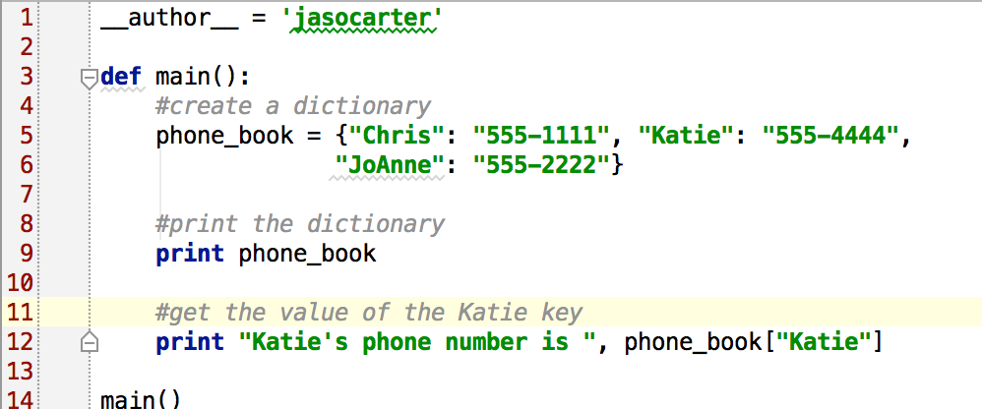
Retrieving a Value from a Dictionary

Slide 6
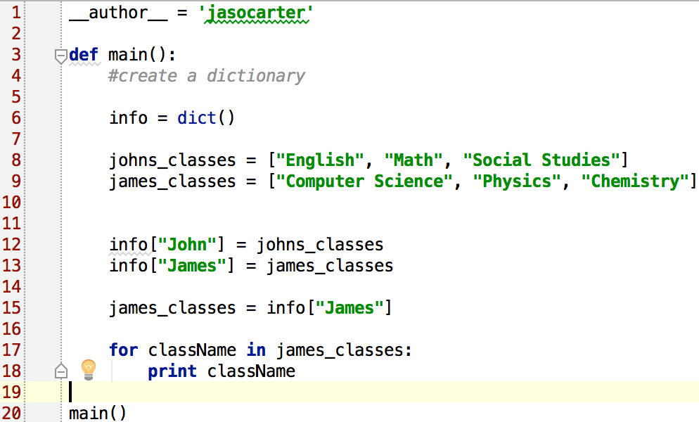
Retrieving a List Value from a Dictionary

Slide 7
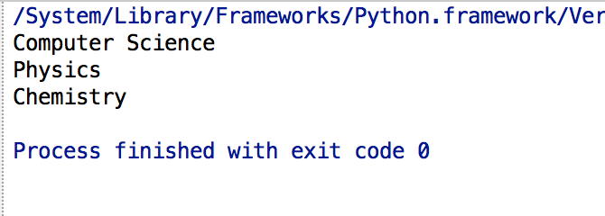
Retrieving a List Value from a Dictionary - Output

Slide 8
Retrieving a Value from a Dictionary – Key Error

Slide 9
Retrieving a Value from a Dictionary – Key Error Output

Slide 10
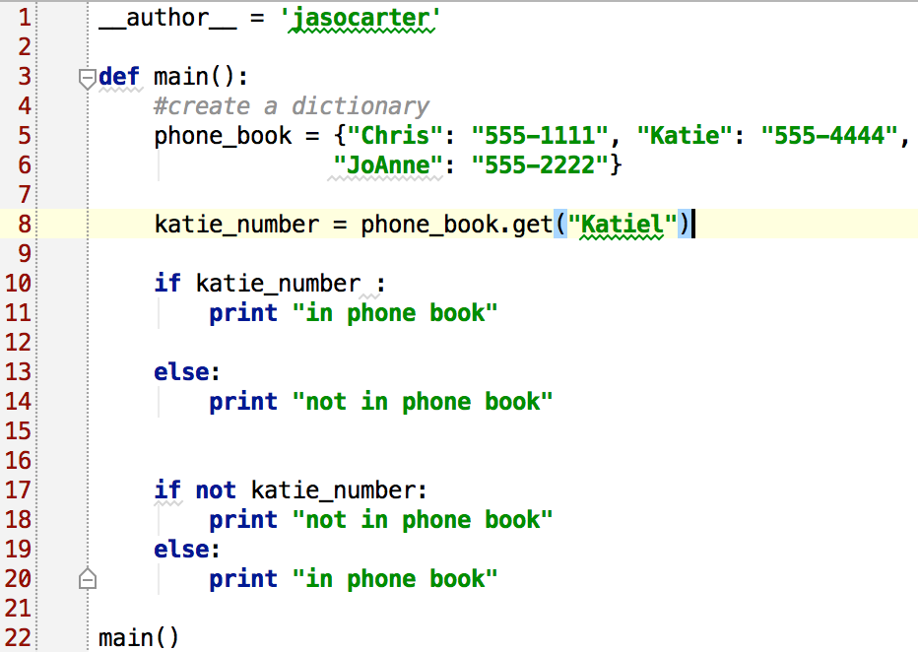
Checking if Key Exists

Slide 11
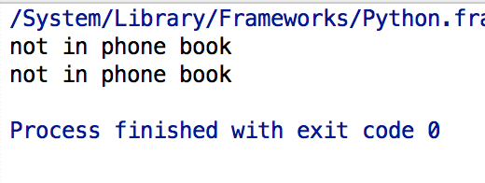
Checking if Key Exists - Output

Slide 12
Adding Elements to an Existing Dictionary
Dictionaries are mutable objects
To add a new key-value pair:
dictionary[key] = value
If key exists in the dictionary, the value associated with it will be changed

Slide 13
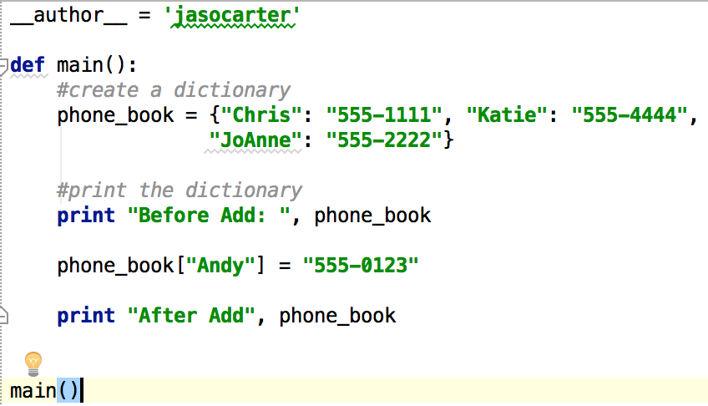
Adding Elements to an Existing Dictionary

Slide 14
Adding Elements to an Existing Dictionary - Output

Slide 15
Deleting Elements From an Existing Dictionary
To delete a key-value pair:
del dictionary[key]
If key is not in the dictionary, KeyError exception is raised

Slide 16
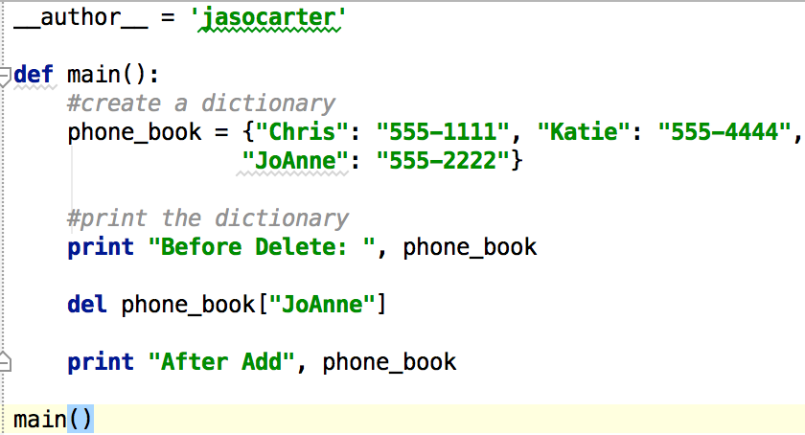
Deleting Elements From an Existing Dictionary

Slide 17
Deleting Elements From an Existing Dictionary - Output

Slide 18
Using a Dictionary as a Color Map
Dictionaries map one value to another
We could map numbers to color names instead of names to phone #s, or to map numbers to images.
Example 1:
colors = {0: ‘white’, 1: ‘black’, 2: ‘pink’, 3: ‘purple’, 4: ‘red’, 5: ‘blue’, 6: ‘green’, 7: ‘orange’, 8: ‘yellow’}
images = {0: ‘blank.gif’, 1: ‘a.gif’, 2: ‘b.gif’, 3: ‘c.gif’, 4: ‘d.gif’, 5: ‘e.gif’, 6: ‘f.gif’, 7: ‘g.gif’, 8: ‘h.gif’}

Slide 19
Getting the Number of Elements and Mixing Data Types
len function: used to obtain number of elements in a dictionary
Keys must be immutable objects, but associated values can be any type of object
One dictionary can include keys of several different immutable types
Values stored in a single dictionary can be of different types

Slide 20
Creating an Empty Dictionary and Using for Loop to Iterate Over a Dictionary
To create an empty dictionary:
Use {}
Use built-in function dict()
Elements can be added to the dictionary as program executes
Use a for loop to iterate over a dictionary
General format: for key in dictionary:

Slide 21
Some Dictionary Methods
get method: gets a value associated with specified key from the dictionary
Format: dictionary.get(key, default)
default is returned if key is not found
Alternative to [] operator
Cannot raise KeyError exception
keys method: returns all the dictionaries keys as a sequence
Format: dictionary.keys()

Slide 22
Some Dictionary Methods (cont’d.)
values method: returns all the dictionaries values as a sequence
Format: dictionary.values()
Use a for loop to iterate over the values

Slide 23
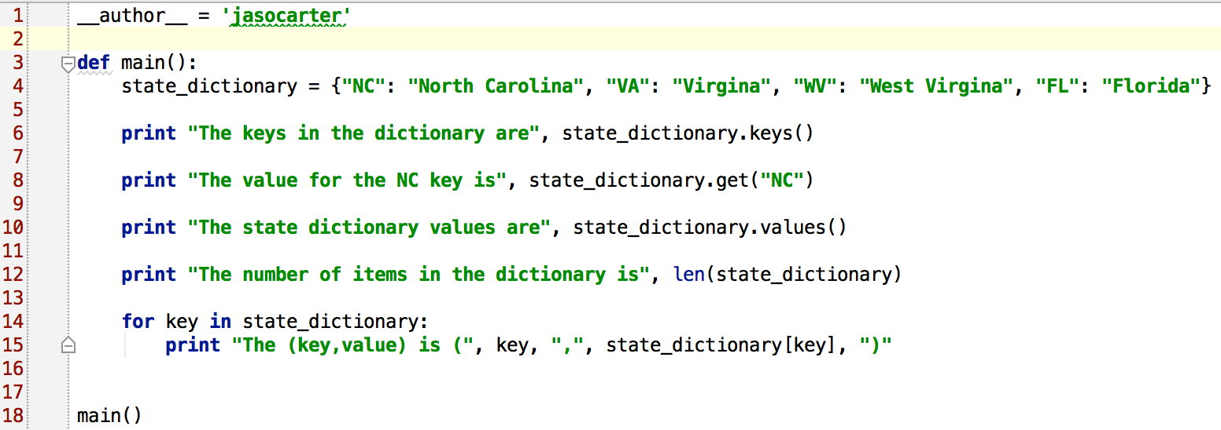
Some Dictionary Methods

Slide 24
Some Dictionary Methods - Output

Slide 25
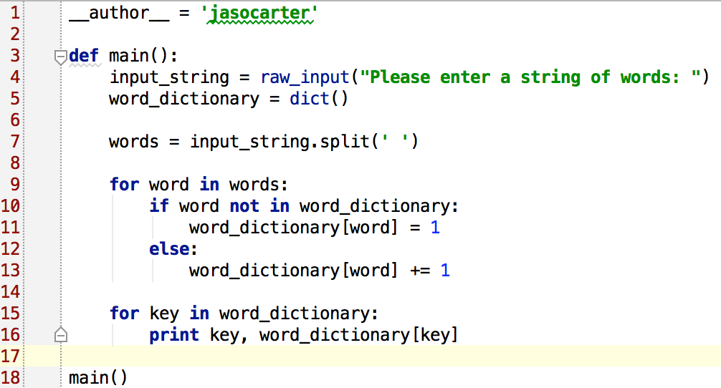

Slide 26
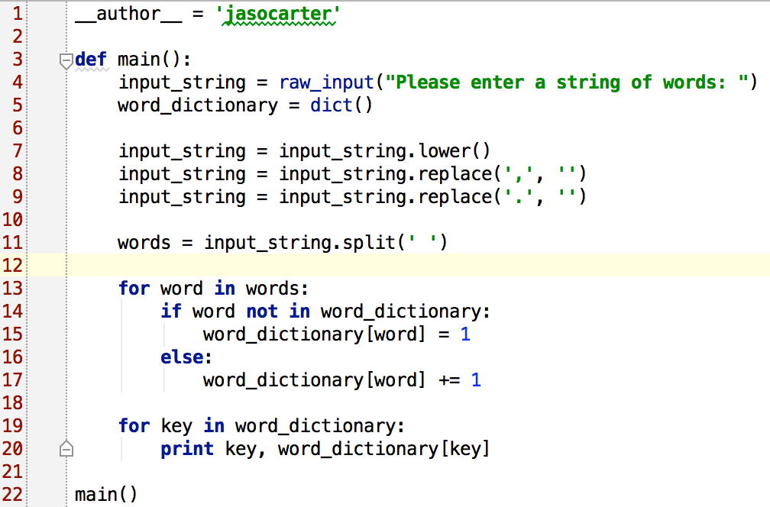

Slide 27
Practice with Dictionaries
Write a program that opens the file text.txt (from Program 4) and counts the number of occurrences of each word.
Print out each word and the number of times it occurs on a separate line.
Loop through the dictionary to find the word that occurred the most – print that out.
Hints: You will need to go through the file line by line and split the line – the split function returns a list – loop through that list of words and put them into your dictionary and keep track of how many times you saw each word.

