Slide 1
INLS 560 – Programming for Information Professionals
Instructor: Jason Carter

Slide 2
A Program
Set of instructions that a computer follows to perform a task or solve a problem
Notes:
If you remember, a program is a set of instructions that a computer follows to perform a task or solve a problem.

Slide 3
Piazza
Signup Link: piazza.com/unc/fall2014/560
Class page: piazza.com/unc/fall2014/560/home

Slide 4
What is a Program?
Set of instructions that a computer follows to perform a task or solve a problem

Slide 5
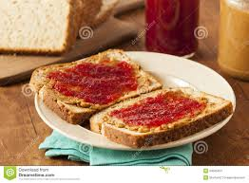
Peanut Butter & Jelly Sandwich
Notes:
If the task was to make a jelly sandwich what instructions would you write.
A computer would follow your exact instructions (dumb)

Slide 6
What Did we Learn From This Exercise?
Computers are dumb!
Computers only do what you tell them to do.
Computers do what you tell them to do really fast, so they appear smart (but they are not).
Computers don’t remember anything unless you tell them how to remember.
Computers take your instructions literally. If you tell them to do something dumb, they do it.
Computers only do what they are told and in exactly the order you tell them.
Notes:
We gave instructions in English.
Does a computer understand the English language?

Slide 7
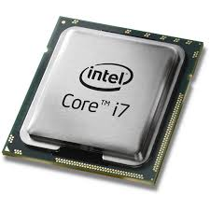
What Language Do Computers Understand?
A computer understands 1’s and 0’s
Sequences of 1’s and 0’s
CPU (Central Processing Unit)
Reads instructions from memory
Decodes fetched instruction to determine which operation to perform
Perform the operation
Operation
Examples: reading data, adding, subtracting, multiplying, and dividing numbers
Notes:
More specifically, 1’s and 0’s are stored in memory
– Examples: reading data, adding, subtracting,
multiplying, and dividing numbers

Slide 8
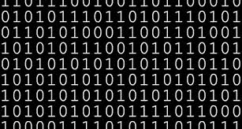
Machine Language
Reasons for not using machine language
Virtually unreadable..
Hard maintain and debug.
No mathematical functions available (we need to create our own code for these routines every time we write a new program).
Memory locations are manipulated directly, requiring the programmer to keep track of every memory location on the computer! (How much memory does your computer have?)
Notes:
As a programmer, we would write a sequence of 0’s and 1’s to tell the computer what we would like for it to do. Raise your hand if you signed up for this class, just to write 1s and 0s.
Why might we not want to use machine language?

Slide 9
Overcome Difficulty of Using Machine Language
Want to use a English like language
Computers only understand machine language( 1’s and 0’s)
English Like Language
Converter
Machine Language
Notes:
We need a way to convert English like language to machine language

Slide 10
High Level Languages
Compiled
Java, C#, C++
Interpreted
Python, PHP
Notes:
These English like languages are high level languages.

Slide 11
Compiled Languages
A compiler reads the program and translates it completely before the program starts running.
Java, C#, C++
Compiler
Machine Language

Slide 12
Interpreted Languages
Interpreter reads code and performs operations one line at a time.
Python, PHP
Interpeter
Machine Language

Slide 13
Which High Level Language Should we Use?
Compiled
Java, C#, C++
Interpreted
Python, PHP
We will use Python.
Notes:
As I showed before, there are many programming langauges

Slide 14
Why Python?
Simpler than other languages
C++
#include <iostream.h>
void main()
{
cout << "Hello, world." << endl;
}
Python
print "Hello, World!"

Slide 15
Why Python?
Modern language.
Good Error Detection.
Rich Library Embodying Many Good Programming Principles

Slide 16
Review
Computers understand machine language.
We will be using Python.
Python is an interpreted language.
How do we use the Python interpreter?
Interactive mode: enter statements on keyboard
Script mode: save statements in Python script
Notes:
– Interactive mode: enter statements on keyboard
– Script mode: save statements in Python script

Slide 17
Script Mode
Save a set of Python statements in a file
The filename should have the .py extension
Notes:
Writing Python Programs and
Running Them in Script Mode

Slide 18
Integrated Development Environment (IDE)
A program that provides tools to write, execute, and test a program
Pycharm Community Edition
Runs in interactive mode
Has built-in text editor with features designed to help write Python programs
Notes:
single program that provides tools to write,
execute and test a program

Slide 19
Programs

