Slide 1
How do computers affect us in our daily lives?

Slide 2
Beyond the Computer Invasion 14 Years ago.
6:15 AM - Timer in coffee maker turns on
6:30 AM - Computerized alarm clock rings
7:30 AM - Drive car/airbag,brakes,radio
8:00 AM - Check email at work
9:00 AM - Check in-coming voice mail
10:00 AM - Receive in-coming fax
12:00 PM - Buy gift. Electronic Kiosk
1:15 PM - Reserve airline ticket over Internet
3:00 PM - Pick up paycheck
5:15 PM - Stop off at ATM
6:30 PM - Grocery store /Checkout
11:30 PM - Microwave dinner

Slide 3
Beyond the Computer Invasion Today
6:15 AM - Timer in coffee maker turns on but coffee maker has built in barcode reader that reads a coffee pod that tells the maker how to brew the coffee.
6:30 AM - Alarm on your smart phone goes off to your favorite music to slowly wake you up from your slumber.
7:00 AM - Drive car/airbag, brakes, radio, gps, hands free texting, etc….
7:30 AM - Check email on your smart phone during your bus ride from the park and ride.
9:00 AM – Read transcribed in-coming voice mail
10:00 AM – Read in-coming text messages
12:00 PM – Buy gift from smart phone app
1:15 PM - Reserve airline ticket on smart phone
3:00 PM – Receive electronic paycheck stub on your smart phone
5:15 PM - Stop off at ATM – not everything has changed.
6:30 PM - Grocery store / use smart phone app to scan groceries and electronically send them to the register as you checkout.
11:30 PM - Microwave dinner

Slide 4
Beyond the Computer Invasion
The reason why computers became pervasive is that they help us…
  perform tasks that are repetitive.
  perform tasks that involve calculation or manipulation of numbers.
  perform tasks that involve storage of large quantities of information.

Slide 5
What Is (and Isn’t) a Computer
Definition:
  A computer is a device that takes data in one form, uses it, and produces a different form of information which is related to (but not the same as) the original data.

Slide 6

What Is (and Isn’t) a Computer
The Abacus is not a computer by our definition.
  It is an early calculation device that only holds numbers for the person using it.

Slide 7
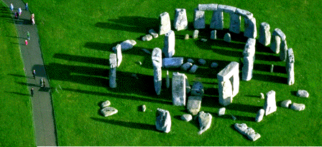
What Is (and Isn’t) a Computer
Stonehenge is a computer by our definition.
  It takes the movement of the planets, sun and other heavenly bodies and provides information concerning eclipses and other astronomical events.

Slide 8
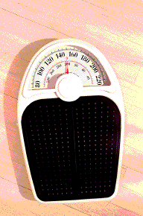
What Is (and Isn’t) a Computer
The bathroom scale is a computer by our definition.
  It takes in the amount of gravitational pull between a human body and the earth and provides us with the amount of pounds or kilograms.

Slide 9
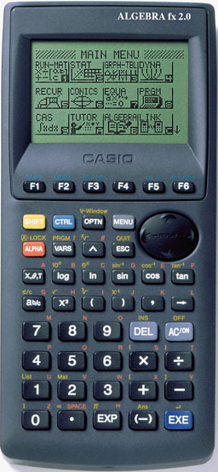
What Is (and Isn’t) a Computer
A calculator is a computer by our definition.
  They range from doing simple arithmetic to powerful models that produce graphic output.

Slide 10
What Is (and Isn’t) a Computer
Smart phones and cell phones are also computers.
  These wireless communication devices provide instant access to voice-mail, e-mail, the interwebs, and 1000s of apps.

Slide 11
The Many Kinds of Computers
Computers can be classified by three sets of characteristics:
Electronic
versus
Mechanical
General-purpose
versus
Special-purpose
Digital
versus
Analog

Slide 12
But how do Computers Work?

Slide 13
How Computers Work

Slide 14
PROCESSOR
CONTROL
UNIT
ARITHMETIC
LOGIC UNIT (ALU)
Instructions
Data
Information
MEMORY
INPUT
DEVICES
Data
OUTPUT
DEVICES
Information
Instructions
Data
Information
Computers process Input (data) into Output (information)
STORAGE
DEVICES

Slide 15

INPUT
Any data or instructions entered into the memory of a computer.
Input Devices:
Keyboard
Mouse
Trackball
Touchpad
Pointing stick
Joystick / Wheel
Light Pen
Touch Screen
Stylus
Digital Pen
Graphics Tablet
Voice / Speech Input
Scanners
Optical Readers
Terminals

Slide 16
PROCESSOR / CPU
Interprets and carries out the basic instructions that operate a computer.
Control Unit:
Component of the processor that directs and coordinates most of the operations in the computer.
Like a Traffic cop:
It interprets each instruction issued by a program and then initiates the appropriate action to carry out the instruction
Arithmetic Logic Unit
Performs
arithmetic,
comparison, and
other operations.
Depending upon the results, different actions may occur.
MACHINE CYCLE

Slide 17
STORAGE
Holds data, instructions, and information for future use.
Storage Medium: Is the physical material in which a computer keeps data.
Floppy Disks
Zip Disks
Hard Disks
CD’s
DVD’s
Tape
PC Cards
Memory Sticks
USB Flash Drives
Microfiche
Storage Device: Is the computer hardware that records and or retrieves items to and from storage media.

Slide 18
OUTPUT
Is data that has been processed into a useful form.
Output Devices:
Are hardware components that convey information to one or more people.
Monitors
Printers
Speakers
Headsets
Fax Machines / Modems
Projectors
Video Card
Plotters
Voice Output
Multifunction Peripherals

Slide 19
MEMORY
Components which store instructions waiting to be executed by the processor, the data need by the instructions and the results of the processed data.
Memory Stores 3 Categories of Items
  Operating System and other Software to maintain the computers devices
  Application programs that carry out a specific task i.e. word processing (Microsoft Office)
  Data being processed by the application programs and resulting information.
RAM – Random Access Memory
  Computer gets turned on programs get loaded into RAM from storage devices for use.
ROM – Read Only Memory
  Refers to memory chips storing permanent data and instructions
CMOS – Complementary metal-oxide semiconductor
  Retains information even when the computer is turned off, i.e. start-up

Slide 20
MACHINE CYCLE
STEP 1: The control unit fetches the math problem's instructions and data from memory. (100 x 52)
5200
Student enters math problem into the memory of the computer
MEMORY
STEP 2: The control unit decodes the math problem’s instructions and sends the instructions and data to the ALU. (100 x 52)
STEP 4: The results of the math problem are stored in memory. (5200)
PROCESSOR
ALU
ARITHMETIC LOGIC UNIT
CONTROL
UNIT
STEP 3: The ALU performs \ executes calculations on the data.
(100 x 52 = 5200)

Slide 21
Client-Server Computing
client-server interaction
is the basis of distributed computing (“…distributed system consists of multiple autonomous computers that communicate through a computer network. The computers interact with each other in order to achieve a common goal….”)

Slide 22
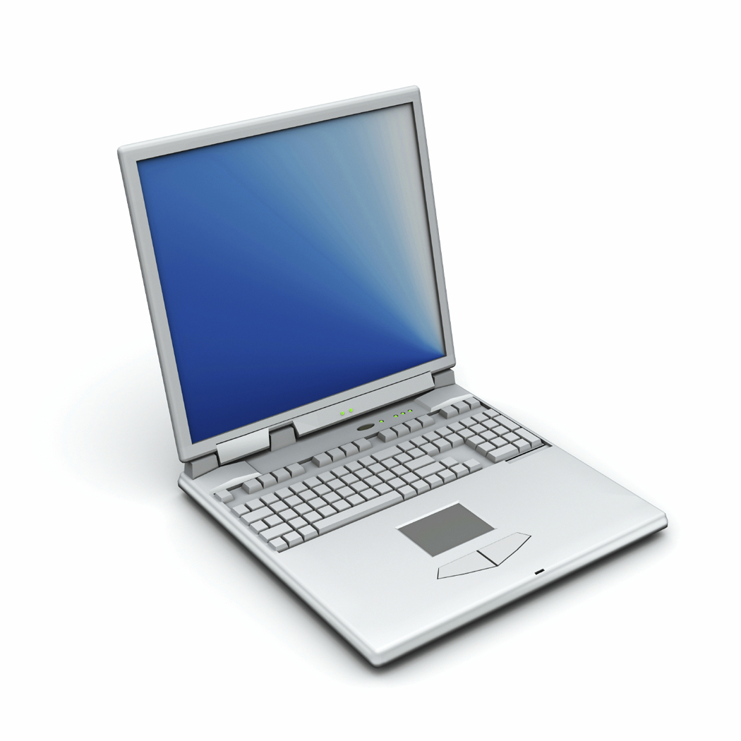
Clients and Servers
Clients
In a standalone mode, a computer is usually just a computer.
However, when the standalone computer seeks something from another location,
either on the computer itself or from another computer,
it becomes part of a relationship
  Typically, a client is an application that runs on a personal computer and relies on a server to perform some operations.
    For example, an e-mail client is an application that enables you to send and receive e-mail.

Slide 23
Clients
Clients
For any given application, there can be many clients
People are more familiar with clients, since they interface with them directly
Examples of clients include:
Browsers
  Chrome
  Firefox
  Safari
Web exchange utilities
  FUGU
  SFTP
  Terminal applications
Any MSOffice or OpenOffice application

Slide 24
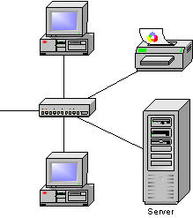
Clients and Servers
Clients
Servers

Slide 25
Clients and Servers
Servers

Slide 26
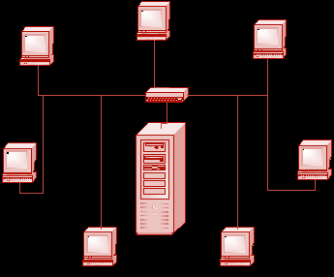
Servers
A computer or device on a network that manages network resources.
Servers
a network server is a computer that manages network traffic.
a file server is a computer and storage device dedicated to storing files. Any user on the network can store files on the server.
a database server is a computer system that processes database queries.
a print server is a computer that manages one or more printers

Slide 27
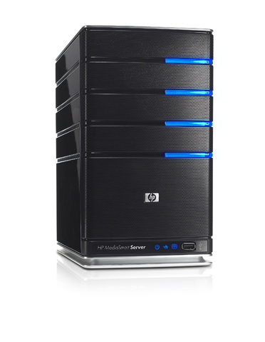
Servers
Servers are often dedicated,
meaning that they perform no other tasks besides their server tasks.
Servers
A server in this case could refer to the program that is managing resources rather than the entire computer.
on multiprocessing operating systems, however, a single computer can execute several programs at once.

Slide 28
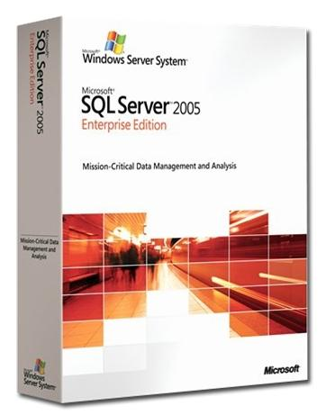
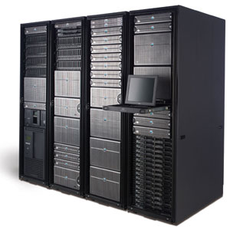
Servers
Servers
Servers can be physical computers
Servers can also be software applications
One server (physical computer)
can run many
at a time
many servers (software applications)
For example, Isis has several:
  listproc
  web
  ftp
  mail
  address book

Slide 29

Access to information
Connection

Slide 30
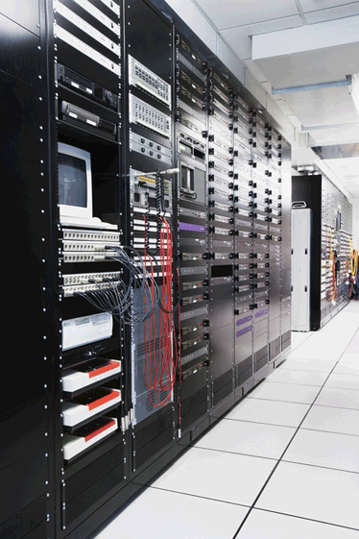
The Client/Server/Protocol Relationship
IP Address: 152.2.81.1
Connection
Server
Initiates a Connection
IP Address: 152.2.81.103
Waits & Responds to Incoming Connections

Slide 31
The Client/Server/Protocol Relationship in theory
IP Address: 152.2.81.1
Connection
Server
Initiates a Connection
IP Address: 152.2.81.103
Client Application
(a program running on the client)
Application Protocol
(HTTP, for example)
Server Application
(a program running on the server)

Slide 32
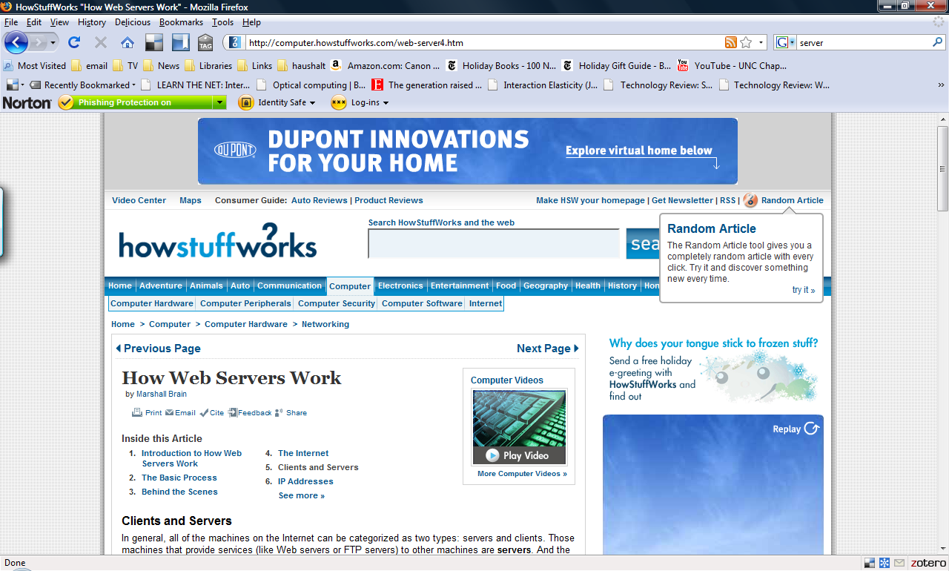
The Client/Server/Protocol Relationship
Connection

Slide 33
The Client/Server/Protocol Relationship in practice
IP Address: 152.2.81.1
Connection
Server
Initiates a Connection
IP Address: 152.2.81.103
Client Application
(your web browser) sends a request for a URL to a server
Application Protocol
(HTTP, for example)
Server Application
The server finds the requested page and sends it back to the client

Slide 34
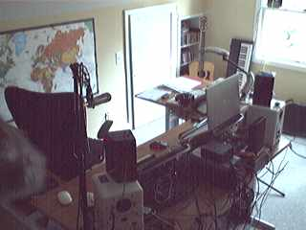
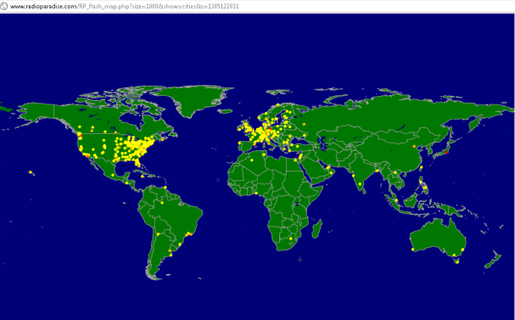
The Client/Server/Protocol Relationship in practice
IP Address: 152.2.81.1
Connection
Server
Initiates a Connection
Doesn’t have to be a big thing
IP Address: 152.2.81.103
Client Application
(your web browser) sends a request for a URL to a server
Application Protocol
(HTTP, for example)
Server Application
The server finds the requested page and sends it back to the client

Slide 35
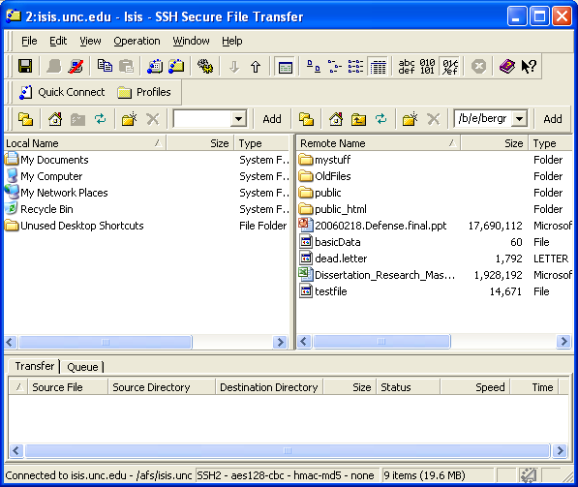
Looking at both sides
Connection
You need to know where you are

Slide 36
Let’s talk terminology

