Slide 1
today’s lineup…
new due date for project description – next tuesday, march 5
distribute and discuss mid-term exam
search skills
subject headings
Boolean operators
proximity operators
team work time

Slide 2
Team Project Description
Identify selected variables (including any subsets)
e.g. SEX=FEMALE, AGE=18-30, INCOME, LAW5=YES
What sort of relationship among these variables will you try to analyze?
e.g. we are interested in young women who have been arrested and what sort of income level they report
What sort of story are you interested in uncovering?
We are interested describing young adult females who have been incarcerated – what sort of social support systems help these offenders get back on the right track to become contributing members of society. We may also look at children of incarcerated mothers – what challenges do they face and what are some ways to help prevent a cycle of poverty and incarceration?
What types of information/statistics/facts do you plan to look for to help you develop the story?
Describe your team work plan
how will you divide the work?
who will pursue which element?
how will you share information?
what is your timeline?
Include names of all teammates

Slide 3
mid-term
Take-home exam (.doc on course website)
Work on your own
May consult a reference librarian
Email to me by 5:00 Thursday, March 7

Slide 4
Subject headings
Subject headings are a set of terms or phrases (known as controlled vocabulary) that classify materials.
Essentially they identify and pull together under a common umbrella information about a given subject.
Most online catalogs and databases use some form of subject headings, though they may also be called descriptors or keywords.

Slide 5
What are the types of alternative fuels being used or developed for automobiles?
alternative fuels | automobiles
electricity ethanol natural gas fuel cells | cars vehicles transportation motor vehicle

Slide 6
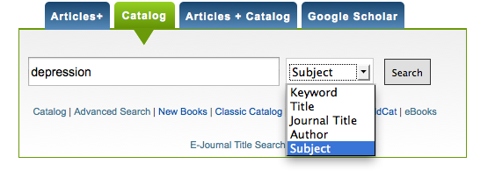

Slide 7
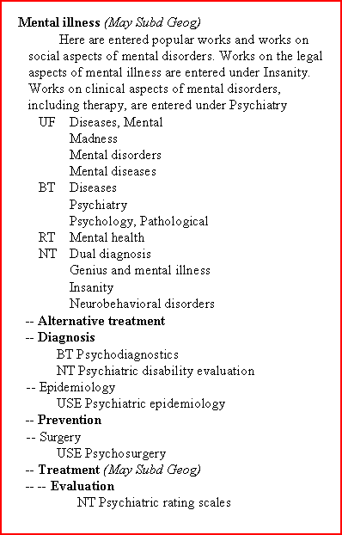
Abbreviations
BT - Broader Topic - Use to expand your search using a broader topic.
NT - Narrower Topics - Use to focus your search using a narrower topic.
RT - Related Topic - Alternative terminology for your topic.
UF - This is the appropriate subject heading is use for these words. DO NOT search by words listed as UF.
USE - Identifies the correct heading to use for your topic.

Slide 8
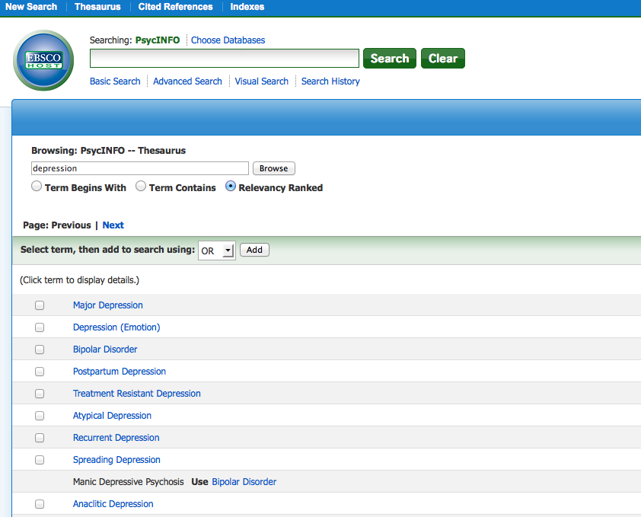

Slide 9
PROXIMITY OPERATORS allow you to specify searches where one word is near, next to, or in the vicinity of another word
adj | specifies that one word is adjacent to another in a document
before/# | specifies that the first word is within # words and before the second word
near/# | specifies that the first word is within # words of the second word

