Slide 1
using large data sets
thur, feb 7, 2012

Slide 2
Collecting Data in a Study
sample survey: sample people from a population and interview them.
example: General Social Survey
experiment: compare responses of subjects under different conditions, with subjects assigned to the conditions.
example: food labeling studies

Slide 3
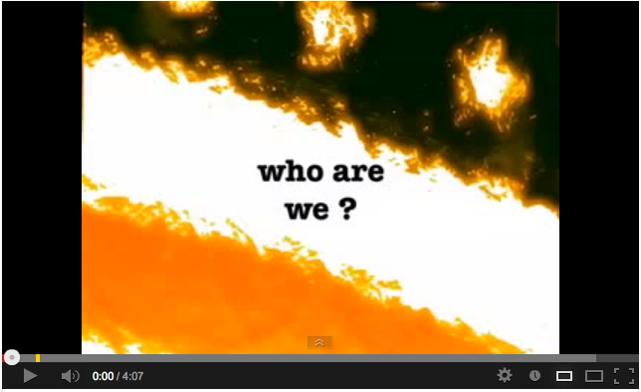
Notes:
http://www.youtube.com/watch?v=GOz5aKtVuzI

Slide 4
General Social Survey
The GSS (General Social Survey) is a biannual personal interview survey of U.S. households conducted by the National Opinion Research Center (NORC). The first survey took place in 1972.
Approximately 3000 American adults are interviewed in person for about 90 minutes and asked around 450 questions.

Slide 5
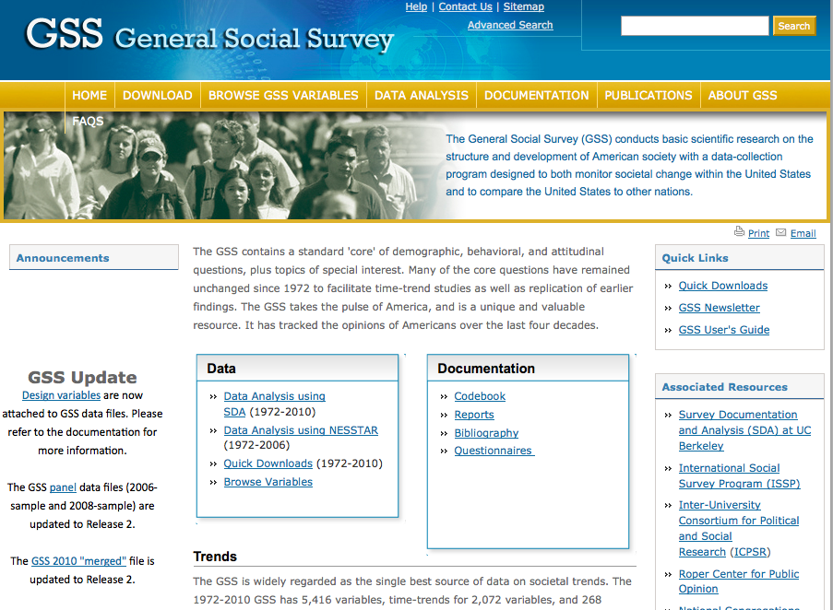
http://www3.norc.org/gss+website/

Slide 6
Purpose of GSS
gather data on contemporary American society in order to monitor and explain trends and constants in attitudes, behaviors, and attributes over time
to compare the United States to other societies

Slide 7
General Social Survey
demographics & attitudes
The questionnaire contains a standard core of demographic and attitudinal variables, plus certain topics of special interest selected for rotation (called "topical modules")
Items include national spending priorities, drinking behavior, marijuana use, crime and punishment, race relations, quality of life, confidence in institutions, and membership in voluntary associations

Slide 8
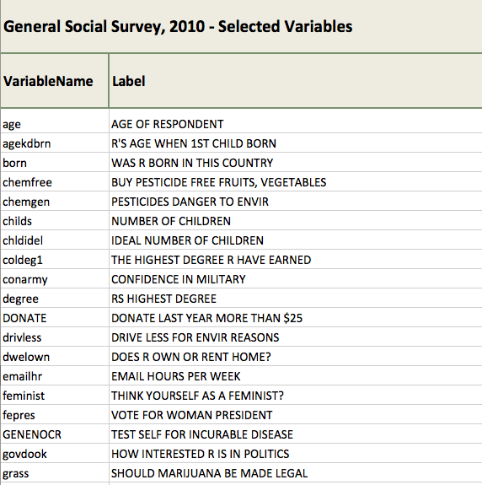

Slide 9
variables
variable – a characteristic that can vary in value among subjects in a sample or a population. We are interested in similarities and differences - variance
types of variables
categorical (also called qualitative)
quantitative

Slide 10
categorical variable
scale for measurement is a set of categories
examples:
Racial-ethnic group (white, black, Hispanic)
Political party identification (Dem., Repub., Indep.)
Vegetarian? (yes, no)
Mental health evaluation (well, mild symptom formation, moderate symptom formation, impaired)
Happiness (very happy, pretty happy, not too happy)
Religious affiliation
Major

Slide 11
SPANKING: Categorical (Single)
Do you strongly agree, agree, disagree, or strongly disagree that it is sometimes necessary to discipline a child with a good, hard spanking?
Categories: Code as:
{strongly_agree} Strongly agree 5
{agree} Agree 4
{disagree} Disagree 3
{strongly_disagree} Strongly disagree 2
{dontknow} DON'T KNOW 1
{refused} REFUSED 0
Sample question from GSS

Slide 12
scales of measurement
for categorical variables, two types:
nominal scale – unordered categories
preference for president, race, gender, religious affiliation, major opinion items (favor vs. oppose, yes vs. no)
ordinal scale – ordered categories
political ideology (very liberal, liberal, moderate, conservative, very conservative)
anxiety, stress, self esteem (high, medium, low)
mental impairment (none, mild, moderate, severe)
government spending on environment (up, same, down)

Slide 13
nominal scale – unordered categories
PRES08: Categorical (Single)
Did you vote for Obama or McCain?
Categories: Code as:
Obama 5
McCain 4
Other Candidate (Specify) 3
Didn’t vote for president 2
Don’t know 1
Refused 0

Slide 14
ordinal scale – ordered categories
POLVIEWS: Categorical (Single)
We hear a lot of talk these days about liberals and conservatives. I'm going to show you a seven-point scale on which the political views that people might hold are arranged from extremely liberal--point 1—to extremely conservative--point 7. Where would you place yourself on this scale?
Categories: Code as:
Extremely liberal 7
Liberal 6
Slightly liberal 5
Moderate, middle of the road 4
Slightly conservative 3
Conservative 2
Extremely conservative 1
DON'T KNOW 0
REFUSED 8

Slide 15
quantitative variable
possible values differ in magnitude
examples:
Age, height, weight, BMI = weight(kg)/[height(m)]²
Annual income
GPA
Time spent on Internet yesterday
Reaction time to a stimulus
(e.g., cell phone while driving in experiment)
Number of “life events” in past year

Slide 16
statistics
descriptive
inferential
estimation
hypothesis testing

Slide 17
use of statistics to describe, summarize, and explain or make sense of a given set of data
descriptive statistics
frequency distribution
measures of central tendency
median
mean
mode

Slide 18
Comparison of mean and median
Mean
Uses all of the data
Has desirable statistical properties
Affected by extreme high or low values (outliers MJ example)
May not best characterize skewed distributions
Median
Not affected by outliers
May better characterize skewed distributions

Slide 20
sample patterns from GSS data
median income of female respondents compared with average income of male respondents
median level of education of respondents who own a gun
number of female respondents who own a gun compared with number of male respondents who own a gun
average age of respondents who indicated the government should spend more on space exploration
self-reported level of happiness compared with income level

Slide 21
Sample characteristics of the GSS
The sampling frame of the General Social Survey is all U.S. adults living in households. The sampling frame includes 97.3 % of all U.S. adults.
Who does not live in a household?
college students in dorms
military personnel in barracks
prisoners
elderly persons in retirement homes

Slide 22
Does the GSS sample really draw from all the adults in its sample frame?
After the GSS is sampled, only 70% of persons in the sample actually respond to the survey (in the 2004 study).
23% refuse or cut the survey off in the middle
2% are unavailable or can’t be found
5% are missing for other reasons
In general, a response rate of 60% or more is considered minimally acceptable, but you should check your results in any way you can.

Slide 23
where can you access SPSS?
Odum Institute
Manning basement – room 001 + overflow lab nearby – ask lab assistant
https://virtuallab.unc.edu
Lab in the Undergraduate Library (need to confirm)

Slide 24
Notes…
Bring a flash drive to the Odum lab on Tuesday – you may want to save your work
The dataset that we are using (GSS 2010) is available for download on our class website
schedule>>feb 12
the dataset is a .sav format – only opens with SPSS

