Slide 1
scholarly research process
tues, jan 31, 2012

Slide 2
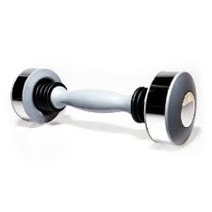
It is hard to know when you are looking at reliable research, and if it is factual.
Television ads and media are always using percentages and data that they claim to be true, but I have found to be false in many cases. A good example is the exercise product known as the Shake Weight. The ads on television give information showing the benefits of the shake weight, while I have seen online other researchers who claim the shake weight does little to nothing for physical fitness. So, how can we be sure if we are getting factual research versus the biased information thrown at us daily?
Uses dynamic inertia, which can increase muscle activity to nearly 300% compared to a standard dumbbell
-Michael Russell

Slide 3
The reading has taught me that almost any form of experimentation, observation, and/or analysis can be considered research. I was particularly interested in the different types of information - QUALITATIVE and QUANTITATIVE. Which form of data do you prefer to use as evidence and draw conclusions from and why? Personally, I like working with quantitative data because it can be organized into tables, graphs, and charts and can allow user to draw conclusions.
Obviously researchers do their best to provide only facts and to be as objective as possible. However, it is very difficult to make all research truly objective. Which of the four types of research (exploratory, descriptive, explanatory, and evaluation) is most subject to bias or personal opinion and therefore possibly not as objective as the others? Which would usually be the most objective?
-Josh Kappert

Slide 4
The classical ideal of science
Theories
Hypotheses
Observation
Generalizations
Induction
Deduction
Method and Measurement
Operationalization
Wallace, W.L. (1969). Sociological Theory: An Introduction. New York: Aldine de Gruyter.
Notes:
Traditional social science has been dominated by an approach to theory and research modeled on the experimental natural sciences. Traditional social science methods are based on a fourfold approach: 1) developing questions, 2) forming hypotheses, 3) testing the hypotheses, and 4) formulating theory.
Assumes that complex phenomena are best understood in terms of fine analysis of parts. It also assumes that social life consists of cause-effect relations.
Hypothesis testing is a painstakingly slow process in which theories are developed and fine-tuned by numerous tests. The fourfold process is thus repeated to generate new questions and improved hypotheses in an incremental building-block process.
Based on five major concepts: hypothesis, operationalism, control and manipulation, covering laws and prediction.
Hypothesis: well-formed guess about a relationship between variables. It is based on intuition, personal experience, or most desirably, previous research and theory. An hypothesis must be testable; in other words, the variables brought together must be carefully defined so that any trained researcher can observe them in precisely the same way.
Operationism states that all variables in a hypothesis should be stated in ways that provide means of observation. How do you know when you see what you’re seeking? Operational definitions are the most precise possible definitions because they tell you how the concept is to be seen. An operational definition of intelligence, for example, is the Stanford-Binet intelligence test. Operationism relies on measurement, in which precise, usually numerical, indices of observations are made.
Measurement is evaluated in terms of two criteria: validity and reliability. Validity is the degree to which an observation meausures what it is intended to measure. Reliability is the degree to which the construct is meaured accurately, and reliability is most often estimated by consistency. If your bathroom scale gives you a different wweight each day, eve though you have not gained or lost, it is unreliable.
Control and manipulation in observation

Slide 6
Whenever ice cream sales rise, so do shark attacks (eating ice cream makes you tastier?)
Perhaps when there is a horrible shark attack on the beach, people stay out of the water and have an ice cream instead. The moral is, if there’s a big queue for Mister Whippy, stay out the water.
Warmer weather brings people to beaches, people buy ice cream at beach, sharks see ice cream, sharks become jealous. The sharks want the ice cream, and attack people to get it.

Slide 7
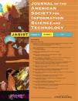
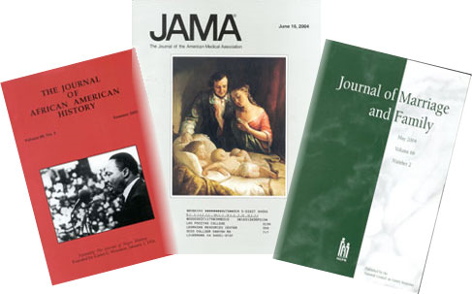
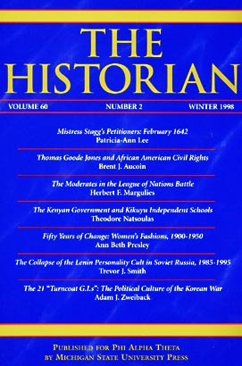
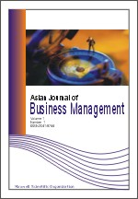
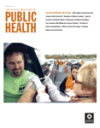
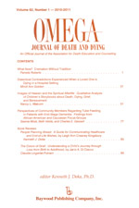
The scholarly journal
vs
The popular publication

Slide 8
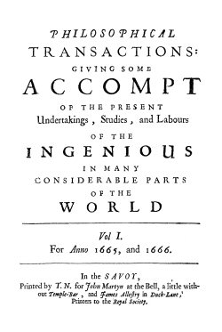

Slide 9
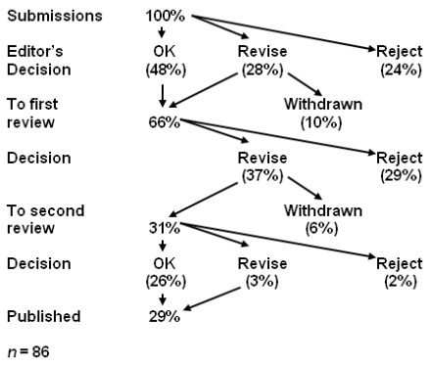

Slide 10
Let’s look at the instructions for authors from three scholarly / peer-reviewed journals…

Slide 11
Submissions judged on criteria such as…
Is the subject appropriate to the editorial aims and scope of the journal?
Originality: does the article say something original, does it add to the body of knowledge, etc.? If a case study, is this its first use?
Research methodology: most journals are concerned about this, as would be expected for an academic publisher. Is the research design, methodology, theoretical approach, critical review, etc. sound? Are the results well presented, do they correlate to the theory, and have they been correctly interpreted? Is the analysis sufficiently rigourous?
Is the paper set in the context of the wider literature, are there sufficient relevant citings, are these well referenced and are other people's views credited?
Is the paper accurate, is any information missing or wrong?
Is the structure logical, is the sequence of the material appropriate, is there a good introduction and are the summary and conclusions adequate?
Does the title of the article accurately reflect its content?
How useful would the article be to a practitioner, is it a useful example of "good practice"?
Could the study be replicated with similar results?
Is the material clearly presented, readable? Are graphs and tables used to good effect? Is the level of detail appropriate? Is the use of terminology appropriate to the readership?
Is the perspective appropriate for an international audience?
Questions of format: are the abstract, keywords etc. appropriate?
Is it an appropriate length (note: many journals will stipulate length requirements in their author guidelines)?

Slide 12
Does knuckle cracking lead to arthritis of the fingers?
During the author’s childhood, various renowned authorities (his mother, several aunts, and, later, his mother-in law [personal communication]) informed him that cracking his knuckles would lead to arthritis of the fingers. To test the accuracy of this hypothesis, the following study was undertaken.
For 50 years, the author cracked the knuckles of his left hand at least twice a day, leaving those on the right as a control. Thus, the knuckles on the left were cracked at least 36,500 times, while those on the right cracked rarely and spontaneously. At the end of the 50 years, the hands were compared for the presence of arthritis. There was no arthritis in either hand, and no apparent differences between the two hands.
Knuckle cracking did not lead to arthritis after a 50-year controlled study by the one participant. While a larger group would be necessary to confirm this result, this preliminary investigation suggests a lack of correlation between knuckle cracking and the development of arthritis of the fingers. A search of the literature revealed only one previous paper on this subject, and the authors came to the same conclusion (Swezey RL. Swezey SE. The consequences of habitual knuckle cracking. West J Med 1973;122:377-9.).
This result calls into question whether other parental beliefs, e.g., the importance of eating spinach, are also flawed. Further investigation is likely warranted.
In conclusion, there is no apparent relationship between knuckle cracking and the subsequent development of arthritis of the fingers. This study was done entirely at the author’s expense, with no grants from any governmental or pharmaceutical source.
Donald L. Unger, MD, Thousand Oaks, CA

Slide 13
CHEMISTRY PRIZE: Makoto Imai, Naoki Urushihata, Hideki Tanemura, Yukinobu Tajima,
Hideaki Goto, Koichiro Mizoguchi and Junichi Murakami of JAPAN, for determining the ideal
density of airborne wasabi (pungent horseradish) to awaken sleeping people in case of a fire or
other emergency, and for applying this knowledge to invent the wasabi alarm.
LITERATURE PRIZE: John Perry of Stanford University, USA, for his Theory of Structured
Procrastination, which says: To be a high achiever, always work on something important, using it
as a way to avoid doing something that’s even more important.

Slide 14
PEACE PRIZE: Arturas Zuokas, the mayor of Vilnius, LITHUANIA, for demonstrating that the
problem of illegally parked luxury cars can be solved by running them over with an armored tank.
PUBLIC SAFETY PRIZE: John Senders of the University of Toronto, CANADA, for conducting
a series of safety experiments in which a person drives an automobile on a major highway while a
visor repeatedly flaps down over his face, blinding him

Slide 15
