Slide 1





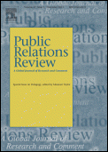
scholarly research & publications
tues jan 29, 2012

Slide 2
Discussion questions…
Instructions for posting your questions in Sakai
https://www.unc.edu/sakai/
Log in with your onyen/password
You should automatically be enrolled in our class, INLS200.002.SP13
Over on the left navigation bar, click on "Discussion and Private Messages”
When that page loads, select "Class Discussions”
You should see entries/topics for each of our readings. Select which you want to respond to and paste/type your question.

Slide 3
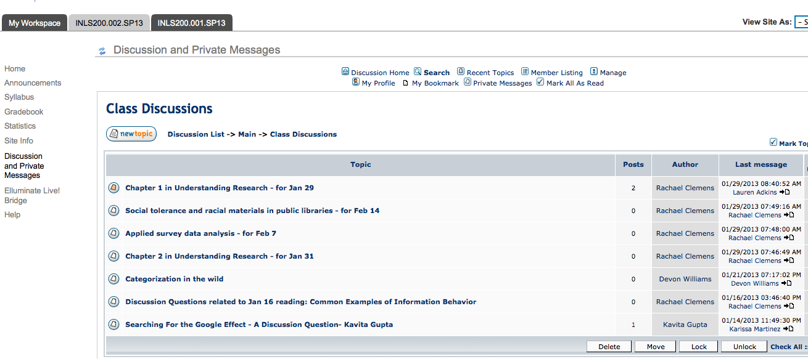
Discussion question extension for Chapter 1 in Understanding Research:
*Post by Wednesday (tomorrow) evening at 5:00 pm*

Slide 4
learning objectives for today
track down the full-text of a specific article
delineate between 3 basic types of research studies (exploratory, descriptive, explanatory)
be able to identify specific components in a scholarly research article
analyzing a scholarly publication
  handout
  homework for next Tuesday

Slide 5
LA Times article exercise
read the piece on food labeling
where does the journalist get her information?
try to identify specific studies that she draws from – write down any clues
in groups of 3, use the library resources (e-journals or academic search complete) to track down one of the original research studies

Slide 7
What year?

Slide 9
What year?
What year?

Slide 10
Study 1
Author(s):
Publication/Journal Title
Study 2
Author(s):
Publication/Journal Title
Study 3
Author(s):
Publication/Journal Title
Approximate date of publication
Approximate date of publication
Approximate date of publication

Slide 11
Steps in research process
Identify topic focus
Hypothesis or research questions
Explore previous research in the area
Design a study to address the research questions or test the hypothesis
Collect data
Analyze data
Draw some conclusions

Slide 12
Steps in research process | Sections of journal article
Identify topic focus | Introduction
Hypothesis or research questions | Purpose of the study
Explore previous research in the area | Literature review
Design a study to address the research questions or test the hypothesis | Methods / research design
Collect data | Data collection
Analyze data | Findings
Draw some conclusions | Analysis / conclusions

Slide 13
Tandon, P.S., Wright, J., Zhou, C., Rogers, C.B., & Christakis, D.A. (2010). Nutrition menu labeling may lead to lower-calorie restaurant meal choices for children. Pediatrics, 125, 244-248.

Slide 14
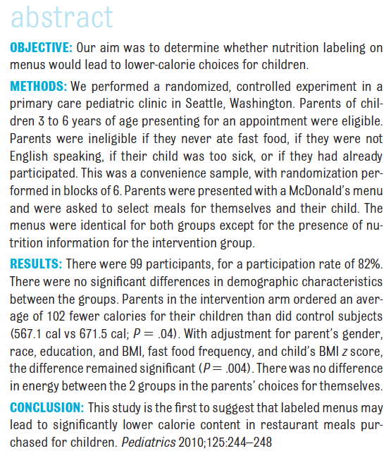

Slide 15
Sections of journal article
Introduction
Purpose of the study
Literature review
Methods / research design
Data collection
Findings
Analysis / conclusions

Slide 16
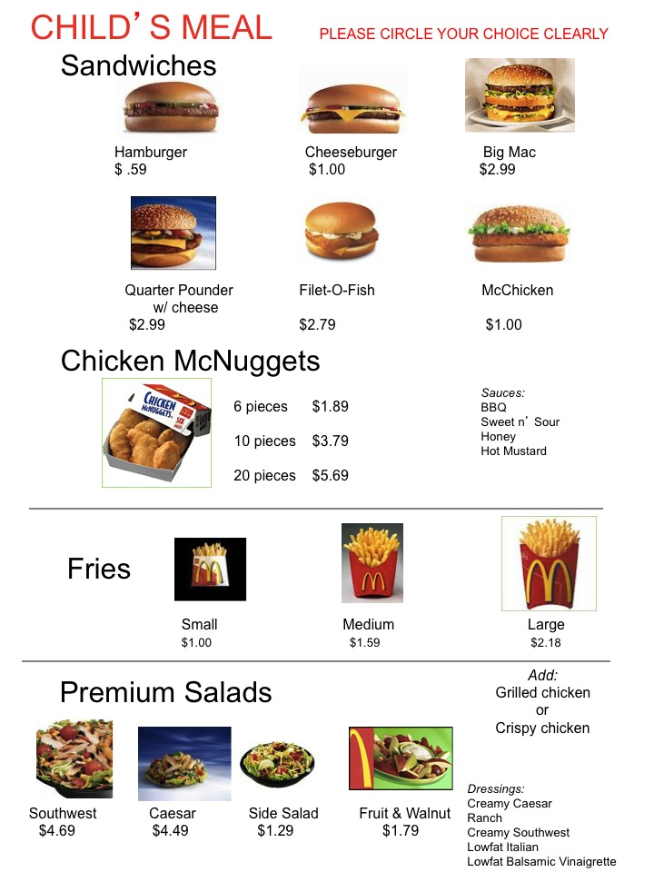
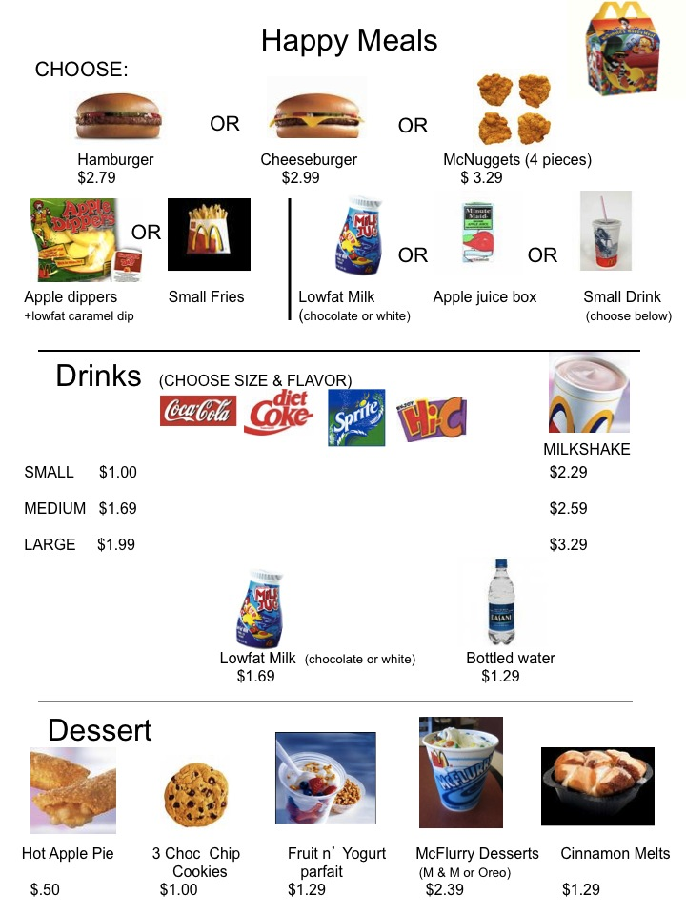

Slide 17
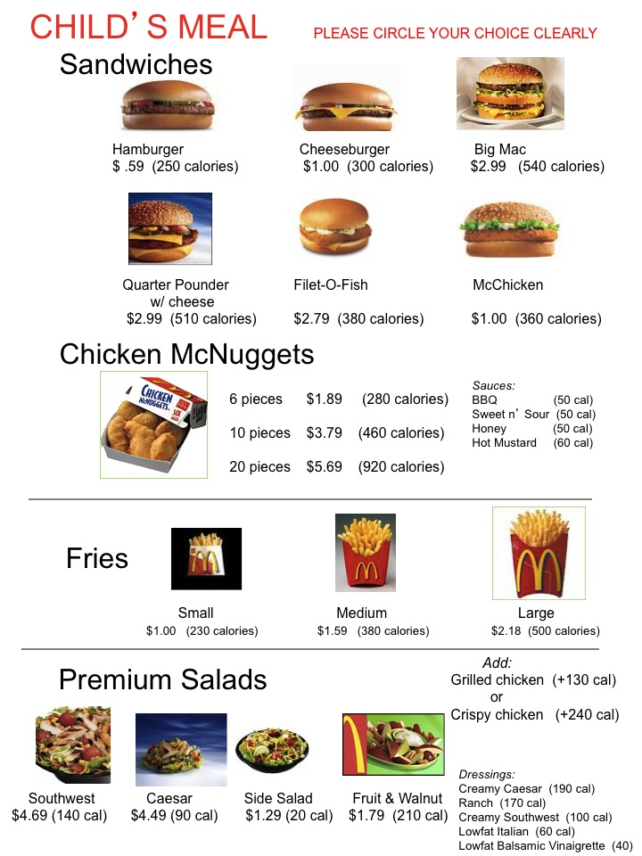


Slide 18
one way to think about research approaches is to consider specific goals of the research:
  exploration
  description
  explanation

Slide 19
exploratory studies
typically conducted when little is known about a particular phenomenon
often employ a variety of research methods with the goal of learning more about a phenomenon, rather than making specific predictions
often have less structured methods
research questions are typically broad and open-ended and hypotheses are uncommon

Slide 20
descriptive studies
focus on documenting and describing a particular phenomenon
main purpose is to provide benchmark descriptions and classifications
often used to inform other studies
may describe variables and correlations
Notes:
Descriptive studies can lead to a weaker form of prediction via correlation analysis. However such studies are not able to explain why a relationship exists between two variables.

Slide 21
explanatory studies
examine the relationship between two or more variables with the goal of prediction and/or explanation
often concerned with establishing causality and because of this require variables of interest to be isolated and studies systematically
Notes:
Not all explanatory studies offer explanations – many just report observations and statistics without offering any explanation. It’s also important to distinguish between prediction and explanation

Slide 22
prediction vs. explanation
it is possible to build predictive models of events without actually understanding anything about WHY such event occur
very often researchers stop at prediction and do not pursue explanation

Slide 23
exploratory
explanatory
descriptive
little is known
WHAT?
outcome: general ideas and research questions
document the phenomenon
WHO?
WHEN?
HOW?
outcome: details & descriptions
test for causes and/or predictions
WHY?
outcome: test a theory

Slide 24
 | purpose | stage in learning process | question | main audience | outcome
exploratory | learn about something new | earliest | what? | varies; usually a researcher | general ideas and research questions
descriptive | provide details on something known | middle | who? when? how? | varies | factual details and descriptions
explanatory | build a new model or test existing explanation | late | why? | professional researchers | test a theory; compare explanations
evaluation | determine effectiveness of program/policy | late | does it work? | practitioners and policy makers | practical recommendation
Neuman, W.L. (2009). Understanding research. Boston, MA: Pearson/Allyn and Bacon

Slide 25
Assignment for Feb 5
read the analyzing research articles guide carefully
read the food labeling research piece assigned to your group in class
write a brief analysis of the article following the format and questions provided in the guide. I realize you may not be a health science expert so it’s okay if you don’t understand every detail of the study. you may use bullet points.
1-page [counts as a pop quiz]

