Slide 1
today’s lineup…
Data-to-Story Project – description due
questions about mid-term?
Bibliometrics and citation analysis

Slide 2
BIBLIO
METRICS
Books
Publications
Bibliography
Count
Measurement
Math / Statistical Analysis

Slide 3
Alan Pritchard 1969
Coined the term "bibliometrics"
"the application of mathematics and statistical methods to books and other media of communication“
Journal of Documentation (1969) 25(4):348-349

Slide 4
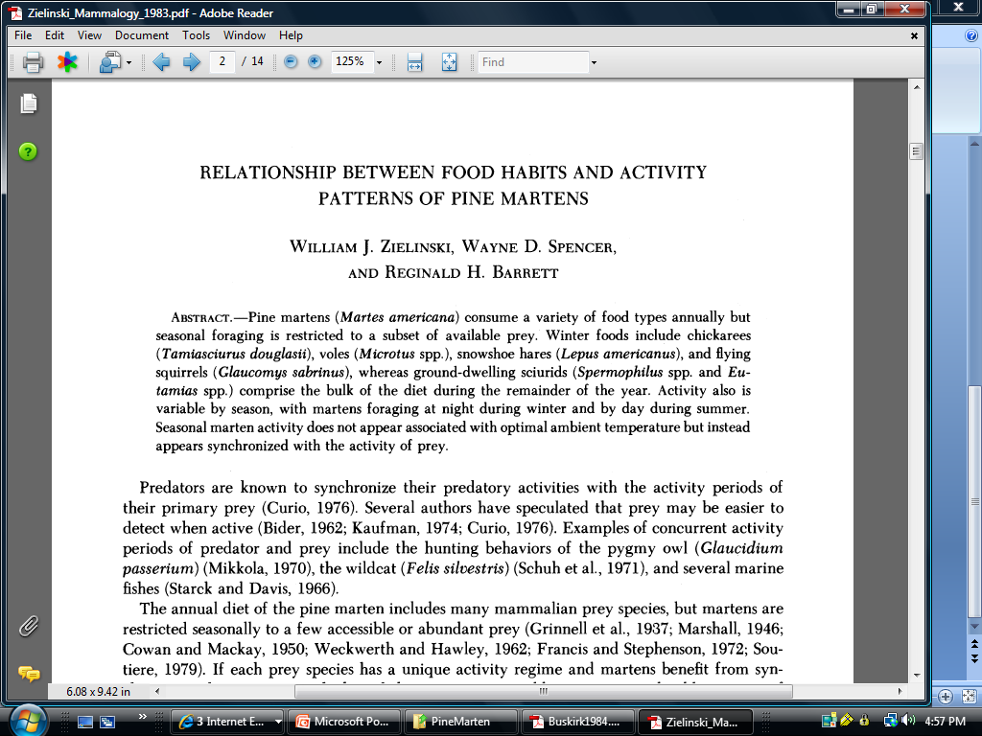
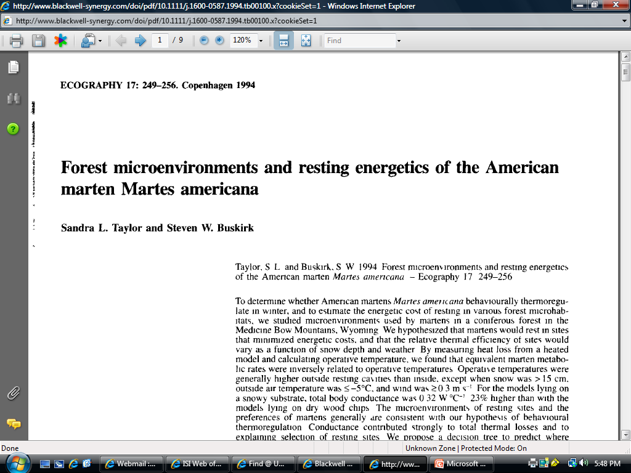
Journal of Mammalogy, Vol. 64, No. 3. (Aug., 1983), pp. 387-396.

Slide 5
CITED
CITING

Slide 8
seminal work

Slide 9
co-citation
these two articles are likely related
author
institution
topic
country
language
journal

Slide 10
what is citation analysis?
utilizes quantitative analysis and statistics to describe patterns of publication within a given field or body of literature

Slide 11
what do you do with citation analysis?
researchers may use bibliometric methods of evaluation to determine the influence of a single writer, for example, or to describe the relationship between two or more writers or works
production and productivity
Impact
co-publication patterns
connections between subject areas

Slide 12
Index of Citations

Slide 13
Institute for Scientific Information Building, Philadelphia
Architect: Venturi, Scott Brown and Associates, Completed 1977
http://www.vsba.com/projects/fla_archive/190.html

Slide 14
ISI
SCI
SSCI
A&H
JCR
Histcite

Slide 15
Arts & Humanities Citation Index
authors co-cited most often with…WHITMAN-W
Author Co-Citation

Slide 16
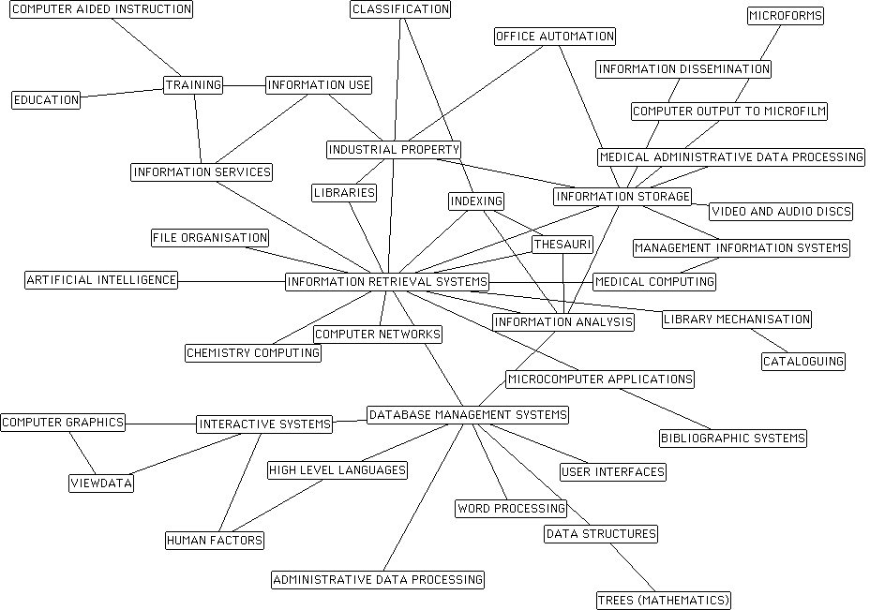
80’s

Slide 17
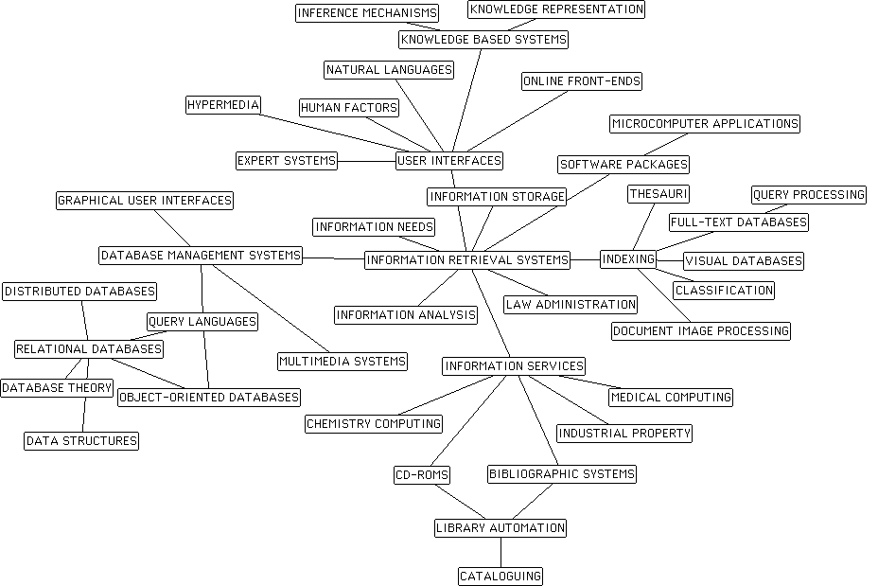
90’s

Slide 18
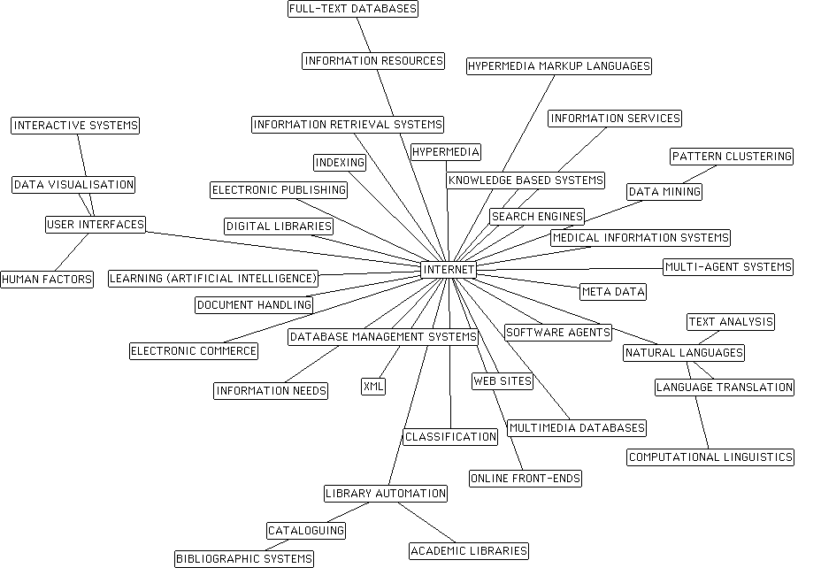
00’s

Slide 19
Science Citation Index

Slide 20
Journal Impact Factor for The New England Journal of Medicine
Number of items published in: | 2008 | 356
Number of items published in: | 2007 | 343
Sum of recent items |  | 699
Cites in 2009 to items published in: | 2008 | 16072
Cites in 2009 to items published in: | 2007 | 16816
Sum of recent citations |  | 32888
Journal Impact Factor | 32888 / 699 | 47.050

Slide 21
Social Sciences Citation Index

Slide 22
Social Sciences Citation Index

Slide 23
http://www.lib.unc.edu/ e-Research tools web of science (ISI)

Slide 24
Provocative Questions for Discussion
What/why do you cite?
What do you infer from a reference list?
Are all citations equal?

Slide 25
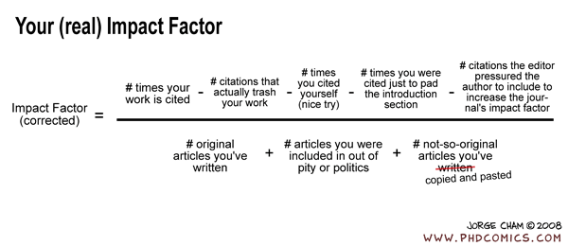
issues & concerns surrounding citation analysis

Slide 26
This traditional method of measuring scholarly impact is being challenged by several forces…we’ll discuss after spring break…

