Slide 1
primary sources tues april 02
today’s line-up
primary sources | what are primary sources? how & why are they collected? how are they organized? where & how could I access them? why would I ever use them?
field trip to Wilson Library on Thursday

Slide 2
primary sources
primary sources

Slide 3
primary sources
provide first-hand testimony or direct evidence concerning a topic under investigation
created by witnesses or recorders who experienced the events or conditions being documented
often these sources are created at the time when the events or conditions are occurring…but could be recorded later
primary sources

Slide 4
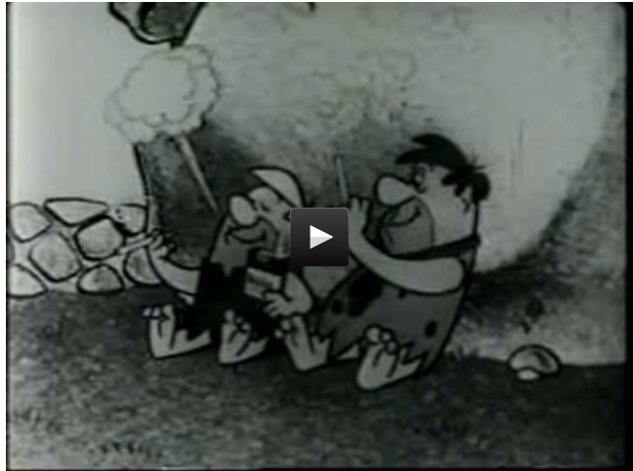
primary sources
diaries & personal papers | The Diary of Anne Frank, which provides a first hand account of life as a Jew in hiding during the Holocaust; Langston Hughe’s edits of one of his poems (next slide)
letters | an apology letter from 18-year-old Michael Jordan to his then-girlfriend Laquette (slides 6 & 7)
court records/transcripts | U.S. Supreme Court oral arguments example (slide 8)
raw data | census data; wind speed measurements from the weather monitoring station at Ocracoke island
official documents | The U.S. Declaration of Independence
photographs | events, places & people (slides 9-12)
sounds | Lost art of Hollerin’
autobiographies | The Story of My Life by Helen Keller, A Living History, Hillary Rodham Clinton's book about her experiences as the First Lady
oral histories | 1974 interview with Jesse Helms at the beginning of his career as a Republican senator from NC
speeches | Martin Luther King Jr.'s "I Have a Dream" speech Babe Ruth’s address to fans at Yankee Stadium

Slide 5
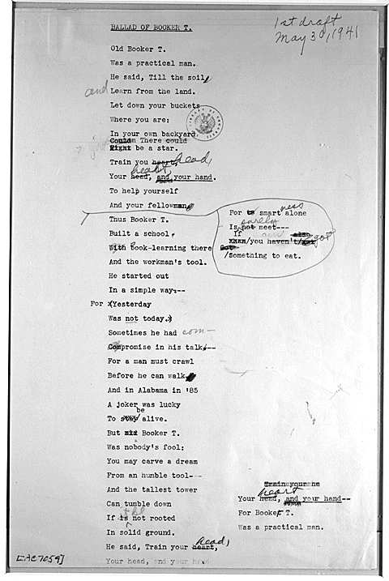
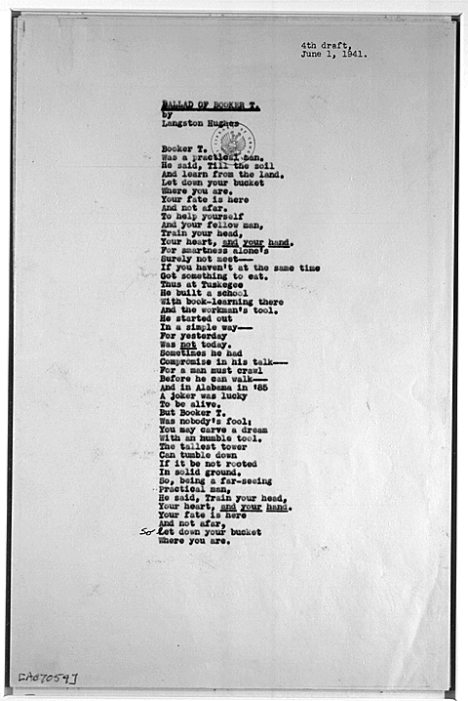
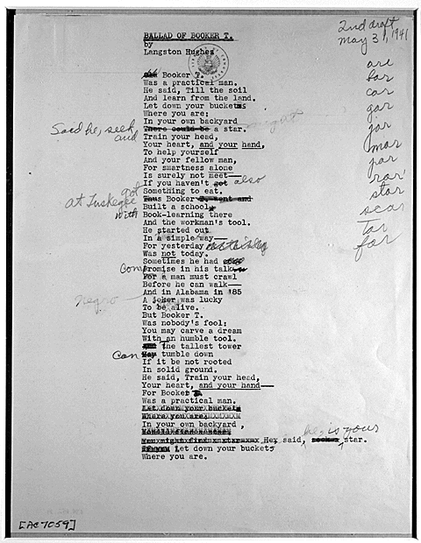
Drafts of Langston Hughes's poem "Ballad of Booker T.,”
30 May-1 June 1941

Slide 6
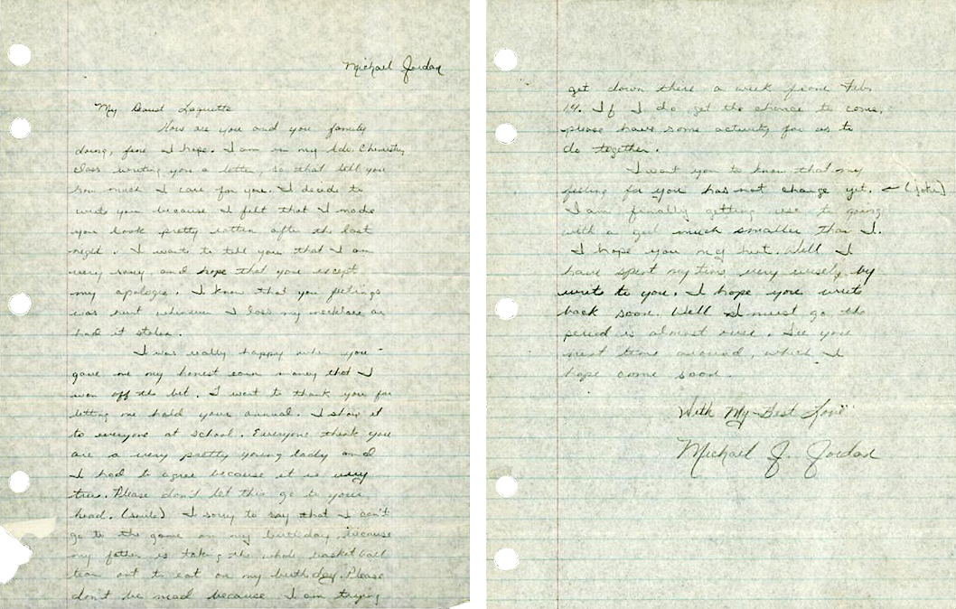

Slide 7
My Dearest Laquette
How are you and your family doing, fine I hope. I am in my Adv. Chemistry class writing you a letter, so that tell you how much I care for you. I decide to write you because I felt that I made you look pretty rotten after the last night. I want to tell you that I am sorry, and hope that you except my apologie. I know that you feelings was hurt whenever I loss my necklace or had it stolen.
I was really happy when you gave me my honest earn money that I won off the bet. I want to thank you for letting me hold your annual. I show it to everyone at school. Everyone think you are a very pretty young lady and I had to agree because it is very true. Please don’t let this go to your head. (smile) I sorry to say that I can’t go to the game on my birthday because my father is taking the whole basketball team out to eat on my birthday. Please don’t be mad because I am trying get down there a week from Feb. 14. If I do get the chance to come please have some activity for us to do together.
I want you to know that my feeling for you has not change yet. ← (joke) I am finally getting use to going with a girl much smaller than I. I hope you my hint. Well I have spent my time very wisely by write to you. I hope you write back soon. Well I must go, the period is almost over. See you next time around, which I hope comes soon.
With my Best Love
Michael J. Jordan

Slide 8
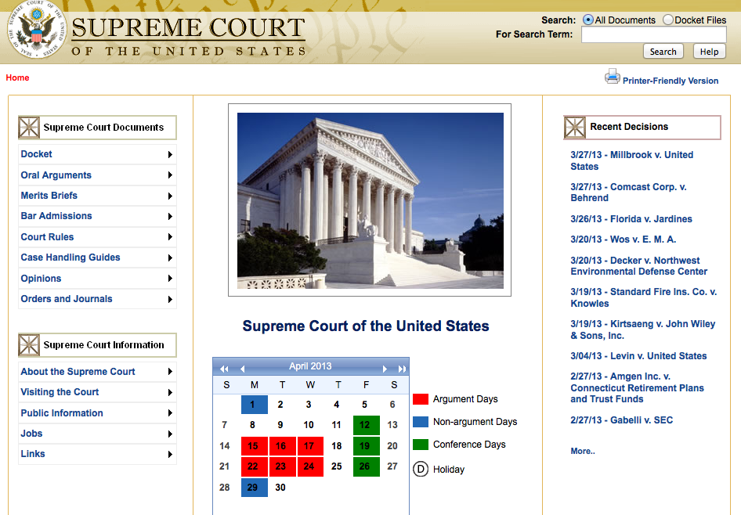
Defense of Marriage Act case United States v. Windsor
Listen to oral arguments
The justices chose for their review the case of Edith Windsor, 83, of New York, who sued to challenge a $363,000 federal estate tax bill after her partner of 44 years died in 2009.
Windsor, who goes by Edie, married Thea Spyer in 2007 in Canada after doctors told them that Spyer would not live much longer. She suffered from multiple sclerosis for many years. Spyer left everything she had to Windsor.
There is no dispute that if Windsor had been married to a man, her estate tax bill would have been zero.
The U.S. 2nd Circuit Court of Appeals in New York agreed with a district judge that the provision of DOMA deprived Windsor of the constitutional guarantee of equal protection of the law.

Slide 9
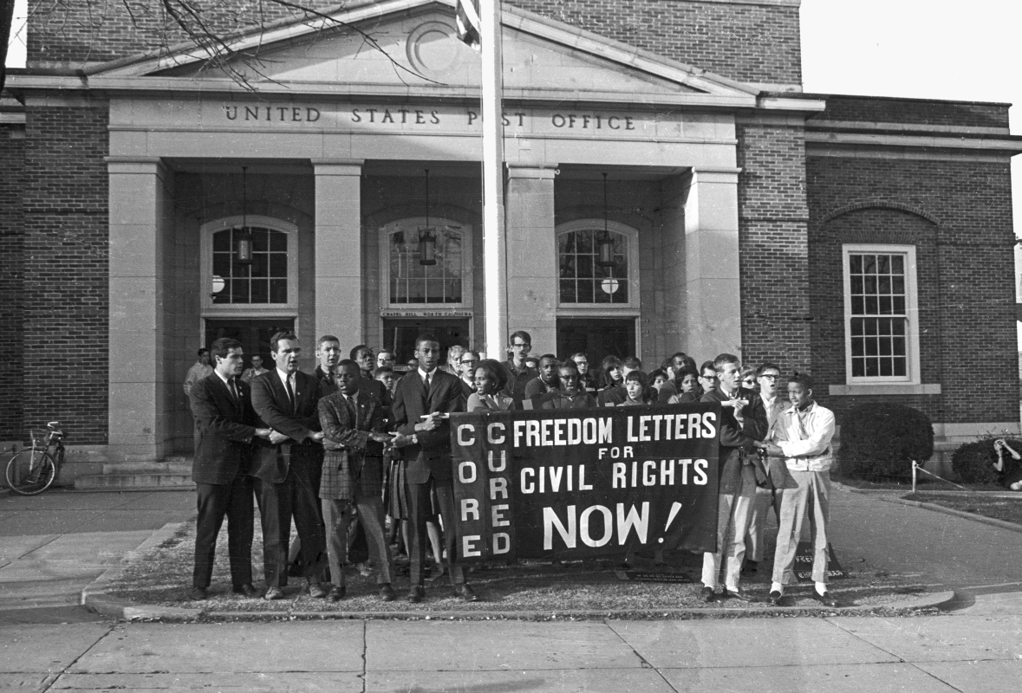
December 1963: Members of several civil rights organizations staged this holiday march, carrying letters addressed to political leaders to urge anti-discrimination legislation. They requested that fellow Chapel Hill citizens follow suit to "Send Freedom Letters for Christmas."

Slide 10
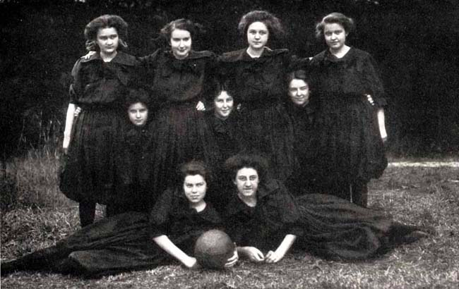
Greensboro, N.C.: North Carolina State Normal and Industrial College, 1909

Slide 11
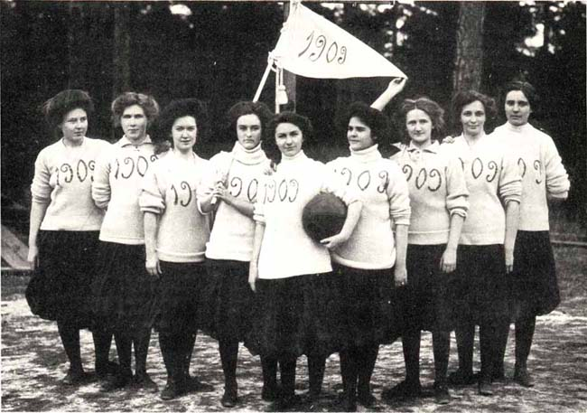
Senior Team Greensboro, N.C.: North Carolina State Normal and Industrial College, 1909

Slide 12
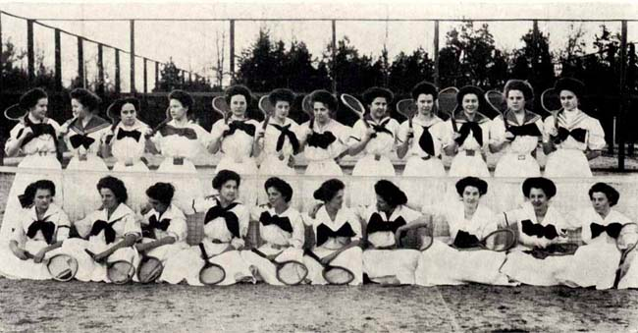

Slide 13
secondary sources
secondary sources
provide ‘second-hand’ information that has been digested, analyzed, reworded or interpreted
often combine information taken from primary sources and even other secondary sources
usually written well after the events they report on and can put past information into its historical context

Slide 14
Does UNC have an archive? if so whose is better?
-Christian

Slide 15
manuscript and archival materials are UNIQUE resources that can be found in only one library or institution (though digital copies or copies on microfilm/microfiche may be available elsewhere)
archives
manuscripts
the records made or received and maintained by an institution or organization in pursuance of its legal obligations or in the transaction of its business
a body of papers of an individual or a family

Slide 16
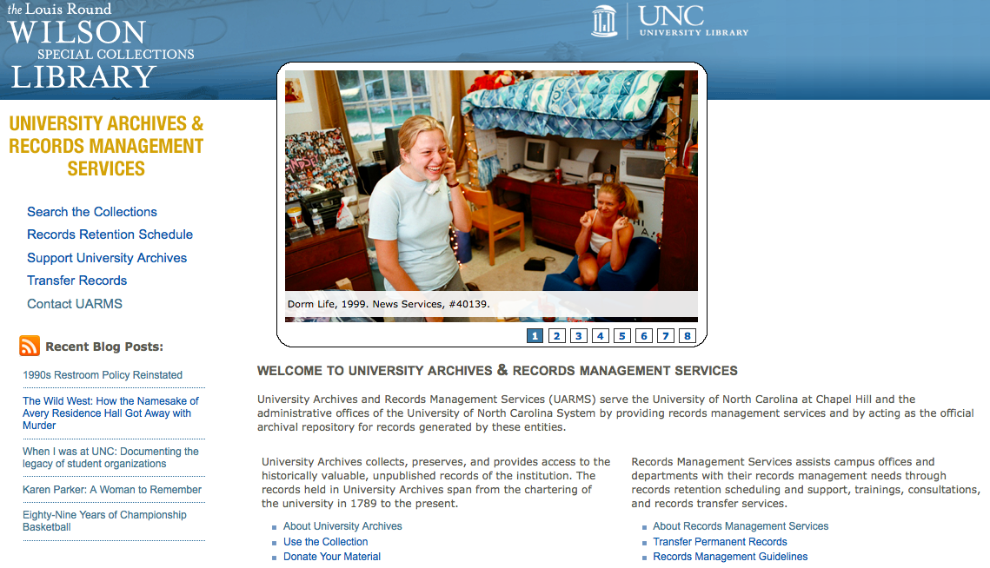

Slide 17
how & why are primary sources collected?
required by law – usually “records” Birth/death certificates; marriage license
company / organization policy Personnel files; incorporation docs
historical societies Photos; military garb
religious groups Membership; sermons; pamphlets
for profit Ancestry.com
intentional collecting – e.g. research, endowment or grant North Carolina Collection (UNC)
family Birth certificates; medical records; photos; scrapbooks; journals

Slide 18
The University of North Carolina at Chapel Hill is a state agency, and its offices and departments are obligated to follow the requirements of the North Carolina Public Records Law (North Carolina General Statute 132) for retention and disposition of records.

Slide 19
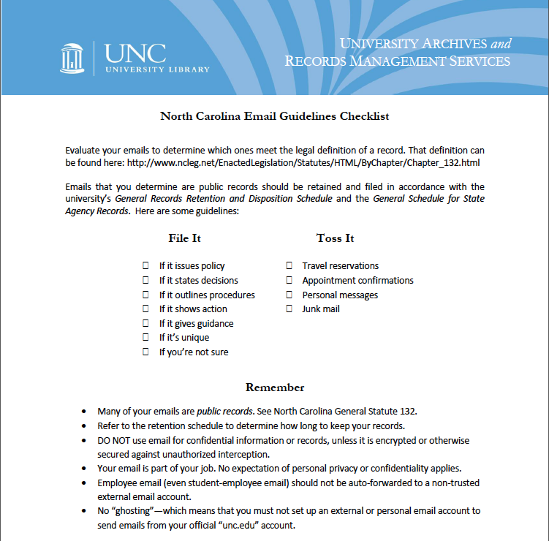

Slide 20
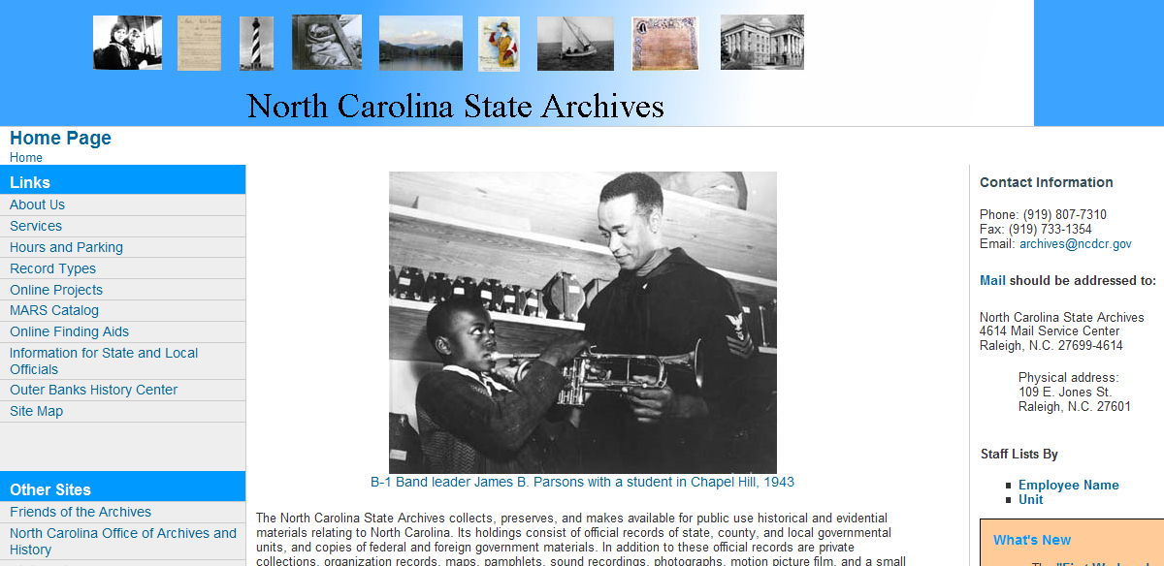
State Archives
http://www.archives.ncdcr.gov/

Slide 21
Is there a good tool for searching archives? Are the UNC archives included in the UNC library search results?
-Josh
original order
provenance

Slide 22
organizing archives
Documents should be maintained or ordered in a way that reflects exactly how they were held and used by the office or person creating the records in contrast to the conventional library approach of organization by subject.
Original order is a fundamental principle of archives.
First, it preserves existing relationships and evidential significance that can be inferred from the context of the records.
Second, it exploits the record creator's mechanisms to access the records, saving the archives the work of creating new access tools.

Slide 23
how are they organized?
depends…
“Finding Aid” - description of an archival collection, usually containing a history of the person or organization that produced the collection and an inventory of its contents
Finding aid for collection on Thursday…
http://www.lib.unc.edu/mss/inv/f/Federal_Writers%27Project.html

Slide 24
where & how to access
think about who might have relevant records/material
government entity (international, national, state, county)
professional organization/society (e.g. state geological society)
dedicated entity (special collection – e.g. TWU’s WASP collection)
ask librarian

Slide 25
why would I ever use an archive?
legislation (statutes, regulations, and orders-in-council) and case law (decisions of courts and administrative tribunals)
genealogy / family tree

Slide 26
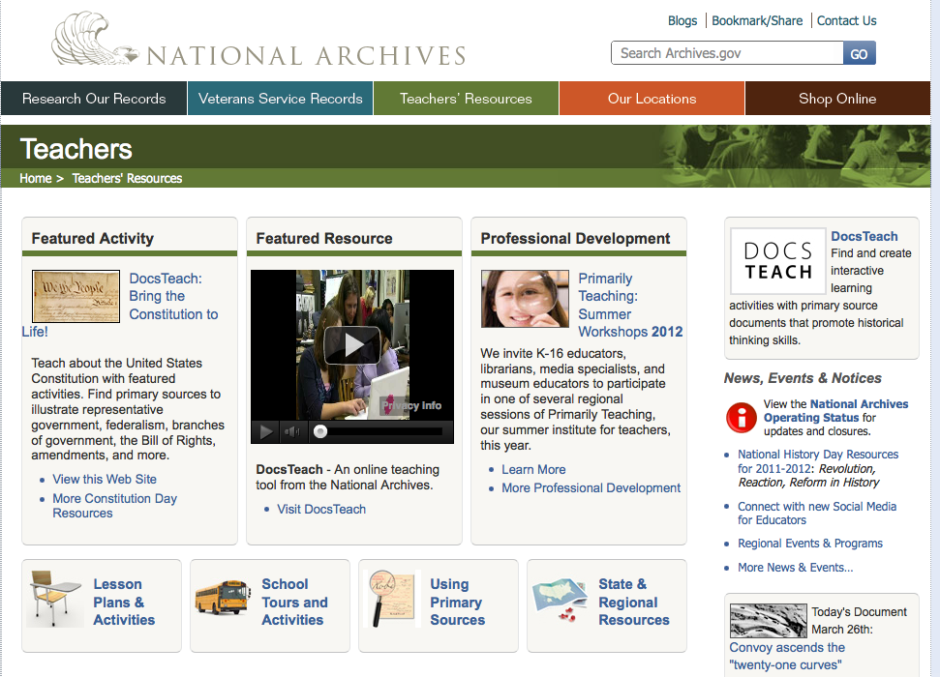

Slide 27
Archivists normatively position themselves as impartial and honest brokering custodians of the past, immune from the pressures and persuasions that conflict the rest of contemporary society.
Consider the politics of record-making and record keeping and how they shape and often mis-shape the construction of the past and present.
Action or inaction
Wallace, D.A. (2011). Memory ethics – or the presence of the past in the present. Archival Science, 11, 1-12.

