Slide 1
Agenda for today
Innovation in library instruction
Jonathan
More resources
Individual consultations regarding instruction projects

Slide 3
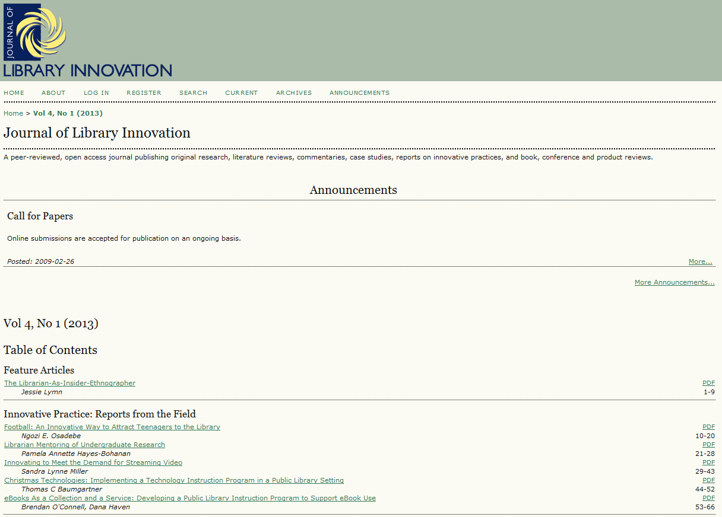
http://www.libraryinnovation.org

Slide 4
http://www.inthelibrarywiththeleadpipe.org/

