Slide 1
Multivariate Display
From tables, charts, graphs
to more complicated methods

Slide 2
Basic Symbolic Displays
Graphs and Charts (covered already)
Maps (in next section on GIS)
Diagrams (briefly here)
From: S. Kosslyn, “Understanding charts and graphs”, Applied Cognitive Psychology, 1989.

Slide 3
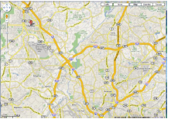
Map
Representation of spatial relations
Locations identified by labels

Slide 4
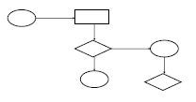
Specialized Diagrams
Structure is important, relates entities to each other
Primarily uses lines, enclosure, position to link entities
Examples: flowchart, family tree, org chart, ...

Slide 5
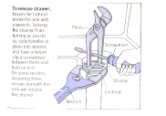
Schematic Diagram
Schematic picture of object or entity
Parts are symbolic
Examples: figures, steps in a manual, illustrations,...

Slide 6
Points, Lines, Bars, Boxes
Points
Useful in scatterplots for 2-values
Can replace bars when scale doesn’t start at 0
Lines
Connect values in a series
Show changes, trends, patterns
Not for a set of nominal or ordinal values
Bars
Emphasizes individual values
Good for comparing individual values
Box Plots
Shows a distribution of values

Slide 7
Bars
Vertical vs. Horizontal
Horizontal can be good if long labels or many items
Multiple Bars
•Can be used to encode another variable

Slide 8
Multivariate: Beyond Tables and Charts
Data sets of dimensions 1,2,3 are common
Number of variables per class
1 - Univariate data
2 - Bivariate data
3 - Trivariate data
>3 - Hypervariate/Multivariate data

Slide 9
Univariate Data
Representations
7
5
3
1
Bill
Tukey box plot
low
Middle 50%
high
Mean
0
20

Slide 10
Bivariate Data
Representations
Scatter plot is common
price
mileage

Slide 11
Trivariate Data
Representations
3D scatter plot is possible
price
horsepower
mileage

Slide 12
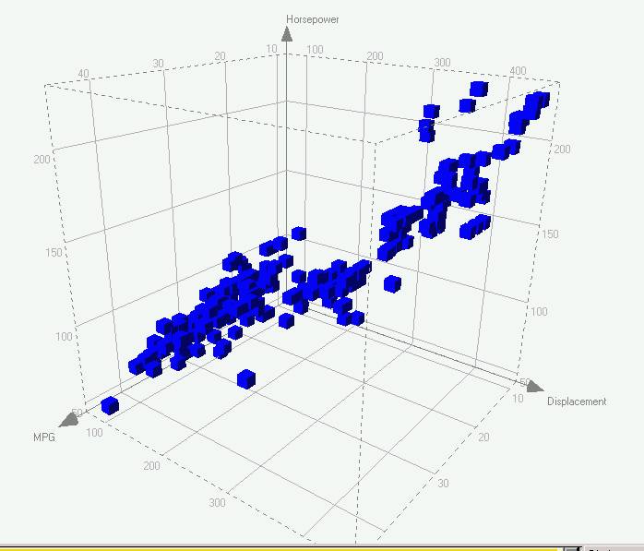
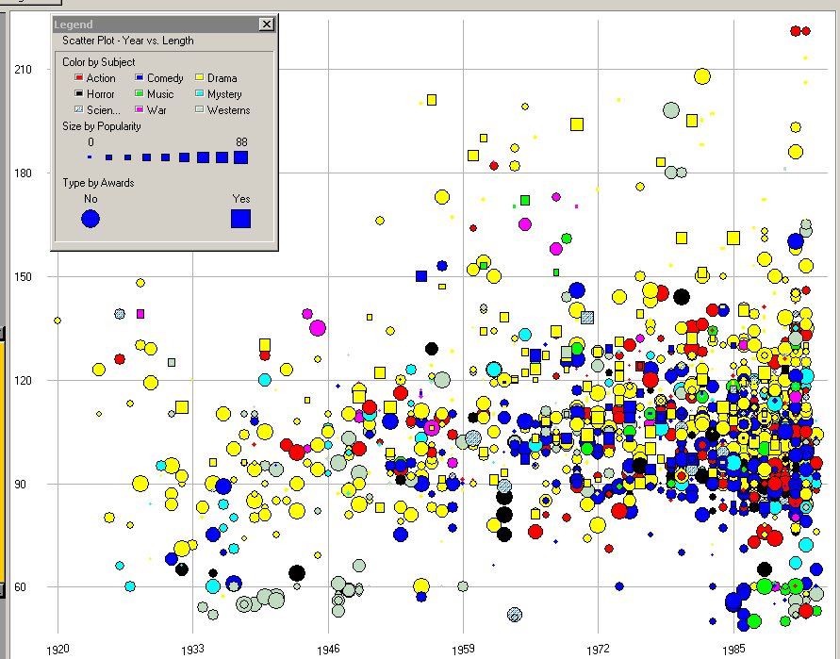
Trivariate
3D scatterplot, spin plot
2D plot + size (or color…)

Slide 13
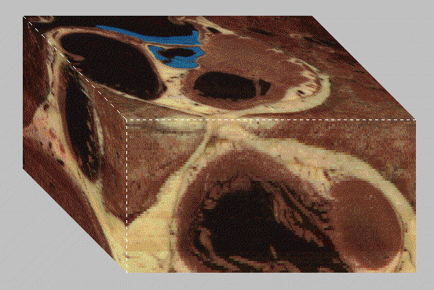
4D = 3D (spatial) + 1D variable

Slide 14
So we can do some “4D”
Spatial 3D plus 1D variable (like tissue density)
Spatial 3D plus 1D time
Orthogonal 3D of data (3D plot) plus time
And even 5D (3D spatial, 1D, and 1D time)
Note that many of the 3D spatial ones are best done only if you have 3D capable display.

Slide 15
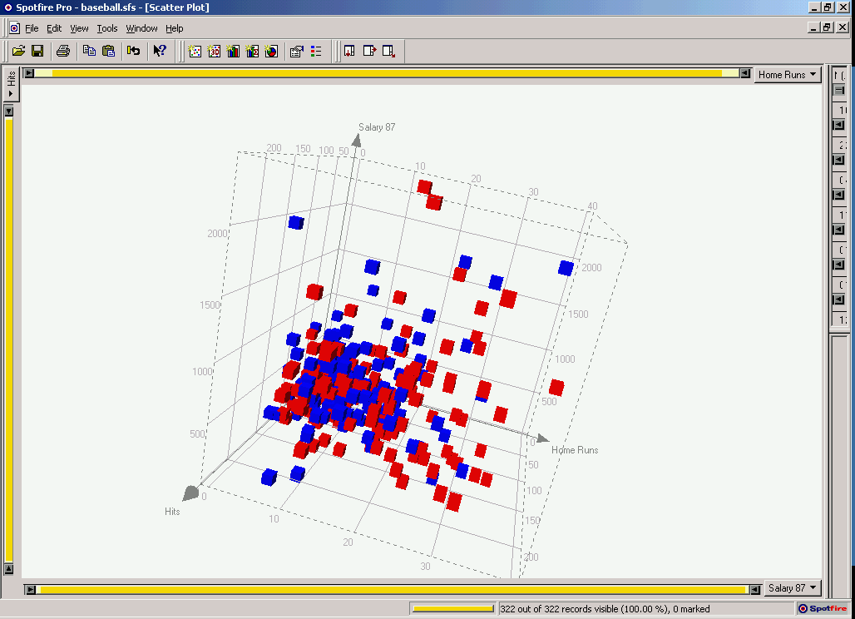
Different Arrangements of Axes
Axes are good
Lays out all points in a single space
“position” is 1st in Cleveland’s rules
Uniform treatment of dimensions
Space > 3D ?
Must trash orthogonality

Slide 16
Multivariate Data
Number of well-known visualization techniques exist for data sets of 1-3 dimensions
line graphs, bar graphs, scatter plots OK
We see a 3-D world (4-D with time)
Some visualization for 3,4,5D when some of variables are spatial or time.
Interesting (challenging cases) are when we have more variables than this. How best to visualize them?

Slide 17
Map n-D space onto 2-D screen
Visual representations:
Complex glyphs
E.g. star glyphs, faces, embedded visualization, …
Multiple views of different dimensions
E.g. small multiples, plot matrices, brushing histograms, Spotfire, …
Non-orthogonal axes
E.g. Parallel coords, star coords, …
Tabular layout
E.g. TableLens, …
Interactions:
Dynamic Queries
Brushing & Linking
Selecting for details, …
Combinations (combine multiple techniques)

Slide 18
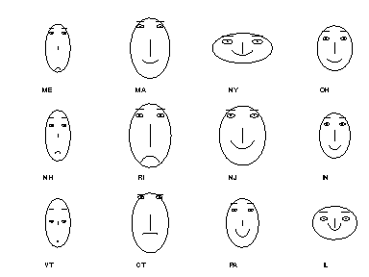
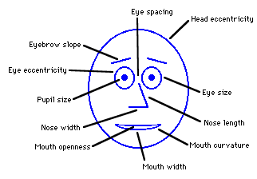
Chernoff Faces
Encode different variables’ values in characteristics
of human face
Cute applets:
http://www.cs.uchicago.edu/~wiseman/chernoff/
http://hesketh.com/schampeo/projects/Faces/chernoff.html

Slide 19
Glyphs: Stars
d1
d7
d2
d6
d3
d5
d4

Slide 20
Star Plots
Var 1
Space out the n
variables at equal
angles around a
circle
Each “spoke” encodes
a variable’s value
Var 5
Var 2
Value
Var 4
Var 3

Slide 21
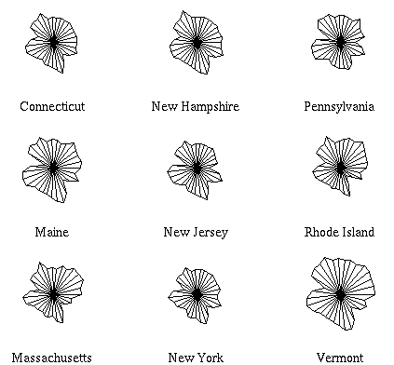
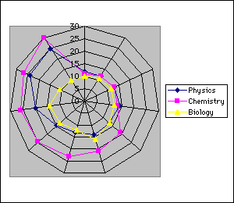
Star Plot examples
http://seamonkey.ed.asu.edu/~behrens/asu/reports/compre/comp1.html

Slide 22
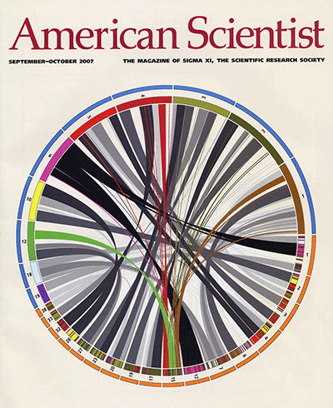
Circos A particular style of circular based displays of multivariable has evolved and is used primarily in the domain of genomics.

Slide 23
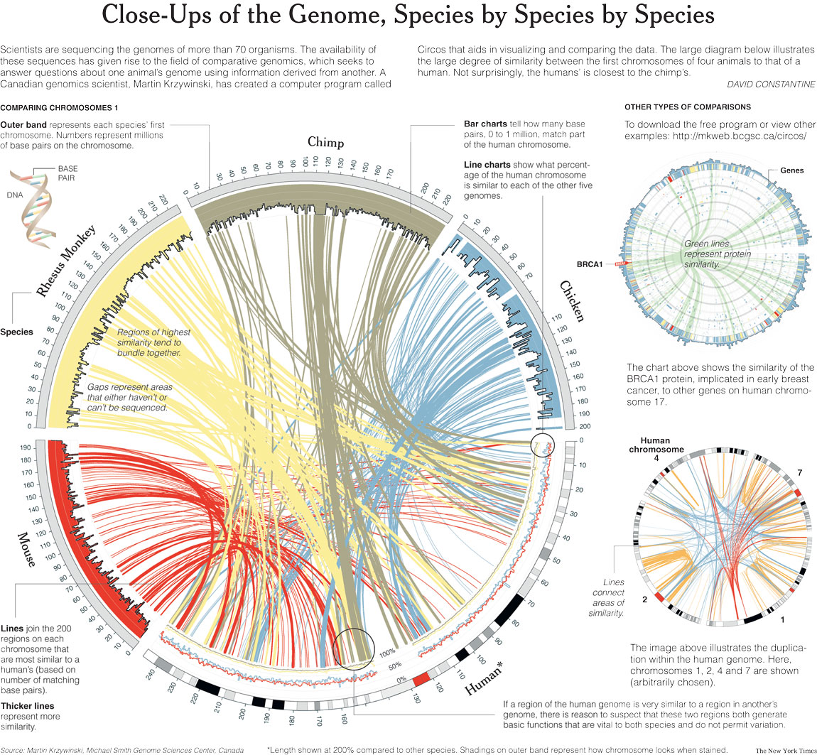

Slide 24
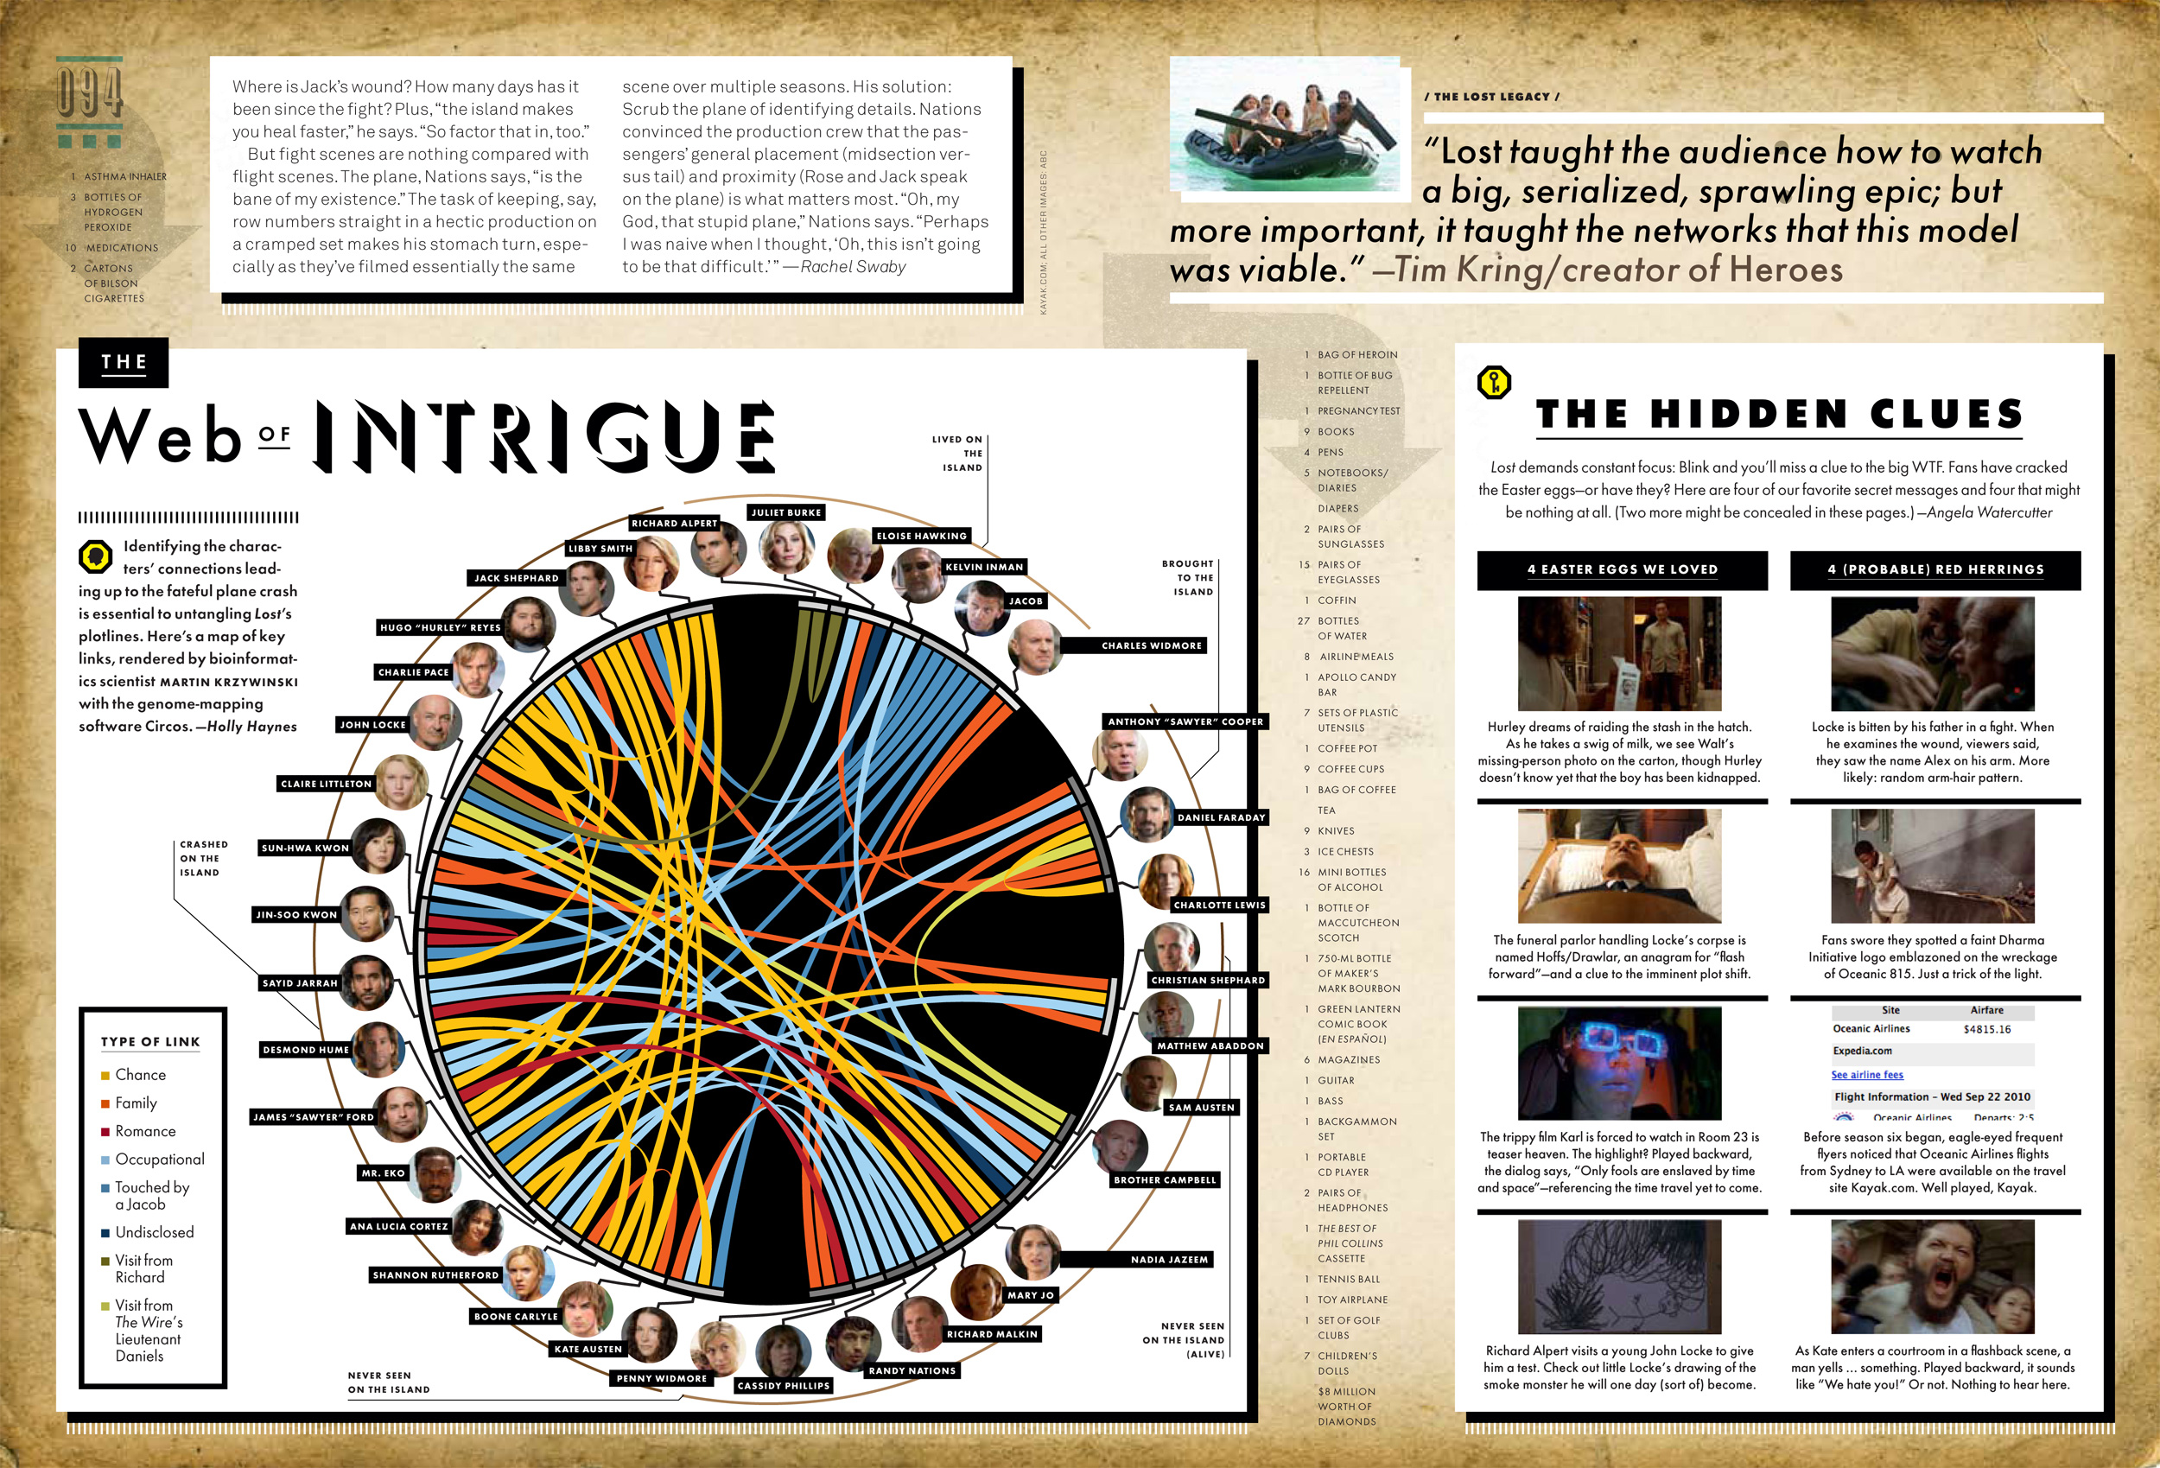

Slide 25
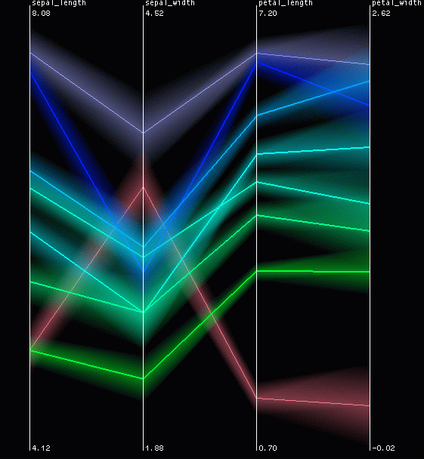
Parallel Coordinates
Inselberg, “Multidimensional detective” (parallel coordinates)

Slide 26
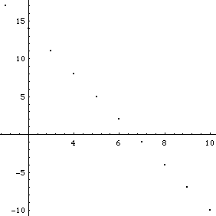
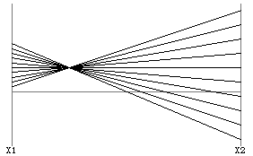
Parallel Coordinates (2D)
Encode variables along a horizontal row
Vertical line specifies values
Dataset in a Cartesian graph
Same dataset in parallel coordinates

Slide 27
Parallel Coordinates (4D)
Forget about Cartesian orthogonal axes
(0,1,-1,2)=
x
y
z
w
0
0
0
0

Slide 28
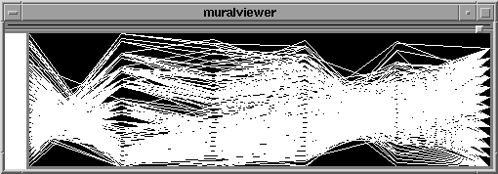
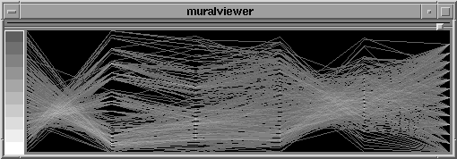
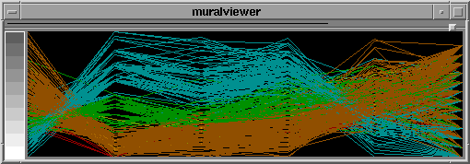
Parallel Coordinates Example
Basic
Grayscale
Color

Slide 29
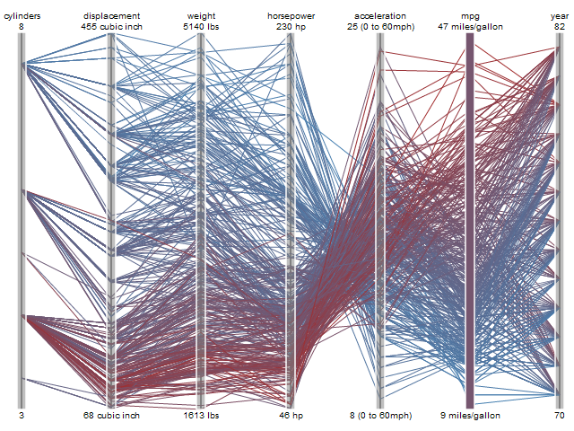

Slide 30
Multiple Views
Give each variable its own display
1
A B C D E
1 4 1 8 3 5
2 6 3 4 2 1
3 5 7 2 4 3
4 2 6 3 1 5
2
3
4
A B C D E

Slide 31
Small Multiples
Nice definitions and examplea from Juice Analytics.

Slide 32
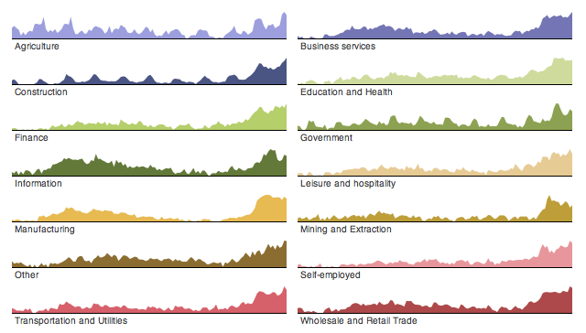
Small Multiples

Slide 33
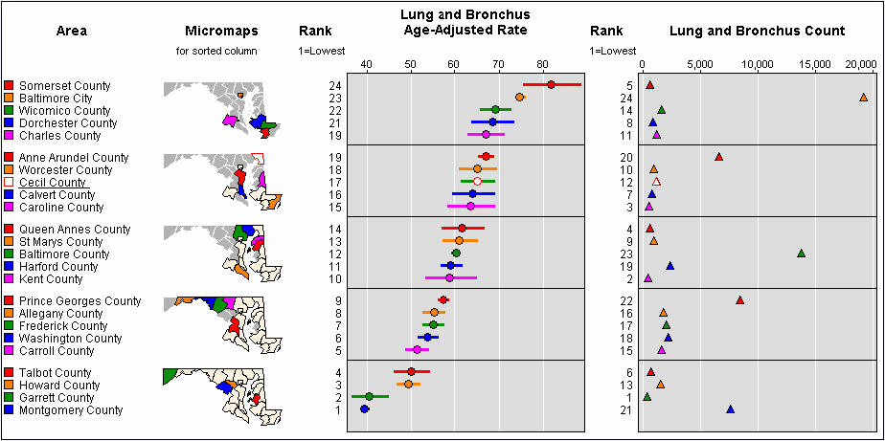
Small Multiples

Slide 34
Multiple Graphs--Trellis
Trellised visualizations enable you to quickly recognize similarities or differences between different categories in the data. Each individual panel in a trellis visualization displays a subset of the original data table, where the subsets are defined by the categories available in a column or hierarchy.
Two Examples (next slides):
Spotfire:For example, if you choose to trellis a visualization based on the two variables "Gender" and "Political affiliation", this will result in four separate panels representing the combinations Female-Republican, Female-Democrat, Male-Republican, and Male-Democrat. If the "Gender" variable is used in conjunction with another variable that has five different values, this will yield ten panels. From this follows that variables with a continuous distribution and a wide range of values (for example, Real values) should be binned before they are used to form a trellis visualization. Otherwise the number of panels quickly becomes unmanageable.
SilverLight: The trellis visualizations allow us to quickly compare data horizontally and vertically with visual sparklines. Not only can you quickly see an individual domain's trend for a region (i.e., domain1 in Europe), but you can also see how domain1.com traffic compares across all three regions. We can also quickly tell if the traffic is meeting our goals by comparing if the trrend line is above or below the KPI line (dotted line).

Slide 35
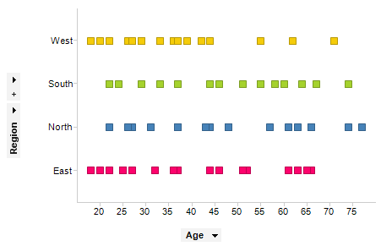

Slide 36
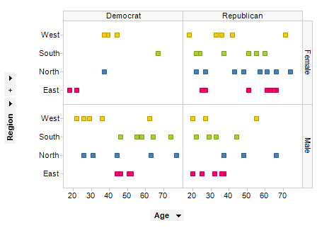

Slide 37
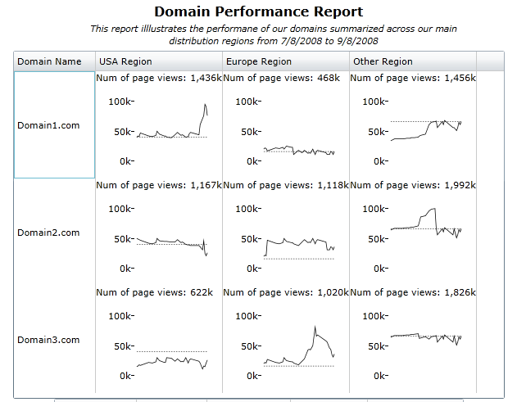

Slide 38
Sparklines
Use matrix, but in each cell put in not single value, but visual that represents compound element. This way you pack in multiple dimensions into each cell, but can easy scan across cells.
Tufte description (originated)
MicroSoft Excel examples
Infragistics example

Slide 39
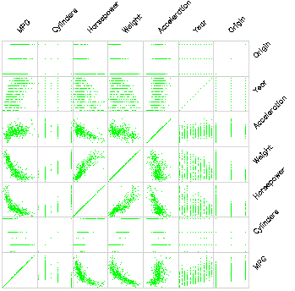
Scatterplot Matrix
Represent each possible
pair of variables in their
own 2-D scatterplot
Useful for what?
Misses what?

Slide 40
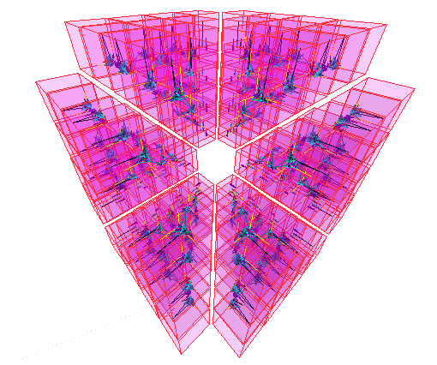
… on steroids

Slide 41
To Do Better…Need Interaction
Separate Static from Interactive
Very nice visual index of static presentations is Visualization Zoo
What can we do if we add interaction to the visualizations? In the next section we go further, by adding zoom, filtering, “brushing”, etc.

Slide 42
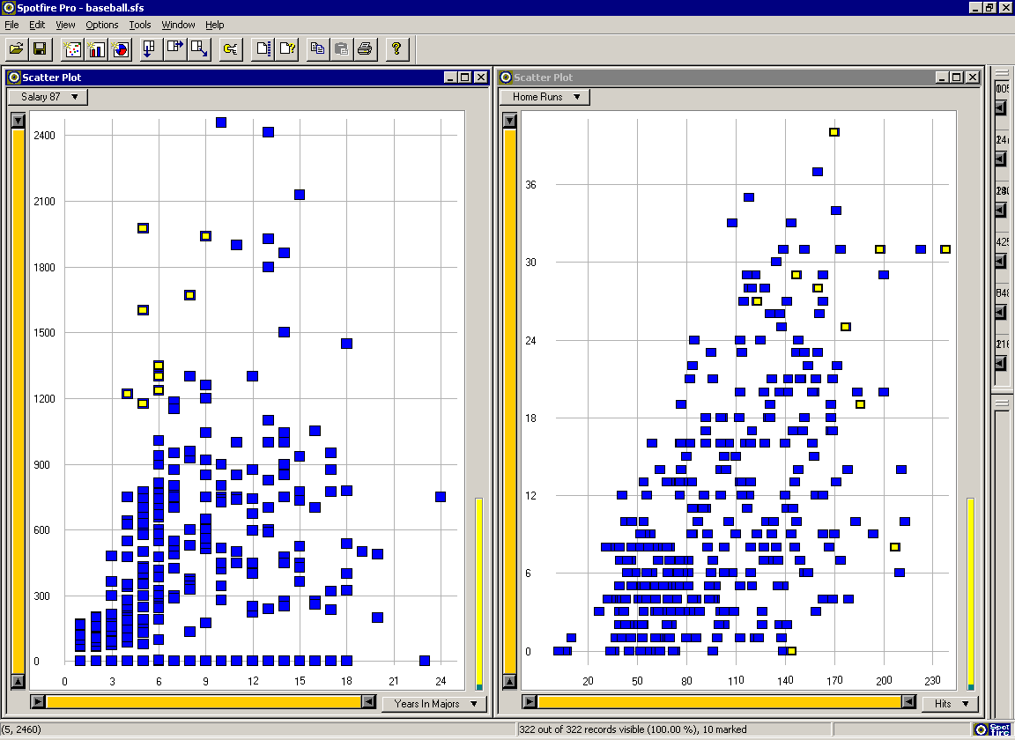
Multiple Views: Brushing-and-linking

Slide 43
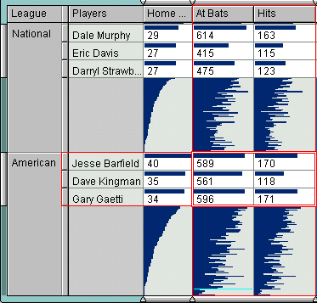
Table Lens
Rao, “Table Lens”

Slide 44
Table Lens
Spreadsheet is certainly one hypervariate data presentation
Idea: Make the text more visual and symbolic
Just leverage basic bar chart idea

Slide 45
Characteristics
Can sort on any attribute (row)
Focus on an attribute value (show only cases having that value) by doubleclicking on it
Can type in queries on different attributes to limit what is presented to. Note this is main contribution: dynamic control (selection/change/querying/filtering) of individual attributes.

Slide 46
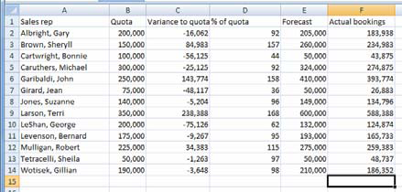

Visual Mapping
Change quantitative
values to bars

Slide 47
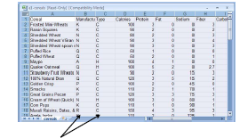
Tricky Part
What do you do for
nominal data?

Slide 48
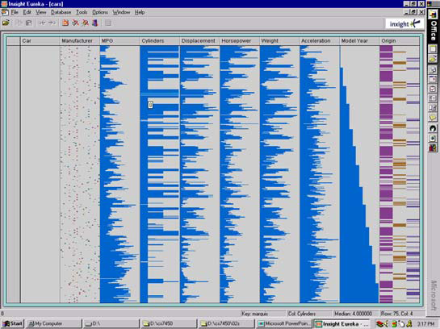
Instantiation

Slide 49
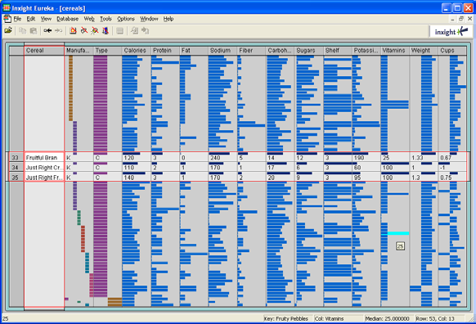
Details
Focus on
item(s)
while
showing
the context

Slide 50
Categorical data?
How about multivariate categorical data?
Students
Gender: Female, male
Eye color: Brown, blue, green, hazel
Hair color: Black, red, brown, blonde, gray
Home country: USA, China, Italy, India, …

Slide 51

Mosaic Plot

Slide 52
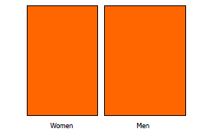
Mosaic Plot

Slide 53
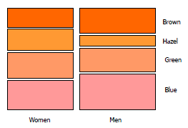
Mosaic Plot

Slide 54
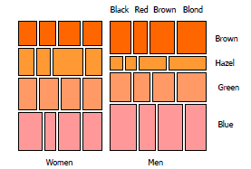
Mosaic Plot

Slide 55
Case Study: The Journey of the TreeMap
The TreeMap (Johnson & Shneiderman ‘91). It may take a while for a visualization technique to develop into something useful (both to improve enough, and to be utilized/accepted).
Idea:
Show a hierarchy as a 2D layout
Fill up the space with rectangles representing objects
Nested rectangles indicated levels of hierarchy
Size on screen indicates relative size of underlying objects.

Slide 56
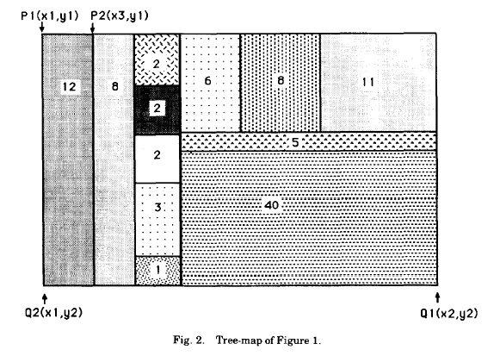
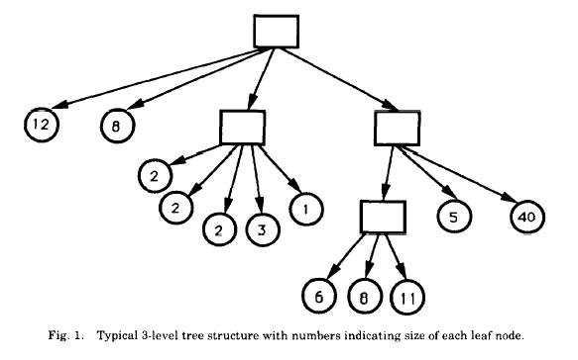
The Journey of the TreeMap
(Johnson & Shneiderman ‘91)

Slide 57
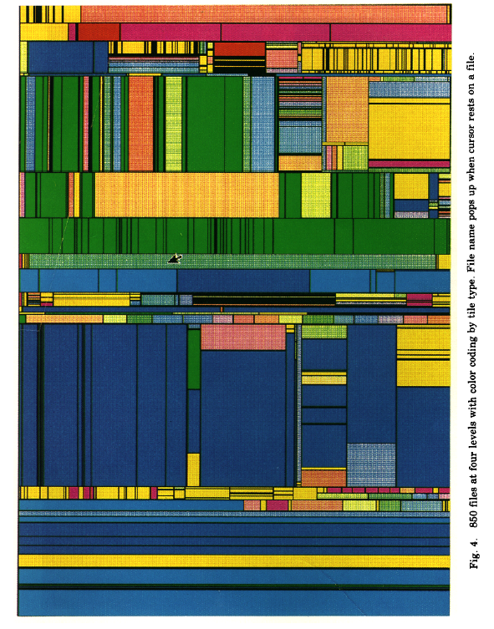
(Johnson & Shneiderman ‘91)

Slide 58
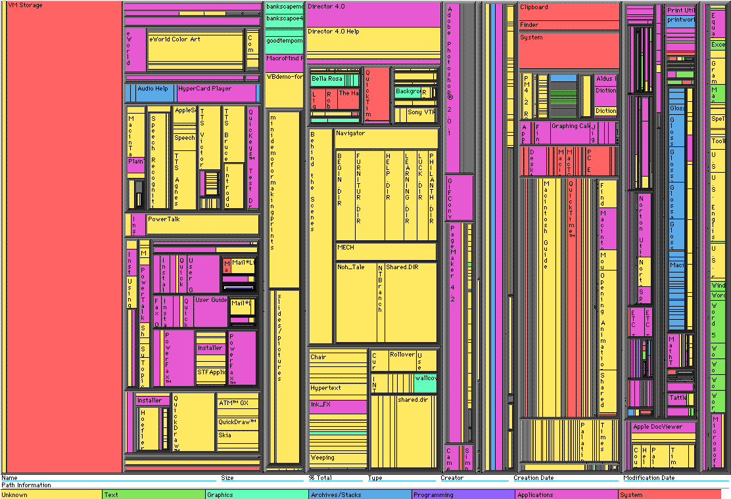
Early Treemap Applied to File System

Slide 59
What’s your reaction?
What problems does Treemap have?
Notes:
Other questions perhaps:
How is it better or worse than traditional tree structure?
Is it intuitive? Or do you have to consciously process?
Do you find the use of color helpful?

Slide 60
Treemap Problems
Too disorderly
What does adjacency mean?
Aspect ratios uncontrolled leads to lots of skinny boxes that clutter
Hard to understand
Must mentally convert nesting to hierarchy descent
Color not used appropriately
In fact, is meaningless here
Wrong application
Don’t need all this to just see the largest files in the OS

Slide 61
Successful Application of Treemaps
Think more about the use
Break into meaningful groups
Make appearance more usable
Fix these into a useful aspect ratio
Do not use nesting recursively
Use visual properties properly
Use color to distinguish meaningfully
Use only two colors:
Can then distinguish one thing from another
When exact numbers aren’t very important
Provide excellent interactivity
Access to the real data
Makes it into a useful tool

Slide 62
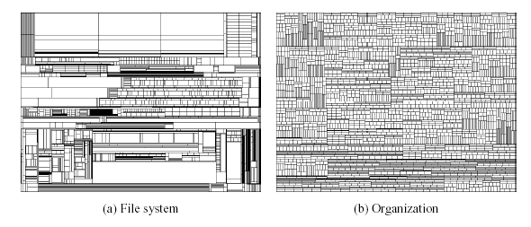
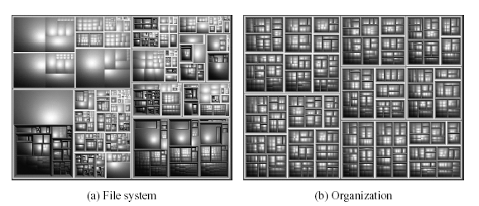
Squarified Treemaps
Bruls, Huizing, van Wijk, 1999
Notes:
Just wondering what this is demonstrating here

Slide 63
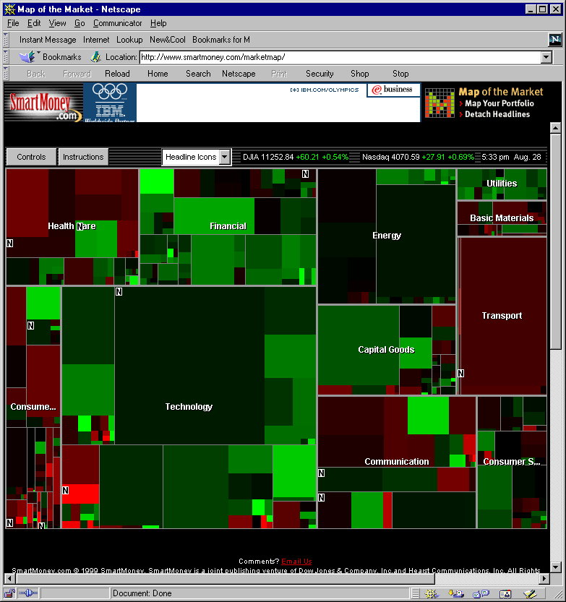
A Good Use of TreeMaps and Interactivity www.smartmoney.com/marketmap
www.smartmoney.com/marketmap

Slide 64
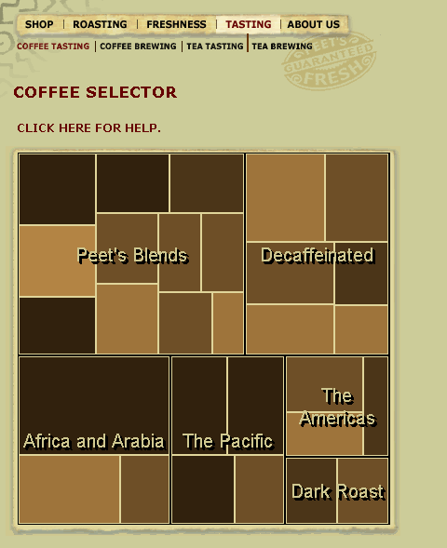
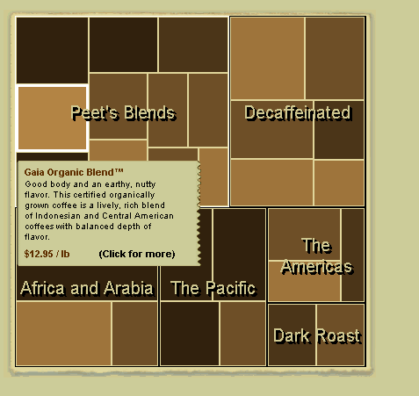
Treemaps in Peets site

Slide 65
Analysis vs. Communication
MarketMap’s use of TreeMaps allows for sophisticated analysis
Peets’ use of TreeMaps is more for presentation and communication
This is a key contrast

Slide 66
IBM Attribute Explorer
Multiple histogram views, one per attribute (like trellis)
Each data case represented by a square
Square is positioned relative to that case’s value on that attribute
Selecting case in one view lights it up in others
Query sliders for narrowing
Use shading to indicate level of query match (darkest for full match)

Slide 67
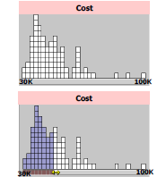
Features
Attribute histogram
All objects on all attribute scales
Interaction with attributes limits

Slide 68
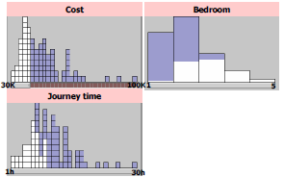
Features
Inter-relations between attributes – brushing

Slide 69
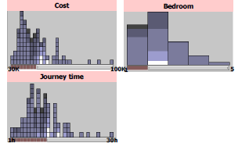
Features
Color-encoded sensitivity

Slide 70
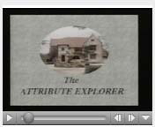
Attribute Explorer
http://www.open-video.org/details.php?videoid=8162

Slide 71
Polaris
See Chris Solte reading for class
Good example of integrated control, dynamic filtering, display.
Now best seen in Tableau (Chris Solte co-founder with adviser, Pat Hanrahan).

Slide 72

Combining Techniques
Multi-Dimensional + GeoSpatial (DataMaps VT)

Slide 73



1. Small Multiples
Multiple views: 1 attribute / map
1976

Slide 74


2. Embedded Visualizations
Complex glyphs: For each location, show vis of all attributes

Slide 75
Comparison of Techniques
ParCood: <1000 items, <20 attrs
Relate between adjacent attr pairs
StarCoord: <1,000,000 items, <20 attrs
Interaction intensive
TableLens: similar to par-coords
more items with aggregation
Relate 1:m attrs (sorting), short learn time
Visdb: 100,000 items with 10 attrs
Items*attrs = screenspace, long learn time, must query
Spotfire: <1,000,000 items, <10 attrs (DQ many)
Filtering, short learn time

Slide 76
Limitations and Issues
Complexity
Many of these systems seem only appropriate for expert use
User testing
Minimal evidence of user testing in most cases

Slide 77
Scaling up further
Beyond 20 dimensions?
Interaction
E.g. Offload some dims to Dynamic Query sliders, …
Reduce dimensionality of the data
E.g. Multi-dimensional scaling
Visualize features of the dimensions, instead of the data
E.g. rank-by-feature

Slide 78
Interactive Control
The most effective tool at your disposal for dealing with multiple dimensions of data is INTERACTIVITY.
Use it to allow user to control what dimensions are seen, how they filter mass of information into selected important parts of information, and to show linkages, and help in understanding data.

Slide 79
End of Main Presentation

