Slide 1
Maps and GIS

Slide 2
Historical Maps

Slide 3
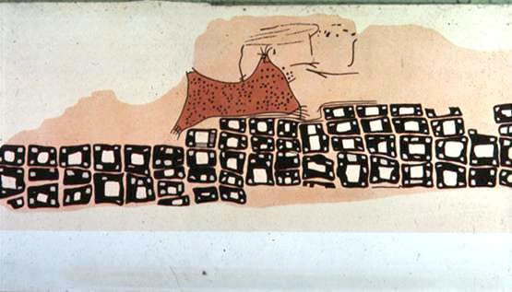
The oldest map?
Konya town map, Turkey, c. 6200 BC
Milestones Project
http://www.math.yorku.ca/SCS/Gallery/milestone/

Slide 4
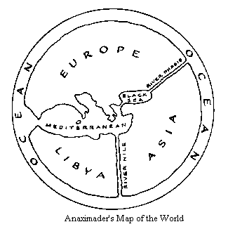
The First World Map
Anaximander of Miletus, Turkey, c. 550 BC
Milestones Project
http://www.math.yorku.ca/SCS/Gallery/milestone/

Slide 5
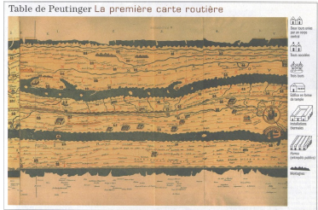
First Route Map
Roman road map, c. 366-335 BC
Milestones Project
http://www.math.yorku.ca/SCS/Gallery/milestone/

Slide 6
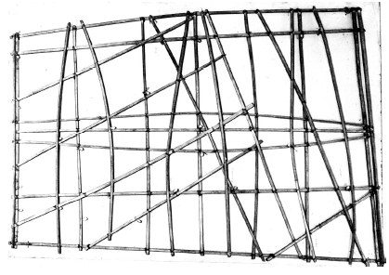
South Sea Islander’s Map
Based on slide from B. Tversky
Notes:
All later sources parrot the explanations of the charts given by Winkler: that the sticks (identified by Davenport as 'palm ribs bound by coconut fiber') represent nothing geographical, but rather the patterns of wave-swells between islands in the archipelago. Here is the secret—the navigators of the Marshall Islands locate island-masses by calculating the refraction and reflection of wave-fronts around and against the island shores. This is a technique specific to the geography of an island nation, and cannot be found anywhere else in the world. Every article on the subject, including the Wiki piece, explains the method to some degree, showing how a wave-swell reacts when it hits an island—curving around at an angle, and interfering with itself and with swells coming from other directions. The patterns of interference coalesce into long lines of 'nodes', stretching out to sea—the navigator can follows these nodes to the island.

Slide 7
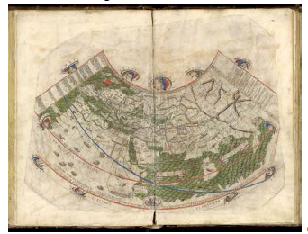
Ptolemy’s World Map
First use of longitude, c. 150 AD
Milestones Project
http://www.math.yorku.ca/SCS/Gallery/milestone/

Slide 8
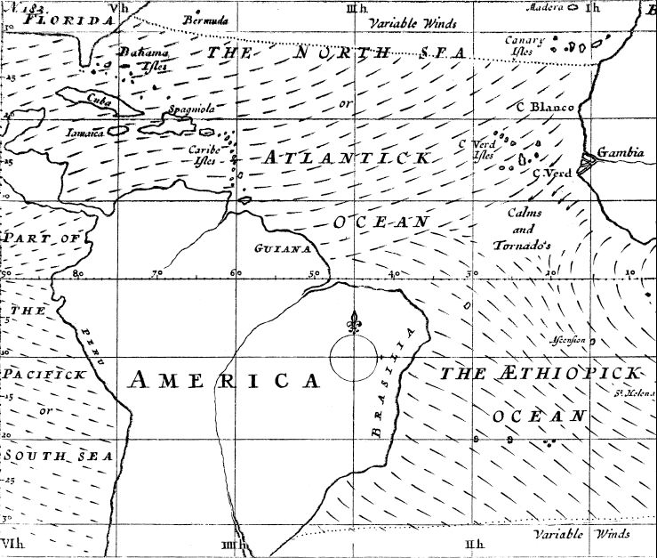
First Weather Map
Halley’s wind map, 1686

Slide 9
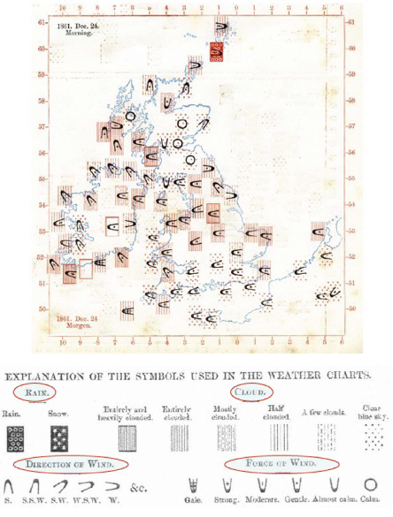
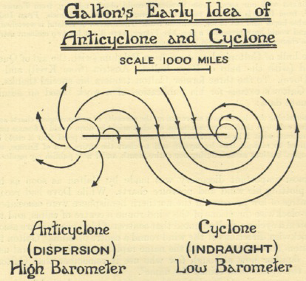
Galton’s Weather Map
Measurements 1861
Milestones Project
http://www.math.yorku.ca/SCS/Gallery/milestone/

Slide 10
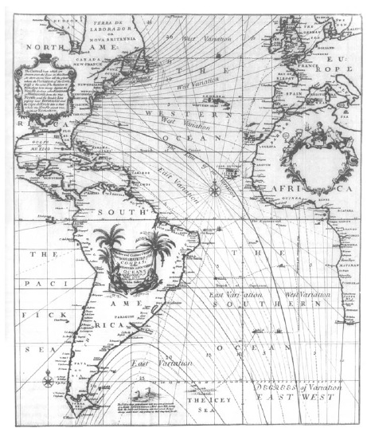
First Contour Map
Halley’s lines of equal magnetic declination, 1701

Slide 11
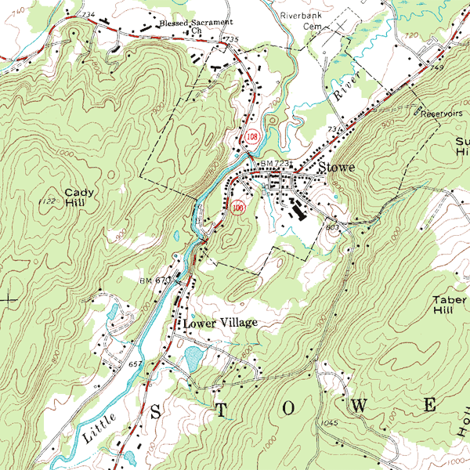
Park Map (contour)
wikipedia.org

Slide 12
Mapping geographic data
Visualizing information which has a spatial component
Graphical representations of our environment
Examples of types of maps:
  Chloropleth (single variable displayed using color, texture on accurate geographic region)
  Cartogram (area used to display value)
  Topographic (accurate detailed depiction of cultural and natural features)
  Nautical charts (same for bodies of water)
  Image (pictures from sky of land/water)
  Thematic (tell a story)
  Abstractions (driving directions)
  etc. etc.

Slide 13
Maps, Earth and Projection
Many properties can be measured on the Earth's surface independently of its geography. Some of these properties are:
  Area
  Shape
  Direction
  Bearing
  Distance
  Scale
Map projections can be constructed to preserve one or more of these properties, though not all of them simultaneously. Each projection preserves or compromises or approximates basic metric properties in different ways. The purpose of the map determines which projection should form the base for the map. Because many purposes exist for maps, many projections have been created to suit those purposes.
http://en.wikipedia.org/wiki/Map_projection

Slide 14
Cont’d
Another major concern that drives the choice of a projection is the compatibility of data sets. Data sets are geographic information. As such, their collection depends on the chosen model of the Earth. Different models assign slightly different coordinates to the same location, so it is important that the model be known and that the chosen projection be compatible with that model. On small areas (large scale) data compatibility issues are more important since metric distortions are minimal at this level. In very large areas (small scale), on the other hand, distortion is a more important factor to consider.
http://en.wikipedia.org/wiki/Map_projection

Slide 15
Map Projections
When mapping the earth, we must consider how to transform the 3D sphere (geoid) into a 2D plane that can be displayed on computer screen or print map.
Map projections are geometric transformations which do this. There are an infinite number of possible projections, but three major variants:
  Conic, using a cone touching the sphere on a line (or two)
  Planar (azimuthal), contact at one point on the sphere, accurate at that point
  Cylindrical, contact at a line

Slide 16
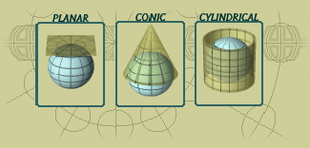

Slide 17
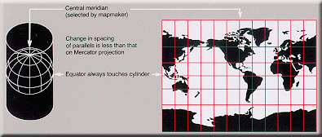
Projection Surface
Cylinder
The Mercator projection is a cylindrical map projection presented by the Flemish geographer and cartographer Gerardus Mercator, in 1569. It became the standard map projection for nautical purposes because of its ability to represent lines of constant course, known as rhumb lines or loxodromes, as straight segments (wikipedia.org)

Slide 18
Preserving spatial characteristics
There are four major features we may wish to preserve on a map:
Shape – feature shapes are maintained (conformal) (but we lose accuracy of size)
Area – the size of features are the same as in reality (lose shape)
Distance – the distance from a point to other points is preserved (typically on azimuthal projections)
Direction – the way to get from A to B is preserved as a straight line

Slide 19
Map Projection Choices
How does this affect our thinking?
Question #1: What is the smallest area?
  China
  US
  Africa
  Western Europe
  Argentina

Slide 20
Question #2: What is the biggest area?
  China
  US
  Africa
  Western Europe
  Argentina
  By how much is it bigger?

Slide 21
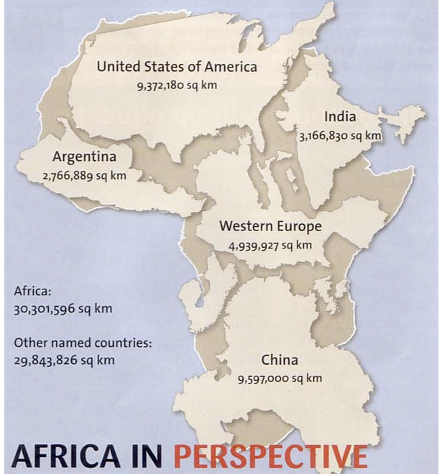
http://strangemaps.wordpress.com/2006/11/20/35-the-size-of-africa/

Slide 22
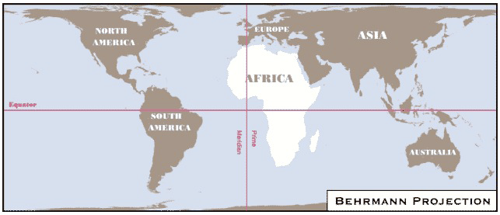
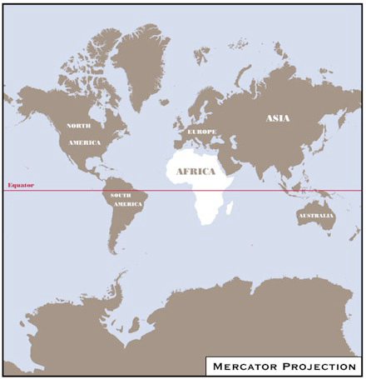
Two different cylinderical map projections
http://exploringafrica.matrix.msu.edu/
students/curriculum/m1/exercise1.php

Slide 23
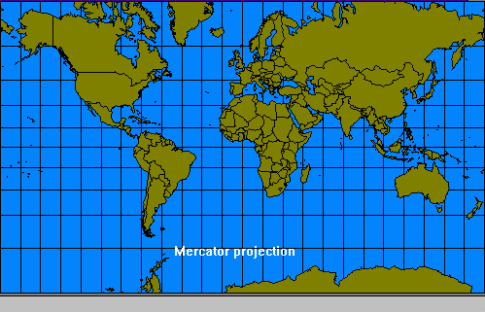
Direction-preserving: Mercator map projection
Question #3: Which is bigger: South America or Greenland?

Slide 24
Direction-preserving: Mercator map projection
Problem with this projection:
  Area of Greenland: 2,166,086 sq km
  Area of South America: 17,819,000 sq km – around 8 times larger!
  This projection has often been accused of furthering tensions between North and South

Slide 25
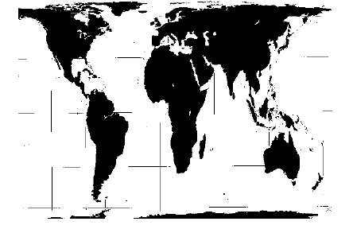
Area-preserving Map: Peters

Slide 26
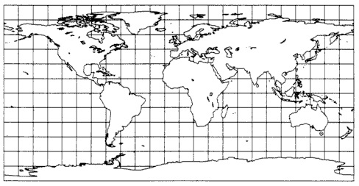
Latitude-Longitude
Snyder, “Flattening the Earth”
Based on slide from Hanrahan

Slide 27
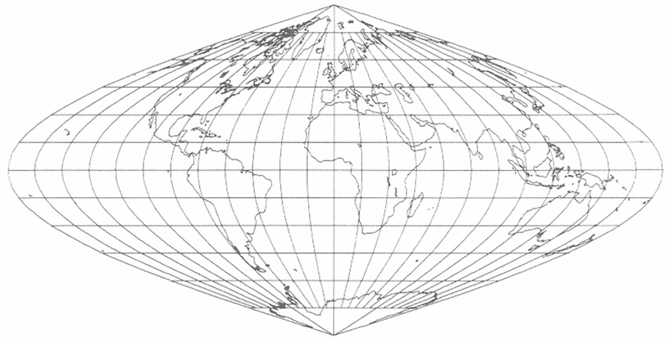
Sinusoidal: Equi-Area
Snyder, “Flattening the Earth”
Based on slide from Hanrahan

Slide 28
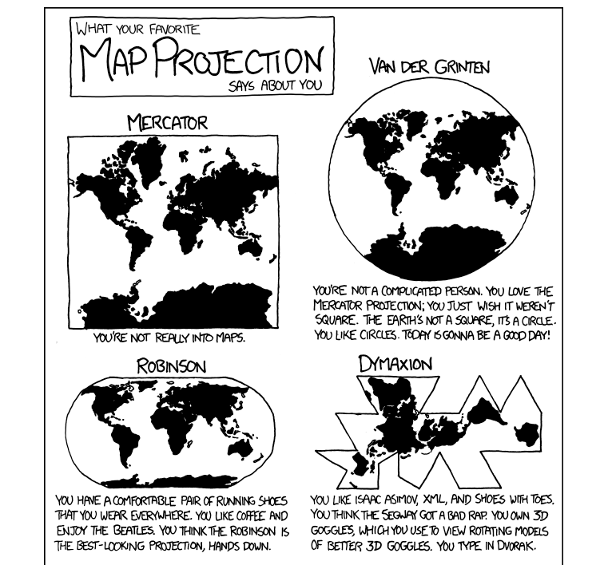
And for the real authority…
XKCD

Slide 29
What does most use look like?
Small scale, web based (route planning, local map (Google Maps), or sometimes larger extent (Google Earth)).
Main issue is to provide tools and interactions that operate accurately with respect to reference scale size.
  How far is the airport?
  What is the area of the property?
and that data from multiple sources aligns properly.

Slide 30
What are the big issues?
While many folks concentrate on whole earth projections, here’s what I think are the “big” issues:
  Democratization of access to maps and individual control of maps
    Ubiquitous GPS
    Personal maps (Google My Maps)
    Interactive Maps
  Displaying multivariate data on maps

Slide 31
Biggest Change #1: GPS
Use of GPS systems is transforming maps in that individual users have accurate spatial location information (x,y coordinates on surface of earth). Think about
  Explorers just click button to record where they are. Lost hikers locations are known.
  Giving your home address as spatial coordinates
  Recording spatial information with everyday actions (pictures taken, location of person via their cellphone, location of your car, geocaching, geoURL)
  Marking property lines by absolute GPS and not landmarks or line of sight surveyors.

Slide 32
Biggest Change #2: Personal Maps
With the advent of the web, and dynamic maps, access to public information and mobile devices that supply GPS information, everyone can now interact with maps. They can both use, and contribute to maps. They can do it dynamically, and interact with maps and share maps and information on maps.

Slide 33
Personal Maps Examples
Route finding (Google Maps); sidenote: when was the pan/zoom interface commonly used in applications like Google Maps first published (late 1980s, comparative study in early 1990s)?
MapMyRun
HousePrices (Zillow)
Transit Maps
  Next Bus, Seattle’s home grown One Bus Away (note positive effect on consumers)
  Google’s format (GTFS) has enabled many such projects (transforming the industry)
Shopping, restaurants (Yelp)
You suggest!

Slide 34
Interactive Maps
Snake Oil (URL), map as an informative layout of categorical/nominal items, with rollover for detail.
Newcomers to New York (URL), standard spatial map but including time, and telling story about people living in neighborhoods, supports indexing searching
Spotfire (URL): Shark Attacks, show multiple panes, trellis style, with linked updates.
As we go through these examples, identify the visualization techniques (combined with HCI techniques) used to effectively (or ineffectively) to present the data.
Notes:
For Spotfire, choose airline incident analysis. Talk about data type choice. Original is continuous then map to interval “hidden” behind the scenes. Bad is that they shown only scale of pos/threshold/neg (blue/white/red), but the maps shows interval graduations of red and blue. Better choice: don’t separate control from legend. Make one and make directly representative. I.e. have bar showing color graduation scale with the control bar displayed on this, allowing you to directly manipulate. (Always use direct controls when possible, and do NOT separate a single “mental” object into multiple separate things (control bar, and legend, etc). Also, don’t like that they highlight in different color (anytime you change representation adds mental load. Just highlight outline or something instead. In other like gas prices it actually changes color to match opposite value which is really confusing).

Slide 35
Multivariable Maps

Slide 36
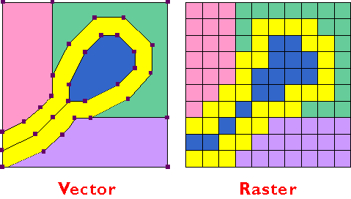
Map Basics
Datatypes
  Raster
  Vector

Slide 37
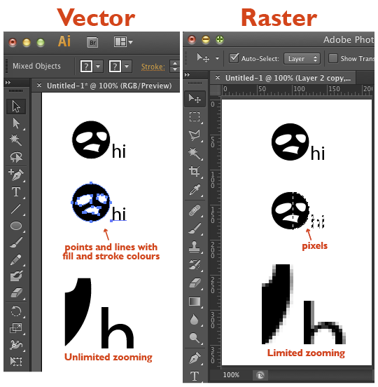

Slide 38
Geographic Data Models - Raster
Models spatial areas by recording the locational extent of a variable
Uniformly spaced grid of discrete cells (pixels)
Simple model, simple storage
Most all display devices use raster display, so 1-1 mapping with display devices
Most sampling devices are raster based: digital photography, passive and active remote sensors (Landsat, Radarsat)

Slide 39
Vector Data Models
Based on the objects that populate a space
Typically broken into four categories
    Points – a city on a small-scale map
    Lines - a hiking trail
    Areas - a wildlife area (represented by polygons)
    Volumes – 3d modelling (TINs)
Spatial objects have topological relationships
  Near, beside, inside, intersection, bounds…
We can also operate at a higher level of abstraction:
  Composition, etc.

Slide 40
Geographic Information Systems
A computer-based approach to managing digital spatial data (layering)
Most powerful programs combine vector and raster tools
Using topology, the GIS can be used for spatial query and inference
  Show me what features are within 50 meters of object of interest.
  In what census tracts > 100 sq km is the median age less than 40?

Slide 41
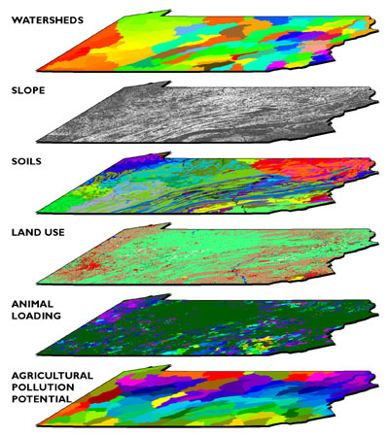

Slide 42
GIS Links and References
Grass
GeoVRML.org
Terraserver (noww MSR Maps)
GeoURL.org
ArcView (ArcInfo/ArcExplorer)
wikipedia list

Slide 43
Geodata from GPS
http://openstreetmap.org/
http://www.geograph.org.uk/

Slide 44
Spatial Information Visualization
Information visualization is well suited to spatial data
  Large volumes of data
  Novice users can receive clear explanations
  Expert users can access high level of detail (e.g. Napoleon’s march), and especially if interactive
Map design process
  1 – visualize different solutions
  2 – specific plan: classes, symbols, etc.
  3 – implement details on map construction
Emphasis for symbols
  Point, line, area, volume emphasis
  Is 3D a viable visualization metaphor? Why or why not?

Slide 45
Cartographic Design Principles
Enhance legibility
  Clear and accurate text and graphics
  Leverage familiarity
Ensure visual contrast
  Symbols need to be distinguishable
Maintain figure-ground organization
  Differentiation
  Gestalt principles
Use hierarchical organization
  Good graphic structure essential

Slide 46
Cartographic abstraction
Generalization is the technique of abstracting information at various levels
Four major techniques in cartography
  Classification – order, scale, group
  Simplification – reduce amount of information
  Exaggeration – enlarge to capture essence
  Symbolization – stylize attribute values (Bertin)

Slide 47
Maps and Interaction
Static maps – historical images (Baghdad), translations of paper maps, limited interactions (e.g. mouseover popups)
Fixed Animations – movies such as Flash, video, user has control of playback (forward, reverse, speed)
Dynamic maps – user has control of maps. Zoom/Pan selection/removal of objects, control of time/animation, filtering, etc. Really leverage the power of the computer.
Dynamic maps, like other web technologies, allow us to move from a push model to a pull model, where the user is in control of what they want to see, how they want to see it, and when they want to see it.

Slide 48
Web mapping tools
Flash and SVG – the vector drawing packages
Internet map servers.
  ESRI IMS
  MapInfo
Where is this area headed?
  OpenGIS.org
  3D viewers (mars)
VRML / X3D
What’s new since 2010—
  Flash is dead
  2D/3D Graphics is well supported directly in HTML5 (canvas object) and through SVG and WebGL. See Google Experiments for examples

Slide 49
Let’s Look at Some Examples

Slide 50
Cartograms
Mini-quiz: What’s definition of “cartogram”?

Slide 51
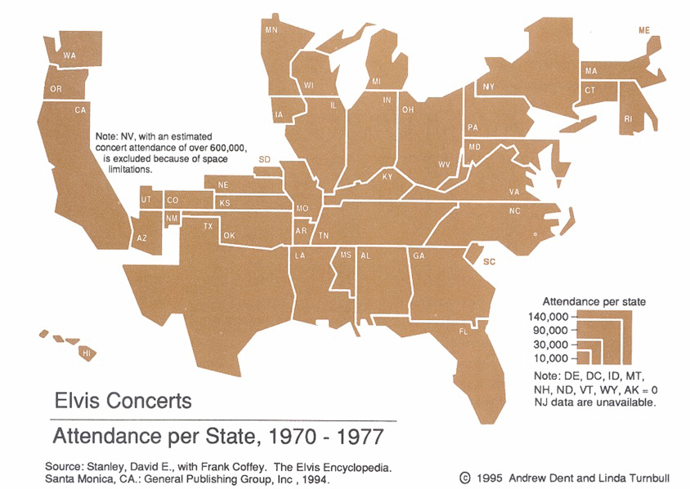
Scale Area by Data
Dent, “Cartography”
Based on slide from Hanrahan

Slide 52
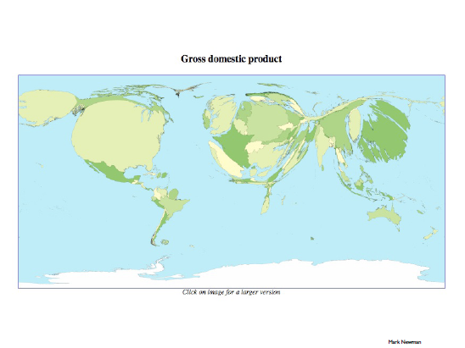
Scale shape by value

Slide 53
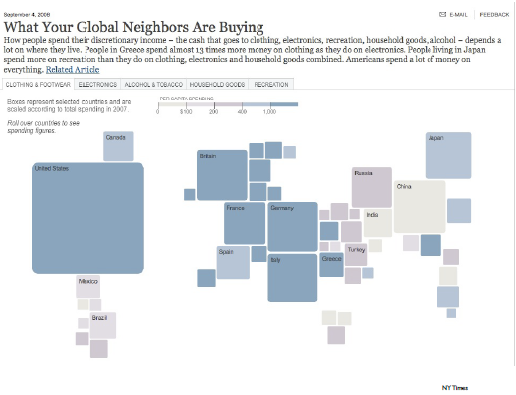
URL

Slide 54
Standard Maps Plus 1D/2D Data
Primary ways to display
Color
Symbol/icon
Bubbles
height

Slide 55
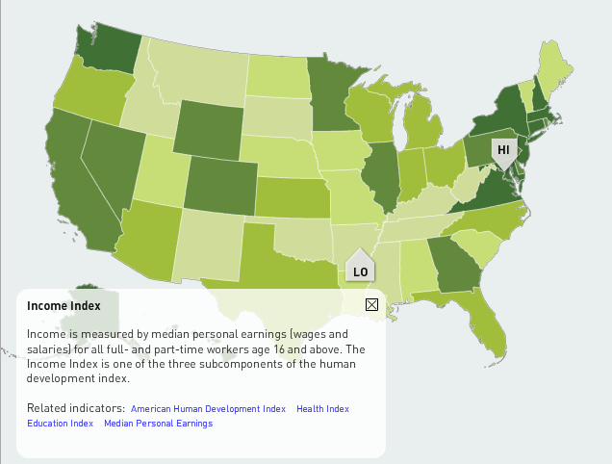
Color
1D as single hue shading
Name for this is?

Slide 56
Color
1D as single hue shading
Name for this is?
Chloropeth

Slide 57
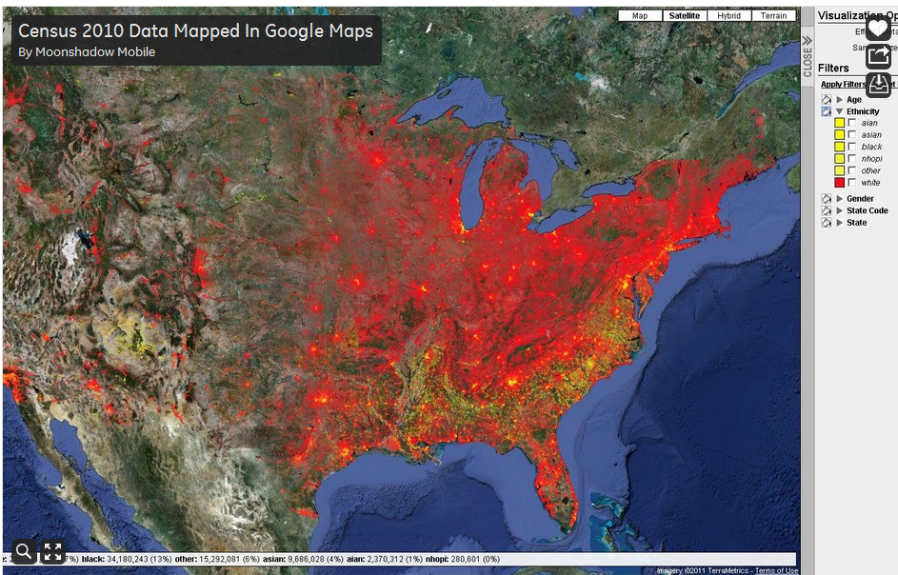
Overlapping use of color
What are problems with this map?

Slide 58
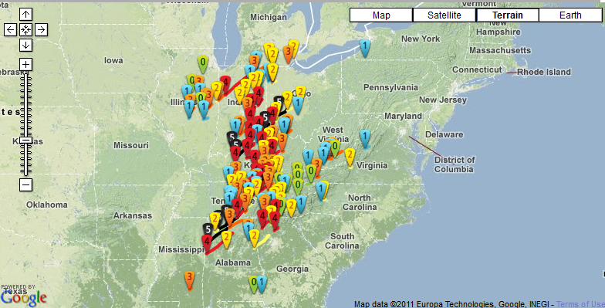
Symbols for 1D: what’s good/bad how can you do this better?

Slide 59
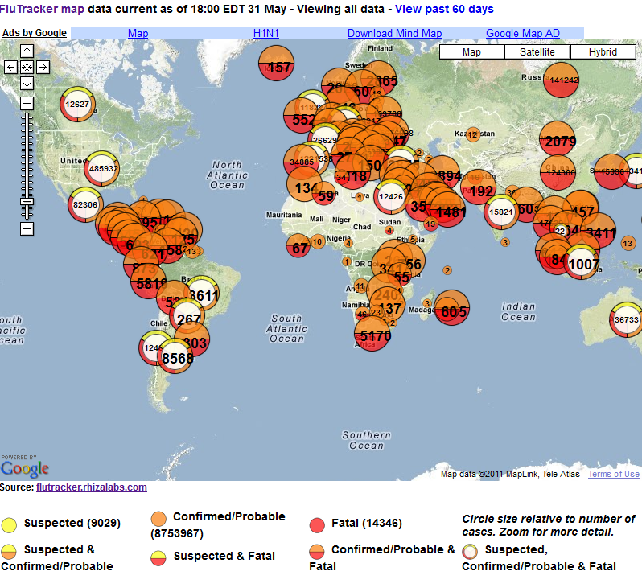
FluTracker
Size of circles
Color/style
Is overview too dense?

Slide 60
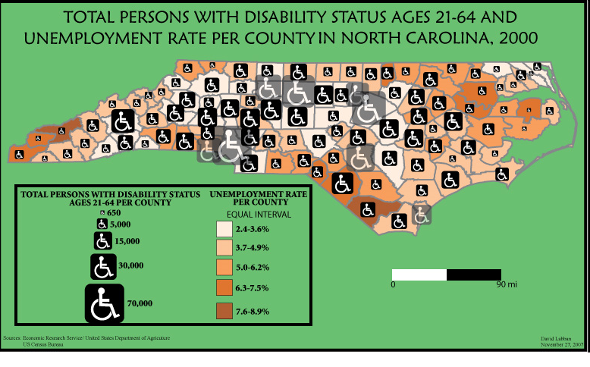
Symbols/Icons (plus color)

Slide 61
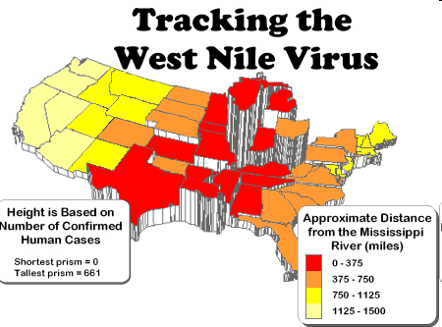
Height plus color

Slide 62
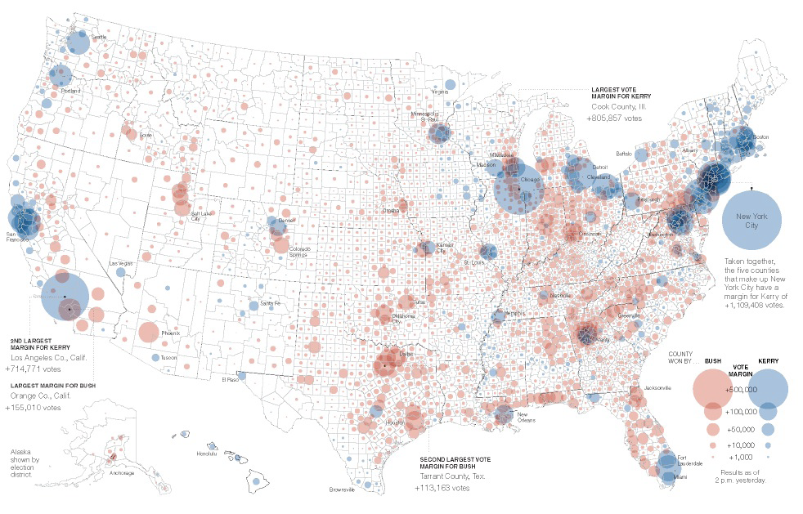
Bubbles
M. Ericson, NY Times

Slide 63
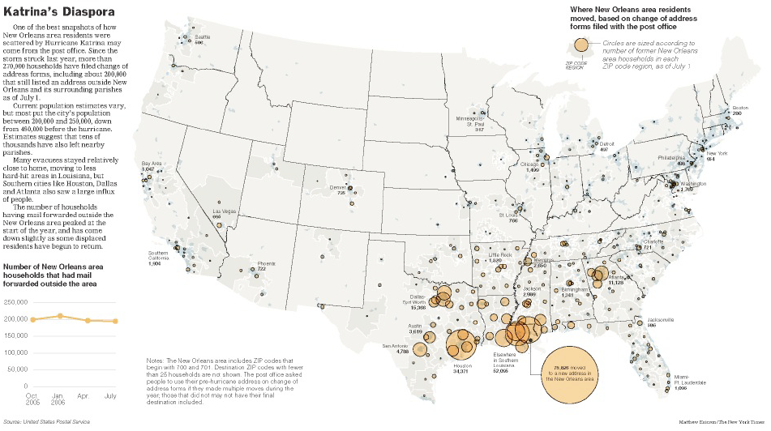
M. Ericson, NY Times

Slide 64
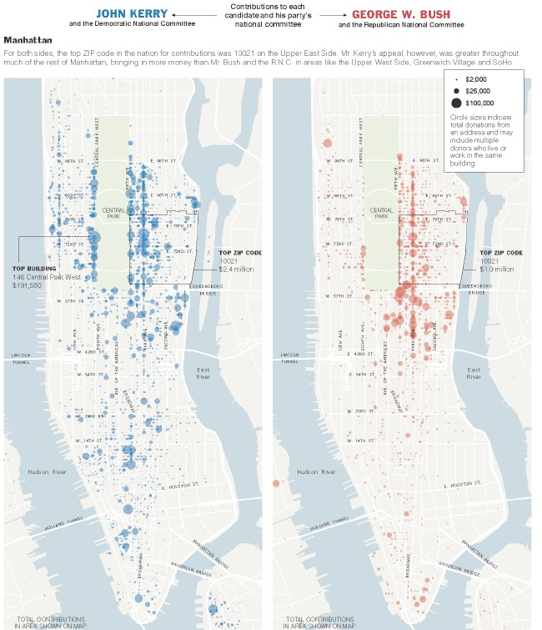
M. Ericson, NY Times

Slide 65
When not to use Maps?
Profile: Matthew Ericson NY Times
Homepage www.ericson.net
  Produced many great visualizations for the NY Times.
  Write about his visualizations AND about how he does them.
When Maps Shouldn’t be Maps

Slide 66
Flow Maps
“Patterns over time”
What if we could track objects over time? And could visualize their paths? What would be the best ways to do this?
  Show all the individual routes?
  Show summaries?

Slide 67
PS… we can track…(everything)
Traces of activity from GPS
http://geotracing.com/
http://realtime.waag.org/ (Amsterdam RealTime)
Social Networks (summary 2012)

Slide 68
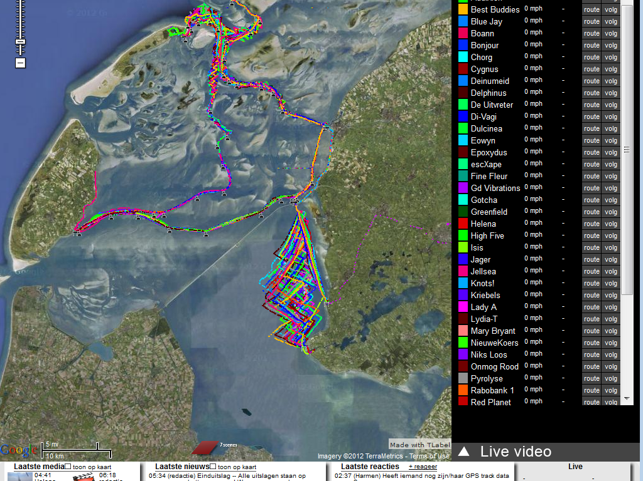
GeoTrace (2008) sailor’s paths

Slide 69
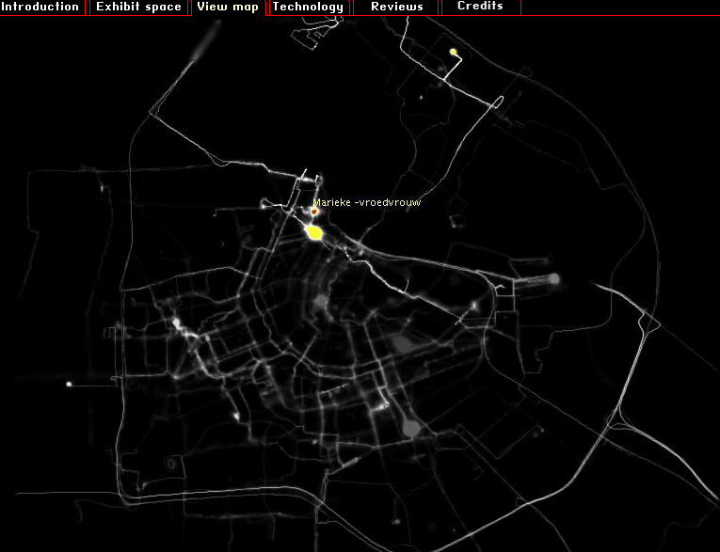
People’s Paths (Amsterdam realtime)

Slide 70
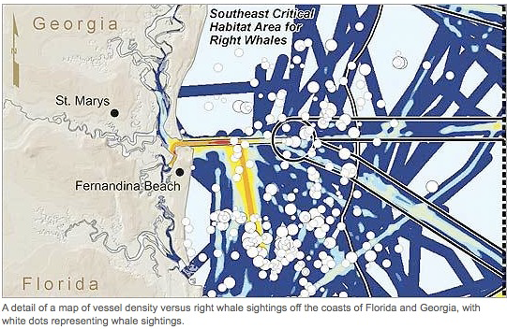

Slide 71
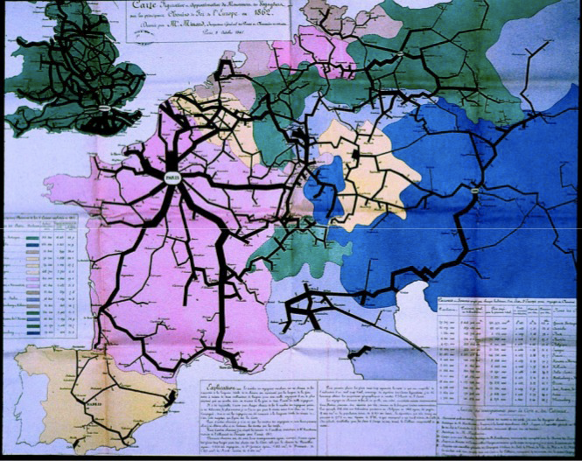
Passengers on Principal
Railroads, 1862
Milestones Project: Data Visualization Gallery

Slide 72
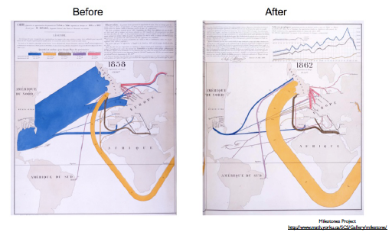
Effect of US Civil War on
Cotton Trade

Slide 73
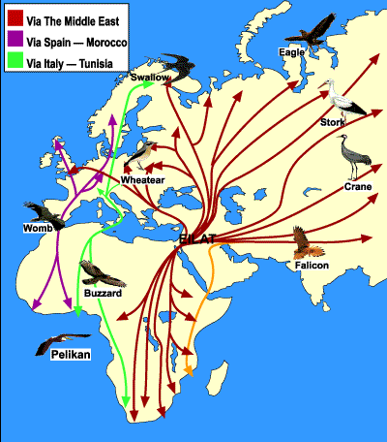
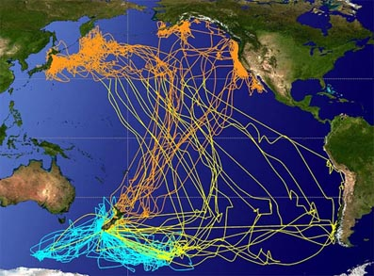
Bird Migrations (see eBird project)

Slide 74
Imagine if we know your every move…
What would your day look like?
Could we better plan cities, transit, work schedules, etc?

Slide 75
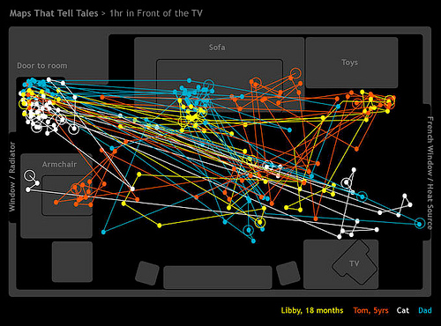
One hour in front of the TV
Like the “traces” showing paths. Eyetracking research is shown this way, and movements of tracked animals, etc.
Map by The Bumblebee
http://www.flickr.com/photos/the_bumblebee/2229041742

Slide 76
Route Maps

Slide 77
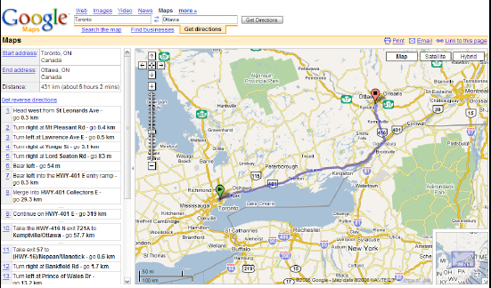
EXACT geography;
landmarks scale dependent

Slide 78
Pros and Cons of exact maps (matching reality in scale and/or appearance) versus abstracted maps (that adjust to emphasize things more meaningful to user).
How do people give directions?
How should computers give directions?
Notes:
Computers:
Precise
Incorporate visual landmarks
Know exactly where you are
Can take advantage of your prior behavior knowledge (go past your CVS store, then turn right)

Slide 79
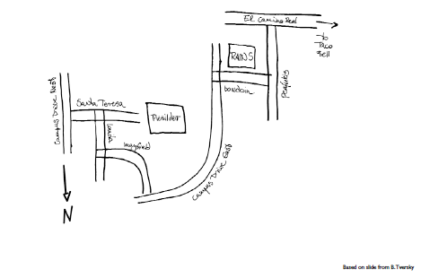
Landmarks & Paths

Slide 80
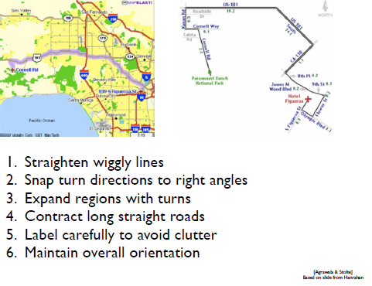

Slide 81
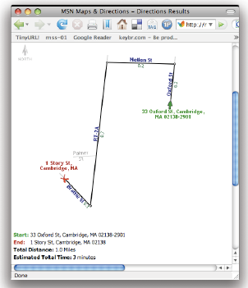

Slide 82
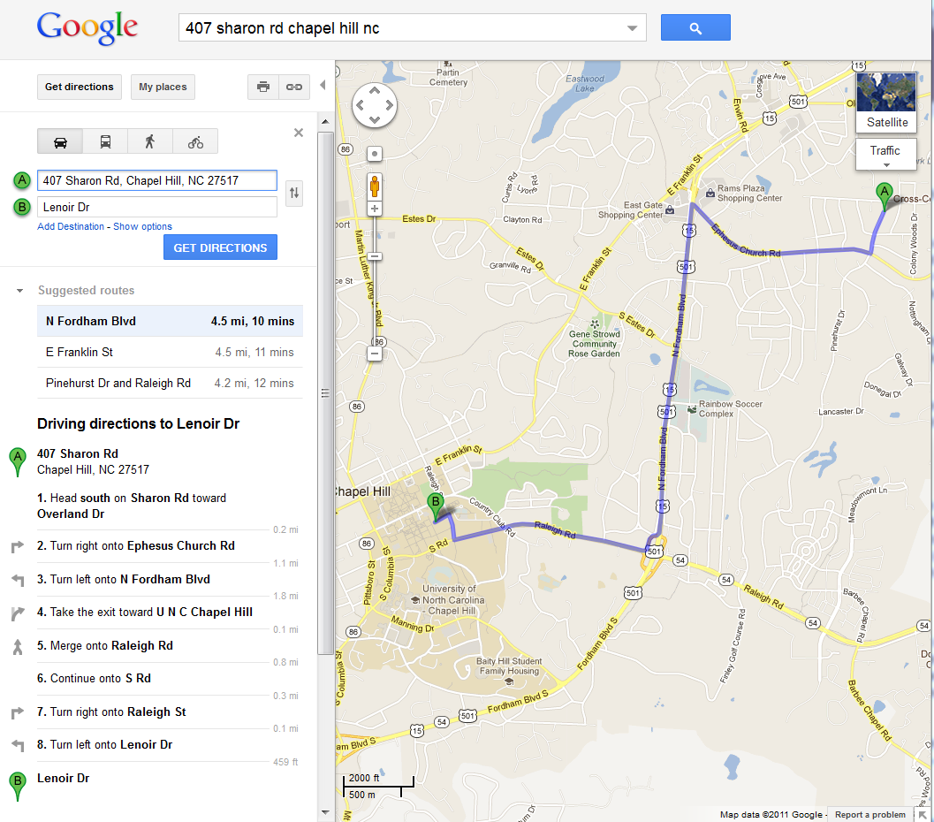
GoogleMaps
(circa 2011)
With this map dynamically scalable, what else do you need (hint: CUT).
Brainstorm: what the best interface!

Slide 83
Real-Time Maps

Slide 84
Traffic Maps
LA DOT
Navtec
SigAlert
Which do you prefer?

Slide 85
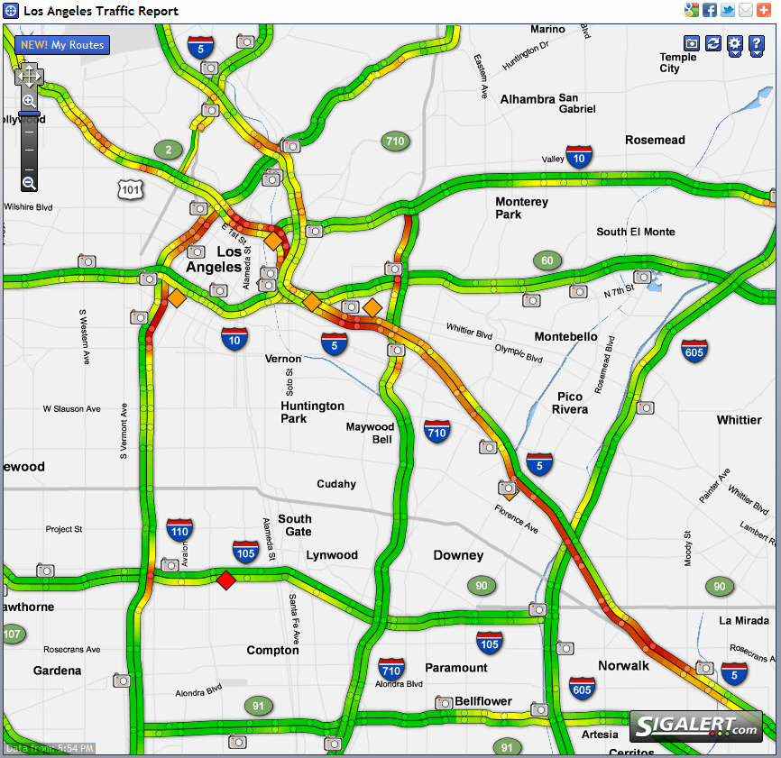
Traffic
Maps

Slide 86
Thematic Maps
Themes, points of view, stories to tell
Often times, these may be combinations (using same chloropeth or symbol based 1D or 2D maps we looked at earlier)

Slide 87
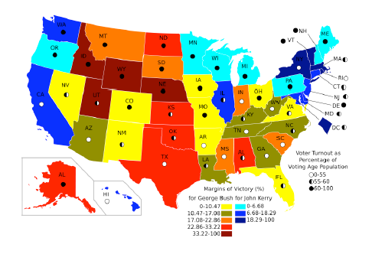
wikpedia.org

Slide 88

Measure of America
Linkage between 2D map and 1D scale (index) plus search (zipcode)

Slide 89

Note control of transparency, multiple variables

Slide 90

Multiple presentation areas; multiple story lines, but all connected
M. Erickson, NYTimes

Slide 91


Slide 92


Slide 93

Engage user interest with pictures of homes

Slide 94

Shows population density (like we talked about for storm surge visualizations)

Slide 95

Show path via “traces” like we did with Google Motion Charts
http://www.msnbc.msn.com/id/26295161?preferredName=Gustav

Slide 96

Describe the visualization type and date types

Slide 97

How has this changed since 2007 ☺?
http://xkcd.com/256/

Slide 98
Virtual Worlds (3D Maps)
Virtual Realities in Games
Virtual Worlds (2nd Life)
Visualization of our 3D world in new ways (need reference to artist/scientist working on this, well known)

Slide 99



Slide 100


Slide 101
End of Slides

Slide 103
Possible Exercises

Slide 104
Design the next generation maps
mMaps (mobile maps on smartphone)
  Driving
  walking
Virtual reality overlay glasses
  Driving
  Walking
What about for sight limited?
  Walking directions?

Slide 105
Route and Path Maps
First, let’s have a little fun
“Directions to my house” exercise
  Spoken/written
  Written with hand-sketches
  Map
  Interactive, dynamic, shared map

Slide 106

Real-Time Train Map
http://www.swisstrains.ch/

