Slide 1
Interaction

Slide 2
Interaction
Interactivity is what distinguishes Information Visualization from fixed (static) visualizations of the past.
Analysis is a process, often iterative, with branches and sideways paths. It is very different from fixed message. It is not controlled or pre-planned.

Slide 3
Main Purposes of Interaction
Tell storyline (usually over time)
Time-based playback
Sequence of actions based playback
Allow user to explore data (visual analytics)
Zoom in on details
Create different views into data
Change/Filter values
Show connections between data (including to other datasets)

Slide 4
Telling a Story over Time
Spread of Walmart (FlowingData)
Hans Rohsling Gapminder
200 countries, 200 years, 4 mins
Washing Machine
Google Motion Chart scatterplots over time (howto instructions)
Hemminger Personal Health Record (phr2)

Slide 5
User Control for Storylines
Fixed presentations: no user control, just plays something over time (video)
User controlled presentation. As much as possible allow them full control play.
Time based (think VCR controls, forward, backward, fast forward, fast reverse, pause, stop)
Abstract (semantic) based controls. Change by semantically meaningful events

Slide 6
Visual Analytics
Zoom in on Details
Create different views into data
Change/Filter values
Show connections between data (including to other datasets)

Slide 7
Zoom in on Data
Fixed Navigations
Overview + Details
Focus + Context
Distortion based techniques (fisheye)
Interactive (scaleable) Zoom Navigations
2D Large Image Navigation
Large collections (photos, etc)
3D navigation (virtual reality, video games, 2nd Life)

Slide 8
Overview + Details
Separate views
No distortion
Shows both overview and details simultaneously
Drawback: requires the viewer to consciously shift there focus of attention.

Slide 9
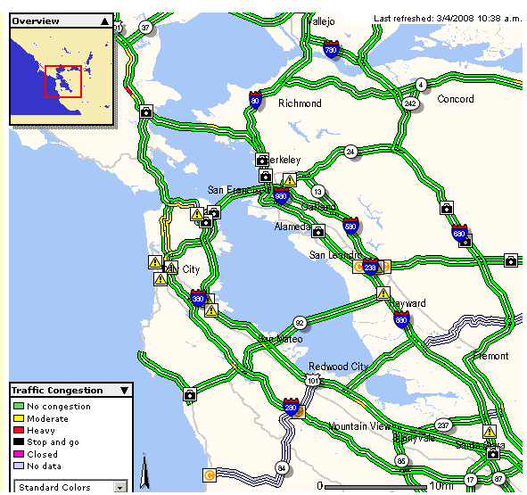
Example: traffic.511.org

Slide 10
Focus + Context
A single view shows information in context
Contextual info is near to focal point
Distortion may make some parts hard to interpret
Distortion may obscure structure in data
Examples:
TableLens
Perspective Wall
Hyperbolic Tree Browser

Slide 11
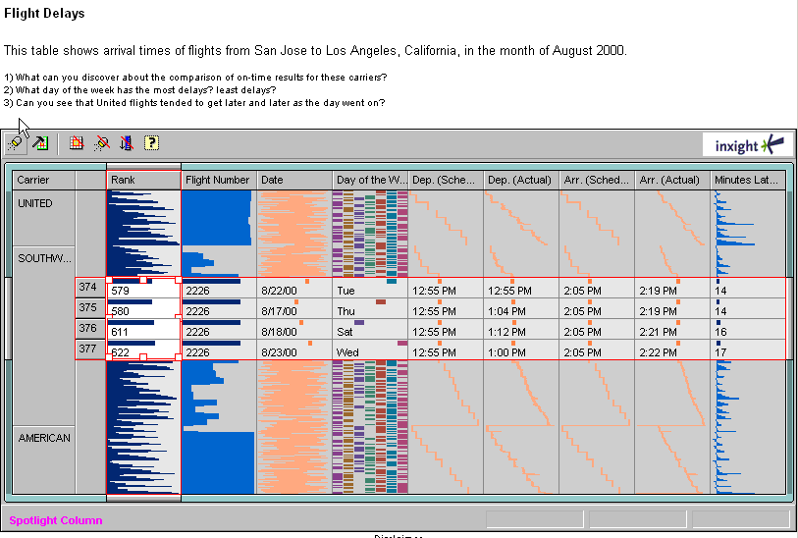
Focus + Context: TableLens from PARC/Inxight
Suggest other ways to visualization departure/arrivals, and contrast with the above visualization.
http://www.inxight.com/products/sdks/tl/
http://www.inxight.com/demos/tl_calcrisis/tl_calcrisis.html

Slide 12
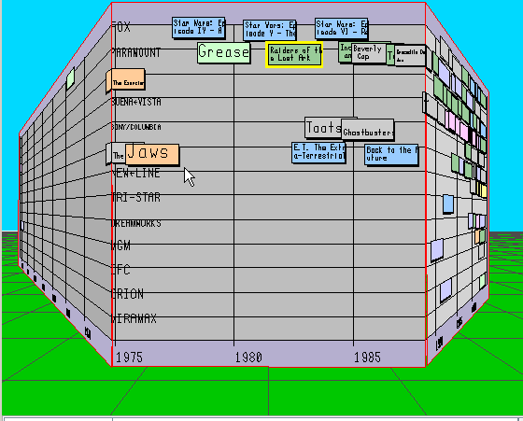
Focus + Context (+ Distortion): Perspective Wall from PARC/Inxight
http://www.inxight.com/demos/timewall_demos

Slide 13
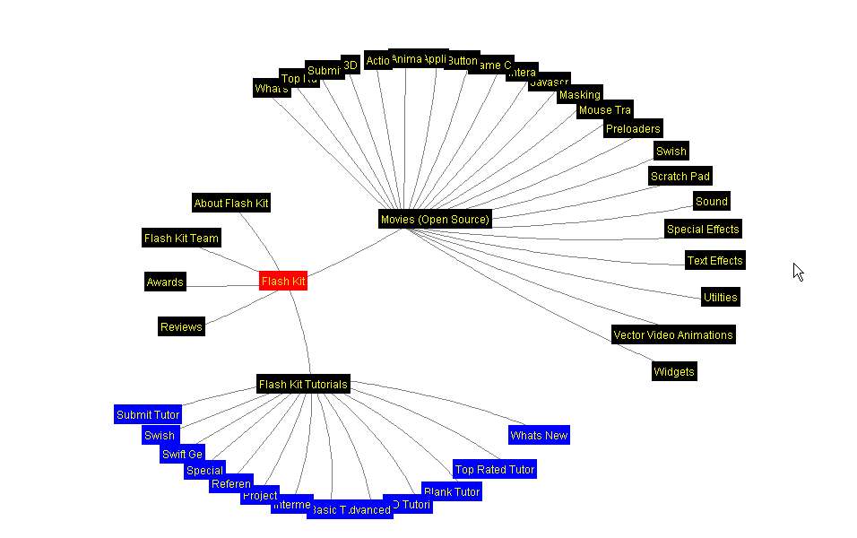
Focus + Context: Hyperbolic Tree from PARC/Inxight
https://philogb.github.io/jit/static/v20/Jit/Examples/Hypertree/example1.html
https://ocsigen.org/js_of_ocaml/2.6/files/hyperbolic/index.html

Slide 14
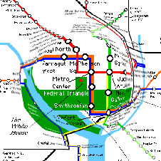
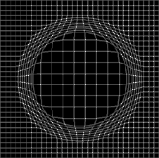
Distortion Based Techniques
ZUIs Bederson, Fisheye views.
FisheyeClassic paper: Furnas, G. W., Generalized fisheye views. Human Factors in Computing Systems CHI '86 Conference Proceedings, Boston, April 13-17, 1986, 16-23.

Slide 15
Interactive Zoom Navigations
Standard (geometric) Zooming
Get close in to see information in more detail
Example: Google earth zooming in
Intelligent Zooming
Show semantically relevant information out of proportion
Smart speed up and slow down
Example: speed-dependent zooming, Igarishi & Hinkley
Semantic Zooming
Zooming can be conceptual as opposed to simply reducing pixels
Example tool: Pad++ and Piccolo projects
http://hcil.cs.umd.edu/video/1998/1998_pad.mpg

Slide 16
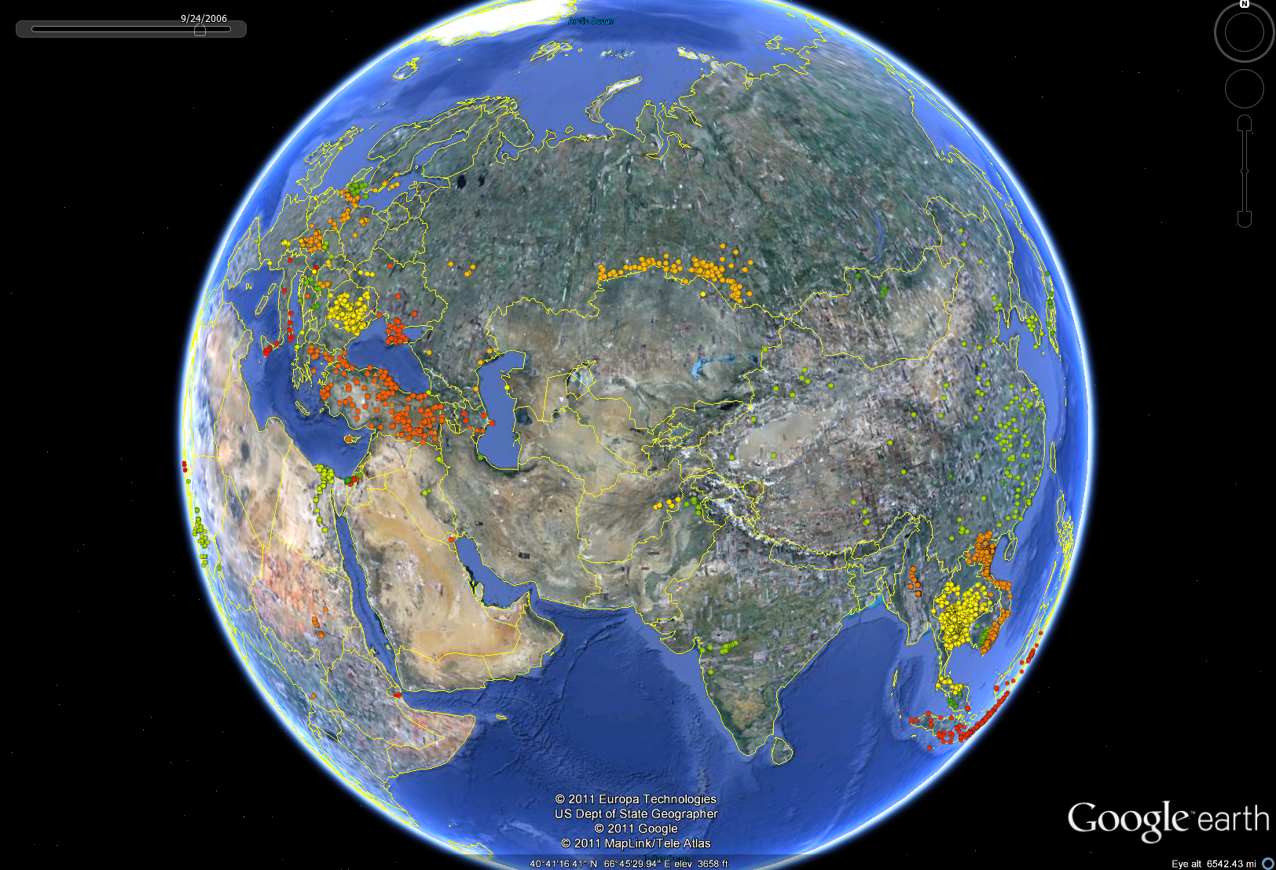
H5N1 Virus Spread

Slide 17
Standard (Geometric Zooming)
Hemminger PanZoom interface
Pad++ (zoomable with multiple linked viewpoints); 1985 video still current
Google Maps (PanZoom interface for satellite view)
H5N1 virus spread (bring up KML file in Google Earth)
Most effective for large 2D photographs or images (sometimes maps) where you want information to scale uniformly and be able to see at fine level of detail as well as overview.

Slide 18
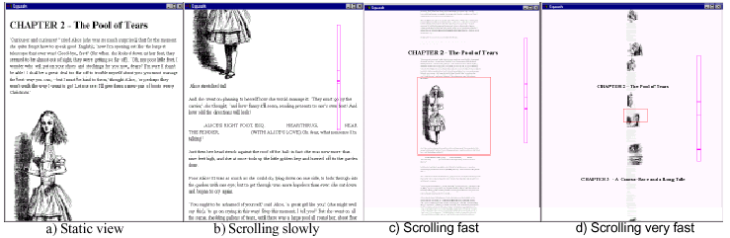
Intelligent Zooming: Speed-dependent Zooming by Igarashi & Hinkley 2000
http://www-ui.is.s.u-tokyo.ac.jp/~takeo/video/autozoom.mov
http://www-ui.is.s.u-tokyo.ac.jp/~takeo/java/autozoom/autozoom.htm

Slide 19
Standard vs. Semantic Zooming
Geometric (standard) zooming:
The view depends on the physical properties of what is being viewed
Semantic Zooming:
When zooming away, instead of seeing a scaled-down version of an object, see a different representation
The representation shown depends on the meaning to be imparted.

Slide 20
When to use Semantic Zoom
More effective when there are different types of objects and you want to be able to maintain them on display despite changing zoom levels. More effective for maps with different levels of symbols, information, or collections of materials.

Slide 21
Semantic Zoom examples
Piccolo (newer version of Pad++) which supports zooming, animation and multiple representations and uses a scene graph hierarchal structure of objects and cameras, allowing the application developer to orient, group and manipulate objects in meaningful ways. (successor to Pad++)
Typical map visualizations (Google Maps/Earth)
Video editing (AC Long paper)

Slide 22
3D Navigation
3D Navigation can build on our real life experiences of moving through world, but also incorporate virtual reality abilities (flying, transportation, multiple viewpoints).
There are also different models of 3D navigation (flying, driving, walking, think 2ndLife, video games)
World in hand
Eyeball in hand

Slide 23
Visual Analytics
Zoom in on Details
Create different views into data
Change/Filter values
Show connections between data (including to other datasets)

Slide 24
Visual Analytics: Multiple Views on Data
TablesLens
Piccolo
Tableau
Spotfire

Slide 25
Visual Analytics
Zoom in on Details
Create different views into data
Change/Filter values
Show connections between data (including to other datasets)

Slide 26
Visual Analytics: Change/Filter Values
Tableau
Spotfire
Piccolo
Baby Name Voyager

Slide 27
Visual Analytics
Zoom in on Details
Create different views into data
Change/Filter values
Show connections between data (including to other datasets)

Slide 28
Visual Analytics: Linking and Connecting Data
TableLens
DateLens (Bederson, Calendar Viewer application).
Tableau

Slide 29
Guidelines

Slide 30
Brad’s Mantra on Interaction
Visualization = static story + interactive exploration
Initial fixed “message” presentation as static story, is selectable (mouse click)
To allow user controlled interactive exploration of original data. Using not just suggested tools, but visualization techniques of the user’s choice. (think standard toolset, like we have for carpenter, or in computer graphics)

Slide 31
Brad’s rule of thumb for Acceptable Response Times
Interactions should be direct manipulations, like we are interacting with the real world around us. Anything less is unsatisfactory.
This means all your interactions should occur in less than 1/10th of a second to give the human the perception of a realtime response. This applies to all interactions, including
Animation, visual continuity, sliders, controls, rendering 2D/3D, etc.

Slide 32
Shneiderman’s Taxonomy of Information Visualization Tasks
Overview: see overall patterns, trends
Zoom: see a smaller subset of the data
Filter: see a subset based on values, etc.
Details on demand: see values of objects when interactively selected
Relate: see relationships, compare values
History: keep track of actions and insights
Extracts: mark and capture data

Slide 33
Shneiderman’s Visualization Mantra
Overview, zoom & filter, details on demand
Overview, zoom & filter, details on demand
Overview, zoom & filter, details on demand
Overview, zoom & filter, details on demand
Overview, zoom & filter, details on demand
Overview, zoom & filter, details on demand
Overview, zoom & filter, details on demand
Overview, zoom & filter, details on demand

Slide 34
The affordance concept
Term coined by JJ Gibson (direct realist)
Properties of the world perceived in terms of potential for action (physical model, direct perception)
Philosophical problem with the generalization of the term to user interfaces
Nevertheless, important and influential

Slide 35
Interactive Visualization + HCI
Interactive visualization by definition connects us to discussions of human computer interaction (HCI), and thinking about good/bad interaction techniques and design. We will not cover this in detail (other good courses at SILS do!), but we will mention some interaction techniques common in interactive visualizations.

Slide 36
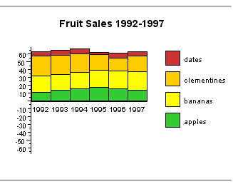
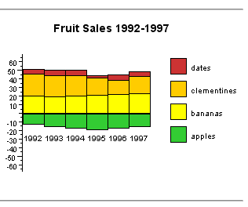
Example: Interactive Stacked Histogram
Even a simple interaction can be quite powerful
http://www.meandeviation.com/dancing-histograms/hist.html

Slide 37
Basic Interaction Techniques
Selection
Mouse over / hover / tooltip
Select Object, Region or Collection
Change Value/Membership
Change value via slider bar, form field, dragging pointer, moving object, etc.
Move object
Delete object

Slide 38
Basic Interaction Techniques
Layout
Reorient
Reorganize, reorder set
Synchronize multiple elements
Open/close portals onto data
Motion through time and space
2D motion techniques
3D motion techniques
Abstract path motions

Slide 39
Advanced Interaction Techniques
Brushing and Linking
2D navigation
Overview + Detail
Focus + Context
Distortion-based Views
Panning and Zooming
3D navigation

Slide 40
A tight loop is needed between user and data Rapid interaction methods
Brushing. All representations of the same object are highlighted simultaneously. Rapid selection.
Dynamic Queries. Select a range in a multi-dimensional data space using multiple sliders (Film finder: Shneiderman)
Interactive range queries: Munzner, Ware
Magic Lenses: Transforms/reveals data in a spatial area of the display
Drilling down – click to reveal more about some aspect of the data

Slide 41
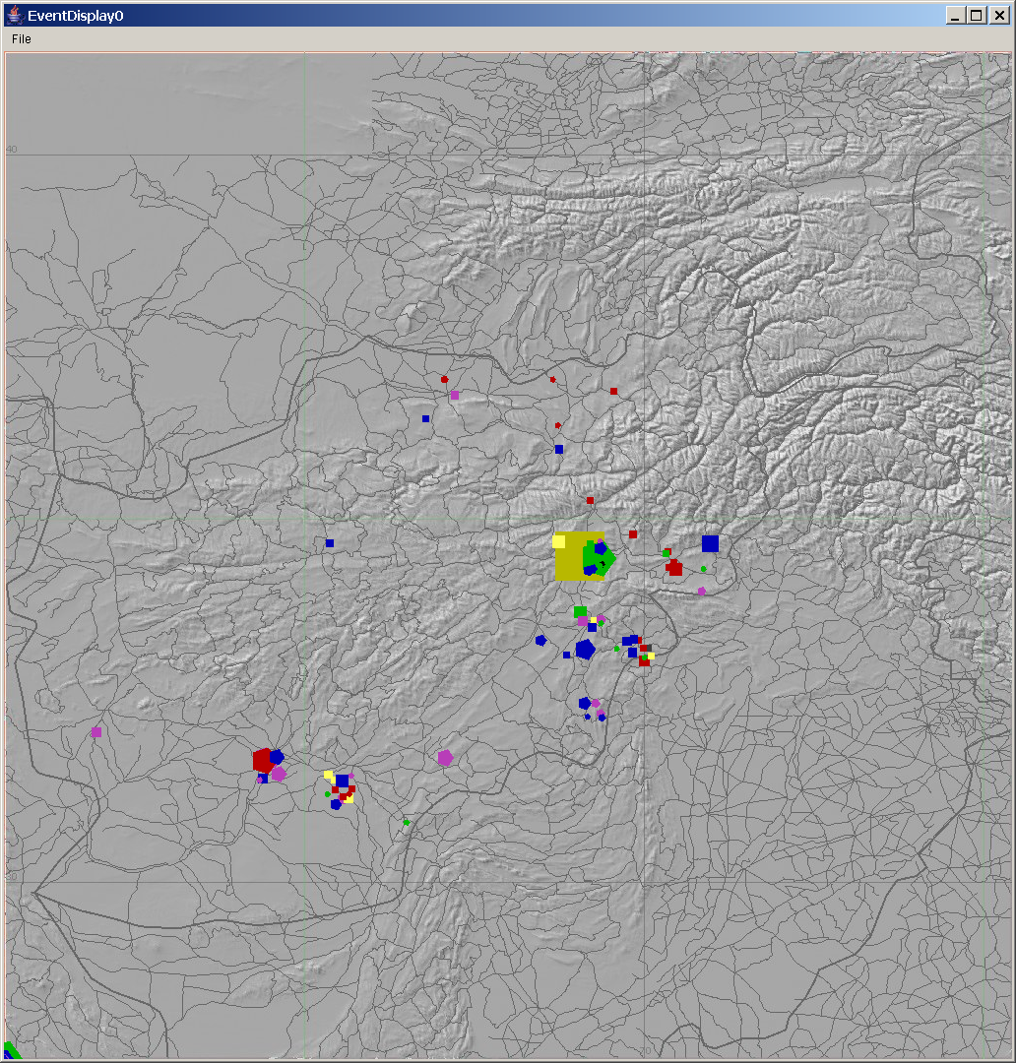
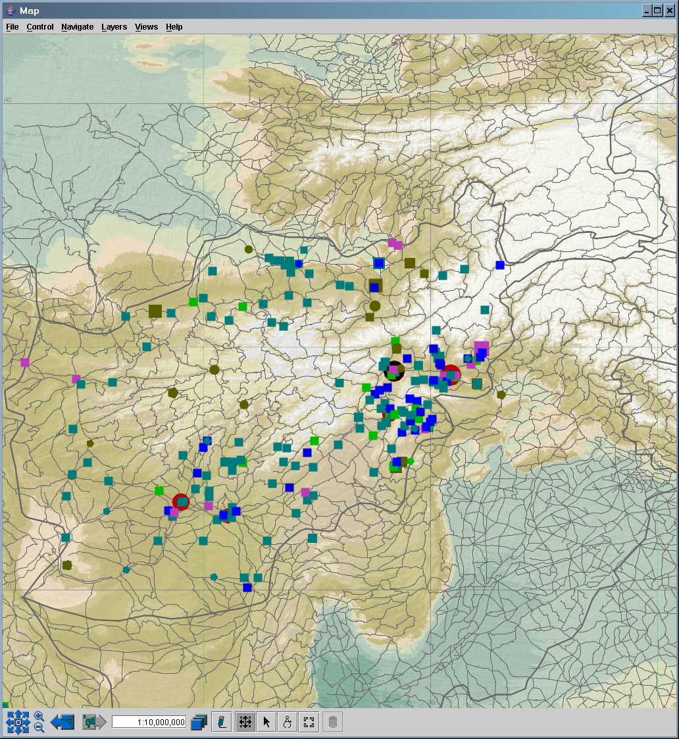
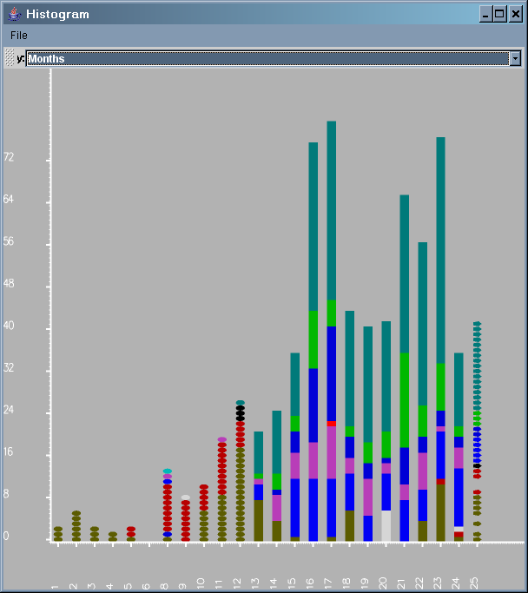
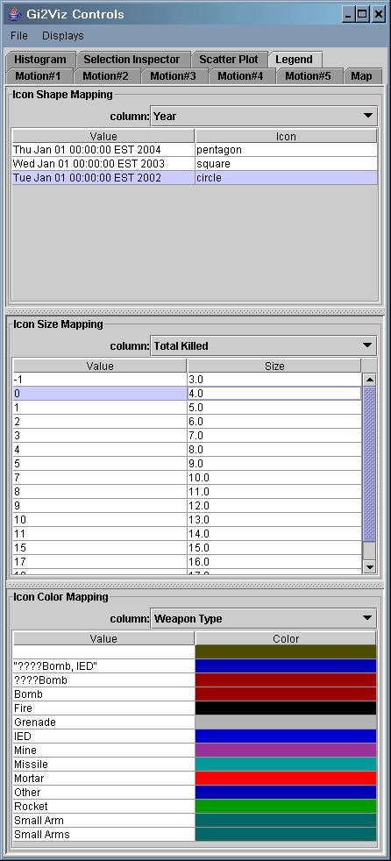
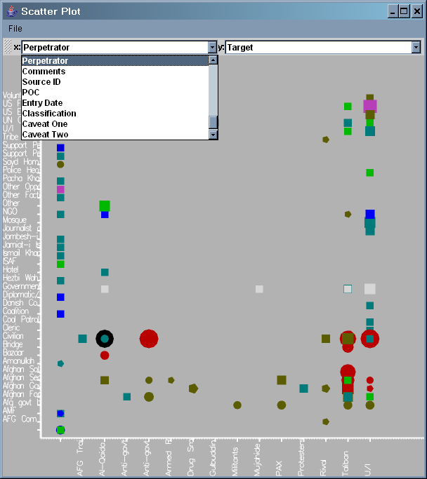
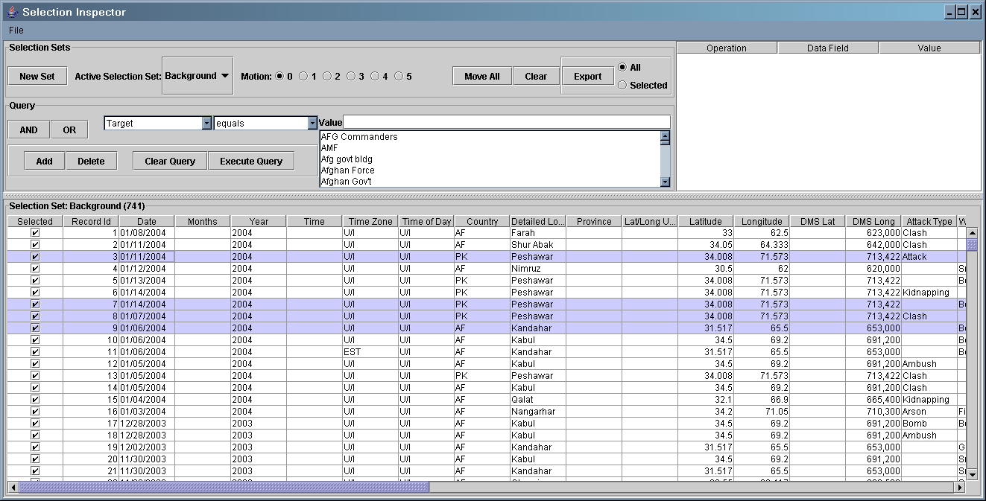
Event Brushing - Linked Kinetic Displays
Event distribution in space
Active Timeline Histogram
Security Events in Afghanistan
Highlighted events move in all displays
Scatterplot - victim vs. city
Motion helps analysts see relations of patterns in time and space

Slide 42
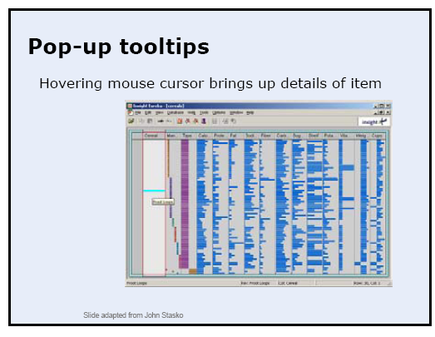
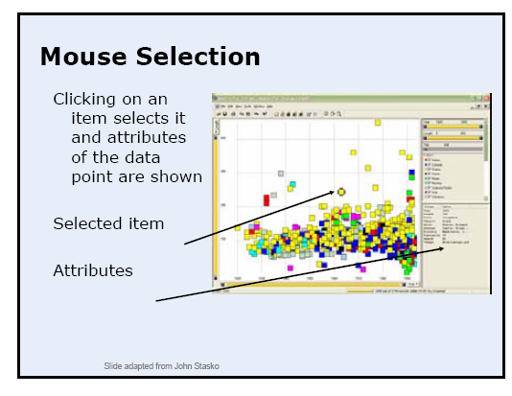
Selecting

Slide 43
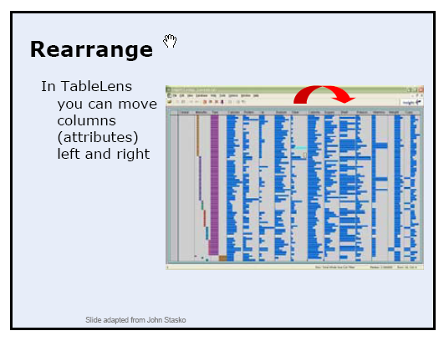
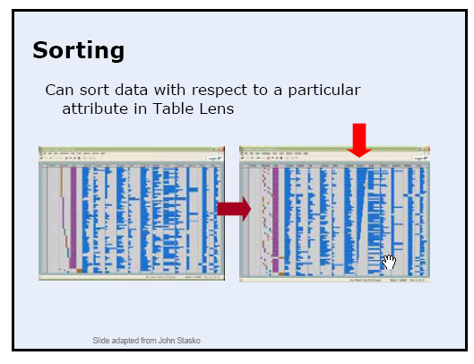
Selecting

Slide 44
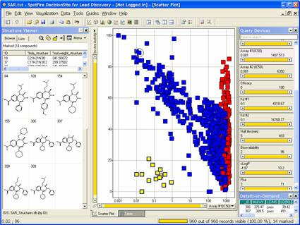
Highlighting / Brushing and Linking / Dynamic Queries
Spotfire, by Ahlberg & Shneiderman
http://hcil.cs.umd.edu/video/1994/1994_visualinfo.mpg
Now a very sophisticated product:
http://spotfire.tibco.com/products/gallery.cfm

Slide 45
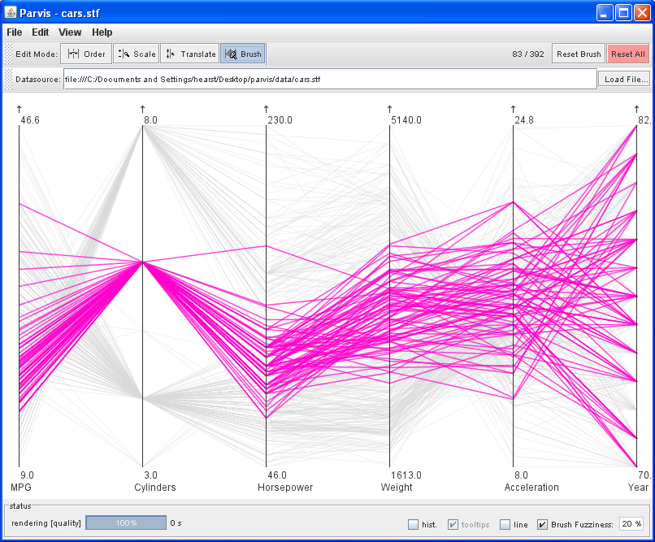
Highlighting and Brushing: Parallel Coordinates by Inselberg
Free implementation: Parvis by Ledermen
http://www.mediavirus.org/parvis/

