Slide 1
Network & Tree Graphs

Slide 2
Examples for in class
Visual Web
  Touchgraph
    Amazon>Movies “Redford”, “Streep”
    Try one…
  Viszter

Slide 3
Graphs, Networks, Trees
The two terms "graph" and "network" are both used in several different ways. Following Dave Winer, the term "graph" is used to refer to (amongst other things):
  a visual representation of the variation of one variable in comparison with that of one or more other variables
  a mathematical concept of a set of nodes connected by links called edges
  a data structure based on that mathematical concept
The term "network" is also used in several ways, including:
  an interconnected system of things (inanimate objects or people)
  a specialized type of graph (the mathematical concept)
Trees are subsets of graphs/networks.

Slide 4

Trees are Limited Version of Graphs
Subcase of general graph
No cycles
Typically directed edges
Special designated root vertex

Slide 5
Tree Hierarchies in the World
Pervasive
  Family histories, ancestries
  File/directory systems on computers
  Organization charts
  Animal kingdom: Phylum,…, genus,…
  Object-oriented software classes
  ...

Slide 6
Trees
Hierarchies often represented as trees
  Directed, acyclic graph
Two main representation schemes
  Node-link
  Space-filling

Slide 7
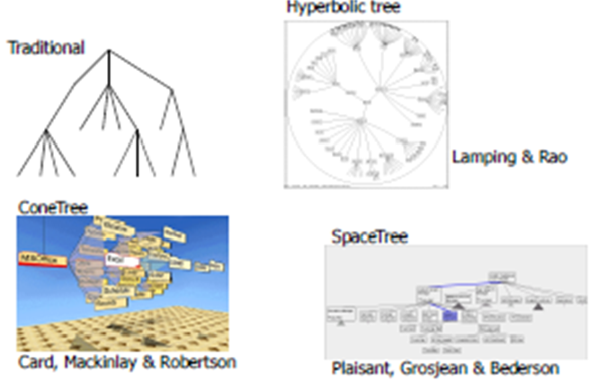
Node-Link Representations

Slide 8
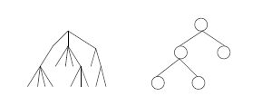
Node-Link Diagrams
Root at top, leaves at bottom is very common

Slide 9
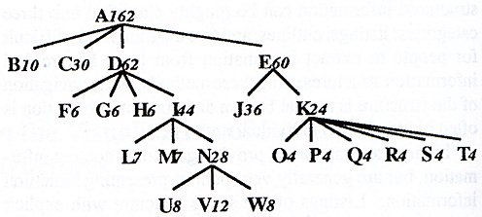
Sample Representation
From: Johnson & Shneiderman, ‘91

Slide 10
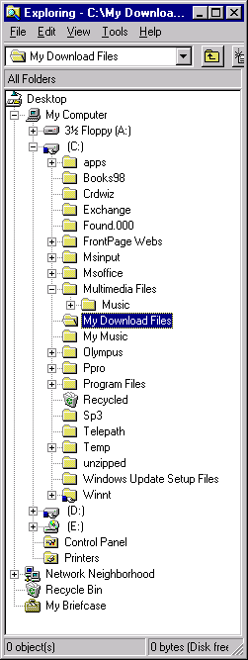
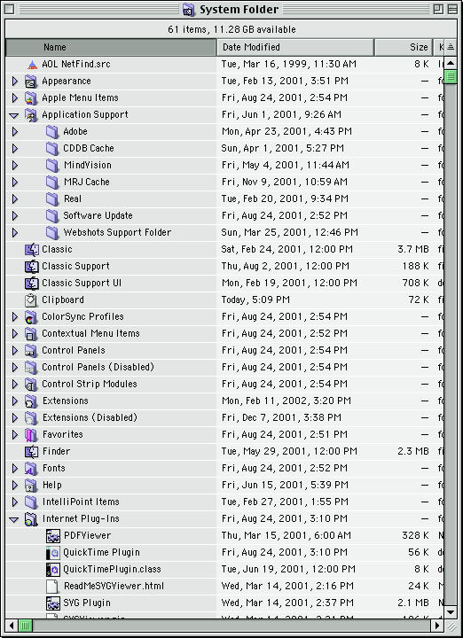
Examples
Good for
  Search
Bad for
  Understanding
  Structure

Slide 11
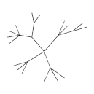
Why Put Root at Top?
Root can be at center with levels growing outward too
Can any node be the root?

Slide 12
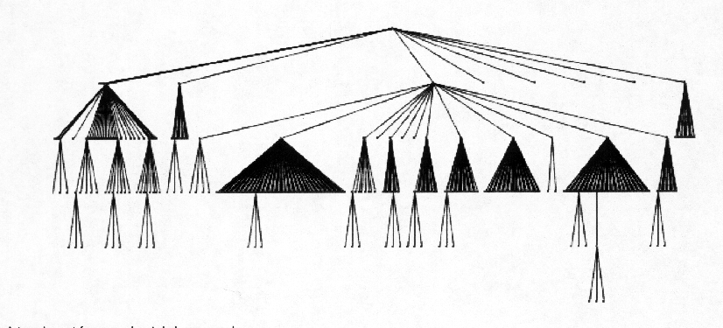
Drawing a Tree
How does one draw this?
  DFS
  Percolate requirements upward

Slide 13
Potential Problems
For top-down, width of fan-out uses up horizontal real estate very quickly
  At level n, there are 2n nodes
Tree might grow a lot along one particular branch
  Hard to draw it well in view without knowing how it will branch

Slide 14
InfoVis Solutions
Techniques developed in Information Visualization largely try to assist the problems identified in the last slide
Alternatively, Information Visualization techniques attempt to
  show more attributes of data cases in hierarchy
  or focus on particular applications of trees

Slide 15
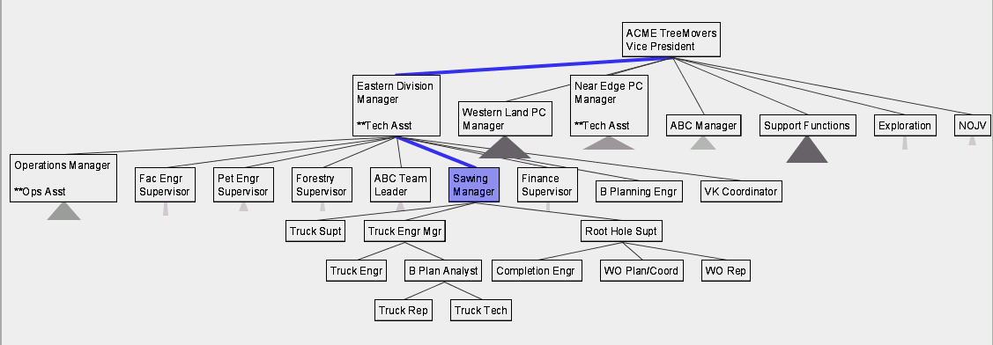
SpaceTree
Uses conventional 2D layout techniques with some clever additions
Grosjean, Plaisant, Bederson
InfoVis ‘02

Slide 16
Characteristics
Vertical or horizontal
Subtrees are triangles
  Size indicates depth
  Shading indicates number of nodes inside
Navigate by clicking on nodes
  Strongly restrict zooming

Slide 17
Design Features
Make labels readable
Maximize number of levels opened
Decompose tree animation
Use landmarks
Use overview and dynamic filtering

Slide 18
3D Approaches
Add a third dimension into which layout can go
Compromise of top-down and centered techniques mentioned earlier
Children of a node are laid out in a cylinder “below” the parent
  Siblings live in one of the 2D planes

Slide 19
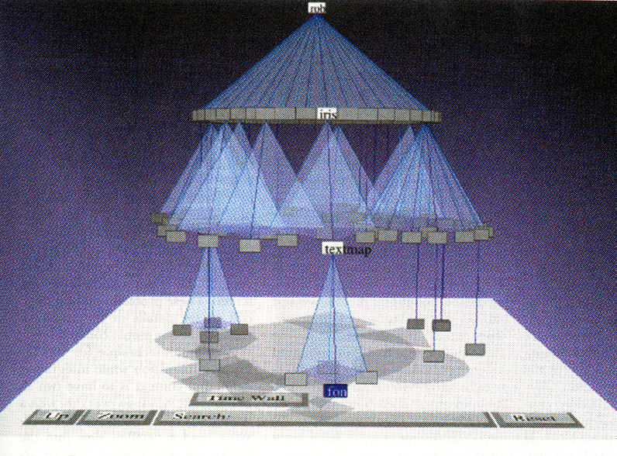
Cone Trees
Developed at Xerox PARC
3D views of hierarchies such as file systems
Robertson, Mackinlay, Card
CHI ‘91

Slide 20
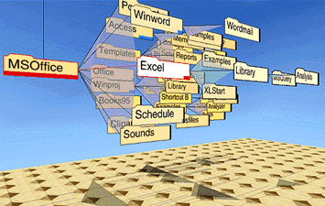
Alternate Views

Slide 21
Cone Trees
Positive
Negative
More space available to lay out tree
Aesthetically pleasing (?)
As in all 3D, occlusion obscures some nodes
Is it really more efficient? For what tasks/users/contexts?

Slide 22
Hyperbolic Browser
Example: BlogWorld (YouTube video)
Focus + Context Technique
  Detailed view blended with a global view
First lay out the hierarchy on the hyperbolic plane
Then map this plane to a disk
Start with the tree’s root at the center
Use animation to navigate along this representation of the plane
Lamping and Rao,
JVLC ‘96

Slide 23
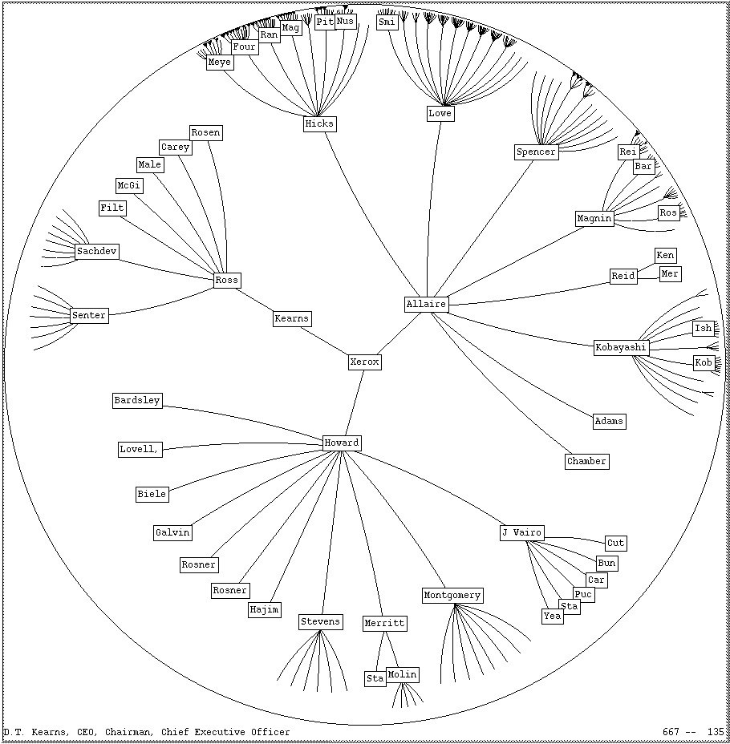
2D Hyperbolic Browser
Approach: Lay out the hierarchy on the hyperbolic plane and map this plane onto a display region.
Comparison
  A standard 2D browser
    100 nodes (w/3 character text strings)
  Hyperbolic browser
    1000 nodes, about 50 nearest the focus can show from 3 to dozens of characters

Slide 24
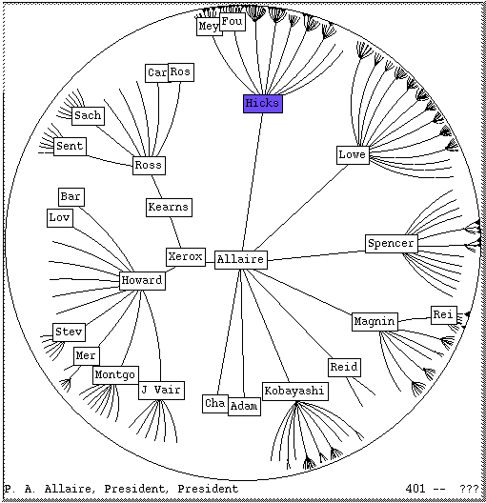
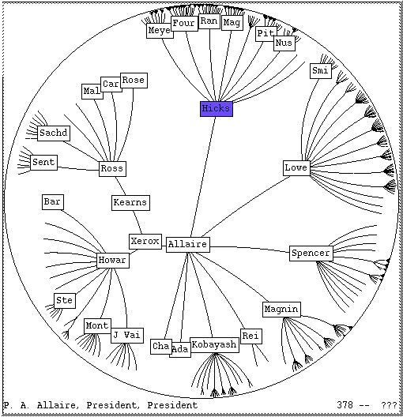
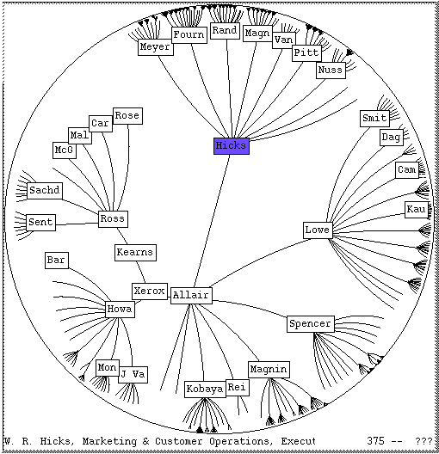
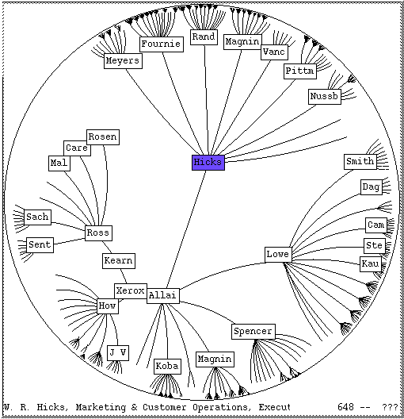
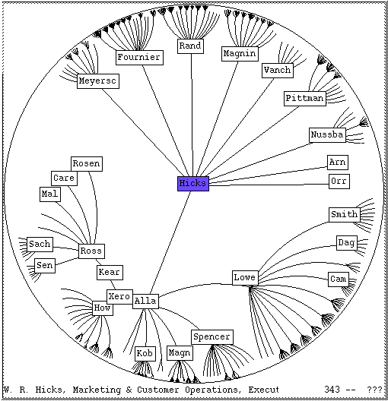
Clicking on the blue
node brings it into
focus at the center

Slide 25
Key Attributes
Natural magnification (fisheye) in center
Layout depends only on 2-3 generations from current node
Smooth animation for change in focus
Don’t draw objects when far enough from root (simplify rendering)

Slide 26
Problems
Orientation
  Watching the view can be disorienting
  When a node is moved, its children don’t keep their relative orientation to it as in Euclidean plane, they rotate
  Not as symmetric and regular as Euclidean techniques, two important attributes in aesthetics

Slide 27
Performance
Handle much larger graphs, i.e. >100,000 edges
Support dynamic exploration & interactive browsing
Maintain a guaranteed frame rate
Example code base (javascript): Hypetree.js

Slide 28
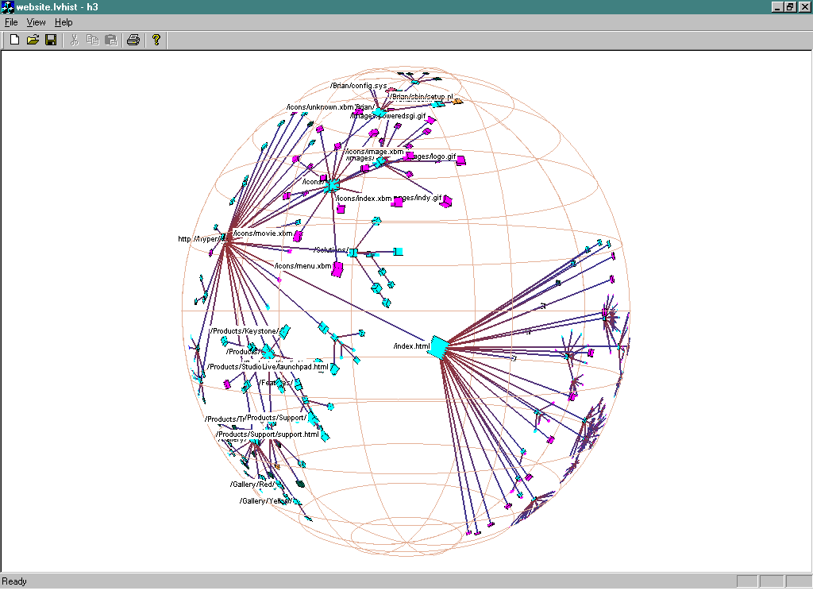
How about 3D?
Can same hyperbolic transformation be applied, but now use 3D space?
Munzner,
IEEE CG&A ‘98

Slide 29
Old School
After all the interest in 3D and hyperbolic techniques in the ’90’s, recently, there has been renewed interest in the old 2D methods (just done better)
  SpaceTree presented earlier
  Next 3 papers…

Slide 30
Degree-of-Interest Trees
Problem
  Trees quickly degrade into line (example below)
Approach
  Use fisheye-like focus & context ideas to control how a tree is drawn

Slide 31
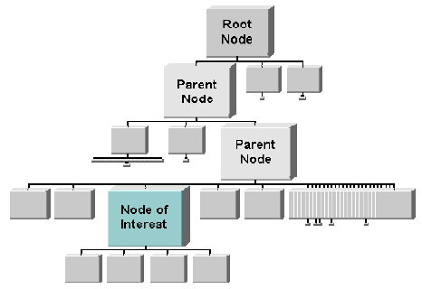
Approach
Combine multiple ideas
  Expanded DOI computation
  Logical filtering to elide nodes
  Geometric scaling
  Semantic scaling
  Clustered representation of large unexpended branches
  Animated transition

Slide 32
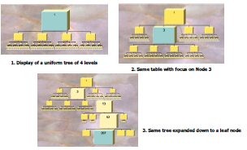
Example Operations

Slide 33

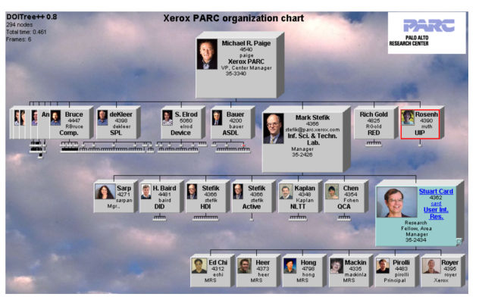
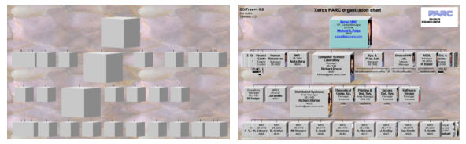
Compression
For nodes: compress to fit (compress in X or in Y)
Within-node compression
  Data deletion
  Word abbreviation
  Node rotation

Slide 34
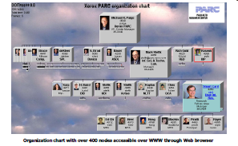
Better View of Org Chart

Slide 35
FlexTree
Horizontally-drawn tree with compression along vertical dimension
One focus is on showing decision trees well
Contextual multi-foci view
Basic idea: Push all nodes down as far as you can
Song, Curran & Sterritt
Information Visualization ‘04

Slide 36
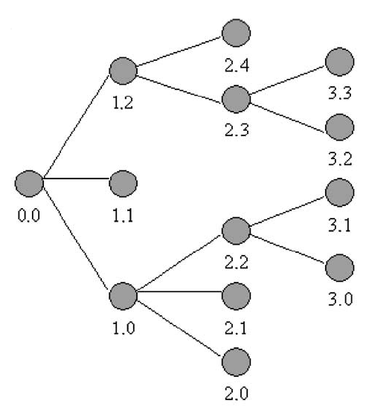
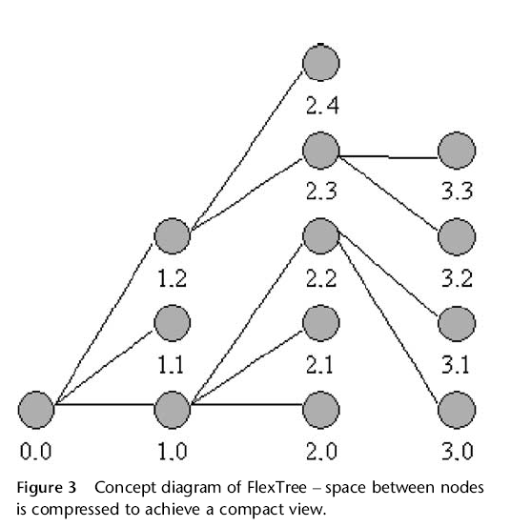
Example

Slide 37
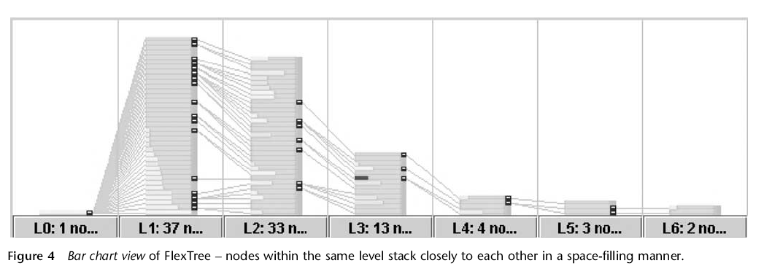
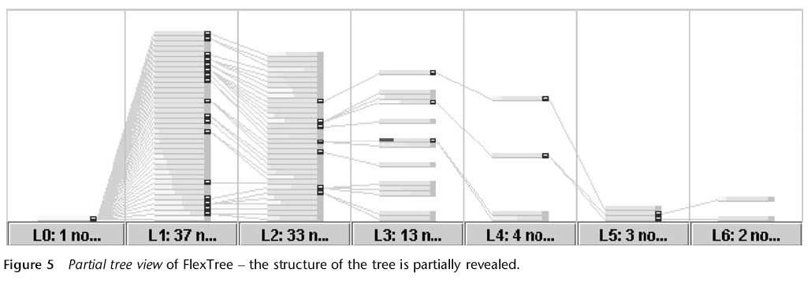
Bar Chart and Partial Views

Slide 38
Node-link Shortcomings
Difficult to encode more variables of data cases (nodes)
  Shape
  Color
  Size
  …but all quickly clash with basic node-link structure

Slide 39

Space-Filling Representations
Each item occupies an area
Children are “contained” under parent

Slide 40
Treemap
Space-filling representation developed by Shneiderman and Johnson, Vis ‘91
Children are drawn inside their parent
Alternate horizontal and vertical slicing at each successive level
Use area to encode other variable of data items

Slide 41
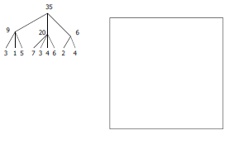
Example

Slide 42
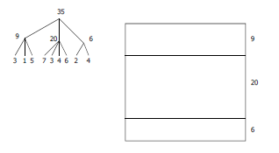
Example

Slide 43
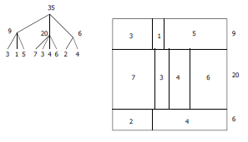
Example

Slide 44
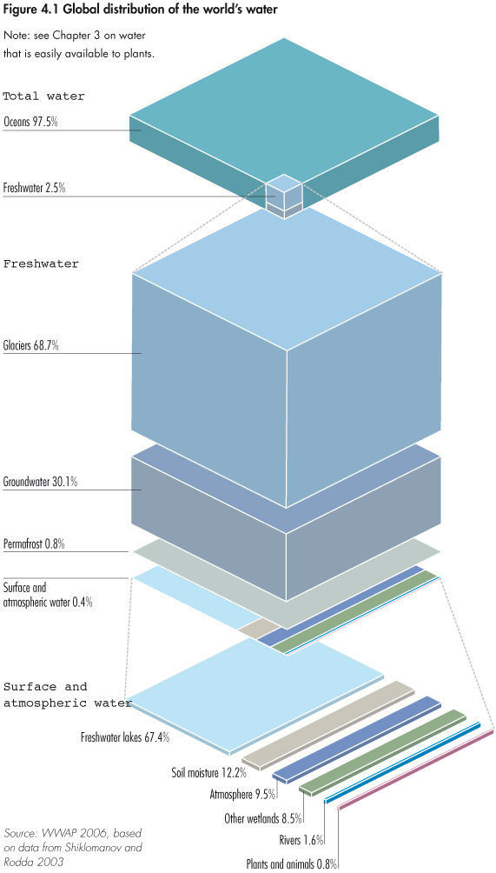
Treemap?
http://blog.wired.com/wiredscience/2008/06/awesome-infogra.html

Slide 45
Treemap Affordances
Good representation of two attributes beyond node-link: color and area
Not as good at representing structure
  What happens if it’s a perfectly balanced tree of items all the same size?
  Also can get long-thin aspect ratios
  Borders help on smaller trees, but take up too much area on large, deep ones

Slide 46
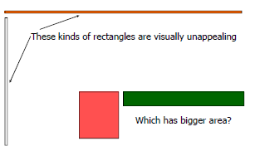
Aspect ratios

Slide 47
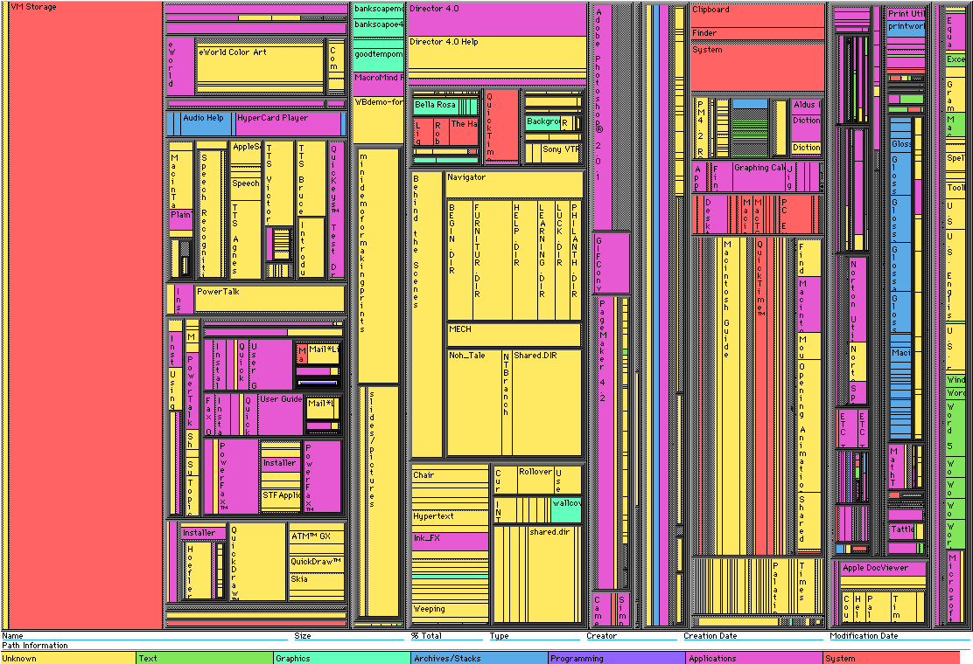
Early Treemap Applied to File System

Slide 48
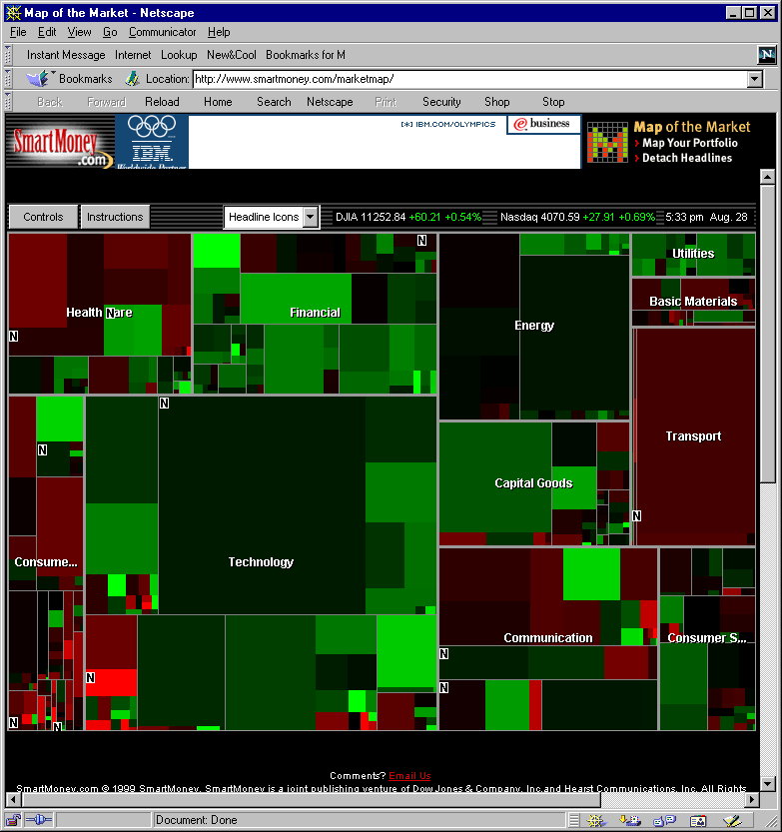
A Good Use of TreeMaps and Interactivity
www.smartmoney.com/marketmap

Slide 49
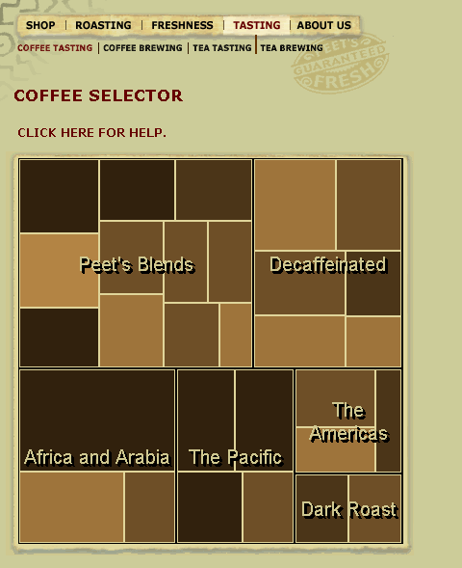
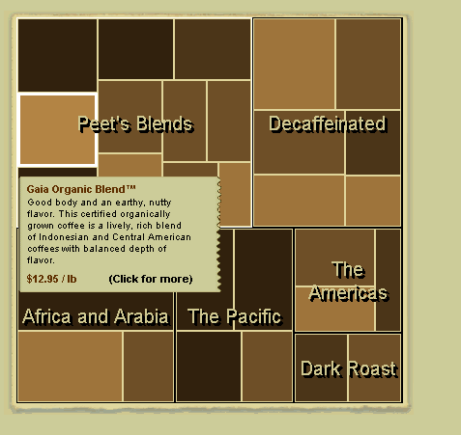
Treemaps in Peets site

Slide 50
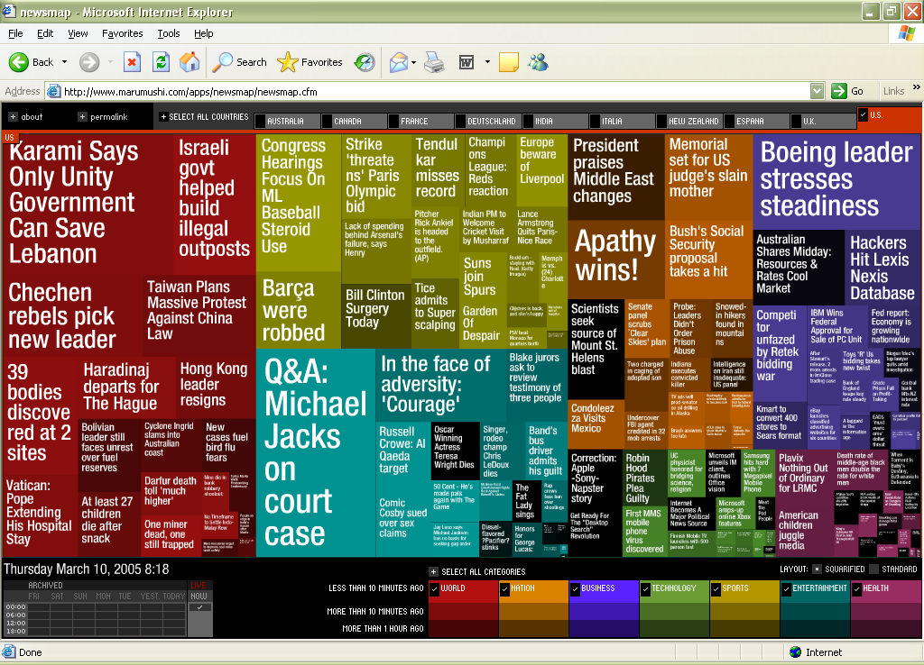
News Stories
http://newsmap.jp/

Slide 51
Variation: “Cluster” Treemap
SmartMoney.com Map of the Market
  Illustrates stock movements
  “Compromises” treemap algorithm to avoid bad aspect ratios
  Basic algorithm (divide and conquer) with some hand tweaking
  Takes advantage of shallow hierarchy
Wattenberg
CHI ‘99
http://www.smartmoney.com/marketmap

Slide 52
SmartMoney Review
Tufte-esque micro/macro view
Dynamic user interface operations add to impact
One of better applications of InfoVis techniques we’ve seen

Slide 53
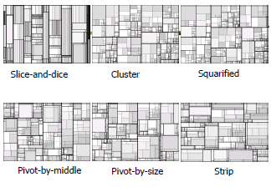
Summary of Variations

Slide 54
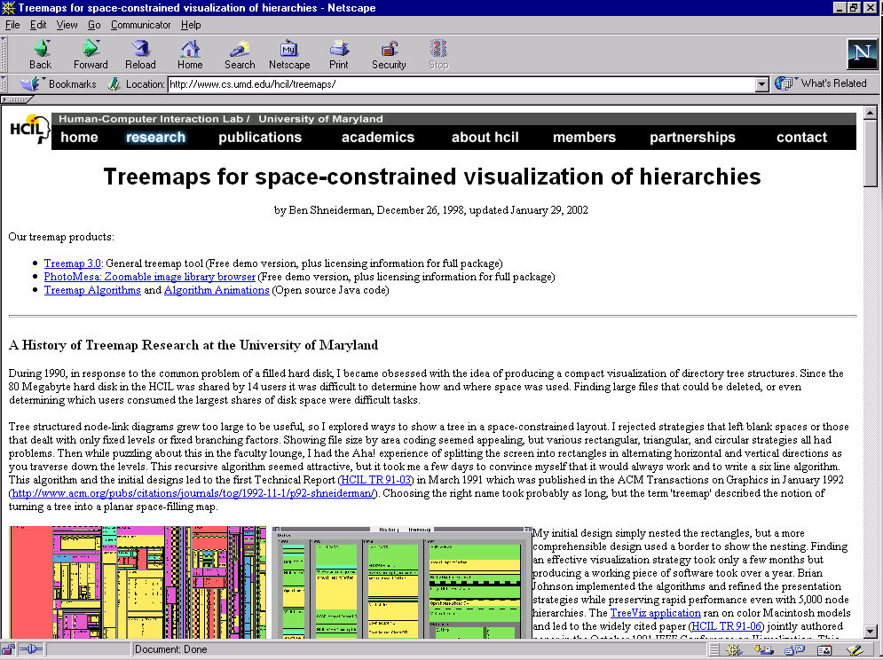
The World of Treemaps
Maryland HCIL
website devoted
to Treemaps
Workshop in
2001 there on
topic
www.cs.umd.edu/hcil/treemap-history/

Slide 55
Another Technique
What if we used a radial rather than a rectangular space-filling technique?
  We saw node-link trees with root in center and growing outward already...
Make pie-tree with root in center and children growing outward
  Radial angle now corresponds to variables rather than area

Slide 56
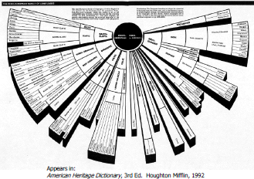

Slide 57
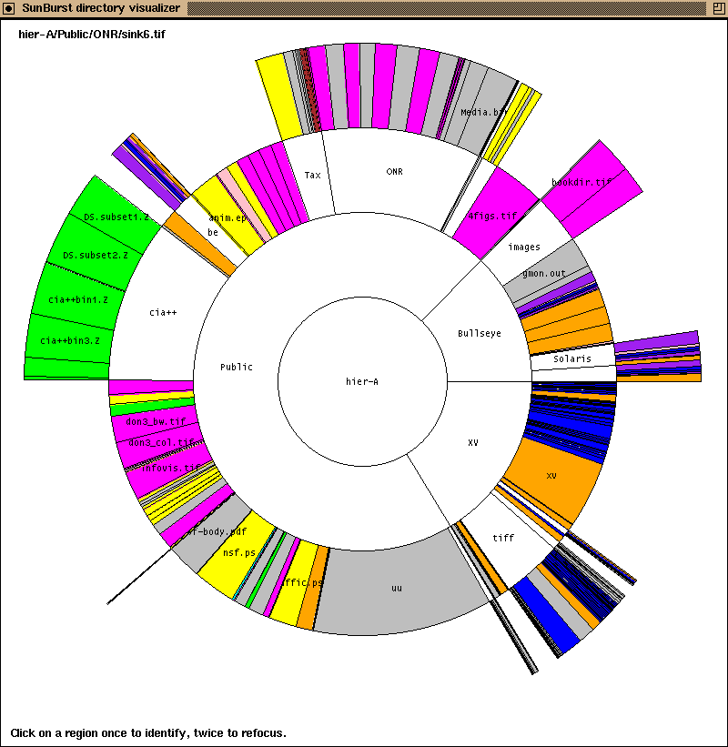
Sunburst:
Demonstration of System
http://www.cc.gatech.edu/gvu/ii/sunburst/

Slide 58
SunBurst
Root directory at center, each successive level drawn farther out from center
Sweep angle of item corresponds to size
Color maps to file type or age
Interactive controls for moving deeper in hierarchy, changing the root, etc.
Double-click on directory makes it new root
http://www.cc.gatech.edu/gvu/ii/sunburst/

Slide 59
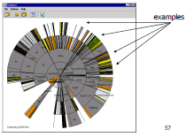
SunBurst (cons)
In large hierarchies, files at the periphery are usually tiny and very difficult to distinguish

Slide 60
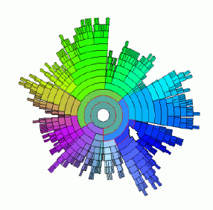
InterRing
Follow-on to Sunburst that provides fixes and new operations….
Yang, Ward & Rudensteiner
InfoVis ‘02

Slide 61
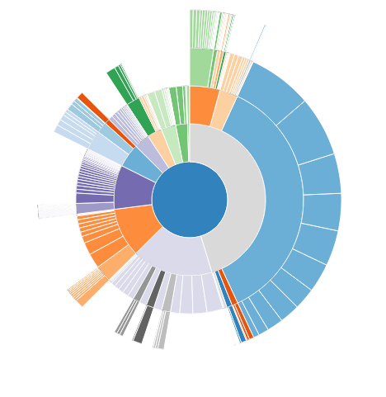
InterRing extended Sunburst
Sunburst extended to incorporate interactive distortion based zooming (InterRing model).
Mike Bostock’s
Interactive Demo
and GitHub code

Slide 62
Summary: NodeLink vs SpaceFilling
Node-link diagrams or space-filling techniques?
It depends on the properties of the data
  Node-link typically better at exposing structure of information structure
  Space-filling good for focusing on one or two additional variables of cases

Slide 63
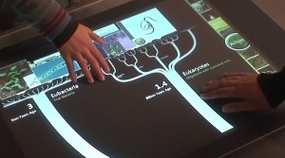
Interaction as Key for Large Trees
While the various techniques have helped some in visualizing trees, especially large ones, I believe the most important things is the addition of interaction (navigation, clustering, ghosting, etc).
Example: Life on Earth museum exhibit

Slide 64
Network Graphs
Networks are different from tree graphs.
They do not have a root, and can have any connections between nodes.
They may include directed links.

Slide 65
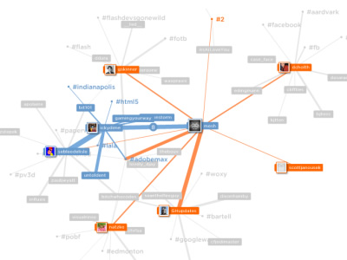
Twitter Network
http://apps.asterisq.com/mentionmap/
Explores your twitter network

Slide 66
Network Graphs show Connections
Connections throughout our lives and the world
  Circle of friends
  Delta’s flight schedules
  …
Model connected set as a Graph

Slide 67
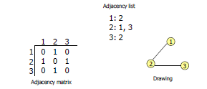
What is a Graph?
Vertices (nodes) connected by
Edges (links)

Slide 68
Graph Terminology
Graphs can have cycles
Graph edges can be directed or undirected
The degree of a vertex is the number of edges connected to it
  In-degree and out-degree for directed graphs
Graph edges can have values (weights) on them (nominal, ordinal or quantitative)

Slide 69
Graph Uses
In information visualization, any number of data sets can be modeled as a graph
  US telephone system
  World Wide Web
  Distribution network for on-line retailer
  Call graph of a large software system
  Semantic map in an AI algorithm
  Set of connected friends
Graph/network visualization is one of the oldest and most studied areas of InfoVis

Slide 70
Graph Visualization Challenges
Graph layout and positioning
  Make a concrete rendering of abstract graph
Navigation/Interaction
  How to support user changing focus and moving around the graph
Scale
  Above two issues not too bad for small graphs, but large ones are much tougher

Slide 71
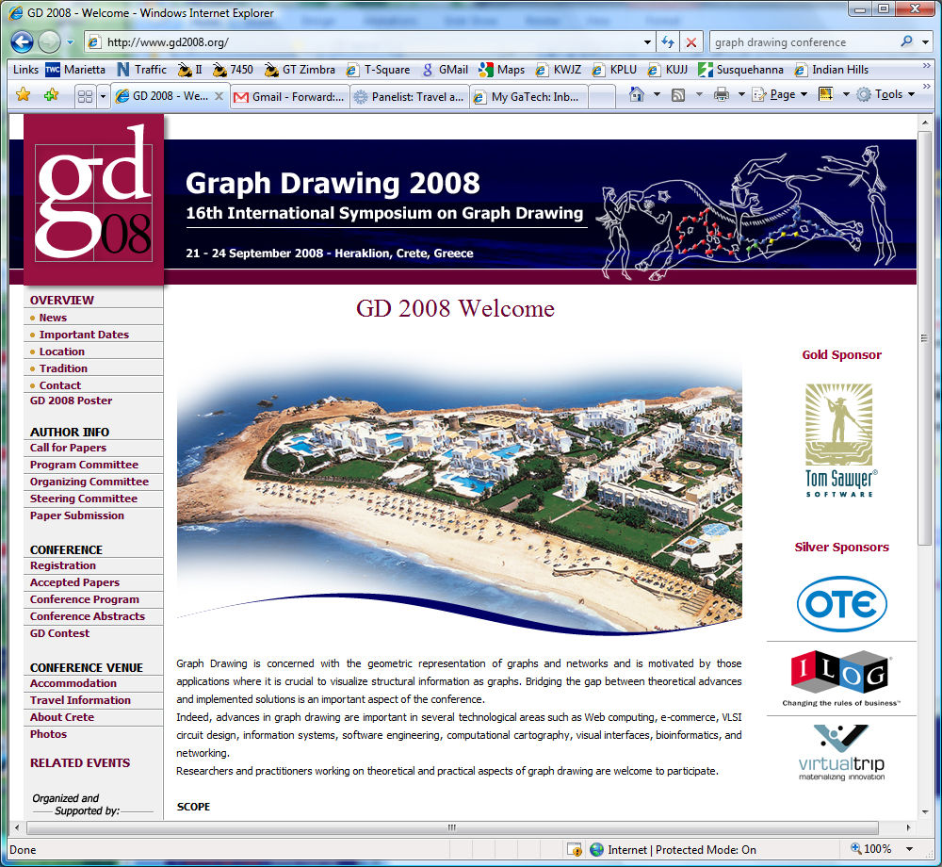
Layout Algorithms
http://www.ics.forth.gr/gd2008/

Slide 72
Layout Heuristics
Layout algorithms can be
  planar
  grid-based
  orthogonal
  curved lines
  hierarchies
  circular
  ...

Slide 73
Common Layout Techniques
Force-directed (gravity “pulls” vertices together)
Circular (laid out on a circle, or a sphere, or the perimeter of a circle (Circos))
Geographic-based (spatial coordinates, or location in space based on similarity)
Clustered (cluster by similarity)
Attribute-based positioned by attribute values, for example clustered together
Matrix row/column orientation

Slide 74
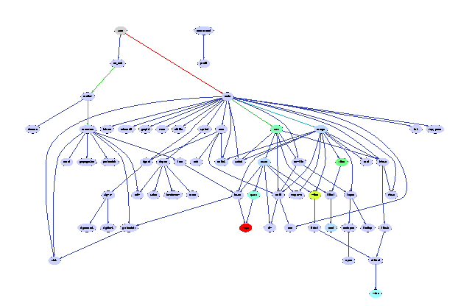
Vertex Choices
Shape: Symbols/Glyphs for vertices could show maybe 5-10 distinguishable. Or could show people’s pictures in boxes (unique but distinguishable only at small scale).
Color: categorical (10-12) colorings
Size: could scale vertex to show ordinal/interval/continuous. But difficult to tell difference. Obscuration a problem.
Location: could pull together “similar” vertices (separate from edge effects) to group.
Label: Could add labels to vertices, but layout problems.

Slide 75
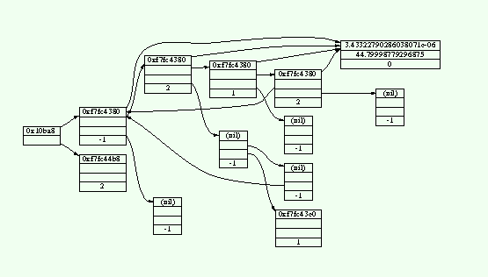
Edge Choices
Thickness (width): ordinal/interval/continuous. Effective, natural. Works up until very large scale.
Length: distance between nodes shows strength.
Color: use colors to denote strength of relationship (ordinal/interval/continuous monochrome scale). Probably hard to distinguish at scale.
Label: can label, but not immediately perceived (cognitive processing) and increases clutter significantly.
Form: to show different types of relationships (dotted, dashed, full line, etc).
Direction: can have arrows at end to indicate direction

Slide 76
Layout Recommendations
Planar in most cases, force directed to capture magnitude of edge relation OR another variable. Also cluster/attribute based can be good choice (Action Science Explorer).
Circles Perimeters are good to emphasize connections between equal things (on perimeter). Circos
Sphere (good for large scale large number of nodes to provide interactive focus zoom).

Slide 77
Vertex Recommendations
Make use of node to depict at least one attribute.
Color is most effective if you want to categorically label nodes.
Pictures are good on social networks (when zoomed in).
Symbols/glyphs for small number of categories if natural shapes (other color generally better).
Label Often good for nodes; semantic zoom so readable at all times if possible.
Size can be helpful to show continuous variable magnitude (at small scale when occlusion isn’t too bad).

Slide 78
Edge Recommendations
Length: Most natural for showing strength of relationship.
Thickness (width): OK choice. Easy to perceive differences, easy to understand. But can make busy, and harder to perceive when busy.
Color: Good if small number of categories and not large scale or muddled.
Label: Generally not helpful for edges (just increases clutter).
Form: Sometimes good, but adds clutter, hard to see at large scale.
Direction: when semantically meaningful

Slide 79
Network Attributes Vocabulary
Bary center – total shortest path of a node to all other nodes
Betweenness centrality – how often a node appears on the shortest path between all other nodes
Closeness centrality – how close a node is compared to all other nodes
Cut-points – the subgraph becomes disconnected if the node is removed
Degree – number of connections for node
HITs – “hubs and authorities” measure
Power centrality – how linked a node is to rest of network

Slide 80
Aesthetic Considerations
Crossings
  minimize towards planar
Total Edge Length
  minimize towards proper scale
Area
  minimize towards efficiency
Maximum Edge Length
  minimize longest edge
Uniform Edge Lengths
  minimize variances
Total Bends
  minimize orthogonal towards straight-line

Slide 81
Which Matters?
Various studies examined which of the aesthetic factors matter most and/or what kinds of layout/vis techniques look best
  Purchase, Graph Drawing ’97
  Ware et al, Info Vis 1(2)
  Ghoniem et al, Info Vis 4(2)
  van Ham & Rogowitz, TVCG ‘08
  …
Results mixed: one generalized finding--Edge crossings do seem important (minimize)

Slide 82
Shneiderman’s NetViz Nirvana
Every node is visible
For every node you can count its degree
For every link you can follow it from source to destination
Clusters and outliers are identifiable

Slide 83
Scale Challenge
May run out of space for vertices and edges (turns into “ball of string”)
Very large datasets can reduce rendering speeds to less than realtime.
Often use clustering to help
  Extract highly connected sets of vertices
  Collapse some vertices together

Slide 84
Navigation/Interaction Issues
How do we allow a user to query, visit, or move around a graph?
Changing focus may entail a different rendering

Slide 85
Social Analysis
Facilitate understanding of complex socioeconomic patterns
Social Science visualization gallery (Lothar Krempel): http://www.mpifg.de/~lk/netvis/substanz.html
Next slide: Krempel & Plumper’s study of World Trade between OECD countries, 1981 and 1992. The structure of world trade of between 28 OECD countries in 1981 and 1992. The size of the nodes gives the volume of flows in dollars (imports and exports) for each country . The size of the links stands for the volume of trade between any two countries. Colors give the regional respectively memberships in different trade organisations: EC countries (yellow), EFTA countries (green), USA and Canada (blue), Japan (red), East Asian Countries (pink), Oceania (Australia , New Zealand) (black).

Slide 86
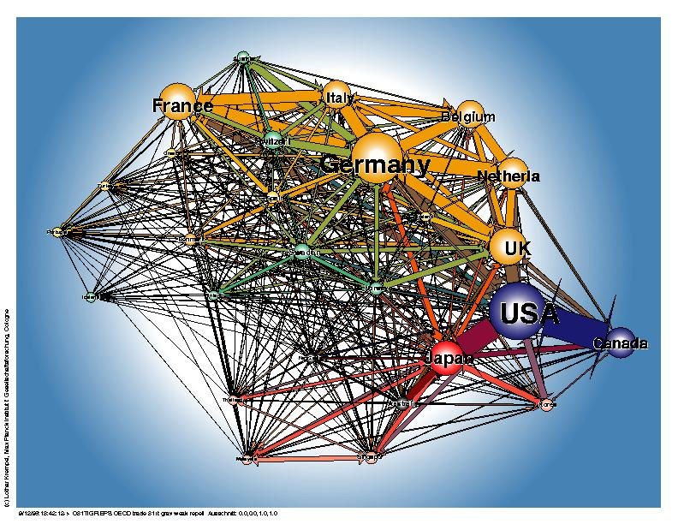
1981
http://www.mpi-fg-koeln.mpg.de/~lk/netvis/trade/WorldTrade.html

Slide 87

Social Network Visualization
Social Network Analysis
Is obesity contagious?

Slide 88
Revisting Subway Maps
Are they graphs or maps?

Slide 89


Slide 90


Slide 91


Slide 92
3 Subway Diagrams
Geographic landmarks largely suppressed on maps, except water (rivers in Paris, London) and asphalt (highways in Atlanta)
  Rather fitting, no?
These are more graphs than maps!

Slide 93

Really Cool Subway Map Exhibit
I saw this at VisWeek 2011
Collection of maps of subways over the years.
Here are a few less common ones.

Slide 94


Slide 95


Slide 96


Slide 97
More Flow/Travel Graphs
Show path, another example of almost if not a map application.

Slide 98


Slide 99

Airline flights

Slide 100
Visual Analytics on Networks
Social Networks (tools for Facebook, twitter, etc)
Political Networks. Policital voting record clustering (like Touchgraph)

Slide 101
Challenge
Senators (Touchgraph example)
  Party afflilation
  Religious association
Political Action Companies (PACs)
Networks
  Senators co-sponsoring bills (# per year)
  PACs support of senators ($$ per year)
How would you visualize?

Slide 102

TouchGraph
www.touchgraph.com

Slide 103
Action Science Explorer
Webpage
Literature linkage exploration. (watch video starting at 2:40 to 3:30 to see automatic grouping)

Slide 104

Many Examples
http://www.visualcomplexity.com

Slide 105
Visual Complexity Two Examples
Seattle Bands
Global Dependency Explorer (view in Chrome)

Slide 106
Big Graphs
20,000 - 1,000,000 Nodes
Works well with 50,000
Projects
  Software Engineering
  Web site analysis
  Large database correlation
  Telephone fraud detection
  All Email traffic

Slide 107
Interaction
One of the key ways we move beyond graph layout to graph visualization
(InfoVis) is interaction with the graph

Slide 108
MoireGraph
Uses radial layout not terribly unlike hyperbolic tree, but no hyperbolic geometry
Impose levels on graph by doing min span tree from some node
Put root at center, nodes at subsequent levels further out radially, with descreasing space for each
Interaction is key
Jankun-Kelly & Ma
InfoVis ‘03

Slide 109

Navigation and interaction…

Slide 110
Focus of Graph
Particular node may be focus, often placed in center for circular layout
How does one build an interactive system that allows changes in focus?
  Use animation
  But intuition about changes not always right

Slide 111
Recent Trends in GraphViz
Attributes of nodes influence geometric positioning
  Not just some arbitrary layout
Utilize graph statistical analysis too
Largely driven by interest in social network analysis

Slide 112
Vizster
Visualize social networking sites like friendster, myspace, facebook
Implementation
  crawled 1.5 million members (Winter 2003)
  written in Java using the prefuse tookit (http://prefuse.sourceforge.net)
Oppose Shneiderman’s mantra. Instead:
  “Start with what you know, then grow.”
Heer & boyd
InfoVis ‘05

Slide 113

Visualization

Slide 114
SocialAction
Combines graph structural analysis (ranking) with interactive visual exploration
Multiple coordinated views
  Lists by ranking for analysis data
  Basic force-directed layout for graph vis
Perer & Shneiderman
TVCG ‘06

Slide 115


Slide 116
Do a Design
Design interface for
  Social network (facebook)
  Shared communications (twitter)
  Scholarly publications

Slide 118
Graph Drawing Resources
Book
  Di Battista, Eades, Tamassia, and Tollis,
  Graph Drawing: Algorithms for the Visualization of Graphs, Prentice Hall, 1999
Tutorial (talk slides)
  http://www.cs.brown.edu/people/rt/papers/gd-tutorial/gd-constraints.pdf
Web links
  http://graphdrawing.org
  http://www.graphviz.org

Slide 119
Graph Drawing Uses
Many domains and data sets can benefit significantly from nice graph drawings
Let’s look at some examples…

