Slide 1
Display Technology

Slide 2
More than just your workstation
We think inherently of computer displays, but there are many display technologies out there. We can classify display presentation methods by
Spatial Resolution
Contrast Resolution
Temporal Resolution

Slide 3
Spatial Resolution
2D versus 3D
physical size of display (cellphone, workstation, wall)
dots per inch
field of view

Slide 4
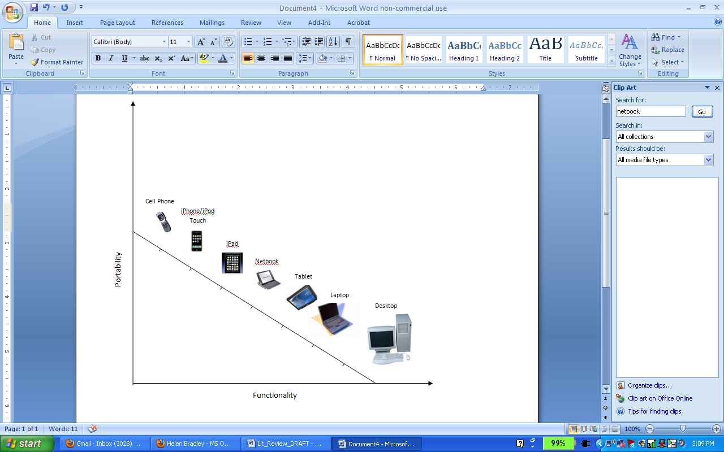
What you see day to day is only a small part of the displays available…

Slide 5
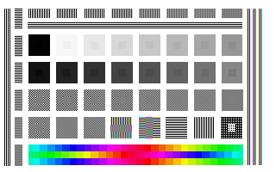
Contrast Resolution
color vs black and white
number of contrast levels in B&W or Color
Notes:
Something like these perhaps?
http://commons.wikimedia.org/wiki/File:Calibration-test-white.png
GNU Free Documentation License
http://commons.wikimedia.org/wiki/File:Color-LCD_Display_Macro-View.jpg
Public domain

Slide 6
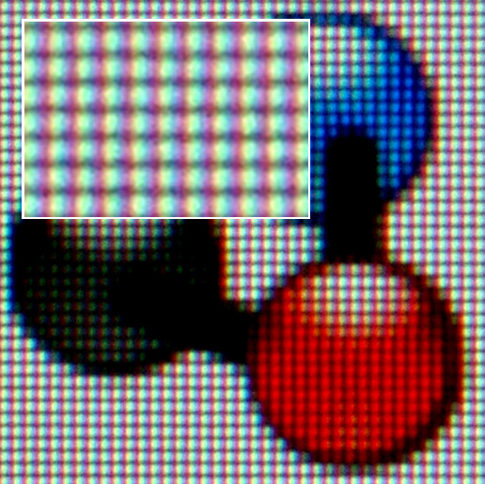

Slide 7
Temporal Resolution
static versus dynamic
update rate for dynamic displays

Slide 8
Technology is the driver of change
As with many things we'll study in information science, the driver for these differences is changes in technology. At first we were only capable of sketching, drawing static images on paper. In the 1920's we begin to have "moving pictures" (films). In the 1950's we had moving pictures in the home, but initially in black and white. Then in 1960s color television became commonly available. Today you are on the cusp of 3D video in the mainstream (becoming more standard place in films, and home TVs are just starting to support). Surround presentations are also becoming more common (IMAX theaters). So the limitations were technological ones, and often cost ones. There are also context issues (you may want permanence of display, or intentionally only black and white). So these choices still exist when deciding what display technology to use.
Notes:
JT: Change from text to timeline?

Slide 9

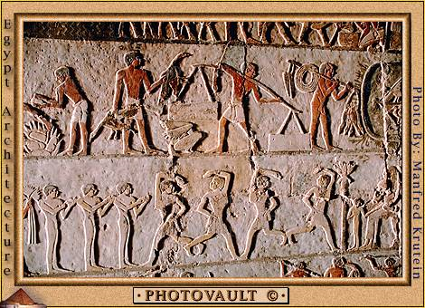

Primitive art
cave drawings
Hieroglyphics
petroglyphs

Slide 10

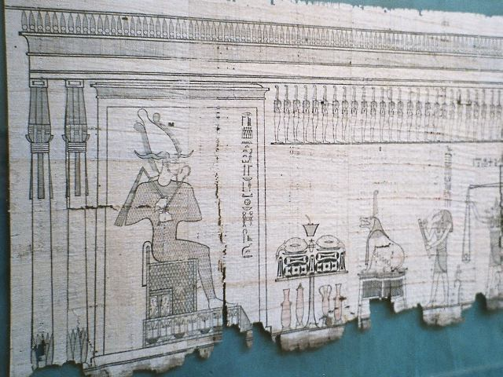
Drawings on transportable media
paper
papyrus
stone tablets
Letters
Leaflets
pictures
Temple in McLeod Ganj , credit: Wolfgang Maehr
Antique papyrus, showing the god Osiris and the weighing of the heart. Egyptian Museum, Cairo, Egypt. Photo taken by Hajor, Dec.2002.
Notes:
Stone tablets from http://commons.wikimedia.org/wiki/File:Stone_tablets_with_prayers_in_Tibetan_language_at_a_Temple_in_McLeod_Ganj.jpg
Author: Wolfgang Maehr, Creative Commons Attribution 2.0
Papyrus taken from
Antique papyrus, showing the god Osiris and the weighing of the heart. Egyptian Museum, Cairo, Egypt
Photo taken by Hajor, Dec.2002. Released under cc.by.sa and/or GFDL.

Slide 11


Moveable Type Printing Press
books (Martin Luther bible)
magazines
journals
pamphlets
posters
Promotional poster for Baum's "Popular Books For Children", 1901
Photograph: Walter J. Pilsak, Waldsassen
Notes:
http://commons.wikimedia.org/wiki/File:Bibel-1.jpg
Bibel aus dem Jahr 1866
Fotograf: Walter J. Pilsak, Waldsassen
Copyright Status: GNU Freie Dokumentationslizenz
http://commons.wikimedia.org/wiki/File:Baum_poster_1b.jpg
Public domain

Slide 12
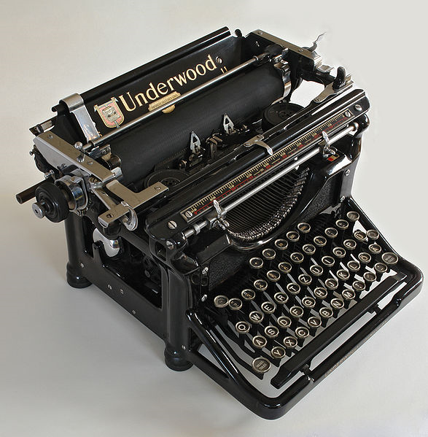
Personal Printing Press
typewriter
http://commons.wikimedia.org/wiki/File:Underwood-overview.jpg
Notes:
http://commons.wikimedia.org/wiki/File:Underwood-overview.jpg
GNU Free Documentation License

Slide 13
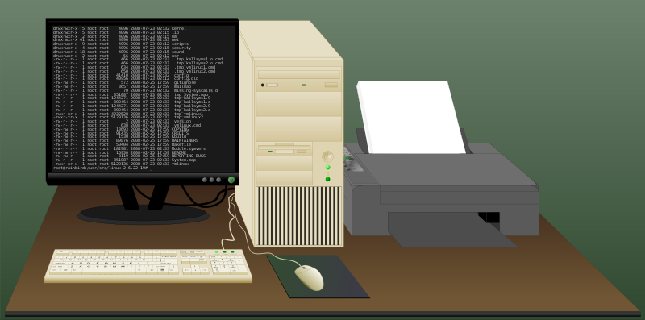
Computers and computer displays
printers
CRTs
Flat Panel displays (LCD, plasma, etc)
http://commons.wikimedia.org/wiki/File:Basic_desktop_computer_system.svg
Notes:
http://commons.wikimedia.org/wiki/File:Basic_desktop_computer_system.svg
Creative Commons Attribution 3.0 Unported License.
JT: This image isn’t great. Many images of just screens, but nothing special.

Slide 14
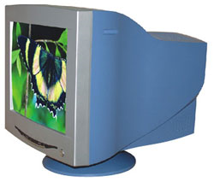
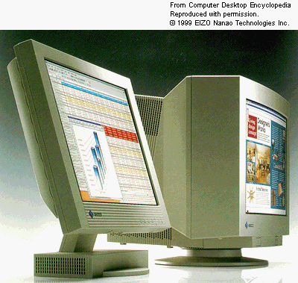
Form Factor

Slide 15
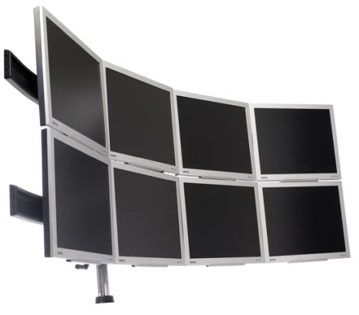
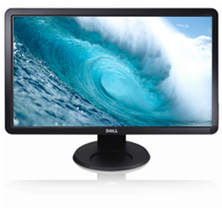
How much Display?

Slide 16
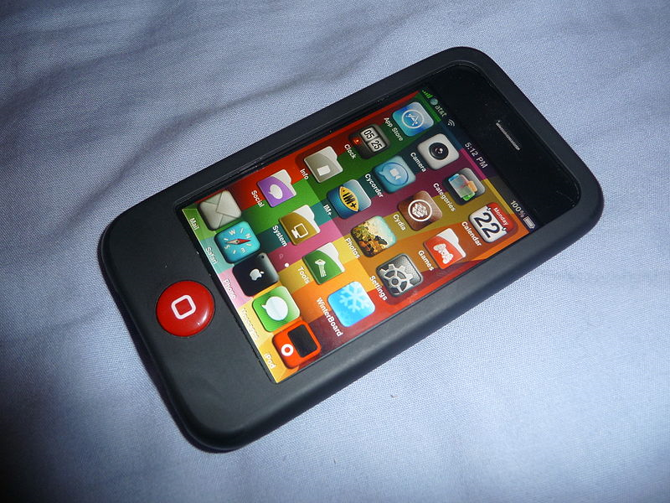
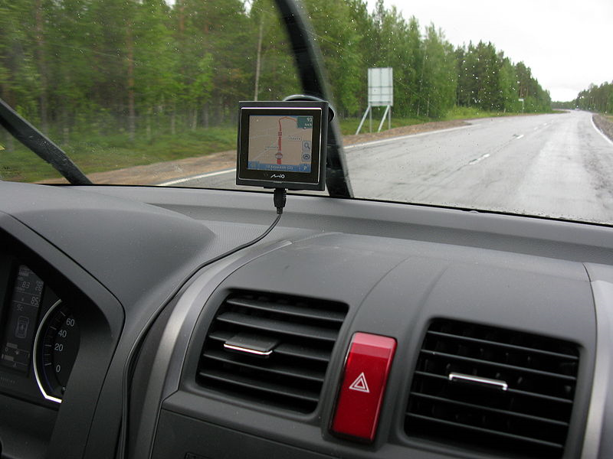
Displays become embedded in everyday objects
cellphones
cars
audio/video players
picture frames
Notes:
http://commons.wikimedia.org/wiki/File:IPhone_3G_Jailbroken.jpg
Public Domain
http://commons.wikimedia.org/wiki/File:Car_navigator_in_action.JPG
Public Domain

Slide 17
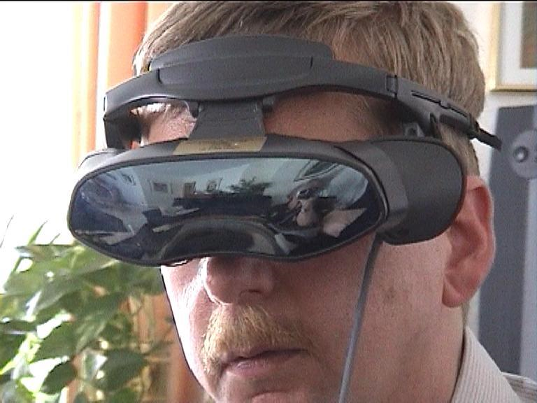
Displays become embedded into people
Head mounted Displays
Wikipedia

Slide 18
Special high end 2D displays
Tabletop displays
Jeff Han TED talk 2006 (http://www.ted.com/talks/lang/eng/jeff_han_demos_his_breakthrough_touchscreen.html)
Portable large table top displays
Hiep Truong (http://www.vizworld.com/2009/07/portable-large-multitouch-display-concept/), also seen on Vimeo video (http://vimeo.com/5452585)
Wall display.
research labs, RENCI
advertising boards (NYC)
sporting events. Who watched the UNC vs Texas basketball game in Dec 2009? At new Cowboys Stadium in Arlington TX. The overhead screen was 160' wide (largest sports screen for indoor stadium in the world currently). Dwarfs the real (physical) basketball court. Required for most spectators to view the event.

Slide 19
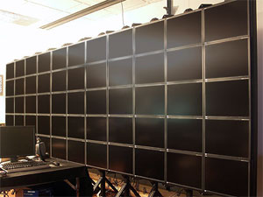
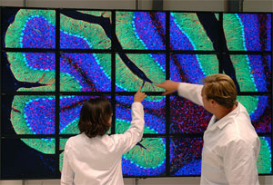
University of Illinois
100mpixel display

Slide 20
3D Displays/Immersive
2.5 D displays (lenticular/autostereograms)
3D stereo projections
Glasses for 3D Stereo Display (reference)
Other 3D technologies (rotating displays, varifocal mirror, holograms (DisneyWorld, etc).
Immersive/Surround Displays
Halfdomes/Domes
Caves
IMAX

Slide 21
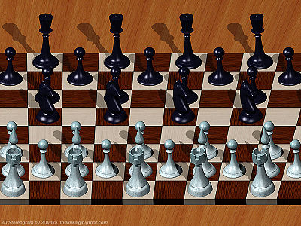

Autostereograms/Lenticular
Fun Examples
Movie Posters with 3D effect
Autostereograms/lenticular (below)
History of lenticular displays

Slide 22
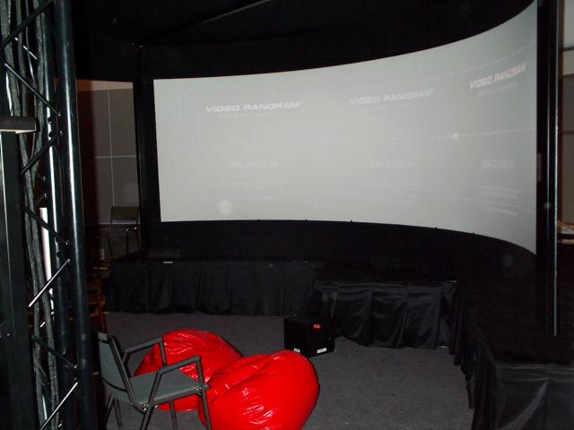
Data walls (near immersion)
Stereo, no head tracking, wide screen

Slide 23
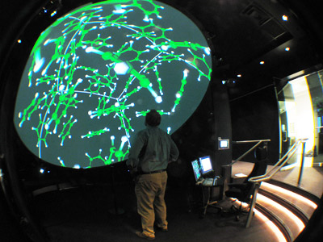
Half Dome: where was this? ☺

Slide 24
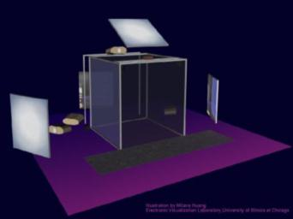
CAVE
Head tracking – stereo-one user
Light scattering problems
Interaction problems

Slide 25
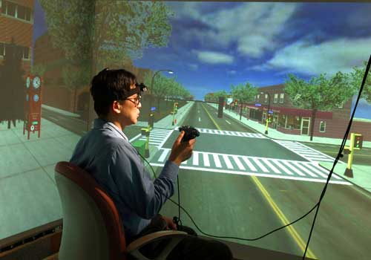
Inside the CAVE

Slide 26
3D Display--Reference
McAllister NCSU Great summary of various 3D technologies that have been used up to 2000 (still pretty current)

Slide 27
Large physical format displays
Nice discussion of pro/cons of large physical format displays based on experiments (Harry Hochheiser slides)
Main paper on this The Perceptual Scalability of Visualization Youst&North 2006
Good practical summary of Perceptual Scalability

Slide 28
Related Equipment
Computer: a computer is required to generate most displays these days. The speed, storage (memory, disk, etc) capacities, and particularly the graphics/video card are all important for how fast the computer can update interactive display presentations. Add information on how fast current graphics cards are versus the past. What are limitations?
Network. The speed of access of data to the computer that drives the display is critical for interactive displays.
300 baud modem (anyone remember one of these)?
56K modem
satellite modem
cell phone (3G, 4G, etc)
wireless modem (WIFI)
broadband connection (T1, cable modem, etc)
What limitations does this impose?

Slide 29
Important Factors
What are important things for us to consider when developing/choosing a visualization?
Is the presentation developed for a
Specific single presentation format? Book? Movie Poster? Pamphlet? Workstation?
Multiple Displays: What types of displays are available to us? I.e. what will users experience the presentation on? Try to abstract the main attributes of display space you can expect them to have available and utilize.
What are the capabilities of these display environments?
spatial (Is 3D available?, what resolution)
contrast (is color available?)
temporal (Is interactivity available?)

Slide 30
Effect of Display on Visualization
Design your visualization to take advantage of your expected model target display device capabilities, while taking into account its limitations.
Limitations commonly encountered:
lack of spatial resolution (cellphone display). See zooming, navigation techniques.
lack of color, or adequate number of grey levels display
lack of interactive display

Slide 31
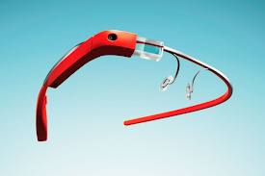
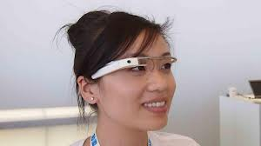
What’s Next?
Merging virtual realities with physical Realities
Google Glass
Microsoft Hololens
Oculus VR
SixthSense (start at 6:45 in)

Slide 32
Your Thoughts
What types of Displays, Environments have you worked with, or are you interested in?

Slide 33
End of Slides

Slide 35
Additional slides from Colin Ware…

Slide 36
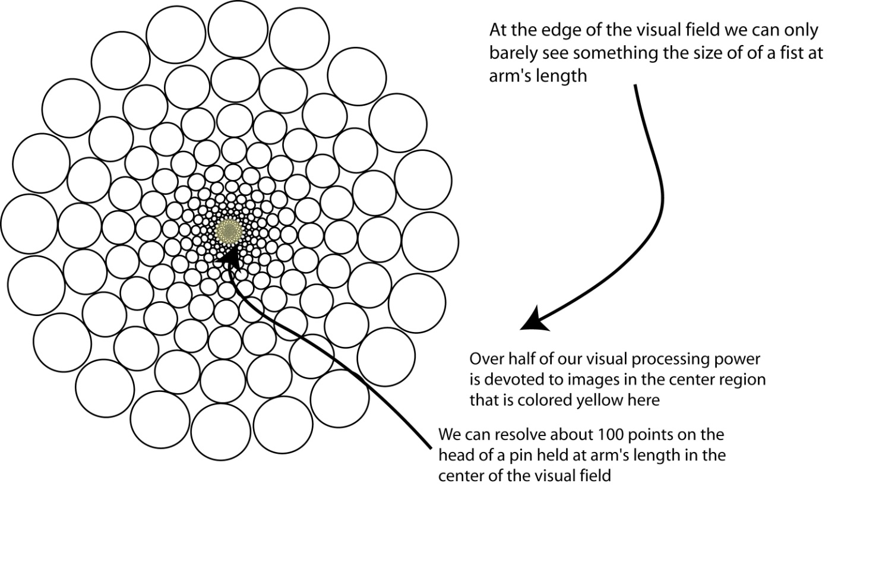
Brain pixel distribution
Ideally get information into every brain pixel

Slide 37
Pixels and Brain Pixels
0.8 BP
1 bp
0.2 BP
Small Screen
Big Screen

Slide 38
1280x1024 simulated
Monitor
CAVE
A conventional monitor covers <45% of our brain pixels

Slide 39
Percent of Brain Pixels Uniquely Stimulated in region covered by the display
Monitor
Cave

Slide 40
How efficiently can we use each display?
It will take approximately 2.5x as long to fixate targets at the edge of the big screen
Head movements accompany eye movements > 25 deg.

Slide 41
Scale matters
Parafovea

Slide 42
University of Illinois
100mpixel display

Slide 43
Data walls (near immersion)
Stereo, no head tracking, wide screen

Slide 44
CAVE
Head tracking – stereo-one user
Light scattering problems
Interaction problems

