Slide 1
Data Models, Representation, Transformation

Slide 2
Visualization Framework
Given
Human Abilities
Visual perception
Cognition
Memory
Motor skills
Design Principles
Visual display
Interaction
Chosen
Imply
Inform design
Design Process
Iterative design
Design studies
Evaluation
Context
User
Tasks
Data types
Data Model
Constrain design
Displays
Visualization Techniques
Graphic adapted from Melanie Tory

Slide 3
Models
Talk about Data Set vs Data Models vs Conceptual Models
Examples to make clear.
Reality: you are citizen of NC and have money
Conceptual model: citizens of North Carolina and their fiscal information.
DataSet: your SSN, financial information
Data Model contains information on specific attributes of citizens of NC, with raw data mapped to specific data types.
SSN = 9 digits
Name = 80 chars
Address = 120 chars
{financial institution/amount}* = FinanceID, currency
Notes:
See Marti Hearst module: Data Types and Graph Types (public lecture) for data model elements

Slide 4
Basic Elements of a Data Model
A data model represents some aspect of the world
Data models consist of these basic elements:
Entities (objects)
Attributes (values/characteristics of Entities)
Relationships between entities

Slide 5
Basic Elements: Entities
Entities are objects of interest
Places, people, movies, animals
Entities allow you to define and reason about a domain
Business
Family tree
University
Scientific model

Slide 6
Basic Elements: Values
Attributes are properties of Entities
Two major types
Quantitative
Categorical (several classes)
Appropriate visualizations often depend upon the type of the data values

Slide 7
Basic Elements: Relations
Relations relate two or more Entities
leaves are part of a plant
a department consists of employees
A person is related to another person

Slide 8
Common Data Types
Categorical (unordered set, supports =)
Ordinal (ordered set, supports <, >, =)
Interval (starts out as quantitative, but is made categorical by subdividing into ordered ranges)
Continuous (ordered and proportional, supports general arithmetic operators)

Slide 9

Categorical
unordered set
Operators: = (equality)
Also know as “Nominal”
Examples
Eye Color
Fruits
Directions: East, West, South, North
Symbols
Colors
Music Genre

Slide 10
Ordinal
ordered set
Operators: =, <, >
Also know as “Ordered”
Examples
Low, Medium, High
Cold, Warm, Hot
First-born, second-born, third-born, …

Slide 11
Interval
Boxing Weight Classes
Months: Jan, Feb, Mar, Apr, …
Binned numbers 0-9, 10-19, 20-29, …
Women’s dress sizes ☺

Slide 12
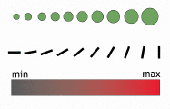
Continuous
Proportional, ordered set
Operators: =, <, >, *, /, %
Also know as “Quantitative, Ratio”
Examples
Temperature
Weight
Pressure
Population
Number of words in document
Any quantities properly represented by integers or rational numbers
Notes:
Graphics taken from http://www.cs171.net/lectures/files/03-Models.pdf
Possible examples:
Secret Lives of Numbers: http://www.turbulence.org/Works/nums/applet.html
Climate Change: http://2.bp.blogspot.com/_oy2DMM6iwUU/Srr4WFbZBcI/AAAAAAAABMU/mgZnd6eccWU/s1600-h/cop15geo_blog_post1.jpg

Slide 13
Dimensions of Data Type
1D (univariate) {eye color} of students
2D (bivariate) {eye color, hair color} of students
3D (trivariate) {eye color, hair color, height} of students
nD (multivariate), n different attributes, for example description of cereal (homework example).
Notes:
POSSIBLE EXAMPLES:
1D: Housing Market Chart: http://www.nytimes.com/interactive/2008/12/04/business/economy/HOUSING_PRICES_GRAPHIC.html
2D: Wine Market Map
http://www.nytimes.com/interactive/2008/12/25/business/20081228-wine-graphic.html
3D: Check-Out Items, Seattle Library
http://www.mat.ucsb.edu/~g.legrady/academic/courses/08w259/prj2/ychuang/implementation.html
nD: FilmFinder
http://www.cs.umd.edu/hcil/pubs/screenshots/FilmFinder/

Slide 14
Other types of data?
Class suggest

Slide 15
Other data types…
Spatial/cartographic
1D: position on line
2D: Surface Map (surface of earth, Longitude/latitude, GPS, GIS)
3D (Medical image, cloud volume, ocean contents)
Higher dimensions!
Time (any other data type sampled over time)
Abstract Data Structures (information constructs) which have implicit visual structures
Trees (hierarchies)
Networks (general graphs)
What else??
Notes:
Relationships? (may go under networks, trees)
Ratios?
Aesthetic?

Slide 16
Relational Databases
Show relational database tables representing the data values, in parallel with conceptual model.
Company database
Notes:
Would this be a good class exercise as well?

Slide 17
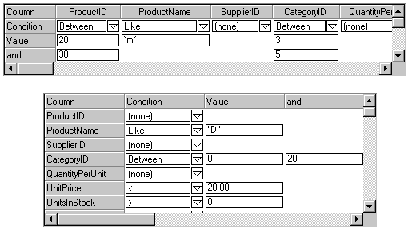
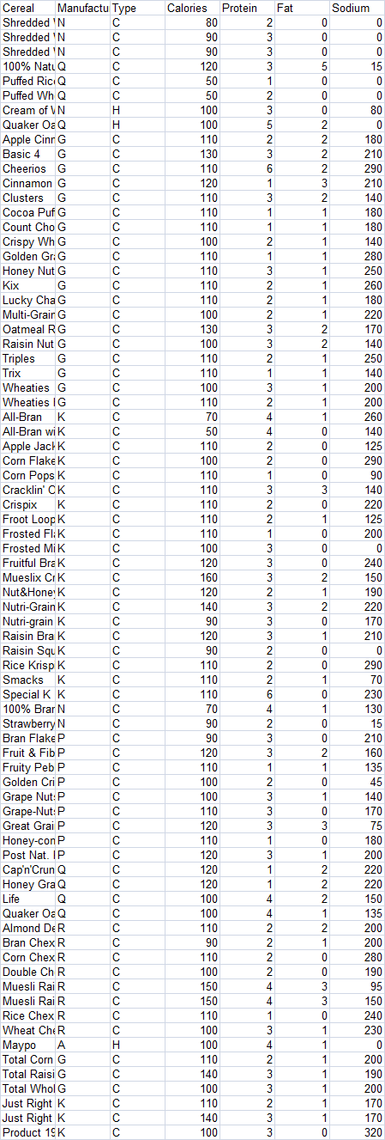
CUT-DDV Framework
Dataset
Mapping to Data Model
Processed
Data
Represented in Data Model
Notes:
Data Sources:
RAW DATA:
Numbers in blue: Clip art.
Galaxy: <div xmlns:cc="http://creativecommons.org/ns#" about="http://www.flickr.com/photos/jaredsmith/176375861/"><a rel="cc:attributionURL" href="http://www.flickr.com/photos/jaredsmith/">http://www.flickr.com/photos/jaredsmith/</a> / <a rel="license" href="http://creativecommons.org/licenses/by-sa/2.0/">CC BY-SA 2.0</a></div>
Photo Collage: <div xmlns:cc="http://creativecommons.org/ns#" about="http://www.flickr.com/photos/p0ps/2586352201/"><a rel="cc:attributionURL" href="http://www.flickr.com/photos/p0ps/">http://www.flickr.com/photos/p0ps/</a> / <a rel="license" href="http://creativecommons.org/licenses/by-nc-sa/2.0/">CC BY-NC-SA 2.0</a></div>
COLLECT:
Satellite: <div xmlns:cc="http://creativecommons.org/ns#" about="http://www.flickr.com/photos/gord99/2224184085/in/set-72157603803185760/"><a rel="cc:attributionURL" href="http://www.flickr.com/photos/gord99/">http://www.flickr.com/photos/gord99/</a> / <a rel="license" href="http://creativecommons.org/licenses/by-nc-nd/2.0/">CC BY-NC-ND 2.0</a></div>
Microscope: <div xmlns:cc="http://creativecommons.org/ns#" about="http://www.flickr.com/photos/spike55151/417096716/"><a rel="cc:attributionURL" href="http://www.flickr.com/photos/spike55151/">http://www.flickr.com/photos/spike55151/</a> / <a rel="license" href="http://creativecommons.org/licenses/by-nc-sa/2.0/">CC BY-NC-SA 2.0</a></div>
Camera: <div xmlns:cc="http://creativecommons.org/ns#" about="http://www.flickr.com/photos/captkodak/271877082/"><a rel="cc:attributionURL" href="http://www.flickr.com/photos/captkodak/">http://www.flickr.com/photos/captkodak/</a> / <a rel="license" href="http://creativecommons.org/licenses/by-nc/2.0/">CC BY-NC 2.0</a></div>
DATASET: cut/paste from excel
PROCESSED DATA:
Starred email: <div xmlns:cc="http://creativecommons.org/ns#" about="http://www.flickr.com/photos/pesut/302429586/"><a rel="cc:attributionURL" href="http://www.flickr.com/photos/pesut/">http://www.flickr.com/photos/pesut/</a> / <a rel="license" href="http://creativecommons.org/licenses/by-sa/2.0/">CC BY-SA 2.0</a></div>
Filter Screenshot: <div xmlns:cc="http://creativecommons.org/ns#" about="http://www.flickr.com/photos/90104203@N00/4050129572/"><a rel="cc:attributionURL" href="http://www.flickr.com/photos/90104203@N00/">http://www.flickr.com/photos/90104203@N00/</a> / <a rel="license" href="http://creativecommons.org/licenses/by-nc-sa/2.0/">CC BY-NC-SA 2.0</a></div>

Slide 18
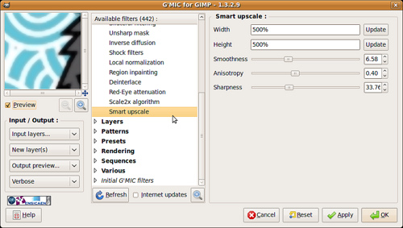


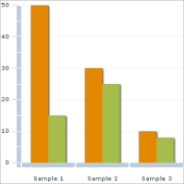
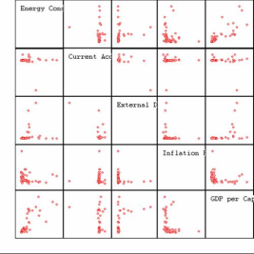
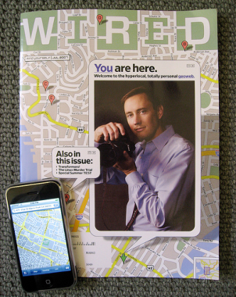
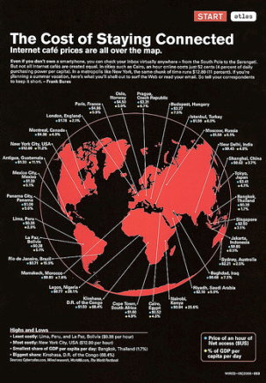
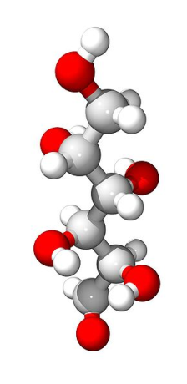
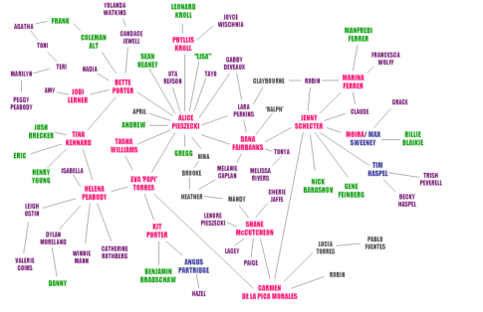

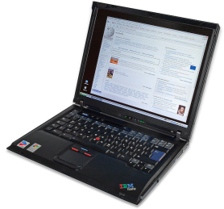
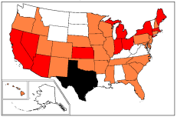
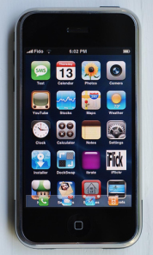
CUT-DDV Framework
Visualization Techniques
Display
Map to Display(s)
Filter,
Transform,
Modify
Notes:
VISUALIZATION TECHNIQUES:
Barchart: http://commons.wikimedia.org/wiki/File:Adobe_Flex_ColumnChart.png
GNU Free Documentation License.
Scatterplot Mulitples: http://commons.wikimedia.org/wiki/File:Scatterplot.jpg
GNU Free Documentation License,
3D (red, white, gray): http://commons.wikimedia.org/wiki/File:Galactose-3D.jpg (public domain)
3D (white,yellow, red, blue, black connectors): http://commons.wikimedia.org/wiki/File:Cevimeline_3D.png (public domain)
Network (with red and green dots):
<div xmlns:cc="http://creativecommons.org/ns#" about="http://www.flickr.com/photos/gustavog/4557105/"><a rel="cc:attributionURL" href="http://www.flickr.com/photos/gustavog/">http://www.flickr.com/photos/gustavog/</a> / <a rel="license" href="http://creativecommons.org/licenses/by-nc-sa/2.0/">CC BY-NC-SA 2.0</a></div>
Network (colored names): http://commons.wikimedia.org/wiki/File:El_chart.png
Creative Commons Attribution 2.5 Generic
US MAP: http://commons.wikimedia.org/wiki/File:2009_flu_US_map.png
GNU Free Documentation License,
DISPLAYS:
Ipod ad on building in Japan: <div xmlns:cc="http://creativecommons.org/ns#" about="http://www.flickr.com/photos/cybernezumi/482820405/"><a rel="cc:attributionURL" href="http://www.flickr.com/photos/cybernezumi/">http://www.flickr.com/photos/cybernezumi/</a> / <a rel="license" href="http://creativecommons.org/licenses/by-nc-sa/2.0/">CC BY-NC-SA 2.0</a></div>
Ipod on street adboard: <div xmlns:cc="http://creativecommons.org/ns#" about="http://www.flickr.com/photos/hur/183065997/"><a rel="cc:attributionURL" href="http://www.flickr.com/photos/hur/">http://www.flickr.com/photos/hur/</a> / <a rel="license" href="http://creativecommons.org/licenses/by-nc-nd/2.0/">CC BY-NC-ND 2.0</a></div>
Wired: The Battle for Blue <div xmlns:cc="http://creativecommons.org/ns#" about="http://www.flickr.com/photos/philgyford/56867986/"><a rel="cc:attributionURL" href="http://www.flickr.com/photos/philgyford/">http://www.flickr.com/photos/philgyford/</a> / <a rel="license" href="http://creativecommons.org/licenses/by-nc-nd/2.0/">CC BY-NC-ND 2.0</a></div>
Wired: GPS <div xmlns:cc="http://creativecommons.org/ns#" about="http://www.flickr.com/photos/djm/3211298331/"><a rel="cc:attributionURL" href="http://www.flickr.com/photos/djm/">http://www.flickr.com/photos/djm/</a> / <a rel="license" href="http://creativecommons.org/licenses/by-nc-sa/2.0/">CC BY-NC-SA 2.0</a></div>
Wired: Cost of Staying Connected: <div xmlns:cc="http://creativecommons.org/ns#" about="http://www.flickr.com/photos/ninjanoodles/156209557/"><a rel="cc:attributionURL" href="http://www.flickr.com/photos/ninjanoodles/">http://www.flickr.com/photos/ninjanoodles/</a> / <a rel="license" href="http://creativecommons.org/licenses/by/2.0/">CC BY 2.0</a></div>
Wired Magazine with Iphone photo: <div xmlns:cc="http://creativecommons.org/ns#" about="http://www.flickr.com/photos/jurvetson/709747240/"><a rel="cc:attributionURL" href="http://www.flickr.com/photos/jurvetson/">http://www.flickr.com/photos/jurvetson/</a> / <a rel="license" href="http://creativecommons.org/licenses/by/2.0/">CC BY 2.0</a></div>
Iphone: <div xmlns:cc="http://creativecommons.org/ns#" about="http://www.flickr.com/photos/antidigerati/1375118941/"><a rel="cc:attributionURL" href="http://www.flickr.com/photos/antidigerati/">http://www.flickr.com/photos/antidigerati/</a> / <a rel="license" href="http://creativecommons.org/licenses/by-sa/2.0/">CC BY-SA 2.0</a></div>
Laptop: http://commons.wikimedia.org/wiki/File:IBM_Thinkpad_R51.jpg
Author: André Karwath aka Aka, Creative Commons Attribution-Share Alike 2.5 Generic license.

Slide 19
Data Processing
Usually you will start with given dataset in a structured format (database tables).
However, you may have control over the acquisition of the raw data, and the mapping of raw data to the base data types in the data model.
Then you have (potentially interactive) control over
Transformations (how to produce an output form given input data values)
Filtering (choosing what to data values to display)
Extractions (selecting a subset to save out)

