Slide 1
altmetrics
an exploratory study of impact metrics based on social media
Jason Priem @jasonpriem

Slide 2
What's a citation?
Precisely:
<resource> <uses> <resource>
More generally, we can think of citations as a trace of a person's use:
<person> <uses> <resource>

Slide 3
The traditional citation
<some scholar>
<wrote part of a peer-reviewed article with the vaguely-defined assistance of>
<some other peer-reviewed article>

Slide 4
This is a Good Thing.
1. Traditional citation maps closely to what we intuitively think of as "impact."
2. For a long time, traditional citation was the only kind of use/impact that left a trace.

Slide 5
But only part of the picture
1. Only one type of person: academics.
2. Only one kind of resource: scholarly articles.
3. Only one kind of use: using to support a scholarly article.

Slide 6
What about all the other uses?
Reading, annotating, bookmarking, saving, discussing, teaching, etc?
We start to confuse “the kind of use we can track” with use and “citation impact” with impact.

Slide 7
Enter the Web.
Suddenly, many forms of use are leaving traces
reference managers
blog citations
social bookmarking
social networks

Slide 8
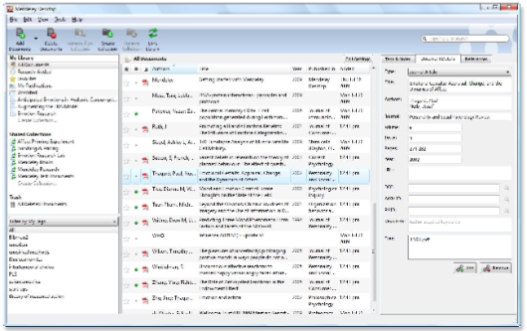
Examples: Mendeley
1.1 million user libraries
106 million papers (MEDLINE has 18 million...)

Slide 9
Examples: Twitter
In one month, over 58k citations from Twitter to scholarly articles (citwaitions?)
It is like having a jury preselect what will probably interest you…. Occasionally there will be something that people will link to, and it will change what I think, or what I’m doing, or what I’m interested in.
-study participant

Slide 10
Research questions
1. How much and what kind of altmetrics data are out there?
Which altmetrics sources generate enough data to be useful?
Is the amount of altmetrics data growing or shrinking?
How rich is the altmetrics data?

Slide 11
Research questions
2. How much and what kind of altmetrics data are out there?
How do they correlate with one another and with citation metrics?
Can we predict citation counts with altmetrics counts?

Slide 12
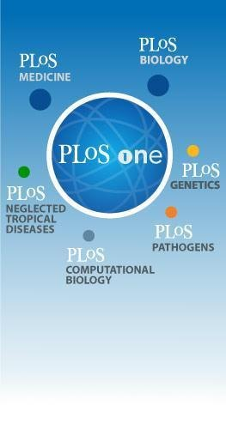
Public Library of Science
Open-access science publisher
6 journals
IF range 4.4 - 12.9
623 - 14,102 articles
Article-Level Metrics (ALM):
citations
blogs posts
bookmarking

Slide 13
Dataset
We collected data for all article published by PLoS:
24,334
articles

Slide 14
Data collection
We built a crawler to find events related to these articles from:
citation in Web of Science, CrossRef, PubMed Central, and Scopus
scholarly bookmarking/reference-management services Mendeley and CiteULike
blogs as tracked by Postgenomic, Nature Blogs, and Research Blogging
popular Web 2.0 services: Facebook, Twitter, and Delicious
citations from Wikipedia
comments from within the PLoS platform,as well as monthly PDF and html downloads.
ratings by Faculty of 1000

Slide 15
Data collection
The resulting dataset contained
1.8 million
rows

Slide 16
Cleaning the data
Two major sources of noise obscuring the impact signal:
trends in global adoption of different services: services get more and less popular
propensity for older articles to have more citation/usage events of all types.

Slide 17
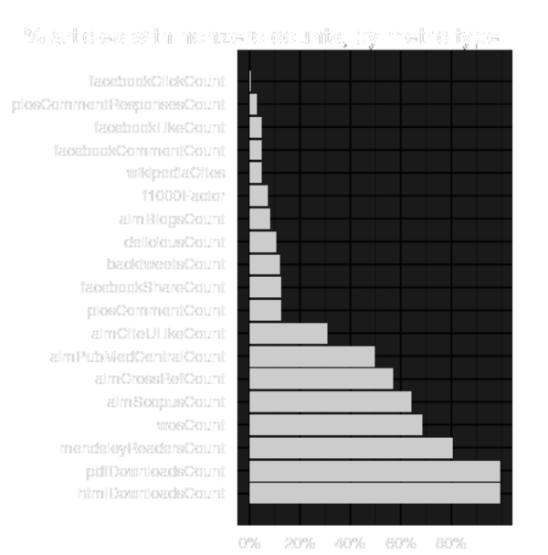
RQ 1.1 Is there enough data?
Some metrics were much more sparse than others, but most event types showed activity on a reasonable percentage of articles.

Slide 18
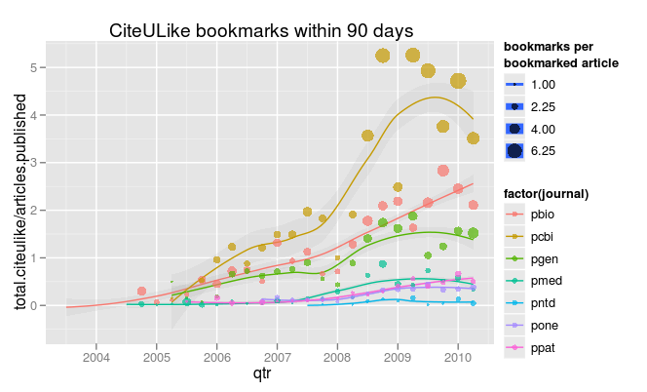
RQ 1.2 Is the amount of data growing?

Slide 19
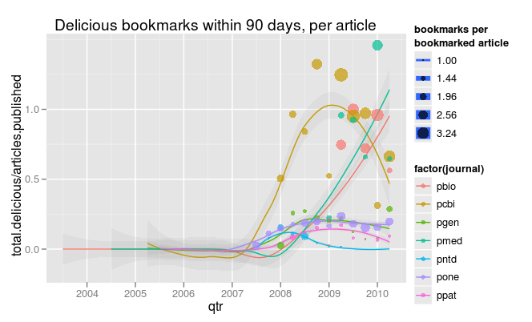
RQ 1.2 Is the amount of data growing?

Slide 20
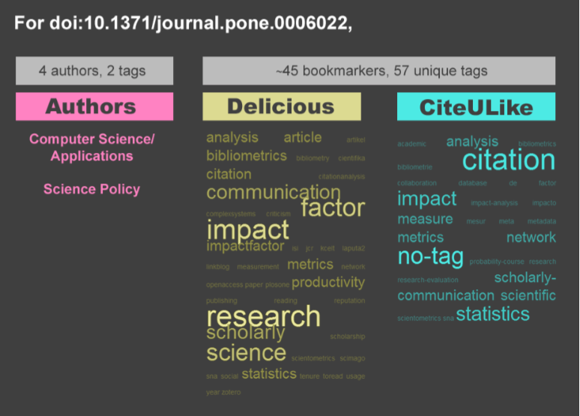
RQ 1.3: How rich is the altmetrics data?
Altmetrics can provide rich metadata, not just counts.

Slide 21
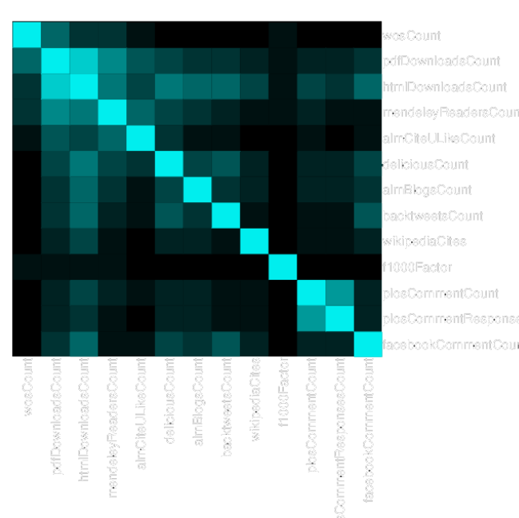
RQ2.1: How do altmetrics correlate?
Altmetrics impact is mostly orthogonal to traditional citation impact.
We need to think about n-dimensional “impact space”

Slide 22
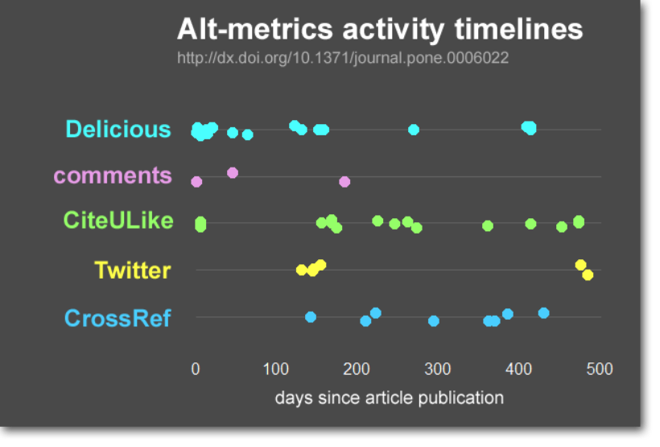
RQ 2.2: Can altmetrics predict citation?
Too early to predict future citation, but looks encouraging:

Slide 23
Conclusions
There are enough altmetrics events to support robust research into usable impact measures.
Social media altmetrics are a significant contributor to citation prediction
Correlation:
altmetrics track impact on varied audiences
altmetrics captures a different sort of impact than citations.

Slide 25
Cleaning the data
We used a Hamming window to normalise event counts for each metric, by:
dividing it by the average metric value of all articles published at about the same time (1yr window),
weighted such that articles published further away in time contributed less to the average.
We then log-transformed counts.

Slide 26
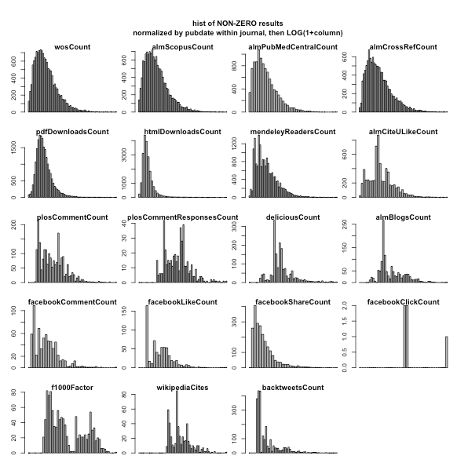
Cleaning the data
Normalised distributions of each event type:

