Slide 1
Science helping the data to help the science
David K Arctur, PhD
UT Schools of Geosciences, Engineering, Information
UNC-SILS Seminar, 2016-02-05
Acknowledgments: David Maidment, Edward Clark, David Gochis, Fernando Salas, Cedric David, Jim Nelson, Simon Cox, Tim Whiteaker, Bill Anderson, Bob Arko, Tom Narock, Maryia Halubok, EarthCube Engagement Team
Notes:
Hi, I’m David Arctur, research scientist / research fellow at three different schools at the University of Texas at Austin. I’d like to talk with you today about some events and advancements that have come out of the last couple years of research. I think this the first presentation I’ve given that ties in all the different threads of my activities at UT Austin. And I have a lot of folks to thank for material and insights that went into this. Before I get started, just want to point out that a lot of references & links & spelled out acronyms are in the speaker notes for this presentation, and I’m making it downloadable.

Slide 2
Scientists helping the data to help the science
David K Arctur, PhD
UT Schools of Geosciences, Engineering, Information
UNC-SILS Seminar, 2016-02-05
Acknowledgments: David Maidment, Edward Clark, David Gochis, Fernando Salas, Cedric David, Jim Nelson, Simon Cox, Tim Whiteaker, Bill Anderson, Bob Arko, Tom Narock, Maryia Halubok, EarthCube Engagement Team
Notes:
And I should mention that social issues play as much of a role here as technical.

Slide 3
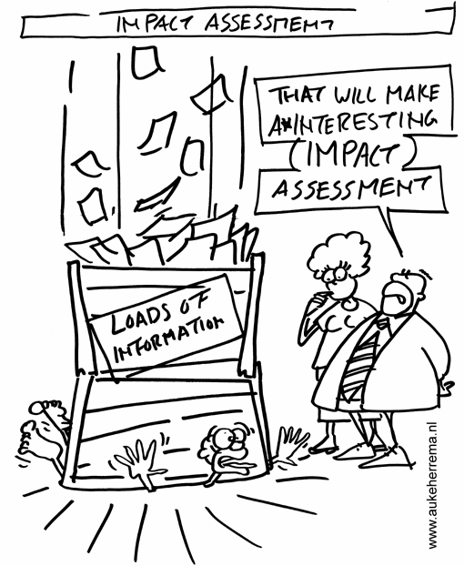
Does data (mgmt)
get you down?
We continually have to get better at making more sense out of bigger data!
Notes:
It seems like every year or two, there’s more data and it’s at higher spatial & temporal resolution than before. It even changes during a project, which is why the guy in this cartoon is hurting so much. We have to keep getting smarter about how we manage data. Somehow we have to start getting ahead of it, not always playing catchup.
The point with the first story ahead is to briefly summarize one example of big data in the real world, and one of the underlying information models. It’s not to teach how to model water observations or streamflow forecasts, but to point out that this one information model can actually accommodate multiple disparate subject domains, and that treating the entire national river network as a network instead of as individual rivers enabled a huge advance in real-world forecasting capability. This is one of the most amazing breakthroughs I’ve seen in my career.

Slide 4
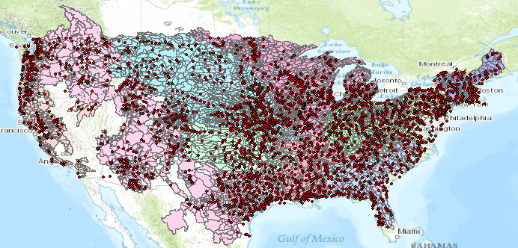
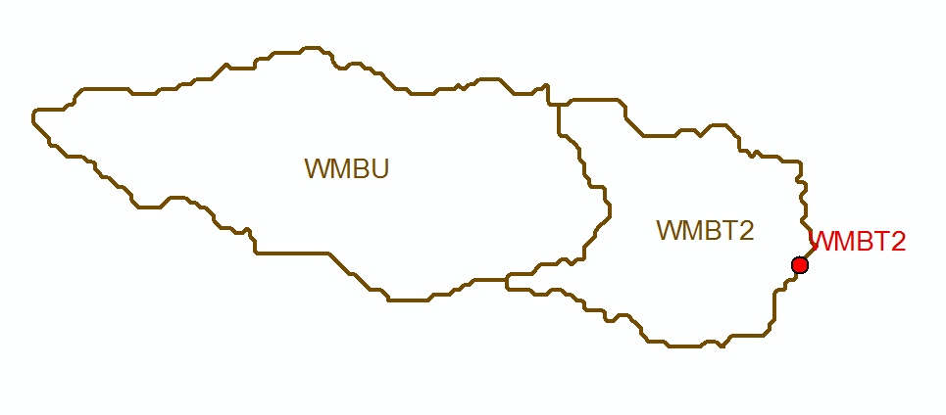
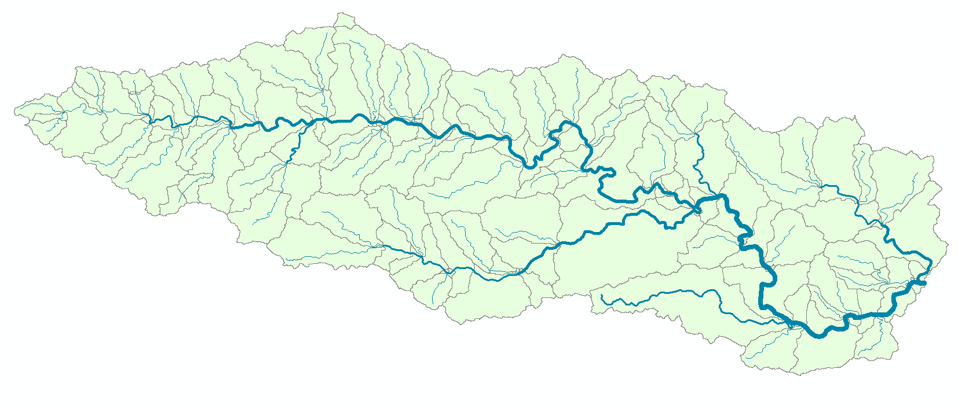
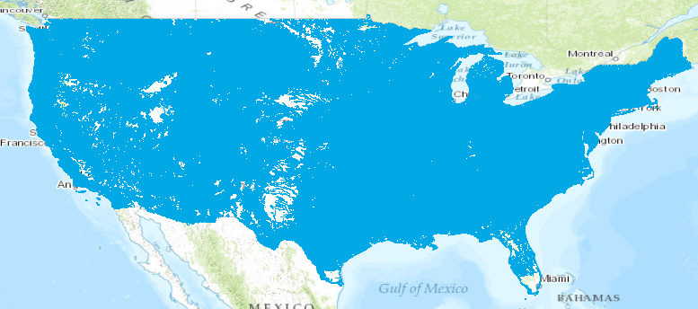
2014-15 National Flood Interoperability Experiment (NFIE): Upgrading the US National Weather Service River Forecasting System…
Blanco River at Wimberley
Current: 6600 basins and 3600 forecast points
Two basins and one forecast point
Basin ~ 400 Sq Mile
become
NFIE: 2.7 million stream reaches and catchments
Reach Catchment ~ 1 Sq Mile
130 Catchments and Flowlines
uniquely labelled
A national flow network
Notes:
Here’s a Big Data story from a recent project, just finishing its second year. This has been led by Prof. David Maidment at the Center for Research in Water Resources, in collaboration with these universities, research centers, and the National Weather Service. Dr. Maidment’s been working for several years with a number of researchers and developers, to come up with a way of predicting the streamflow and flooding at a continental scale. In 2014, a few key breakthroughs catalyzed the project that became NFIE. This is enabling the NWS to advance the coverage and density of its River Forecasting System by more than two orders of magnitude. It’s also incorporating all coastal areas, which are not included in the current River Forecasting System.
NCAR = National Center for Atmospheric Research, Boulder CO
CUAHSI = Consortium of Universities for the Advancement of Hydrologic Science, Medford MA
Note that Univ of Alabama in Tuscaloosa is the home of the new National Water Center of the National Weather Service.

Slide 5
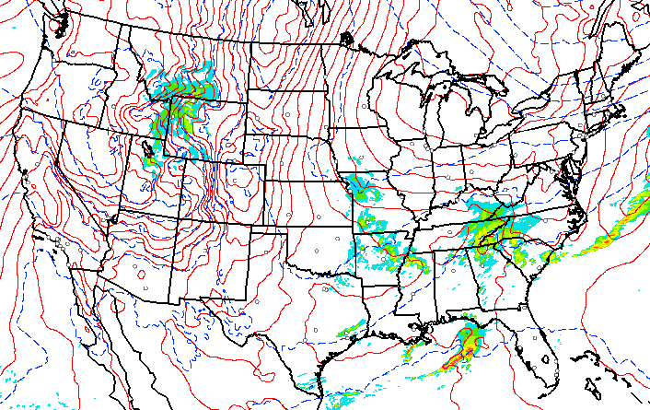
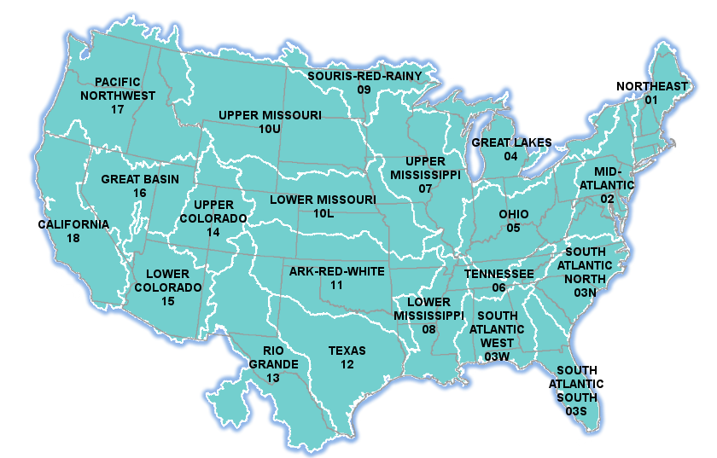
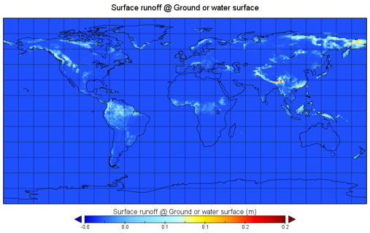
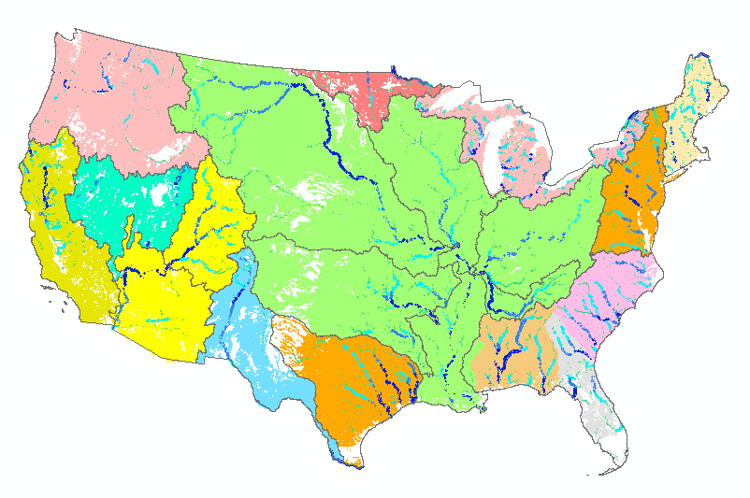
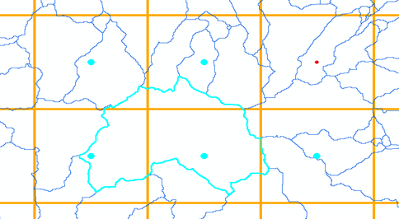
Coupling Land-Surface Models with Streamflow Routing Model
US National Weather Forecast
(HRRR)
15-hr rainfall forecast, updated ~1 hour
50-forecast ensemble: 15-day rainfall & runoff, updated ~12 hrs
US high-resolution
stream network, catchments, dams, gages
Global Weather Forecast & Land Surface Modeling (ECMWF – HTESSEL)
Land Surface Model (Noah-MP)
BYU-HydroShare Cloud
Runoff
Streamflow Routing Model
(RAPID)
Runoff
Convert grids to catchments
Convert grids to catchments
Notes:
This diagram represents two distinct modeling workflows: one for the US NWS, and one for global prediction (academic use only). The stream network, GIS layers, and grid-downscaling matrix are prepared ahead of time, to provide important context (inputs) for the forecasting models. The total processing time from weather forecast input to streamflow forecast output is about 12 minutes for the continental US, thanks to TACC. This workflow is repeated every 3 hours, 24x7 (will be every hour in 2016).
The global modeling workflow is run every 12 hours, for selected watersheds in various countries participating in the research (US, Colombia, Greece, New Zealand, and others). The ERA Interim product provides >35 years of global weather backcasting. This is very useful for developing countries and remote regions lacking meteorological & hydrological records. This is downscaled to the same catchments and watershed boundaries used in the forecasting models. I was the programmatic lead in the global outreach project. The science lead was Prof. Jim Nelson at BYU.
NHDPlus = USGS National Hydrography Dataset; digital map of US stream network at 1:100k, with 2.7 million stream segments & catchments, topologically related.
HRRR = National Weather Service’ s High-Resolution Rapid-Refresh weather forecast, http://ruc.noaa.gov/hrrr/
WRF-Hydro = Weather Research & Forecast – Hydrologic modeling framework, https://www.ral.ucar.edu/projects/wrf_hydro
NOAH-MP is a land-surface model, which is coupled with RAPID in WRF-Hydro. This is developed and maintained by NCAR.
RAPID = River Application for Parallel ComputatIon of Discharge, http://rapid-hub.org/ (see next slide)
ECMWF = European Centre for Medium-Range Weather Forecasting; uses HTESSL land-surface model. ERA Interim is the ECMWF Reanalysis product.
NWS does not use the ECMWF forecasts or modeling outputs; it’s part of the academic research workflow.
TACC = Univ of Texas Advanced Computing Center in Austin. Provides computational platform for academic research workflow.
BYU = Brigham Young Univ, Provo UT, which provides computational support for the global forecasting applications; to be hosted through HydroShare (in progress) See www.tethysplatform.org.

Slide 6
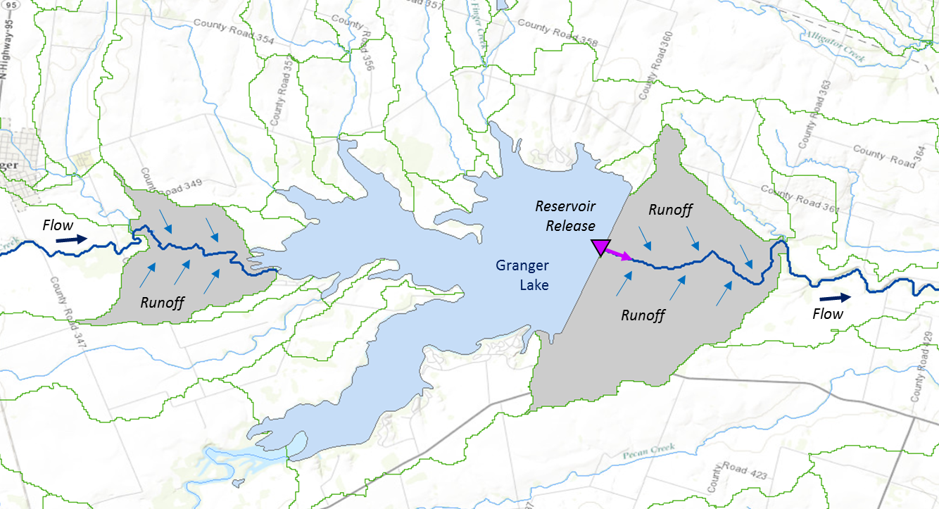
Muskingum
Method
RAPID River Routing Model
River Application for Parallel ComputatIon of Discharge
S_{prism} = KQ
S_{wedge} = KX (I – Q)
Computational Unit for Rivers
Forcing: Runoff and reservoir releases
NHDPlus Catchment
Flow
Legend
Dam
Junction
Catchment
http://rapid-hub.org/
Notes:
RAPID is a hydrologic model that estimates the flow rate in cubic feet or meters per second, in each stream segment, based on the incoming streamflow and the runoff from its surrounding catchment. It also takes into account releases from dams in the stream, where these are known. This was developed by Cedric David at Univ of Texas at Austin, now maintained at NASA Jet Propulsion Lab (JPL).
The orange grid overlay represents the NOAH-MP land surface model grid, which is mapped to the NHDPlus catchment boundaries, using an area-based weighting approach.

Slide 7
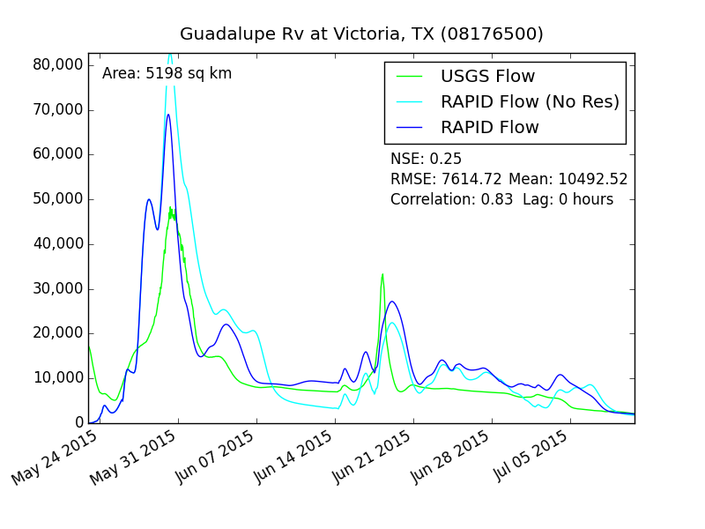
How well does the simulated forecast match the observations?
Simulated, no reservoir releases (light blue)
Simulated, with reservoir releases (dark blue)
USGS stream gage recording (green)
Notes:
This is a graph comparing model results with observation. This graph shows high correlation when the reservoir releases are taken into account. But the model does not always correlate so well, such as when flooding goes above the stream banks.
USGS Flow = observations from USGS NWIS stream gage (identified just above graph frame)
RAPID Flow (No Res) = RAPID simulation without reservoir releases taken into account
RAPID Flow = RAPID simulations with reservoir releases accounted as external inputs (NWS feed)

Slide 8
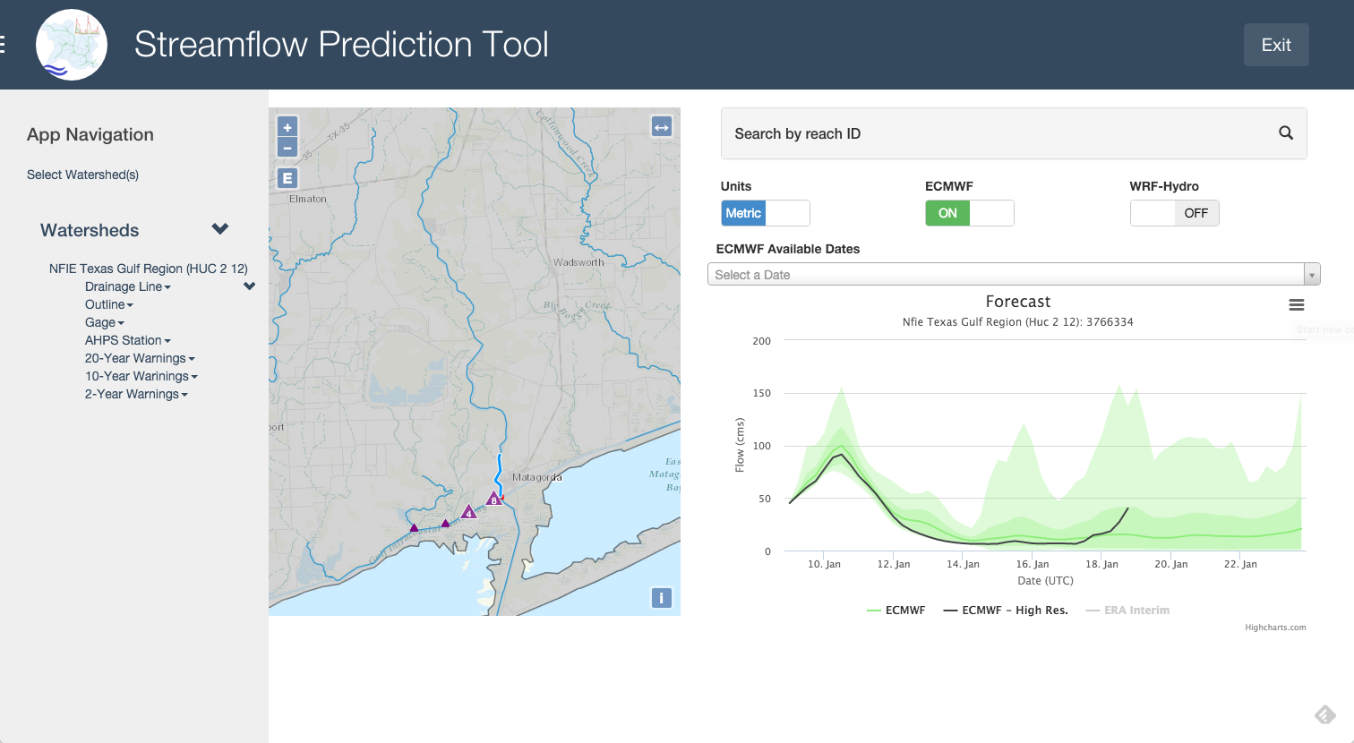
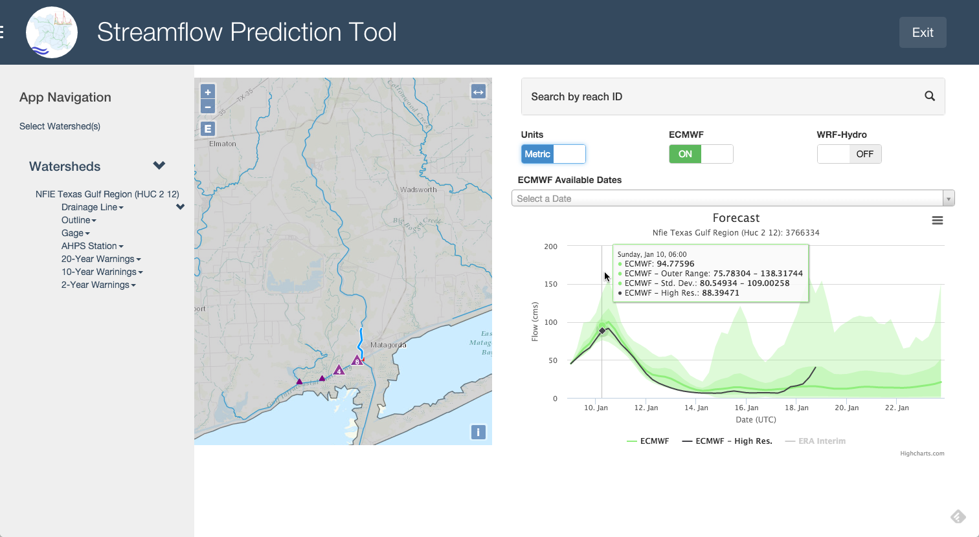
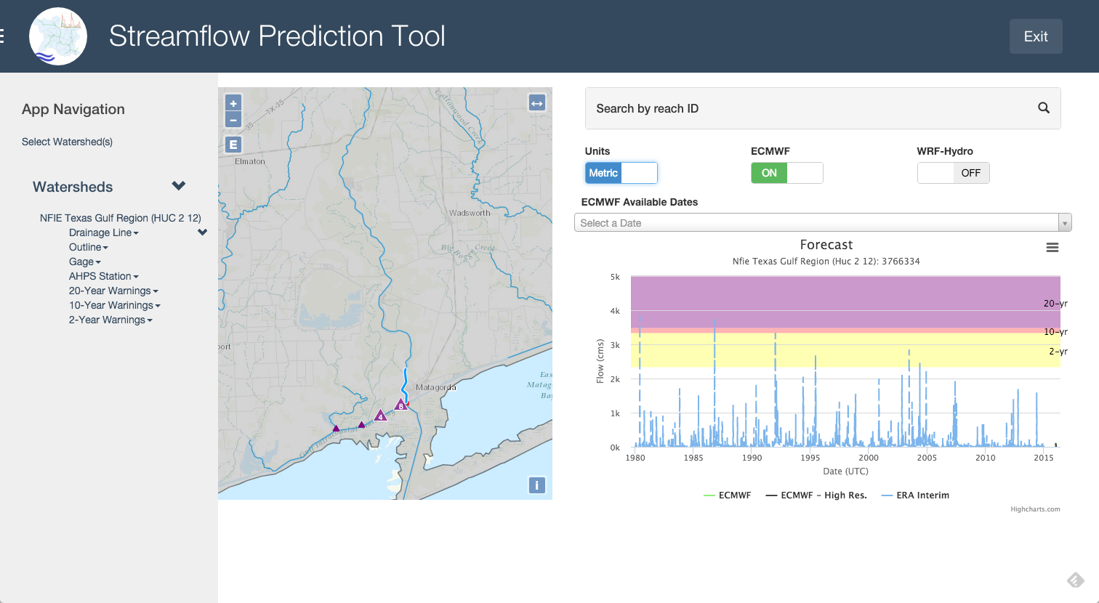
Client apps are being built (www.tethysplatform.org)
http://demo.tethysplatform.org/apps/erfp-tool/
Notes:
This Streamflow Prediction Tool is a web app developed at BYU for NFIE. It’s showing a map of Texas coastal streams and gages.
Click once to see ERA Interim data added to forecast; this is 35-year history of streamflow at this location, based on ECMWF Reanalysis product.
Click again and you should see a fuzzy speaker icon; click on the icon and it will show a video of a recent storm that created floods across Texas.
With (free) Esri post processing tools we can generate animations of the 15 day forecasts showing the timing of the larger flows from last October’s flooding.

Slide 9
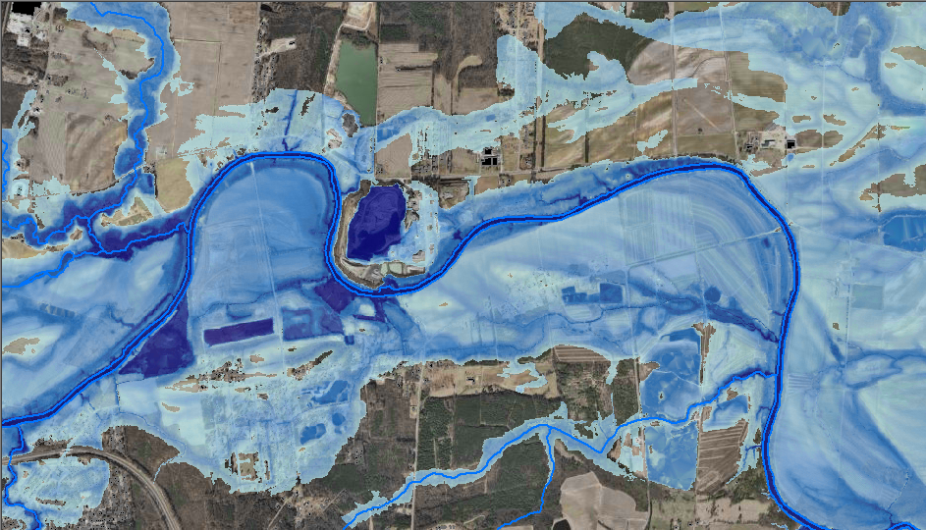
In Development: Mapping Flood Depth
Notes:
The next stage of development is to map flood inundation. This can’t be done in real-time (yet). Several approaches are being investigated. This is planned to be complete during 2016. I could say more about this, but I want to get into a couple other topics in the time remaining.

Slide 10
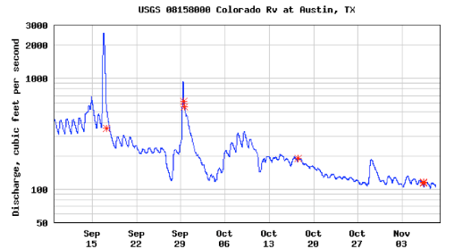
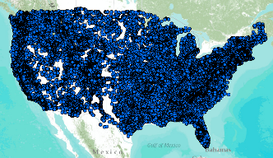
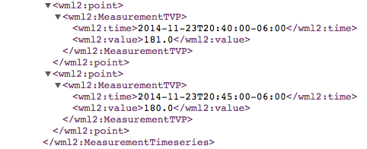
Enabled by data standards, protocols & institutions… WaterML & Web Services
CUAHSI – Consortium of Universities for Advancement of Hydrologic Science
USGS – U.S. Geological Survey
NWS – U.S. National Weather Service
OGC – Open Geospatial Consortium (international standards for data exchange)
WMO – World Meteorological Organization (operational meteorology & climate data)
Water time series data on the internet
24/7/365 service
For daily and real-time data
. . . Operational water web services system for the United States
http://waterservices.usgs.gov/nwis/iv/?format=waterml,2.0&sites=08158000&period=P1D&parameterCd=00060
Notes:
WaterML is a profile of OGC O&M specifically designed for water observations (time series). This diagram shows recent WaterML output from the US Geological Survey for one of their 8 or 9 thousand river gages (this one is on the Colorado River in Austin TX). The red marks represent calibrations of the stream gage.

Slide 11
OGC Observations & Measurements data model: a way of relating features & phenomena
An Observation is an action whose result is an estimate of the value of some property of the feature-of-interest, obtained using a specified procedure
GFI_Feature
1
+featureOfInterest
0..*
OM_Observation
GF_PropertyType
+
phenomenonTime
1
+
resultTime
+observedProperty
+
validTime [0..1]
+
resultQuality [0..*]
+
parameter [0..*]
0..*
1
+procedure
+result
OM_Process
Any
Source: ISO 19156
Notes:
One of the ways science is helping the data is in the careful definition of observations, as described in the Open Geospatial Consortium (OGC) / ISO data model standard presented here. This describes and relates several distinct aspects of an observation or measurement. The diagram shows a subset of key properties of the various components of an observation. The labels on the directed arrows represent the role of each target class.
The OGC Observations & Measurements conceptual model is also known as ISO 19156. This is the underlying data model for OGC WaterML (next slide)

Slide 12
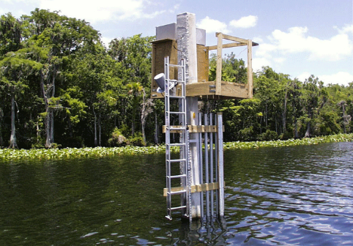
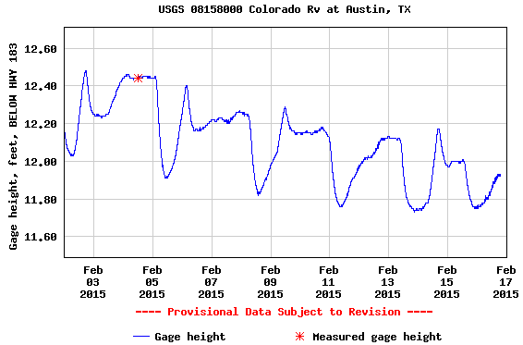
Using OGC O&M model for water level …
(WaterML2 Part 1)
GFI_Feature
Stream Gage
1
+featureOfInterest
sampling feature
River is a
sampled feature
0..*
Stage Height
OM_Observation
GF_PropertyType
+
phenomenonTime
1
+
resultTime
+observedProperty
+
validTime [0..1]
+
resultQuality [0..*]
+
parameter [0..*]
0..*
1
+procedure
+result
Time series of values
OM_Process
Any
Water level measurement
Source: USGS
An Observation is an action whose result is an estimate of the value of some property of the feature-of-interest, obtained using a specified procedure
Notes:
This diagram shows how WaterML2 applies the OGC O&M model to a stream gage time series. The height (or depth) of a stream is generally a quick, direct measurement.

Slide 13
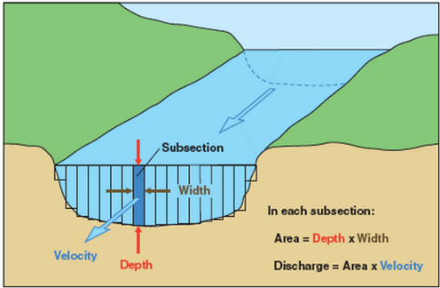
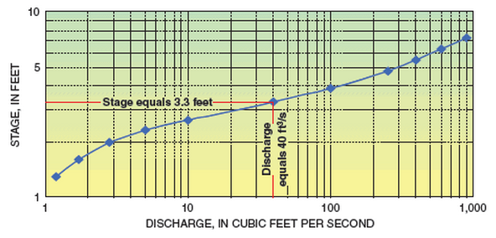
Treating rating curves as a measurement …
(WaterML2 Part 2)
GFI_Feature
Gage Location (x-section)
1
+featureOfInterest
sampling feature
(Depth, Flowrate) pair
0..*
OM_Observation
GF_PropertyType
+
phenomenonTime
1
+
resultTime
+observedProperty
+
validTime [0..1]
+
resultQuality [0..*]
+
parameter [0..*]
0..*
1
+procedure
+result
OM_Process
Any
(Depth, Flowrate) values
Observation or Conversion Method
Source: USGS
An Observation is an action whose result is an estimate of the value of some property of the feature-of-interest, obtained using a specified procedure
Notes:
Rating curves are developed on a planned & as-needed basis, by taking direct measurements of depth and flow, and plotting the curve from this data. This computation is what it means to calibrate a stream gage (red asterisk in time series graphs). The curve is then used to convert real-time measurements of depth into real-time values of discharge.
The object of WaterML 2.0 Part 2 is to apply the OGC O&M conceptual model and WaterML XML schema to convey the set of (stage, discharge) values.
Source: http://water.usgs.gov/edu/measureflow.html
See also: OGC 13-021r3 WaterML 2.0 – Part 2.

Slide 14
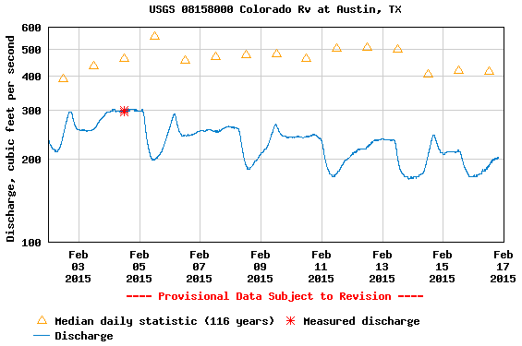
The stream flow determined from a rating curve
(WaterML2 Part 1)
GFI_Feature
Stream Gage
1
+featureOfInterest
sampling feature
River is a
sampled feature
0..*
Discharge
OM_Observation
GF_PropertyType
+
phenomenonTime
1
+
resultTime
+observedProperty
+
validTime [0..1]
+
resultQuality [0..*]
Rating Curve updated
+
parameter [0..*]
0..*
1
+procedure
+result
Time series of values
OM_Process
Any
Flow rate conversion
Source: USGS
An Observation is an action whose result is an estimate of the value of some property of the feature-of-interest, obtained using a specified procedure
Notes:
Stream flow in cubic feet or meters per second is typically not determined in real-time, as it depends on the integration of varying flow rates at a given cross-section; not just a point measurement. This calibration information is captured in a rating curve is shown in the next slide.
Graph source: http://waterdata.usgs.gov/nwis/uv?cb_00060=on&cb_00065=on&cb_00065=on&format=gif_default&site_no=08158000&period=&begin_date=2015-02-02&end_date=2015-02-16

Slide 15
OGC WaterML2 Time Series Types (can vary per point)
Continuous (ie, regular interval)
Discontinuous
Instantaneous total
Average in preceding interval
Maximum in preceding interval
Minimum in preceding interval
Preceding total
Average in succeeding interval
Maximum in succeeding interval
Minimum in succeeding interval
Succeeding total
Constant in preceding interval
Constant in succeeding interval
Statistical (user-defined)
Source: OGC 10-126r4 WaterML 2.0 Part 1 - Timeseries, p.50-55
Notes:
Time series can be measured, modeled, or categorical. This is a list of the types of measured or modeled time series.

Slide 16
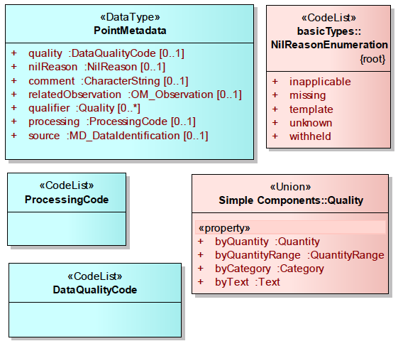
WaterML2 Time Series Point Metadata
Enables point-level:
Quality
Processing code
Related observation
Source
Etc
Quality numeric or categories:
Good
Suspect
Estimate
Poor
Unchecked
Missing
Could be extended
Source: OGC 10-126r4 WaterML 2.0 Part 1 - Timeseries, p.40
Notes:
OGC WaterML also defines time-instance-level metadata that could be assigned to observations. For example, USGS generally marks their initial observations as “P” for provisional, until a validation check has been completed.

Slide 17
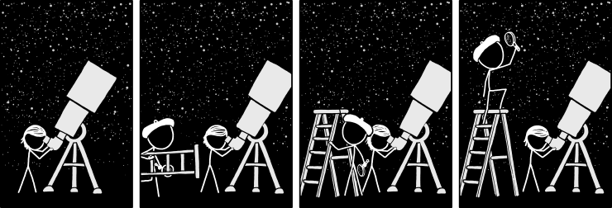
http://xkcd.com/1522/
Okay, enough about the observation data model for now…
Notes:
Ok how are we doing so far? Tired of metaphors yet? My primary goal is really to enable sharing data across disciplines, in practical & useful ways. I wanted to show you one example how that’s being advanced; how data is helping science.
Now I’d like to mention a few reasons why we should care about sharing data.

Slide 18
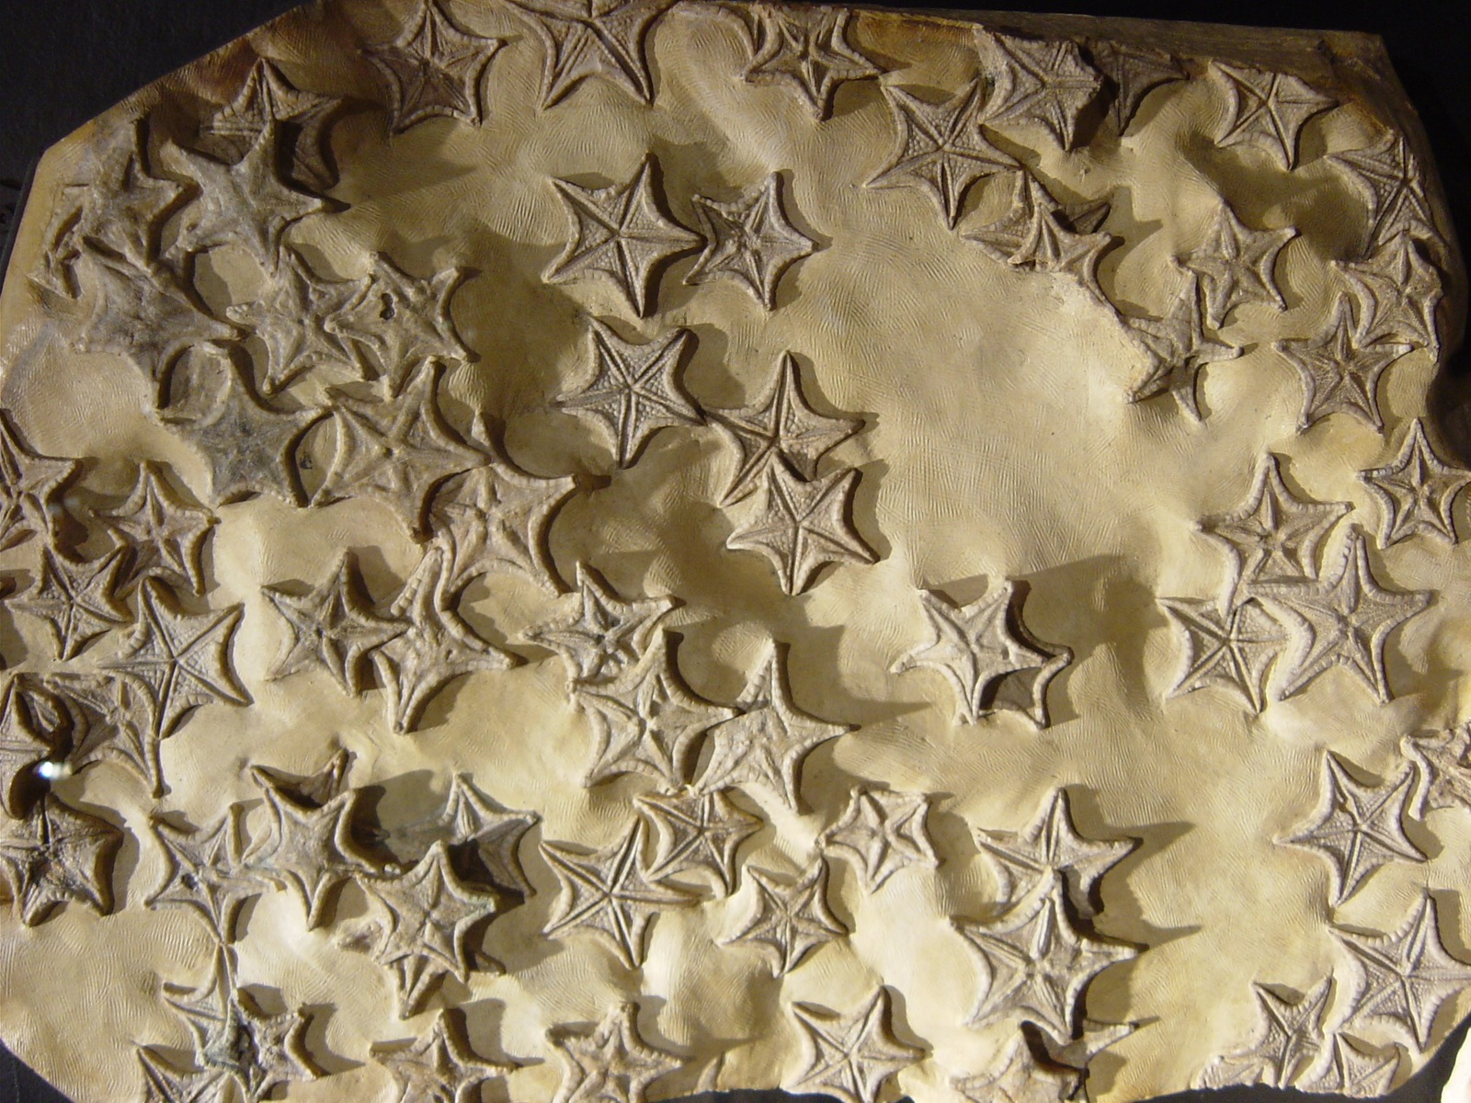
Consider how many creatures that ever lived became fossils? That we’ve found?
Photo: D.Arctur
Notes:
Consider what a small percentage of all previous life on Earth has been captured in fossils, and what a small percentage of these we’ve even found.

Slide 19
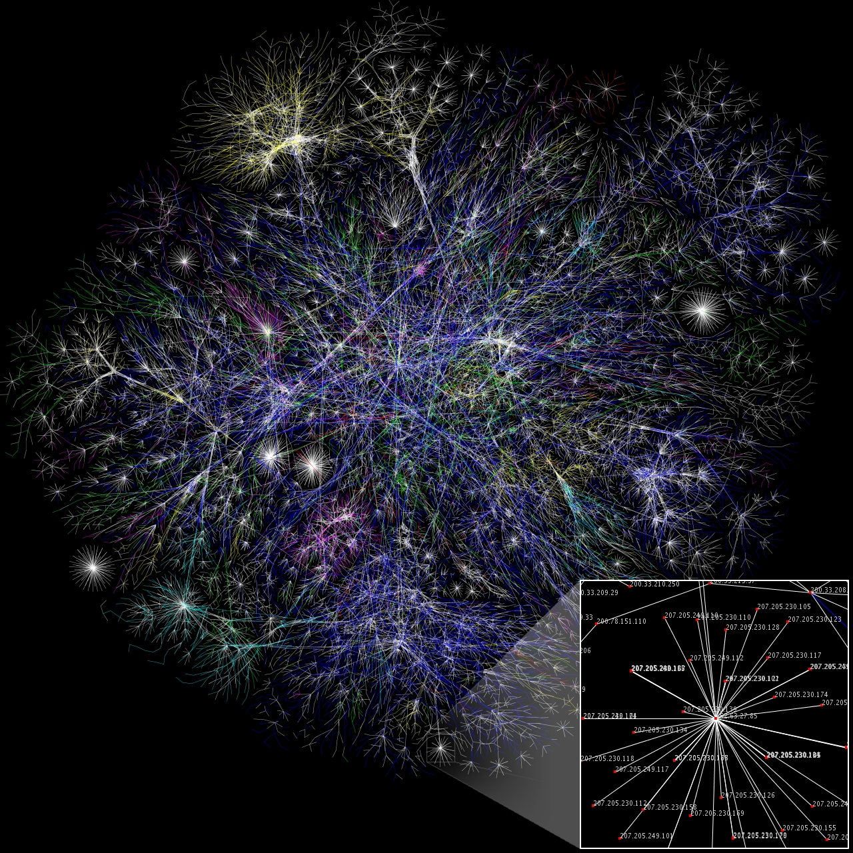
How many nodes on the Internet today will still be around in 5 years? 50? 100?
https://en.wikipedia.org/wiki/Wikipedia:Featured_picture_candidates/Internet_Map
Notes:
Now consider the Internet fossil record. Oh wait, there aren’t any. They just give 404 errors.

Slide 20
How much of your data will anyone be able to find and understand in 5 years? 50?
https://www.datapipe.com/blog/wp-content/uploads/2015/12/data_management.png
Notes:
And how much of your own data will find its way to future scientists (which may be you!) a few months or decades from now?

Slide 21
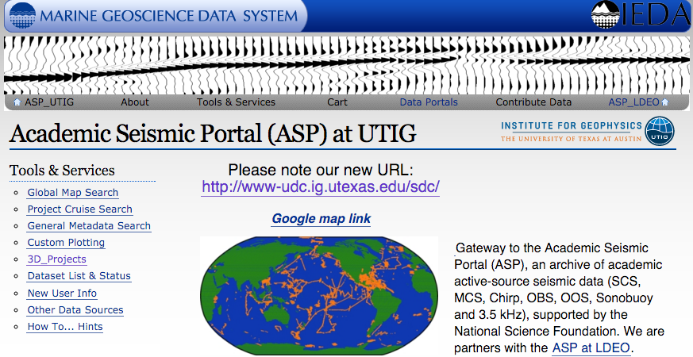
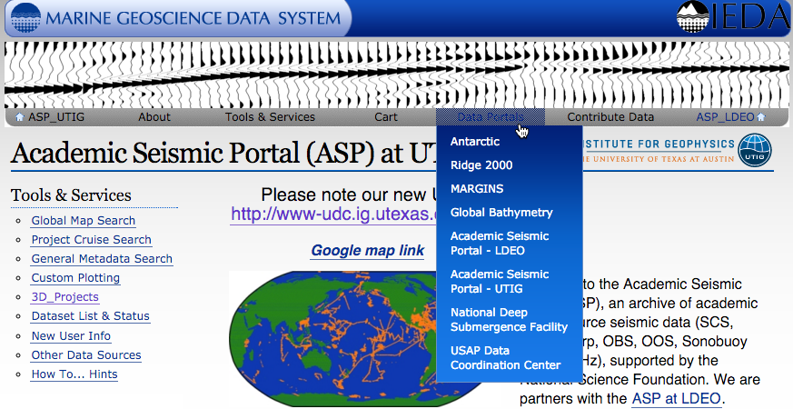
If it’s, e.g., marine seismic data, no problem
http://www-udc.ig.utexas.edu/sdc/
Notes:
If your data is managed through the ASP at UTIG, you’re actually in pretty good shape. The University of Texas Institute for Geophysics (UTIG) and the Lamont Doherty Earth Observatory (LDEO) at Columbia University document and host a large amount of marine seismic and other data for current use. The National Geophysical Data Center (NGDC) in Boulder harvests and archives that data. It should be accessible for many decades.

Slide 22
But suppose your data was someone else’s context, or... you’re looking for context from someone else’s data... how would you find each other’s?
Notes:
But how would others outside your discipline know where to find it? Google?

Slide 23
Now consider: what does this image of nodes on the Internet have in common with…
https://en.wikipedia.org/wiki/Wikipedia:Featured_picture_candidates/Internet_Map
Notes:
Let’s revisit that map of the Internet (made in 1995) …

Slide 24
… this image of a neural net?
http://thelastwanderer.deviantart.com/art/Neural-Network-205781521
Notes:
And compare it with this map of a neural network. Or… (next slide)

Slide 25
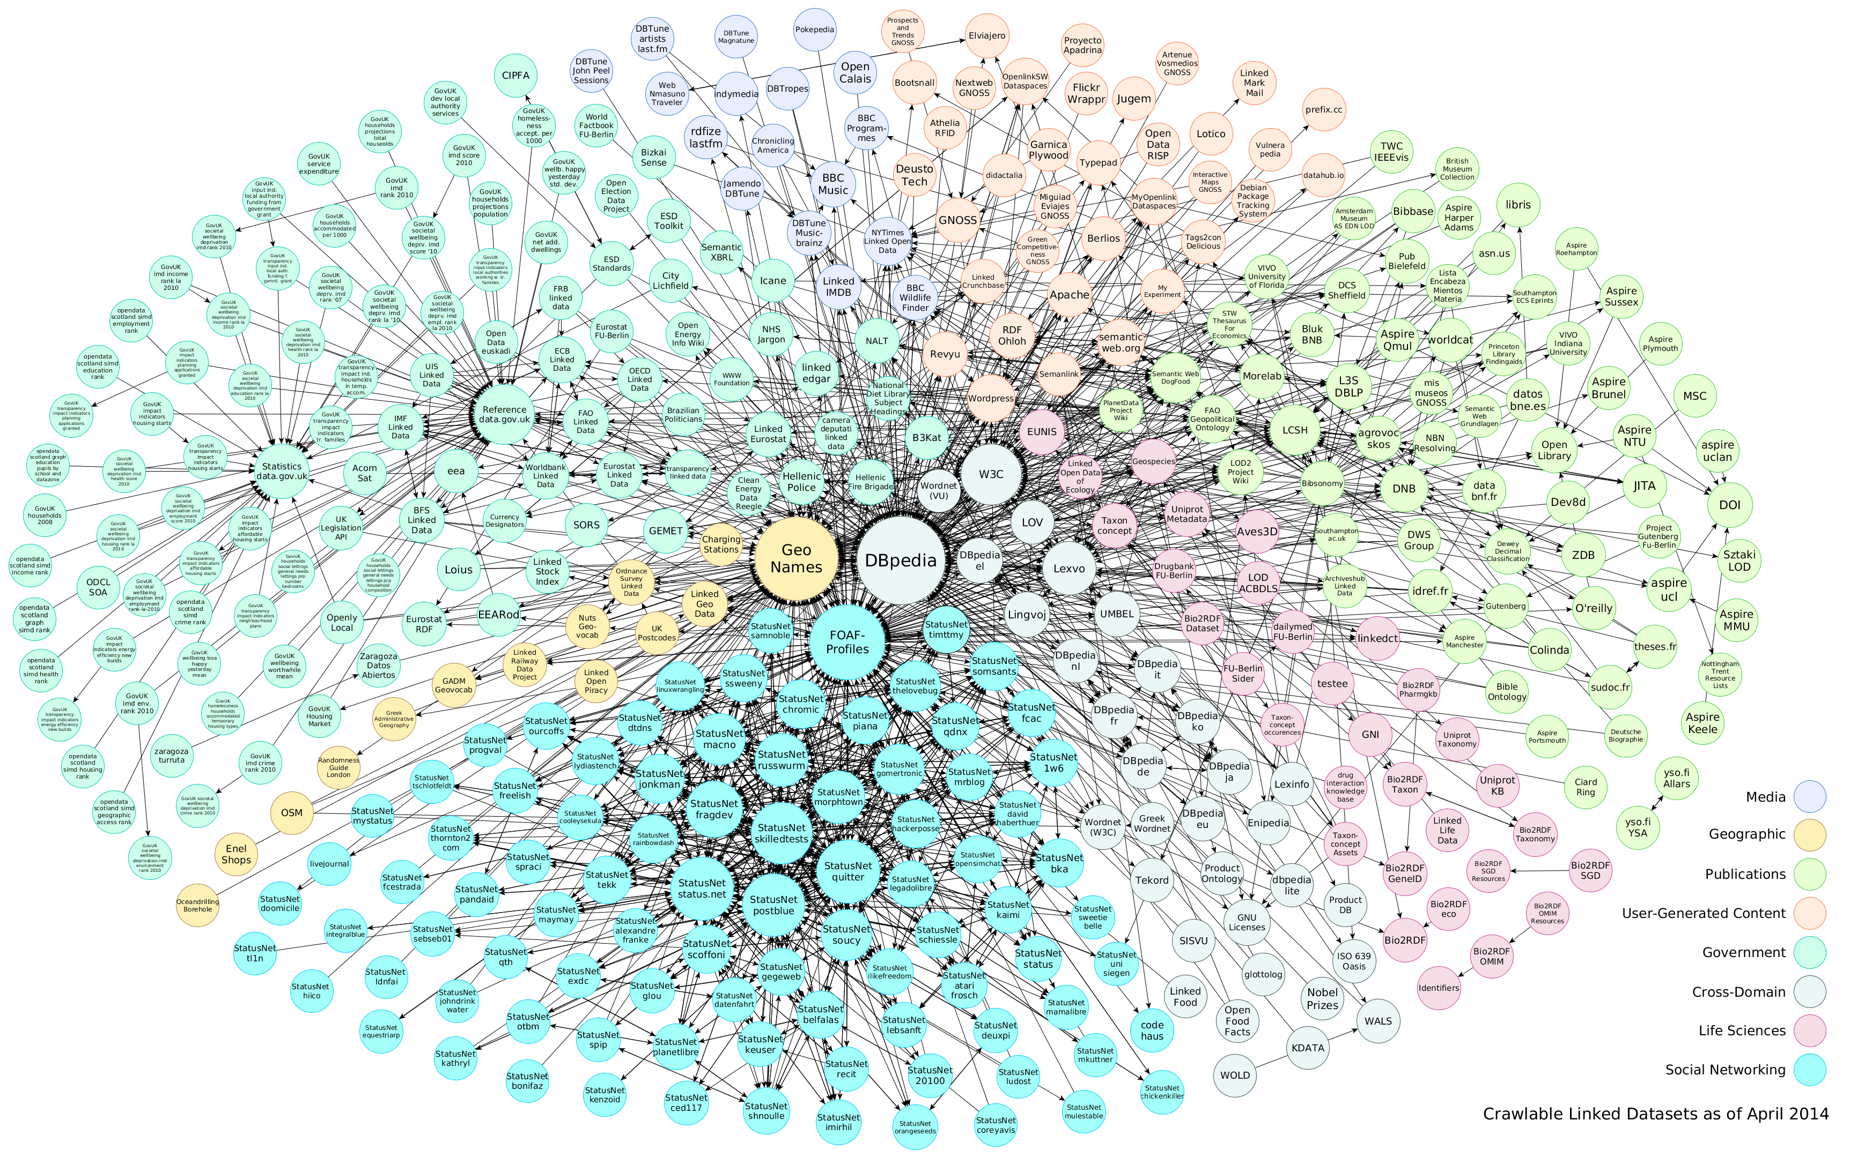
… or this map of linked open data?
https://en.wikipedia.org/wiki/Linked_data
Notes:
And how about this network of linked open datasets (made in 2014)? (next slide)
Note: Below DBpedia is FOAF (an acronym of Friend of a friend) – this is a machine-readable ontology describing persons, their activities and their relations to other people and objects. Anyone can use FOAF to describe him- or herself. See http://semanticweb.org/wiki/FOAF

Slide 26
When we have more context, more connections with other data… We can cast a wider net when searching… and ask more kinds of questions…
Notes:
These are all connectivity networks. Every relationship provides further context. The more context a dataset has, the more forms of meaning it can have. This is how an interdisciplinary knowledge base gets formed. To be a part of the “bigger brain” that’s emerging from our collective knowledge, it’s not enough to share your publications. It’s important to share the data as soon as you can.

Slide 27
From a marine seismic perspective...
Suppose you’re trying to understand
Major subsidence events/earthquakes/volcanic eruptions/hazards;
Dynamics of sea level rise; likely shoreline changes over next 100 years;
Sedimentary evolution of continental margins from Greenhouse to Icehouse (warm climates to cold climates);
Combinations of factors for modes of slip on fault zones;
Impacts of seismic surveys on marine life, chemosynthetic seafloor communities near fluid seeps, etc.
These require studies of data from biology, geology, geohydrology, tectonics, bathymetry, …
From the Marine Seismic Data Workshop, Executive Summary, San Francisco, December 11-13, 2014
http://earthcube.org/document/2014/marine-seismic-domain-workshop-report

Slide 28
From a climate science perspective…
Suppose you’re trying to understand
Predictability of climate phenomena
Across different temporal scales (short term to deep time)
Evaluation of model representation of physical phenomena
How do we know how good the models are
How can we ever predict extreme or surprise events
How to model and evaluate climate change mitigation / geoengineering approaches
Reflective aerosol dispersion; land- or space-based mirrors ; etc.
Dynamics of sea level rise; likely shoreline changes over next 100 years
These require studies of data from atmosphere, land surface, remote sensing, observation networks, paleoclimatology, geology, geomorphology, hydrology, …

Slide 29
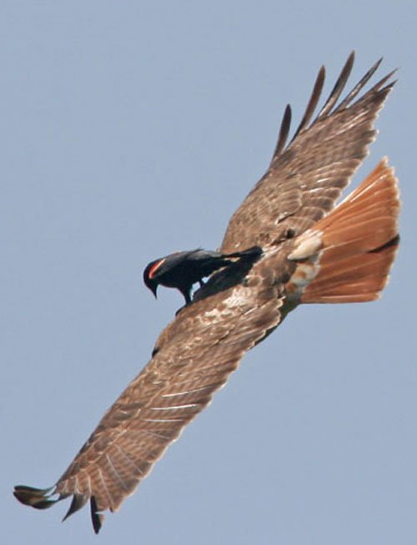
But anticipating interdisciplinary questions gets really hard! Is there a general approach for that?
http://iwishicouldfly.com/iwishicouldfly/journal/images/053007a.jpg
Notes:
It’s hard enough managing a domain-specific database like marine seismic surveys. What does it even mean to plan for interdisciplinary questions?
There is a general approach, and in general you start with what you know.

Slide 30
Just keep remembering: nothing is in isolation
Every system is embedded in another system
Need descriptions using shared vocabularies
Enable machine processing of the descriptions
Let machines help with the analysis
Look for & improve community standard formats & protocols for data exchange.
Avoid proprietary formats, eg, publish CSV not XLS
Notes:
I’m trying to advance the concept of data sharing. Here’s where it starts: with good descriptions using community-adopted vocabularies.
The descriptions should be machine-processable. That means using tools to build standard metadata, with standard terms and meanings. The data formats should be standard, and the means of discovering, requesting and receiving the data should use standard formats and protocols.

Slide 31
We also need permanent, unique identifiers
Like an ISBN for books, and DOI for technical articles, we need unique identifiers for data granules, datasets, and physical samples
Use globally unique, standard identifiers
DOI, ARK (http://ezid.cdlib.org/) – document & data identity
IGSN (http://www.geosamples.org/) – physical sample identity
And if you don’t have an ORCID, you should get one & start using it when you publish papers or data
ORCID (http://orcid.org/) – open researcher/contributor identity
Notes:
ISBN = International Standard Book Number
DOI = Digital Object Identifier; involves a commitment to maintained permanently
ARK = Archival Resource Key; does not require permanent status
ORCID = Open Researcher and Contributor ID

Slide 32
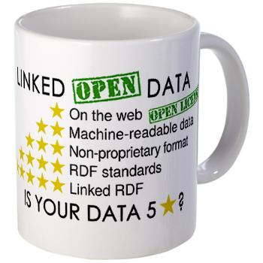
4 Rules for Linked Open Data
Use URIs as names for things
Use HTTP URIs so that people can look up those names (eg, http://orcid.org/0000-0002-4708-6302 )
When someone looks up a URI, provide useful information, using the standards (RDF & JSON-LD, SPARQL & RESTful services)
Include links to other URIs, so that they can discover more things.
GeoJSON and GeoSPARQL are map-enabling the semantic web; ODM2 is an emerging standard vocabulary
Adapted from Tim Berners-Lee, 2006 http://www.w3.org/DesignIssues/LinkedData
Notes:
URI = Uniform Resource Identifier, could be URL (see http://tools.ietf.org/pdf/rfc3986.pdf)
RDF = Resource Description Framework, a flexible schema-less data model. It is one of the core technologies of the Semantic Web and the current W3C standard to represent data on the web. An RDF data store is sometimes called a “triple-store” because it has 3 columns: source, object, and predicate.
SPARQL = is a recursive acronym standing for SPARQL Protocol and RDF Query Language. Able to retrieve and manipulate data stored in RDF format.
JSON = JavaScript Object Notation; JSON-LD = JSON for linked data, which directly maps to RDF.
ODM2 = Observation Data Model v2; built on CUAHSI ODM & OGC O&M; see docs: https://github.com/ODM2/ODM2/wiki/documentation

Slide 33
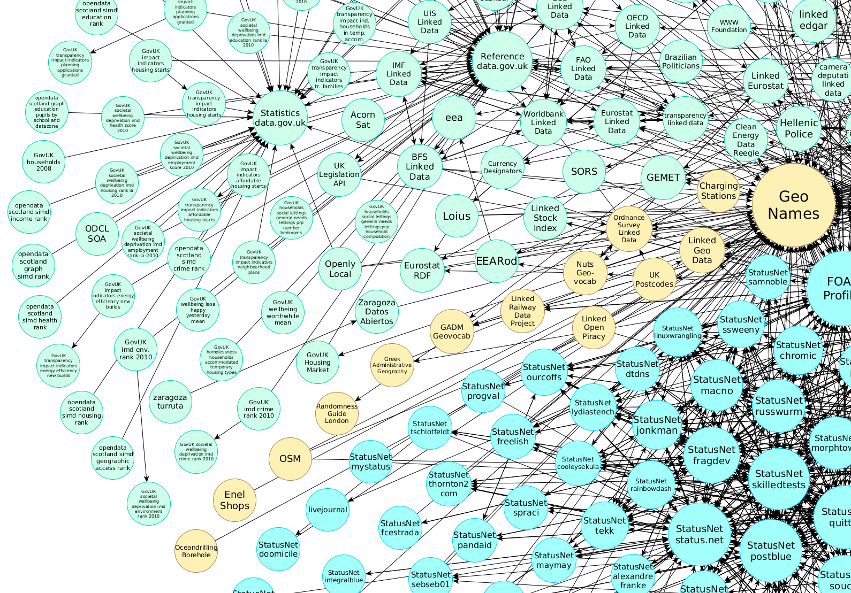
Then patterns of concepts and relationships can emerge…
https://en.wikipedia.org/wiki/Linked_data
Notes:
Notice the yellow datasets have to do with geospatial data, including GeoNames (placenames gazetteer) and OpenDrillingBorehole. These are mostly because the British are ahead of us in this area.

Slide 34
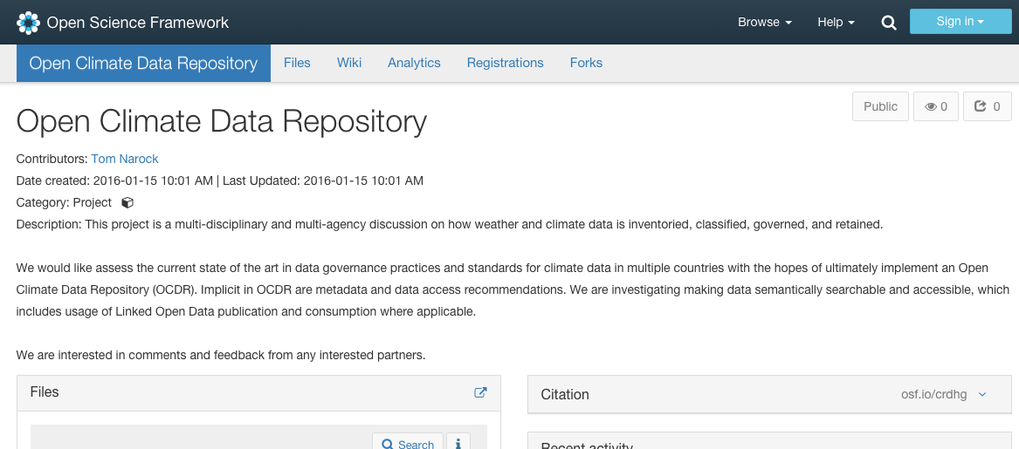
Just out: call for input: https://osf.io/crdhg/ (a project of Earth Science Information Partners http://esipfed.org/ )
Notes:
To climate science community – a call for information (Jan-Feb 2016 timeframe) and watch this space!
Tom Narock is active in the Earth Science Information Partners (ESIP) which has an newly formed group called the Semantics Technologies Committee. He posted this on Jan 15, 2016:
Steve Adler (IBM) gave an interesting presentation at the Winter ESIP meeting [Jan 4-8, 2016, Wash DC] regarding open climate data and what this might entail.
I have since followed up with Steve to see what our ESIP Semantic Technologies Committee might do to help out. Personally, I am intrigued by his discussion of semantics and Linked Data. But, this has led to a broader discussion of bringing in other ESIP Clusters, Working Groups, and individual members who have knowledge and experience in climate data, societal impacts, data management, and data integration.
To this end, we have created a project using the Open Science Framework: https://osf.io/crdhg/. At the moment, it’s very basic as we are just in the information gathering phase. But this is where you can help! If you are interested in working on some of the things Steve discussed or have pointers to relevant information - please email me. We can add you to the project discussion and/or link to your resources in our wiki page.
I offered to help gather resources and information within ESIP. Steve is doing the same at IBM and NASA. In a few weeks we’ll regroup and see where we are. Any comments/suggestions on what you’d like to see or where this might go are welcome.
Reply to: Tom Narock <tnarock@marymount.edu>

Slide 35
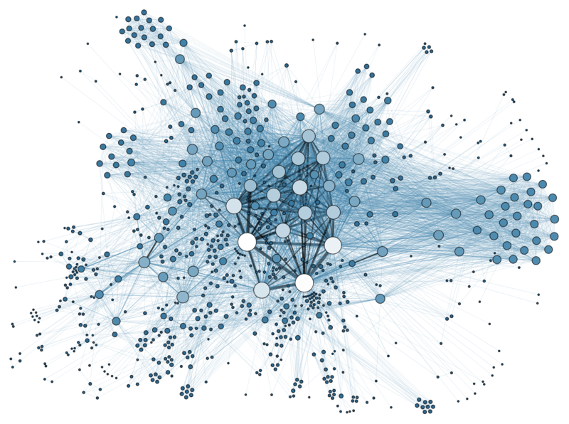
But the landscape is fragmented…
Institutional
Repositories
Just making data open is a conflicting, emerging topic… eg, when & how much to publish
Good article on tradeoffs and guidelines (6-Jan-2016): http://www.nature.com/naturejobs/science/articles/10.1038/nj7584-117a
Journals (538 publishers) are leading the way, see Nosek, B. et al. Science 348, 1422–1425 (2015)
Data
Centers
Community-Led
Databases
Governmental
Organizations
Industry
Partners
Field
Geoscientists
Graphic : "Social Network Analysis Visualization" by Martin Grandjean https://commons.wikimedia.org/wiki/File:Social_Network_Analysis_Visualization.png#/media/File:Social_Network_Analysis_Visualization.png
Notes:
The fundamental challenge is to bring all the players to the table, but we face a fractured & fragmented landscape.

Slide 36
EarthCube…
Balancing infrastructure development & scientific advancement to create sustainable, multidisciplinary solutions
Science
End User
Workshops
EarthCube
Committees
RCNs
Integrative
Activities
Building
Blocks
Cyber
Infrastructure
Notes:
Which brings me to my last topic.
EarthCube is a long-term NSF initiative to advance science through advancements in data creation, management and sharing.
Balancing “Scientific Progress” and “Cyberinfrastructure Development” is a significant challenge, and it requires acknowledging that cyberinfrastructure solutions are primarily scientifically driven. The portfolio of initiatives that EarthCube has supported reflect fundamental investments in cyberinfrastructure development, motivated by scientific advancement within the geosciences.

Slide 37
EarthCube Building Block
GeoLink: Semantics and Linked Data for the Geosciences
http://earthcube.org/group/geolink
GeoLink is enabling partner data systems to publish their content as Linked Data using a shared vocabulary
Eg, a shared concept is “Seismic Survey”…
IEDA will publish a L-D resource (chunk of metadata) for ~200 multi-channel seismic surveys
Each will, in turn, be linked to the R2R master catalog of ~6000 cruises
Each cruise is linked to the SESAR catalog which includes ~150k physical samples from cruises
How does this help the researcher?
Notes:
IEDA = Interdisciplinary Earth Data Alliance, http://www.iedadata.org/
SESAR = System for Earth Sample Registration, http://www.geosamples.org/
IODP = Integrated Ocean Drilling Program, http://www.iodp.org/
R2R = Rolling Deck to Repository Program, http://www.rvdata.us/
BCO-DMO = Biological & Chemical Oceanography Data Management Office, http://www.bco-dmo.org/
Other GeoLink partner repositories include:
DataONE = Data Observation Network for Earth, https://www.dataone.org/
LTER = Long-Term Ecological Research Program, http://www.lternet.edu/
MBLWHOI = Library of the Marine Biological Laboratory / Woods Hole Oceanographic Insititute, http://www.mblwhoilibrary.org/

Slide 38
EarthCube Building Block
GeoLink: Semantics and Linked Data for the Geosciences
http://earthcube.org/group/geolink
Google search automatically raises the rank of objects that link to others.
By interlinking entire huge metadata collections, this raises the rank of all the metadata in google searches → easier to search for any shared vocabulary term.
Notes:
Example google searches: “Cruise TN303”
Example use case: A scientist is reading an online journal article about a trace element dataset collected and analyzed during a recent oceanographic research cruise. She clicks on the DOI for the dataset, and arrives at the BCO-DMO database. BCO-DMO provides a link to download the dataset +accompanying documentation.
In addition, BCO-DMO provides a link to the GeoLink knowledgebase which has additional info related to the field expedition (cruise) and/or the person who collected +published the dataset. This might include the cruise report and navigation data from the R2R database; links to related cruises from the same large-scale science program (eg. GEOTRACES), curatorial details about the physical samples from the SESAR database; related conference abstracts from the AGU Meetings database; funding award abstracts from the NSF Fastlane database, etc.

Slide 39
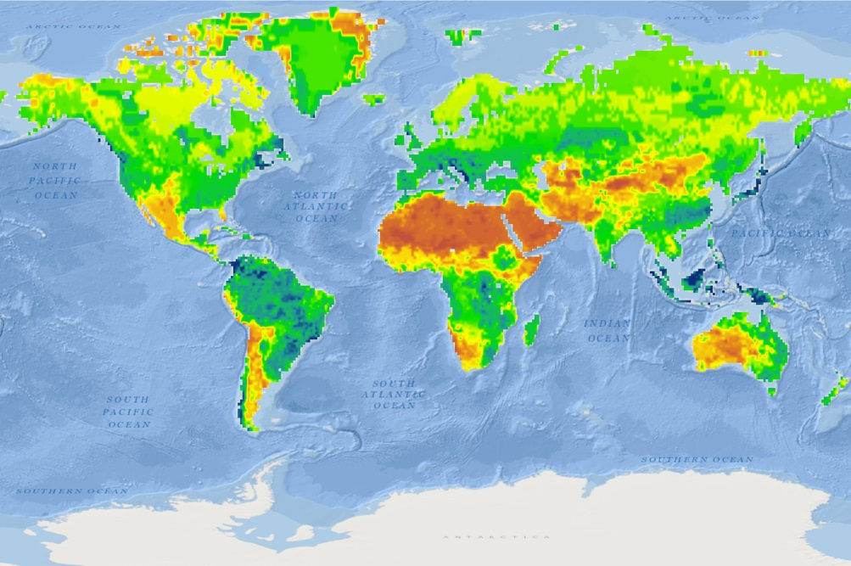
More EarthCube Building Blocks
DisConBB
Building Block for Integrating Discrete & Continuous Data
Integrating gridded (atmospheric) and vector (stream networks) datasets to perform continental-scale stream flow modeling. This project funded part of the National Flood Interoperability Experiment. http://earthcube.org/group/discrete-continuous-data-disconbb
Earth System Bridge
Spanning Scientific Communities with Interoperable Modeling Frameworks
Earth System Bridge will allow interoperable modeling frameworks, enabling communities to collaborate and advance earth system science. http://earthcube.org/group/earth-system-bridge
-
GeoDataSpace
Simplifying Data Management for Geoscience Models
Developing a cyberinfrastructure that will assist scientists and communities to create and maintain collections of geounits that pertain to a specific research project. http://earthcube.org/group/geodataspace
Notes:
These are just three of the several BBs underway or recently completed. Prof. David Maidment was PI of DisConBB (2013-2015, now completed)
GeoSoft Collaborative Open Source Software Sharing for the Geosciences
GeoWS Geoscience Web Services
ODSIP An Open Data-Services-Invocation Protocol (ODSIP)
CHORDS Cloud-Hosted Real-Time Data Services for the Geosciences
CyberConnector - Bridging the Earth Observations and Earth Science Modeling for Supporting Model Validation, Verification, and Inter-comparison
Digital Crust - An Exploratory Environment for Earth Science Research and Learning
EarthCollab - Enabling Scientific Collaboration and Discovery through Semantic Connections
GeoDataspace - Simplifying Data Management for Geoscience Models
GeoLink - Leveraging Semantics and Linked Data for Data Sharing and Discovery in the Geosciences
GeoSemantics - A Geo-Semantic Framework for Integrating Long-Tail Data and Models

Slide 40
Research Coordination Networks (RCN)
Cyber4Paleo
Collaboration & Cyberinfrastructure for Paleogeosciences
C4P RCN focuses on development of standards for aggregation & dissemination of paleogeoscience data, to facilitate research on Earth-Life history. http://earthcube.org/group/c4p
https://www.youtube.com/user/cyber4paleo
iSamples
Internet of Samples in Earth Sciences
iSamples RCN is to dramatically improve discovery, access, sharing, analysis, and curation of physical samples and data generated by their study. http://earthcube.org/group/isamples
-
ECOGEO
EarthCube Oceanography & Geobiology Environmental ‘Omics
ECOGEO will facilitate integration ocean/geoscience and cyberinfrastrucure ‘omics domains and environmental data, to better adapt to rapidly changing technologies for data acquisition and analysis. http://earthcube.org/group/oceanography-geobiology-environmental-omics
Notes:
To that end, research coordination networks have been developed to connect domain scientists to developments in cyberinfrastructure, providing a range of resources.
These are 4 of at least 16 RCNs underway or recently completed. One of the iSamples co-PI’s is Ann Molineux, and the PI of SEN is Wonsuck Kim, both in UT JSG.

Slide 41
Be a part of the evolution…
Leadership Council
Office
Science Committee
Engagement Team
Technology & Architecture Committee
Council of Data Facilities
Liaison Team
Talk to EarthCube participants
Attend EarthCube Workshops
Join the mailing list at earthcube.org
Follow on twitter @earthcube
Apply for funding (EC Travel Grants, Distinguished Lecturers)
Notes:
EarthCube governance, and how to engage…

Slide 42
New EarthCube Funding
NSF 16-514, Amendment 5: Prototypes, Capabilities and RCNs
Released Dec 5, 2015; replaces NSF 13-529
http://www.nsf.gov/funding/pgm_summ.jsp?pims_id=504780
Prototypes & Capabilities proposals due March 24, 2016
1-2 prototype awards, 36 months, up to $2.5 million each
<= 12 capabilities awards, 24-36 months, $500k-$1.7 million each
RCN proposals accepted anytime
3-5 RCN awards, 24 months, up to $300k each
Notes:
This CFP was just released Dec 5, 2015.

Slide 43
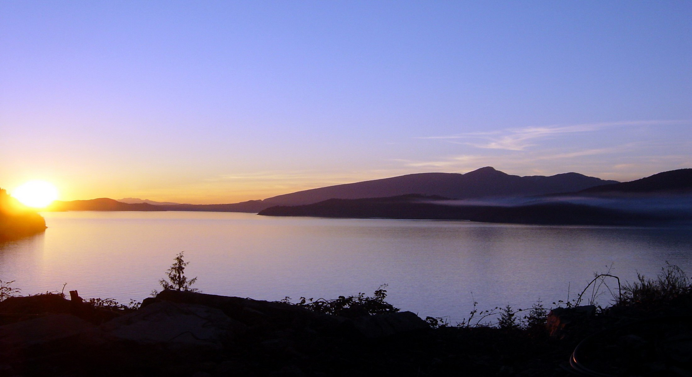
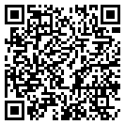
The point is to share data in a way that is practical and useful.
Thank you!
David K Arctur
david.arctur [at] utexas.edu
http://earthcube.org/document/2016/science-helping-data
Notes:
Share link for this presentation on EarthCube is: http://earthcube.org/document/2016/science-helping-data
QR code is for the same URL.

Slide 44
Relevant pubs in 2015
1 - Mayernik, M. S. Ramamurthy, M. K., & Rauber, R. M. (2015). Data archiving and citation within AMS journals. Mon. Wea. Rev., 143, 993–994. doi: 10.1175/2015MWR2222.1
2 - Downs, R. R., Duerr, R., Hills, D. J., & Ramapriyan, H. K. (2015). Data stewardship in the Earth sciences. D-Lib, 22(7/8). doi: 10.1045/july2015-downs
3 - GeoResJ Special Issue: Rescuing Legacy Data for Future Science
Hills, D. (2015). Let’s make it easy: A workflow for physical sample metadata rescue. GeoResJ, 6, 1-8. doi: 10.1016/j.grj.2015.02.007
Ramdeen, S. (2015). Preservation challenges for geological data at state geological surveys. GeoResJ, 6, 213-220. doi: 10.1016/j.grj.2015.04.002
4 - Hills, D., Downs, R. R., Duerr, R., Goldstein, J. C., Parsons, M. A., & Ramapriyan, H. K. (2015). The importance of data set provenance for science. EOS, 96. doi: 10.1029/2015EO040557
5 - Peng, G., Privette, J. L., Kearns, E. J., Ritchey, N. A., & Ansari, S. (2015). A unified framework for measuring stewardship practices applied to digital environmental datasets. Data Science Journal, 13, 231-253. doi: 10.2481/dsj.14-049
6 - Hou, C.-Y. (2015). Meeting the needs of data management training: The Federation of Earth Science Information Partners (ESIP) Data Management for Scientists Short Course. Issues in Science and Technology Librarianship, 80. doi: 10.5062/F42805MM

