Slide 1
“I’m not a social worker!”
But some of my patrons need one ………..

Slide 2
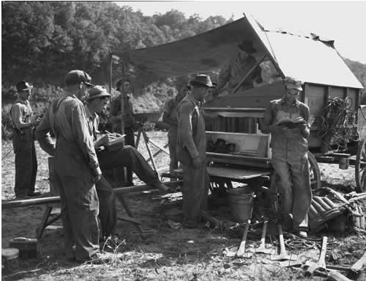
TVA “toolbox library”
Notes:
http://www.tnla.org/general/custom.asp?page=260

Slide 3
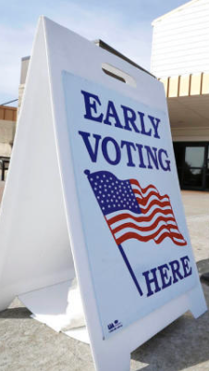
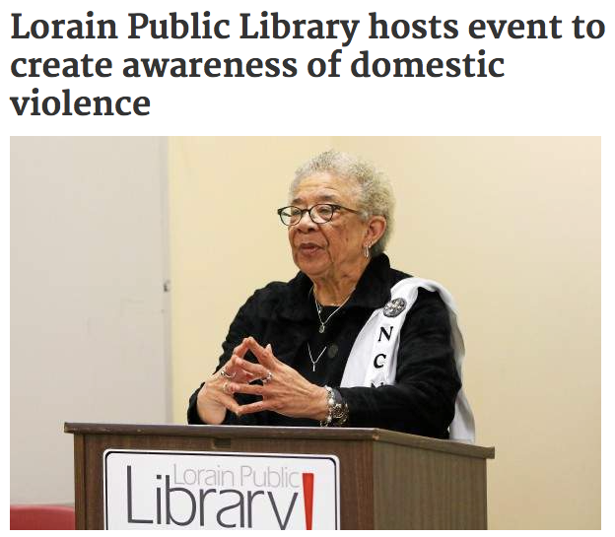
Community Involvement
Notes:
http://www.morningjournal.com/general-news/20150421/lorain-public-library-hosts-event-to-create-awareness-of-domestic-violence Ohio
http://www.abqjournal.com/489723/news/15-million-early-votes-cast-in-31-states-so-far.html Davenport

Slide 4
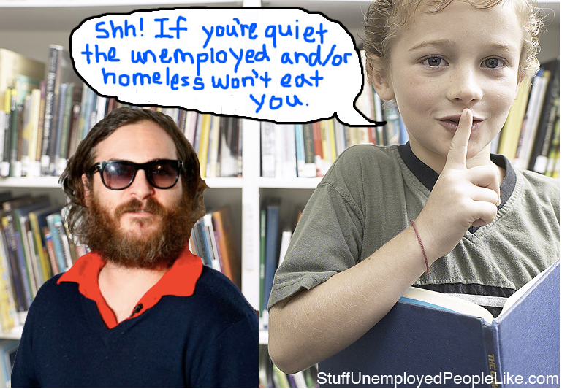
Notes:
http://stuffunemployedpeoplelike.com/2009/03/02/26-public-libraries/

Slide 5
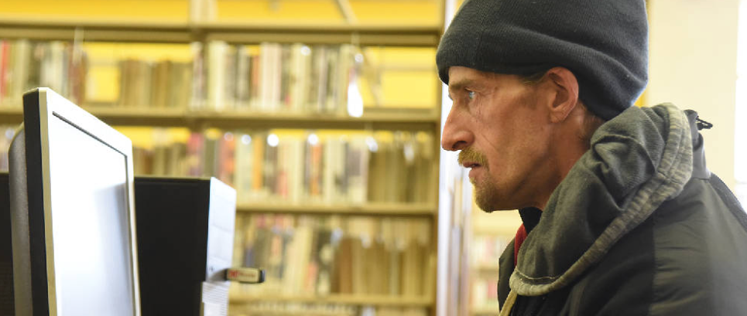
Chattanooga Public Library
Homeless Support Programs
Notes:
http://www.library.pima.gov/?attachment_id=171788
http://www.timesfreepress.com/news/local/story/2015/mar/03/haven-homeless/291213/

Slide 6
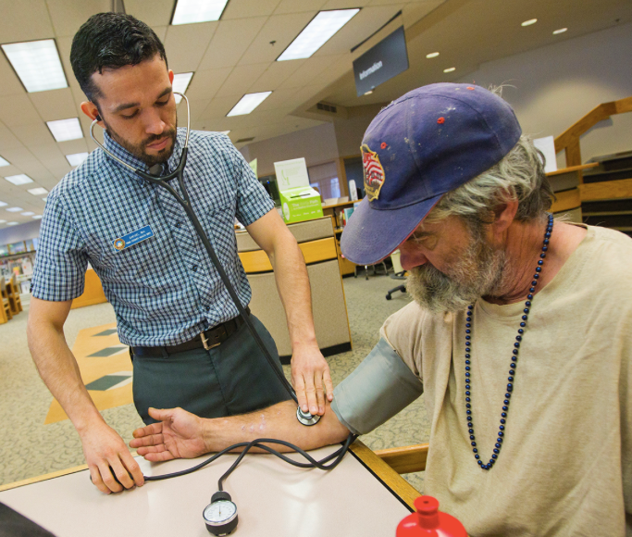
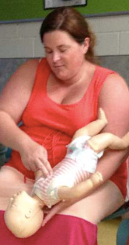
Red Bank Public Library Infant CPR Class
Pima County Health Department Library Nurse
Notes:
Pima County Health Department Library Nurse Daniel Lopez takes the blood pressure of homeless man Jim Truitt at the Main Joel D. Valdez Pima County Public Library on November 24th, 2014 in Tucson, Arizona. Lopez is one of many Library Nurses that spend time helping patrons at local libraries. They do everything from take blood pressures to help patrons find services they need.
http://www.redbankgreen.com/2013/07/red-bank-library-a-lesson-in-lifesaving.html
http://www.library.pima.gov/?attachment_id=171788

Slide 7
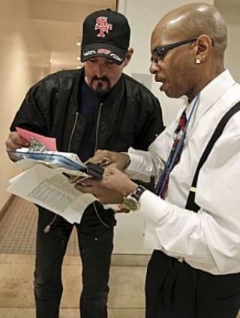
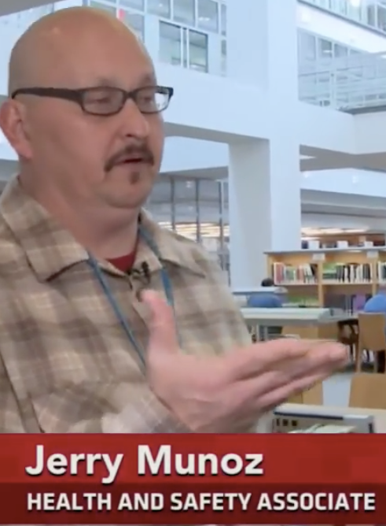
San Francisco Public Library:
hiring formerly homeless patrons
Notes:
http://www.sfgate.com/bayarea/article/Library-adds-social-worker-to-assist-homeless-3275950.php#photo-2425591
http://www.pbs.org/newshour/rundown/see-libraries-across-country-serving-homeless/

Slide 8
What determines the line between librarianship and social work?
Educational preparation
Community needs
Social expectations
Professional values
Personal identity
Something else??

Slide 9
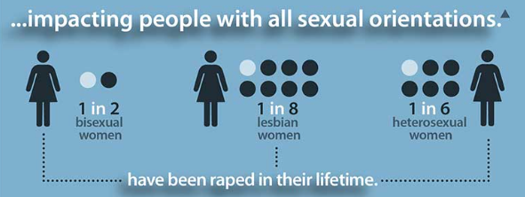
Context of Practice: IPV
After being punched in the head a few weeks ago, I decided to search the web on brain injury in abused women. Amazing results. (Survivor, posting)
1.3 million abused annually
42% of women experience IPV in their lifetime
1 in 6 women are stalked
Notes:
CDC

Slide 10
LIBRARY PATRON
counseling
client
court
witness
shelter
resident
crime
victim
apartment
tenant
ER
patient
Individual
mother
wife
student
employee

Slide 11
Patron’s self-perception
in the context of transcendent self-perception
Librarians’ service foci
in the context of transcendent social norms
Monitor the crisis pacing
Self-perceptions
driven by the crisis
Respect the affective impetus
Engage - don’t “solve”
Teach information evaluation
Self-perceptions
driven by a crisis service
Teach information management
Demonstrate social respect
Self-perceptions
driven by a general service
Manage the service’s requirements

Slide 12
I’m not a social worker
but I know where to find one
I am a social worker with an extremely limited portfolio

Slide 13
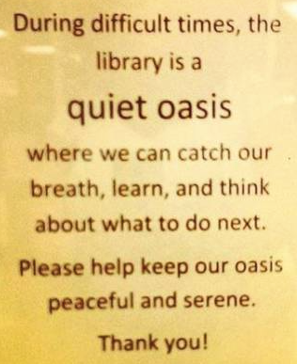
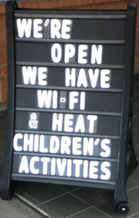
After the Ferguson shooting
and Hurricane Sandy
Notes:
https://magpielibrarian.files.wordpress.com/2014/09/12268_778122398917494_3500598993675419658_n.jpg?w=560&h=554
https://magpielibrarian.files.wordpress.com/2014/09/12268_778122398917494_3500598993675419658_n.jpg?w=560&h=554

Slide 14
Lynn Westbrook, Associate Professor
School of Information
University of Texas at Austin
For the full article on which this is based, see: “I’m not a social worker”: An Information Service Model for Helping Patrons in Crisis. Library Quarterly. 85(1): 6-25. 2015.
Educational preparation
Community needs
Social expectations
Professional values
Personal identity
Something else??
What determines the line between librarianship and social work?

