Slide 1

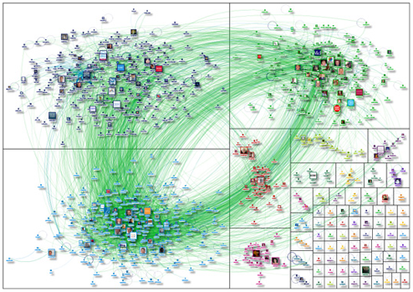
Data Grid Services
NSF I-Corps Project
April-May 2013 Cohort
Arcot Rajasekar (PI), Leesa Brieger (EL), Kevin Wright (Mentor)
A services company to provide support for the
open source Data Grid software developed in our lab

Slide 2
About NSF I-Corps
Primary goal: to foster entrepreneurship leading to the commercialization of technology that has been supported previously by NSF funding.
Transitioning technology out of an academic laboratory requires different skills than academic research requires (those more common in a start-up environment).
I-Corps will help develop entrepreneurial knowledge and skills in a new cadre of scientists and engineers.
Use the 6-month I-Corps project to address knowledge gaps and assess the position of the technology wrt industry.
I-Corps teams, sites, and nodes

Slide 3
I-Corps Cohort Teams – Across the Spectrum of NSF Research
DGS: Data Grid Services
SWIFT: Short-Term Wind Forecasting Technology
Aerogels - Rapid Supercritical Processing of Aerogels
AquaInvadrID - Commercialization of Genetic Identification Services for Invasive Aquatic Plant Management
Blood Microdevice - ABO-Rh Blood Type Identification Microdevice
DEFT: Data-Enabled Forecasting Tools for Big Data
Cloud Services Broker
SeePlusPlus - Determining Excavator Proximity to Buried Utilities
Secure Document Management in the Cloud

Slide 4
Course Materials
The Startup Owner’s Manual – Steve Blank and Bob Dorf
Business Model Generation – Alexander Osterwalder and Yves Pigneur
The Business Model Canvas
The Lean Startup methodology – the scalable startup

Slide 5
Our Special Circumstances
A peculiarity of our Data Grid Services:
We avoided any contact with any current iRODS users in order to avoid any perception of conflict of interest with the iRODS Consortium.
Compelled to explore domains in industry, where iRODS is completely unknown. Thus we targeted a variety of companies, trying to understand their data management issues across several industries.
NB: Customer contact with iRODS users is necessary even for the iRODS Consortium in order to recognize and respond to actual need.

Slide 6
Kick-off Meeting in NYC
Pre-meeting assignments
Schedule appointments with potential customers
Fill out business canvas
Cold call interviews
NY Natives – online media
the Mayor’s office of Data Analytics
Broadpeak Partners – data services for energy traders
Careplanners – small health care support office
Do Good Buy Us – online marketing
Mediasilo – data services media support (metadata)

Slide 7
Building the Business Model
Market Size
TAM: Total Available Market
SAM: Served Available Market/Segmented Addressable Market
Target
Archetypes and the Ecosystem
Revenue flow and strategy
Minimum Viable Product
Experiments for validating your hypotheses (or throwing them out)

Slide 8
Assessing the Technology: Hypothesis-Validation Approach
Value proposition: what customer needs are we satisfying?
Customer/user pain points: what, why, and how important?
Demand creation: how to help customers learn about the product and how to create desire for it?
Channel development: how to reach users and how to deliver product?
Revenue model: strategy for generating cash from customer segments?
Partnership strategy: key partners and suppliers needed to make the business model work (e.g., strategic alliances between non-competitors)?
Resource requirement: most important assets (human, intellectual, financial and/or physical) to make the business model work?

Slide 9







The Business Model Canvas
Helps build the narrative that is the
basis for your business model
For information, search YouTube for
“Business Model Generation, Alexander Osterwalder”

Slide 10

The Business Model Canvas
These are all hypotheses to be verified by actual customer contact.
(Our First)
Maintain commercial
service level - tier 2 & 3
Consulting
feature development
integration
troubleshooting
data policy support
Training: usage, support, dev
Marketing: Proselytize on data issues and importance of data policy
Cloud provisioning/hosting???
Ease of providing custom data infrastructure (not one-offs), specialized to individual, complex need
Flexibility to adapt & expand as needs change & grow
Reliability for mission-critical services
Support for development of data management strategies in support of business activities
Outsource custom, specialized cloud services
Phone, web, personal contact for support services
Tier 2 & 3 support
Mission-critical support levels: 24-hour availability
Integrators
Storage vendors
Federal agencies
Media
Web-based businesses????
IT companies????
Community clouds???
Massive data volume
media
genomics
climate
storage vendors
Complex data services
(data sharing, protected
data, reprocessing,…)
climate
medical
research
enterprise
integrators
On-site training
On-site and remote consulting
Embedded customer dev visitors
Channel partners provide tier 1 support
Trained personnel, cumulative expertise
Storage resources, IT infrastructure for testing (and hosting?)
Fixed costs
Personnel
Storage resources, IT infrastructure for testing (and hosting?)
Service subscriptions
support
data hosting services
Consulting contracts

Slide 11
Lessons Learned the 1st Week
Commercial products are *very* targeted (narrow)
Broadpeak Partners
Mediasilo
Commercial products are polished and user-friendly.
Domain experts help when you target a segment.
Not everyone is looking for a solution to data issues
workarounds exist
problem isn’t bad enough yet

Slide 12
Biggest Lessons Learned Overall
Until you listen to potential customers, there is no way to know the realities on the ground… well-informed guessing or knowing the technology isn’t enough.
Universally true for every team in our cohort. (Universally true.)
Some considerations are independent of the technology
regulations
economic realities (the Great Recession)
tradition in customer communities
stuff you just don’t know about till you get out and find it
Use cases may be unexpected.
Know your “archetypes”

Slide 13
Data Grid Services
Wrap-up Meeting of our I-Corps Cohort – Lessons Learned
A services company to provide support for the
open source Data Grid software developed in our lab
Initial idea: Strong showing in research and with Big Data all the rage, surely in industry they’ll be clamoring for the software and our services to help them organize, maintain, and get value from their data.
Size of the opportunity: very large. Big Data.

Slide 14


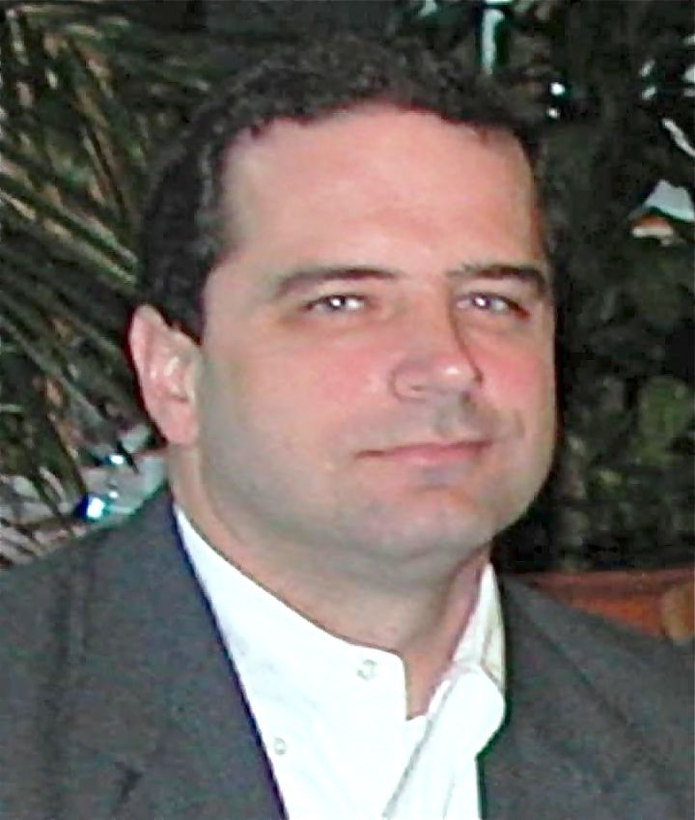
Professor in the School of Information and Library Sciences, UNC
Chief Scientist at RENCI, UNC
Co-Director of the Data Intensive Cyber Environments (DICE) – at SDSC and at UNC
15 years of research and development in data grid technology
Arcot Rajasekar, PI
Computational scientist by training and profession (numerical analysis)
Experienced at providing user support in HPC (SDSC)
Eight years of experience in user support for data grids
iRODS trainer
Leesa Brieger, EL
Ran IBM’s Extreme Blue program (IBM’s premier innovation incubator)
Part of several of IBM’s leading-edge entrepreneurial initiatives: entry into the home personal computer market, e-business middleware, …
Adjunct professor at Duke and NC State, teaching services, solutions, innovation, and strategy
Kevin Wright,
Mentor

Slide 15
Lessons Learned
The business canvas helped us clarify our own thinking about a business plan; provided necessary structure. We didn’t know what we didn’t know.
Confusion: unclear separation between the open-source software and our services
Talking to customers is really as helpful as they say for getting a real-world point of view on data issues
not perceived as extreme
there are workarounds
institutional will is not always there to change
Once we segmented the market appropriately, all flowed from that: value propositions - separation between software and services, the channels, customer relationships, key partners

Slide 16
Main points
Commercializing a data management product will require narrowing the focus, perhaps drastically.
We are ahead of the curve for (some) industry data management.
Is this our attributing data problems to companies who will never have them? We say no:
Big Data opportunity is still only opportunity because the infrastructure isn’t there to support the reality. Yet.
We’re early on the technology adoption curve. The early majority hasn’t recognized the problems yet. But they will. In time.

Slide 17
The Business Model Canvas
Day 1 – April 3
Maintain commercial
service level - tier 2 & 3
Consulting
feature development
integration
troubleshooting
data policy support
Training: usage, support, dev
Marketing: Proselytize on data issues and importance of data policy
Cloud provisioning/hosting???
Ease of providing custom data infrastructure (not one-offs), specialized to individual, complex need
Flexibility to adapt & expand as needs change & grow
Reliability for mission-critical services
Support for development of data management strategies in support of business activities
Outsource custom, specialized cloud services
Phone, web, personal contact for support services
Tier 2 & 3 support
Mission-critical support levels: 24-hour availability
Integrators
Storage vendors
Federal agencies
Media
Web-based businesses????
IT companies????
Community clouds???
Massive data volume
media
genomics
climate
storage vendors
Complex data services
(data sharing, protected
data, reprocessing,…)
climate
medical
research
enterprise
integrators
On-site training
On-site and remote consulting
Embedded customer dev visitors
Channel partners provide tier 1 support
Trained personnel, cumulative expertise
Storage resources, IT infrastructure for testing (and hosting?)
Segments: we included many groups using the technology in research or federal agencies
VPs: a mixture of the value of the software and
value of our services
Fixed costs
Personnel
Storage resources, IT infrastructure for testing (and hosting?)
Service subscriptions
support
data hosting services
Consulting contracts

Slide 18
The Business Model Canvas
Day 2 – April 4
Maintain commercial
service level - tier 2 & 3
Consulting
feature development
integration
troubleshooting
data policy support
Training: usage, support, dev
Marketing: Proselytize on data issues and importance of data policy
Cloud provisioning/hosting???
Control of data:
metadata enables organization and discovery
data curation services can be automated (easier and more reliable)
Support:
guaranteed service levels, up-time, response time, troubleshooting
data strategies (help in realizing what your company data operations depend on)
custom features provided
Phone, web, personal contact for support services
Tier 2 & 3 support
Mission-critical support levels: 24-hour availability
Integrators
Storage vendors
Enterprises:
Media
Web-based businesses????
IT companies????
Integrators
development managers
(existing customers)
business managers
(new customer targets)
Storage vendors
VP of marketing??
Mid-market Enterprises
founder
CEO
On-site training
On-site and remote consulting
Embedded customer dev visitors
Channel partners provide tier 1 support
Trained personnel, cumulative expertise
Storage resources, IT infrastructure for testing (and hosting?)
Some narrowing of the segments, targeting people.
VPs: value of the software separated from the value of the services of the company.
Fixed costs
Personnel
Storage resources, IT infrastructure for testing (and hosting?)
Service subscriptions
support
data hosting services
Consulting contracts

Slide 19
#179 Data Grid Services
Day 3 – April 5
Maintain commercial
service level - tier 2 & 3
Consulting
feature development
integration
troubleshooting
data policy support
Training: usage, support, dev
Marketing: Proselytize on data issues and importance of data policy
Cloud provisioning/hosting???
Phone, web, personal contact for support services
Tier 2 & 3 support
Mission-critical support levels: 24-hour availability
Storage vendors
Enterprises:
media
finance
Enable efficient data discovery
Global view of distributed collections
CTOs of small to medium companies:
digital multi-
media
financial
Integrator
Vendor
Direct
Trained personnel, cumulative expertise
Storage resources, IT infrastructure for testing (and hosting?)
Media company: we would pay $5000-$30,000 per year for your
services, depending on ROI. We anticipate needing this.
Financial trader: our data management success is based on domain
expertise and a very narrow focus on data needs in that domain
Fixed costs
Personnel
Storage resources, IT infrastructure for testing (and hosting?)
Service subscriptions
support
data hosting services
Consulting contracts

Slide 20
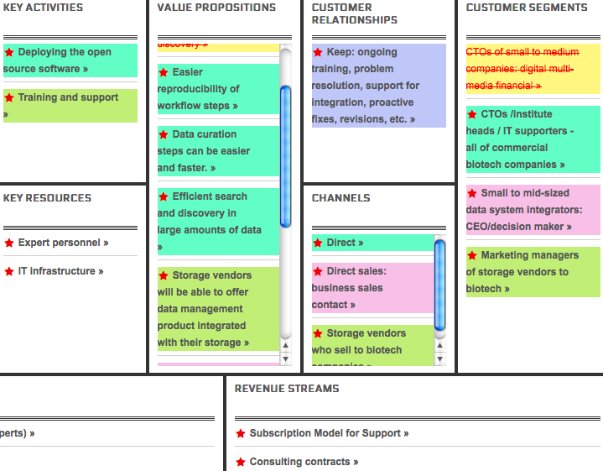
Week 1 - April 9
Not such big demand in media. Pivot to biotech,
where there is bigger demand for data support (we think).

Slide 21
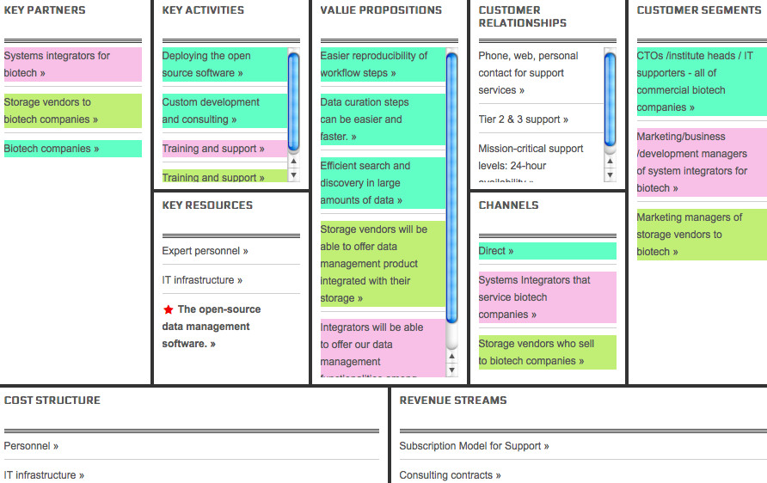
Week 2 - April 16
Not much demand among direct customers.
A possible earlyvangelist: an integrator who
wants to see a user-friendly interface.

Slide 22
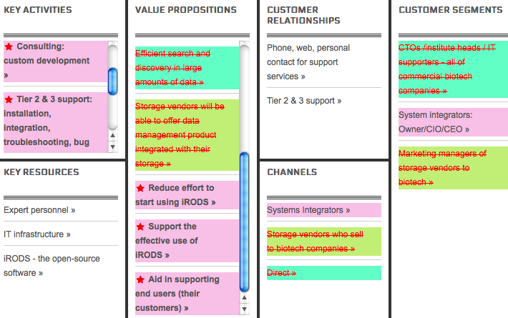
Week 3 - April 23
Integrators much more interested than direct customers (decision makers) are.
Another possible earlyvangelist found – an integrator for life sciences labs.
Value propositions don’t include value for the software itself at this stage.
Decision makers are disjoint from their technical recommenders – very different
motivations.

Slide 23
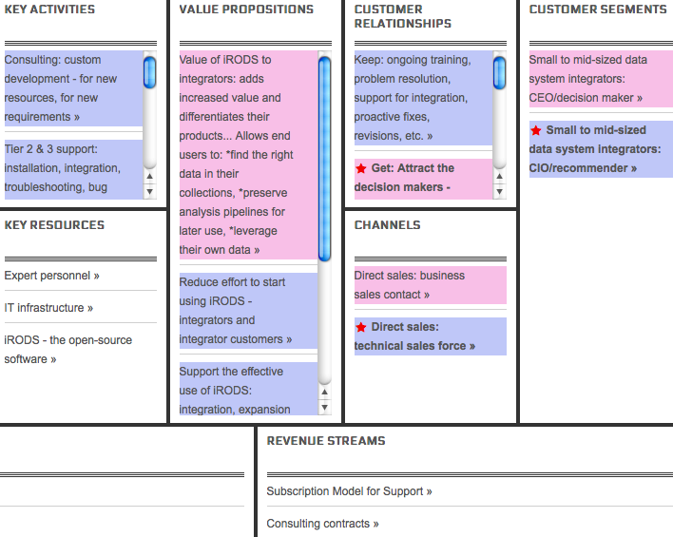
Week 4 - April 30
Major rethinking – segment the market into decision makers and technical recommenders.
This puts the value of the software back onto the canvas.
Value to decision makers: the software.
Value to the technical recommenders: our services.

Slide 24
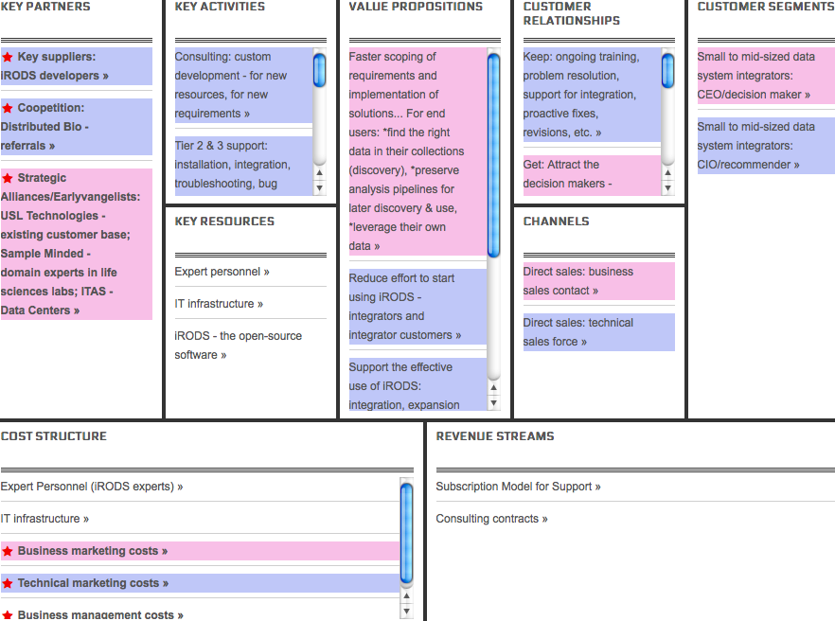
Week 5 - May 7
Data Center World conference. A movement is under way
to educate data center managers about how content (data) management can allow them to manage more efficiently.
ICOR - International Consortium for Organizational Resilience -
Is a standards organization that trains data center managers.
Now embarking on educating about content management.
Thought leaders to work with.
AFCOM – the Association for Data Center Management Professionals – also trying to teach managers that content
management makes good business sense.

Slide 25
Data Grid Services
We’ve had enough positive responses that we have a conditional GO for the business... depending on how things come together
Being ahead of the curve means it will take longer than originally anticipated to get going.
We must educate decision makers, create a buzz.
SBIRs / STTRs are perhaps more critical than we thought.
Next Steps
Write up data management educational materials - ICOR
More conferences, some articles, white papers.
Create a MVP for the technical sales.
Pursue negotiations with the potential earlyvangelists.
Get out of the building!

Slide 26
Activities Along the Way to Building the Business Plan

Slide 27
Market Size
Total Available Market: $6.5 billion in 2015
IDC Report: Worldwide Big Data Technology and Services 2012-2015 Forecast expectations
The Big Data technology and services market to be $16.9 billion in 2015
Services in 2015 (IT services, analysis, …): $6.5 billion
Segmented Addressable Market: $1.3 billion (20% of TAM)
Data management: customization, metadata management, aggregation of data, training, …
Segments for us? Storage vendors, integrators, mid-market enterprises (startups – large)
Target: $130 million (10% of $1.3 billion)

Slide 28

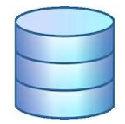
Archetypes and the Ecosystem
CEO
Decision
maker
CTO
CFO
Recommender
Payer
Admin
Client
Recommenders: integrator developers and supporters
Client
Influencers: end users
(integrator customers)
Data grid software
services
services
services
Distributed storage resources

Slide 29
Archetypes – a Day in the Life
Integrator CTO – recommender
Arrive at work, evaluate new customer’s requirements, new equipment arrives–evaluate how to tie it into the LIMS and integrate the new data with other collections, existing customers request new analyses–need new data operations to support that, look for new tools for that support, deploy tools (install, integrate, customize), support end users in use of infrastructure (training, troubleshooting, bug fixing, etc)
Integrator CEO – decision maker/buyer
Come in, look at new potential customers, work with developers to define requirements – project-by-project OR in a unified way, see what tools the others are using, evaluate resource availability to support new tools and customers (staff expertise, number of staff, etc), bid on contracts
Integrator CFO – payer
Integrator customers (end users and IT supporters) – influencers
End users: Arrive, get started on an analysis, can’t find the data, find the data, lose the data, regenerate the data, analyze, complain to IT supporters,
IT supporters: respond to user requests, look for better tools, evaluate new tools, make recommendations, plead users’ case to center managers, work with integrators

Slide 30
Data Conference Takeaways
Enterprises - trying to figure out data management
majority of talks: how to convince decision makers to support data programs
data centers: cost centers or revenue centers, protecting and enhancing the value of data content
How do we find data professionals?! Hire or train? Whom do we hire? Social scientists – they have experience with data content.
It means something different to each community
Data centers… ignoring data and yet managing it
backup management, replica management, tiered storage
Data Governance – data quality (integrity, provenance, protection over the long run)
Big Data (analytics) – however, these groups are looking to incorporate unstructured data in with their RDBS’s (structured data)
EUDAT – data management like we know it with iRODS

Slide 31
Key Data Findings
There is some concern in business sectors about data challenges, but many are unaware of how to react to the problem. Why?
Intimidated by Big Data, which they perceive to require costly, gargantuan, and disruptive infrastructure upgrades
Big Data means analytics anyway and we don’t do that
There is significant demand for simple data services.
Back-up, replica, tiered storage management
Automation across diverse platforms
More education and outreach is needed to increase awareness of the power of incremental solutions to automate data services; such solutions can be provided by middleware that integrates into existing infrastructure.

Slide 32
More Key Data Findings
Commercial products require ‘turn-key” readiness; any software product we hope to commercialize must respond to domain-specific need and provide very polished tools.
Integrators are our best target market.
Open source is becoming more accepted in commercial environments.

Slide 33
Revenue Flow – Data Grid Services
Customer CEO
Integrator CEO
Business
Marketing
DGS Sales
Integrator
DGS Support
Influence
Technical
Marketing
Integrator CIO
Customer CIO

Slide 34
Revenue Model
Subscription-based support contracts
Possibly some hourly rate-based support
Consulting contracts
Value-based pricing

Slide 35
Minimum Viable Product
A demo data grid with user-friendly presentation
user-friendly client
present diverse data
present some well-chosen end-user services
present data grid administrator services
plug-in examples
Service Level Agreements for Tier 2, 3 support

