Slide 1
Big Data in Healthcare: An Environmental Scan
Doug Johnston, MTS
Director, Health IT Policy
Shellery Cunningham, MSPH
Health IT Scientist

Slide 2
Background
Big data represents an important development in computing for the creation, management and analysis of massive data sets (e.g. petabyte or Exabyte).
The types and sources of data falling under the big data rubric are broad: from fully structured to unstructured data types, from static databases to real-time data streams.
As EHR adoption rises – and the usemobile technologies, and other forms of clinical and patient technologies proliferate – even larger data stores will be produced.
For healthcare, the potential insights derived from analyzing these data to assure quality, decrease cost and improve outcomes are alluring.

Slide 3
Examples of Big Data in Healthcare
Brigham and Women’s Hospital Congestive Heart Failure Project
  Brigham and Women’s’ Hospital is collaborating with GNS Healthcare to build predictive models for congestive heart failure patients.
  The models will include large complex datasets—EHR data, claims, and pharmacy data to prevent readmissions for heart failure patients.
  Predictive modeling will enable providers to identify high risk patients and intervene sooner to prevent readmission.

Slide 4
Examples of Big Data in Healthcare
PARR Tool and Virtual Wards
  Using a predictive modeling tool, the National Health Service identifies patients who are at the highest risk of unplanned hospitalization.
  Providers intervene and deliver multispecialty care while patients are still living in their homes to prevent hospitalizations which are much more costly.
  The delivery of care in the home setting is termed a “virtual ward”. Providers, nurses, and case managers still share records and communicate about the patients’ outcomes

Slide 5
Objectives and Methods
Objectives
  Define Big Data
  Review issues with accessing and analyzing extremely large health care data sets
  Identify potential areas of policy development
Methods
  Literature Review
  Informal discussions with various stakeholders, including:
    Payers (SeeChange Health)
    Technology Companies (Cloudera, Humedica)
    Hospitals (Children’s Hospital Los Angeles)
    Research Consortiums (eMERGE Network, OMOP)
    Internal RTI Staff

Slide 6
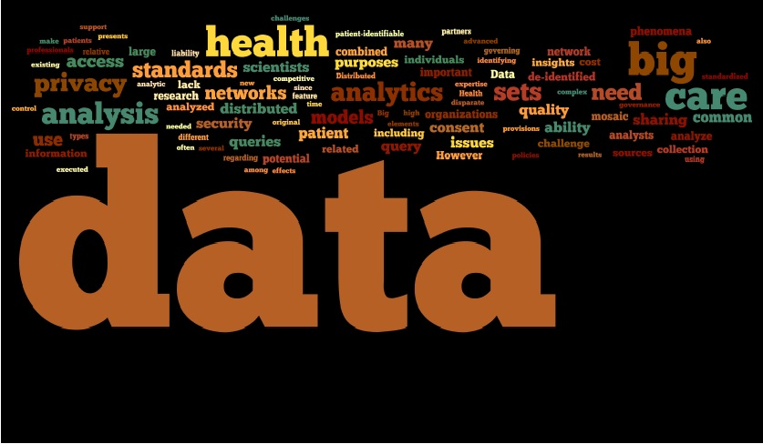
What is Big Data?

Slide 7
Potential Issues Identified
Privacy
Access
Standards
Workforce

Slide 8
Privacy
De-identification—Big data sets often aggregate different data from multiple sources –and some of which may be de-identified.
Patient Consent—Big data presents new forms of “secondary use”, where data may be combined, shared, and mined for uses outside of the original purposes behind their initial collection.
Mosaic Effects—Once combined and analyzed, seemingly disparate data may result in “mosaic effects” – where data elements and patterns and relationships revealed through analysis may begin to create pictures of individuals.

Slide 9
Access
Patient Acceptance
  Will patients consent to secondary use of their data?
Governance
  Distributed research networks such as DEcIDEnet, SPAN, HMO Research Network, eMERGE network, and others provide insights into approaches for accessing and analyzing large clinical, administrative, and biological data stores.
  Multiple IRB and governance bodies
Competitive Advantage
  Some stakeholders may not want to share their patient level data.

Slide 10
Standards
Structured Data
  Using big data analytic techniques to detect certain phenomena, such identifying possible adverse drug events in a population, may not require highly standardized data.
  However, using analytics to further characterize these phenomena – identifying which therapeutic agents, at what doses, for which patients, in which regions, at what times, at what frequencies and resulting in what outcomes – may be accomplished with greater confidence using structured, coded, and normalized data.
Integration
  Standards facilitate interoperability.

Slide 11
Workforce
Data Scientists
  By 2018, McKinsey predicts the need for 140,000 to 190,000 additional data analysts. Additionally, 1.5 million managers and analysts will be needed in the U.S. to effectively make decisions based upon analysis of big data.
  Data Scientist named the “Sexiest Job of the 21st Century” by Harvard Business Review.
Multidisciplinary Professionals
  Several sources we consulted noted the relative lack of collaboration on big data projects between computer scientists and data scientists and health informaticists and clinicians.

Slide 12
Conclusions
The U.S. health care system is beginning to understand and use big data.
Other issues identified, including security, data quality and management, intellectual property, and technology issues (hardware, software), may require their own analysis and recommendations.

Slide 13
References
Bollier, D (Rapporteur). (2010) The Promise and Perils of Big Data. Aspen Institute, Washington, DC.
Manyika J., Chui M., Brown B., et al. (2011) Big Data: The Next Frontier for Innovation, Competition, and Productivity. McKinsey Global Institute.
http://www.cloudera.com/blog/2011/11/using-hadoop-to-analyze-adverse-drug-events/
http://strata.oreilly.com/2011/01/what-is-hadoop.html
Cousins, M.S., L.M. Shickle, and J.A. Bander. (2002) An introduction to predictive modeling for disease management risk stratification. Disease Management 5(3):157–67.
http://research.google.com/archive/mapreduce.html
http://www.nih.gov/news/health/mar2012/nhgri-29.htm
Office of Science and Technology. (2012) Fact Sheet: Big Data Across the Federal Government. Office of Science and Technology Policy, Executive Office of the President. Washington, DC.
http://www.gnshealthcare.com/news-and-events/gns-healthcare-announces-collaboration-with-nationally-ranked-hospital
http://visualization.geblogs.com/visualization/network/
http://www.iarpa.gov/solicitations_spar.html
The White House. (2012) Consumer Data Privacy in a Networked World: A Framework for Protecting Privacy and Promoting Innovation in the Global Digital Economy. The White House, Washington, DC.
http://www.ftc.gov/reports/privacy3/fairinfo.shtm
http://www.amstat.org/meetings/jsm/2011/onlineprogram/AbstractDetails.cfm?abstractid=302255
Platt R, Brown J. PopMedNet: Distributed Networking Technologies for Population Medicine. ONC Summer Concert series. August 3, 2011. Accessed at: http://wiki.siframework.org/Query+Health+-+Summer+Concert+Series
http://www.hdiforum.org/page/show/530336-health-data-affiliate-network
Ibid.
http://mucmd.org/
http://datakind.org/
http://www.hackreduce.org/
For recent work on Personalized Health Care, see ONC’s September 2012 white paper on this topic by Jon Wald and Michael Shapiro.

Slide 14
More Information
Doug Johnston, MTS
Director, Health IT Policy Center for the Advancement of Health IT (CAHIT)
RTI International
Waltham, MA
phone: 781-370-4021 djohnston@rti.org
Shellery Cunningham, MSPH
Health IT Scientist
Center for the Advancement of Health IT (CAHIT)
RTI International
Phone: 919.541.8811 email: scunningham@rti.org

Slide 15
Thank you!
www.rti.org/healthit

