Slide 1

Juan E. Gilbert, Ph.D.
IDEaS Professor
Chair Human-Centered Computing Division
School of Computing
Clemson University
juan@clemson.edu
http://www.JuanGilbert.com/
http://www.HumanCenteredComputing.org/
http://www.clemson.edu/computing

Slide 2
Outline
Prime III Voting System Model
Demo
What’s Next?
Discussion

Slide 3
Prime III Paper Ballot
This process begins with a blank ballot
  Ballot paper is a specific stock
  The ballot may contain a watermark
After the voter is authorized to vote using the voter registration database/roll

Slide 4

Prime III Paper Ballot
Voter’s ballot identification number
Ballot language
Voter Ready Ballot is placed in Prime III Machine and the voter’s ballot is loaded with the appropriate language.

Slide 5
Prime III
Universal Accessibility

Slide 6


Multimodal
Multimodal Interactions
  Voters can speak and touch interchangeably

Slide 7
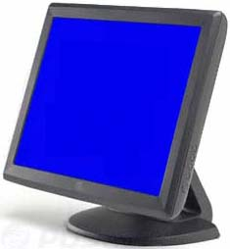
Voter - Touch
Large touch screens
  Large fonts
  Images or No Images
  Touchable Names centered on button
Voter touches the screen to make selection
  Confirmation is visual
Ballot layout
  One race per screen
  Voter confirms ballot before it is recorded

Slide 8
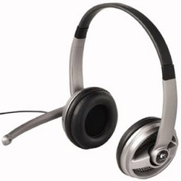
Voter - Verbal
Headset
  The system speaks to the voter through the headset
  Conversation is confidential – no one can hear the machine’s speech, but the voter
  System’s speech can be pre-recorded or computer generated or both.
Embedded microphone in the headset
  Voter speaks words like “vote”, “continue”, etc. or blows into the microphone
  Confirmation is verbal

Slide 9
Voter – Universal Accessibility
Sighted
Blind
Deaf
Illiteracy
  Sighted and Blind
Physical Disabilities
  Limited or no use of hands
  For example, wounded military, elderly, etc.
All of these voters can privately and independently vote on the same machine!

Slide 10


Software
Prime III DVD
  Bootable DVD contains Prime III
  Created, approved and sealed

Slide 11
VVGB
Voter-Verified and Generated Ballot (VVGB)
  Printed ballots will contain only the selections for each race
Barcode on printed ballots for scanning
  More accurate and easier to scan
  Ballot contents may be read back to the voter
VVGB is scanned by a separate, independent machine

Slide 12
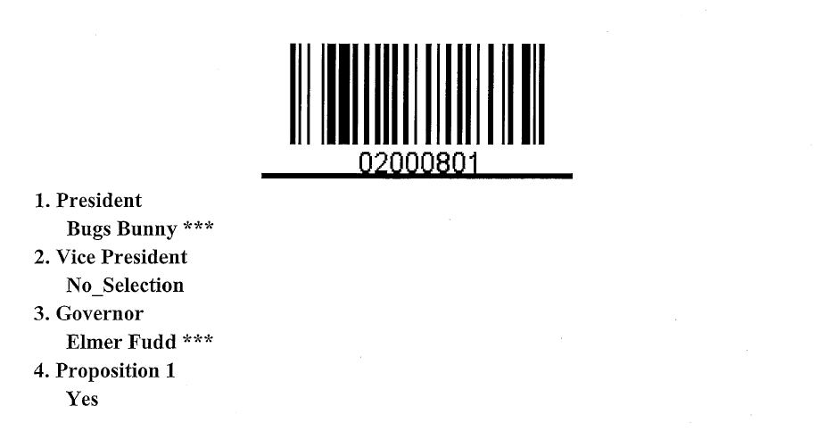
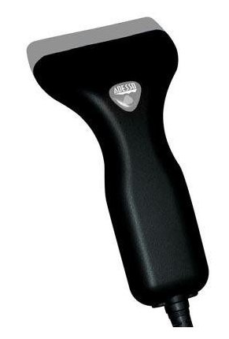
Security

Slide 13
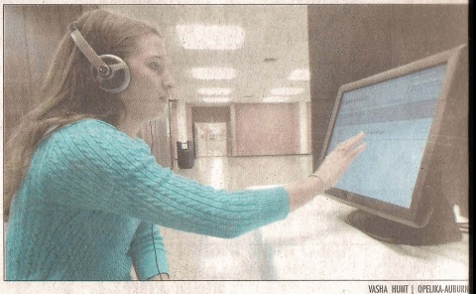
Demo

Slide 14
What did you see and hear?

Slide 15
Visual
Voter ready ballot
One race per screen
Delay after each touch
Names are centered on each button
  W. Virginia vote flipping
VVGB

Slide 16
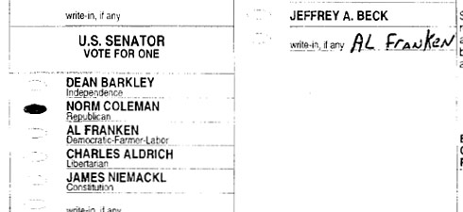
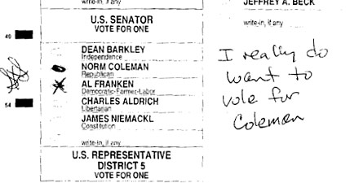
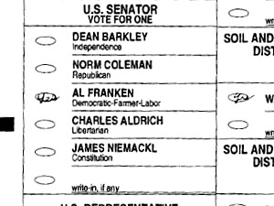
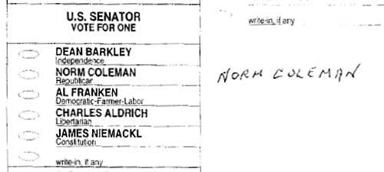
VVGB Prevents - Minnesota
Image taken from Minnesota Public Radio Website

Slide 17
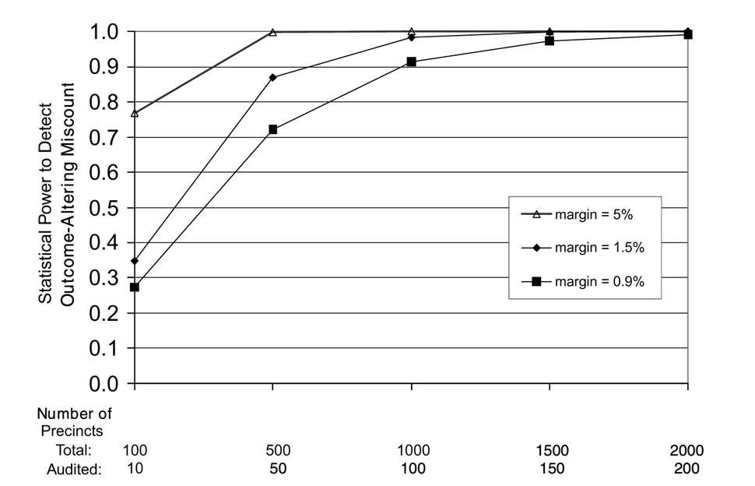
Statistical Power of 10% Audits
Percentage-Based versus Statistical-Power-Based Vote Tabulation Audits John McCarthy , Howard Stanislevic , Mark Lindeman , Arlene S . Ash , Vittorio Addona , Mary Batcher The American Statistician Feb 2008, Vol. 62, No. 1: 11–16.

Slide 18
VVGB
Preliminary studies against VVPAT and Optical Scan
  Osher Lifelong Learning Institute
  More efficient on speed and accuracy
Barcode scanning is magnitudes more accurate than optical scans

Slide 19
Verbal
Verbal response to touch
Privacy in voice interactions
I blew into the microphone to make a selection
Voters can hear the ballot results after they are printed

Slide 20

Conclusions

Slide 21
Conclusions
Universal Design
  1 machine for everyone (California Incident)
  Poll workers are trained on 1 platform
  Multimodal Interface accommodates nearly everyone
Software Independent
  No undetectable change or error in the software or system can cause an undetectable change or error in the election outcome
    Software Independence (Rivest & Wack, 2006; EAC, 2007)
  Voter verified paper trail
  Statistical audit
  More accurate than optical scan
  No more Minnesota

Slide 22
Conclusions
Recount ability
  Thus far, better than optical scan and VVPAT
Component based design adaptable for
  Military and overseas voting
    Fax, Internet, Mail, Phone, etc.
  Mail-In voting (Oregon)

Slide 23
Conclusions – What’s Next?
Usability studies with different populations
Ergonomic design of the actual machine(s)
Voter registration and administration
Election management and poll worker training
Maybe a real election
  Any volunteers?

Slide 24


http://www.PrimeVotingSystem.org
Thank You
Juan E. Gilbert, Ph.D.
IDEaS Professor & Chair Human Centered Computing Division
School of Computing
Clemson University
juan@clemson.edu
http://www.JuanGilbert.com/
http://www.HumanCenteredComputing.org/
http://www.clemson.edu/computing

