Slide 1
Decision Trees

Slide 2
Decision Trees
Supervised Learning
learn decision tree from training examples
predict classes for novel testing examples
Generalization is how well we do on the testing examples.
Only works if we can learn the underlying structure of the data.

Slide 3
Choosing attributes
How do we ﬁnd a decision tree that agrees with the training data?
Could just choose a tree that has one path to a leaf for each example - but this just memorizes the observations (assuming data are consistent) - we want it to generalize to new examples
Ideally, best attribute would partition the data into positive and negative examples
Strategy (greedy): - choose attributes that give the best partition ﬁrst
Want correct classiﬁcation with fewest number of tests

Slide 4
Challenges
How do we which attribute or value to split on?
When should we stop splitting?
What do we do when we can’t achieve perfect classiﬁcation?
What if tree is too large?
Can we approximate with a smaller tree?

Slide 5
Basic algorithm for learning decision trees
start with whole training data
select attribute or value along dimension that gives “best” split
create child nodes based on split
recurse on each child using child data until a stopping criterion is reached
all examples have same class
amount of data is too small
tree too large
Central problem: How do we choose the “best” attribute?

Slide 6
Information Gain
Based on the decrease in entropy after a dataset is split on an attribute.
Constructing a decision tree is all about finding attribute that returns the highest information gain (i.e., the most homogeneous branches).

Slide 7
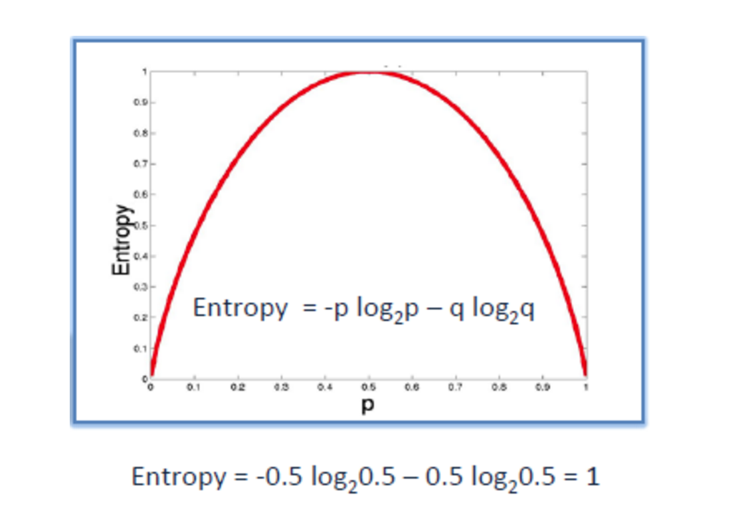
Entropy
Entropy calculates the homogeneity of a sample
If the sample is completely homogeneous the entropy is zero and if the sample is an equally divided it has entropy of one

Slide 8
Entropy

Slide 9
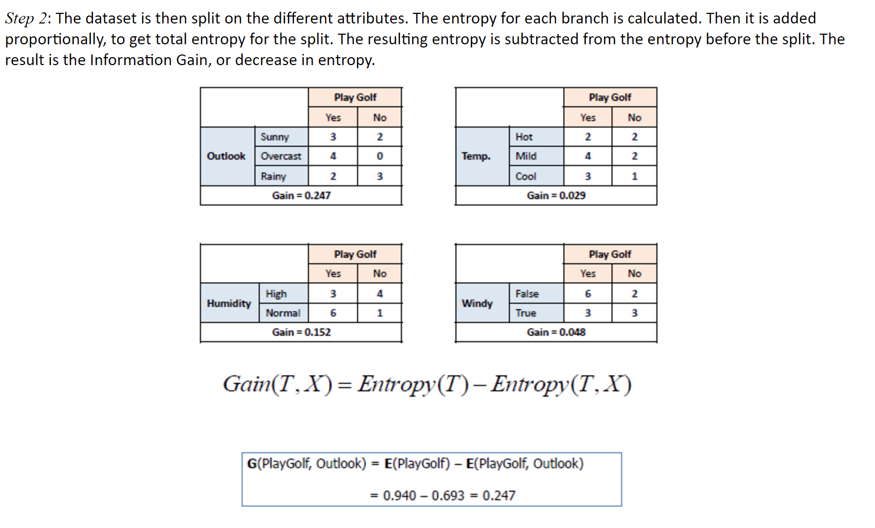
Entropy

Slide 10
Entropy

Slide 11
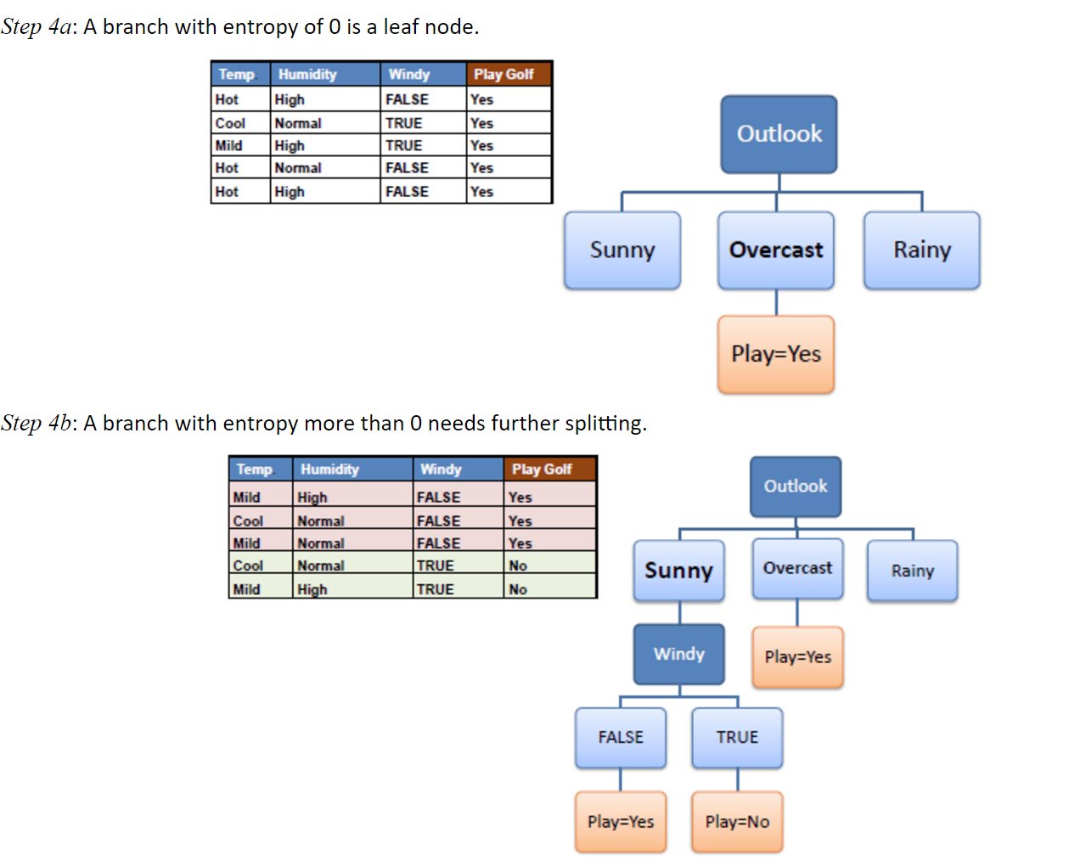

Slide 12
