Slide 1
Local & Inter Networks
how are we all wired together?

Slide 2

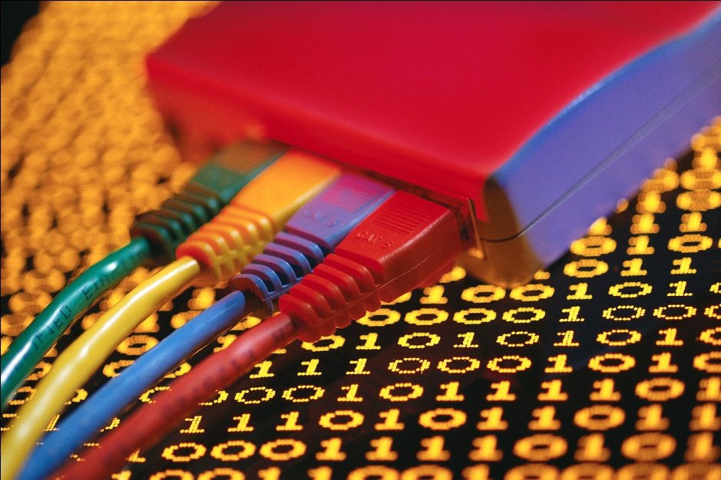
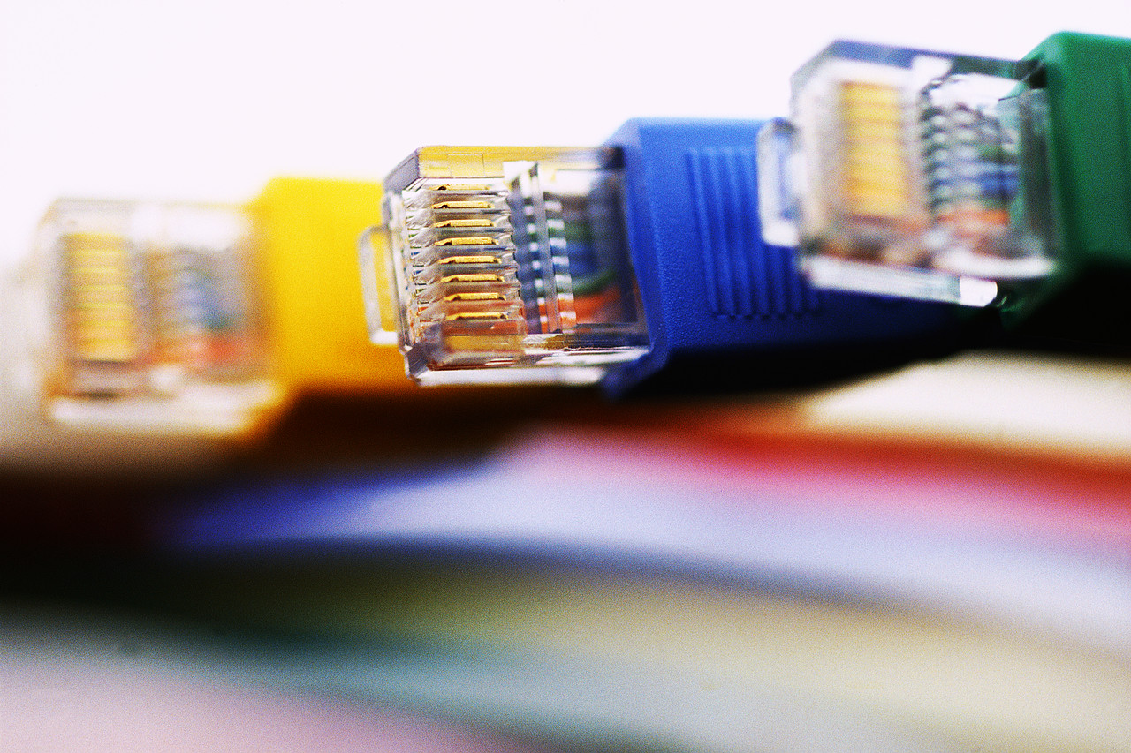
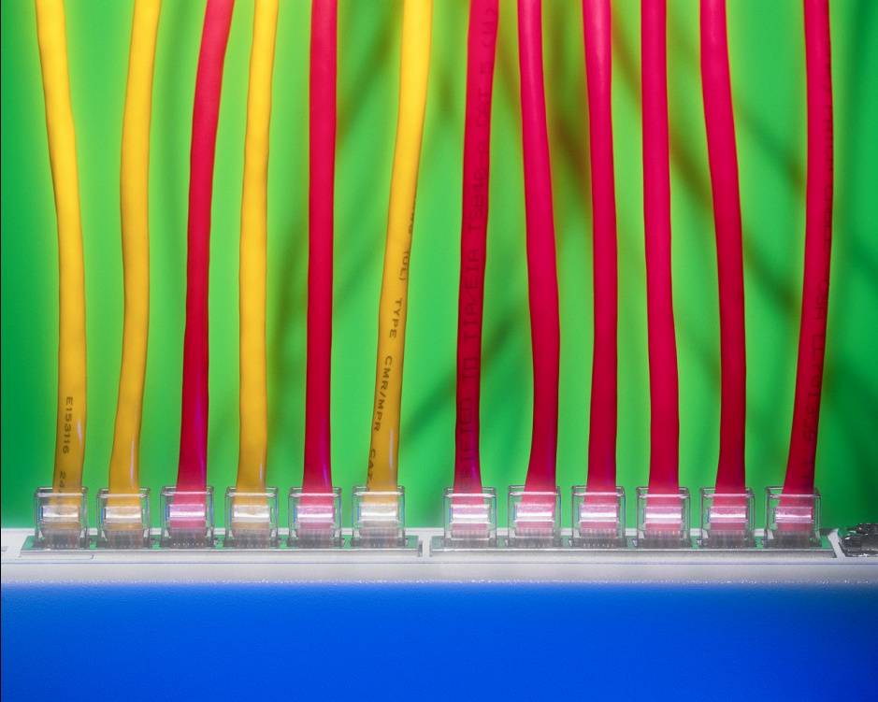
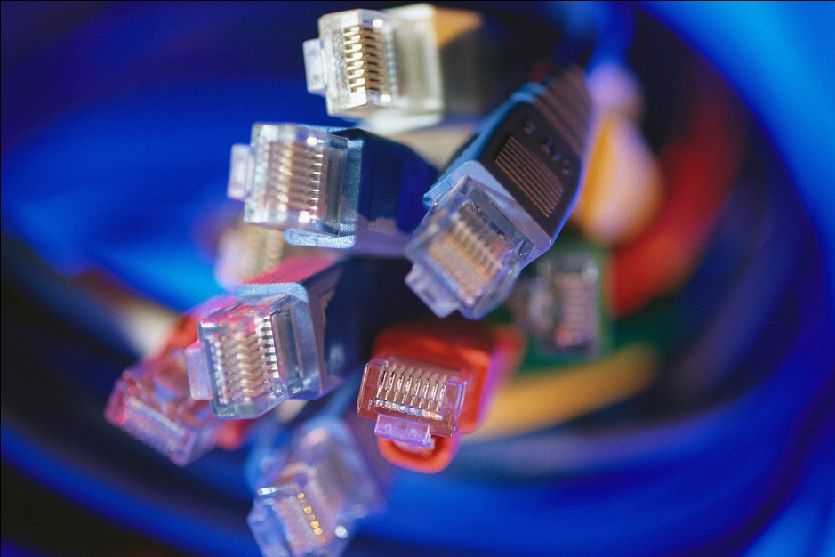


How do networks work?
Software
another software “packetizes” the data and addresses the “envelope” to send to...
an application asks for or receives data

Slide 3

How do networks work?
software
an application asks for data
another software “packetizes” the data and addresses the “envelope” to send to...

Slide 4
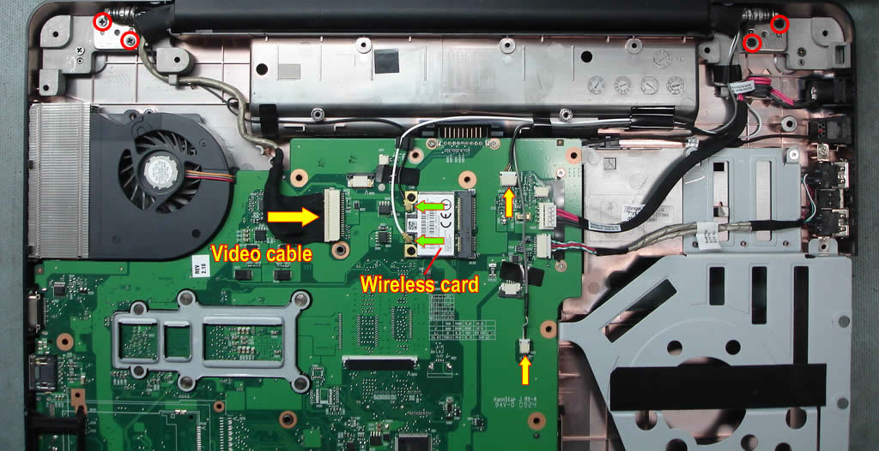
How do networks work?
hardware
the network computer receives these packets and pushes them out the door over...

Slide 5
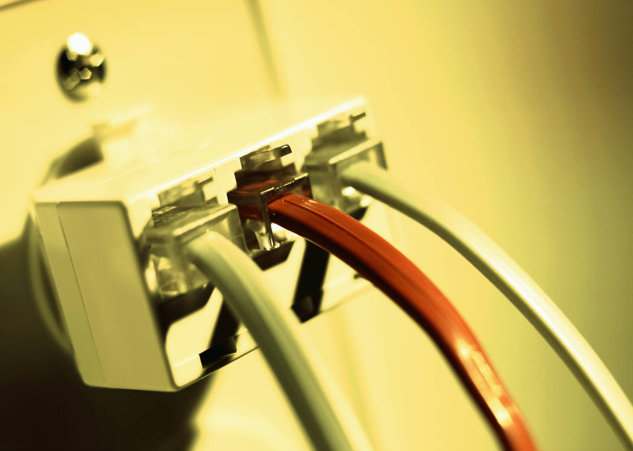
How do networks work?
wires & electronics
the cable connecting the computer to the network electronics
which forwards the packets to other electronics until they get to their destination

Slide 6
How do networks work?
switches
Sw1
1.A
1.B
1.C
1.D
1.E
System 1.A seeking System 2.B
Switches work by keeping track of the systems located off their ports
Sw2
2.A
2.B
2.C
if the system that is sought is not connected to that switch, the switch will send the request to other switches until it is able to find the switch that contains the sought system.

Slide 7
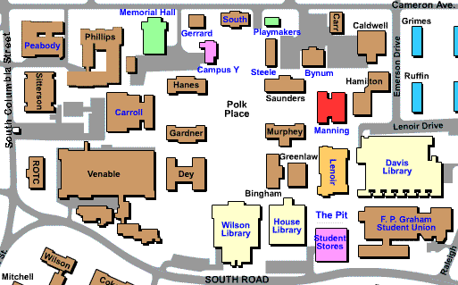
Internal Switches
So, in Manning,
we have several switches,
several servers,
and several networks
Our switches and "main" servers for the building plug into the main switch for Manning itself.

Slide 8
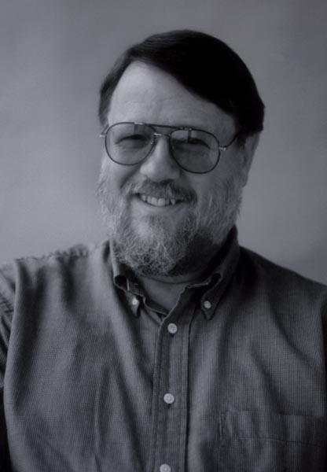
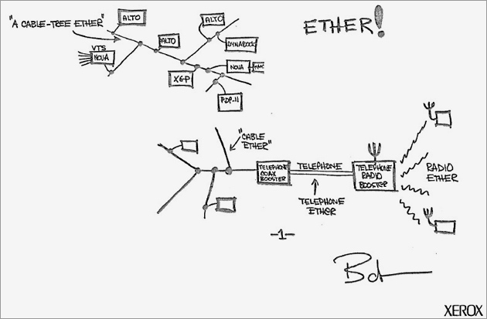
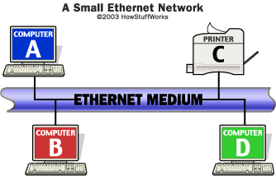
Ethernet
In 1973, while working on a way to link Xerox’s "Alto" computer to a printer, Bob Metcalfe developed the physical method of cabling that connected devices as well as the standards that governed communication on the cable. Called Ethernet, it has since become the most popular and most widely deployed network technology in the world.
Since a signal on the Ethernet medium reaches every attached node, the destination address is critical to identify the intended recipient of the frame.

Slide 9
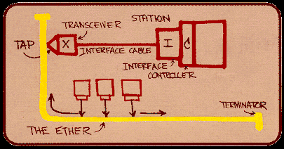
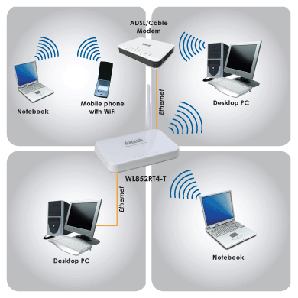
Ethernet
Most of the Ethernet ports in SILS have a speed set to 100mb
In comparison, the wireless ports are set to somewhat lower. The speed on the wireless is limited by the current available technology.

Slide 10
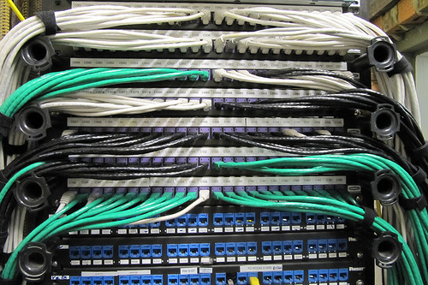
In Manning
The Ethernet connections go to one of several wiring closets in the building
Each wiring closet contains Tier 1 switches, to which are connected
cat5 utp wires
Which themselves are connected to the main switch in the main closet
Which itself is the fiber uplink to the Tier 2 switches

Slide 11
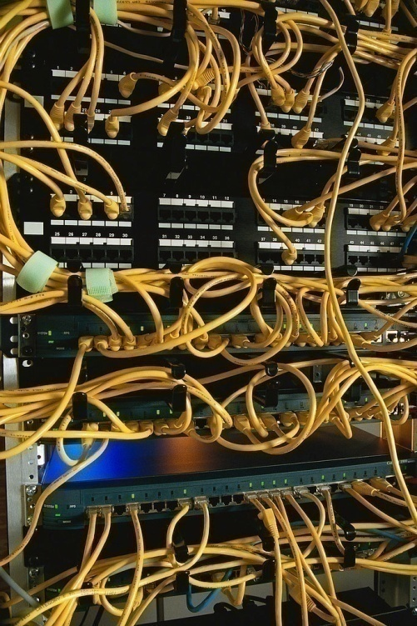
Within Manning
Within Manning hall there are 3 networking closets to serve parts of the buildings.

Slide 12
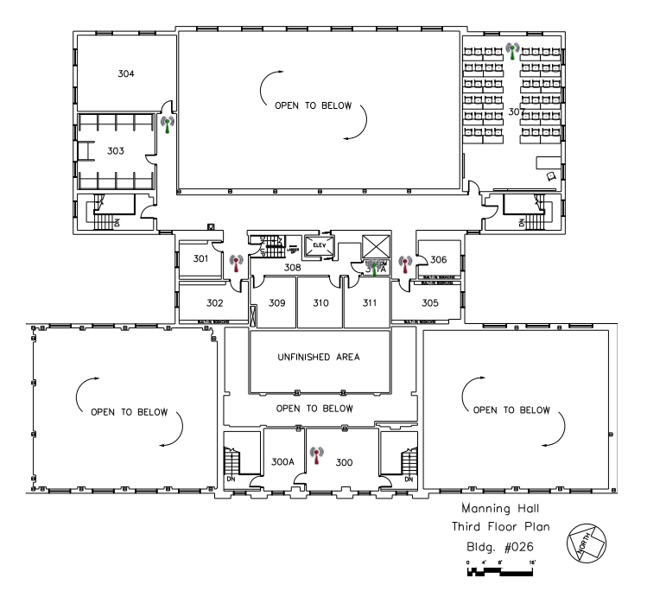
Within Manning, 3rd Floor
The 3rd floor closet is in the 5th level stacks inside the library.

Slide 13
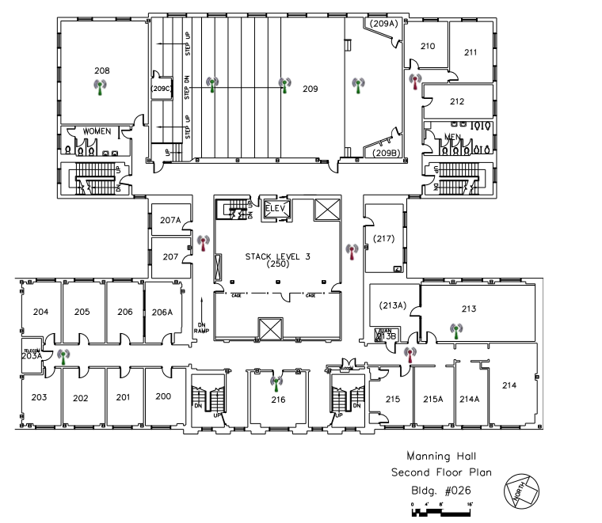
Within Manning, 2nd Floor
The 2nd floor closet is at the end of the hall where the faculty offices are found

Slide 14
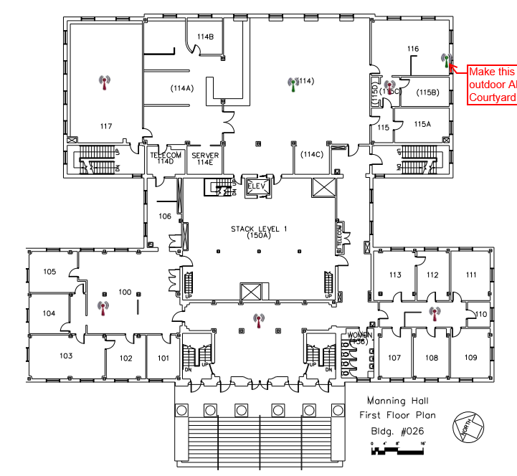
Within Manning, 1st Floor
The main closet located off the SILS Computer Lab has the fiber uplink to the campus network going into it.
This is a 1 Gbit uplink

Slide 15
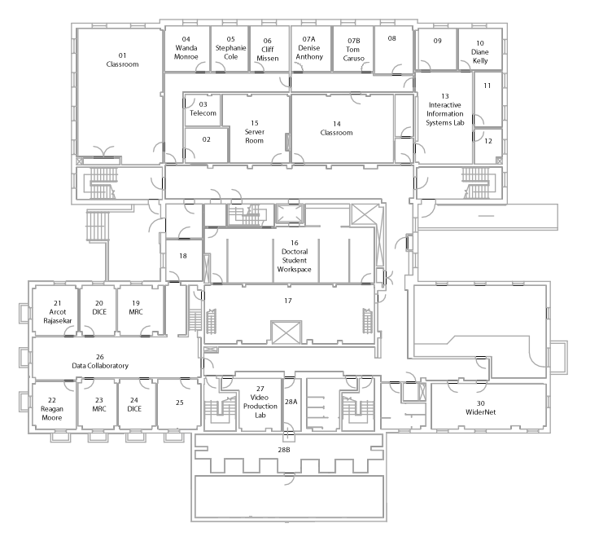
Within Manning, Garden Level
The main 1 Gbit uplink is in a telecom closet in the basement

Slide 16
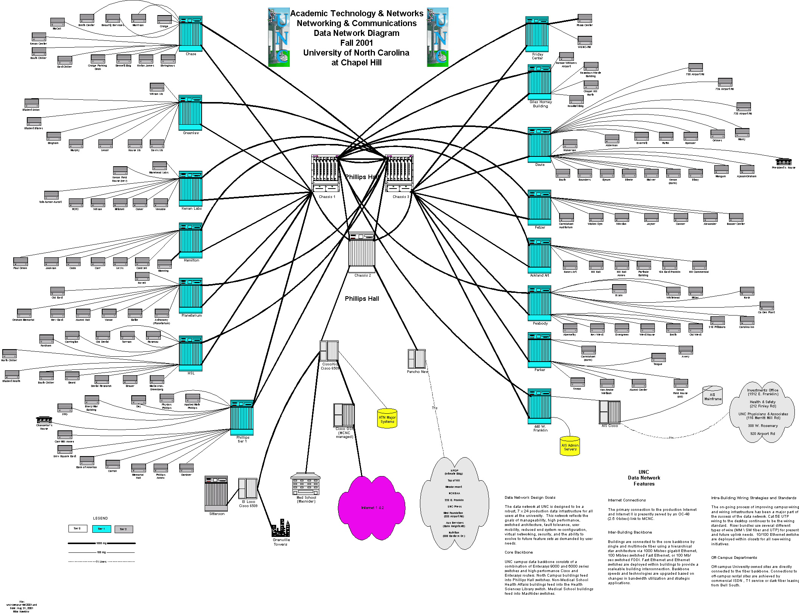
Moving out into the star
Manning Hall
The core switches are then linked out to other Tier 2 Switches that provide links to other buildings near them.
In each building, there are switches to provide ports for each wall port.
  For each port on the wall, there is a port somewhere on a switch that it is connected to.
  for the most part, there are in fact more wall ports than switch ports, so in some cases not all the ports in a building can be connected at once.

Slide 17
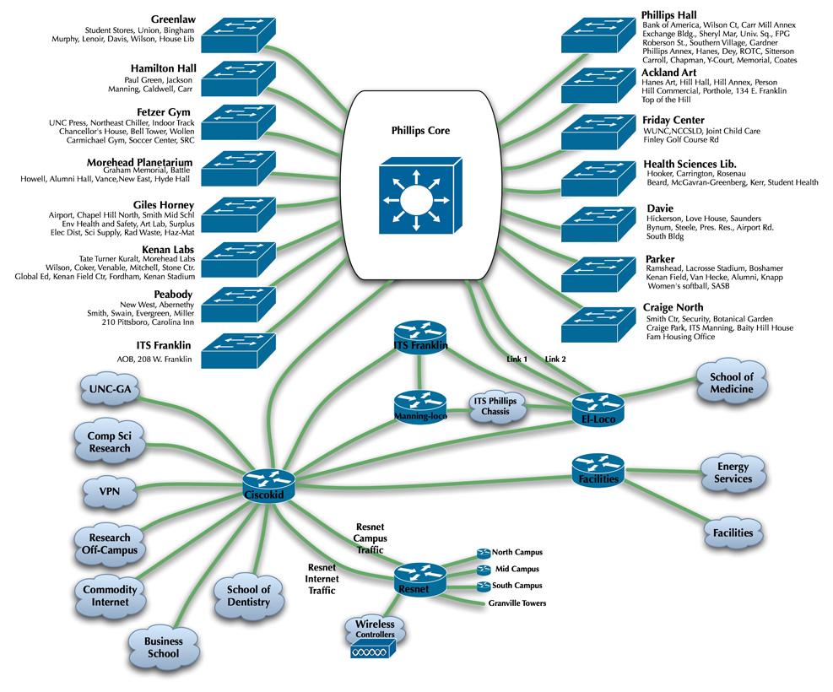
UNC Campus
The campus is laid out in a "star" topology in which central switches are linked in a star fashion.
Different devices can be connected to a switch and a switch can include other switches, computers, wireless access points, or any other network device.

Slide 18
UNC Campus
A main "core" set of three (for redundancy) switches are located in the control center in Phillips

Slide 19
UNC Campus
Isis uplinks to the commodity internet (the "real" internet) through Cisco Kid to MCNC(our ISP).
We have a 2.4 Gbit uplink to the internet through this. We share a link with many of the other universities and schools in North Carolina.
Cisco Kid is our main router that does all the "work" of finding addresses and managing traffic into, and out of our network
Cisco Kid

Slide 20
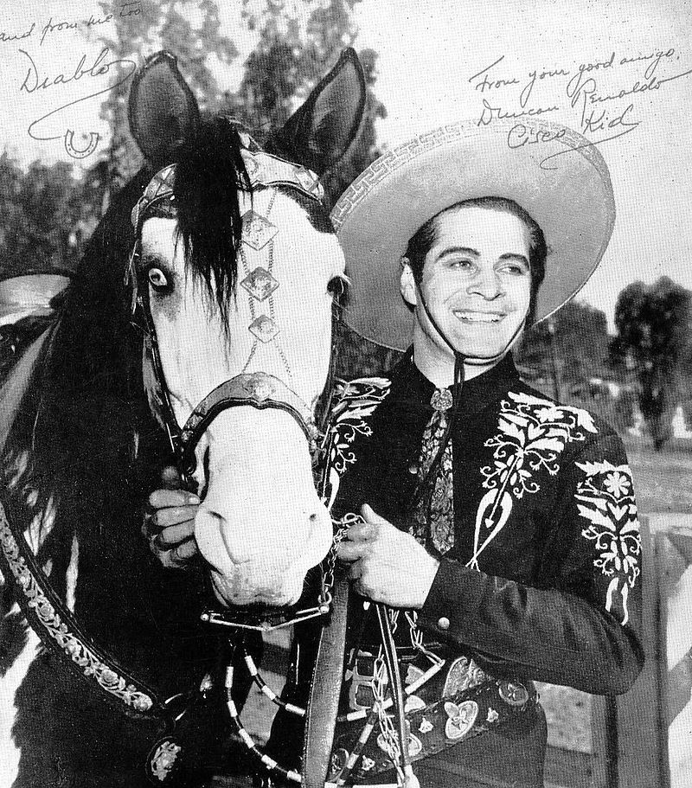
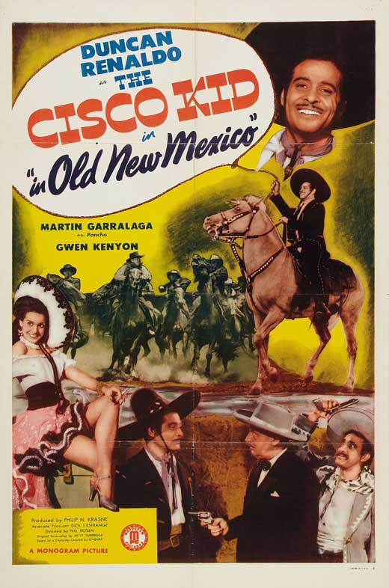
The Cisco Kid there are reasons for everything
Movie
TV program

Slide 21
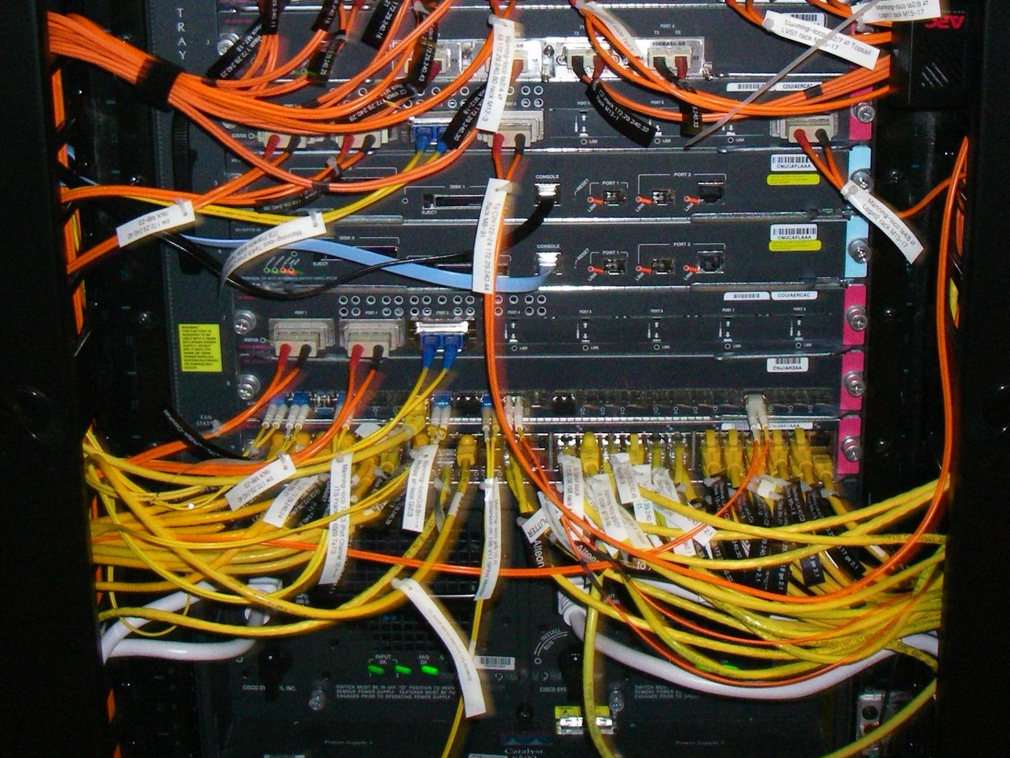
Manning-Loco located in the Data Center in ITS Manning
If you are accessing one of the ITS servers (like www.unc.edu or help.unc.edu)
then your traffic flows through this router.

Slide 22
But how does it all tie together?
For the answer, we have to look at some Internet Principles

Slide 23
The TCP/IP Standard Model
Application/process to process
FTP, telnet, HTTP, SSH
Transport/host to host
TCP
Internetworking
IP
Hardware – wires, hosts, routers

Slide 24
The TCP/IP Standard Model
Application/process to process
FTP, telnet, HTTP, SSH
Transport/host to host
TCP
Internetworking
IP
Hardware – wires, hosts, routers
What’s a host?

Slide 25
The TCP/IP Standard Model
It’s an Internet connected computer with
an Internet address and (perhaps) a domain name.
An internet address
is a unique, 4-byte integer.
unambiguously identifies a computer (actually a network interface card)
Application/process to process
FTP, telnet, HTTP, SSH
Transport/host to host
TCP
Internetworking
IP
Hardware – wires, hosts, routers
What’s a host?
it connects to other hosts via the next layer

Slide 26
The TCP/IP Standard Model
Application/process to process
FTP, telnet, HTTP, SSH
Transport/host to host
TCP
Internetworking
IP
Hardware – wires, hosts, routers
Protocols & standards are key

Slide 27
The Internet Evolved
Started as four machine demonstration - ARPANET (UCLA, UCSB, SRI, Utah)
But to link them into networks …
Protocols, or standards, were needed
Application/process to process
FTP, telnet, HTTP, SSH
Transport/host to host
TCP
Internetworking
IP
Hardware – wires, hosts, routers
Thus was born TCP/IP, which provided
Interoperability across heterogeneous machines
End-to-end communication
Reliability in the face of data link failures

Slide 28
TCP/IP
Stands for
Transmission Control Protocol/Internet Protocol
Provides reliable, in-order, end-to-end transmission of data
Application/process to process
FTP, telnet, HTTP, SSH
Transport/host to host
TCP
Internetworking
IP
Hardware – wires, hosts, routers
consider the alternative

Slide 29
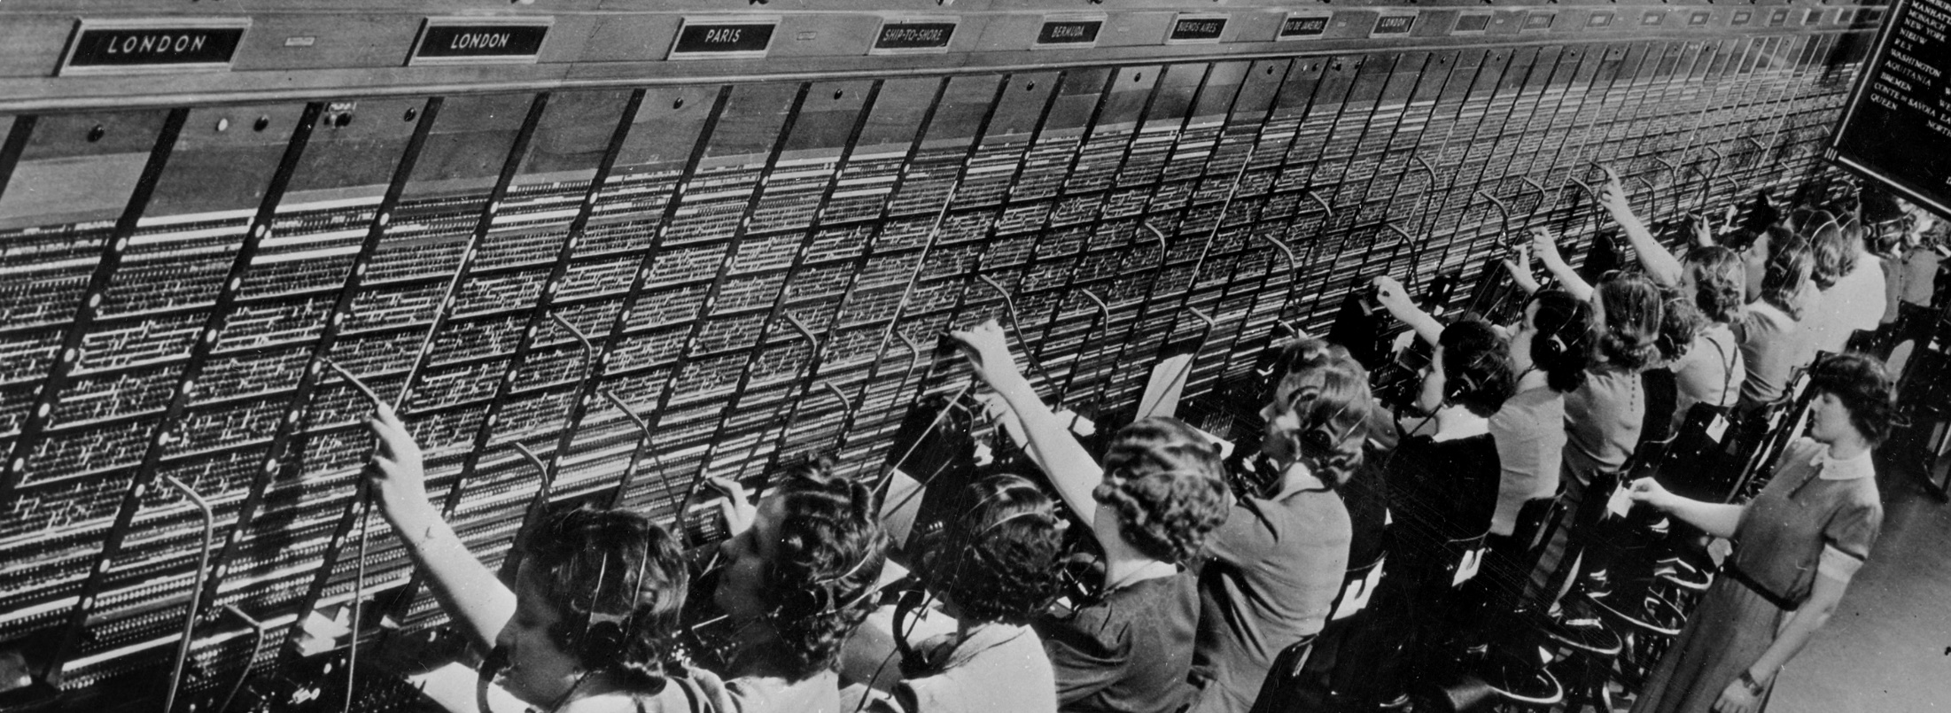
TCP/IP
consider the alternative

Slide 30
More on Protocols
Think of sending a letter
IP makes sure the envelope is addressed in the same way so that anyone could receive it
TCP is more like sending a certified letter - you get a response that someone has received it.
TCP also makes sure that the parts of the letter are all received and are IN ORDER
Application/process to process
FTP, telnet, HTTP, SSH
Transport/host to host
TCP
Internetworking
IP
Hardware – wires, hosts, routers
protocols & standards are key

Slide 31
More on Protocols
Service & application layer protocols (i.e. HTTP, FTP) ensure that the sender and receiver are speaking the same language, and that the letter can be interpreted
Application/process to process
FTP, telnet, HTTP, SSH
Transport/host to host
TCP
Internetworking
IP
Hardware – wires, hosts, routers
protocols & standards are key

Slide 32
What are packets?
In reality, each “letter” is sent in a bunch of pieces
- as if you had sent it one page at a time.
These pieces are packets.
Local Area Network
Routers

Slide 33
Let’s consider an example
Local Area Network
Could be us
Routers

Slide 34
For us to get train tickets from “Die Bahn”, we have to send it a message
The Internet
Local Area Network
Could be us
Routers
“Ruby”
152.2.81.1
They are there
Cisco Kid
“www.bahn.de”
81.200.192.68

Slide 35
A packet example - suppose Alice wants to talk to Bob
The Internet
Alice.com
Routers
Bob.edu

Slide 36
A packet example - suppose Alice wants to talk to Bob
Alice creates a message on her client
The Internet
Hi, Bob, what’s up?
Routers
Bob.edu

Slide 37
A packet example - suppose Alice wants to talk to Bob
Her client breaks it up into small TCP packets for transmission
The Internet
Hi, B
ob
, W
hat
s’ up?
Routers
Bob.edu

Slide 38
A packet example - suppose Alice wants to talk to Bob
And sends it on its way
The Internet
Alice.com
Routers
but it doesn’t have to go in a single order
or along a single path
s’ up?
Bob.edu
s’ up?
ob
ob
hat
hat
, W
, W
Each router reads the address and rejects it if the address isn’t on its network
Hi, B
Hi, B

Slide 39
A packet example - Overly simplified
The Internet
IP gets it to the right place
Alice.com
And so it gets to its destination
TCP puts the pieces back together in order
Bob.edu
s’ up?
Hi, Bob, what’s up?
ob
hat
, W
Hi, B

Slide 40
The TCP/IP Standard Model
Or run - Application/process to process
FTP, telnet, HTTP, SSH
Transport/host to host
TCP – to provide
Internetworking
IP – to provide
Hardware – wires, hosts, routers - use
protocols & standards are key

Slide 41
The TCP/IP Standard Model
Servers can be physical computers; Servers can also be software applications
One server (physical computer) can run many servers (software applications) at a time
So, how does the host application know when the data being received is for it?
Or run - Application/process to process
FTP, telnet, HTTP, SSH
Transport/host to host
TCP – to provide
Internetworking
IP – to provide
Hardware – wires, hosts, routers - use
protocols & standards are key

Slide 42
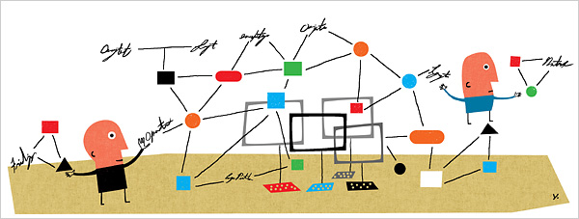
It uses standards
Or run - Application/process to process
FTP, telnet, HTTP, SSH
Transport/host to host
TCP – to provide
Internetworking
IP – to provide
Hardware – wires, hosts, routers - use
protocols & standards are key

Slide 43
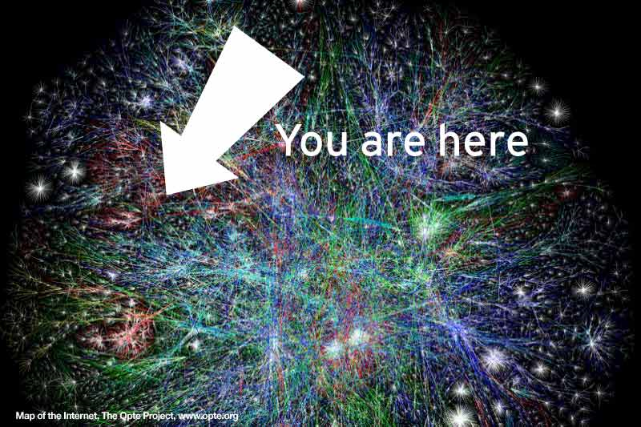
Next - More about the Internet

