Slide 1
Client-Server Computing
client-server interaction
is the basis of distributed computing

Slide 2
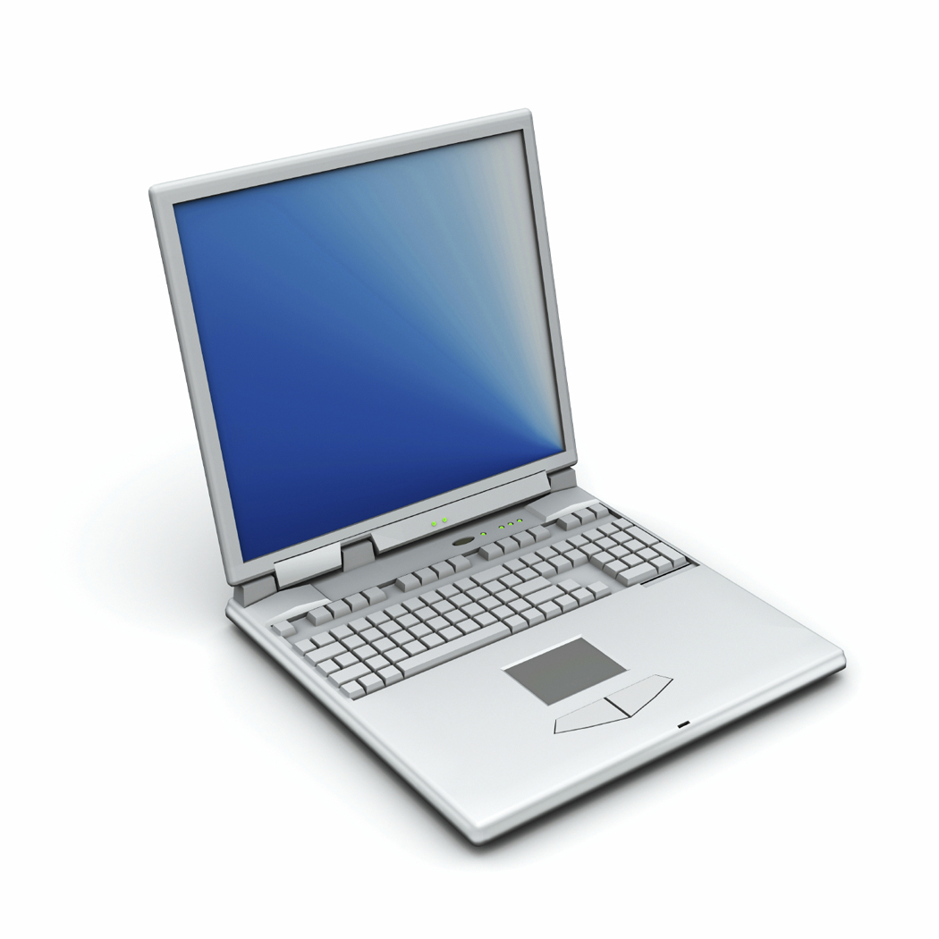
Clients and Servers
In a standalone mode, a computer is usually just a computer.
However, when the standalone computer seeks something from another location,
either on the computer itself or from another computer,
it becomes part of a relationship
  Typically, a client is an application that runs on a personal computer and relies on a server to perform some operations.
    For example, an e-mail client is an application that enables you to send and receive e-mail.

Slide 3
Clients
For any given application, there can be many clients
People are more familiar with clients,
since they interface with them directly
Examples of clients include:
Browsers
  Internet Explorer
  Mozilla Firefox
  Safari
Web exchange utilities
  Fetch
  SFTP
  Terminal applications
Any MSOffice or LibreOffice application

Slide 4
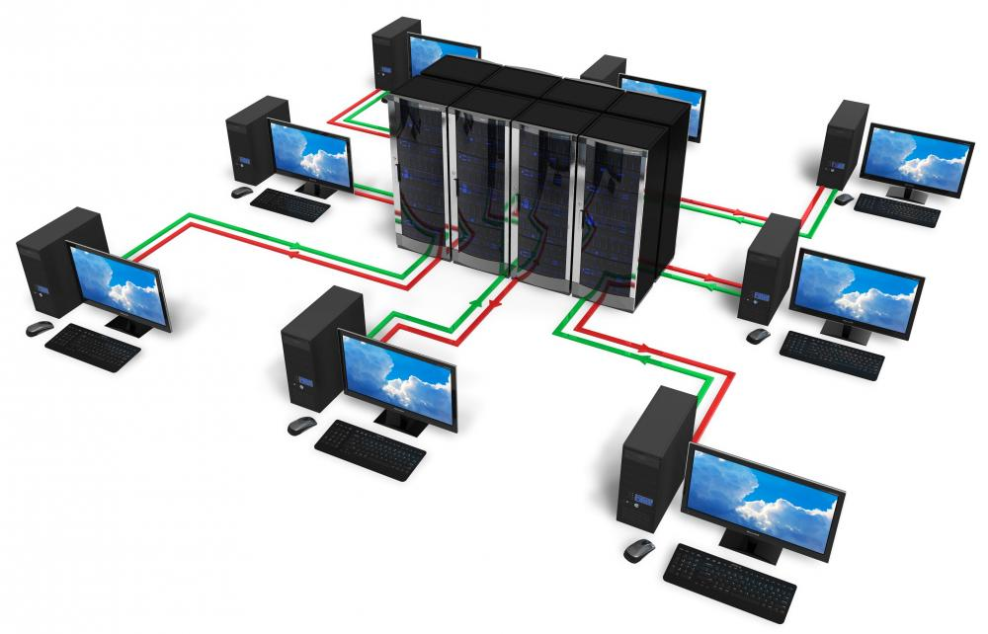
Clients and Servers

Slide 5
Clients and Servers
What changed?

Slide 6
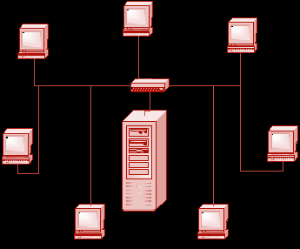
Servers
A computer or device on a network that manages network resources.
a network server is a computer that manages network traffic.
a file server is a computer and storage device dedicated to storing files. Any user on the network can store files on the server.
a database server is a computer system that processes database queries.
a print server is a computer that manages one or more printers

Slide 7
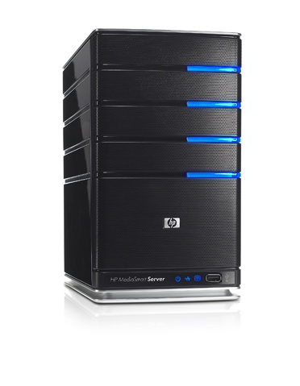
Servers
Servers are often dedicated,
meaning that they perform no other tasks besides their server tasks.
A server in this case could refer to the program that is managing resources rather than the entire computer.
on multiprocessing operating systems, however, a single computer can execute several programs at once.

Slide 8
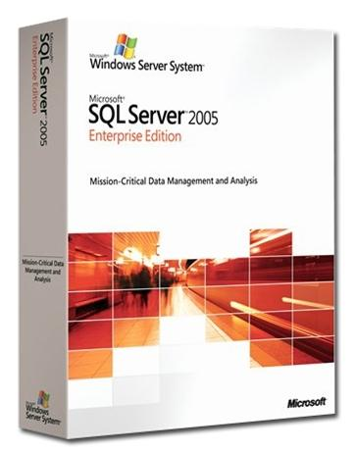
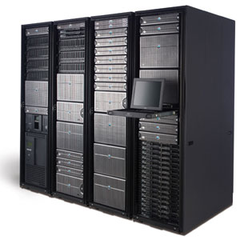
Servers
Servers can be physical computers
Servers can also be software applications
One server (physical computer)
can run
at a time
many servers (software applications)
For example, Isis has several:
  listproc
  web
  ftp
  mail
  address book

Slide 9
Access to information

Slide 10
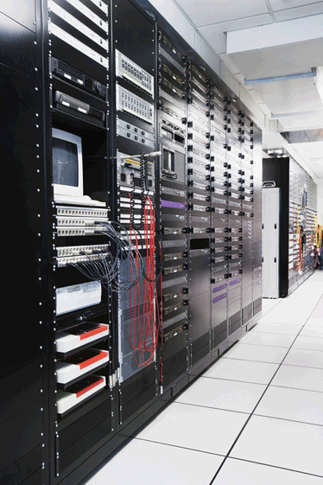
The Client/Server/Protocol Relationship
Server
IP Address: 152.2.81.1
IP Address: 152.2.81.103
Waits & Responds to Incoming Connections

Slide 11
The Client/Server/Protocol Relationship
Server
IP Address: 152.2.81.1
Initiates a Connection
IP Address: 152.2.81.103
Client Application
(a program running on the client)
Application Protocol
(HTTP, for example)
Server Application
(a program running on the server)

Slide 12
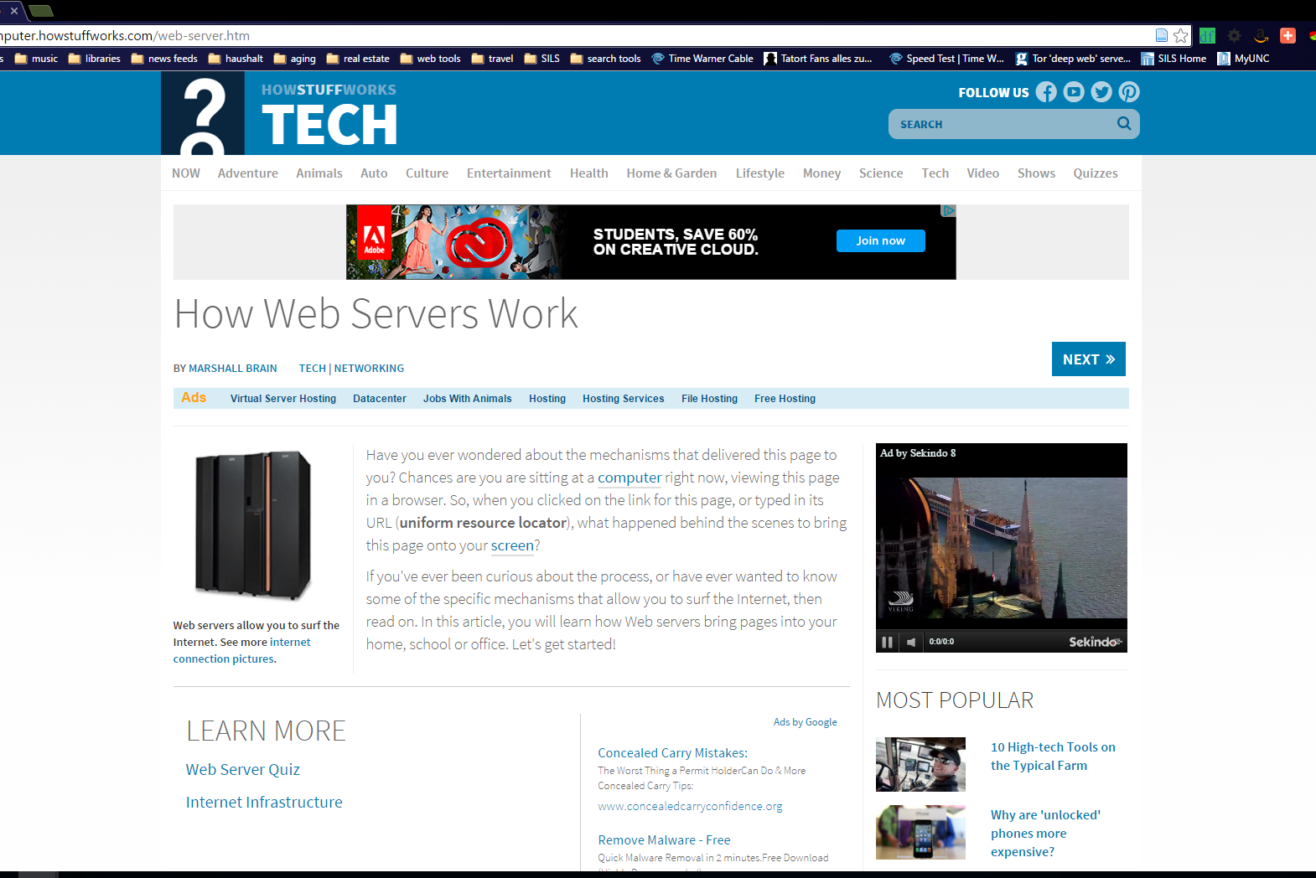
The Client/Server/Protocol Relationship

Slide 13
The Client/Server/Protocol Relationship in practice
Server
IP Address: 152.2.81.1
Initiates a Connection
IP Address: 152.2.81.103
Client Application
(a program running on the client)
Application Protocol
(HTTP, for example)
Server Application
(a program running on the server)

Slide 14
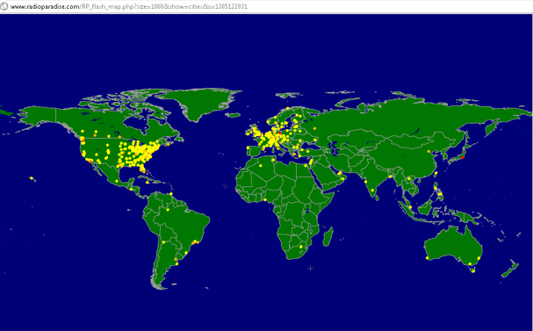
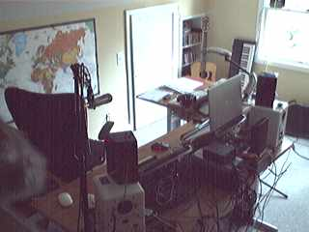
The Client/Server/Protocol Relationship in practice
IP Address: 23.29.117.2
Server
Initiates a Connection
Doesn’t have to be a big thing
IP Address: 152.2.81.103
Client Application
(a program running on the client)
Application Protocol
(HTTP, for example)
Server Application
(a program running on the server)

Slide 15
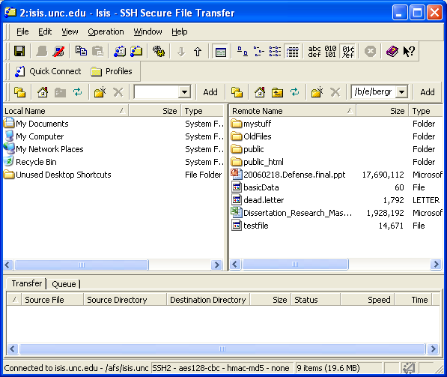
Looking at both sides
You need to know where you are

Slide 16
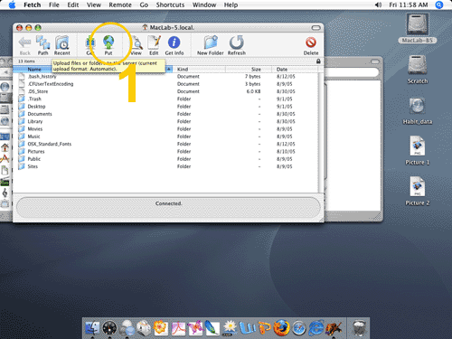
Looking at both sides
You need to know where you are

Slide 17
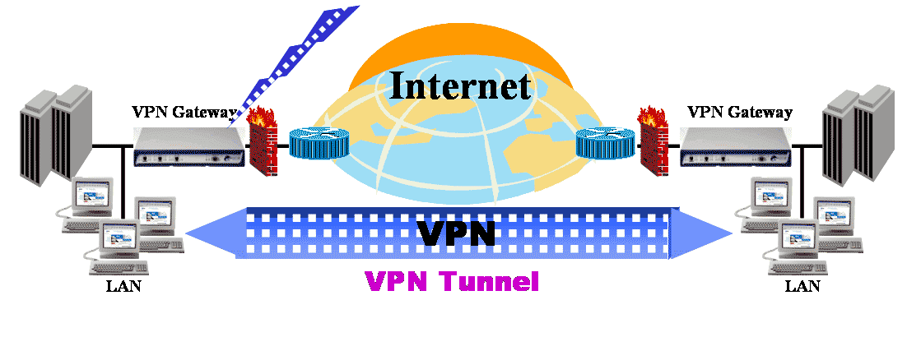
Virtual Private Networks
Why VPN?
VPN technology creates tunnels—encrypted data communications sessions—across the public Internet.
You will need VPN to connect to UNC servers when your laptop is outside of the UNC networks.
For example, in China using a VPN is basically a must if you want to access any Google-based websites.
While many governments don’t like people using VPNs, they rarely do anything about it. While we don’t know if it will be enforced in practice, the UAE has just enacted one of the strictest laws on VPN use - $545,000 – “if they are found to use vpns fraudulently”. 03 Aug 2016

Slide 18
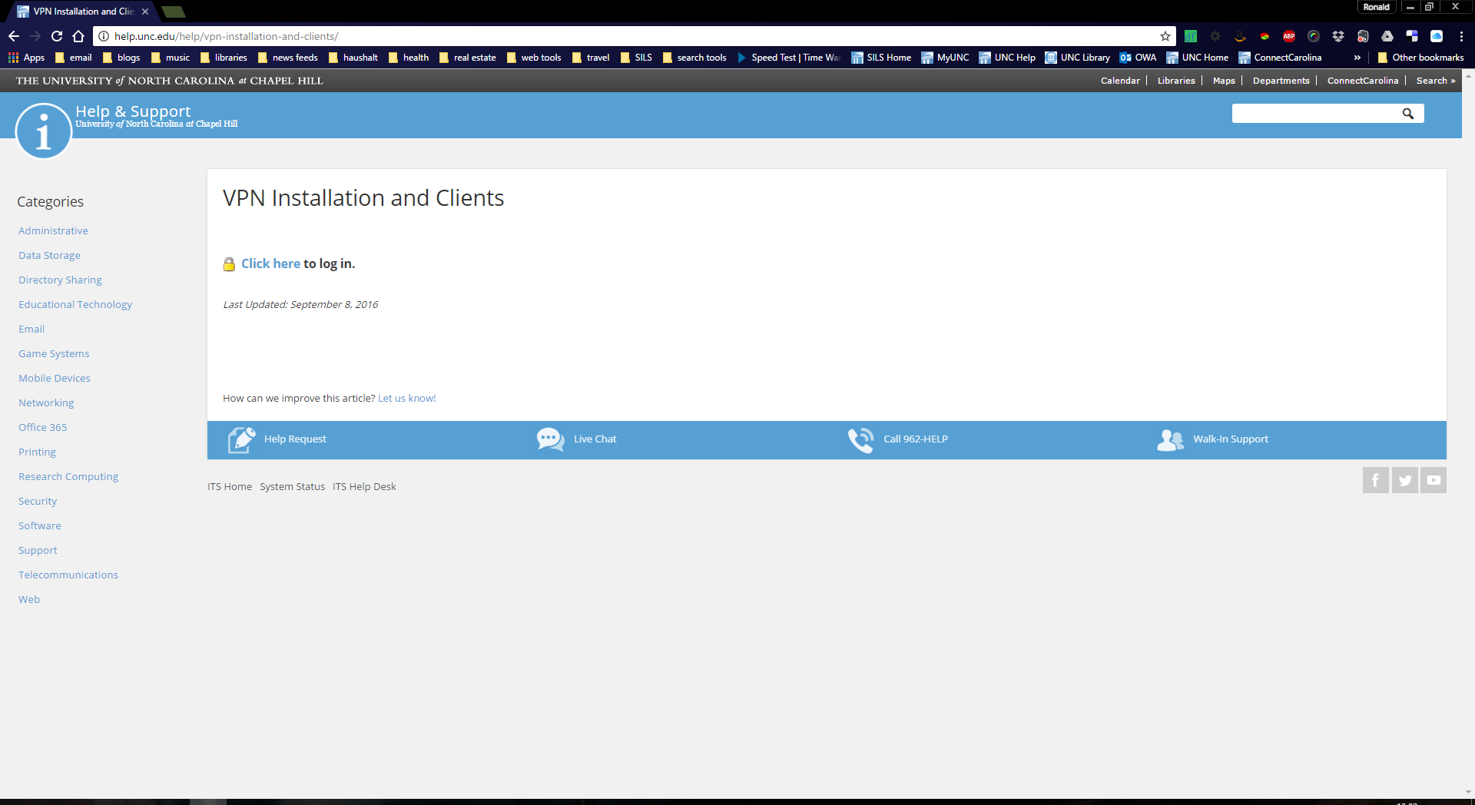
To get VPN on your laptop

Slide 19
Let’s talk terminology

