Slide 1
MON April 11
INLS 151

Slide 2
Annotated bibliography – due April 18
Fischer, C.S. (2008). What wealth-happiness paradox? A short note on the American case. Journal of Happiness Studies, 9(2), 219-226. doi: 10.1007/s10902-007-9047-4
This article furthers the idea that income increases happiness, but inheritance does not. More than simply income, effort is an integral part to happiness. This article points out that someone could have a high paying job, but put limited effort into it. People with these types of jobs typically do not have as much happiness because they subconsciously do not feel entitled to the money they receive.
This article comes from the Journal of Happiness Studies, which is a well-respected peer-reviewed scientific journal (according to Ulrich’s). It specializes in speculating and empirically investigating subjective well-being. The author, Claude S. Fischer, is a social psychologist who specializes in urban sociology. From the time span of 1986-1998, Fischer won multiple scholarly awards for his work in the field of sociology. This article has been cited by 9 subsequent articles, demonstrating its impact on related research.

Slide 3
Team Members | Topic | Presentation Date
Jorge | How/why have U.S. attitudes toward homosexuality changed in recent years? | April 18
Addie, Dorian, Lunden & Jennifer | How does self-reported level of general happiness relate to family income? | April 20
Colin, Jake & Aiden | What is the relationship between armed service personnel (and veterans) and gun ownership? | April 20
Rishabh, Anna, Kelly & Kalsey | How does self-reported level of general happiness relate to family income? | April 25
Anis, Nick, Cassandra & Joseph | What is the relationship between income and gender? | April 25
Alex and Ranni | Gun ownership by region of country: Do stereotypes of rural American South hold true?
Grace & Emily | What is the relationship between gender, happiness and income?
Presentation date options: Mon April 18, Wed April 20, Mon April 25

Slide 4
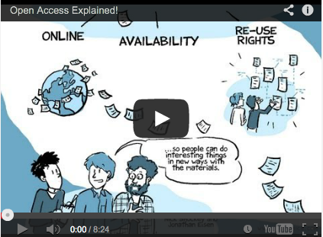
http://www.sparc.arl.org/resources/resource-type/webcasts-videos-podcasts
Jonathan Eisen & Nick Shockey
PLOS Public Library of Science http://www.plos.org/

Slide 5
INFORMATION IS NOT “FREE” – IT IS A COMMODITY!
INFORMATION WANTS TO BE FREE!
OTHER OPTIONS

Slide 6
Michael Eisen's article regarding the shackles that are being put on our ability to access scientific research offered some insight that I had not previously considered. Mainly, our "unlimited" access to research here at the university has blinded me to the real troubles that people outside of academia have when they try to access research.
-Joseph

Slide 7
Why aren’t research products “free”?

Slide 8
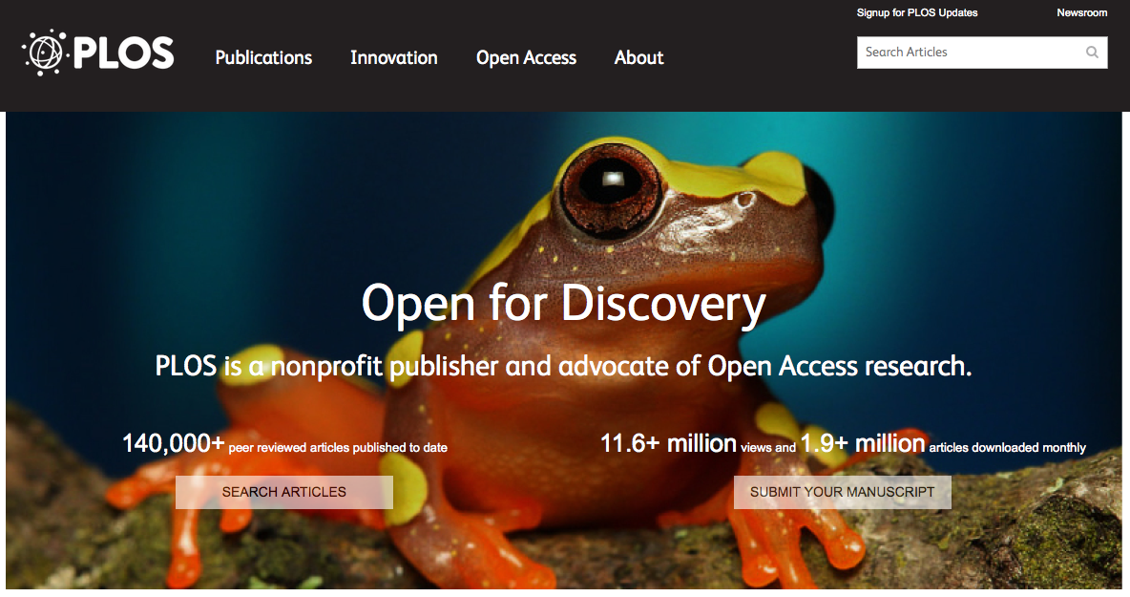
Public Library of Science (PLOS)
https://www.plos.org/

Slide 9
So what would be better? Eisen suggests:
The outlines of an ideal system are simple.
There should be no journal hierarchy, only broad journals like PLOS ONE.
When papers are submitted, they should immediately be made available online for free—clearly marked as not yet reviewed, but there to be used by people in the field who are capable of deciding on their own whether the work is sound and important.
The journal would then organize a different type of peer review, in which experts are asked about a paper’s technical soundness—as we currently do at PLOS ONE—and about its appropriate scientific audience and its relative importance. This assessment would then be attached to the paper, there for everyone to see.

Slide 10
My question is: Do you think the health care field suffers because health care professionals do not have adequate access to online research? Is there a possibility that they could better help patients of they had access to these journals?
My second question is: How did this hierarchy of journals come about? Were the people who started journals, like Nature, more popular, or are they popular because they are older journals?
-Lunden

Slide 11
The arrest and suicide of Aaron Swartz after illegally downloading millions of articles from JSTOR shed some light on the problems of having to pay for access to scholarly literature.
Eisen’s article titled, Science Wants to Be Free, argues that the publishing of scholarly research doesn’t have to follow the traditional journal approach. After all, why should individuals be restricted from the most important and credible research available that their taxes often pay for?
-Anna
The Story of Aaron Swartz Full Documentary (1 hr 45 min)
https://www.youtube.com/watch?v=gpvcc9C8SbM

Slide 12
As society progresses there is a large disparity in the accessibility of information on the internet. I wondered why are companies and peers so focused on making money and withholding these resources that they are available to the public. I found it absurd that many physicians and health care providers lack access to basic medical research, as do students and teachers at high schools and small colleges who must resort to textbooks.
-Anis

Slide 13
Researchers (profit/nonprofit)
Publishers (add value)
Libraries
Government Funders (Taxes)
Joe/Jane Public Citizen (Taxpayers)
Journals / Conferences
Vested-interest Corporations
Universities (faculty / researchers)

Slide 14
What about the quality of “peer review” in open access & free publications? Would it diminish? Could we be flooded with poorly conducted research that slips through the cracks?
-Emily

Slide 15
I beg to differ with one of his [Eisen] principal ideas/statements: "When papers are submitted, they should immediately be made available online for free—clearly marked as not yet reviewed, but there to be used by people in the field who are capable of deciding on their own whether the work is sound and important."
…I think he may be underestimating the research skills and analytical skills of an average "researcher" and its potential consequences…does has the appropriate skill set to make that determination? …the traditional peer-review process would sift out these kind of scenarios [as opposed to] this proposed information "free for all."
-Alex

Slide 16
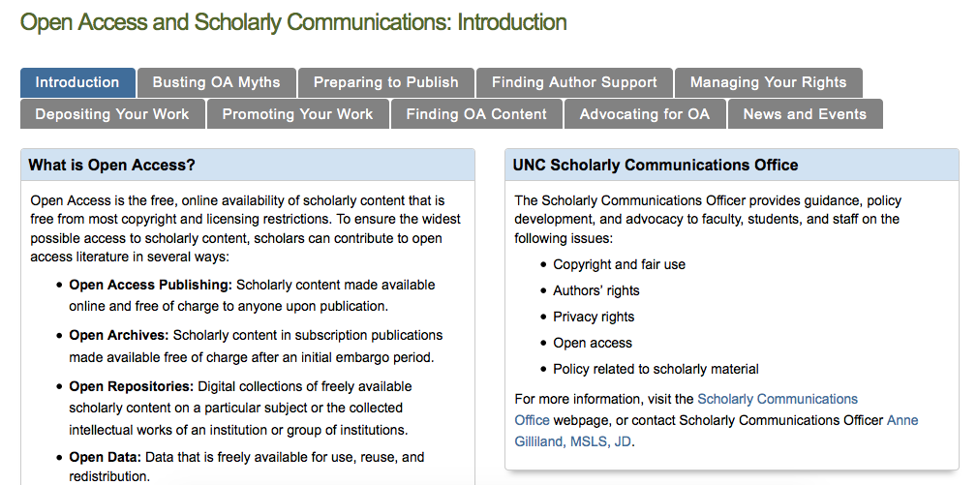
http://guides.lib.unc.edu/open-access-and-scholarly-communications
Institutional Repositories

Slide 17
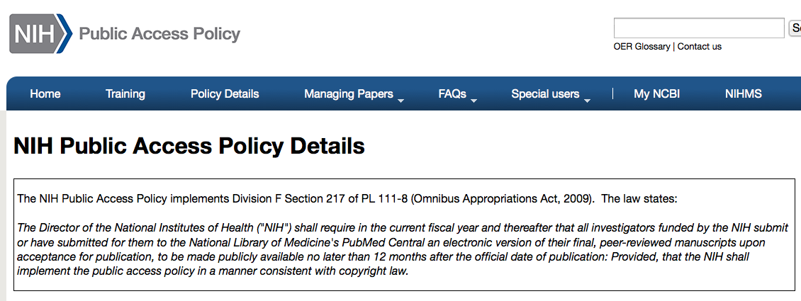
http://publicaccess.nih.gov/policy.htm
The National Institutes of Health (NIH), a part of the U.S. Department of Health and Human Services , is the nation’s medical research agency
NIH is the largest source of funding for medical research in the world

Slide 18
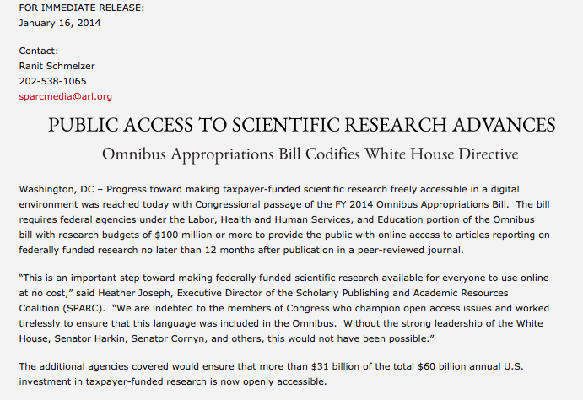
http://www.sparc.arl.org/news/omnibus-appropriations-bill-codifies-white-house-directive

Slide 19
Discussion groups…
Health-related information
6 constituents
$
expertise
information needs
What sort of model/process can you come up with to ensure access to information trustworthiness of content?

