Slide 1
wed march 2 agenda
Focusing on a topic
Search strings & operators
Where to go for statistics
What does “peer review” mean?
Ethical use of information
Style guides (APA example)

Slide 3
search process
Divide your topic into individual concepts
Single mothers
Happiness | well-being | life satisfaction
Think of synonyms to craft search strings
(single mother* OR single mom* OR “single parent” OR single dad* OR single father*)
AND
(happiness OR well-being OR “life satisfaction”)
Look for a subject heading that addresses each individual concept
Combine searches (search history) using “AND” or “OR”
May need to do some free text term searches
THEN try a similar search in another database

Slide 4
SEARCH OPERATORS & SYNTAX
AND OR NOT | Connect your search words together to either narrow or broaden your set of results Combine using parentheses (death or dying) AND grief (woman or female or girl) AND (athlete or sports)
* truncation | Searches alternate word endings wom* (searches for woman or women) Genetic* (finds genetic, genetics, genetically)
“phrases” | Searches multiple words as a phrase in that specific order “death and dying”

Slide 5
Statistical Sources
Pew Research Center | collect their own data | Free http://www.pewresearch.org/
Statista | collect own data + other sources | http://library.unc.edu/ >> E-Resources by Discipline >> Statistics
Statistical Abstracts of the U.S. | based on census data | http://library.unc.edu/ >> E-Resources by Discipline >> Statistics
Historical Statistics of the U.S. | based on census data | http://library.unc.edu/ >> E-Resources by Discipline >> Statistics

Slide 6
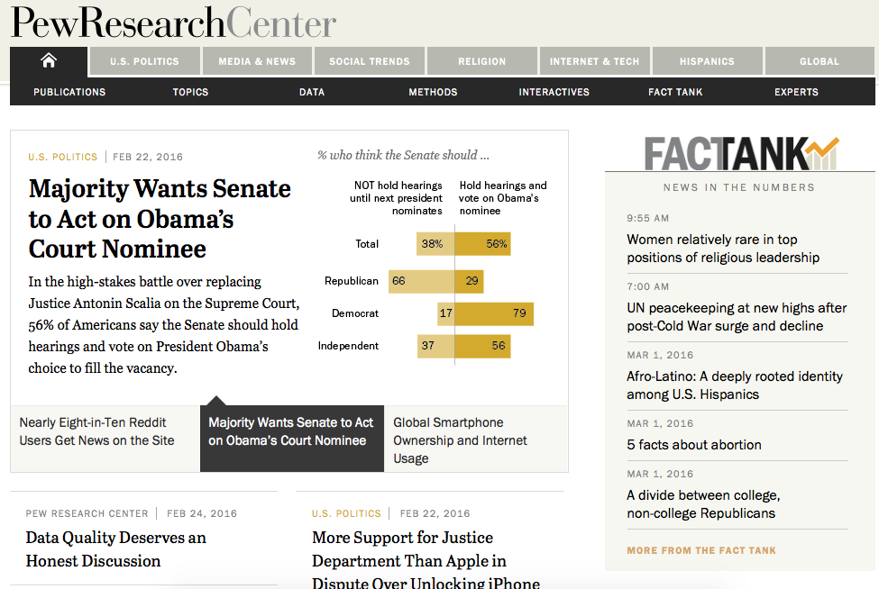
http://www.pewresearch.org/

Slide 7
Pew Research Center is a nonpartisan fact tank that informs the public about the issues, attitudes and trends shaping America and the world. It conducts public opinion polling, demographic research, media content analysis and other empirical social science research.
Pew Research does not take policy positions.
It is a subsidiary of The Pew Charitable Trusts.

Slide 8
Statistia
Sample search: viral videos
Sample search: Groupon

Slide 9
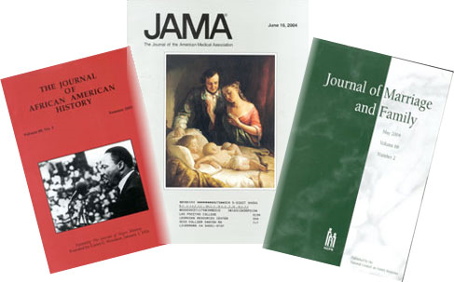
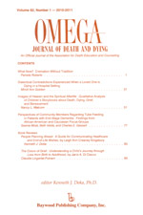
[handout from last class: types of periodicals]
The scholarly journal
vs
The popular publication

Slide 10
Royal Society of London for Improving Natural Knowledge
Notes:
first journal in the world exclusively devoted to science and also the world's longest-running scientific journal

Slide 11
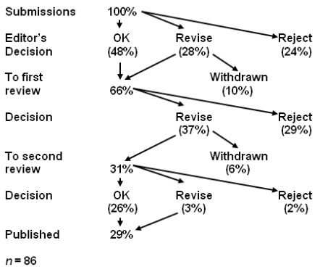

Slide 12
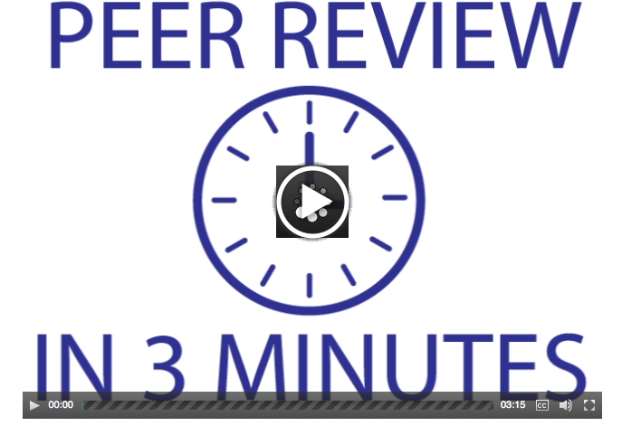

Slide 13
3 types of peer review
BLIND REVIEW | DOUBLE BLIND REVIEW | OPEN REVIEW
The names of the reviewers are hidden from the author | Both the reviewer and the author remain anonymous | Reviewer and author are known to each other

Slide 14
3 types of peer review
BLIND REVIEW | DOUBLE BLIND REVIEW | OPEN REVIEW
Advantages | Advantages | Advantages
Reviewer anonymity allows for impartial decisions free from influence by the author | Author anonymity prevents any reviewer bias based on, for example, an author's country of origin or previous controversial work. Articles written by 'prestigious' or renowned authors are considered on the basis of the content of their papers, rather than on the author's reputation | Some scientists feel this is the best way to prevent malicious comments, stop plagiarism, prevent reviewers from drawing upon their own 'agenda' and encourage open, honest reviewing.

Slide 15
3 types of peer review
BLIND REVIEW | DOUBLE BLIND REVIEW | OPEN REVIEW
Disadvantages | Disadvantages | Disadvantages
Reviewers may use their anonymity as justification for being unnecessarily critical or harsh when commenting on the author's work. | It is uncertain whether a paper can ever truly be 'blind' – especially in specialty 'niche' areas. Reviewers can often identify the author through the paper's style, subject matter or self-citation. | Some see open review as a less honest process in which politeness or fear of retribution may cause a reviewer to withhold or tone down criticism. For example, junior reviewers may hesitate to criticize more esteemed authors for fear of damaging their prospects.

Slide 16
Let’s look at the instructions for authors from one scholarly / peer-reviewed journal…

Slide 17
article submission & review process
Nature publication guidelines:
http://www.nature.com/nature/authors/get_published/1a_Editorial_process.pdf
Type of review
Rigor / acceptance rate
Process & criteria

Slide 18
Submissions judged on criteria such as…
Is the subject appropriate to the editorial aims and scope of the journal?
Originality: does the article say something original, does it add to the body of knowledge, etc.? If a case study, is this its first use?
Research methodology: most journals are concerned about this, as would be expected for an academic publisher. Is the research design, methodology, theoretical approach, critical review, etc. sound? Are the results well presented, do they correlate to the theory, and have they been correctly interpreted? Is the analysis sufficiently rigorous?
Is the paper set in the context of the wider literature, are there sufficient relevant citings, are these well referenced and are other people's views credited?
Is the paper accurate, is any information missing or wrong?
Is the structure logical, is the sequence of the material appropriate, is there a good introduction and are the summary and conclusions adequate?
Does the title of the article accurately reflect its content?
How useful would the article be to a practitioner, is it a useful example of "good practice"?
Could the study be replicated with similar results?
Is the material clearly presented, readable? Are graphs and tables used to good effect? Is the level of detail appropriate? Is the use of terminology appropriate to the readership?
Is the perspective appropriate for an international audience?
Questions of format: are the abstract, keywords etc. appropriate?
Is it an appropriate length (note: many journals will stipulate length requirements in their author guidelines)?

Slide 19
Why is citing sources so important?
Cite sources you use
Supports your case/research
Avoid plagiarism
Places your work within scholarly dialogue
Use reference lists to find additional/relevant material
Look for material that cites your source – will be more recent

Slide 20
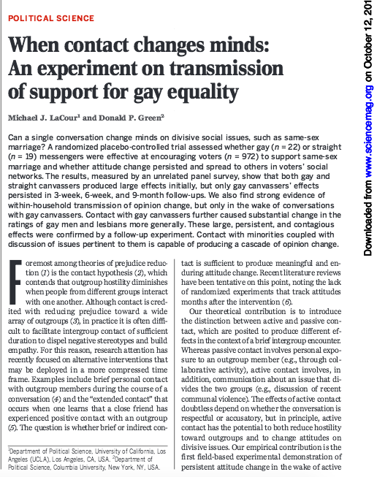
Ethics in scholarly communication

Slide 21
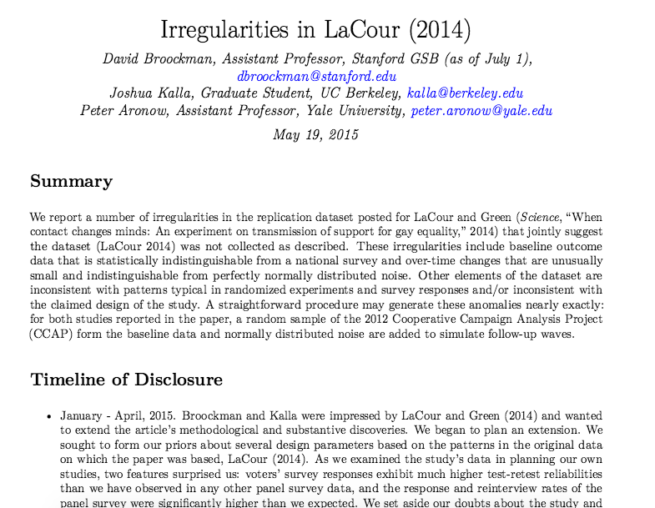
http://stanford.edu/~dbroock/broockman_kalla_aronow_lg_irregularities.pdf

Slide 23
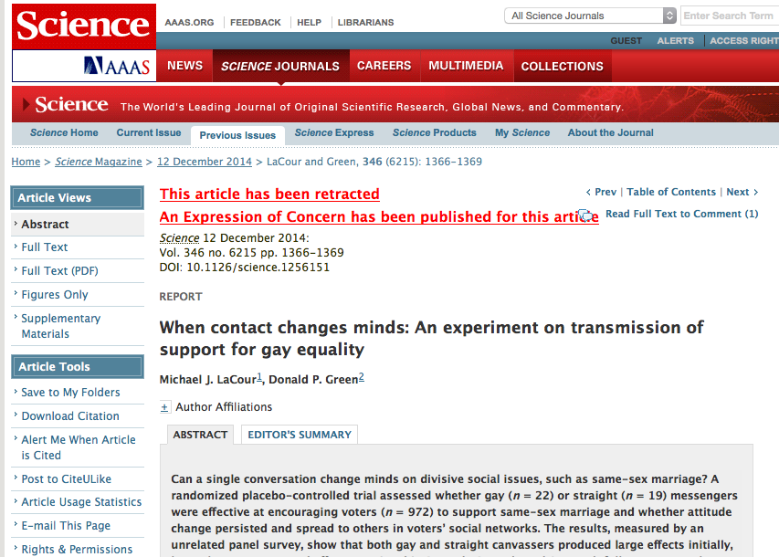

Slide 24
Discipline | Citation Style
Anthropology | Chicago Manual of Style
Biology | Council of Science Editors. Scientific Style and Format: The CSE Manual for Authors, Editors, and Publishers.
Business | American Management Association. The AMA Style Guide for Business Writing.
Engineering | Institute of Electrical and Electronics Engineers. IEEE Editorial Style Manual.
History | The Chicago Manual of Style.
Journalism | Associated Press Stylebook
Law | Harvard Law Review et al. The Bluebook: A Uniform System of Citation (20th edition, fall 2015)
Math | American Mathematical Society. AMS Author Handbook.
Medicine | American Medical Association. AMA Manual of Style: A Guide for Authors and Editors.
Political Science | American Political Science Association. APSA Style Manual for Political Science.
Psychology and other social sciences | American Psychological Association. Publication Manual of the American Psychological Association.

Slide 25
What is a style guide for?
How to format a paper for publication
Writing style (clarity, accuracy, reducing bias)
Ethics
Editorial process
Mechanics of style
Crediting sources
Displaying results

Slide 26
Style example…
Refer to participants at the appropriate level of specificity. The manual provides the example of using women and men to refer to all human beings instead of only using man. Man is appropriate to use when referring to one man but not when referring to a population that includes men and women.

Slide 27
Reducing bias example…
Refer to participants how they wish to be called. Try to avoid labels if possible, but if this is not avoidable, be respectful. Focus on the people and not the label. For example, instead of labeling a group “the elderly" or "the arthritic," labels in which individuals are lost, try “older adults" or "a woman with arthritis."

Slide 28
Mechanics example…
Punctuation—the sixth edition of APA returns to two spaces after the period at the end of the sentence recommended for ease of reading comprehension.

Slide 29
Crediting sources example…
References that appear in the text must appear in the references list in alphabetical order by the author’s last name, with the exception of personal communication; only cite personal communication in the text, not in the reference list.

Slide 30
APA Reference List
Order: Entries should be arranged in alphabetical order by authors' last names. Sources without authors are arranged alphabetically by title within the same list.
Authors: Write out the last name and initials for all authors of a particular work. Use an ampersand (&) instead of the word "and" when listing multiple authors of a single work. e.g. Smith, J. D., & Jones, M.
Titles: Capitalize only the first word of a title or subtitle, and any proper names that are part of a title.
Pagination: Use the abbreviation p. or pp. to designate page numbers of articles from periodicals that do not use volume numbers, especially newspapers. These abbreviations are also used to designate pages in encyclopedia articles and chapters from edited books.
Indentation*: The first line of the entry is flush with the left margin, and all subsequent lines are indented (5 to 7 spaces) to form a "hanging indent".
APA Cheat Sheet handout

Slide 31
What is a DOI?
A digital object identifier (DOI) is a unique alphanumeric string assigned by a registration agency (the International DOI Foundation) to identify content and provide a persistent link to its location on the Internet. The publisher assigns a DOI when your article is published and made available electronically.
http://www.doi.org/
The DOI system provides a technical and social infrastructure for the registration and use of persistent interoperable identifiers, called DOIs, for use on digital networks.

Slide 32
Journal article, one author, accessed online
Ku, G. (2008). Learning to de-escalate: The effects of regret in escalation of commitment. Organizational Behavior and Human Decision Processes, 105(2), 221-232. doi:10.1016/j.obhdp. 2007.08.002

Slide 33
Journal article, more than two authors, accessed online
Van Vugt, M., Hogan, R., & Kaiser, R. B. (2008). Leadership, followership, and evolution: Some lessons from the past. American Psychologist, 63(3), 182-196. doi: 10.1037/0003-066X. 63.3.182

Slide 34
Magazine article from a subscription database (no DOI)
Colvin, G. (2008, July). Information worth billions. Fortune, 158(2), 73-79. Retrieved from Business Source Complete, EBSCO.

