Slide 1
INLS 151
mon, feb 29, 2016

Slide 2
Today’s line-up
Status reports (handout)
Database report (Kalsey)
Data-to-Story Project quick check-in
Suggested resources for project (handout)
Finding statistics
Pass out & discuss mid-term exam
Evaluating resources (type of resources & eval handout)
Controlled vocabulary (subject headings)
In-class work time on project plan

Slide 3
Data-to-Story Project Teams
Alex and Ranni
Addie, Dorian, Lunden & Jennifer
Rishabh, Anna, Kelly & Kalsey
Colin, Jake & Aiden
Anis, Nick, Cassandra & Joseph
Jorge
Grace & Emily

Slide 4
SPSS classes in Odum
Monday, Feb 29, 2:00 pm – 3:30 pm
Intro to SPSS, how to work with data
Tuesday, March 1, 2:00 pm – 3:30 pm
Work with SPSS syntax
Wednesday, March 2, 2:00 pm – 3:30 pm
Basic analytical procedures, working with SPSS graphics
Classes held in Davis Library, room 219
free, no registration required

Slide 5
Project: variables + statistics
Could use only 1 variable (frequency, descriptive – mean, median, mode)
Could use 2 categorical variables and use contingency tables (crosstabs) + Chi squared
Could focus on certain responses (select cases) + frequency table
Think about what you WANT to look at and we’ll figure out how…

Slide 6
Project Plan
Identify selected variables (including any subsets)
e.g. SEX=FEMALE, AGE=18-30, INCOME, LAW5=YES
What sort of relationship among these variables will you try to analyze?
e.g. we are interested in young women who have been arrested and what sort of income level they report
What sort of story are you interested in uncovering?
We are interested describing young adult females who have been incarcerated – what sort of social support systems help these offenders get back on the right track to become contributing members of society. We may also look at children of incarcerated mothers – what challenges do they face and what are some ways to help prevent a cycle of poverty and incarceration?
What types of information/statistics/facts do you plan to look for to help you develop the story?
Statistics describing the population & incarceration rates of young adult women in the U.S.
Background on women in prison (e.g. what does prison look like for women? what sort of support/education programs are in place, what sort of research has been done on women in and after prison, research on children of prison mothers)
How are female prisoners portrayed in popular media?
Describe your team work plan
how will you divide the work?
how will you share information?
what is your timeline?
Plan due by class time on Wednesday; few paragraphs; email or print

Slide 7
Handout:
Suggested Resources for the Data to Story Project
Most valuable handout of the class

Slide 8
Statistical Sources
Pew Research Center | collect their own data | Free http://www.pewresearch.org/
Statista | collect own data + other sources | Subscription UNC Lib
Statistical Abstracts of the U.S. | based on census data | free + subscription UNC Lib
Historical Statistics of the U.S. | based on census data | free + subscription UNC Lib

Slide 9
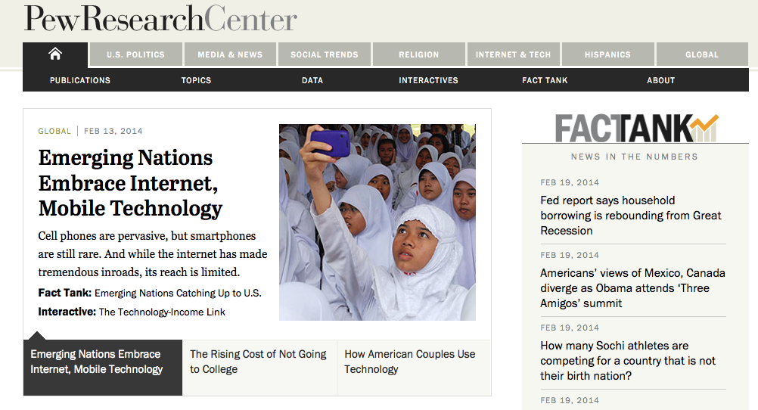
http://www.pewresearch.org/

Slide 10
Pew Research Center is a nonpartisan fact tank that informs the public about the issues, attitudes and trends shaping America and the world. It conducts public opinion polling, demographic research, media content analysis and other empirical social science research.
Pew Research does not take policy positions.
It is a subsidiary of The Pew Charitable Trusts.

Slide 11
Statistia
Sample search: viral videos
Sample search: Groupon

Slide 12
mid-term exam
Pass out print version
.doc will be on website this evening
Due by 5:00 pm on Wed, March 9 (no class that day)

Slide 13
Refresher from reading…
In the context of an information retrieval system, what is a controlled vocabulary?
If an information retrieval system has a controlled vocabulary, how would using it improve your search experience?

Slide 14
What is a controlled vocabulary?
a controlled vocabulary is a list of terms (words or phrases) used for indexing
organized lists of words and phrases, that are used to initially tag content, and then to find it through navigation or search
while capturing the richness of variant terms, controlled vocabularies also promote consistency in preferred terms and the assignment of the same terms to similar content.
consistent labeling system
almost always, controlled vocabularies show relationships among terms

Slide 15
Subject headings
Subject headings are a set of terms or phrases (known as controlled vocabulary) that classify materials.
Essentially they identify and pull together under a common umbrella information about a given subject.
Most online catalogs and databases use some form of subject headings, though they may also be called descriptors or keywords.

Slide 16
why is CV useful in an IR system?
In a library system, we put “like items” with “like items” – allows you to browse the shelves for similar items
In a digital collection, items will be linked with similar items
In a library database, limiting to a subject heading will pull up items that have been identified as REALLY relating to the subject – not material that just happens to have a keyword in the text

Slide 17
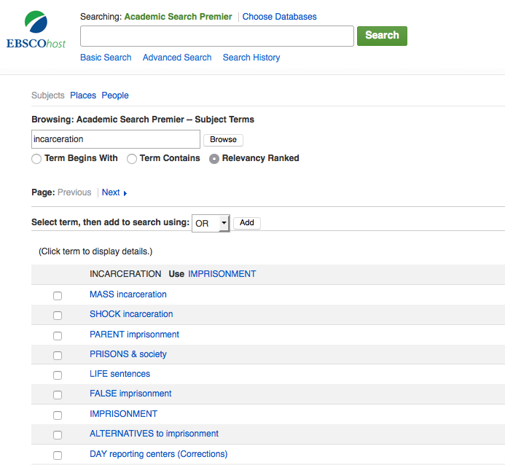
Example
Look up INCARCERATION in
Academic Search Premier’s
SUBJECT TERMS

Slide 18
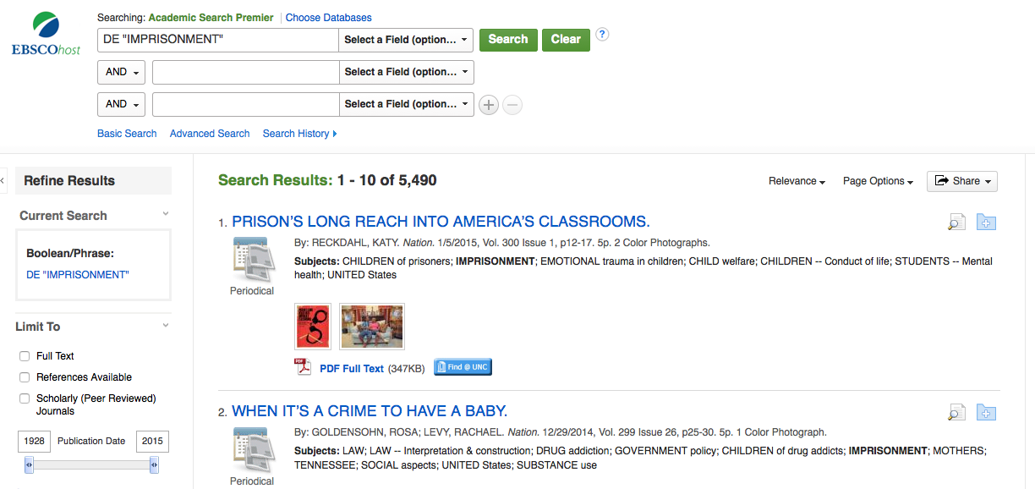

Slide 19
why is CV useful in an IR system?
Authority: How does this database index material about/by a particular person? How is the name spelled? What is the agreed-upon “name” or “term” for this concept?
Example:
What is the subject heading for a particular author/researcher?
Robinson, Leeah
Robinson, M.L.
Robinson, MelLeeah
Robinson, Mel’Leeah

Slide 20
why is CV useful in an IR system?
Authority: How does this database index material about/by a particular person? How is the name spelled? What is the agreed-upon “name” or “term” for this concept?
Example:
What is the subject heading for a particular author/researcher?
Robinson, Leeah
Robinson, M.L.
Robinson, MelLeeah
Robinson, Mel’Leeah
Robinson, Mel’Leeah
Robinson, M.

Slide 21
why is CV useful in an IR system?
How does this database index material about/by a particular place or concept?
Examples:
Burma (1800’s) or Myanmar (1989)
Ceylon (1948) or Sri Lanka (1972)
Constantinople or Istanbul

Slide 22
What are the types of alternative fuels being used or developed for automobiles?
alternative fuels | automobiles
electricity ethanol natural gas fuel cells | cars vehicles transportation motor vehicle

Slide 23
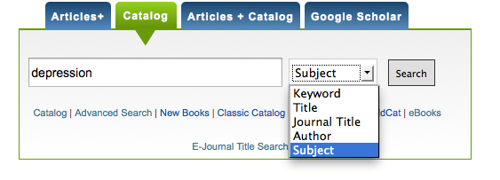

Slide 24
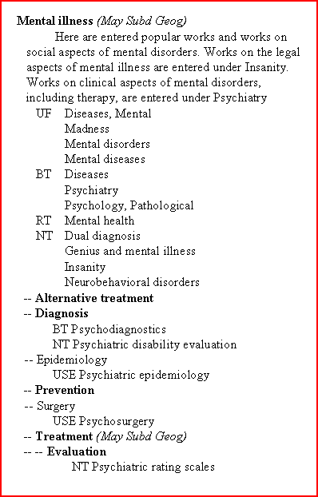
Abbreviations
BT - Broader Topic - Use to expand your search using a broader topic.
NT - Narrower Topics - Use to focus your search using a narrower topic.
RT - Related Topic - Alternative terminology for your topic.
UF - This is the appropriate subject heading is use for these words. DO NOT search by words listed as UF.
USE - Identifies the correct heading to use for your topic.

Slide 25
SEARCH OPERATORS & SYNTAX
AND OR NOT | Connect your search words together to either narrow or broaden your set of results Combine using parentheses (death or dying) AND grief (woman or female or girl) AND (athlete or sports)
* truncation | Searches alternate word endings wom* (searches for woman or women) Genetic* (finds genetic, genetics, genetically)
“phrases” | Searches multiple words as a phrase in that specific order “death and dying”

Slide 26
search process
Divide your topic into individual concepts
Single mothers
Happiness | well-being | life satisfaction
Look for a subject heading that addresses each individual concept
Combine searches (search history) using “AND” or “OR”
May need to do some free text term searches
THEN try a similar search in another database

Slide 28
In-class work
Look at the potential topic(s) you are considering for your project
How can you break this topic down into unique/specific components?
Write down your overarching topic
Write down synonyms for each component of the topic
See if there are corresponding subject headings in one of the databases

Slide 29
UNC Library Homepage: http://library.unc.edu/
E-research by discipline
Academic Search Complete

Slide 30
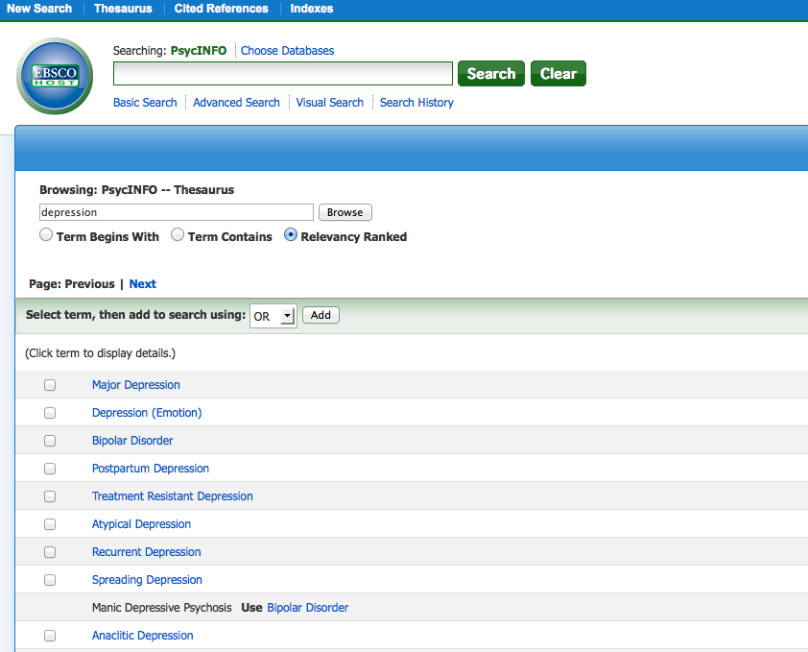

Slide 31
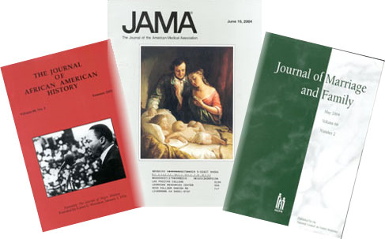
[handout: types of periodicals]
The scholarly journal
vs
The popular publication

Slide 32
Royal Society of London for Improving Natural Knowledge

Slide 33
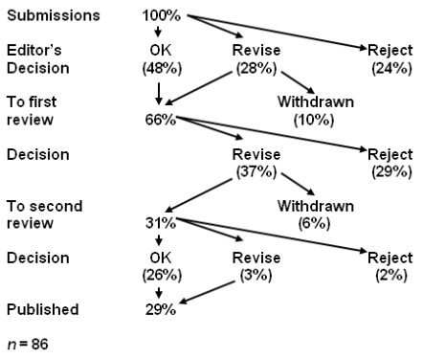

Slide 34
3 types of peer review
BLIND REVIEW | DOUBLE BLIND REVIEW | OPEN REVIEW
The names of the reviewers are hidden from the author | Both the reviewer and the author remain anonymous | Reviewer and author are known to each other

Slide 35
3 types of peer review
BLIND REVIEW | DOUBLE BLIND REVIEW | OPEN REVIEW
Advantages | Advantages | Advantages
Reviewer anonymity allows for impartial decisions free from influence by the author | Author anonymity prevents any reviewer bias based on, for example, an author's country of origin or previous controversial work. Articles written by 'prestigious' or renowned authors are considered on the basis of the content of their papers, rather than on the author's reputation | Some scientists feel this is the best way to prevent malicious comments, stop plagiarism, prevent reviewers from drawing upon their own 'agenda' and encourage open, honest reviewing.

Slide 36
3 types of peer review
BLIND REVIEW | DOUBLE BLIND REVIEW | OPEN REVIEW
Disadvantages | Disadvantages | Disadvantages
Reviewers may use their anonymity as justification for being unnecessarily critical or harsh when commenting on the author's work. | It is uncertain whether a paper can ever truly be 'blind' – especially in specialty 'niche' areas. Reviewers can often identify the author through the paper's style, subject matter or self-citation. | Some see open review as a less honest process in which politeness or fear of retribution may cause a reviewer to withhold or tone down criticism. For example, junior reviewers may hesitate to criticize more esteemed authors for fear of damaging their prospects.

Slide 37
Let’s look at the instructions for authors from three scholarly / peer-reviewed journals…

Slide 38
article submission & review process
Nature publication guidelines:
http://www.nature.com/nature/authors/get_published/
Science publication guidelines:
http://www.sciencemag.org/site/feature/contribinfo/prep/gen_info.xhtml
Health Affairs publication guidelines:
http://www.healthaffairs.org/1410i_for_authors_prep_and_review.php
Type of review
Rigor / acceptance rate
Process & criteria

Slide 39
Submissions judged on criteria such as…
Is the subject appropriate to the editorial aims and scope of the journal?
Originality: does the article say something original, does it add to the body of knowledge, etc.? If a case study, is this its first use?
Research methodology: most journals are concerned about this, as would be expected for an academic publisher. Is the research design, methodology, theoretical approach, critical review, etc. sound? Are the results well presented, do they correlate to the theory, and have they been correctly interpreted? Is the analysis sufficiently rigorous?
Is the paper set in the context of the wider literature, are there sufficient relevant citings, are these well referenced and are other people's views credited?
Is the paper accurate, is any information missing or wrong?
Is the structure logical, is the sequence of the material appropriate, is there a good introduction and are the summary and conclusions adequate?
Does the title of the article accurately reflect its content?
How useful would the article be to a practitioner, is it a useful example of "good practice"?
Could the study be replicated with similar results?
Is the material clearly presented, readable? Are graphs and tables used to good effect? Is the level of detail appropriate? Is the use of terminology appropriate to the readership?
Is the perspective appropriate for an international audience?
Questions of format: are the abstract, keywords etc. appropriate?
Is it an appropriate length (note: many journals will stipulate length requirements in their author guidelines)?
[Handout: analyzing research articles]

Slide 40
Let’s look at a few articles from scholarly (peer-reviewed) publications…and get a jump on an upcoming assignment…

Slide 41
Identify a research study on a topic of interest to you…
http://library.unc.edu/
E-research by discipline
Academic Search Premier
Limit to Scholarly (Peer Reviewed) Journals
Look at the article and work through the evaluation criteria from the handout…

